Slide 1
SECURE DATA HIDING IN IMAGES USING STEGANOGRAPHY
SECURE THE DATA TO PREVENT HACKERS
Presented By:
Student Name : MANOJ V
College Name : SRI SAIRAM ENGINEERING COLLEGE
Department : Computer Science and Business Systems

Slide 2
OUTLINE
Problem Statement
Technology used
Wow factor
End users
Result
Conclusion
Git-hub Link
Future scope

Slide 3
Problem Statement
Challenge: With the rise of digital communication, securing sensitive information is crucial. Secure message transmission is a critical concern in cybersecurity. Traditional encryption methods can raise suspicion, making hidden communication necessary.
Solution: Image Steganography – hiding secret messages inside images without altering their visible appearance.

Slide 4
Technology used
Programming language – Python , HTML
Framework - Flask
Libraries – OpenCV , OS , Flask , String , JSON
Storage – Local storage
OS - Linux

Slide 5
Wow factors
Converts characters into pixel values for secure embedding.
Ensures that only authorized users can decrypt the message.
Simple and user-friendly Flask application for encryption and decryption.
The image looks unchanged to the naked eye, making it ideal for covert communication.

Slide 6
End users
Cybersecurity Enthusiasts – Learning about data hiding techniques.
Investigators & Journalists – Secure communication in sensitive cases.
Businesses – Protecting confidential data.
General Users – Anyone who needs private communication

Slide 7
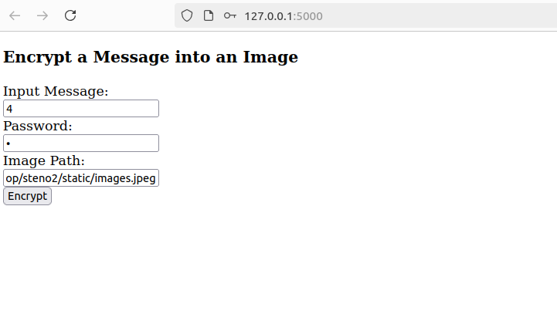
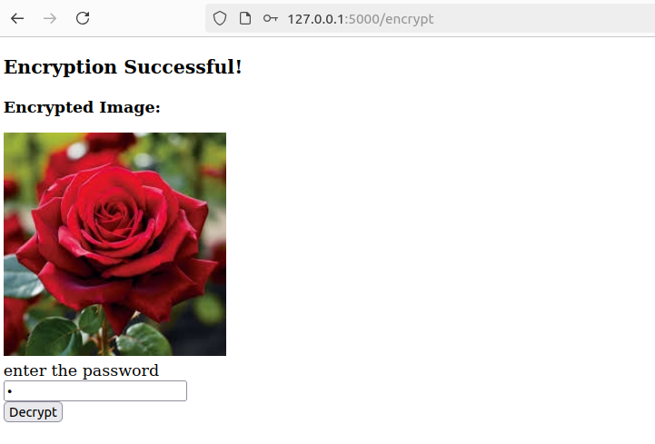
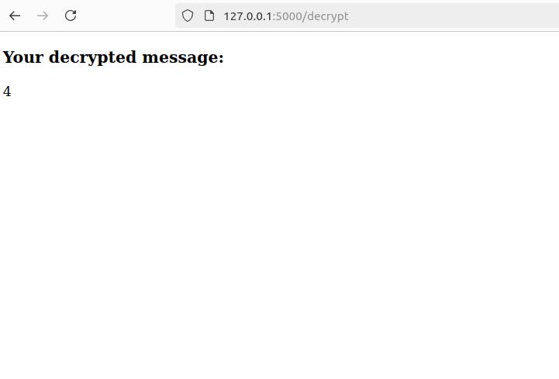
Results

Slide 8
Conclusion
Secure and hidden communication method.
Protects sensitive data without raising suspicion.
Can be enhanced further with AI and cryptography.

Slide 9
GitHub Link
https://github.com/SPARKY-manoj/steganography

Slide 10
Future scope(optional)
Integrating AES encryption before embedding the message.
Creating an Android/iOS app for easy use.
Secure cloud-based encrypted image storage.

Slide 11
THANK YOU

