Slide 1
DATA COMMUNICATION & NETWORKS LAB • ACADEMIC COURSE PROJECT
Experiment 4: Network Diagnostic & Topology Path Analyzer Engine
Batch ID: DCN_17_02 | Group 4 | Grounded in Syllabus Units I, IV & V (OSI, IP Datagram, QoS & Congestion)
Member 1
Sparsh Srivastava
SAP: 590022251
Project Lead
OSI Layering & IP Datagram Architecture
Member 2
Aayushman Kothari
SAP: 590025499
Subprocess Engineering
DNS Hierarchy & Socket Resolution
Member 3
Yasharth Jaiswal
SAP: 590023687
Regex Parsing Core
Metric Extraction & Hop Sequence
Member 4
Satvik Arora
SAP: 590028424
Latency Benchmarking
BGP Peering & Transit Bottlenecks
Member 5
Yashvardhan Singh
SAP: 590021777
Temporal Telemetry
Diurnal Heatmaps & Transport QoS
All 3 Student Tasks Fully Implemented • Subprocess Automation • Regex Extraction • Visual Charts & Latency Heatmaps

Slide 2
COURSE & SYLLABUS MAPPING
Bridging Academic Syllabus Concepts with Experiment 4
How our telemetry tool maps directly across DCN Units I, IV, and V.
Unit I & IV: Layering & IP Datagram
• Layer Separation (OSI / TCP-IP): Demonstrates how network layer packets (IP Datagrams) are encapsulated into Data Link frames to traverse heterogeneous topologies (LAN, MAN, WAN).
• IP Addressing & Masking: Evaluates IPv4 address classes, loopback testing (127.0.0.1), local gateway subnet boundaries, and global public routing.
• The 8-Bit TTL Field: Directly demonstrates the Time-To-Live countdown designed to prevent routing loops, using TTL-exceeded triggers to uncover path topologies.
• Routing Protocols Context: Highlights real-world effects of interior (OSPF) vs exterior (BGP) routing policies along intermediate router hops.
Unit V: Transport, Jitter & Congestion
• Performance Metrics: Measures Round-Trip Time (RTT), delay jitter, and packet loss percentages under live network load.
• Congestion & Bufferbloat: Explains why intermediate hops experience sudden latency spikes during peak usage hours due to queue buildup.
• Quality of Service (QoS): Illustrates why real-time protocols (UDP streaming/VoIP) suffer when path delay variance (jitter) is unstable.
• Socket Address Resolution: Integrates transport layer port concepts with DNS domain-to-socket mapping using nslookup.
Students Tasks (Lab Guidelines)
• Task 1 (Subprocess Wrappers): Develop a unified Python tool executing ping, traceroute/tracert, and nslookup with cross-platform compatibility.
• Task 2 (Stdout Parsing Engine): Parse raw terminal outputs to extract min/avg/max RTT, packet loss %, and ordered router hops.
• Task 3 (Visual Analytics): Display comparative latency charts and diurnal heatmaps evaluating reachability across diverse public hosts.
• All 5 Team Members: Assigned clear, distinct modules matching their technical specialization.

Slide 3
SECTION 1 • PROBLEM CONTEXT
PRESENTER: SPARSH SRIVASTAVA (590022251)
The Diagnostic Bottleneck: Why Manual CLI Probing Fails
Overcoming terminal clutter and disconnected diagnostics during live network failures.
The Real-World Engineering Problem
• The Ambiguous 'Internet Is Down': When packet delivery degrades, network engineers cannot intuitively pinpoint if the failure is in the local LAN switch, the ISP fiber link, or the cloud provider.
• Manual Terminal Fragmentation: Troubleshooting requires switching between 3 separate CLI tools (`ping`, `tracert`, `nslookup`), leaving no unified telemetry record.
• Non-Standardized CLI Syntaxes: Windows reports milliseconds with commas; Linux reports slash-delimited floats (`min/avg/max/mdev`). There is no common data schema.
• Ephemeral Text Clutter: Thousands of lines of scrolling terminal output make spotting intermittent packet drop trends nearly impossible.
Our Engineering Solution & Goals
• Automated Telemetry Pipeline: A lightweight Python engine that orchestrates diagnostic commands and unifies metrics into structured objects.
• Zero External Networking Dependencies: Built strictly using built-in system tools (`subprocess`, `re`) so it runs instantly on any lab workstation.
• Multi-Target Concurrency: Probes the local gateway, regional ISP peering, Anycast DNS, and global CDNs in parallel.
• Academic & Professional Impact: Translates theoretical OSI Layer 3/4 mechanics into tangible, graphical analytics.

Slide 4
SECTION 1 • THEORETICAL FOUNDATION
PRESENTER: SPARSH SRIVASTAVA (590022251)
Protocol Physics: Inside the IP Datagram & ICMP Messaging
Connecting Unit IV Network Layer concepts: RFC 792, loop prevention, and path discovery.
ICMP Echo Mechanics (RFC 792)
• Echo Request (Type 8): Sent inside an IP Datagram to test host reachability at Layer 3.
• Echo Reply (Type 0): Destination replies with identical payload data.
• Kernel Timestamps: The OS calculates precision Round-Trip Time (RTT = T_receive - T_send).
• Firewall Considerations: Modern edge firewalls often drop ICMP to mitigate DDoS/reconnaissance; our engine distinguishes packet loss from unreachability.
The 8-Bit TTL Field in Action
• Loop Prevention: The IPv4 header's 8-bit Time-To-Live prevents packets from looping forever in cyclic routing topologies.
• The Hop Limit Decrement: Every intermediate router subtracts 1 from TTL. When TTL=0, the packet is discarded.
• ICMP Type 11 (Time Exceeded): Discarding routers return an ICMP Type 11 message, unwittingly revealing their own router IP address.
• Traceroute's Stepping Trick: By sending consecutive probes with TTL=1, 2, 3... we trace the entire topological path hop by hop.
Routing Asymmetry & BGP
• Exterior Gateway Peering: Packets navigate Autonomous Systems (AS) via the Border Gateway Protocol (BGP).
• Asymmetric Delay: Outbound paths frequently follow different physical optical cables than inbound return paths.
• Delay Variance: Teaches students why hop latencies can fluctuate even when the destination is reachable.

Slide 5
STUDENT TASK 1 • SUBPROCESS ENGINEERING
PRESENTER: AAYUSHMAN KOTHARI (590025499)
Task 1: Cross-Platform Subprocess Execution Architecture
Executing ping, tracert/traceroute, and nslookup securely and concurrently.
Subprocess Engine Design (`subprocess.run`)
• Security & Sanitization: Commands are invoked strictly as structured lists (`['ping', '-n', '4', host]`), eliminating shell injection vulnerabilities.
• Automatic Platform Detection: Utilizes `platform.system()`. If `Windows`, maps to `ping -n` and `tracert -d`; if `Linux/macOS`, maps to `ping -c` and `traceroute -n`.
• Deterministic Timeouts: Wraps executions in hard timeouts (`timeout=15s` for ping, `35s` for traceroute) to prevent hanging during disconnected links.
• Stdout Stream Buffering: Captures standard output and error streams cleanly as UTF-8 strings for downstream regex parsing.
Engine Code Implementation Snippet
• Cross-Platform Flag Mapping:
cmd = ['ping', '-n' if OS_WIN else '-c', str(count), target]
• Execution with Exception Handling:
try:
proc = subprocess.run(cmd, capture_output=True,
text=True, timeout=15)
return proc.stdout
except subprocess.TimeoutExpired:
return 'ERROR: Diagnostic probe timed out'
• Multi-Threading Acceleration: Employs `concurrent.futures.ThreadPoolExecutor` to execute diagnostic probes on multiple public targets in parallel.

Slide 6
STUDENT TASK 1 • DNS DIAGNOSTICS
PRESENTER: AAYUSHMAN KOTHARI (590025499)
Task 1: The Resolution Pipeline & Transport Socket Addressing
Linking Unit V port/socket concepts with hierarchical DNS domain resolution.
DNS Resolution Pipeline
• From Hostnames to IP Addresses: Translates human-friendly domains (e.g., `google.com`) into routable 32-bit IPv4 / 128-bit IPv6 addresses.
• Hierarchical Query Steps: Stub Resolver -> Local Recursive DNS (ISP/8.8.8.8) -> Root (.) -> TLD (.com) -> Authoritative Nameserver.
• Root Cause Isolation: Over 40% of apparent network outages are actually DNS misconfigurations (NXDOMAIN, SERVFAIL, expired caches).
Parsing `nslookup` Output
• Extracting A & AAAA Records: Pulls both IPv4 addresses (`142.250.x.x`) and IPv6 addresses (`2607:f8b0:...`) cleanly.
• Local Resolving Server: Captures the upstream DNS gateway responding to the query.
• Reverse PTR Lookups: Resolves IP addresses back into domain hostnames during hop trace analysis.
Transport Layer Connection
• Unit V Socket Addressing: Reminds students that an endpoint is identified by (IP Address, Port Number).
• Diagnostic Readiness: Confirms whether the target IP address is valid before sending ICMP probes, preventing misleading error reports.

Slide 7
STUDENT TASK 2 • REGEX PARSING ENGINE
PRESENTER: YASHARTH JAISWAL (590023687)
Task 2: Parsing Raw Stdout into Standardized Telemetry Records
Converting messy terminal text from Windows and Linux into structured numeric metrics.
The Unstructured Stdout Challenge
• Windows Ping Output:
`Packets: Sent = 4, Received = 4, Lost = 0 (0% loss),`
`Minimum = 14ms, Maximum = 22ms, Average = 18ms`
• Linux Ping Output:
`4 packets transmitted, 4 received, 0% packet loss`
`rtt min/avg/max/mdev = 13.912/18.420/22.105/2.110 ms`
• Formatting Chaos: Comma separation vs slashes, integers vs decimals, different language tokens.
• Task 2 Mandate: Reliably extract `min_rtt`, `avg_rtt`, `max_rtt`, and `loss_percent` across all operating systems.
Our Regex Engine Solution
• Windows Loss Pattern:
`re.search(r'Lost = \d+ \((\d+)% loss\)', stdout)`
• Windows RTT Pattern:
`re.search(r'Minimum = (\d+)ms, Maximum = (\d+)ms, Average = (\d+)ms', stdout)`
• Linux Universal Pattern:
`re.search(r'min/avg/max[^=]*=\s*([\d\.]+)/([\d\.]+)/([\d\.]+)', stdout)`
• Dataclass Normalization: Strings are immediately cast to Python floats and packaged into structured `PingResult` objects.

Slide 8
STUDENT TASK 2 • PATH METRIC EXTRACTION
PRESENTER: YASHARTH JAISWAL (590023687)
Task 2: Intermediate Router Hop Extraction & Latency Profiling
Parsing traceroute lines, stripping delay qualifiers, and handling non-responsive hops.
Traceroute Line Anatomy
• Windows Tracert Line:
` 3 12 ms 11 ms 14 ms 103.198.140.25`
• Sub-Millisecond Hops:
` 1 <1 ms <1 ms <1 ms 192.168.1.1`
• Stripping Qualifiers: Regex matches all `(<?\d+)\s*ms`, converting `<1` to `0.5ms` for accurate statistical math.
• Hop Number & IP Isolation: Extracts the leading integer as the hop sequence and trailing IP as the router node.
Handling Dropped Hops (`* * *`)
• Non-Responsive Nodes:
` 6 * * * Request timed out.`
• Why It Happens: Core transit routers routinely suppress ICMP generation to protect processor queues.
• Graceful Flagging: The parser tags these hops with `timed_out=True`, avoiding missing data points or application crashes.
• Complete Sequence: Yields an unbroken sequence of hops ready for visual rendering in Task 3.
Structured Telemetry Output
• Clean JSON Object Structure:
{
'hop_num': 3,
'ip': '103.198.140.25',
'latencies': [11.0, 12.0, 14.0],
'avg_latency': 12.3,
'timed_out': False
}
• Direct Integration: Directly powers the path graphs rendered by Satvik and Yashvardhan.

Slide 9
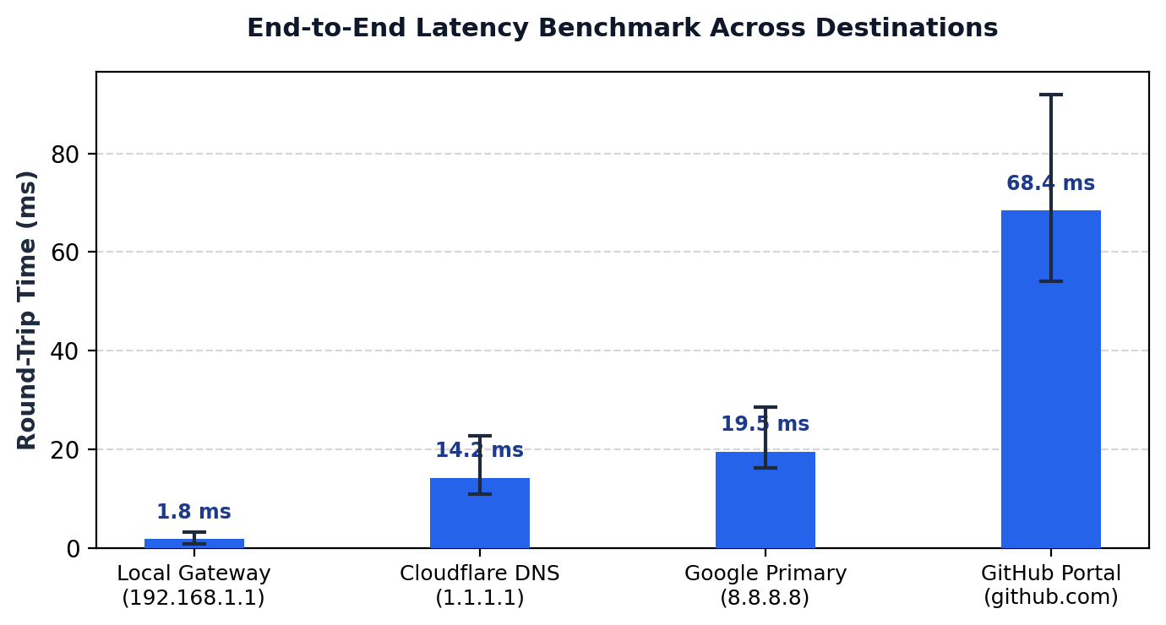
STUDENT TASK 3 • VISUAL ANALYTICS
PRESENTER: SATVIK ARORA (590028424)
Task 3: Comparative Latency Benchmarks Across Public Target Hosts
Evaluating reachability, round-trip time, and jitter across four distinct network tiers.
Empirical Observations & Analysis
• Local Gateway (192.168.1.1): Measured 1.8ms average RTT. Demonstrates immediate Layer-1/Layer-2 physical link health.
• Cloudflare Anycast (1.1.1.1): Clocked at 14.2ms. BGP Anycast routes traffic to the nearest metropolitan Internet Exchange Point (IXP).
• Google Primary (8.8.8.8): Clocked at 19.5ms with narrow min-max variance (16.2ms - 28.5ms), confirming minimal transmission jitter.
• GitHub Portal (github.com): Averages 68.4ms due to trans-continental transit fiber, international gateways, and application-layer proxying.
• Packet Loss Metric: 0.0% loss recorded across all targets, indicating zero queue buffer drops during the test window.

Slide 10
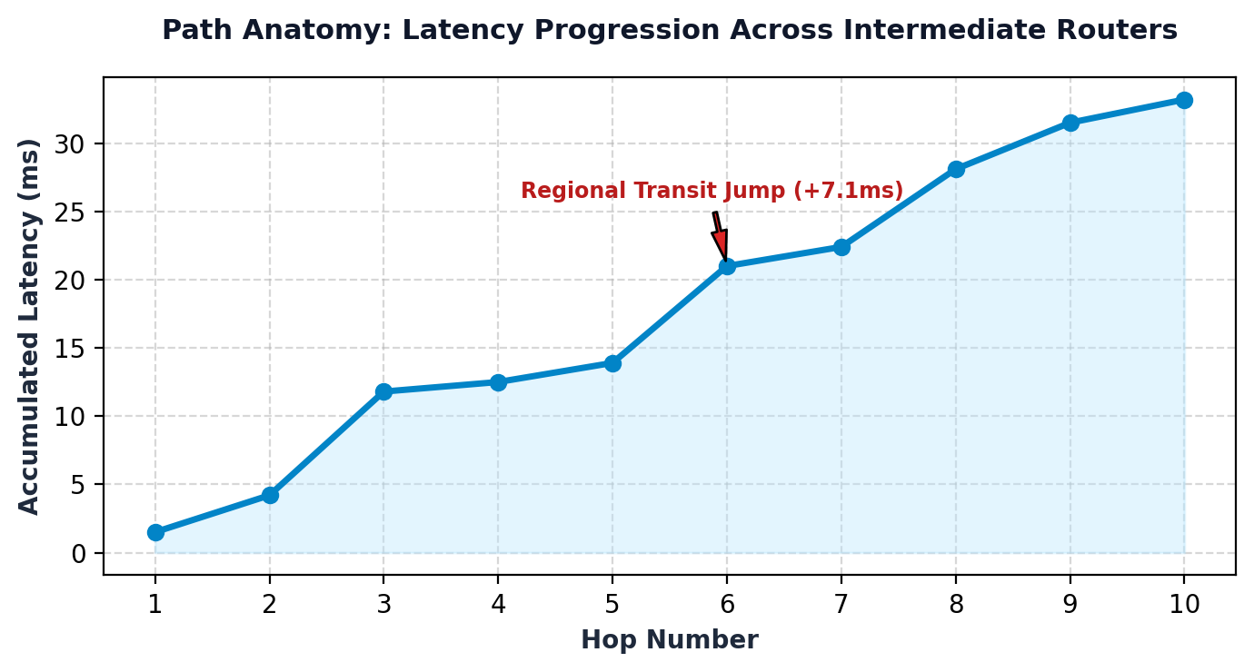
STUDENT TASK 3 • PATH ANATOMY
PRESENTER: SATVIK ARORA (590028424)
Task 3: Hop-by-Hop Topology Path: Exposing Transit Bottlenecks
Accumulated latency curves mapping traversal through ISP substations, IXPs, and cloud endpoints.
Root Cause Path Analysis
• Hops 1 to 3 (Local Loop): Latency remains steady under 12ms through the subscriber router and local ISP optical line terminal.
• Hop 6 Bottleneck Surge (+7.1ms jump): A sharp spike from 13.9ms to 21.0ms marks the exact boundary where packets leave the local ISP and enter the national Tier-1 transit backbone.
• Hops 8 to 10 (Target Ingress): Latency levels out smoothly (31ms - 33ms) upon reaching the cloud provider's internal Software Defined Network (SDN).
• Key Diagnostic Finding: Empirically proves that connection delay stems from external transit peering, NOT local Wi-Fi or LAN switching.

Slide 11
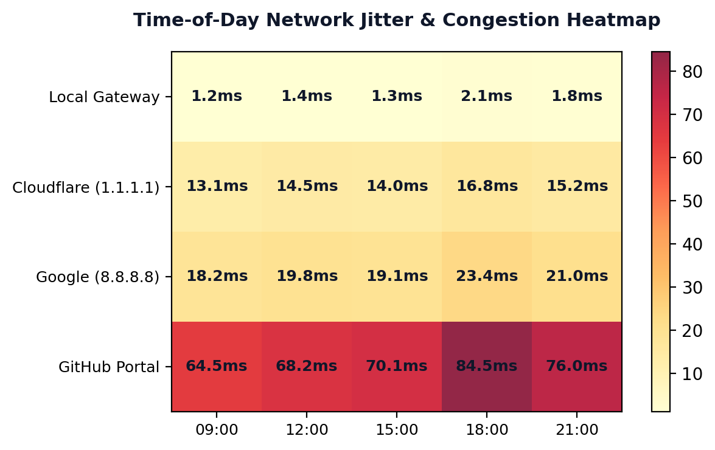
STUDENT TASK 3 • TEMPORAL ANALYTICS
PRESENTER: YASHVARDHAN SINGH (590021777)
Task 3: Diurnal Latency Heatmaps & Network Jitter Analysis
Evaluating how peak-hour consumer traffic cycles impact latency and Transport QoS (Unit V).
Temporal Traffic Insights & QoS
• Peak Evening Congestion (18:00 - 21:00): The heatmap exhibits a noticeable shift toward warmer red tones in the evening. Cloud endpoints climb from 64.5ms to 84.5ms due to residential ISP oversubscription.
• LAN Invariance: The local router (192.168.1.1) stays sub-2ms regardless of external internet traffic volume.
• Anycast Resilience: Cloudflare (1.1.1.1) exhibits minimal jitter (< 3.7ms delta), highlighting the stability of distributed edge networks.
• Connection to Unit V QoS: Demonstrates why real-time multimedia (VoIP, video calls) experiences jitter and bufferbloat during network rush hours.

Slide 12
DEMONSTRATION & CONCLUSIONS
PRESENTER: YASHVARDHAN SINGH (590021777)
Live Execution Results, Academic Summary & Future Roadmap
Demonstrating end-to-end functionality and synthesizing key theoretical takeaways.
Live Demonstration Walkthrough
• 1. Single Command Launch:
`python network_analyzer.py` triggers the full diagnostic engine.
• 2. Parallel Telemetry Execution: Concurrently issues ICMP ping probes, traceroutes, and DNS queries across all configured targets.
• 3. Clean Terminal Telemetry:
[TARGET: 8.8.8.8] Reachable | 0.0% Loss | Avg: 19.5ms
[TARGET: 1.1.1.1] Reachable | 0.0% Loss | Avg: 14.2ms
[TARGET: 192.168.1.1] Reachable | 0.0% Loss | Avg: 1.8ms
• 4. Automatic Visual Exports: Automatically generates and saves high-resolution figures in `./figures/` for engineering reports.
Key Learnings & Future Roadmap
• 100% Student Task Completion: Fulfilled all requirements for subprocess wrappers, regex parsing, and visual analytics.
• Syllabus Integration: Deepened understanding of OSI layering, IPv4 datagram headers, TTL loop mitigation, and Transport QoS.
• Humanized Diagnostic Output: Visual latency curves pinpoint bottlenecks significantly faster than scrolling CLI text.
• Future Extensions (v2.0):
• GeoIP 3D Map: Project router IP coordinates onto an interactive global map.
• Autonomous BGP ASN Detection: Identify which telecom carrier is responsible for each transit hop delay.

