Slide 1
plt.figure()
=> Allocate space for plotting

Slide 2
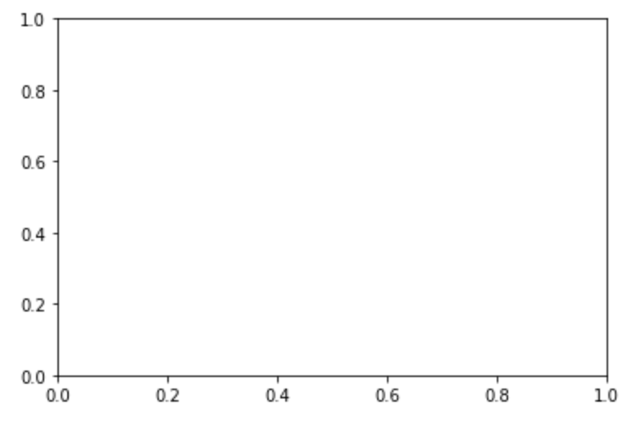
plt.figure()
=> Allocate space for plotting
ax = plt.add_subplot(1, 1, 1)
=> Create an instance of an axes object

Slide 3
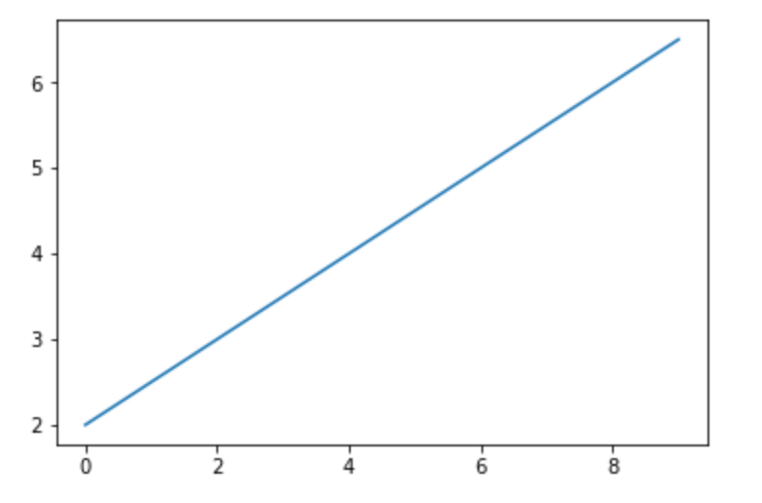
plt.figure()
=> Allocate space for plotting
ax = plt.add_subplot(1, 1, 1)
=> Create an instance of an axes object
ax.plot(x, y)
=> Plot x and y in the axes object

