Slide 1
Classical statistical inference
Part 1
Associated notebook:
03-Basic_statistics_and_proba_concepts/Basic-statistics_01.ipynb

Slide 2
Why some statistics ?
Python for data (observation / numerical simulations) manipulation
Data most often contain a stochastic component: observational device, numerical noise, simulation of stochastic process, …
Data ≋ Random variable (RV)
Statistics is the tool needed to manipulate RV
Goals for 2nd part of the lecture:
Uncertainty calculation (no, this is not black magic)
Make prediction based on data modelling (first step towards machine learning)

Slide 3
Definitions and notations recap
Ω: Sample space ≡ all possible outcome of an experiment
Ω
e.g. of experiment
I measure the magnitude of a star (in a binary system, for a transit, …)
I count galaxies for different L at a given z
I obtain the spectrum of a candidate SN
I measure a GW signal
…
This is an abstract space. For the mag of a star, Ω ≡ ℝ

Slide 4
Definitions and notations recap
Ω: Sample space ≡ all possible outcome of an experiment
ω: Realisations of the experiment
Ω
E.g. There have been 10 measurements of the magnitude of a star.
Each measurement is a different realisation
ω

Slide 5
Definitions and notations recap
Ω: Sample space ≡ all possible outcome of an experiment
ω: Realisations of the experiment
A: Event ≡ a subsample of ω ≅ Your data set
Ω
A
E.g. You have obtained and are working on 5 measurements of the magnitude of the star.
But an event can be a bit more convoluted quantity, e.g. all measurements you’ve done that have m < 15 mag
ω

Slide 6
Definitions and notations recap
Ω: Sample space ≡ all possible outcome of an experiment
ω: Realisations of the experiment
A: Event ≡ a subsample of ω ≅ Your data set
p(A): Probability of an event / value to be in [x-dx, x+dx]
Ω
A
e.g. probability that m < 15 mag
What means p(A) in frequentist/classical inference ?
ω
Relative frequency of an event
if experiment is repeated an infinite number of times

Slide 7
Random variable
A random variable is a variable whose value results from the measurement of a quantity that is subject to random variations
In Python: np.random
np.random.choice(array): choice at random in an array
np.random.seed(value): sets the seed of the rnd generator
np.random.rand(shape): random floats drawn from uniform distribution
np.random.randint(low, high, shape): rnd integers btw low and high
Go to: Sect. I.2. of the notebook

Slide 8

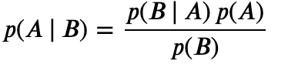

Conditional probability p(A | B)
= fraction of times that A occurs given than B occurred
Reads “Probability of A given B”
The calculation of p(A | B) follows Bayes theorem
The probability to have a flu given that you have fever is different from the probability to have fever given that you have a flu

Slide 9
Bayes theorem
Question:
A: rare disease that affects 0.1 % of the population.
B: test that is efficient at 99 % (i.e. 1 % False positive rate).
If you have a positive test (B), what is the probability for you to be affected by this disease (A) ?
NB: Efficiency is NOT sensitivity (sensitivity generally means fraction of true positive).

Slide 10
Bayes theorem
Question
A: rare disease that affects 0.1 % of the population.
B: test that is efficient at 99 % (i.e. 1 % False positive rate).
If you have a positive test (B), what is the probability for you to be affected by this disease (A) ?
Solution: (See Sect. I.3. of the notebook )
Among 1000 persons, 1 has the disease (it touches 0.1 % of the population = p(A) ).
The test has 99% efficiency (=p(B | A) ). Which means that 1% of the people will be tested positive while not being sick.
=> 10 people will be positive while healthy. You should also have ≈ 1 being positive while being effectively sick. p(B)=0.01 + 0.001 =0.011
=> p(disease | +) ≈ 1/11 = 9 %
BEWARE
RARE events common in astronomy
Conditional probabilities are often implicit

Slide 11
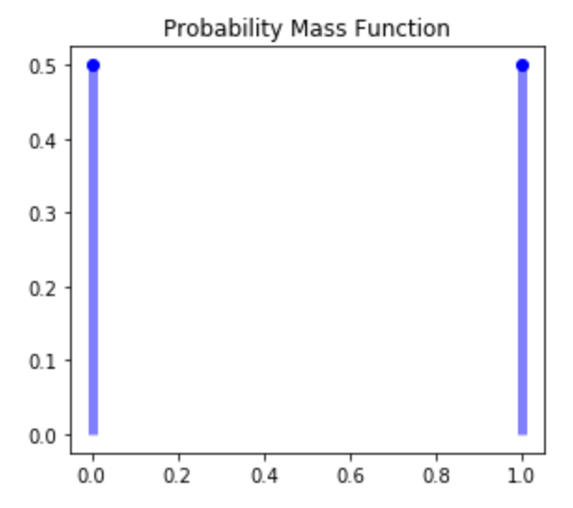


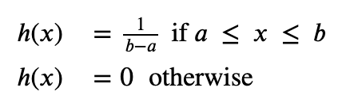
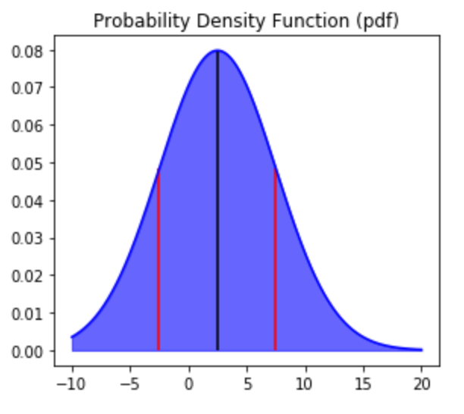
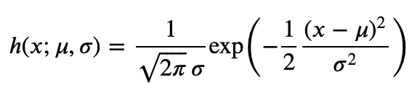
Probability density / mass function
Coin Toss (Bernouilli PMF): The PDF is the normalised histogram we had obtained
k in {0, 1} ≡ {failure, success}
parameter (success rate)
Uniform PDF:
Gaussian PDF:
PDF In Python: go to Sect. I.4 of the notebook

Slide 12
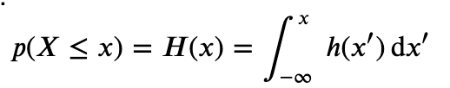
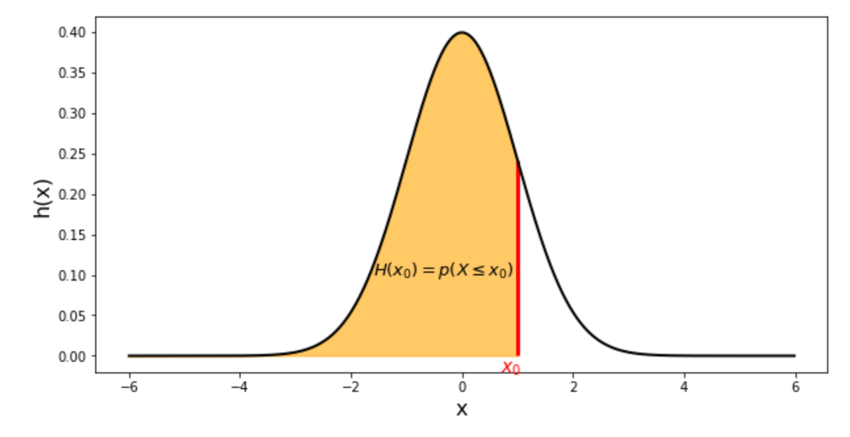
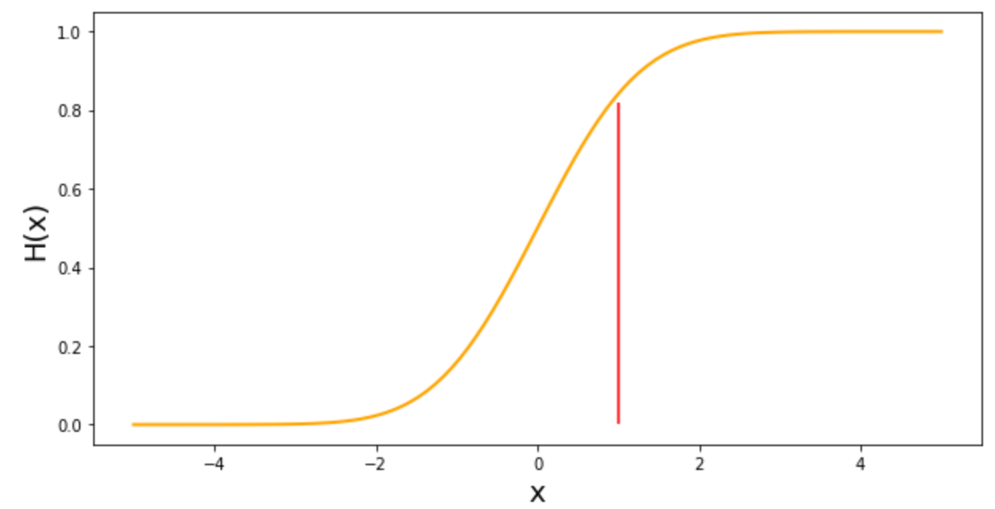
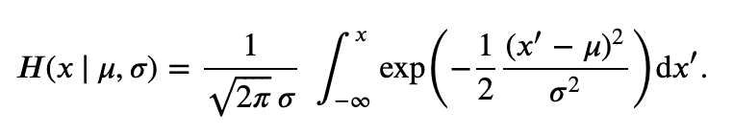
Cumulative density function
This is the integral of the PDF:
CDF In Python: go to Sect. I.5 of the notebook

Slide 13
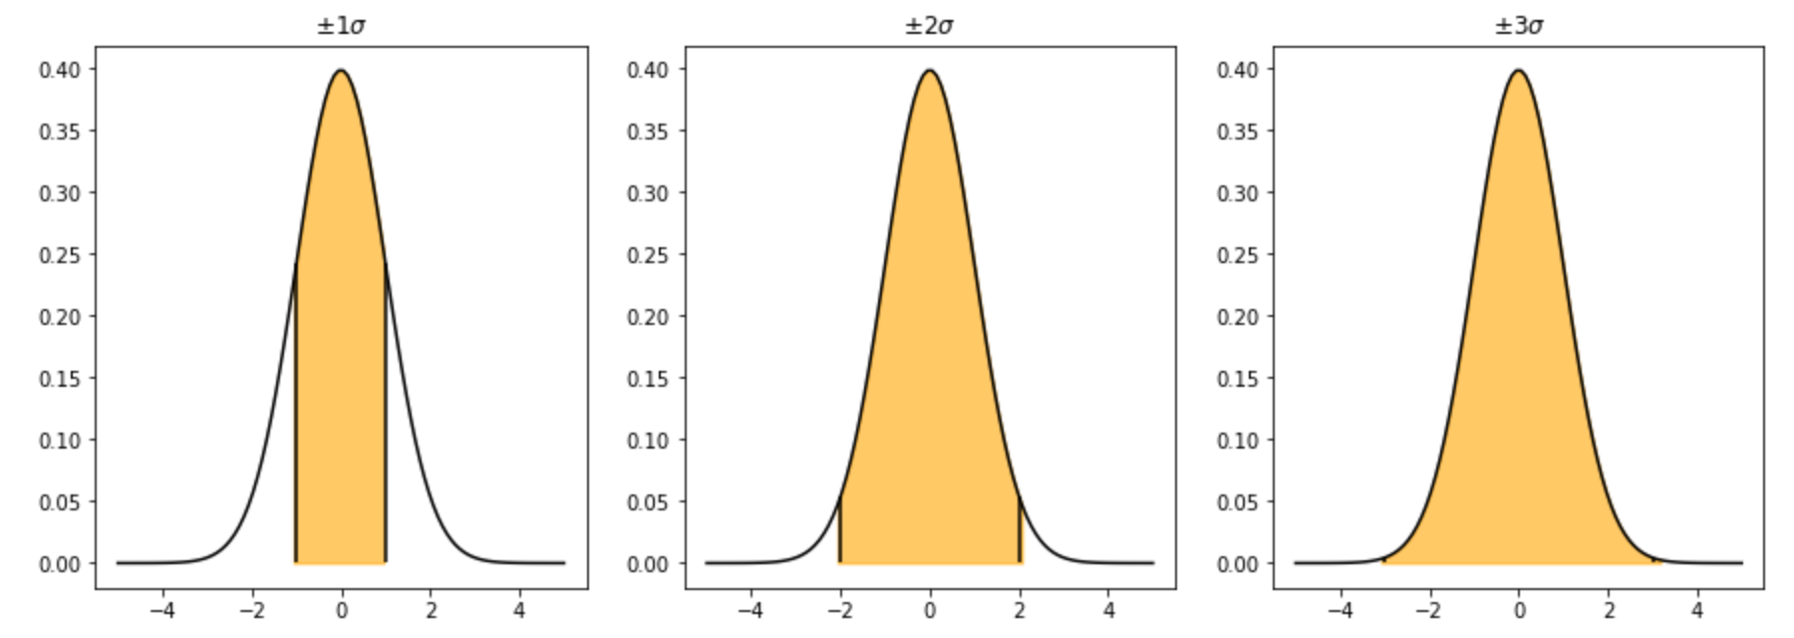
Probability enclosed between 1-2-3 σ for N(μ, σ)
See the last exercise of Sect. I.5 of the notebook
68.3%
95.5%
99.7%

