Slide 1
Classical statistical inference
Part 2
Associated notebook:
04-Basic_statistical_inference_frequentists_2/Frequentist_inference_01.ipynb

Slide 2
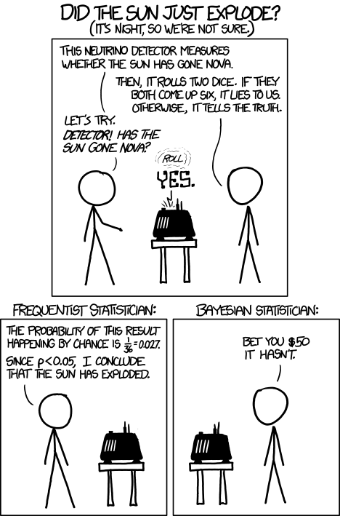
What is inference?
Derive INFORMATION based on DATA
Examples:
Exoplanet transit ⇒ M, d ⇒ P(M | d)
Supernovae distances ⇒ Expansion rate H₀
Inference generally implies an underlying statistical model: PDF or regression laws with parameters θ
Three types of inference:
Point estimation: “best” θ
Confidence interval: Confidence around θ
Hypothesis testing: data OK w. model ?
https://xkcd.com/1132/

Slide 3

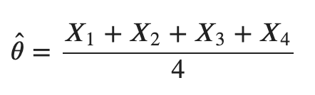
Point estimate
Example:
θ = mean mag. of a population of galaxies
A: Your data set = subsample of measurements:
A = {X_{1,} X₂, X₃, X₄} where X = mag. (this is a RV)
1
3
A
≡ Point estimate of θ
2
4
If you do the experiment with another sample
(⇒ different realisation) you will get another
= galaxy

Slide 4

Point estimate
Generalisation:
Point estimate of a param. is a function of RV X₁, …
It is as well a Random Variable (RV)
It can be biased, is characterized by a variance but should ideally be consistent (converges towards θ)
Distribution of is called sampling distribution
1
3
A
2
4
= galaxy

Slide 5
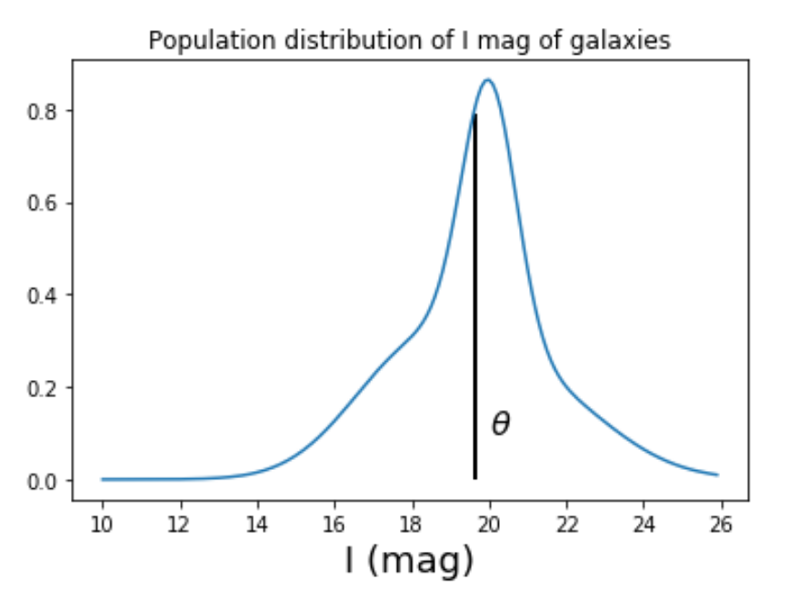
Point estimate
Population mean: θ = 19.66
Notes:
GOD formula to generate the population:
g1 = scipy.stats.norm(18, 1.7)
g2 = scipy.stats.norm(20, 0.7)
g3 = scipy.stats.norm(21, 2)
x = np.arange(10, 26, 0.1)
g_pop = g1.pdf(x)+g2.pdf(x)+g3.pdf(x)
plt.plot(x, g_pop)
plt.title("Population distribution of I mag of galaxies")
g_mean = (18+20+21) / 3. # the 3 gaussians are normalised => no weighted mean
plt.xlabel('I (mag)', size=18)
x_m= np.searchsorted(x, g_mean)
plt.vlines(g_mean, 0, g_pop[x_m-1], color='black', lw=2)
f, ax = plt.subplots(ncols=3, nrows=2, sharex=True, sharey=True)
mean_sample = []
k = 0
for j in range(2):
for i in range(3):
k+=1
ndat = 30
sample1, sample2, sample3 = g1.rvs(ndat), g2.rvs(ndat), g3.rvs(ndat)
sample = np.hstack((sample1, sample2,sample3))
mean_sample.append(sample.mean())
ax[j,i].hist(sample, density=True, color='red')
ax[j,i].text(18, 0.3, r'$\hat \theta_%i$ = %.1f'%(k, sample.mean()))
ax[j,i].set_ylim(0, 0.35)
mean_sample = []
f, ax = plt.subplots(ncols=1)
for k in range(1000):
ndat = 30
sample1, sample2, sample3 = g1.rvs(ndat), g2.rvs(ndat), g3.rvs(ndat)
sample = np.hstack((sample1, sample2,sample3))
mean_sample.append(sample.mean())
qq = ax.hist(mean_sample, color='green', density=True, bins=20)
ax2 = plt.twinx(ax)
ax2.hist(mean_sample_6, color='red', density=False, bins=qq[1], alpha=0.4)
ax.set_xlabel(r'$\hat \theta$', size=18)
ax.set_ylabel('Sampling PDF', color='green')
ax2.set_ylabel('N - subsample', color='red')

Slide 6
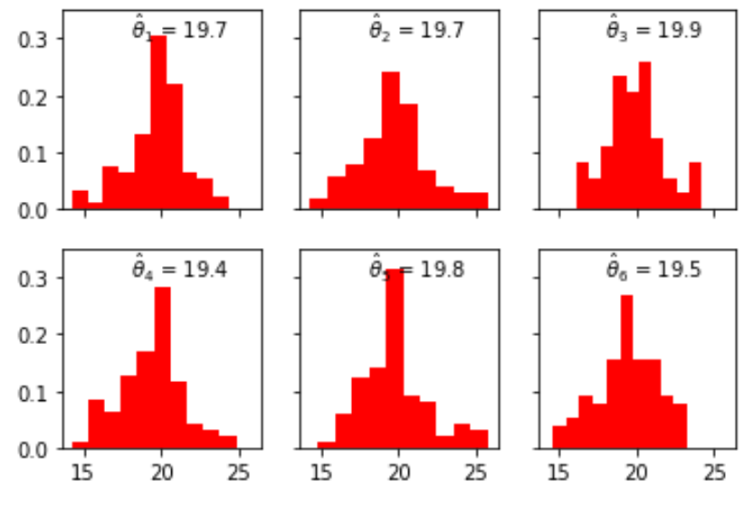
Point estimate
Six different samples drawn from the true population
Samples
Population mean: θ = 19.66
Notes:
GOD formula to generate the population:
g1 = scipy.stats.norm(18, 1.7)
g2 = scipy.stats.norm(20, 0.7)
g3 = scipy.stats.norm(21, 2)
x = np.arange(10, 26, 0.1)
g_pop = g1.pdf(x)+g2.pdf(x)+g3.pdf(x)
plt.plot(x, g_pop)
plt.title("Population distribution of I mag of galaxies")
g_mean = (18+20+21) / 3. # the 3 gaussians are normalised => no weighted mean
plt.xlabel('I (mag)', size=18)
x_m= np.searchsorted(x, g_mean)
plt.vlines(g_mean, 0, g_pop[x_m-1], color='black', lw=2)
f, ax = plt.subplots(ncols=3, nrows=2, sharex=True, sharey=True)
mean_sample = []
k = 0
for j in range(2):
for i in range(3):
k+=1
ndat = 30
sample1, sample2, sample3 = g1.rvs(ndat), g2.rvs(ndat), g3.rvs(ndat)
sample = np.hstack((sample1, sample2,sample3))
mean_sample.append(sample.mean())
ax[j,i].hist(sample, density=True, color='red')
ax[j,i].text(18, 0.3, r'$\hat \theta_%i$ = %.1f'%(k, sample.mean()))
ax[j,i].set_ylim(0, 0.35)
mean_sample = []
f, ax = plt.subplots(ncols=1)
for k in range(1000):
ndat = 30
sample1, sample2, sample3 = g1.rvs(ndat), g2.rvs(ndat), g3.rvs(ndat)
sample = np.hstack((sample1, sample2,sample3))
mean_sample.append(sample.mean())
qq = ax.hist(mean_sample, color='green', density=True, bins=20)
ax2 = plt.twinx(ax)
ax2.hist(mean_sample_6, color='red', density=False, bins=qq[1], alpha=0.4)
ax.set_xlabel(r'$\hat \theta$', size=18)
ax.set_ylabel('Sampling PDF', color='green')
ax2.set_ylabel('N - subsample', color='red')

Slide 7
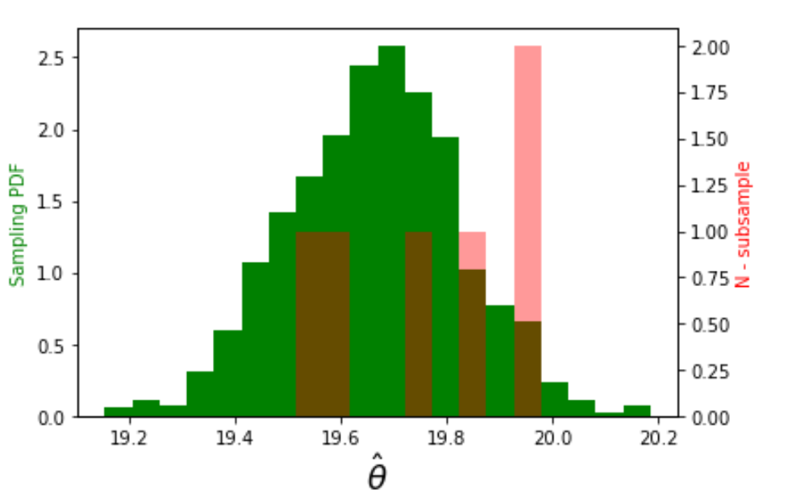
Point estimate
Six different samples drawn from the true population
Samples
Population mean: θ = 19.66
Go to: Sect. II.1 of the notebook
Notes:
GOD formula to generate the population:
g1 = scipy.stats.norm(18, 1.7)
g2 = scipy.stats.norm(20, 0.7)
g3 = scipy.stats.norm(21, 2)
x = np.arange(10, 26, 0.1)
g_pop = g1.pdf(x)+g2.pdf(x)+g3.pdf(x)
plt.plot(x, g_pop)
plt.title("Population distribution of I mag of galaxies")
g_mean = (18+20+21) / 3. # the 3 gaussians are normalised => no weighted mean
plt.xlabel('I (mag)', size=18)
x_m= np.searchsorted(x, g_mean)
plt.vlines(g_mean, 0, g_pop[x_m-1], color='black', lw=2)
f, ax = plt.subplots(ncols=3, nrows=2, sharex=True, sharey=True)
mean_sample = []
k = 0
for j in range(2):
for i in range(3):
k+=1
ndat = 30
sample1, sample2, sample3 = g1.rvs(ndat), g2.rvs(ndat), g3.rvs(ndat)
sample = np.hstack((sample1, sample2,sample3))
mean_sample.append(sample.mean())
ax[j,i].hist(sample, density=True, color='red')
ax[j,i].text(18, 0.3, r'$\hat \theta_%i$ = %.1f'%(k, sample.mean()))
ax[j,i].set_ylim(0, 0.35)
mean_sample = []
f, ax = plt.subplots(ncols=1)
for k in range(1000):
ndat = 30
sample1, sample2, sample3 = g1.rvs(ndat), g2.rvs(ndat), g3.rvs(ndat)
sample = np.hstack((sample1, sample2,sample3))
mean_sample.append(sample.mean())
qq = ax.hist(mean_sample, color='green', density=True, bins=20)
ax2 = plt.twinx(ax)
ax2.hist(mean_sample_6, color='red', density=False, bins=qq[1], alpha=0.4)
ax.set_xlabel(r'$\hat \theta$', size=18)
ax.set_ylabel('Sampling PDF', color='green')
ax2.set_ylabel('N - subsample', color='red')

Slide 8
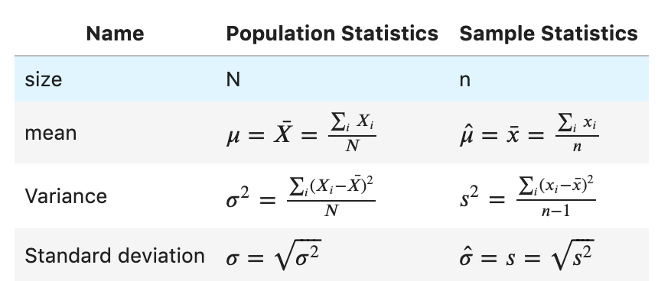
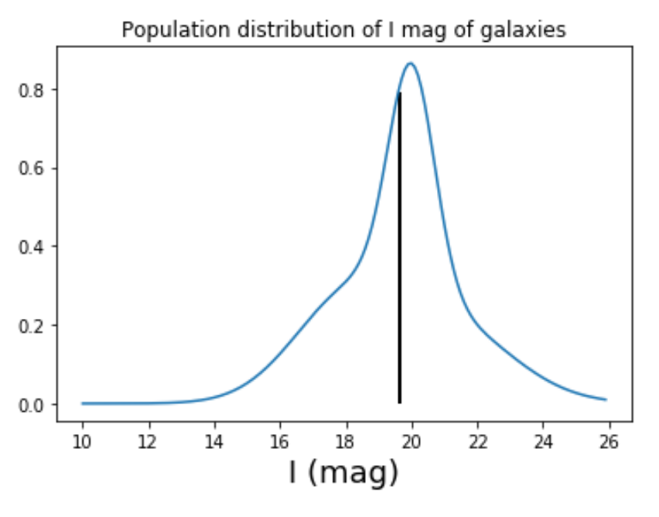
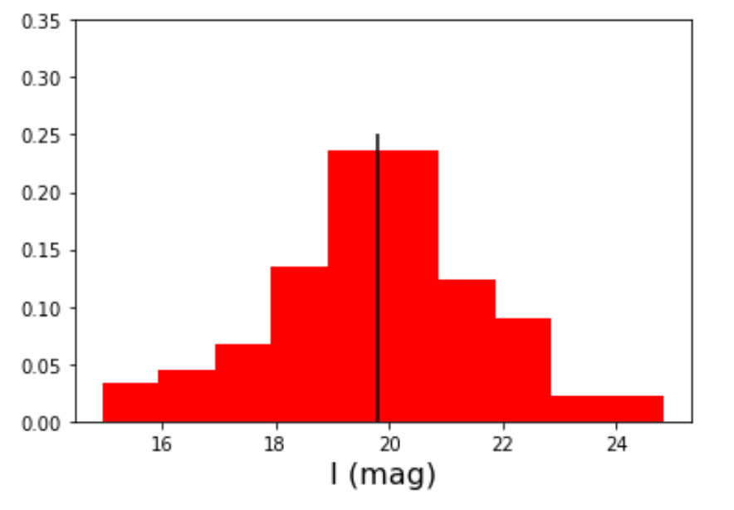



Summary statistics
Sampling distribution
N = 9 10⁹
n = 90
σ
Notes:
GOD formula to generate the population:
g1 = scipy.stats.norm(18, 1.7)
g2 = scipy.stats.norm(20, 0.7)
g3 = scipy.stats.norm(21, 2)
x = np.arange(10, 26, 0.1)
g_pop = g1.pdf(x)+g2.pdf(x)+g3.pdf(x)
plt.plot(x, g_pop)
plt.title("Population distribution of I mag of galaxies")
g_mean = (18+20+21) / 3. # the 3 gaussians are normalised => no weighted mean
plt.xlabel('I (mag)', size=18)
x_m= np.searchsorted(x, g_mean)
plt.vlines(g_mean, 0, g_pop[x_m-1], color='black', lw=2)
f, ax = plt.subplots(ncols=3, nrows=2, sharex=True, sharey=True)
mean_sample = []
k = 0
for j in range(2):
for i in range(3):
k+=1
ndat = 30
sample1, sample2, sample3 = g1.rvs(ndat), g2.rvs(ndat), g3.rvs(ndat)
sample = np.hstack((sample1, sample2,sample3))
mean_sample.append(sample.mean())
ax[j,i].hist(sample, density=True, color='red')
ax[j,i].text(18, 0.3, r'$\hat \theta_%i$ = %.1f'%(k, sample.mean()))
ax[j,i].set_ylim(0, 0.35)
mean_sample = []
f, ax = plt.subplots(ncols=1)
for k in range(1000):
ndat = 30
sample1, sample2, sample3 = g1.rvs(ndat), g2.rvs(ndat), g3.rvs(ndat)
sample = np.hstack((sample1, sample2,sample3))
mean_sample.append(sample.mean())
qq = ax.hist(mean_sample, color='green', density=True, bins=20)
ax2 = plt.twinx(ax)
ax2.hist(mean_sample_6, color='red', density=False, bins=qq[1], alpha=0.4)
ax.set_xlabel(r'$\hat \theta$', size=18)
ax.set_ylabel('Sampling PDF', color='green')
ax2.set_ylabel('N - subsample', color='red')

Slide 9
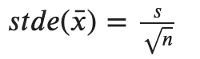

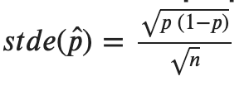
Summary (sample) statistics: standard error
Standard error (stde) ≠ Standard deviation (std)
Name | Formula
Standard error on the mean
Standard error on the stdev
Standard error on proportions

Slide 10
Central limit theorem
When independent random variables are added, their sum tends towards a normal distribution (if n >>)
This is true even if the original RV are not normally distributed
Sampling dist. of mean tends (for large n ) towards a Normal distribution
Sampling dist. of variance (for large n) does NOT tend towards a Normal distribution
Go to: Sect. II.1.1. of the notebook

Slide 11

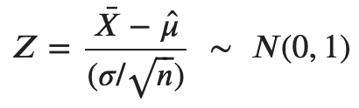
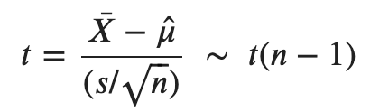
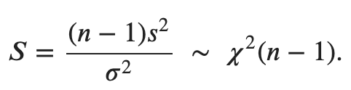
Distribution of estimators
If RV {X_{i}} whose population is distributed as N(μ, σ)
Sample distribution of
Sample distribution of
Sample distribution of
⟺
s is derived from the sample dist.
Student distribution
Chi square distribution

Slide 12
Classical statistical inference: confidence interval
Part 3
Associated notebook:
04-Basic_statistical_inference_frequentists_2/Frequentist_inference_02.ipynb

Slide 13
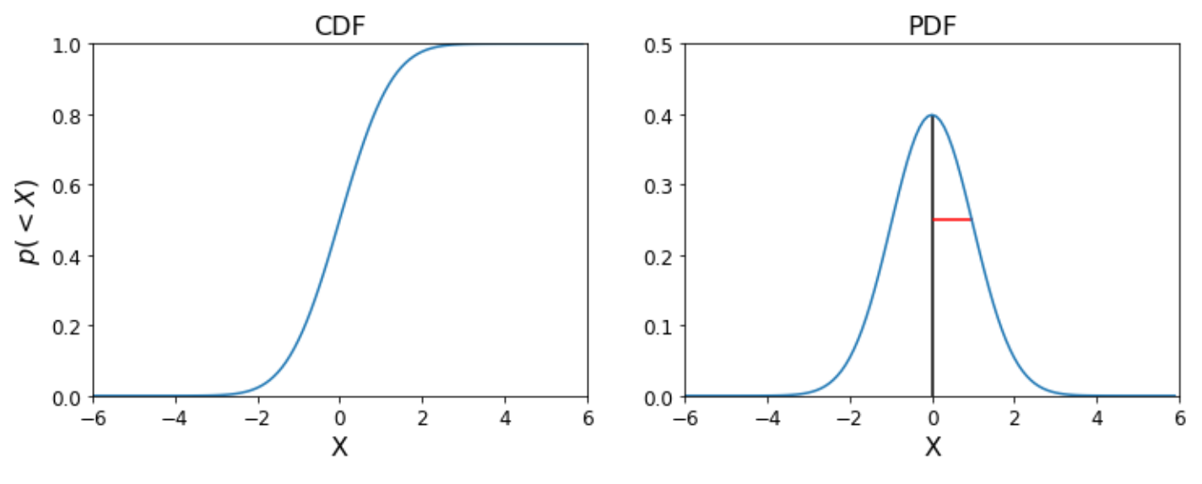
Confidence interval on a RV (descriptive stat)
If RV {X_{i}} whose population is distributed as N(μ, σ)
σ
μ

Slide 14
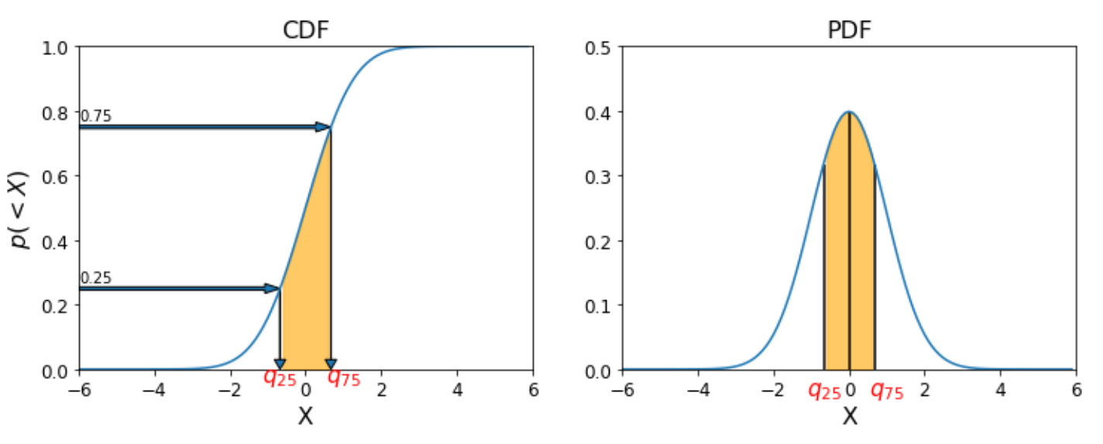
Confidence interval on a RV (descriptive stat)
If RV {X_{i}} whose population is distributed as N(μ, σ)
μ
Interquartile IQ = [q₂₅, q₇₅] ≡ 50 % CI around μ
1 – α CI ≡ [a, b] such that p(a ≤ X ≤ b) = ( 1 – α )

Slide 15
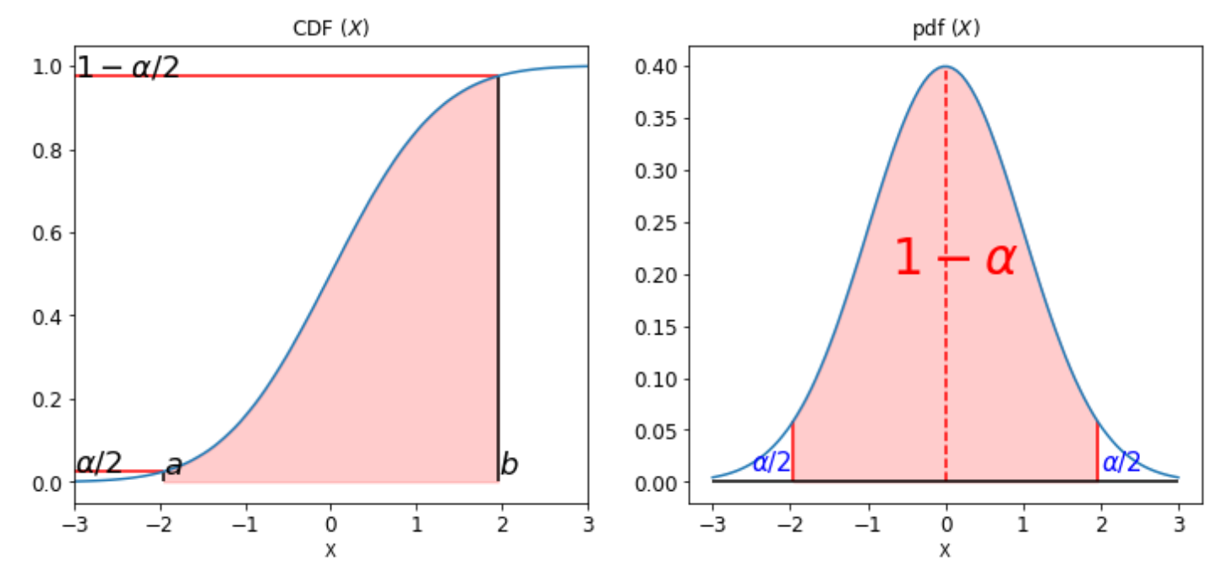
Confidence interval on a RV (descriptive stat)
If RV {X_{i}} whose population is distributed as N(μ, σ)
1 – α CI ≡ [a, b] such that p(a ≤ X ≤ b) = ( 1 – α )

Slide 16
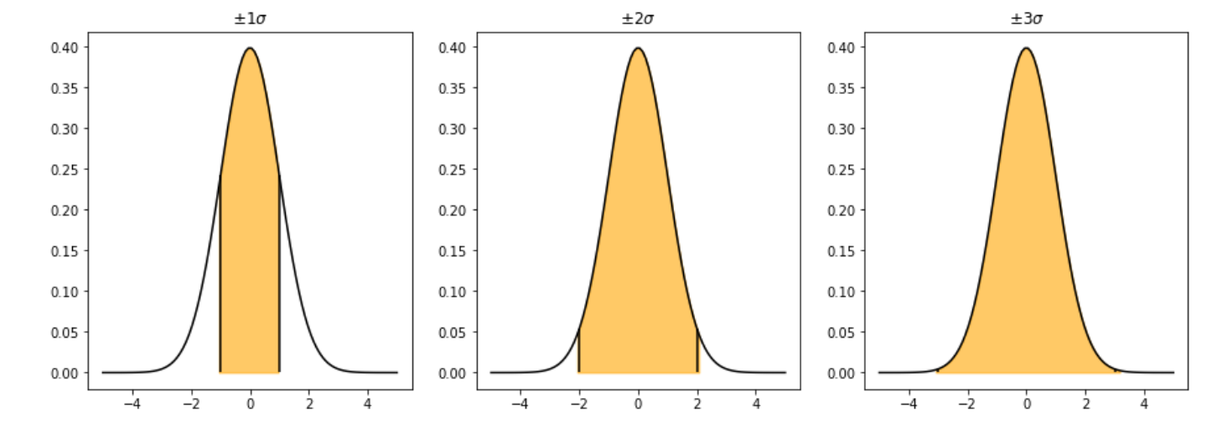
Confidence interval on a RV (descriptive stat)
If RV {X_{i}} whose population is distributed as N(μ, σ)
68.3 %
95.5 %
99.7 %
[μ – 1 σ, μ + 1 σ] ≡ 68.3 %
[μ – 2 σ, μ + 2 σ] ≡ 95.5 %
[μ – 3 σ, μ + 3 σ] ≡ 99.7 %

Slide 17
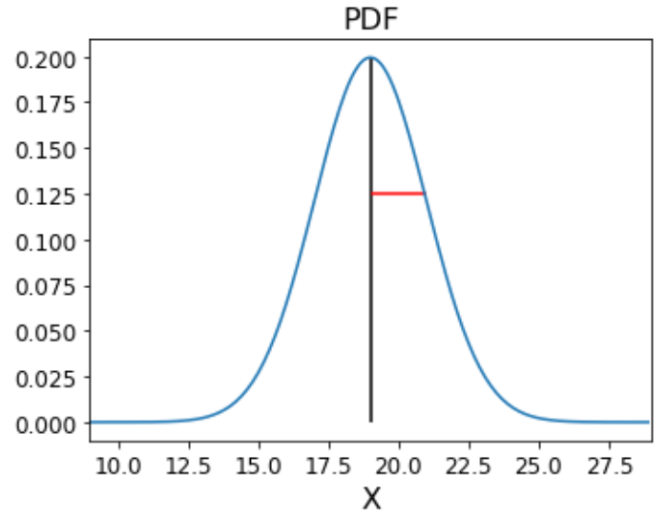
Confidence interval on from an estimator
If RV {X_{i}} whose population is distributed as N(μ, σ)
S₁ = {x₁, x₂, x₃, x₄}
σ
1
3
S₁
2
4
μ

Slide 18
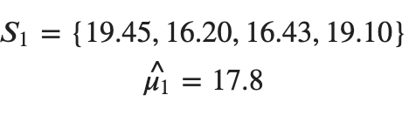

Confidence interval from an estimator
If RV {X_{i}} whose population is distributed as N(μ, σ)
S₁ = {x₁, x₂, x₃, x₄}
σ
1
3
μ
S₁
2
4

Slide 19

Confidence interval from an estimator
If RV {X_{i}} whose population is distributed as N(μ, σ)
S₁ = {x₁, x₂, x₃, x₄}
σ
1
3
μ
S₁
95.5 % CI on ?
2
4
We need to look at the distribution of the estimator

Slide 20
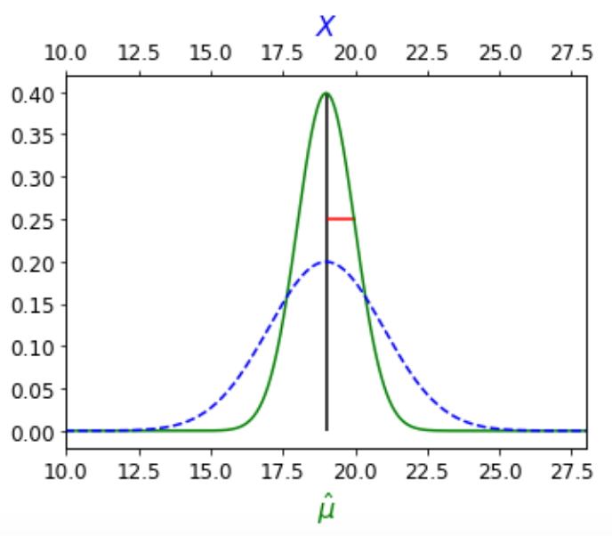




Confidence interval on the mean
95.5 % CI on ?
If RV {X_{i}} whose population is distributed as N(μ, σ)
Case 1: σ is known
1
3
μ
S₁
2
4

Slide 21
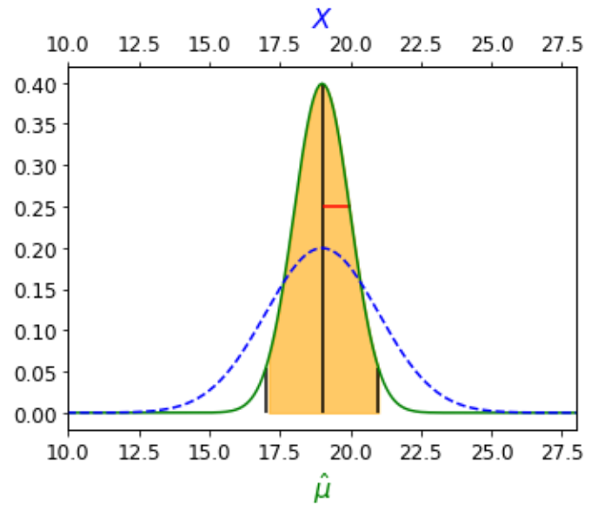


Confidence interval on the mean
95.5 % CI on ?
If RV {X_{i}} whose population is distributed as N(μ, σ)
Case 1: σ is known
1
3
S₁
2
4

Slide 22
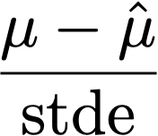

Confidence interval on the mean
95.5 % CI on μ ?
If RV {X_{i}} whose population is distributed as N(μ, σ)
Case 1: σ is known
1
3
S₁
2
4
m depends on the distribution of the normalised estimator:

Slide 23
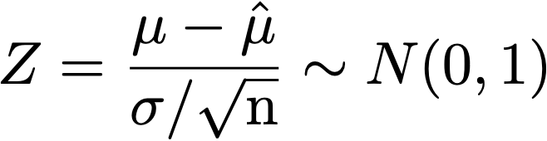

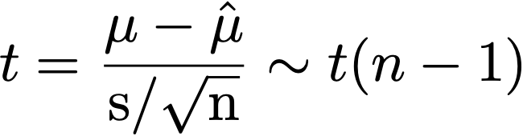
Confidence interval on the mean
95.5 % CI on μ ?
If RV {X_{i}} whose population is distributed as N(μ, σ)
Case 1: σ is known
1
Case 2: σ is unknown
3
S₁
2
4
Go to: Student_vs_Gauss.ipynb

Slide 24

Confidence interval
“Generic” strategy:
Look at the PDF of the estimator of interest (the latter is often an output of Bayesian analysis) or of a normalised estimator of known distribution.
Define region around your estimator (or a normalised estimator for which you know the distribution) that encloses (1 - α) X 100 % of the area under the PDF.
- For CI around the mean:
For CI on other statistics (e.g. variance, difference between 2 means, proportions) : see Frequentist_inference_03.ipynb
(Material in Frequentist_inference_03.ipynb is supplementary material)
Go to: Sect. II.2. of the notebooks

