Slide 1
Classical statistical inference Regression and Model fitting
Associated notebook:
05-MLE_and_regression/Regression_short.ipynb

Slide 2
Regression and model fitting
Problem: the quantities of interest are parameters of a model, not the RV that you measure
Examples
Observation | Quantity of interest | Model
Position of a star: x(t) | Proper motion (velocity) of the star | V = f(x, t, …)
Photometry of an asteroid: mag(t) | P (period of rotation) | mag = f(t, P, …)
Transit of a planet: mag(t) | P (period), e (eccentricity), D (dist to star) | Δ m = f (t, P, e, D, …)
Spectrum of a QSO: F (λ) | M_{BH} (Black hole mass of QSO) | FWHM = f(M_{BH}, L, …)

Slide 3
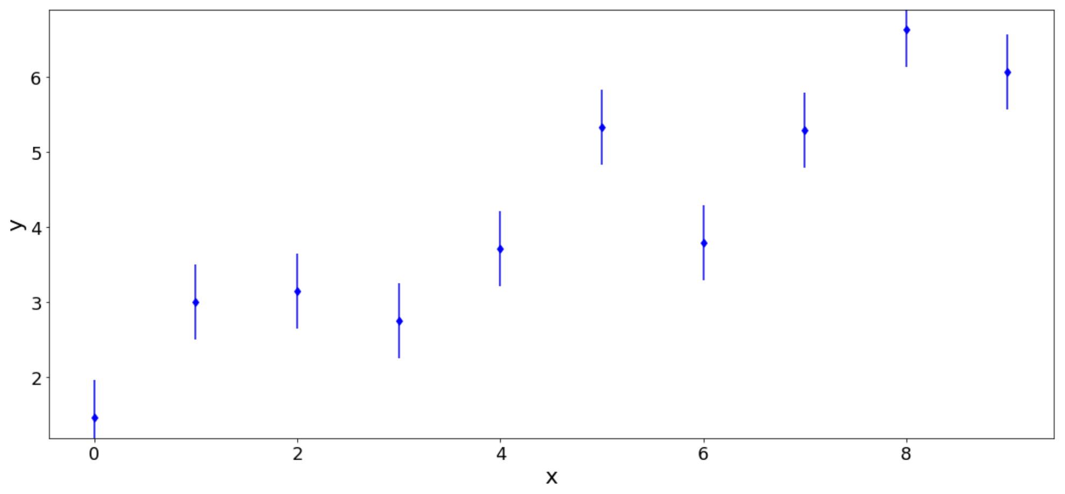
Regression and model fitting
Problem: You measure D ≡ ({y_{i}}, {x_{i}})
Data: {x_{i}}, {y_{i}} w. σ_{ι}
Model: M(θ)

Slide 4
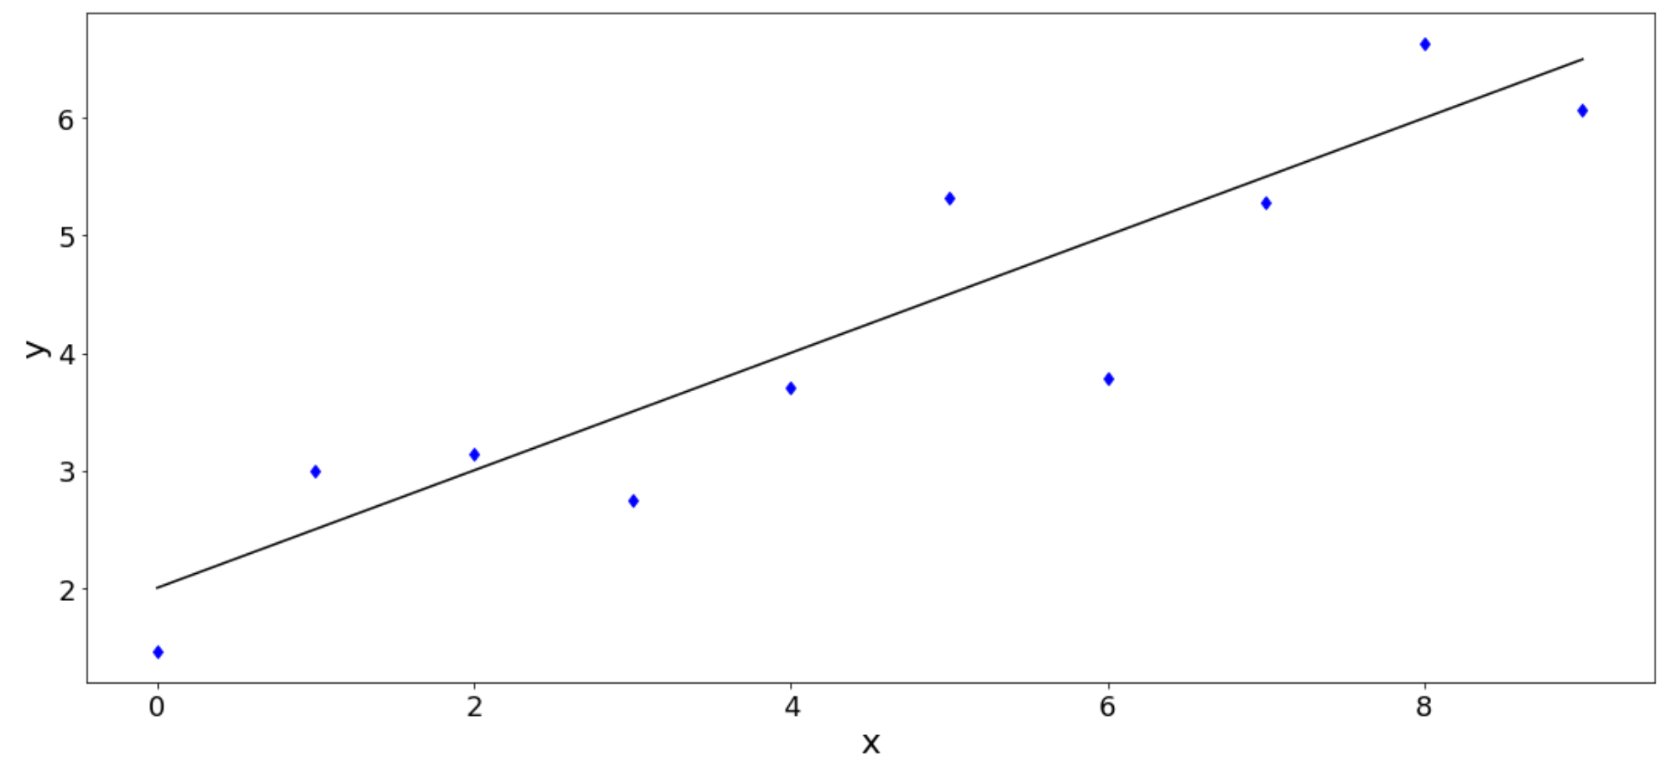
Regression and model fitting
Problem: You measure D ≡ ({y_{i}}, {x_{i}})
Data: {x_{i}}, {y_{i}} w. σ_{ι}
Model: M(θ)
y = a * x + b
θ = a, b
M(θ): y = a * x + b

Slide 5
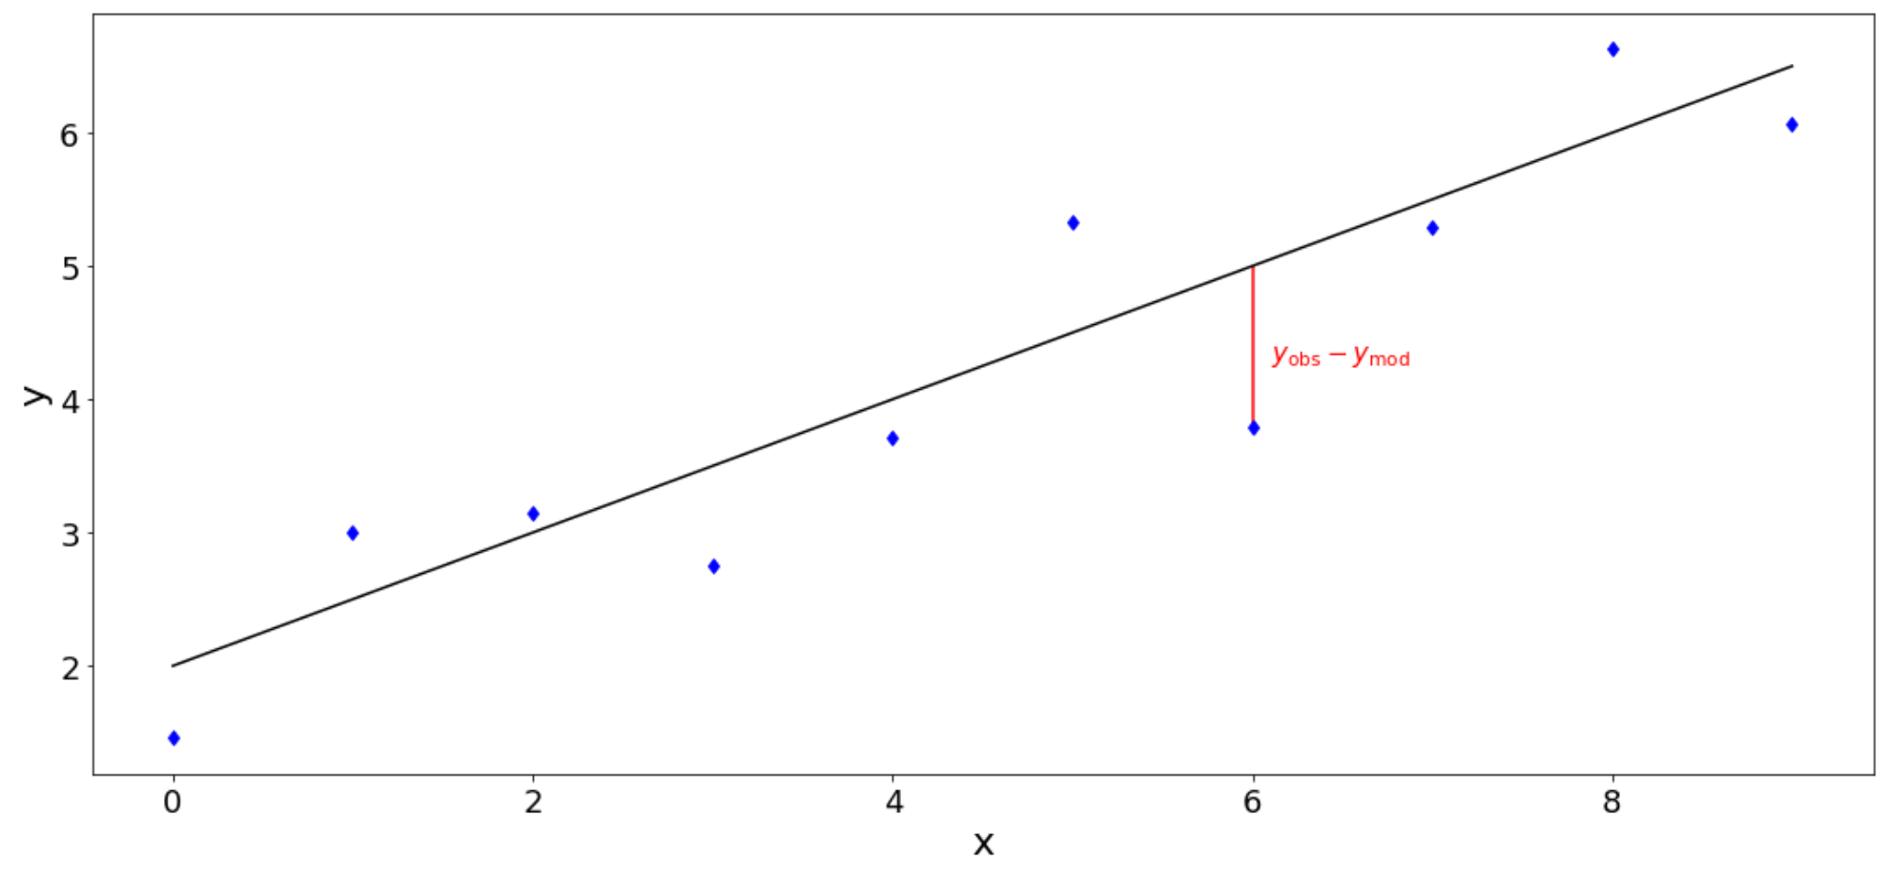
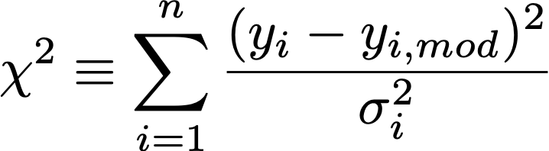
Regression and model fitting
How to find a good model?
Model: M(θ)
y = a * x + b
= f(x | θ)
θ = a, b
Data: {x_{i}}, {y_{i}} w. σ_{ι}
Minimize

Slide 6
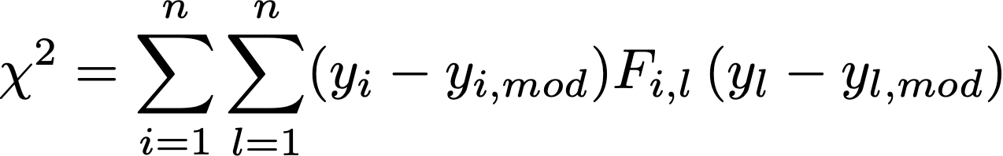
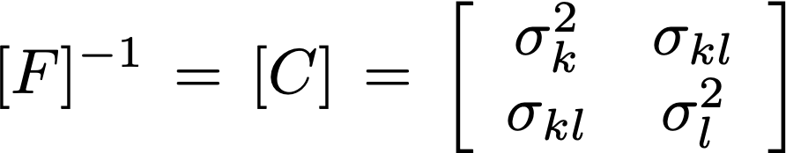
Regression and model fitting
If σ_{i} = 1 : Least square regression
If σ_{i} ≠ 1 : chi-square regression
The χ² is called a merit function
When uncertainties between variables
are correlated, the χ² is expressed:
Where F is the Fisher matrix

Slide 7



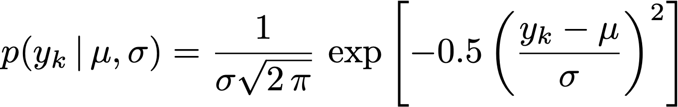
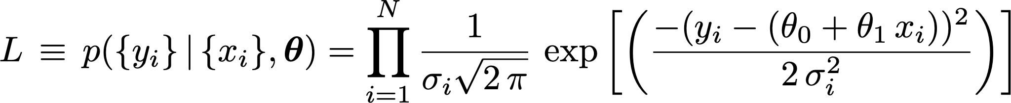
Link between χ² and likelihood
Case of a straight line:
with
For each y_{k} we have:
Hence, we have for our data set D:

Slide 8
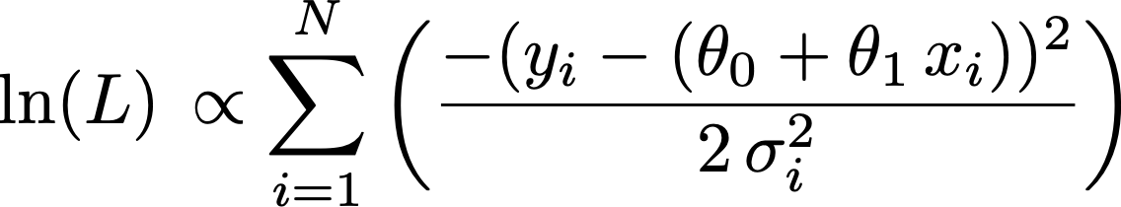

Link between χ² and likelihood
Hence, we have for our data set D:
⇒
Minimizing χ² is equivalent to maximizing L

Slide 9
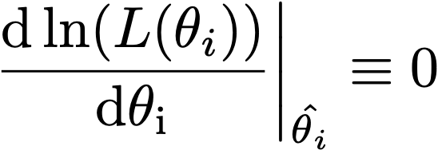
Regression and model fitting
How to find a good model? Maximum Likelihood Estimation
Model: M(θ)
y = a * x + b
θ = a, b
Data: x_{i}, y_{i} , σ_{ι}
M(θ): y = a * x + b
MLE ⇒ maximize L(θ)

Slide 10
Regression and model fitting
How to find a good model? Maximum Likelihood Estimation
Model: M(θ)
y = a * x + b
= f(x | θ)
θ = a, b
Data: x_{i}, y_{i} , σ_{ι}
M(θ): y = a * x + b
MLE allows you to find
θ ⇒ E( f(x | θ) )

Slide 11
Regression of a straight line in python
Linear model fitting:
See Sect. IV.1
Python implementation: numpy.polyfit(x, y, deg=1, w=1/sigma)
Go to Sect. IV.1.1 of the Notebook for practical example

Slide 12
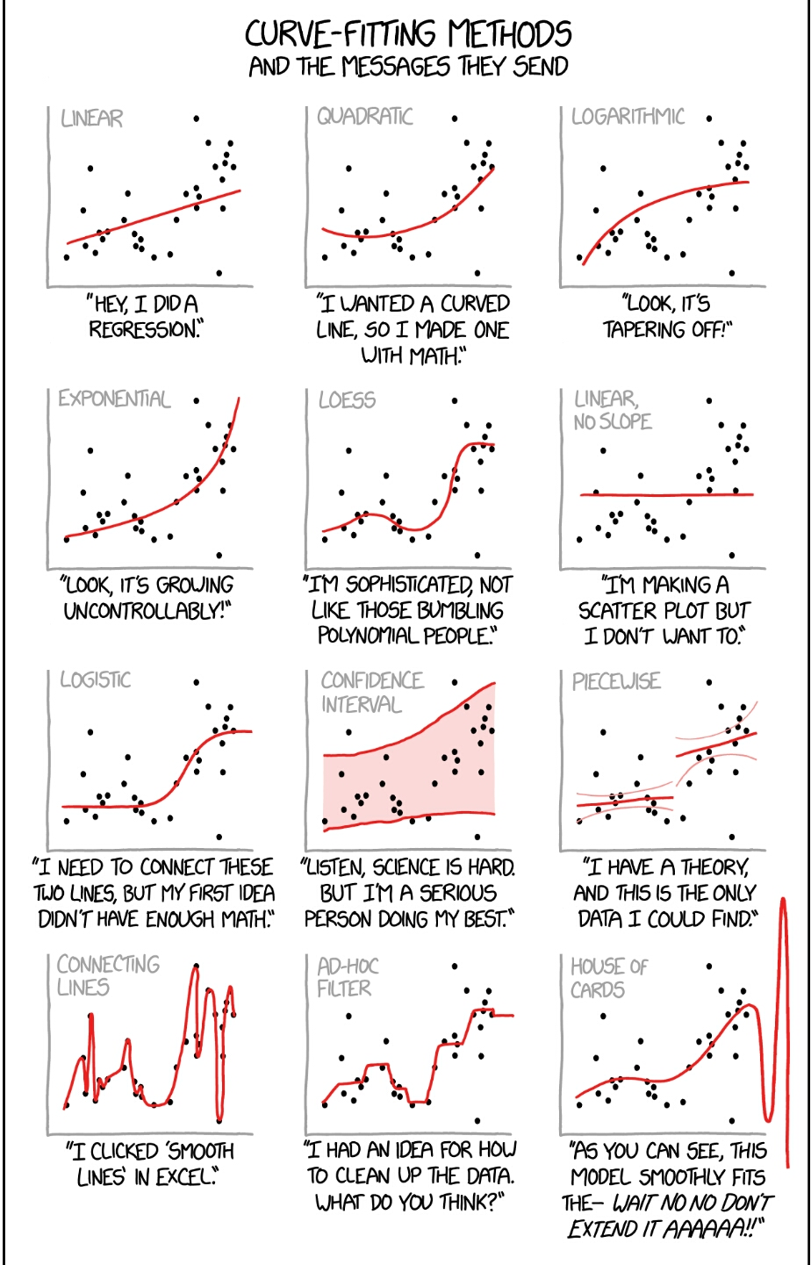
Regression and model fitting
https://xkcd.com/2048/

Slide 13
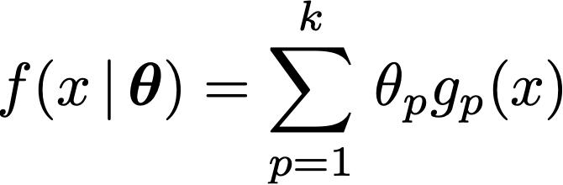
How to choose a suitable regression method ?
The way you will tackle a regression problem may depend on:
Linearity: is the model linear in its parameters?
Complexity: large number of parameters increase complexity and covariance matrix on uncertainties
Error behaviour: uncertainties on dependent and independent variable and their correlation.

Slide 14
How to choose a suitable regression method ?
Frequentist: (this lecture) | Bayes (future lecture):
Optimization with some merit function | Sampling of the likelihood
Search for best (fit) model parameters | PDF on parameters
Often when simple error behaviour | More complex error behaviour

Slide 15
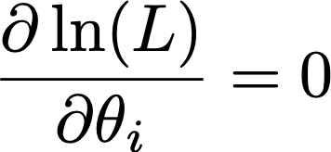
Linear vs non linear regression
A model is linear if:
g_{p}(x) can be a non linear function of x BUT does not depend on any free parameter
In this case, the values of the parameters that yield (max. likelihood ) can be found “analytically”
When the model is not linear , the minimization of the χ² has to be performed numerically

Slide 16
Linear vs non linear regression
Linear model fitting:
See Sect. IV.1
Python implementation: numpy.polyfit(x, y, deg=1, w=1/sigma)
NON Linear model fitting:
See Sect. IV.3
Python implementation: scipy.optimize.curvefit()
Go to Sect. IV.1.1 of the Notebook for practical example

Slide 17
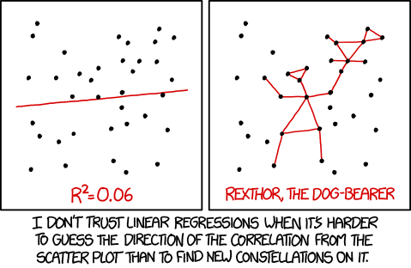
Quality of the regression
xkcd.com/1725/

Slide 18
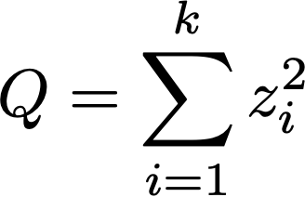
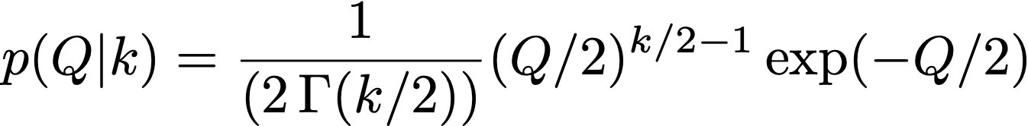
Quality of the regression
Your χ² is a random variable !
➝
k = degree of freedom = N points – n parameters
If you fit a model with 2 parameters on a set of 100 points => 98 d.o.f.
Expectation E(χ²) = 100 – 2 = 98
Reduced χ² : χ²_{red} = χ²_{dof} / d.o.f. ⇒ Reduced χ² ≡ 1. if good fit
See also the Notebook 03-Basic_statistics_and_proba_concepts/Descriptive_statistics_02.ipynb

Slide 19
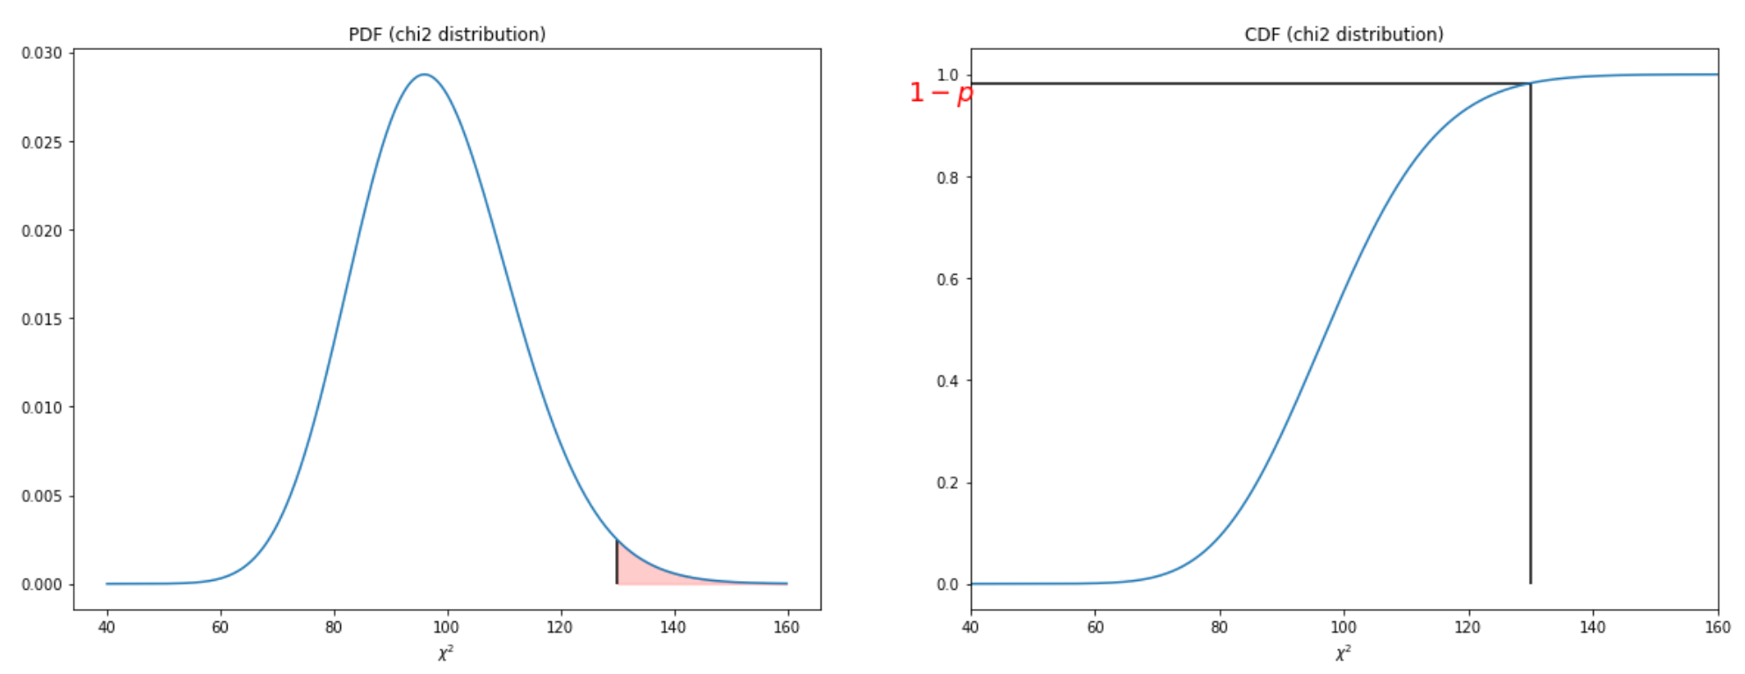


Quality of the regression
CDF
Typically:
p-value < 0.05 : ☹️
0.05 < p-value < 1: 😀
p-value close to 1 : 😕
Q
Q
1-scipy.stats.chi2.cdf(chi2_data, df= len(data)-nparam)
Go to Sect. IV.1.1 of the Notebook for practical example
Notes:
\rm{p-value}= p(Q \geq \chi^2_{\rm {obs}})

Slide 20
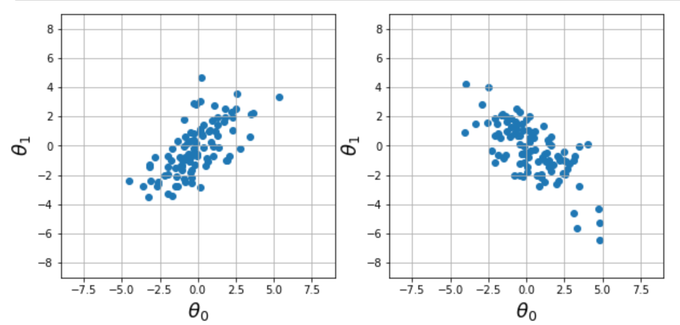
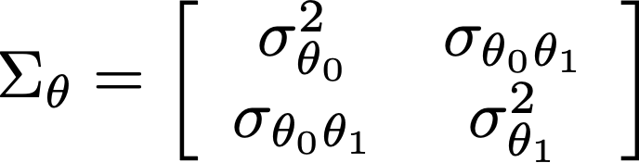
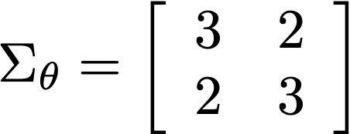
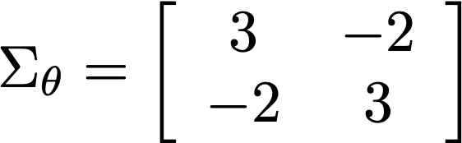
Uncertainty on the fitted parameters
The python functions return a covariance matrix (Warning : use arg. cov=True)
The diagonal elements of the matrix give the variance on the parameters (uncertainty²)
Notes:
Figure: see makefig.ipynb
\Sigma_\theta = \left[ \begin{array}{cc}
\sigma_{\theta_0}^2 & \sigma_{\theta_0 \theta_1} \\
\sigma_{\theta_0 \theta_1} & \sigma_{\theta_1}^2 \\
\end{array} \right]

Slide 21
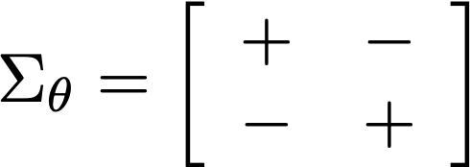
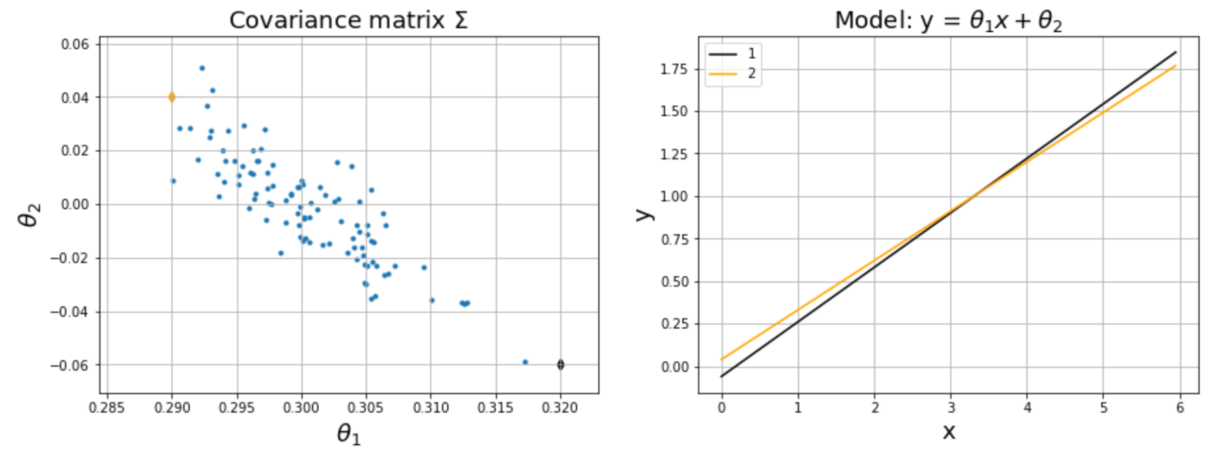
Uncertainty on the fitted parameters
Notes:
Figure: see makefig.ipynb
\Sigma_\theta = \left[ \begin{array}{cc}
\sigma_{\theta_0}^2 & \sigma_{\theta_0 \theta_1} \\
\sigma_{\theta_0 \theta_1} & \sigma_{\theta_1}^2 \\
\end{array} \right]

Slide 22
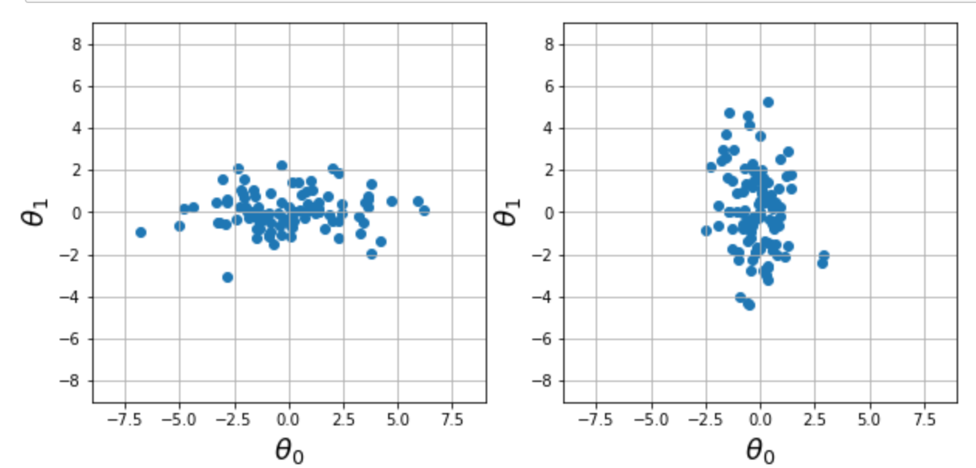
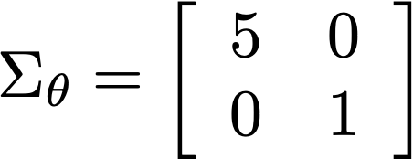
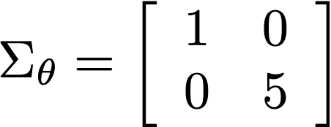
Uncertainty on the fitted parameters
Notes:
Figure: see makefig.ipynb
\Sigma_\theta = \left[ \begin{array}{cc}
\sigma_{\theta_0}^2 & \sigma_{\theta_0 \theta_1} \\
\sigma_{\theta_0 \theta_1} & \sigma_{\theta_1}^2 \\
\end{array} \right]

