Slide 1
f = plt.figure()
=> Allocate space for plotting

Slide 2
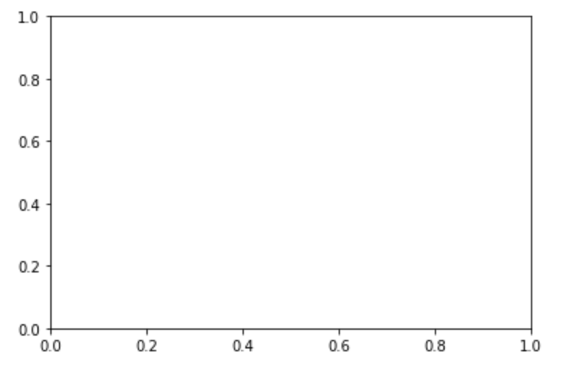
f = plt.figure()
=> Allocate space for plotting
ax = f.add_subplot(1, 1, 1)
=> Create an instance of an axes object

Slide 3
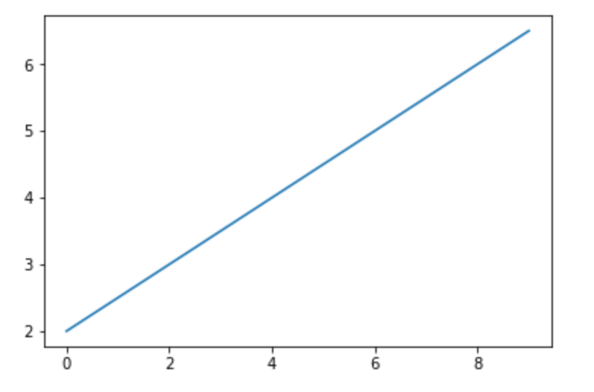
f = plt.figure()
=> Allocate space for plotting
ax = f.add_subplot(1, 1, 1)
=> Create an instance of an axes object
ax.plot(x, y)
=> Plot x and y in the axes object

Slide 4
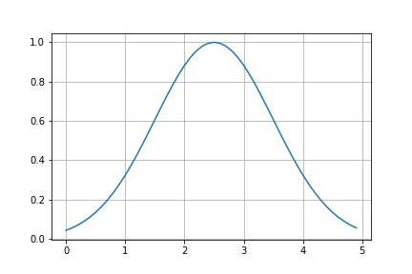
np.meshgrid(): What is it?
def gauss1D(x, I, xc, sigx):
arg = (x - xc) / sigx
return np.exp( -0.5 * arg**2)

Slide 5
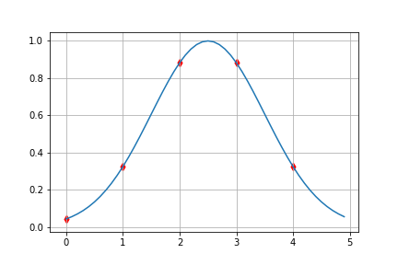
np.meshgrid(): What is it?
def gauss1D(x, I, xc, sigx):
arg = (x - xc) / sigx
return np.exp( -0.5 * arg**2)
If you create a 1D array:
x = np.arange(0, 5, 1)
You sample your gaussian for x = 0,1…, 5
g1D = gauss1D(x, 1, 2.5, 1.)
ax.scatter(x, g1D, marker=‘d’)

Slide 6
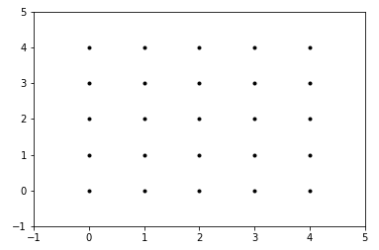
How to do with a 2D gaussian?
def gauss2D(x, y, I, xc, sigx, yc, sigy):
argx = (x - xc) / sigx
argy = (y - yc) / sigy
g2D = np.exp(-0.5*(argx**2 + argy**2)
return g2D

Slide 7
How to do with a 2D gaussian?
def gauss2D(x, y, I, xc, sigx, yc, sigy):
argx = (x - xc) / sigx
argy = (y - yc) / sigy
g2D = np.exp(-0.5*(argx**2 + argy**2)
return g2D
If you create two 1D array:
x = np.arange(0, 5, 1)
y = np.arange(0, 5, 1)
You sample your gaussian only along the diagonal [(0,0), (1,1), …, (4, 4)]
g2D = gauss2D(x, y, *args)

Slide 8
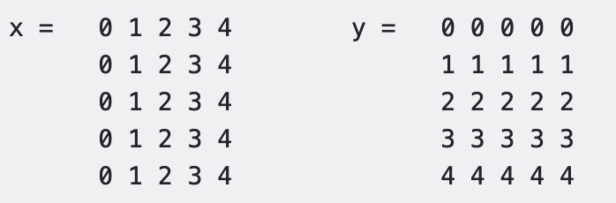
Meshgrid is the solution
def gauss2D(x, y, I, xc, sigx, yc, sigy):
argx = (x - xc) / sigx
argy = (y - yc) / sigy
g2D = np.exp(-0.5*(argx**2 + argy**2)
return g2D
(0,4)
(1,4)
(2,4)
(3,4)
(4,4)
You need a 2D array with coords. of (x,y):
(0,3)
(1,3)
(2,3)
(3,3)
(4,3)
(0,2)
(1,2)
(2,2)
(3,2)
(4,2)
(0,1)
(1,1)
(2,1)
(3,1)
(4,1)
(0,0)
(1,0)
(2,0)
(3,0)
(4,0)
X, Y = np.meshgrid(x, y)
g2D = gauss2D(X, Y, *args)

