Slide 1
Classical statistical inference
Part 1
Associated notebook:
03-Basic_statistics_and_proba_concepts/Basic-statistics_01.ipynb

Slide 2
Why some statistics ?
Python for data (observation / numerical simulations) manipulation
Data most often contain a stochastic component: observational device, numerical noise, simulation of stochastic process, …
Data ≋ Random variable (RV)
Statistics is the tool needed to manipulate RV
Goals for 2nd part of the lecture:
Uncertainty calculation (no, this is not black magic)
Make prediction based on data modelling (first step towards machine learning)

Slide 3
Definitions and notations recap
Ω: Sample space ≡ all possible outcome of an experiment
Ω
e.g. of experiment
I measure the magnitude of a star (in a binary system, for a transit, …)
I count galaxies for different L at a given z
I obtain the spectrum of a candidate SN
I measure a GW signal
…
This is an abstract space. For the mag of a star, Ω ≡ ℝ

Slide 4
Definitions and notations recap
Ω: Sample space ≡ all possible outcome of an experiment
ω: Realisations of the experiment
Ω
E.g. There have been 10 measurements of the magnitude of a star.
Each measurement is a different realisation
ω

Slide 5
Definitions and notations recap
Ω: Sample space ≡ all possible outcome of an experiment
ω: Realisations of the experiment
A: Event ≡ a subsample of ω ≅ Your data set
Ω
A
E.g. You have obtained and are working on 5 measurements of the magnitude of the star.
But an event can be a bit more convoluted quantity, e.g. all measurements you’ve done that have m < 15 mag
ω

Slide 6
Definitions and notations recap
Ω: Sample space ≡ all possible outcome of an experiment
ω: Realisations of the experiment
A: Event ≡ a subsample of ω ≅ Your data set
p(A): Probability of an event / value to be in [x-dx, x+dx]
Ω
A
e.g. probability that m < 15 mag
What means p(A) in frequentist/classical inference ?
ω
Relative frequency of an event
if experiment is repeated an infinite number of times

Slide 7
Random variable
A random variable is a variable whose value results from the measurement of a quantity that is subject to random variations
In Python: np.random
np.random.choice(array): choice at random in an array
np.random.seed(value): sets the seed of the rnd generator
np.random.rand(shape): random floats drawn from uniform distribution
np.random.randint(low, high, shape): rnd integers btw low and high
Go to: Sect. I.2. of the notebook

Slide 8

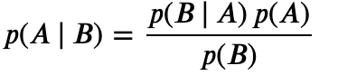

Conditional probability p(A | B)
= fraction of times that A occurs given than B occurred
Reads “Probability of A given B”
The calculation of p(A | B) follows Bayes theorem
The probability to have a flu given that you have fever is different from the probability to have fever given that you have a flu

Slide 9
Bayes theorem
Question:
A: rare disease that affects 0.1 % of the population.
B: test that is efficient at 99 % (i.e. 1 % False positive rate).
If you have a positive test (B), what is the probability for you to be affected by this disease (A) ?
NB: Efficiency is NOT sensitivity (sensitivity generally means fraction of true positive).

Slide 10
Bayes theorem
Question
A: rare disease that affects 0.1 % of the population.
B: test that is efficient at 99 % (i.e. 1 % False positive rate).
If you have a positive test (B), what is the probability for you to be affected by this disease (A) ?
Solution: (See Sect. I.3. of the notebook )
Among 1000 persons, 1 has the disease (it touches 0.1 % of the population = p(A) ).
The test has 99% efficiency (=p(B | A) ). Which means that 1% of the people will be tested positive while not being sick.
=> 10 people will be positive while healthy. You should also have ≈ 1 being positive while being effectively sick. p(B)=0.01 + 0.001 =0.011
=> p(disease | +) ≈ 1/11 = 9 %
BEWARE
RARE events common in astronomy
Conditional probabilities are often implicit

Slide 11
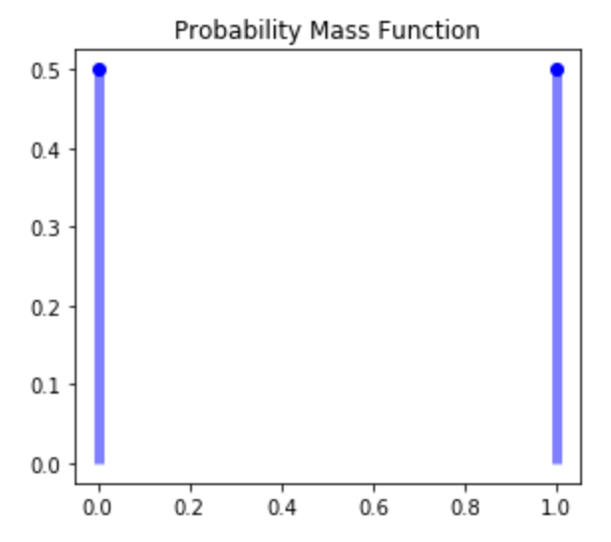


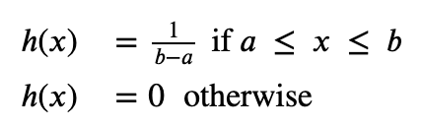
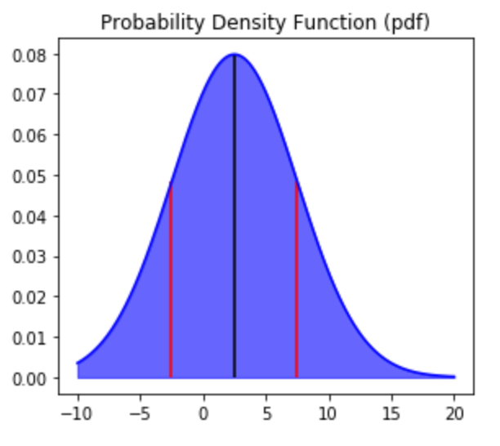
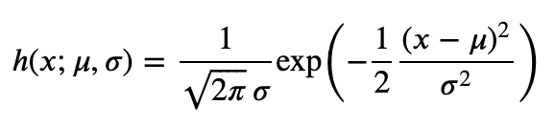
Probability density / mass function
Coin Toss (Bernouilli PMF): The PDF is the normalised histogram we had obtained
k in {0, 1} ≡ {failure, success}
parameter (success rate)
Uniform PDF:
Gaussian PDF:
PDF In Python: go to Sect. I.4 of the notebook
Notes:
Tell them that the PDF is very similar to a histogram. For a discrete variable we have a PMF, for a continuous variable (such as time, length, …), you can imagine that you have very narrow bins, such that the histogram does not look anymore like an histogram.
This PDF gives you information about the relative frequency of an event. For the coin toss with a fair coin, you have the same frequency for both head and tail. For the gaussian at the bottom, you have a higher probability to have an even closer to the mean than farther away.
Property of pdf: the proba. To have an event X between a and b (let’s say the 2 red curve) is the area under the pdf between those 2 vertical lines.

Slide 12
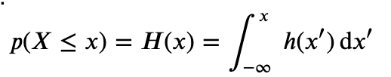
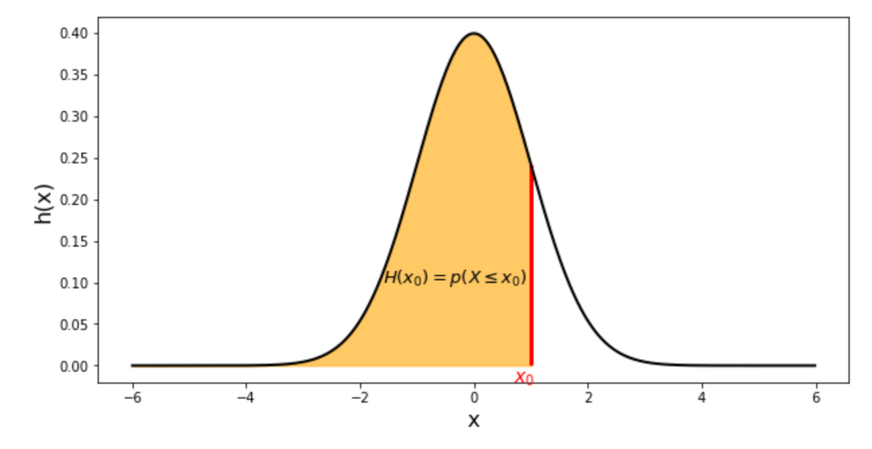
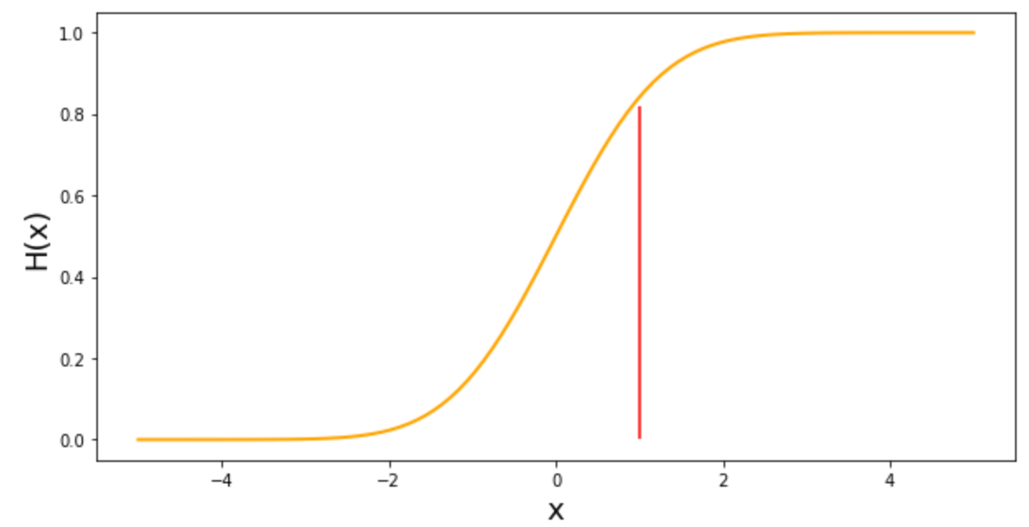
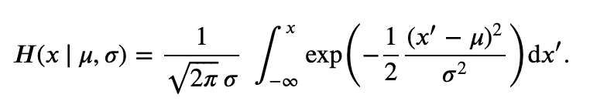
Cumulative distribution function
This is the integral of the PDF:
CDF In Python: go to Sect. I.5 of the notebook
Notes:
H(x0) is p (X <= x0 )
The main purpose of the CDF is to easily calculate probabilities as it directly returns the area. .

Slide 13
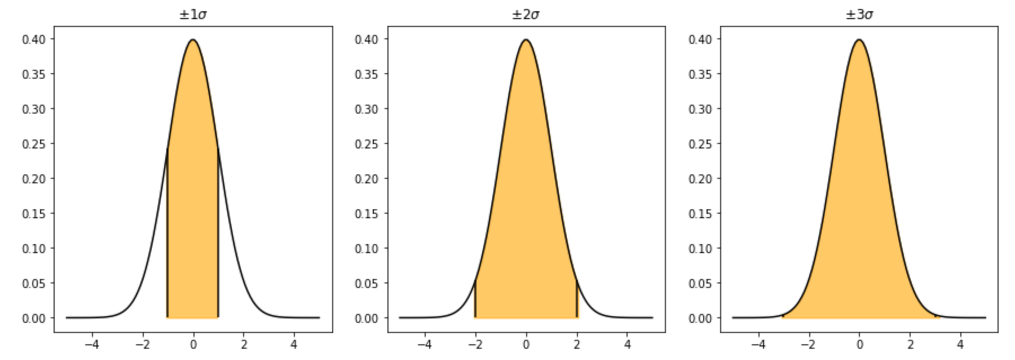
Probability enclosed between 1-2-3 σ for N(μ, σ)
See supplementary exercise of Sect. I.6.2 of the notebook Basic_statistics_02.ipynb
68.3%
95.5%
99.7%

