Slide 1
Classical statistical inference
Part 2
Associated notebook:
04-Basic_statistical_inference_frequentists_2/Frequentist_inference_01.ipynb

Slide 2
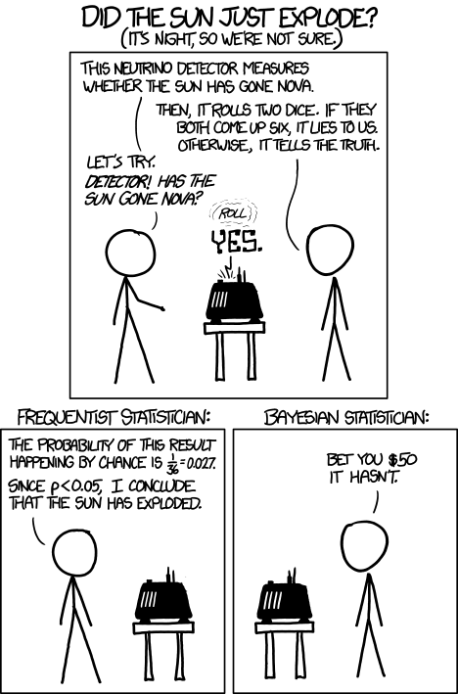
What is inference?
Derive INFORMATION based on DATA
Examples:
Exoplanet transit ⇒ M, d ⇒ P(M | d)
Supernovae distances ⇒ Expansion rate H₀
Inference generally implies an underlying statistical model: PDF or regression laws with parameters θ
Three types of inference:
Point estimation: “best” θ
Confidence interval: Confidence around θ
Hypothesis testing: data OK w. model ?
https://xkcd.com/1132/
Notes:
Joke: Idea is to say that inference is to derive information about data. They have a machine which counts neutrino and roll a dice to account for the proba. Of false positives.
The main joke of this cartoon is the difference btween frequentist and Bayesian … The frequentist will ignore the prior and infer that the sun has exploded, while the Bayesian knows that the proba. Of the sun exploding is 0, independant of any measurement.
But well, the main message I want to convey here is that inference consists in deriving information based on data, and quantify the reliability of this information.
This can be done using directly the parameters of interest. Let’s imagine that you get the mass and distance of an exoplanet though the modelling of a transit, then you can derive the posterior probability P(M | d). What you measure mighg also be a bit intricate, such as the distance to SN. Then you can recalculate the distance for various H0.

Slide 3

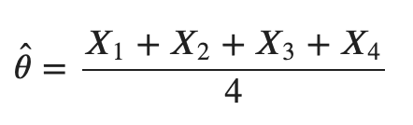
Point estimate
Example:
θ = mean mag. of a population of galaxies
A: Your data set = subsample of measurements:
A = {X_{1,} X₂, X₃, X₄} where X = mag. (this is a RV)
1
3
A
≡ Point estimate of θ
2
4
If you do the experiment with another sample
(⇒ different realisation) you will get another
= galaxy

Slide 4

Point estimate
Generalisation:
Point estimate of a param. is a function of RV X₁, …
It is as well a Random Variable (RV)
It can be biased, is characterized by a variance but should ideally be consistent (converges towards θ)
Distribution of is called sampling distribution
1
3
A
2
4
= galaxy

Slide 5
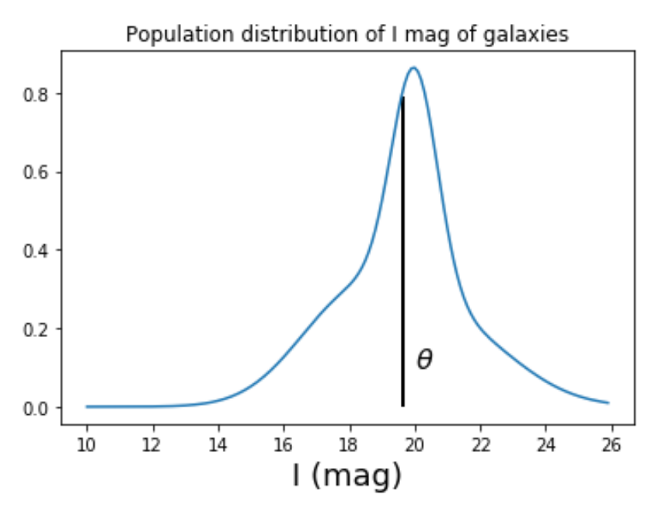
Point estimate
Population mean: θ = 19.66
Notes:
GOD formula to generate the population:
g1 = scipy.stats.norm(18, 1.7)
g2 = scipy.stats.norm(20, 0.7)
g3 = scipy.stats.norm(21, 2)
x = np.arange(10, 26, 0.1)
g_pop = g1.pdf(x)+g2.pdf(x)+g3.pdf(x)
plt.plot(x, g_pop)
plt.title("Population distribution of I mag of galaxies")
g_mean = (18+20+21) / 3. # the 3 gaussians are normalised => no weighted mean
plt.xlabel('I (mag)', size=18)
x_m= np.searchsorted(x, g_mean)
plt.vlines(g_mean, 0, g_pop[x_m-1], color='black', lw=2)
f, ax = plt.subplots(ncols=3, nrows=2, sharex=True, sharey=True)
mean_sample = []
k = 0
for j in range(2):
for i in range(3):
k+=1
ndat = 30
sample1, sample2, sample3 = g1.rvs(ndat), g2.rvs(ndat), g3.rvs(ndat)
sample = np.hstack((sample1, sample2,sample3))
mean_sample.append(sample.mean())
ax[j,i].hist(sample, density=True, color='red')
ax[j,i].text(18, 0.3, r'$\hat \theta_%i$ = %.1f'%(k, sample.mean()))
ax[j,i].set_ylim(0, 0.35)
mean_sample = []
f, ax = plt.subplots(ncols=1)
for k in range(1000):
ndat = 30
sample1, sample2, sample3 = g1.rvs(ndat), g2.rvs(ndat), g3.rvs(ndat)
sample = np.hstack((sample1, sample2,sample3))
mean_sample.append(sample.mean())
qq = ax.hist(mean_sample, color='green', density=True, bins=20)
ax2 = plt.twinx(ax)
ax2.hist(mean_sample_6, color='red', density=False, bins=qq[1], alpha=0.4)
ax.set_xlabel(r'$\hat \theta$', size=18)
ax.set_ylabel('Sampling PDF', color='green')
ax2.set_ylabel('N - subsample', color='red')

Slide 6
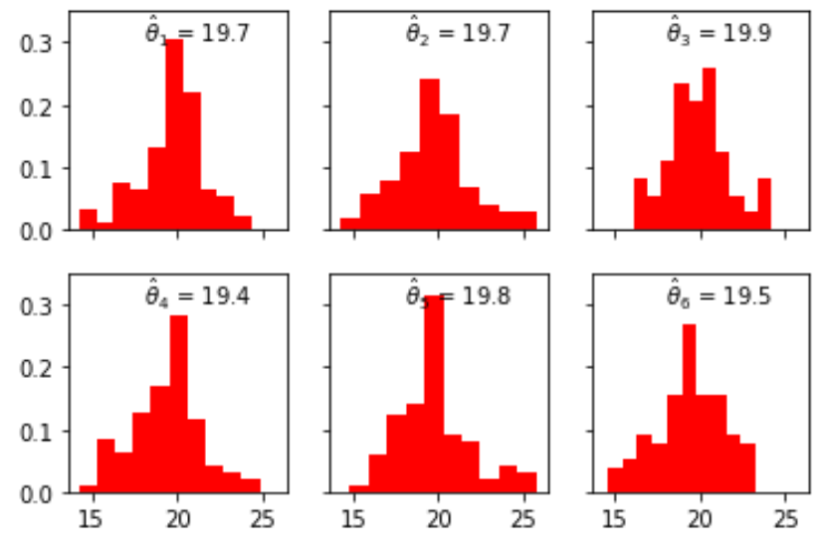
Point estimate
Six different samples drawn from the true population
Samples
Population mean: θ = 19.66
Notes:
GOD formula to generate the population:
g1 = scipy.stats.norm(18, 1.7)
g2 = scipy.stats.norm(20, 0.7)
g3 = scipy.stats.norm(21, 2)
x = np.arange(10, 26, 0.1)
g_pop = g1.pdf(x)+g2.pdf(x)+g3.pdf(x)
plt.plot(x, g_pop)
plt.title("Population distribution of I mag of galaxies")
g_mean = (18+20+21) / 3. # the 3 gaussians are normalised => no weighted mean
plt.xlabel('I (mag)', size=18)
x_m= np.searchsorted(x, g_mean)
plt.vlines(g_mean, 0, g_pop[x_m-1], color='black', lw=2)
f, ax = plt.subplots(ncols=3, nrows=2, sharex=True, sharey=True)
mean_sample = []
k = 0
for j in range(2):
for i in range(3):
k+=1
ndat = 30
sample1, sample2, sample3 = g1.rvs(ndat), g2.rvs(ndat), g3.rvs(ndat)
sample = np.hstack((sample1, sample2,sample3))
mean_sample.append(sample.mean())
ax[j,i].hist(sample, density=True, color='red')
ax[j,i].text(18, 0.3, r'$\hat \theta_%i$ = %.1f'%(k, sample.mean()))
ax[j,i].set_ylim(0, 0.35)
mean_sample = []
f, ax = plt.subplots(ncols=1)
for k in range(1000):
ndat = 30
sample1, sample2, sample3 = g1.rvs(ndat), g2.rvs(ndat), g3.rvs(ndat)
sample = np.hstack((sample1, sample2,sample3))
mean_sample.append(sample.mean())
qq = ax.hist(mean_sample, color='green', density=True, bins=20)
ax2 = plt.twinx(ax)
ax2.hist(mean_sample_6, color='red', density=False, bins=qq[1], alpha=0.4)
ax.set_xlabel(r'$\hat \theta$', size=18)
ax.set_ylabel('Sampling PDF', color='green')
ax2.set_ylabel('N - subsample', color='red')

Slide 7
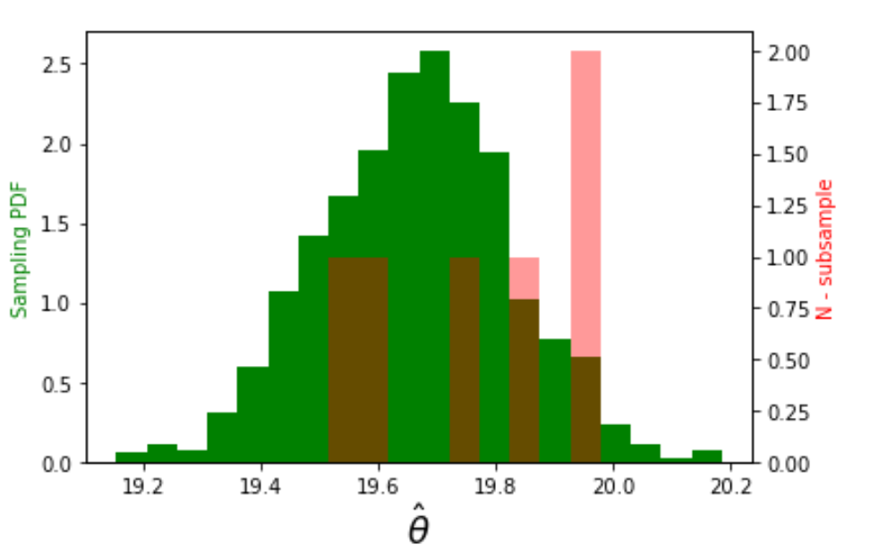
Point estimate
Six different samples drawn from the true population
Samples
Population mean: θ = 19.66
Go to: Sect. II.1 of the notebook
Notes:
GOD formula to generate the population:
g1 = scipy.stats.norm(18, 1.7)
g2 = scipy.stats.norm(20, 0.7)
g3 = scipy.stats.norm(21, 2)
x = np.arange(10, 26, 0.1)
g_pop = g1.pdf(x)+g2.pdf(x)+g3.pdf(x)
plt.plot(x, g_pop)
plt.title("Population distribution of I mag of galaxies")
g_mean = (18+20+21) / 3. # the 3 gaussians are normalised => no weighted mean
plt.xlabel('I (mag)', size=18)
x_m= np.searchsorted(x, g_mean)
plt.vlines(g_mean, 0, g_pop[x_m-1], color='black', lw=2)
f, ax = plt.subplots(ncols=3, nrows=2, sharex=True, sharey=True)
mean_sample = []
k = 0
for j in range(2):
for i in range(3):
k+=1
ndat = 30
sample1, sample2, sample3 = g1.rvs(ndat), g2.rvs(ndat), g3.rvs(ndat)
sample = np.hstack((sample1, sample2,sample3))
mean_sample.append(sample.mean())
ax[j,i].hist(sample, density=True, color='red')
ax[j,i].text(18, 0.3, r'$\hat \theta_%i$ = %.1f'%(k, sample.mean()))
ax[j,i].set_ylim(0, 0.35)
mean_sample = []
f, ax = plt.subplots(ncols=1)
for k in range(1000):
ndat = 30
sample1, sample2, sample3 = g1.rvs(ndat), g2.rvs(ndat), g3.rvs(ndat)
sample = np.hstack((sample1, sample2,sample3))
mean_sample.append(sample.mean())
qq = ax.hist(mean_sample, color='green', density=True, bins=20)
ax2 = plt.twinx(ax)
ax2.hist(mean_sample_6, color='red', density=False, bins=qq[1], alpha=0.4)
ax.set_xlabel(r'$\hat \theta$', size=18)
ax.set_ylabel('Sampling PDF', color='green')
ax2.set_ylabel('N - subsample', color='red')

Slide 8
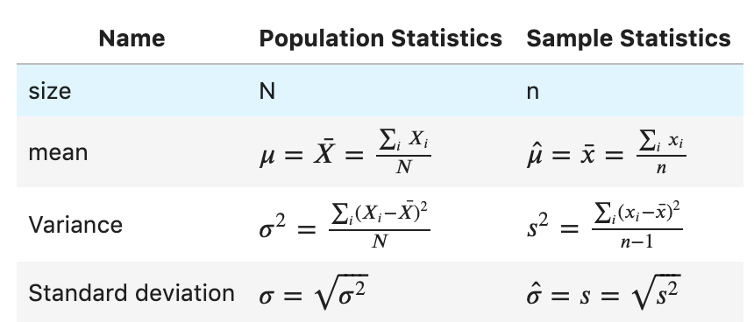
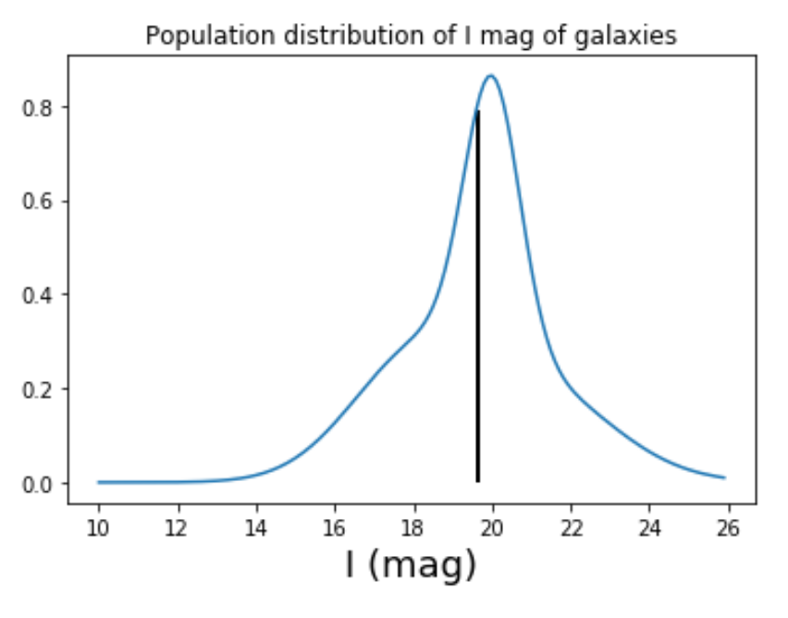
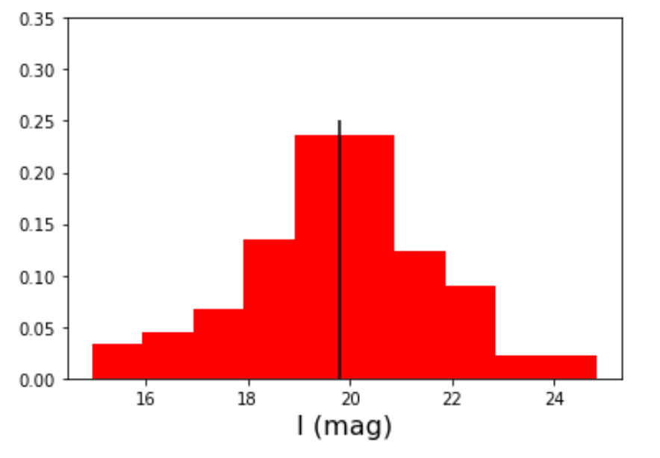



Summary statistics
Sampling distribution
N = 9 10⁹
n = 90
σ
Notes:
GOD formula to generate the population:
g1 = scipy.stats.norm(18, 1.7)
g2 = scipy.stats.norm(20, 0.7)
g3 = scipy.stats.norm(21, 2)
x = np.arange(10, 26, 0.1)
g_pop = g1.pdf(x)+g2.pdf(x)+g3.pdf(x)
plt.plot(x, g_pop)
plt.title("Population distribution of I mag of galaxies")
g_mean = (18+20+21) / 3. # the 3 gaussians are normalised => no weighted mean
plt.xlabel('I (mag)', size=18)
x_m= np.searchsorted(x, g_mean)
plt.vlines(g_mean, 0, g_pop[x_m-1], color='black', lw=2)
f, ax = plt.subplots(ncols=3, nrows=2, sharex=True, sharey=True)
mean_sample = []
k = 0
for j in range(2):
for i in range(3):
k+=1
ndat = 30
sample1, sample2, sample3 = g1.rvs(ndat), g2.rvs(ndat), g3.rvs(ndat)
sample = np.hstack((sample1, sample2,sample3))
mean_sample.append(sample.mean())
ax[j,i].hist(sample, density=True, color='red')
ax[j,i].text(18, 0.3, r'$\hat \theta_%i$ = %.1f'%(k, sample.mean()))
ax[j,i].set_ylim(0, 0.35)
mean_sample = []
f, ax = plt.subplots(ncols=1)
for k in range(1000):
ndat = 30
sample1, sample2, sample3 = g1.rvs(ndat), g2.rvs(ndat), g3.rvs(ndat)
sample = np.hstack((sample1, sample2,sample3))
mean_sample.append(sample.mean())
qq = ax.hist(mean_sample, color='green', density=True, bins=20)
ax2 = plt.twinx(ax)
ax2.hist(mean_sample_6, color='red', density=False, bins=qq[1], alpha=0.4)
ax.set_xlabel(r'$\hat \theta$', size=18)
ax.set_ylabel('Sampling PDF', color='green')
ax2.set_ylabel('N - subsample', color='red')

Slide 9
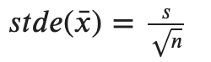

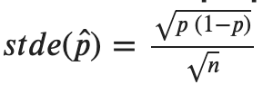
Summary (sample) statistics: standard error
Standard error (stde) ≠ Standard deviation (std)
Name | Formula
Standard error on the mean
Standard error on the sample stdev
Standard error on proportions

Slide 10
Central limit theorem
When independent random variables are added, their sum tends towards a normal distribution (if n >>)
This is true even if the original RV are not normally distributed
Sampling dist. of mean tends (for large n ) towards a Normal distribution
Sampling dist. of variance (for large n) does NOT tend towards a Normal distribution
Go to: Sect. II.1.1. of the notebook

Slide 11

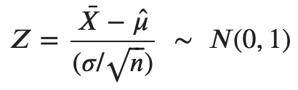
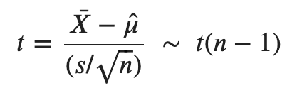
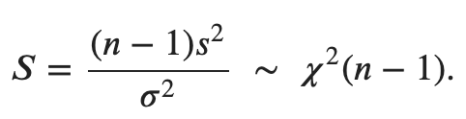
Distribution of sample quantities
If RV {X_{i}} whose population is distributed as N(μ, σ)
Sample distribution of
Sample distribution of
Sample distribution of
μ
⟺
μ
s is derived from the sample dist.
Student distribution
Chi square distribution

Slide 12
Classical statistical inference: confidence interval
Part 3
Associated notebook:
04-Basic_statistical_inference_frequentists_2/Frequentist_inference_02.ipynb

Slide 13
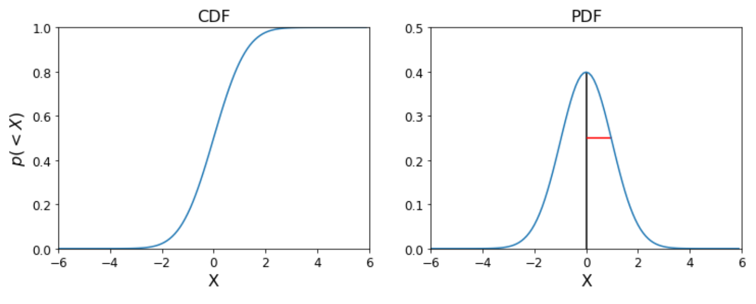
Confidence interval on a RV (descriptive stat)
If RV {X_{i}} whose population is distributed as N(μ, σ)
σ
μ

Slide 14
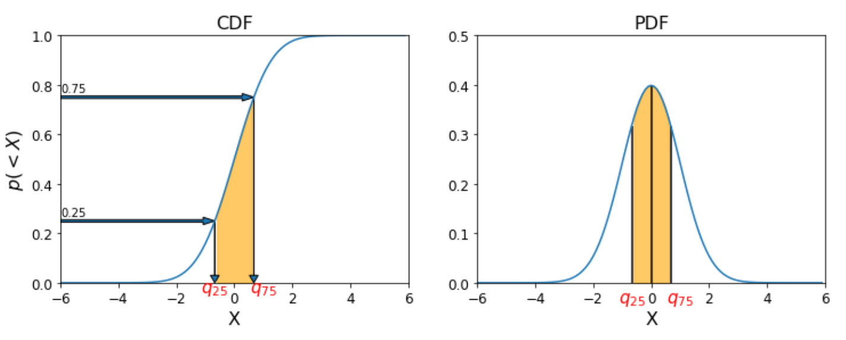
Confidence interval on a RV (descriptive stat)
If RV {X_{i}} whose population is distributed as N(μ, σ)
μ
Interquartile IQ = [q₂₅, q₇₅] ≡ 50 % CI around μ
1 – α CI ≡ [a, b] such that p(a ≤ X ≤ b) = ( 1 – α )

Slide 15
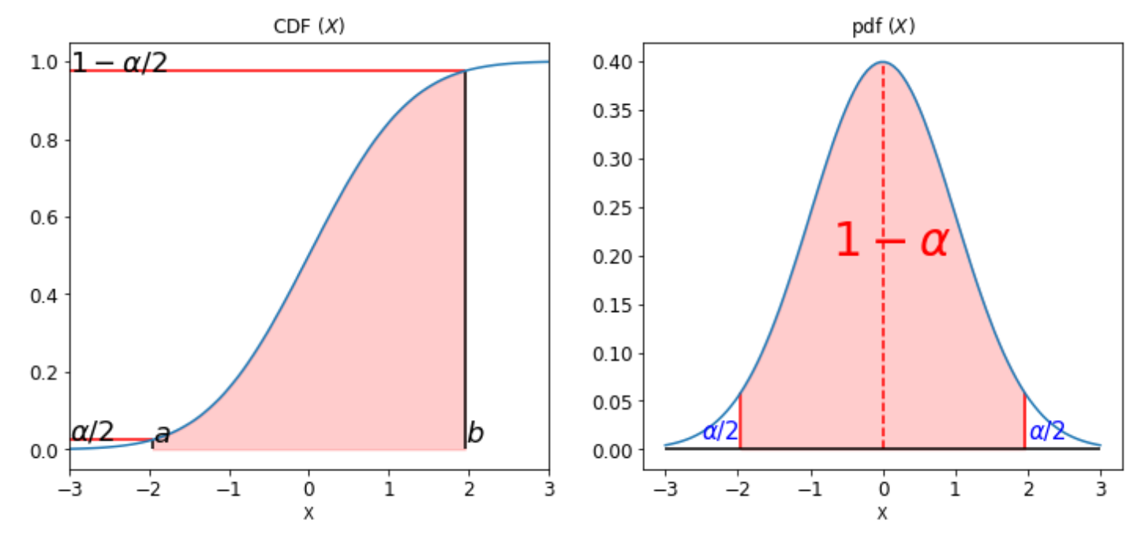
Confidence interval on a RV (descriptive stat)
If RV {X_{i}} whose population is distributed as N(μ, σ)
1 – α CI ≡ [a, b] such that p(a ≤ X ≤ b) = ( 1 – α )

Slide 16
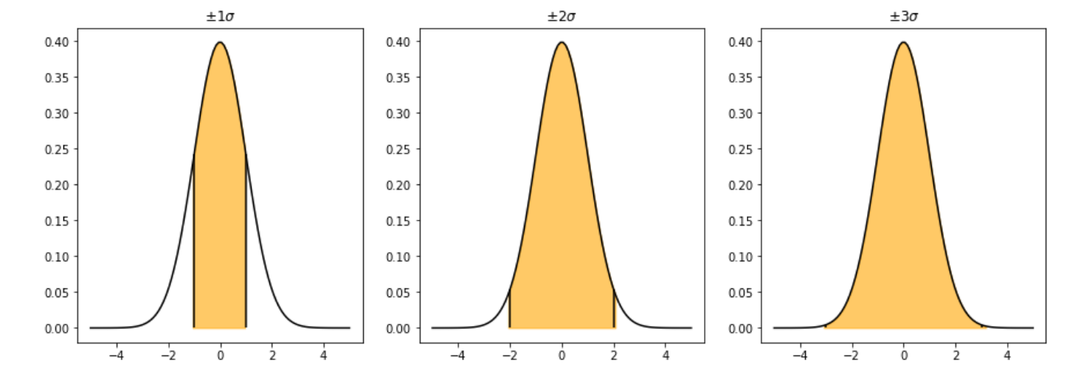
Confidence interval on a RV (descriptive stat)
If RV {X_{i}} whose population is distributed as N(μ, σ)
68.3 %
95.5 %
99.7 %
[μ – 1 σ, μ + 1 σ] ≡ 68.3 %
[μ – 2 σ, μ + 2 σ] ≡ 95.5 %
[μ – 3 σ, μ + 3 σ] ≡ 99.7 %

Slide 17
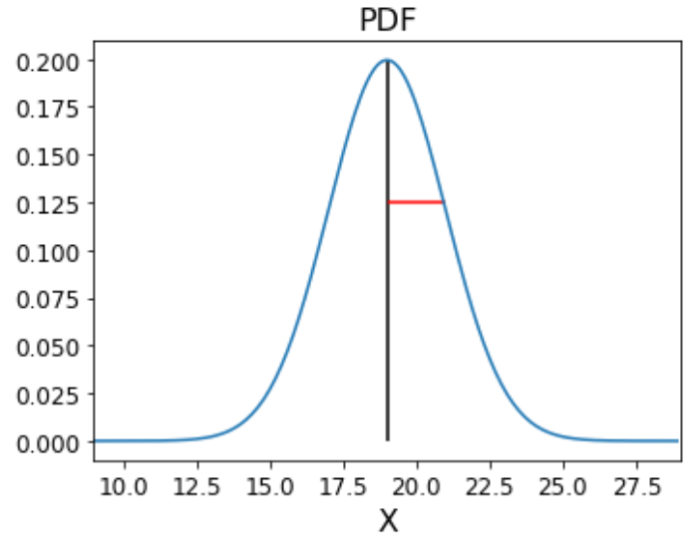
Confidence interval from an estimator
If RV {X_{i}} whose population is distributed as N(μ, σ)
S₁ = {x₁, x₂, x₃, x₄}
σ
1
3
S₁
2
4
μ

Slide 18
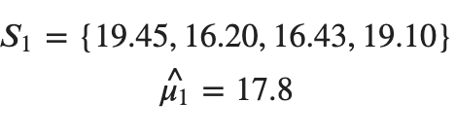

Confidence interval from an estimator
If RV {X_{i}} whose population is distributed as N(μ, σ)
S₁ = {x₁, x₂, x₃, x₄}
σ
1
3
μ
S₁
2
4

Slide 19
Confidence interval from an estimator
If RV {X_{i}} whose population is distributed as N(μ, σ)
S₁ = {x₁, x₂, x₃, x₄}
σ
1
3
μ
S₁
95.5 % CI on sample mean?
2
4
We need to look at the distribution of the sample mean

Slide 20

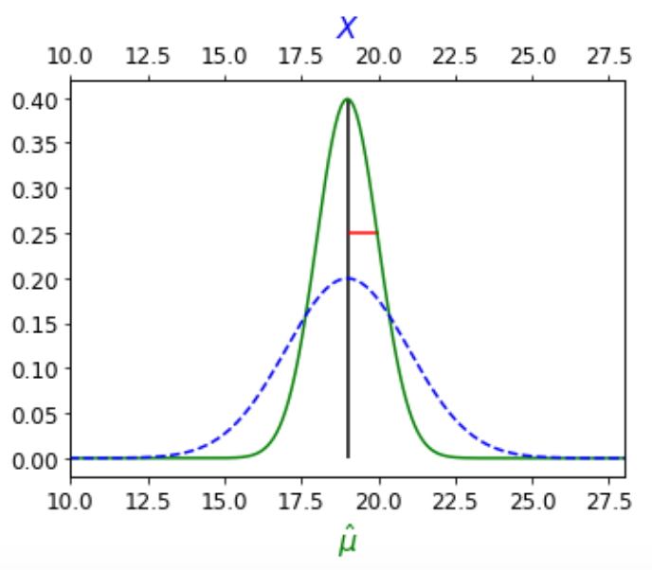




Confidence interval on the mean
95.5 % CI on ?
If RV {X_{i}} whose population is distributed as N(μ, σ)
Case 1: σ is known
1
3
μ
S₁
2
4

Slide 21
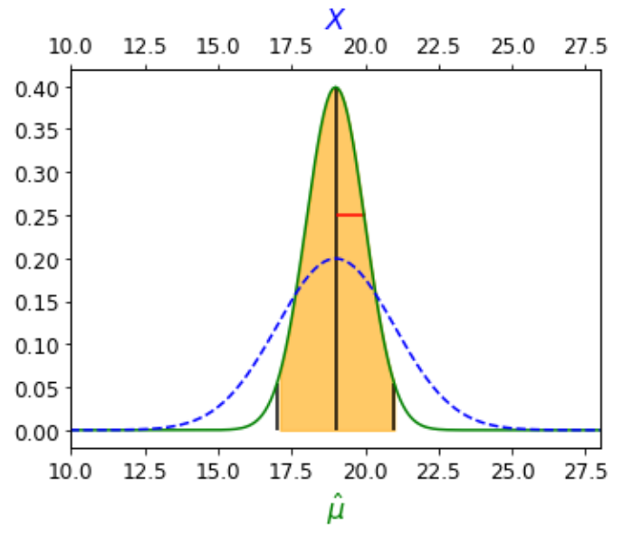


Confidence interval on the mean
95.5 % CI on ?
If RV {X_{i}} whose population is distributed as N(μ, σ)
Case 1: σ is known
1
3
S₁
2
4

Slide 22
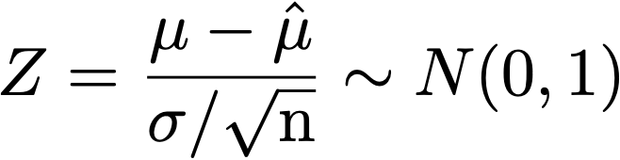

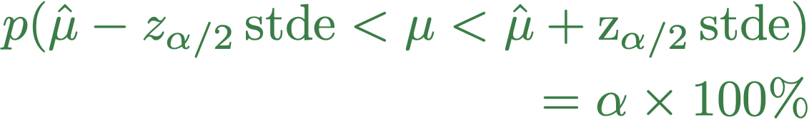

Confidence interval on the mean
95.5 % CI on μ ?
If RV {X_{i}} whose population is distributed as N(μ, σ)
Case 1: σ is known
σ = 1
1
3
p (-z_{α/2} < Z < z_{α/2} ) = α ∗ 100 %
p (-z_{α/2} * stde < < z_{α/2} *stde)
= α ∗ 100 %
S₁
-z_{α/2}
z_{α/2}
2
4
Z
For 95.5 % CI, z _{α/2} = m = 2
Notes:
In fact, formally, to get convinced that this is correct, we should do the same exercise with a normalised RV which involved mu (the quantity we are interested in) and \hat_mu, the quantity we effectively measure
LATEXit
p(\hat \mu - z_{\alpha/2} \, \rm{stde} < \mu < \hat \mu + z_{\alpha / 2} \, \rm{stde}) \\ = \alpha \times 100 \%
z_{\alpha/2} = CDF^{-1}(1-\alpha/2)

Slide 23
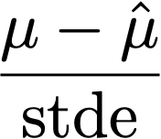
Confidence interval on the mean
95.5 % CI on μ ?
If RV {X_{i}} whose population is distributed as N(μ, σ)
Case 1: σ is known
1
3
S₁
2
4
m depends on the distribution of the normalised estimator:

Slide 24

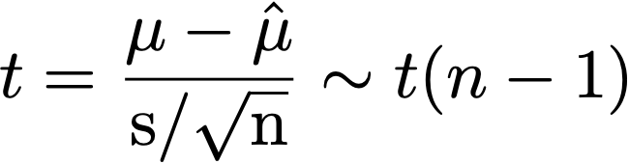
Confidence interval on the mean
95.5 % CI on μ ?
If RV {X_{i}} whose population is distributed as N(μ, σ)
Case 1: σ is known
1
Case 2: σ is unknown
3
S₁
2
4
Go to: Student_vs_Gauss.ipynb

Slide 25

Confidence interval
“Generic” strategy:
Look at the PDF of a normalised/scaled estimator of known distribution.
Define region around your (normalised) estimator (of know the distribution) that encloses (1 - α) X 100 % of the area under the PDF.
- For CI around the mean:
For CI on other statistics (e.g. variance, difference between 2 means, proportions) : see Frequentist_inference_03.ipynb
(Material in Frequentist_inference_03.ipynb is supplementary material)
μ
μ
Go to: Sect. II.2. of the notebooks

