Slide 1
Classical statistical inference Uncertainties on arbitrary RV
Part 4
Associated notebook:
04-Basic_statistical_inference_frequentists_2/Frequentist_Monte_Carlo.ipynb

Slide 2




Uncertainty calculation
How to calculate stde (or simply std) on a RV if it is a function of one or multiple RV ?
Case 1:
Case 2:

Slide 3

Uncertainty calculation
Case 1:
Example:

Slide 4
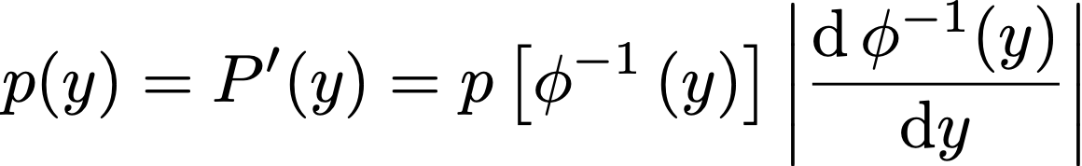
Uncertainty calculation
Case 1:
Example:
Variable transformation:

Slide 5



Uncertainty calculation
Case 1:
Example:
Variable transformation:
1 if x ∈ [0,1]
0 if x ∉ [0,1]

Slide 6
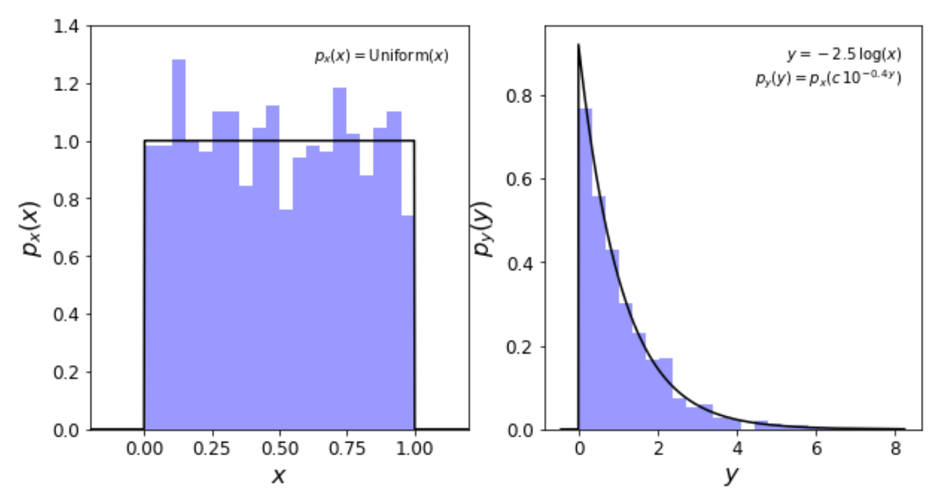
Uncertainty calculation
Go to: Sect. II.4.1 of the notebook
Example:

Slide 7
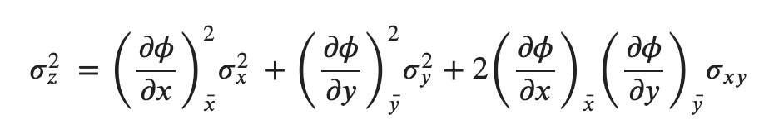


Uncertainty calculation
Case 2:
Error propagation formula
Results from Taylor expanding z around and => neglects some high order terms
Go to: Sect. II.4.2 of the notebook for the demo

Slide 8
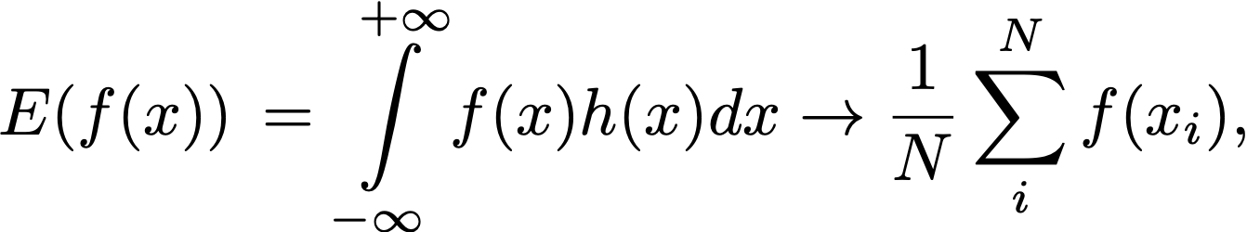
Uncertainty calculation
Monte-Carlo
c = Φ(a, b): σ_{c} ?
The expectation (“average”) of a function f(x) of a RV x can be approximated by drawing a virtually infinite sample from x
You can specialise f() to the calculation of the mean, or the variance of a RV.
Draw random samples from h(a; μ_{a ,} σ_{a} ), h(b, ; μ_{b ,} σ_{b} )
Construct a random (monte-carlo) sample of c_{i} = Φ(a_{i}, b_{i})
Derive σ_{c} from your Monte-Carlo sample

Slide 9
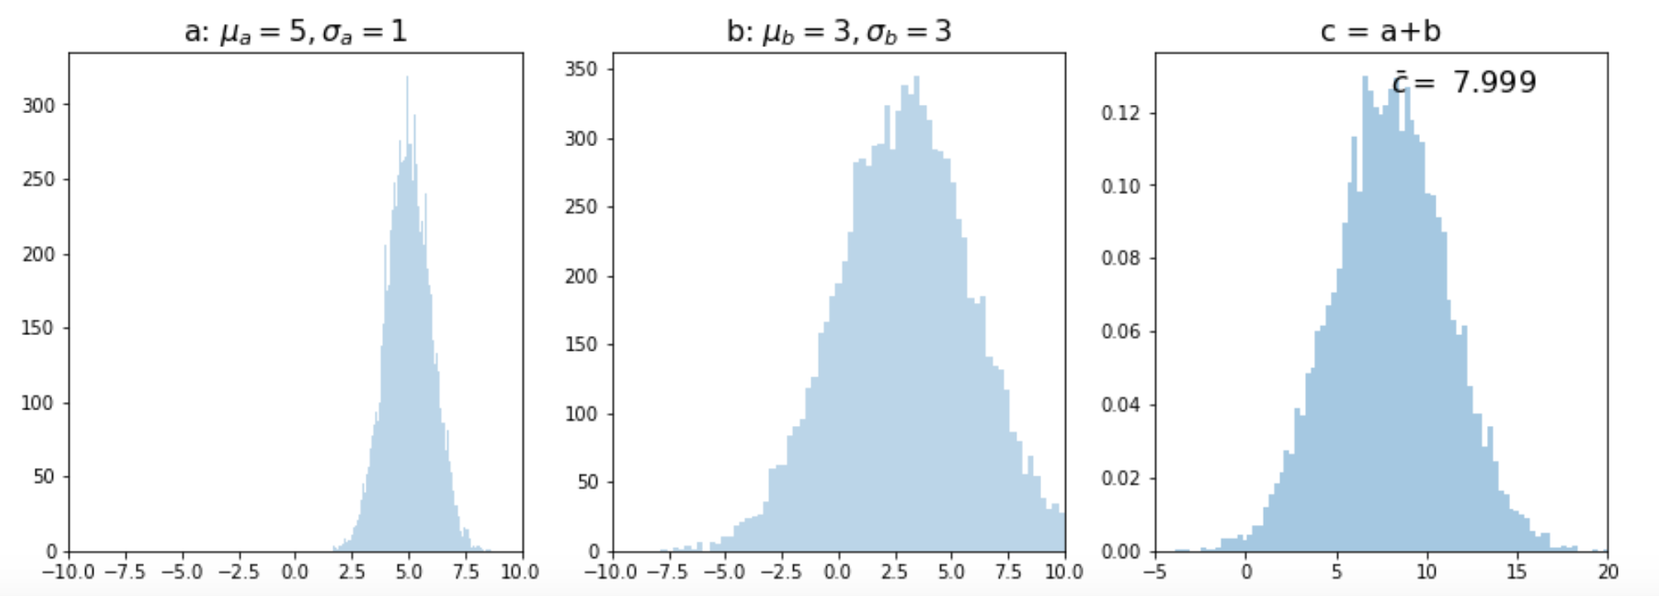

Uncertainty calculation
Monte-Carlo
c = a + b
Go to: Sect. II.4.3 of the notebook
Draw random samples from h(a; μ_{a ,} σ_{a} ), h(b, ; μ_{b ,} σ_{b} )
Construct a random (monte-carlo) sample of c_{i} = Φ(a_{i}, b_{i})
Derive σ_{c} from your Monte-Carlo sample

Slide 10
Classical statistical inference Bootstrap and Jacknife
Part 5
Associated notebook:
04-Basic_statistical_inference_frequentists_2/ Frequentist_inference_Bootstrap.ipynb

Slide 11
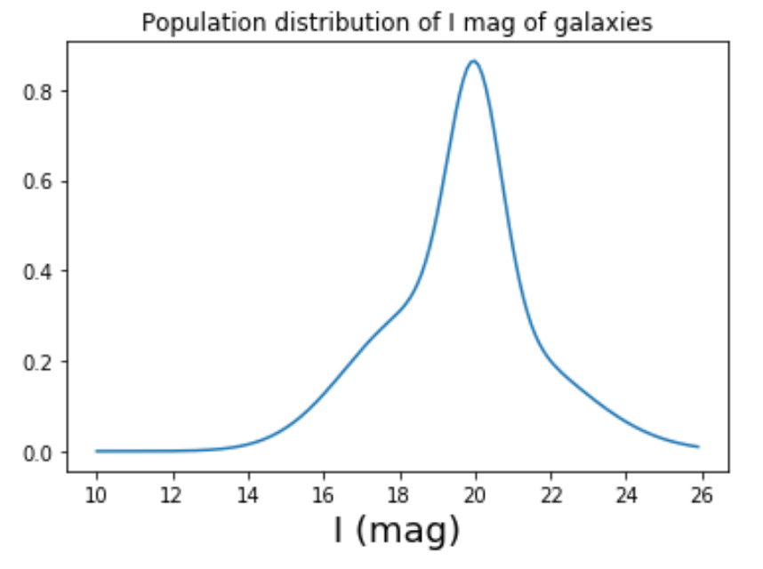
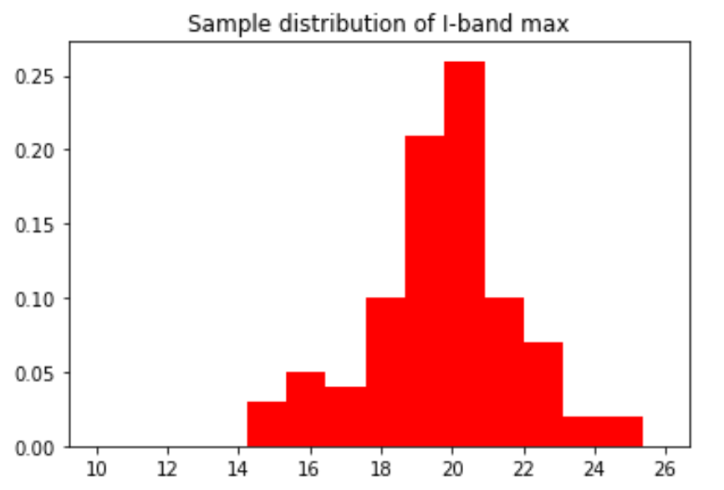



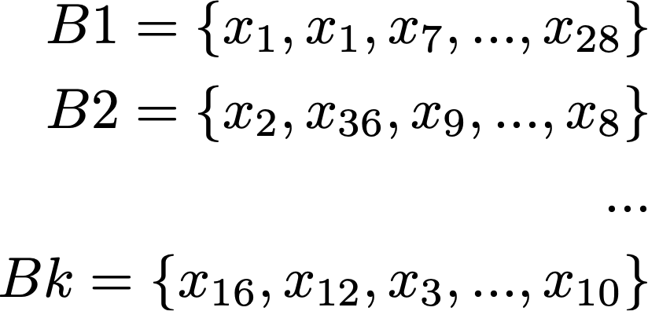
Bootstrap
Go to: Sect. II.5 of the notebook
Unknown
My data:
Bootstrap ≡ Draw samples from the sample PDF , allowing from replacements
e.g.

Slide 12

Bootstrap Confidence Interval
Go to: Sect. II.5.1 of the notebook
Unknown
My data:
Calculate the estimate of your statistics q from all the bootstrapped samples + its associated stde^{B}(q)
Normal CI:
Percentile CI:

Slide 13
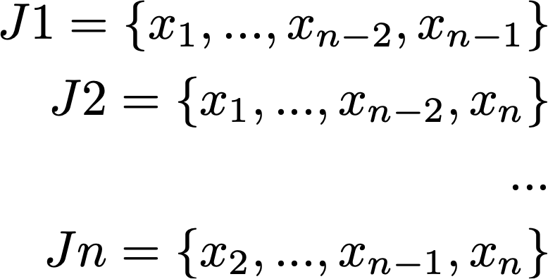
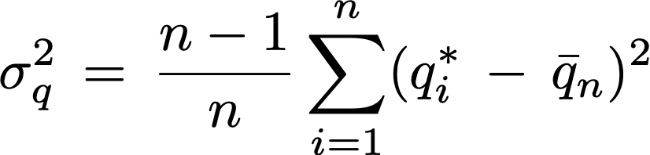

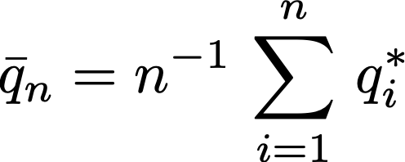
Jacknife
Go to: Sect. II.5.2 of the notebook
My data:
Unknown
With n-1 point per sample
Jacknife ≡ Remove 1 data point from your sample, n times
WARNING: statistics q_{n} from Jacknife is biased
w.

