Slide 1
Classical statistical inference Regression and Model fitting
Associated notebook:
05-MLE_and_regression/Regression_short.ipynb

Slide 2
Regression and model fitting
Problem: the quantities of interest are parameters of a model, not the RV that you measure
Examples
Observation | Quantity of interest | Model
Position of a star: x(t) | Proper motion (velocity) of the star | V = f(x, t, …)
Photometry of an asteroid: mag(t) | P (period of rotation) | mag = f(t, P, …)
Transit of a planet: mag(t) | P (period), e (eccentricity), D (dist to star) | Δ m = f (t, P, e, D, …)
Spectrum of a QSO: F (λ) | M_{BH} (Black hole mass of QSO) | FWHM = f(M_{BH}, L, …)

Slide 3
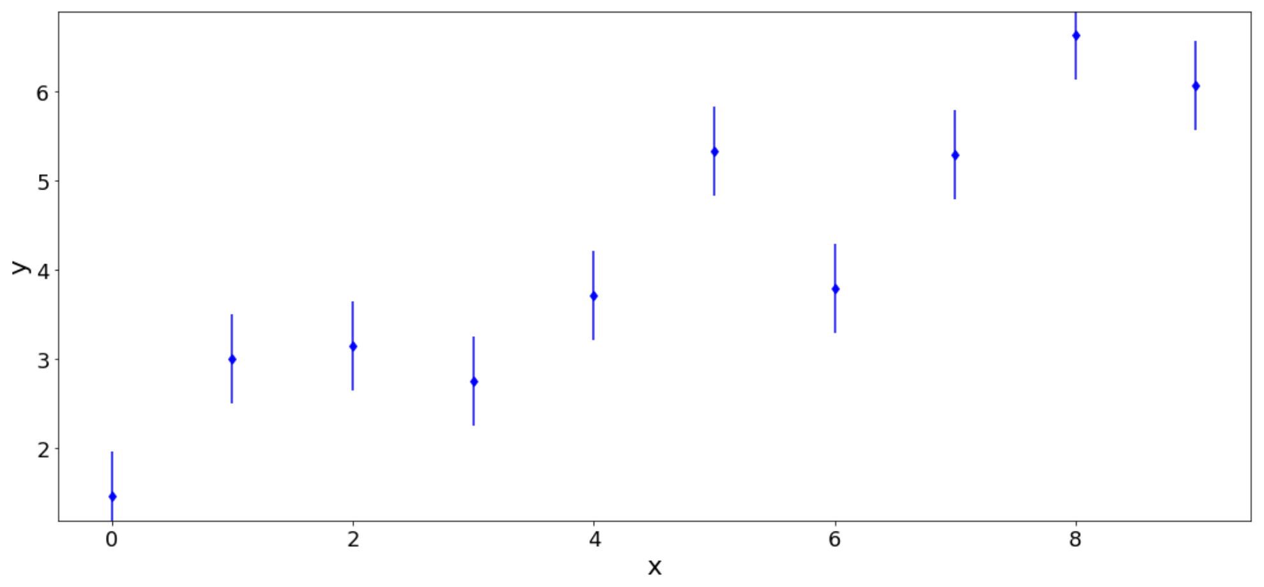
Regression and model fitting
Problem: You measure D ≡ ({y_{i}}, {x_{i}})
Data: {x_{i}}, {y_{i}} w. σ_{ι}
Model: M(θ)

Slide 4
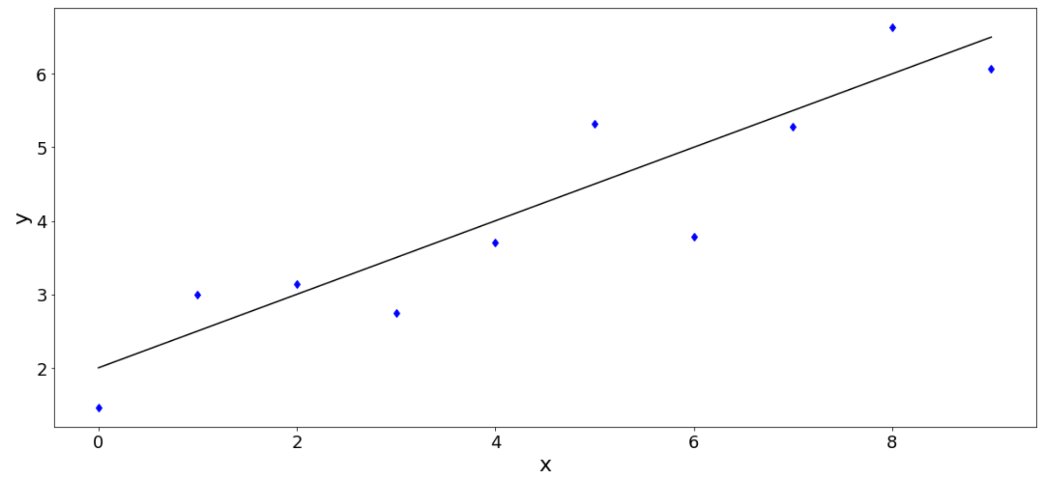
Regression and model fitting
Problem: You measure D ≡ ({y_{i}}, {x_{i}})
Data: {x_{i}}, {y_{i}} w. σ_{ι}
Model: M(θ)
y = a * x + b
θ = a, b
M(θ): y = a * x + b

Slide 5
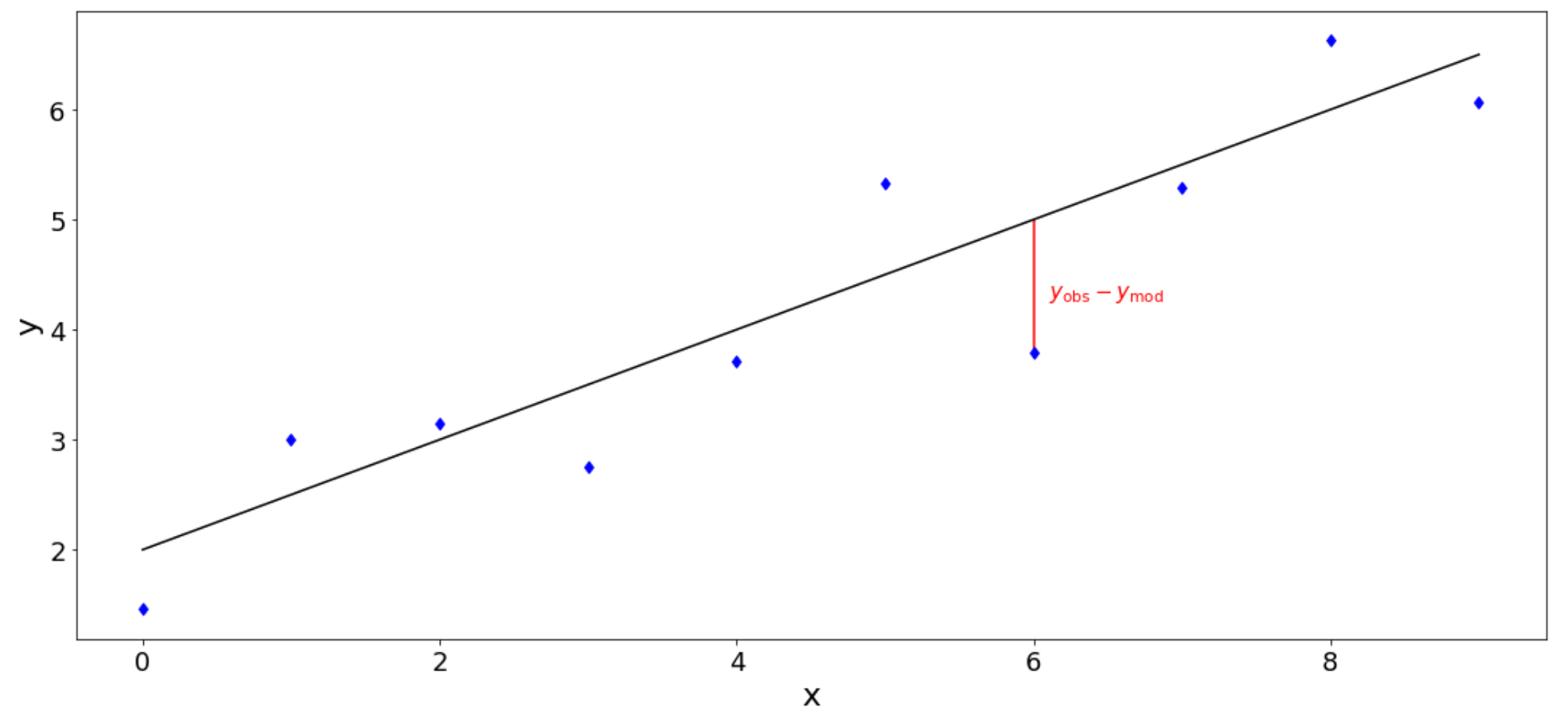
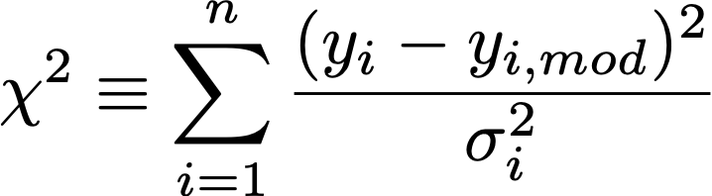
Regression and model fitting
How to find a good model?
Model: M(θ)
y = a * x + b
= f(x | θ)
θ = a, b
Data: {x_{i}}, {y_{i}} w. σ_{ι}
Minimize

Slide 6
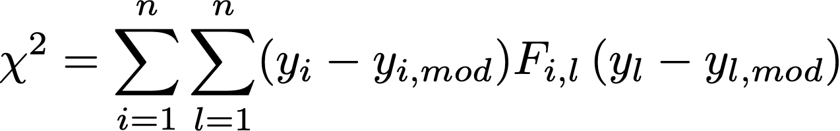
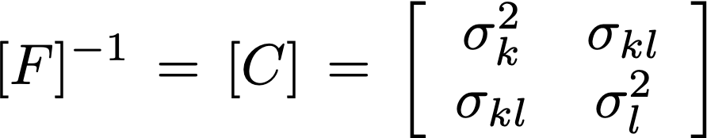
Regression and model fitting
If σ_{i} = 1 : Least square regression
If σ_{i} ≠ 1 : chi-square regression
The χ² is called a merit function
When uncertainties between variables
are correlated, the χ² is expressed:
Where F is the Fisher matrix

Slide 7
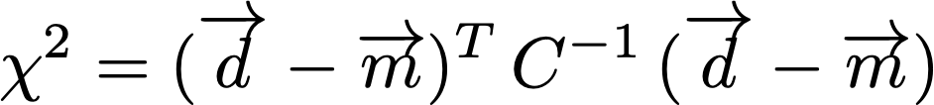
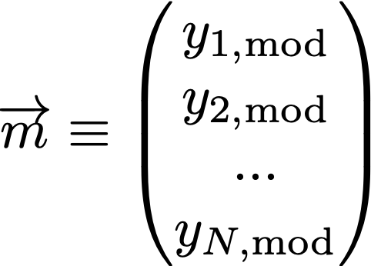
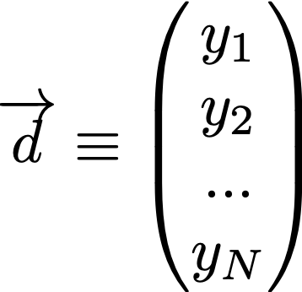
Regression and model fitting
If σ_{i} = 1 : Least square regression
If σ_{i} ≠ 1 : chi-square regression
When uncertainties between variables
are correlated, the χ² is expressed:
Notes:
\overrightarrow d \equiv
\begin{pmatrix}
y_{1} \\
y_{2} \\
... \\
y_{N} \\
\end{pmatrix}
\overrightarrow m \equiv
\begin{pmatrix}
y_{1, \rm{mod}} \\
y_{2, \rm{mod}} \\
... \\
y_{N, \rm{mod}} \\
\end{pmatrix}

Slide 8



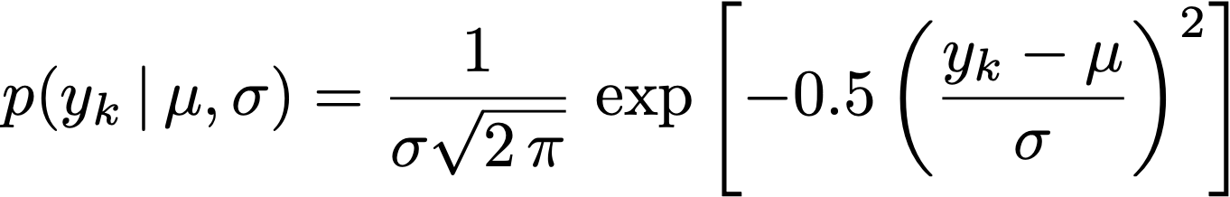

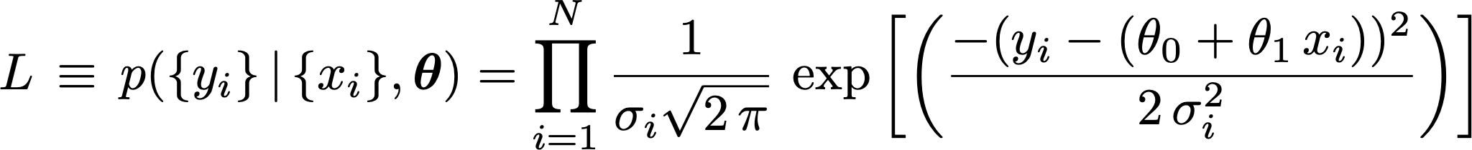
Link between χ² and likelihood
Case of a straight line:
with
For each y_{k} we have:
With e.g.
If the model is “correct”
Hence, we have for our data set D:

Slide 9
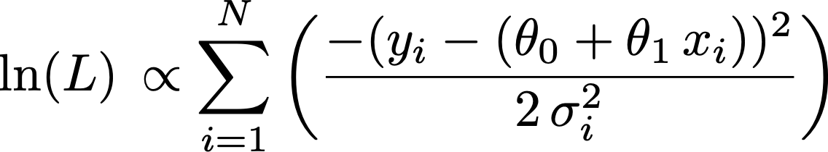

Link between χ² and likelihood
Hence, we have for our data set D:
⇒
Minimizing χ² is equivalent to maximizing L

Slide 10
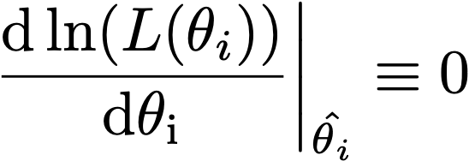
Regression and model fitting
How to find a good model? Maximum Likelihood Estimation
Model: M(θ)
y = a * x + b
θ = a, b
Data: x_{i}, y_{i} , σ_{ι}
M(θ): y = a * x + b
MLE ⇒ maximize L(θ)

Slide 11
Regression and model fitting
How to find a good model? Maximum Likelihood Estimation
Model: M(θ)
y = a * x + b
= f(x | θ)
θ = a, b
Data: x_{i}, y_{i} , σ_{ι}
M(θ): y = a * x + b
MLE allows you to find
θ ⇒ E( f(x | θ) )

Slide 12
Regression of a straight line in python
Linear model fitting:
See Sect. IV.1
Python implementation: numpy.polyfit(x, y, deg=1, w=1/sigma)
Go to Sect. IV.1.1 of the Notebook for practical example

Slide 13
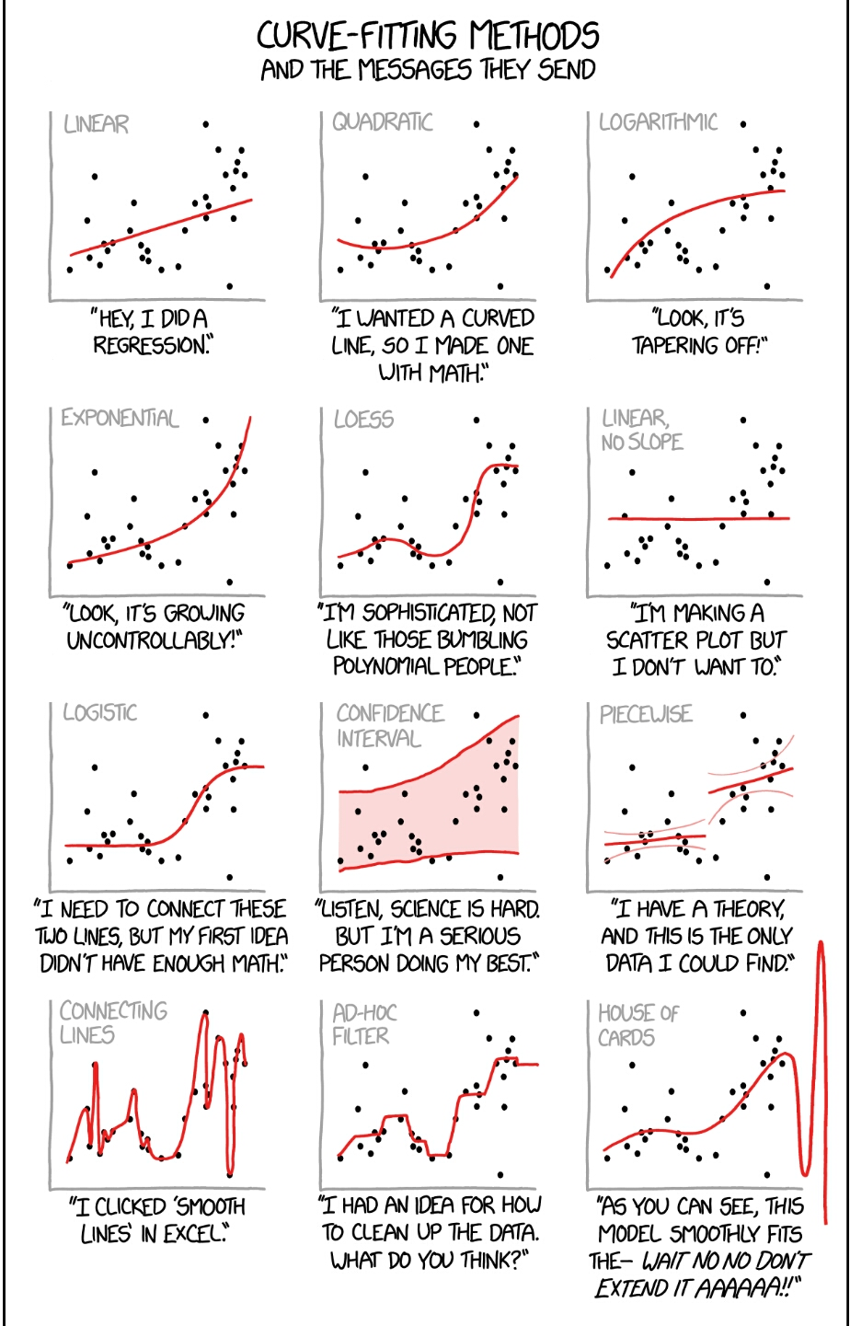
Regression and model fitting
https://xkcd.com/2048/

Slide 14
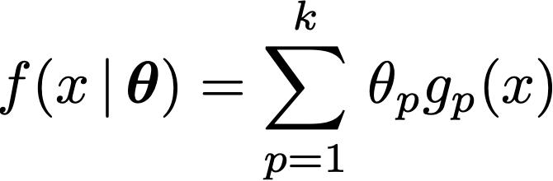
How to choose a suitable regression method ?
The way you will tackle a regression problem may depend on:
Linearity: is the model linear in its parameters?
Complexity: large number of parameters increase complexity and covariance matrix on uncertainties
Error behaviour: uncertainties on dependent and independent variable and their correlation.

Slide 15
How to choose a suitable regression method ?
Frequentist: (this lecture) | Bayes (future lecture):
Optimization with some merit function | Sampling of the likelihood
Search for best (fit) model parameters | PDF on parameters
Often when simple error behaviour | More complex error behaviour

Slide 16
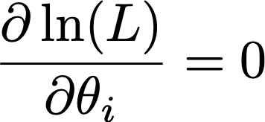
Linear vs non linear regression
A model is linear if:
g_{p}(x) can be a non linear function of x BUT does not depend on any free parameter
In this case, the values of the parameters that yield (max. likelihood ) can be found “analytically”
When the model is not linear , the minimization of the χ² has to be performed numerically

Slide 17
Linear vs non linear regression
Linear model fitting:
See Sect. IV.1
Python implementation: numpy.polyfit(x, y, deg=1, w=1/sigma)
NON Linear model fitting:
See Sect. IV.3
Python implementation: scipy.optimize.curvefit()
Go to Sect. IV.3 of the Notebook for practical example

Slide 18
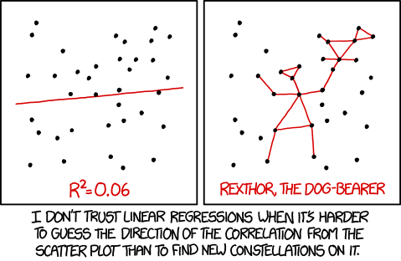
Quality of the regression
R² = Coefficient of determination of Pearson
xkcd.com/1725/

Slide 19
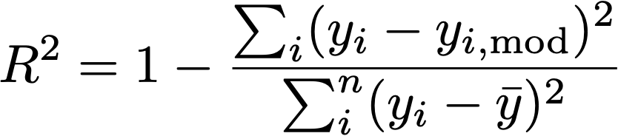

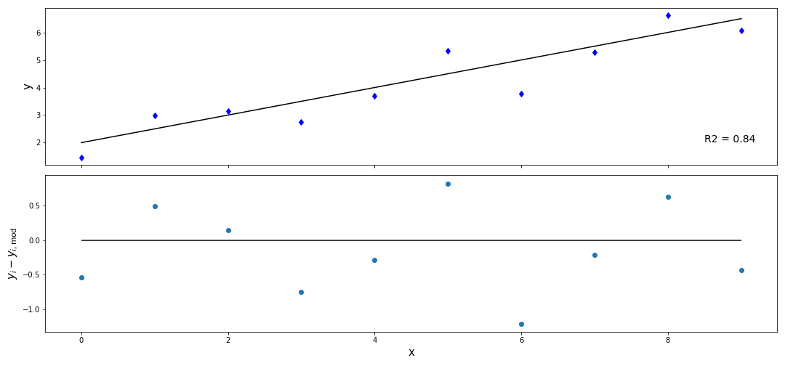
Quality of the regression
Coefficient of determination of Pearson
Look at the residuals:
Closer R² is to 1, more the model is good at explaining the data (or at making predictions).
But use with care as it is originally designed for linear models and does not account for uncertainty on data points (cf least-square vs χ² regression)

Slide 20
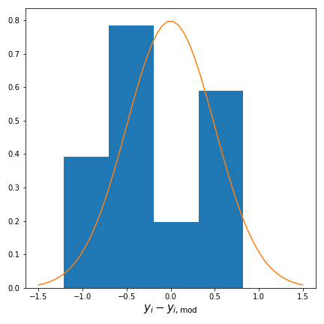
Quality of the regression
Compare variance of residuals to σ² on y_{i}
Look at the residuals:

Slide 21
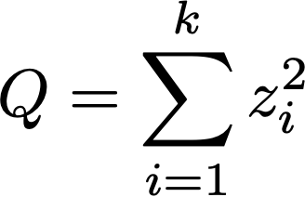
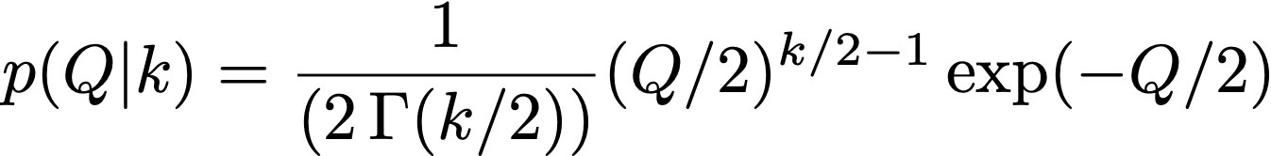
Quality of the regression
Your χ² is a random variable !
➝
k = degree of freedom = N points – n parameters
If you fit a model with 2 parameters on a set of 100 points => 98 d.o.f.
Expectation E(χ²) = 100 – 2 = 98
Reduced χ² : χ²_{red} = χ²_{dof} / d.o.f. ⇒ Reduced χ² ≡ 1. if good fit
See also the Notebook 03-Basic_statistics_and_proba_concepts/Descriptive_statistics_02.ipynb

Slide 22
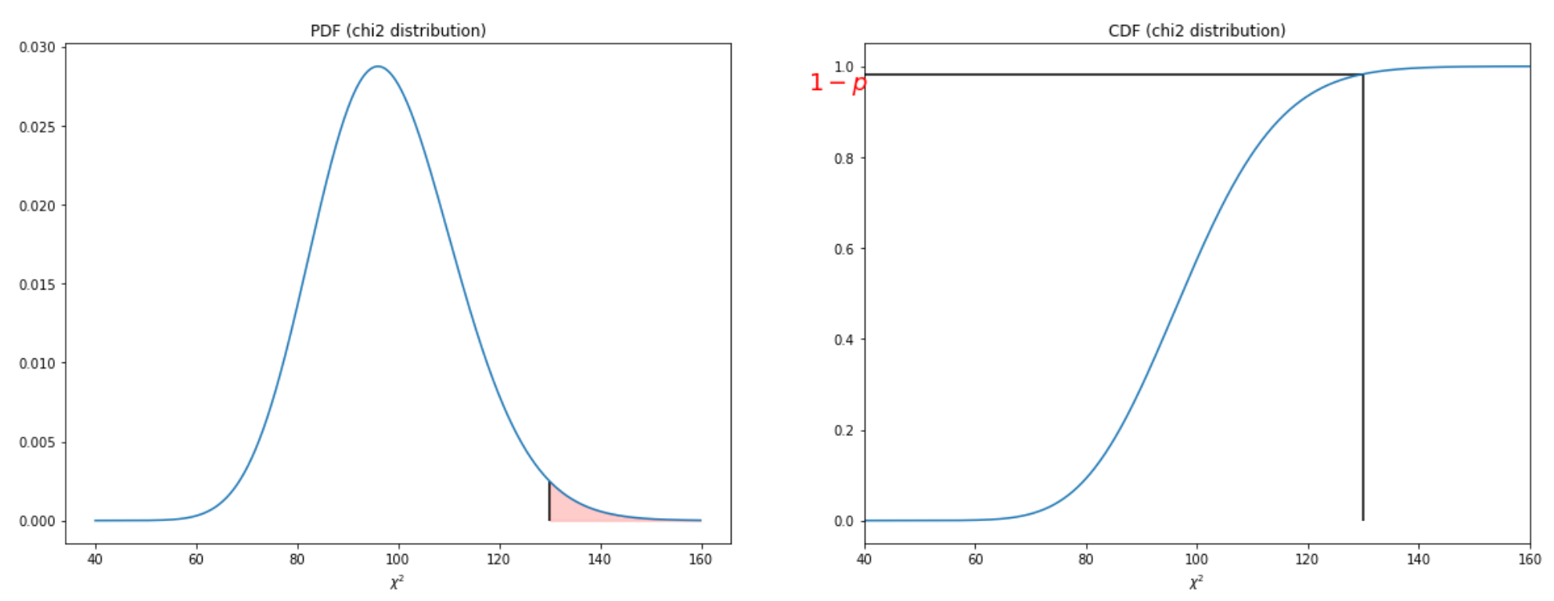


Quality of the regression
CDF
Typically:
p-value < 0.05 : ☹️
0.05 < p-value < 1: 😀
p-value close to 1 : 😕
Q
Q
1-scipy.stats.chi2.cdf(chi2_data, df= len(data)-nparam)
Go to Sect. IV.1.1 of the Notebook for practical example
Notes:
\rm{p-value}= p(Q \geq \chi^2_{\rm {obs}})

Slide 23
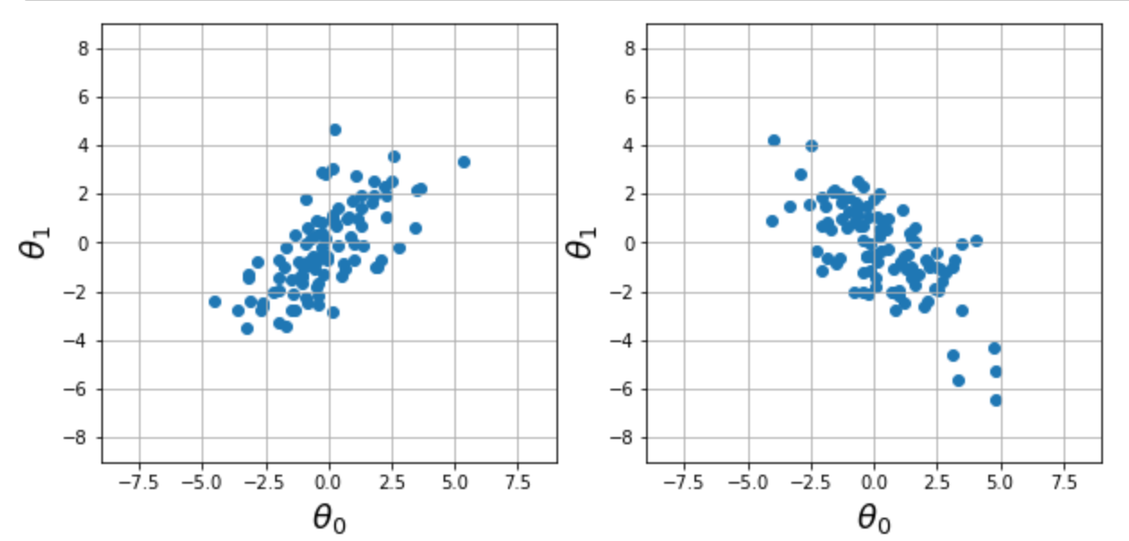
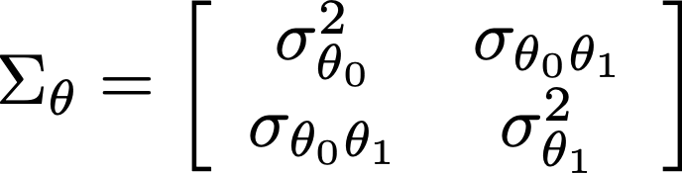
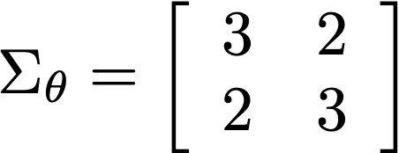
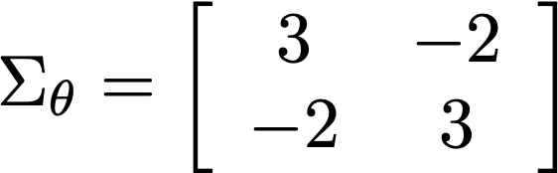



Uncertainty on the fitted parameters
The python functions return a covariance matrix (Warning : use arg. cov=True)
The diagonal elements of the matrix give the variance on the parameters (uncertainty²)
Notes:
Figure: see makefig.ipynb
\Sigma_\theta = \left[ \begin{array}{cc}
\sigma_{\theta_0}^2 & \sigma_{\theta_0 \theta_1} \\
\sigma_{\theta_0 \theta_1} & \sigma_{\theta_1}^2 \\
\end{array} \right]

Slide 24
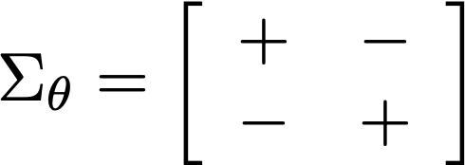
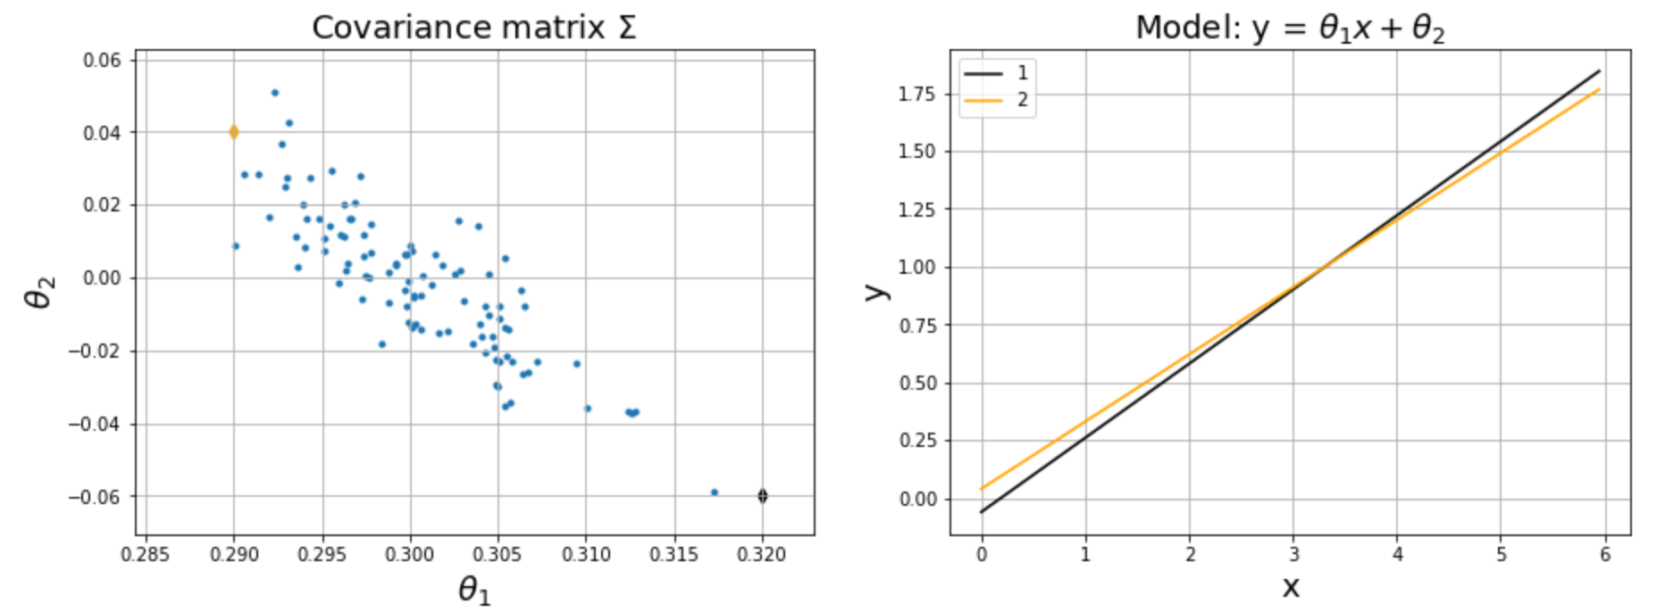
Uncertainty on the fitted parameters
Notes:
Figure: see makefig.ipynb
\Sigma_\theta = \left[ \begin{array}{cc}
\sigma_{\theta_0}^2 & \sigma_{\theta_0 \theta_1} \\
\sigma_{\theta_0 \theta_1} & \sigma_{\theta_1}^2 \\
\end{array} \right]

Slide 25
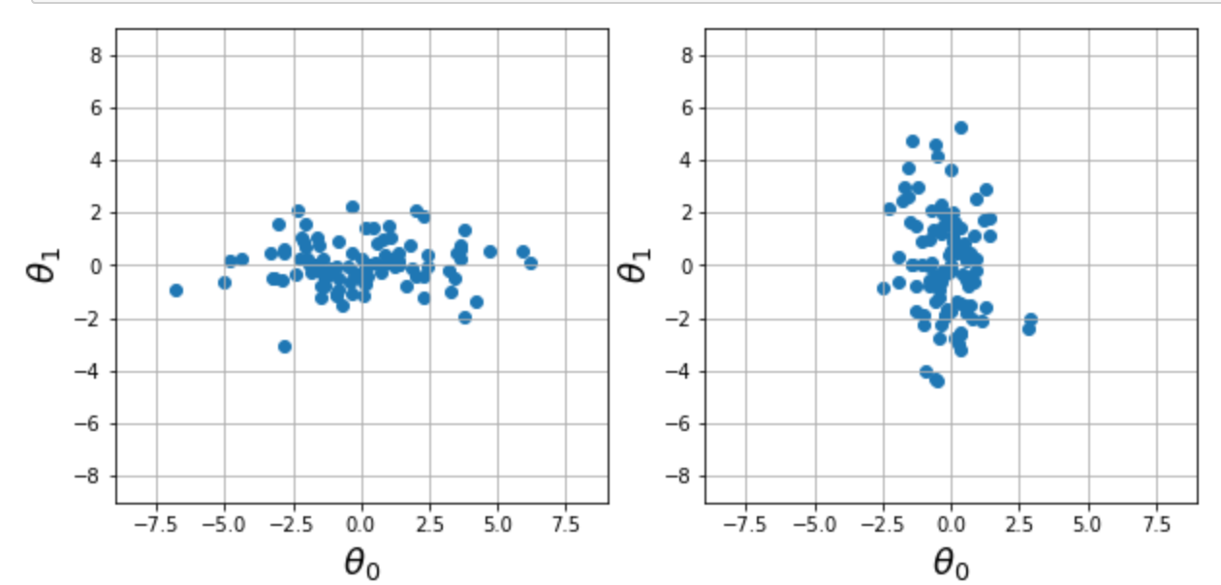
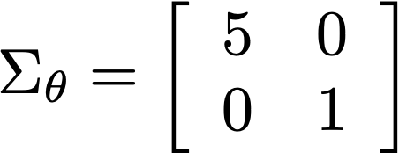
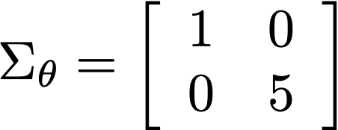
Uncertainty on the fitted parameters
Notes:
Figure: see makefig.ipynb
\Sigma_\theta = \left[ \begin{array}{cc}
\sigma_{\theta_0}^2 & \sigma_{\theta_0 \theta_1} \\
\sigma_{\theta_0 \theta_1} & \sigma_{\theta_1}^2 \\
\end{array} \right]

Slide 26
Non linear models and initial conditions
Non linear regression use numerical methods to find the minimum χ². For this reason the results are highly sensitive to initial conditions!
Tips for choosing good initial conditions
Visualise the prediction of the model for various sets of parameters
If too many parameters: R andomly sample the parameter space and calculate the χ² .
If the optimization is fast, repeat with different sets of initial conditions

