Slide 1
Bayesian statistical inference Regression
Associated notebooks:
06-Bayesian_inference_MCMC/Bayes_basics_short.ipynb
06-Bayesian_inference_MCMC/Bayes_simple_modeling.ipynb

Slide 2
Bayesian problem setting
Science:
Mass of a planet
Rotation P of asteroid
Super massive BH mass
…
P(science)

Slide 3
Bayesian problem setting
data:
Observations
Results of a simulation
…
P(science | data)

Slide 4
Bayesian problem setting
background information:
≡ What you know before getting any data
Physical range (e.g. M > 0)
Previous measurement
…
P(science | data, background info)

Slide 5
Bayesian problem setting
P(science, nuisance parameters | data, background info)
Nuisance parameters:
≡ parameters you are not interested in
Secular motion of a star during a transit
Dust extinction in SN distance measurement
…

Slide 6
Bayesian problem setting
P(science, nuisance parameters | data, background info)
P( θ_{S}, θ_{Ν} | D, I )
P( θ | D, I )
≡ Posterior probability

Slide 7
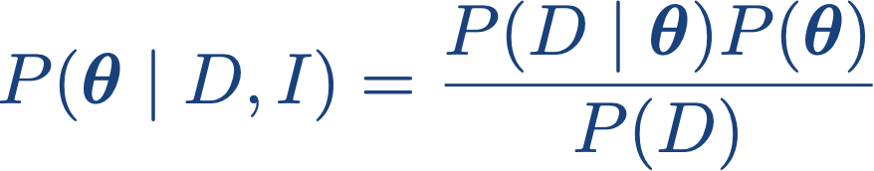
Bayes theorem
Notes:
P(\boldsymbol{\theta} \mid D,I) = \frac{P(D \mid \boldsymbol{\theta},I)P(\boldsymbol{\theta} \mid I)}{P(D \mid I)}

Slide 8
Bayes theorem
Likelihood
Notes:
P(\boldsymbol{\theta} \mid D,I) = \frac{P(D \mid \boldsymbol{\theta},I)P(\boldsymbol{\theta} \mid I)}{P(D \mid I)}

Slide 9
Bayes theorem
Prior
Notes:
P(\boldsymbol{\theta} \mid D,I) = \frac{P(D \mid \boldsymbol{\theta},I)P(\boldsymbol{\theta} \mid I)}{P(D \mid I)}

Slide 10
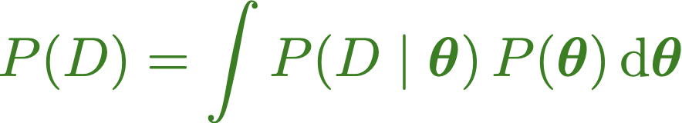
Bayes theorem
Evidence
/
Fully Marginalized likelihood
Notes:
P(\boldsymbol{\theta} \mid D,I) = \frac{P(D \mid \boldsymbol{\theta},I)P(\boldsymbol{\theta} \mid I)}{P(D \mid I)}
P(D) = \int P(D\mid\boldsymbol{\theta}) \, P(\boldsymbol{\theta}) \, \rm{d}\boldsymbol{\theta}

Slide 11

Bayes theorem
Likelihood
X
Prior
=
Evidence
Notes:
P(\boldsymbol{\theta} \mid D,I) = \frac{P(D \mid \boldsymbol{\theta},I)P(\boldsymbol{\theta} \mid I)}{P(D \mid I)}
P(D) = \int P(D\mid\boldsymbol{\theta}) \, P(\boldsymbol{\theta}) \, \rm{d}\boldsymbol{\theta}

Slide 12

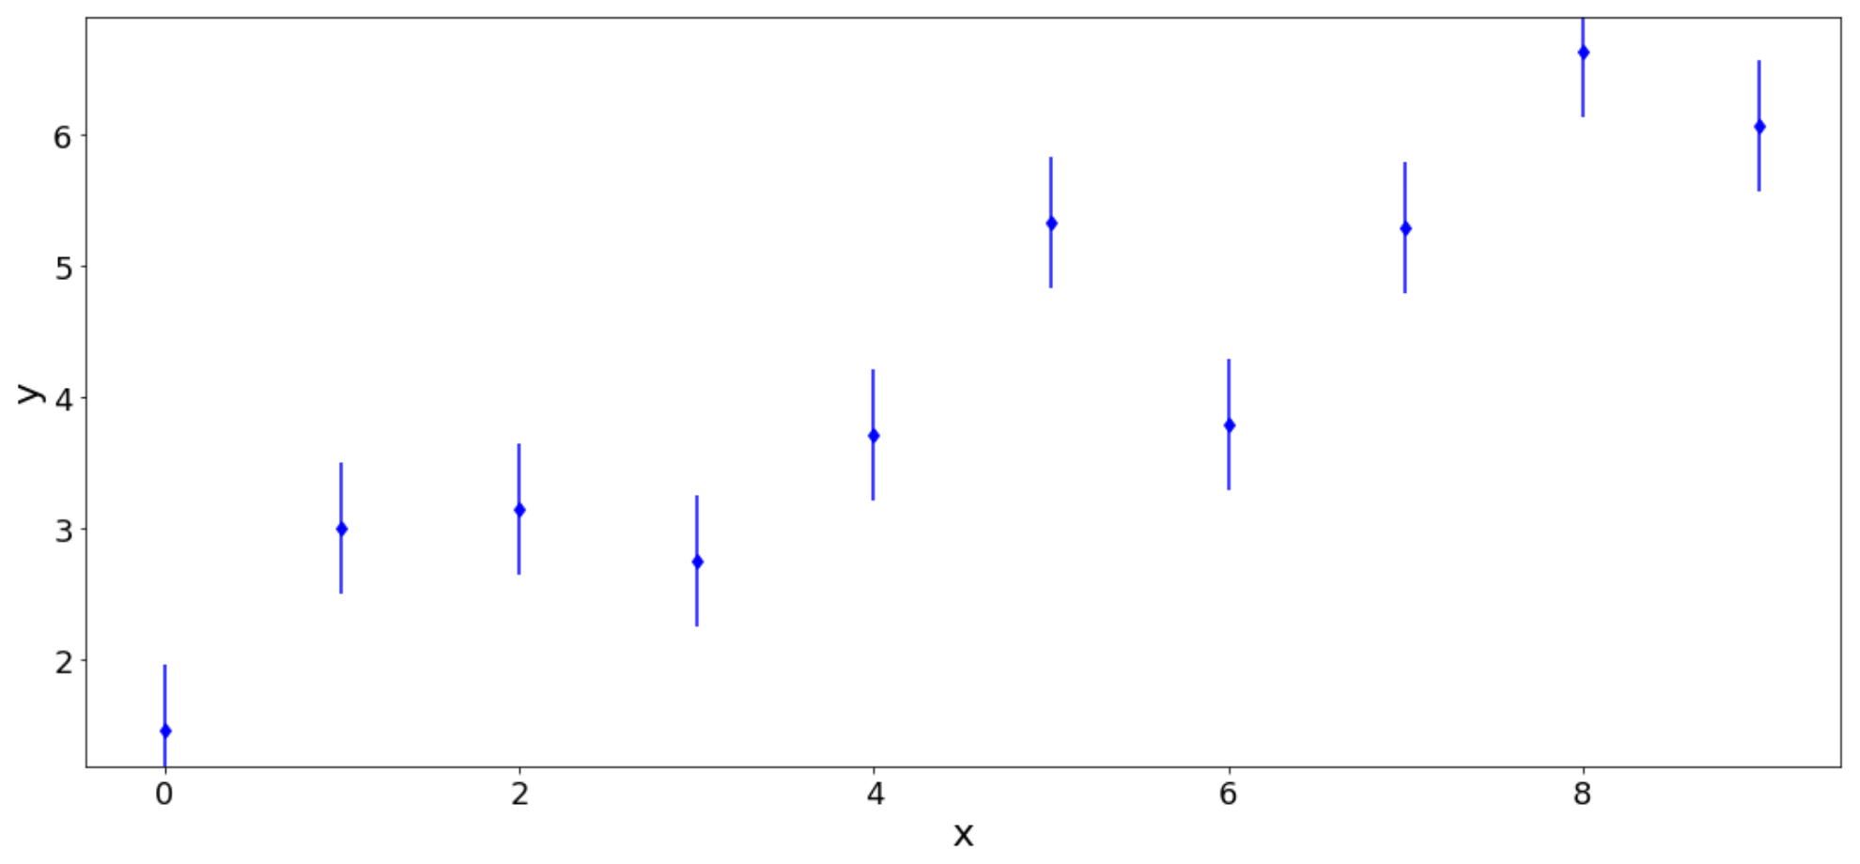
Regression in the Bayesian framework
Let’s assume that:
Data: {x_{i}}, {y_{i}} w. σ_{ι}
Notes:
P(\boldsymbol{\theta} \mid D,I) = \frac{P(D \mid \boldsymbol{\theta},I)P(\boldsymbol{\theta} \mid I)}{P(D \mid I)}
P(D) = \int P(D\mid\boldsymbol{\theta}) \, P(\boldsymbol{\theta}) \, \rm{d}\boldsymbol{\theta}

Slide 13
“Bayesian” Regression
Model choice:
Notes:
\ln(P(D\mid\boldsymbol{\theta})) \, = -\frac{1}{2}\,\sum_{i=1}^{N} \left (\ln(2\pi\sigma_i^2) + \frac{ (y_i - (\theta_0+\theta_1\,x_i))^2}{\sigma_i^2} \right)

Slide 14
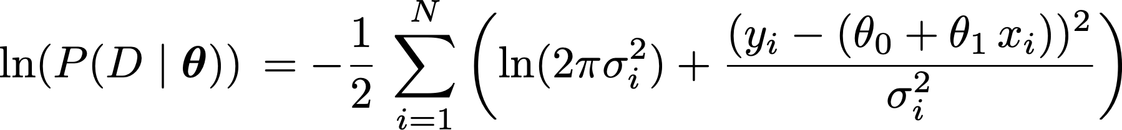
“Bayesian” Regression
Model choice:
Likelihood:
Notes:
\ln(P(D\mid\boldsymbol{\theta})) \, = -\frac{1}{2}\,\sum_{i=1}^{N} \left (\ln(2\pi\sigma_i^2) + \frac{ (y_i - (\theta_0+\theta_1\,x_i))^2}{\sigma_i^2} \right)

Slide 15
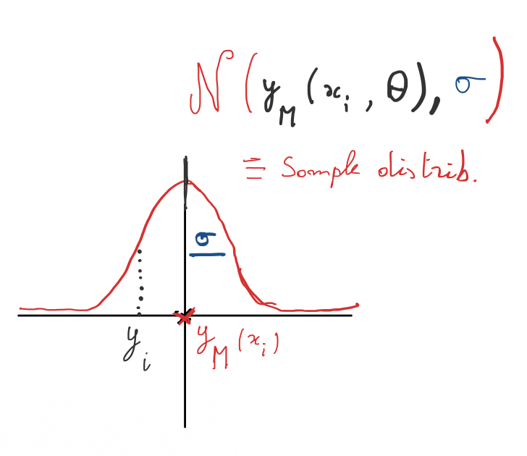
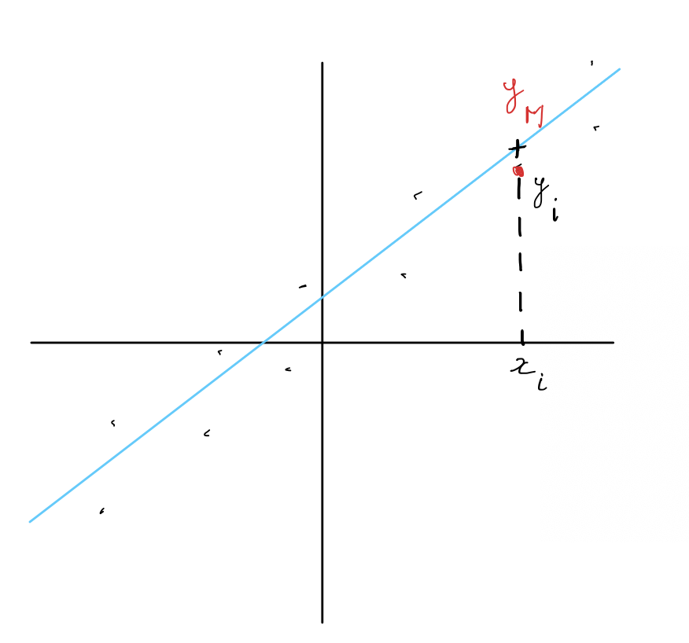
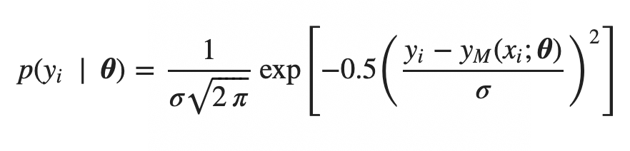
“Bayesian” Regression

Slide 16
“Bayesian” Regression

Slide 17
“Bayesian” Regression
Model choice:
Likelihood:
Prior:
Conjugate (allows one to get analytic form of P(q | D) )
Empirical: based on previous measurement
Flat: constant between 2 bounds (but can be informative)
Non / less informative
Go to Sect. IV.2 of the Notebook

Slide 18
“Bayesian” vs “Frequentist” regression
Frequentist: | Bayes:
Optimization with some merit function | Sampling of the likelihood
Search for best (fit) model parameters | PDF on parameters
“Ignore” the priors | Accounts explicitly for the priors

