Slide 1
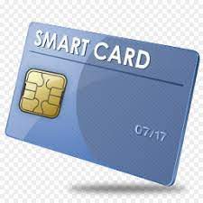
SMART CARD TECHNOLOGY

Slide 2
INTRODUCTION
WHAT IS SMART CARD?
It is an special sort of card-like gadget which contains an incorporated circuit chip implanted in it.
The IC chip can be a microchip with memory or simply a straightforward memory circuit.

Slide 3
smart card is a card with which we can trade information, store it and control information. smart cards are regularly a similar size as a driver's license or credit card and can be made out of metal or plastic.

Slide 4
Types of smart card
Memory cards
Contact cards
Contactless smart cards
Hybrid cards
Microprocessor cards
crytographic

Slide 5
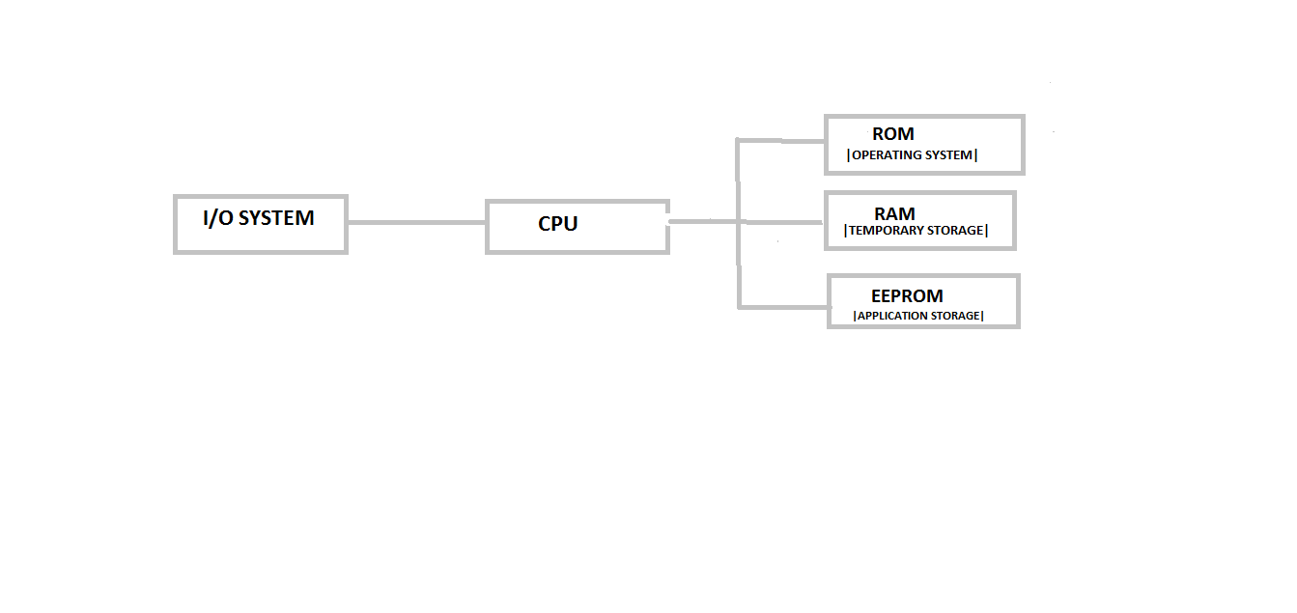
Architecture of smart card

Slide 6
WORKING OF SMART CARDS
smart card microchips or memory chips transfer information with card readers and different frameworks over a sequential interface. The smart card itself is controlled by an outer source, normally the smart card reader.
A smart card speaks with reader either through direct actual contact or utilizing a short-range remote network standard like RFID or NFC.

Slide 7
WORKING OF SMART CARD
The card reader then transfer information from the smart card to its proposed objective, generally a payment or authentication system linked to the smart card reader over a connection.

Slide 8
APPLICATION OF SMART CARDS
Communication Application
Transportation
University Identification

Slide 9
ADVANTAGES OF SMART CARD
smart card is easy to use
it is flexiable
cost
it is secure

Slide 10
DISADVANTAGES OF SMART CARD
high change to stolen
lack of knowledge

Slide 11
CONCLUSION
The smart card being generally secure and demonstrated for its security, yet was not used in payment schemes. The financial organizations were watching the improvements in the space of smart card, until it get developed.

