Slide 1


Open Data Standards for Open Source Software Risk Management Routines: An Examination of SPDX
Georg Link
Coauthors: Robin Gandhi and Matt Germonprez
GROUP 2018, Sanibel Island, Florida, USA
Paper https://doi.org/10.1145/3148330.3148333
Notes:
Exchange of software – software supply chain
To support the exchange – need standards -> lead to SPDX
Explicating that risk involved with software exchange is a contribution of SPDX
Work on entry

Slide 2
The SPDX Specification
“The Software Package Data Exchange® (SPDX®) specification is a standard format for communicating the components, licenses and copyrights associated with software packages.” - www.spdx.org

Slide 3
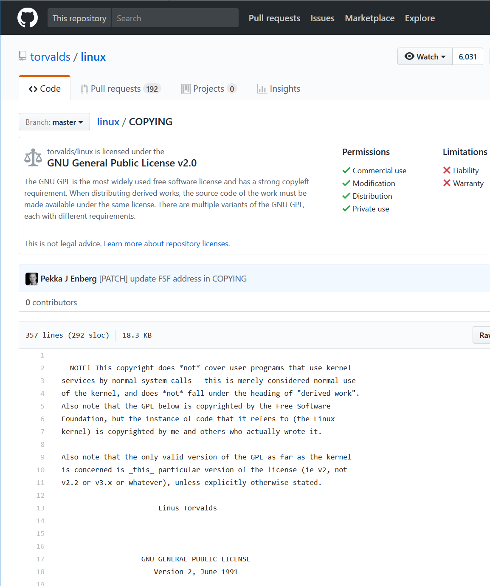
GitHub Repo with License file
File header with license information
Many licenses
License File

Slide 4
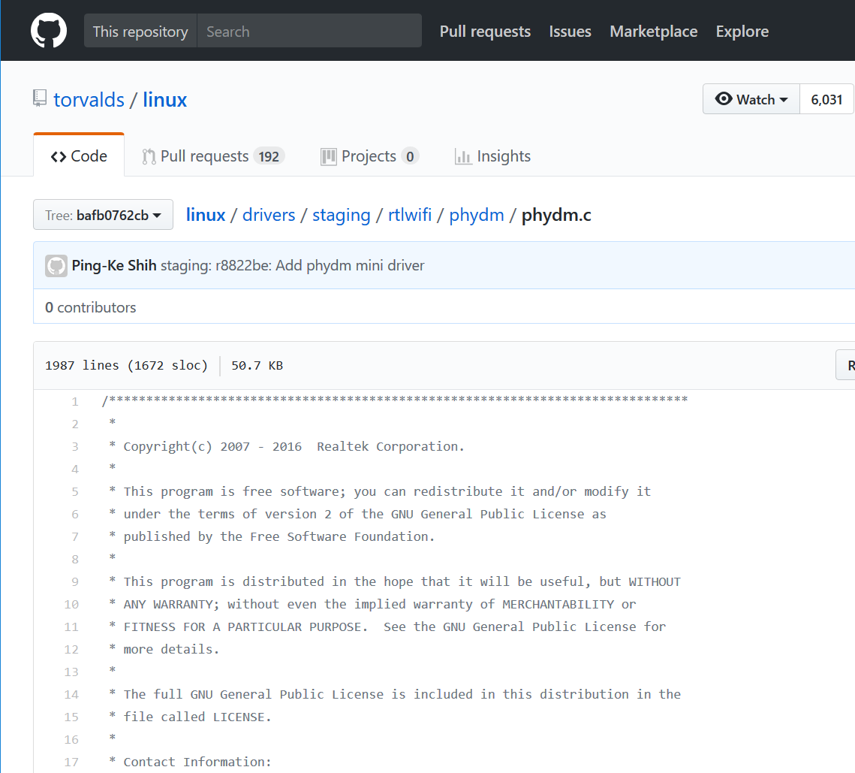
GitHub Repo with License file
File header with license information
Many licenses
Short License Header

Slide 5
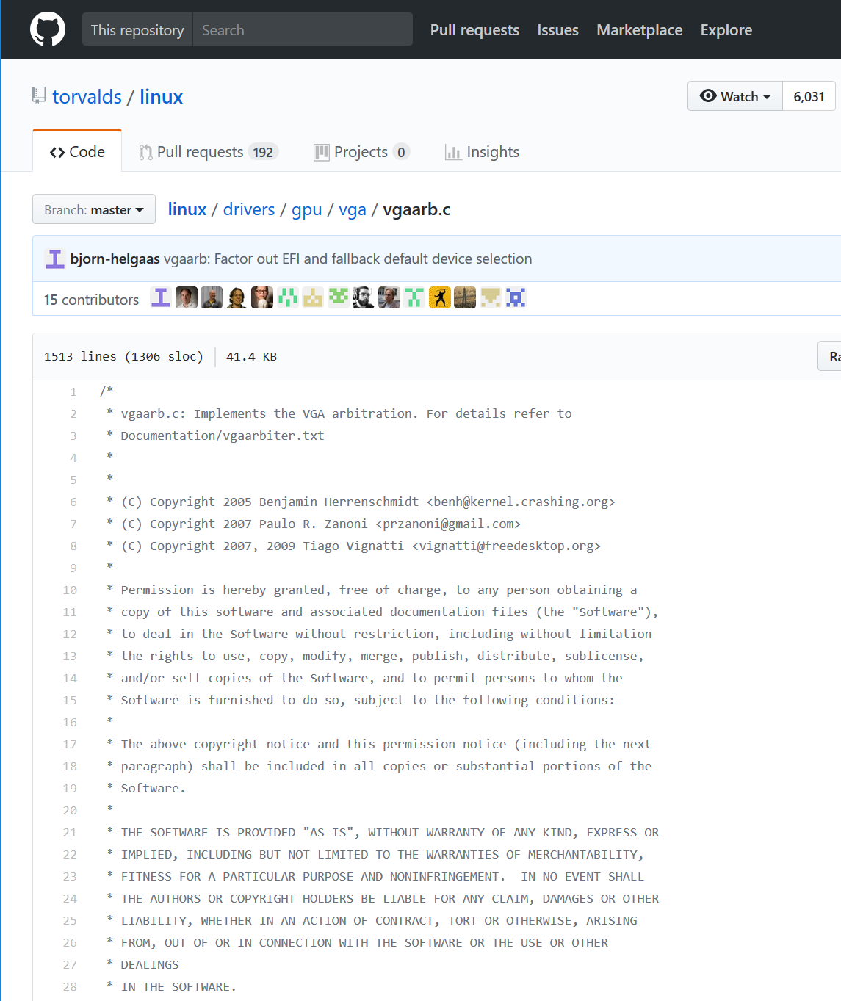
MIT License, not GPL
GitHub Repo with License file
File header with license information
Many licenses

Slide 6
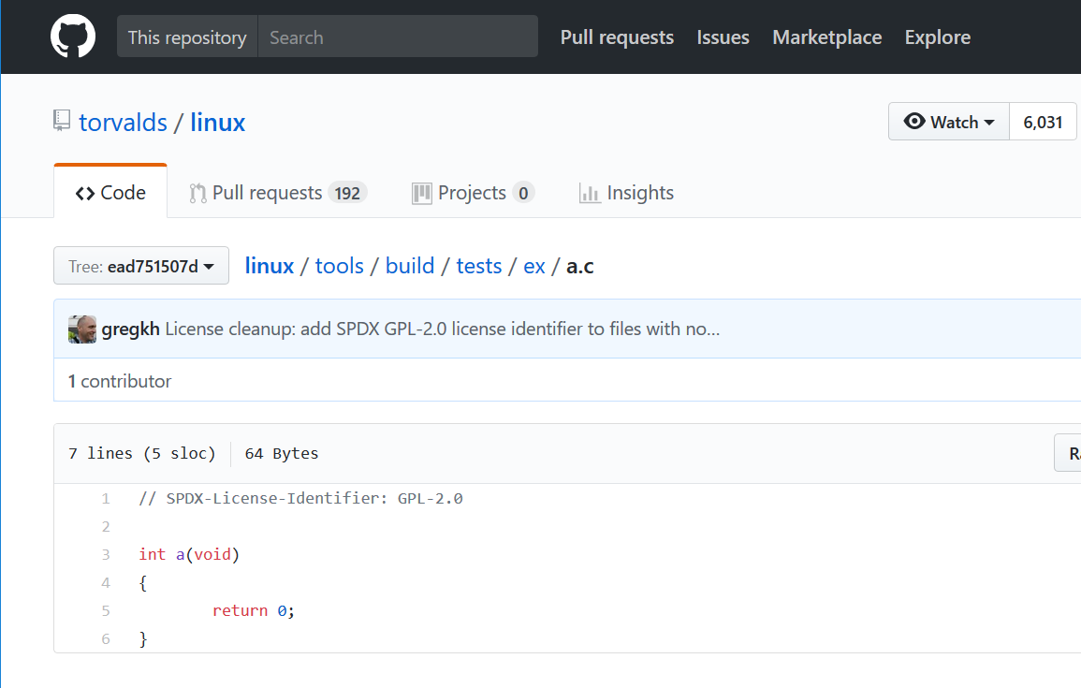
SPDX License Header
GitHub Repo with License file
File header with license information
Many licenses

Slide 7

Community
SPDX® (Software Package Data Exchange®)
The vision of SPDX is to achieve license compliance with minimal cost across the supply chain
SPDX community produces
License List
SPDX specification
Tools
Notes:
Became Linux Foundation Project in 2010.
The community consists of lawers, open source officers, and CEOs who want to support their companies with license risk
Tools produce/validates SPDX documents

Slide 8
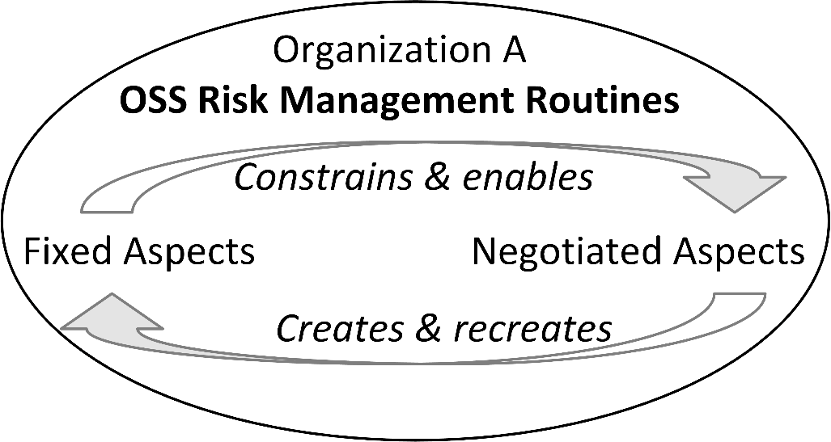
OSS Risk Management Routines

Slide 9
Research Questions
RQ1: How do organizations participating in the SPDX community describe their local interpretations of communally structured OSS risk management routines?

Slide 10
Shared OSS Risk Management Routines In the Shared SPDX Standard Development
RQ1

Slide 11
Research Questions
RQ1: How do organizations participating in the SPDX community describe their local interpretations of communally structured OSS risk management routines?
RQ2: How do these local interpretations influence the extent of their SPDX adoption?

Slide 12
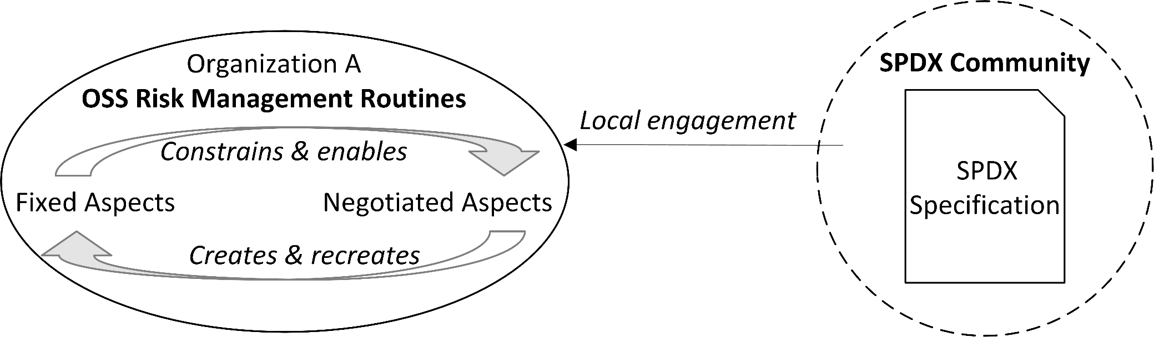
Shared OSS Risk Management Routines In the Shared SPDX Standard Development
RQ2

Slide 13
Research Questions
RQ1: How do organizations participating in the SPDX community describe their local interpretations of communally structured OSS risk management routines?
RQ2: How do these local interpretations influence the extent of their SPDX adoption?
RQ3: How do these member organizations seek to guide the advancement of the shared SPDX specification?

Slide 14
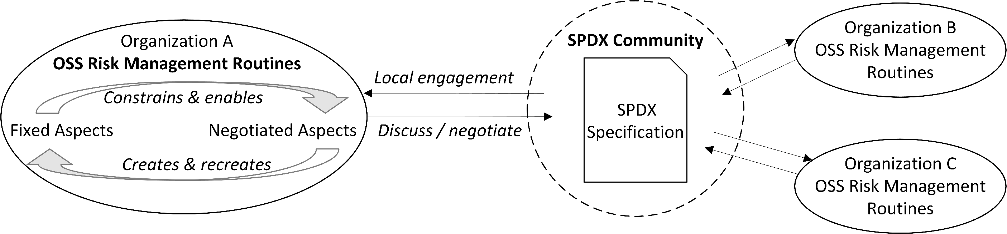
Shared OSS Risk Management Routines In the Shared SPDX Standard Development
RQ3
Notes:
Maybe an example for this… autograte linux maybe – Toyota, honda, … don’t want to rebuild the operating system but contribute back to the project

Slide 15
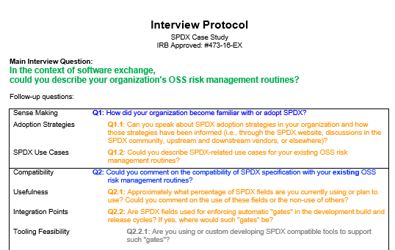
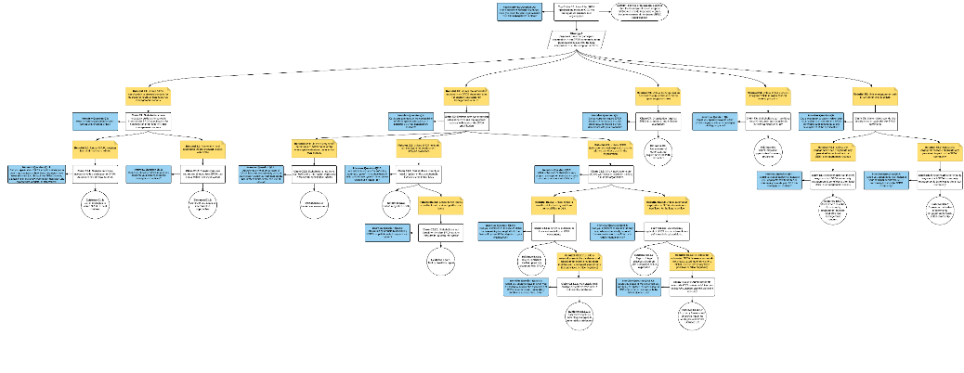
Data Collection and Validation
Assurance Case Method
16 Interviews
15 Organizations
10 hours of recording
Field notes
Validation
Focus Group with 15 SPDX members at Open Source Leadership Summit 2017
https://github.com/SPDX-CaseStudy/files
Notes:
Characterize the organizations
Heavily involved
LF contributors
Fortune 100 companies
Validation: be assured about ground validation – planned and not accidental
Important data and hard to get (imply)
Qualitative analysis

Slide 16
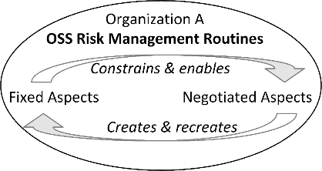
Answering the Research Question 1
RQ1: How do organizations participating in the SPDX community describe their local interpretations of communally structured OSS risk management routines?
Very differently, ranging from using full standard to learning from early adopters.
“When I hear my guys having modeling discussions, I often say, ‘look at SPDX, if it's a coin flip what to call this field, let's go with the standard.’”
Notes:
Spend more time …
Word-cloud – combine the comments – show the variability
Remind the audience that the understanding is localized within the organization.
- Add the picture of the routine (box on just the left circle) – add to others aswell

Slide 17

Answering the Research Question 2
RQ2: How do these local interpretations influence the extent of their SPDX adoption?
Local interpretation is the adoption of SPDX for local needs.
“The cost of distributing license information was our business driver for adopting SPDX.“

Slide 18

Answering the Research Question 3
RQ3: How do these member organizations seek to guide the advancement of the shared SPDX specification?
Local interpretations are source of innovation for communal practices.
“[In the SPDX group] we talked about the merits of different fields, how to characterize them, and how to serialize formats.”

Slide 19
Implications for Research and Practice
Parallels to risk practices
Many organizations attempt to address risk close to delivery
Federating risk practices throughout product development can be successful
Built-in gradation for adoption
Partial and successive implementation enables maturing local practices
Notes:
More general
Header bullets – reduce to 3-4 words only

Slide 20
Implications for Research and Practice
Stabilizing highly dynamic practices
SPDX specification improves guidance by declaring potential risks in OSS
SPDX stabilizes the complexities in software design
SPDX is itself entails responsive design within the duality of routines
Strategic and brokered communities
Brokers, such as the Linux Foundation, shape the ecosystem
SPDX is one example of a community that enables new interactions
Brokered engagements can include internal communal needs and external needs from brokering foundations
Notes:
Say as much as I can fully explain – leave out what I don’t have time to explain – people can read the other bullets
- Focus on how SPDX stabilizes the ecosystem by establishing shared routines
Tighter discussion on the ecosystem – keep it at a higher level
- With open source standards, suggest having a broker

Slide 21
Contributions to
Routines: Uncover complexities involved in the development of communal risk related open data standards.
Open source: Report how the SPDX project is changing the open source ecosystem by developing shared routines and encoding fixed elements in the SPDX specification
Standard setting: Demonstrate how shared practices shape standards
Methodology: Demonstrate the use of the assurance case driven case study design.

Slide 22
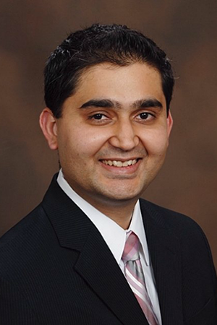


Thank you!
Robin Gandhi rgandhi@unomaha.edu
Matt Germonprez mgermonprez@unomaha.edu
Georg Link glink@unomaha.edu
Robin
Matt
Georg
Assurance case and interview protocol:
https://github.com/SPDX-CaseStudy/files
Full Paper:
https://doi.org/10.1145/3148330.3148333
© 2016-2018 Robin Gandhi, Matt Germonprez, and Georg J.P. Link. The presentation is provided under the Attribution 4.0 International (CC BY 4.0) License.

Slide 23
Backup Slides

Slide 24
Key Findings
Rebuttal | Elimination Summary
Rebuttal R1: Unless the SPDX specification is deemed complex for operational needs of local OSS risk management routines. | Rebuttal R1 is not eliminated for organizations just starting with SPDX. Organizations engaged in the SPDX community for a long time easily address the rebuttal.
Rebuttal R2: Unless the information recorded in an SPDX document does not support local OSS risk management routines. | Rebuttal R2 is eliminated in most organizations by mapping parts of SPDX to local OSS risk management routines.
Rebuttal R3: Unless the organization does not require SPDX documents upon supply or intake. | Rebuttal R3 is not eliminated in most organizations as SPDX adoption in OSS supply chains is not widespread. Few organization are starting to use and ship SPDX to customers.
Rebuttal R4: Unless SPDX does not integrate well in to organizational training programs. | Rebuttal R4 is partially eliminated by the inclusion of License List in developer training and best practices. However, there is only mention of SPDX in formal training.
Rebuttal R5: Unless engagement with SPDX community is difficult. | Rebuttal R5 is eliminated in organizations that directly participate, observe, or engage through proxy representation in the SPDX community. SPDX community is perceived as open and inviting.
Table 1. Rebuttals and summary of findings.

Slide 25
Exchanging Organizational Routines
Routine = Set of actions executed repeatedly with reliable outcomes
Fixed vs. negotiated aspects
Fixed: artifacts, workflows, forms, tools, standards, …
Negotiated: actual use, workarounds, shortcuts, …
Knowledge boundary complicates exchange of routines

Slide 26
Creating Shared Routines through Shared Standards
Shared standards embody the fixed aspects of shared routines
Achieve compatability and foster exchange
Requires building shared understanding
Adoption is local interpretation
Unexpected implementations result from deviant interpretations
Audits and certifications assure uniform implementations
Standardization process benefits participant organizations
Align standard with local interpretation
Align organization with emerging standard
Information advantage

Slide 27

Method: Assurance Case
https://github.com/SPDX-CaseStudy/files

Slide 28
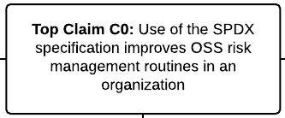
Assurance Case: Top Claim C0

Slide 29
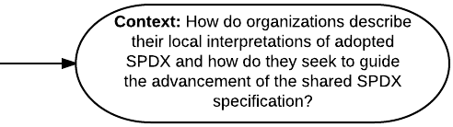
Assurance Case: Top Claim C0

Slide 30
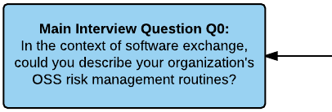
Assurance Case: Top Claim C0

Slide 31
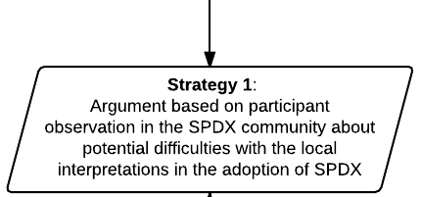
Assurance Case: Top Claim C0
Rebuttal R1
Rebuttal R2
Rebuttal R3
Rebuttal R4
Rebuttal R5

Slide 32
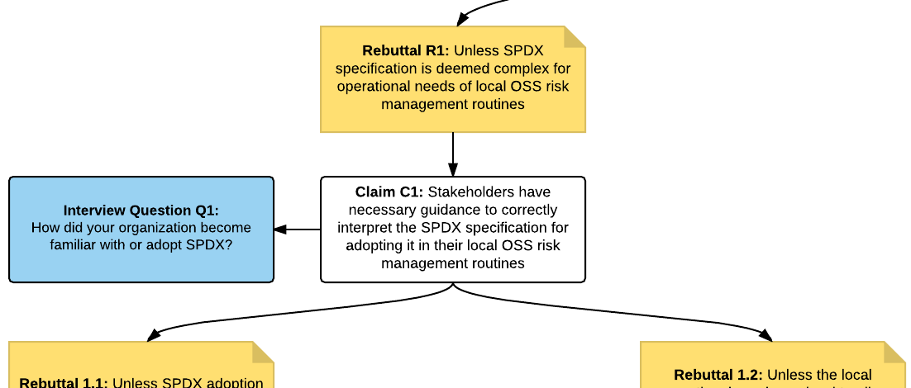
Assurance Case: Rebuttal R1

Slide 33
Assurance Case: Rebuttal R1

Slide 34
Assurance Case: Rebuttal R1

Slide 35
Assurance Case: Rebuttal R1

