Slide 1
Figures for IPCD Paper
March 26th, 2020

Slide 2
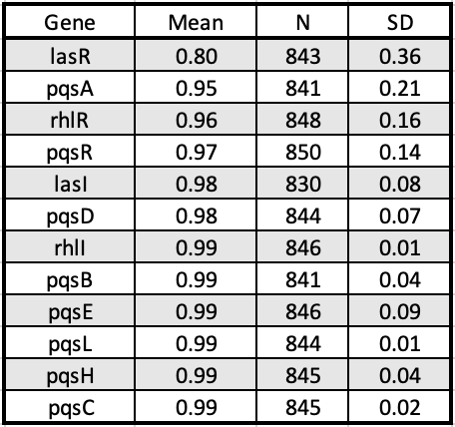
Fig 1a. (Will remake this figure. Currently this is a screen shot of excel) We used BLOSUM80 to calculate the similarity scores of each isolate’s protein compared to reference, we determined the mean similarity and standard deviation for each gene. The LasR protein has the lowest mean similarity score compared to other QS proteins.
Notes:
Mean +/- SD
Turn this into a barplot with +/- error bars.
** Add qscR

Slide 3
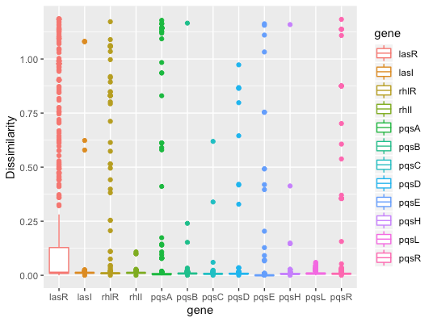
Fig 1b. We created a box-and-whisker plot using BLOSSUM80 dissimilarity scores compared to a reference. Most boxes are too short to be seen, because the majority of sequences are identical or similar to the reference.
Notes:
*dissimilarity score needs a bit of thinking.
** this will be replaced by a barplot version of slide 2.

Slide 4
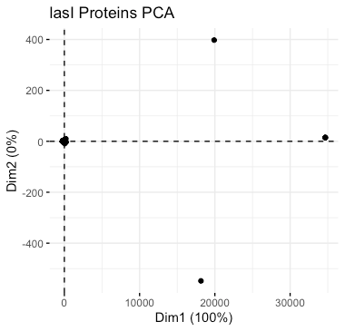
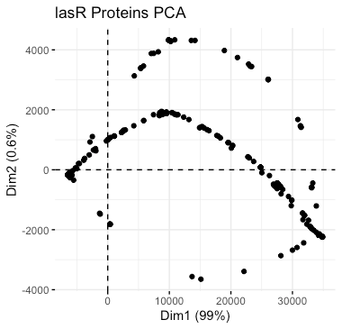
Fig 1c. We used the BLOSSUM80 dissimilarity scores of LasR and LasI genes to assemble PCA plots. LasR has many variable points, while LasI primarily clusters together.
Notes:
1c – pca on lasR
1d – pca on lasI

Slide 5
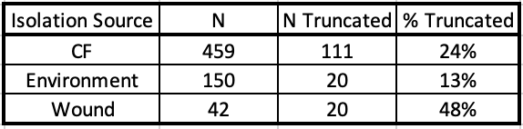
Fig 1d (Will re-do this table, currently a screen shot) We calculated the number of truncations present in each group of isolates. Wound isolates have the highest percentage of truncations.
Notes:
Everything figure 2 is LasR
2a – turn this into a barplot

Slide 6
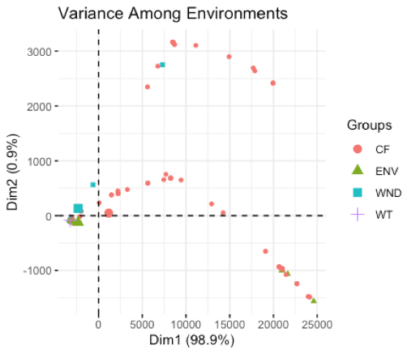
Fig 2. (This is not final graph - we have fewer than 651 isolates here, I will update soon) We used the BLOSSUM80 LasR protein dissimilarity scores to plot a PCA plot of the 651 labeled strains. CF appears to be the most variable group.
Notes:
2b – lasR by environment. Include ALL truncations – not just truncations with early stop codons.

Slide 7
New figures – updated 04/03/2020

Slide 8
Now including qscR
Notes:
This is just updated slide 3. Add qscR
This is getting replaced.

Slide 9
Notes:
Don’t worry about this figure.

Slide 11
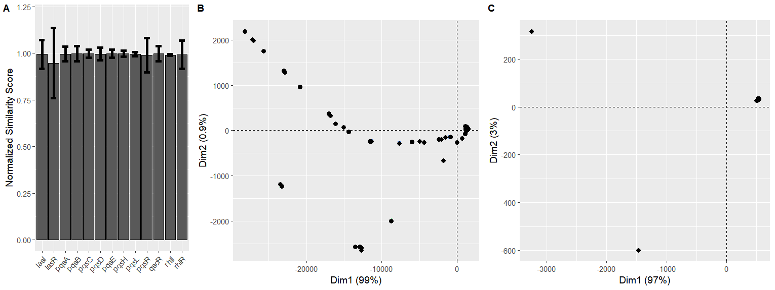
Figure 1

Slide 12
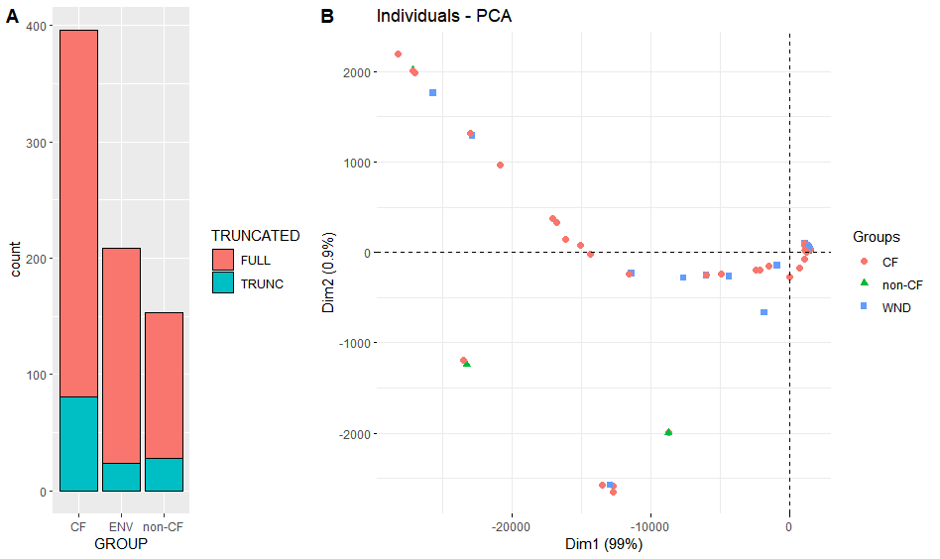
Figure 2

