Slide 1



Python accessing SPECCHIO
Andy Hueni¹
¹ Remote Sensing Laboratories, University of Zurich, Switzerland
OPTIMISE SPECCHIO Programming Course
Page <number>

Slide 2
Agenda
Configuring your machine for SPECCHIO access from Python
Connecting to SPECCHIO
Selecting data
Load spectral data from database
Load metadata from database
Page <number>

Slide 3
Java – Python Bridge
Two bridging packages have been tested, but only JPype is currently supported:
Py4J: https://www.py4j.org
JPype: https://jpype.readthedocs.io/en/latest/#
Install JPype packages on your operating system.
Based on tests, JPype is currently the preferred option, as transfers of Java arrays (i.e. spectral matrices) to Python arrays are much faster.
* Py4J is partly supported from client build 160 onwards
Page <number>

Slide 4
Connecting to SPECCHIO – Python – JPype
Create a new Python script, test each of the lines below as you enter them.
Import jpype, start JVM with clas path pointing to specchio client jar file, get specchio client package:
from jpype import *
startJVM('/Library/Java/JavaVirtualMachines/jdk1.7.0_79.jdk/Contents/MacOS/libjli.dylib', "-ea", "-Djava.class.path=/Applications/SPECCHIO/SPECCHIO.app/Contents/Java/specchio-client.jar")
SPECCHIO = JPackage('ch').specchio.client
Create a client factory instance and get a list of all connection details:
cf = SPECCHIO.SPECCHIOClientFactory.getInstance();
db_descriptor_list = cf.getAllServerDescriptors();
Create client for the first entry in the database connection list:
specchio_client = cf.createClient(db_descriptor_list.get(0)) # zero indexed
If no error appears then you are connected successfully to the SPECCHIO database running in your SPECCHIO VM
Page <number>

Slide 5
Connecting to SPECCHIO – Python – JPype
If you want to see what server you just connected to, type:
db_descriptor = db_descriptor_list.get(0)
db_descriptor.getDataSourceName()
Page <number>

Slide 6
Selecting data – Python – JPype
The SPECCHIO tutorial dataset contains some spectra that have a spatial position.
We are now going to select spectra based on their altitude above sea level. Our condition is that the altitude must be 50m or higher.
Create a query object:
QUERIES = JPackage('ch').specchio.queries
query = QUERIES.Query();
Create query condition for the altitude attribute and configure it:
attr = specchio_client.getAttributesNameHash().get('Altitude’)
cond =QUERIES.EAVQueryConditionObject(attr)
cond.setValue('50.0');
cond.setOperator('>=');
query.add_condition(cond);
Get spectrum ids that match the query:
ids = specchio_client.getSpectrumIdsMatchingQuery(query);
Page <number>

Slide 7
Selecting data – Python – JPype
Check how many spectra we found
ids.size()
Add another condition to restrict the maximum altitude:
cond = QUERIES.EAVQueryConditionObject(attr);
cond.setValue('55.0');
cond.setOperator('<');
query.add_condition(cond);
Get spectrum ids that match the query
ids = specchio_client.getSpectrumIdsMatchingQuery(query);
Check the size of the ids variable again – there should be less spectra selected than before
Page <number>

Slide 8
Load spectral data from database – Python – JPype
Refer to the general presentation on SPECCHIO explaining the Spectral Space concept and the Space Factory; the following statements are using the implementation of these concepts.
Create spectral spaces and order the spectra by their acquisition time (note: this does not load the spectral vectors yet but only prepares the ‘containers’) :
spaces = specchio_client.getSpaces(ids, 'Acquisition Time');
Find out how many space we have received:
len(spaces)
Get the first space:
space = spaces[0]
The order of the ids may have changed because the vectors in the space are ordered by their Acquisition Time; therefore get the ids in their correct sequence to match the vector sequence:
ids = space.getSpectrumIds(); # get them sorted by 'Acquisition Time’
Load the spectral data from the database into the space:
space = specchio_client.loadSpace(space);
Page <number>

Slide 9
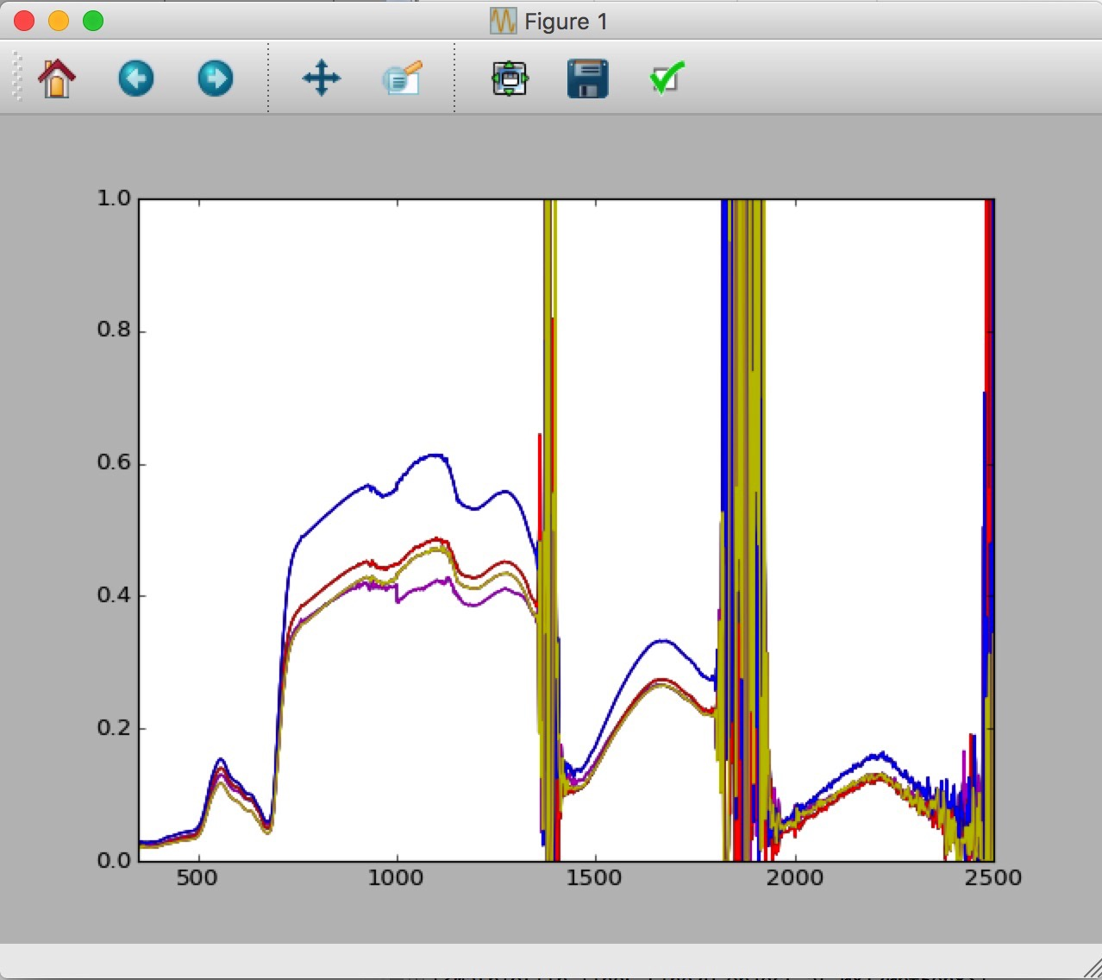
Load spectral data from database – Python – JPype
Get the spectral vectors, wavelengths and measurement unit, the plot using matplotlib.
vectors = space.getVectorsAsArray();
wvl = space.getAverageWavelengths();
unit = space.getMeasurementUnit().getUnitName();
import numpy
import matplotlib.pyplot as mp
axes = mp.gca()
axes.set_xlim([350,2500])
axes.set_ylim([0,1])
y = numpy.rot90(vectors,3)
mp.plot(wvl, y)
# end connection to Java
shutdownJVM()
Page <number>

Slide 10




Thank you for your attention!
For more information on the current version of SPECCHIO see: www.specchio.ch
https://twitter.com/SPECCHIO_DB
Page <number>

Slide 11
Appendix: Py4J Documentation
Note: support for Py4J is currently disabled!
Page <number>

Slide 12
Connecting to SPECCHIO – Python – Py4J
Create a new Python script, test each of the lines below as you enter them.
Start the SPECCHIO java client. This starts the Java Py4J Gateway. (If you start the SPECCHIO client from the terminal, you will see a message similar to:
Welcome to 3.2.1.3 Alpha
Specchio - Python Gateway Server Started
Import the PyJ4 Gateway and get the gateway object:
from py4j.java_gateway import JavaGateway
gateway = JavaGateway()
Create a client factory instance and get a list of all connection details:
cf=gateway.entry_point.getClientFactory()
db_descriptor_list = cf.getAllServerDescriptors()
Create client for the first entry in the database connection list:
specchio_client = cf.createClient(db_descriptor_list.get(0)) # zero indexed
If no error appears then you are connected successfully to the SPECCHIO database running in your SPECCHIO VM
Page <number>

Slide 13
Connecting to SPECCHIO – Python – Py4J
If you want to see what server you just connected to, type:
db_descriptor = db_descriptor_list.get(0)
db_descriptor.getDataSourceName()
Page <number>

Slide 14
Selecting data – Python – Py4J
The SPECCHIO tutorial dataset contains some spectra that have a spatial position.
We are now going to select spectra based on their altitude above sea level. Our condition is that the altitude must be 50m or higher.
Create a query object:
query = specchio_client.getQueryObject()
Create query condition for the altitude attribute and configure it:
attr = specchio_client.getAttributesNameHash().get('Altitude’)
cond =specchio_client.getEAVQueryConditionObject(attr)
cond.setValue('50.0');
cond.setOperator('>=');
query.add_condition(cond);
Get spectrum ids that match the query:
ids = specchio_client.getSpectrumIdsMatchingQuery(query);
Page <number>

Slide 15
Selecting data – Python – Py4J
Check how many spectra we found
ids.size()
Add another condition to restrict the maximum altitude:
cond = specchio_client.getEAVQueryConditionObject(attr);
cond.setValue('55.0');
cond.setOperator('<');
query.add_condition(cond);
Get spectrum ids that match the query
ids = specchio_client.getSpectrumIdsMatchingQuery(query);
Check the size of the ids variable again – there should be less spectra selected than before
Page <number>

Slide 16
Load spectral data from database – Python – Py4J
Refer to the general presentation on SPECCHIO explaining the Spectral Space concept and the Space Factory; the following statements are using the implementation of these concepts.
Create spectral spaces and order the spectra by their acquisition time (note: this does not load the spectral vectors yet but only prepares the ‘containers’) :
spaces = specchio_client.getSpaces(ids, 'Acquisition Time');
Find out how many space we have received:
len(spaces)
Get the first space:
space = spaces[0]
The order of the ids may have changed because the vectors in the space are ordered by their Acquisition Time; therefore get the ids in their correct sequence to match the vector sequence:
ids = space.getSpectrumIds(); # get them sorted by 'Acquisition Time’
Load the spectral data from the database into the space:
space = specchio_client.loadSpace(space);
Page <number>

Slide 17
Load spectral data from database – Python – Py4J
Get the spectral vectors, wavelengths and measurement unit, the plot using matplotlib. Note: conversion of the vectors to the list data format is time consuming.
vectors = space.getVectorsAsArray();
wvl = space.getAverageWavelengths();
unit = space.getMeasurementUnit().getUnitName();
wavelengths = list(wvl)
import matplotlib.pyplot as mp
mp.hold
axes = mp.gca()
axes.set_xlim([350,2500])
axes.set_ylim([0,1])
for i, dataset in enumerate(vectors):
mp.plot(wavelengths, list(dataset))
# further option using numpy, but also not faster …
import numpy
from numpy import array
x = array(wavelengths)
v=array(list(vectors))
mp.plot(x, numpy.rot90(v))
a = numpy.asarray(list(vectors))
Page <number>

