Slide 1
Green Paradise

Slide 2
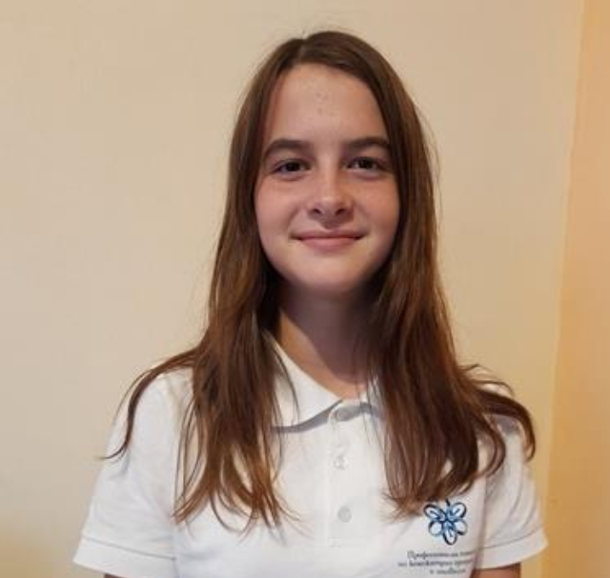

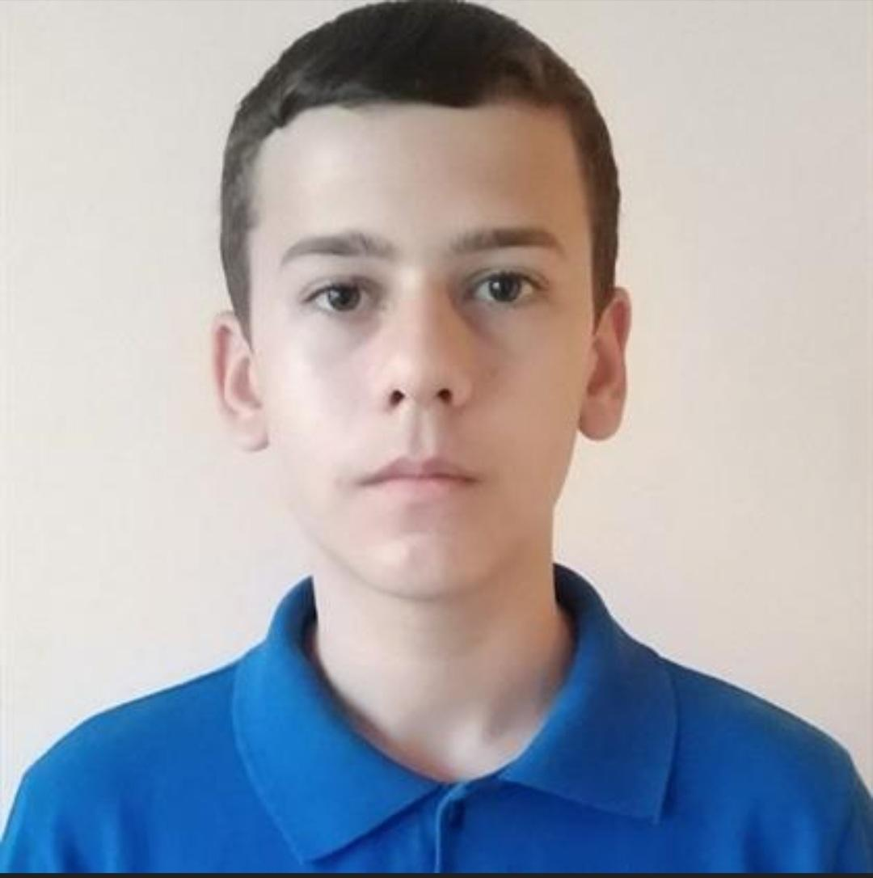
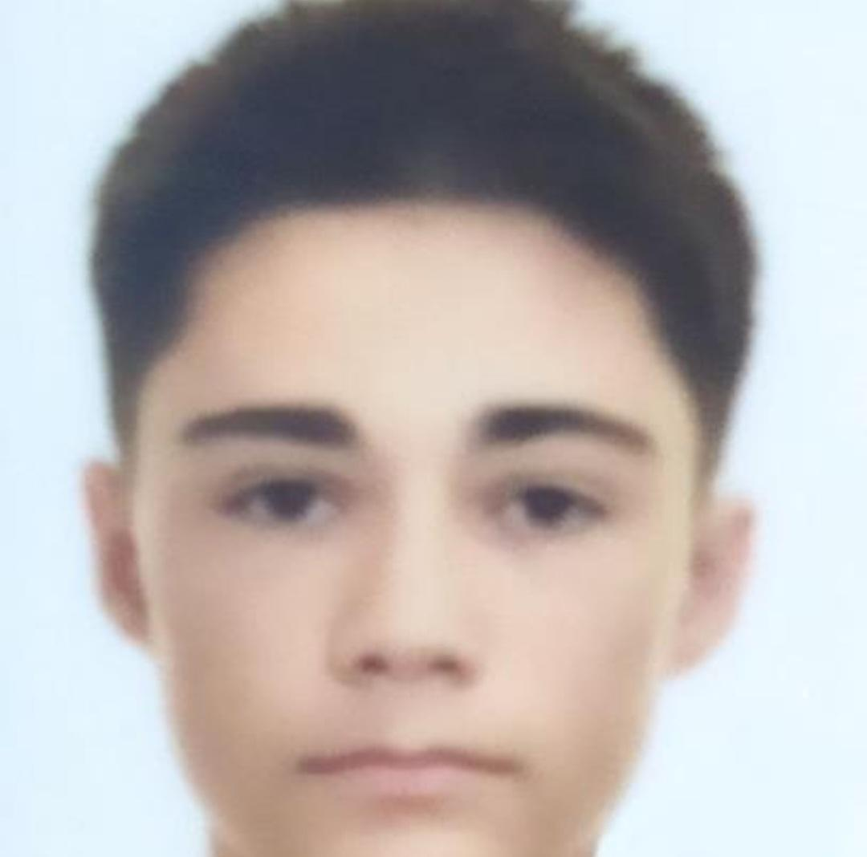
Stela Georgieva
Alexandra Zheleva
Alexander Popov
Mikhail Avagyan
Scrum trainer
Frontend developer
Backend developer
Backend developer

Slide 3
Stages of creation
02
03
01
04
We assigned roles
We came up with a name
We chose the theme of the game
05
06
We made the game
We made a presentation and documentation
We practiced our presentation

Slide 4
The game

Slide 5








Technologies used

Slide 6
Let's get to the game

