Slide 1

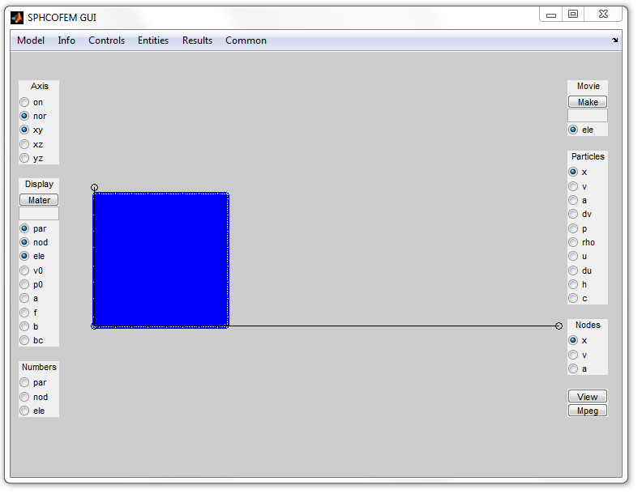
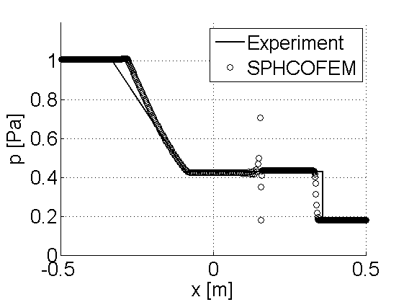
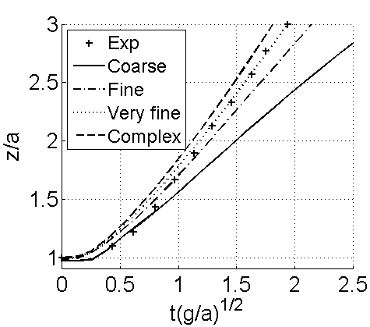

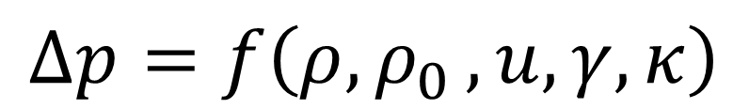
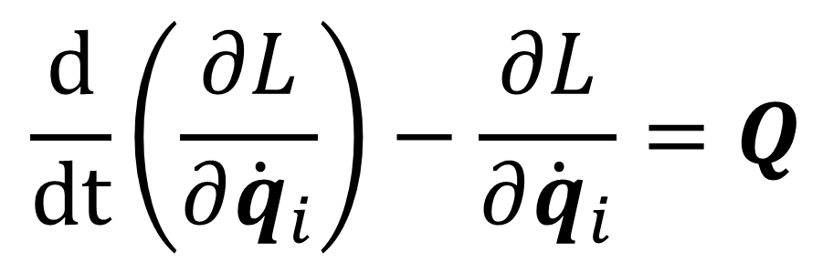
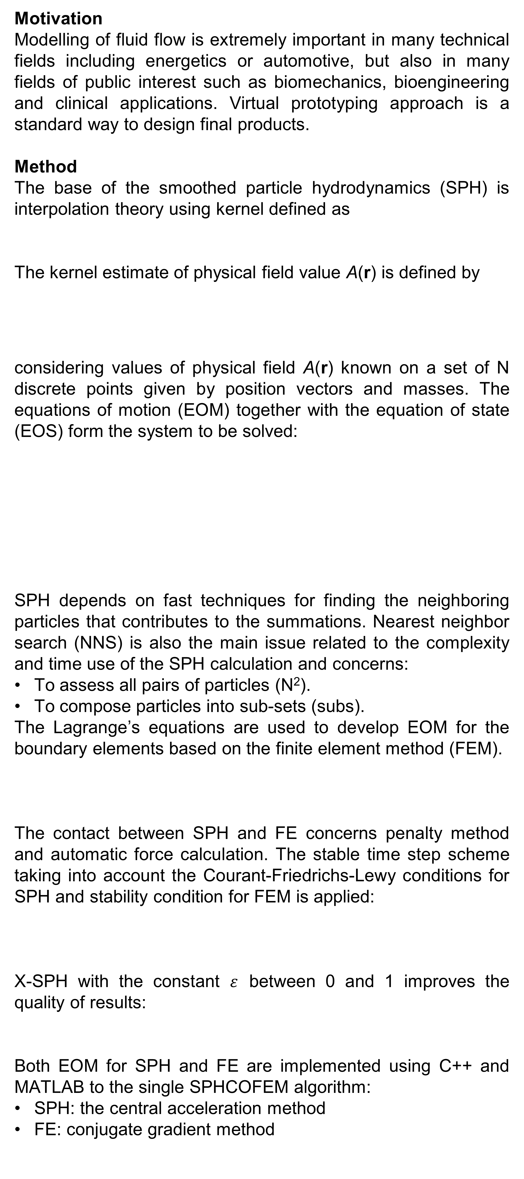
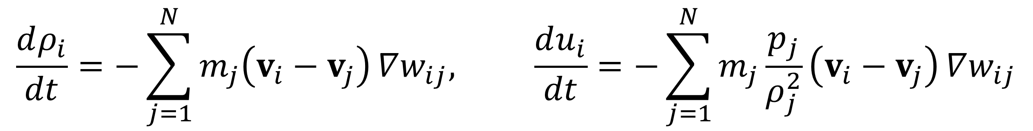

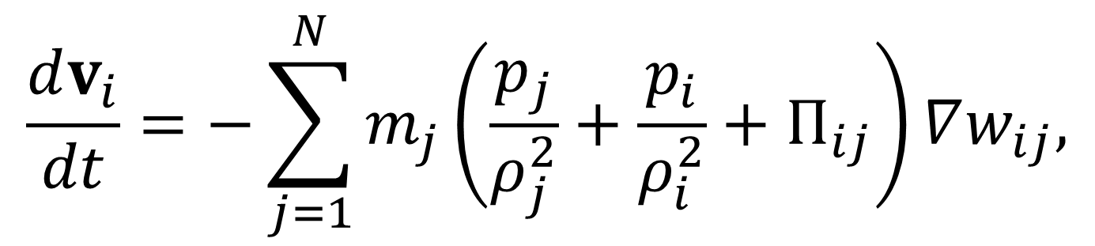
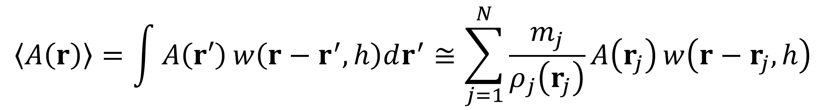
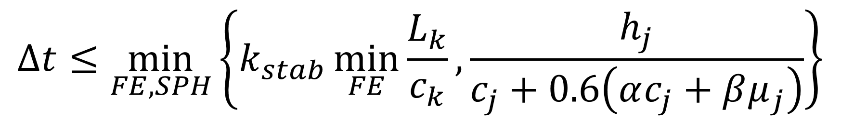
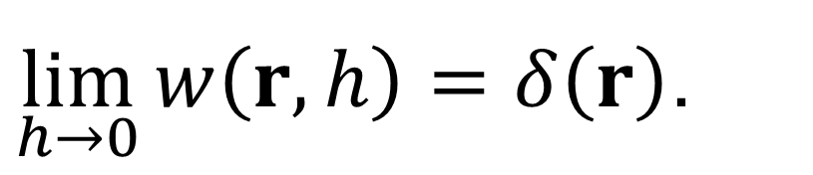
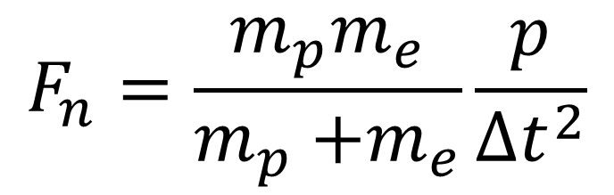
SPHCOFEM: Solver for coupling SPH and FE
Luděk Hynčík
New Technologies – Research Centre, University of West Bohemia
7th WACBE World Congress on Bioengineering 2015
6 – 8 July 2015, Singapore
Paper ID 13
Motivation
Modelling of fluid flow is extremely important in many technical fields including energetics or automotive, but also in many fields of public interest such as biomechanics, bioengineering and clinical applications. Virtual prototyping approach is a standard way to design final products.
Method
The base of the smoothed particle hydrodynamics (SPH) is interpolation theory using kernel defined as
The kernel estimate of physical field value A(r) is defined by
considering values of physical field A(r) known on a set of N discrete points given by position vectors and masses. The equations of motion (EOM) together with the equation of state (EOS) form the system to be solved:
SPH depends on fast techniques for finding the neighboring particles that contributes to the summations. Nearest neighbor search (NNS) is also the main issue related to the complexity and time use of the SPH calculation and concerns:
To assess all pairs of particles (N²).
To compose particles into sub-sets (subs).
The Lagrange’s equations are used to develop EOM for the boundary elements based on the finite element method (FEM).
The contact between SPH and FE concerns penalty method and automatic force calculation. The stable time step scheme taking into account the Courant-Friedrichs-Lewy conditions for SPH and stability condition for FEM is applied:
X-SPH with the constant $ε$ between 0 and 1 improves the quality of results:
Both EOM for SPH and FE are implemented using C++ and MATLAB to the single SPHCOFEM algorithm:
SPH: the central acceleration method
FE: conjugate gradient method
The code and the validation
There is a structured input text file describing the task to be investigated by the code. Due to the pre- and post-processor developed as GUI in MATLAB, the M-file can be used to design the structure is also defined.
Shock tube
Stationary gas divided by diaphragm into two regions
Initial pressures and densities
Broken dam
Free surface flow
Sensitivity analysis
Crashing ball
Full 3D problem
$\lim_{h→0}{w\left(r,h\right)=δ\left(r\right)}$.
$$〈A\left(r\right)〉=\int{A\left(r′\right)}w\left(r−r^{′}, h\right)dr^{′}≅\sum_{j=1}^{N}{\frac{m_{j}}{ρ_{j}\left(r_{j}\right)}A\left(r_{j}\right)}w\left(r−r_{j}, h\right)$$
Results
SPHCOFEM investigating the problems of fluid flow and its interaction with deformable boundaries was developed.
The core of the package in C++ is the Lagrangean method for fluid flow simulation by SPH that is coupled to boundary FE via continuous contact model.
MATLAB is used for pre- and post-processing.
The presented algorithm is implemented as in-house software for fluid flow in 1D, 2D or 3D.
$$\frac{dv_{i}}{dt}=−\sum_{j=1}^{N}{m_{j}\left(\frac{p_{j}}{ρ_{j}^{2}}+\frac{p_{i}}{ρ_{i}^{2}}+Π_{ij}\right)}∇w_{ij},$$
$$∆p=f\left(ρ{,ρ}_{0},u,γ,κ\right)$$
$$\frac{dρ_{i}}{dt}=−\sum_{j=1}^{N}{m_{j}\left(v_{i}−v_{j}\right)}∇w_{ij}, \frac{du_{i}}{dt}=−\sum_{j=1}^{N}{m_{j}\frac{p_{j}}{ρ_{j}^{2}}\left(v_{i}−v_{j}\right)}∇w_{ij}$$
$$\frac{d}{dt}\left(\frac{∂L}{∂{\dot{q}}_{i}}\right)−\frac{∂L}{∂{\dot{q}}_{i}}=Q$$
$$M\ddot{q}+B\dot{q}+Kq=Q$$
GUI is developed for reading the input file in the text format defined by keywords. The study shows both advantages and disadvantages using SPH coupled to FE and its exploitation for real engineering problems.
Model | Particles | Variant | NNS | Time [s]
Coarse | 19 x 19 | SPH | N² | 1.34
 |  | SPH | Subs | 1.32
 |  | X-SPH | N² | 5.40
 |  | X-SPH | Subs | 5.33
Fine | 57 x 57 | SPH | N² | 80.65
 |  | SPH | Subs | 56.00
 |  | X-SPH | N² | 779.04
 |  | X-SPH | Subs | 754.14
Very fine | 114 x 114 | SPH | N² | 1 850.75
 |  | SPH | Subs | 974.21
Complex | 228 x 228 | SPH | N² | 79 243.73
 |  | SPH | Subs | 14 290.08
$$∆t≤\min_{FE,SPH}\left\{k_{stab}\min_{FE}{\frac{L_{k}}{c_{k}}}, \frac{h_{j}}{c_{j}+0.6\left(αc_{j}+βμ_{j}\right)}\right\}$$
$$F_{n}=\frac{m_{p}m_{e}}{m_{p}{+m}_{e}}\frac{p}{∆t^{2}}$$
Acknowledgments
The work is co-financed by the project SGS-2013-026 “Development of biomechanical models for medicine”.
University of West Bohemia
New Technologies – Research Centre
Univerzitní 8, 306 14 Plzeň, Czech Republic
Tel.: +420 377 63 4701, fax: +420 377 63 4702
ntc@ntc.zcu.cz, ntc.zcu.cz
HUMAN BODY MODELLING AND MONITORING
Assoc. Prof. Luděk Hynčík, Ph.D. | hyncik@ntc.zcu.cz | Tel.: +420 377 634 709

