Slide 1

SPI BOF
Bdale Garbee
president@spi-inc.org
Andrew McMillan

Slide 2
Agenda
Board members and officers
A brief overview and history of SPI
Associated projects
Financial status
Q&A

Slide 3
Board Members and Officers
Bdale Garbee, President
Joerg Jaspert, Vice President
Jonathan McDowell, Secretary
Michael Schultheiss, Treasurer
Clint Adams
Robert Brockway
Joshua D. Drake
Jimmy Kaplowitz
Martin Zobel-Helas

Slide 4
What is SPI?
Software in the Public Interest
SPI is a non-profit organization which was founded to help organizations develop and distribute open hardware and software.
The organization that holds Debian funds in the USA and other assets like trademarks, domain names, and the copyright to the Debian logo

Slide 5
A Brief History of SPI
Incorporated 16 June 1997 as a non-profit organization in the state of New York
In 1999 the US Internal Revenue Service determined that SPI qualifies for 501(c)3 tax status, which means contributions from donors in the USA may be tax deductible
While originally started to serve a Debian need, SPI was crafted and has grown to serve many significant free software projects

Slide 6


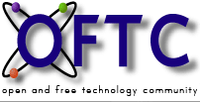












Privoxy

Slide 7






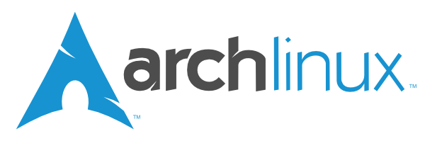
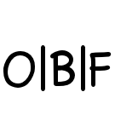










PATH64

Slide 8
Recent Activities
SPI has selected a new book keeping firm to handle our increasing transaction flow
We just made our first-ever financial grant, $10k US to support the Software Freedom Conservancy project developing Free Software for book keeping and accounting processes in non-profit organizations

Slide 9
Financial Status
Reserves held in trust
0 A.D. Earmark 140.58
ankur.org.in 1,000.00
aptosid Earmark 181.06
Arch Linux Earmark 10,567.97
Debian Earmark 107,618.94
DebConf 13 Earmark 56,492.18
Drizzle 4,311.30
FFmpeg 656.39
Fluxbox 995.00
Freedesktop.org Earmark 18,334.67
FreedomBox Foundation Earmark 24,420.13
Gallery Earmark 8,161.26
GNU TeXmacs Earmark 274.02
Haskell Earmark 16,070.61
Jenkins Earmark 9,938.91
LibreOffice Earmark 69,333.39
madwifi-project.org Earmark 1,494.90
MinGW Earmark 545.65
OpenVAS 56.21
OpenWrt 3,061.51
Open Bioinformatics Earmark 37,556.78
Open Voting Foundation Earmark 158.74
OSUNIX 2.92
Path64 14.40
Plan 9 Earmark 6,500.00
PostgreSQL Earmark 23,023.54
Privoxy Earmark 796.77
The HeliOS Project Earmark 22.54
TideSDK Earmark 230.91
Tux4Kids Earmark 16,277.50
YafaRay Earmark 4,884.73
Total held in trust 423,123.51
General reserves 56,565.51
Total Equity 479,689.02

Slide 10
SPI Membership
Anyone who agrees with the principles of SPI is eligible & encouraged to apply for membership!
Those who participate actively in the free software community may apply for contributing membership, which includes the right to vote
http://www.spi-inc.org/about-spi/membership

Slide 11
Getting Involved
All board meetings are held on an open IRC channel, #spi on irc.oftc.net
Discussions are held on several mailing lists, see lists.spi-inc.org for more information
Take advantage of having several current board members and officers present at Debconf to discuss topics with us in person!

Slide 12
Questions?

