Slide 1


Slide 2
Mansour Imam
Shiraj Pokharel
Carrington Seawright
Sayed Hossein Saghaeiannejad Esfahani
John Bent

Slide 3
INTRODUCTION
Airline Reservation System
Customers reserve flights
Employees manage flights
Single airline / single terminal
Home screen shows status of terminal
Collects and stores customer information required by regulations
Intuitive for new customers

Slide 4
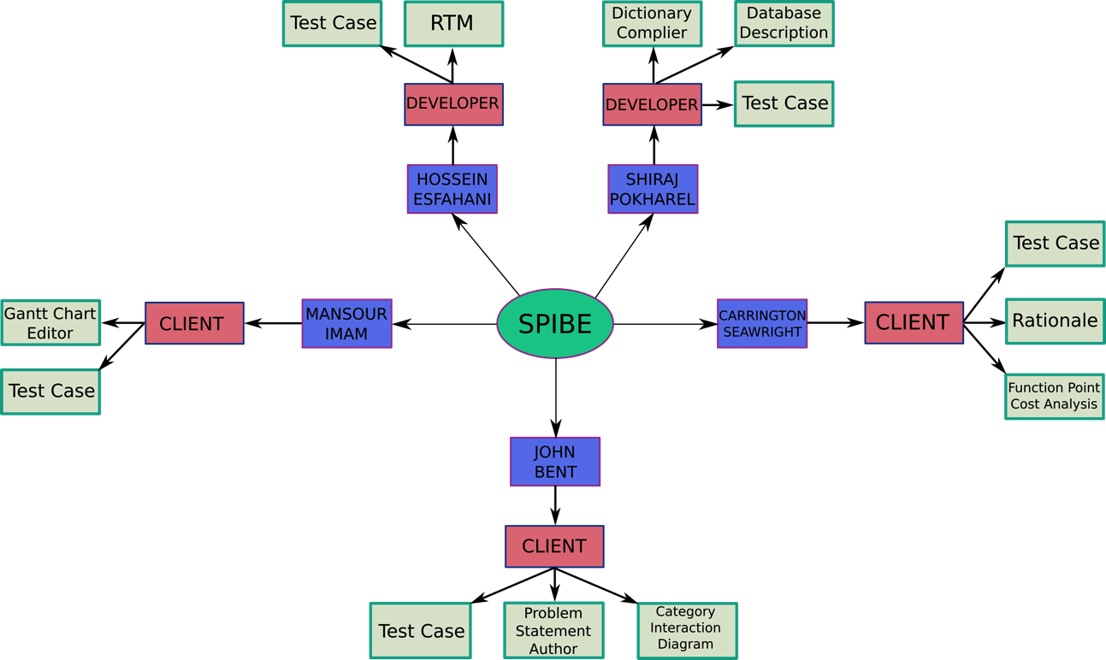

Slide 5
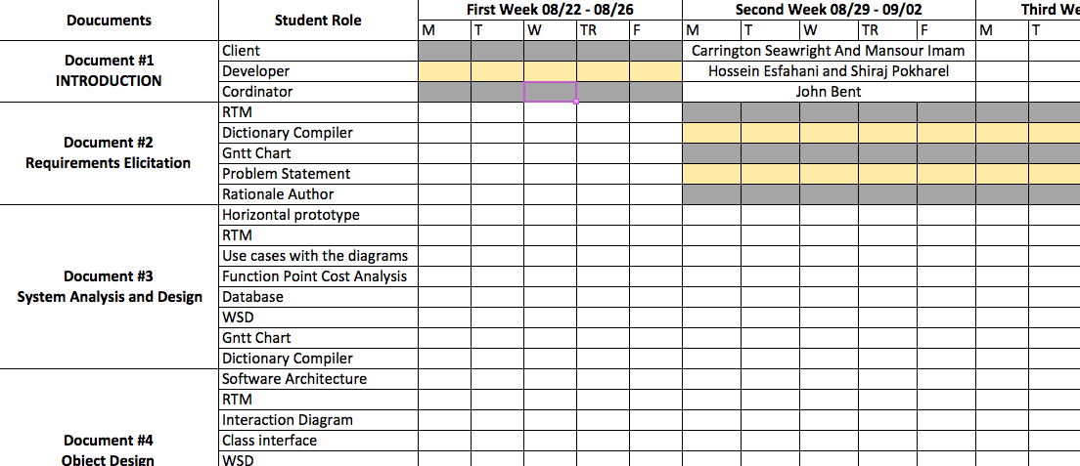
GANTT CHART

Slide 6
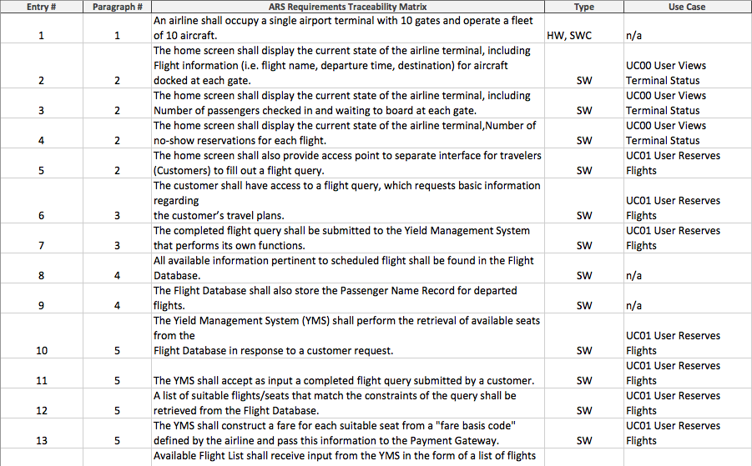
RTM

Slide 8
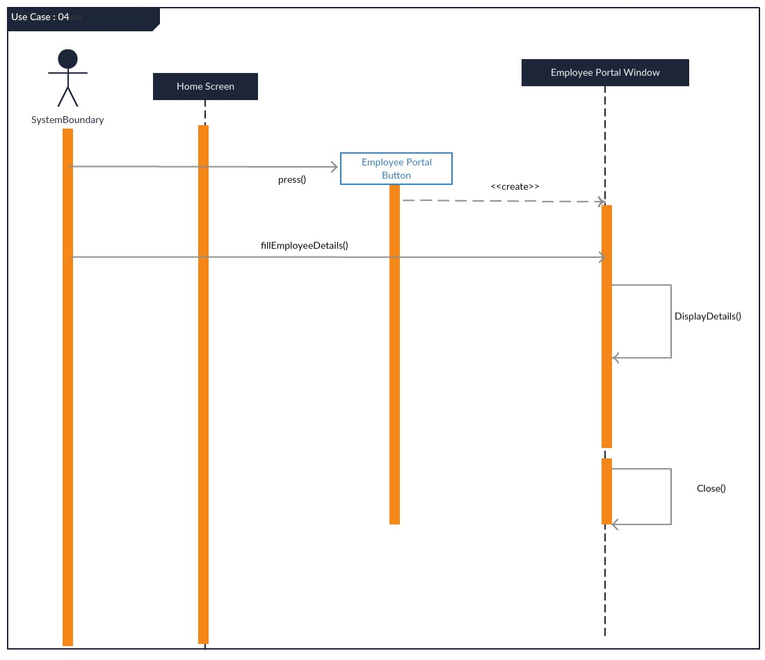

Slide 9
USE CASES / INTERACTION DIAGRAMS
Implementation ultimately different than initial use cases and interaction diagrams, but…
Use cases helped to bridge gap between requirements and system component design
In creating use cases, we began making decisions about how the details of the system would come together
Interaction diagrams aided in designing the flow of software
Without use cases and interaction diagrams, the system would have been less modular

Slide 10
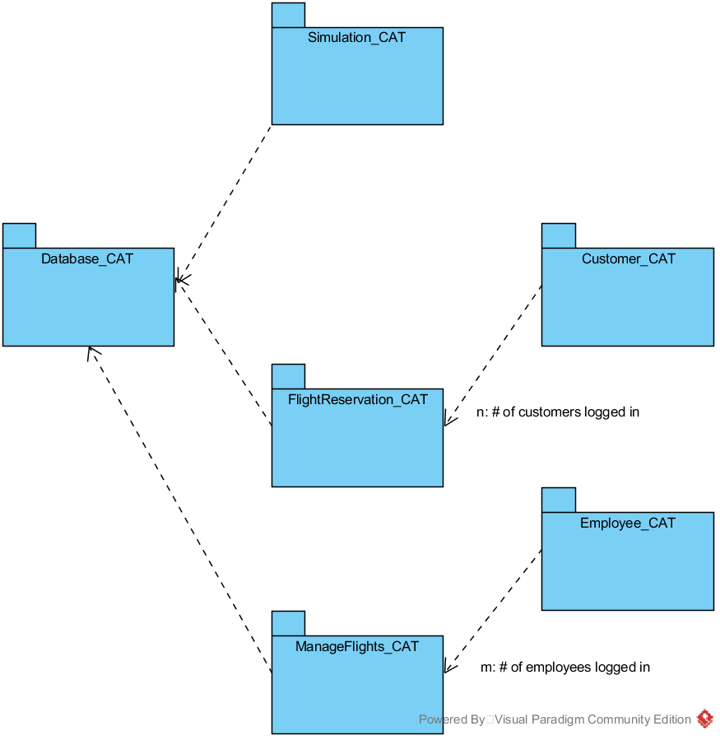
Category Interaction Diagram

Slide 11
Database
Java ArrayList to store Flight objects
Passenger list for each Flight
Text files used for more constant data
Destination cities
Aircraft in the airline’s fleet
If the performance drops upon scaling, we will switch to SQL Lite for storing flight data

Slide 13
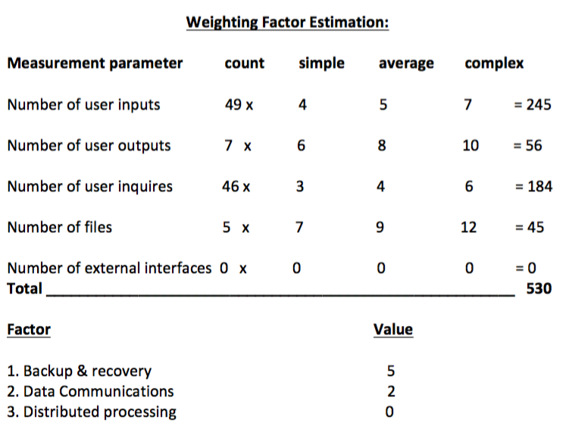
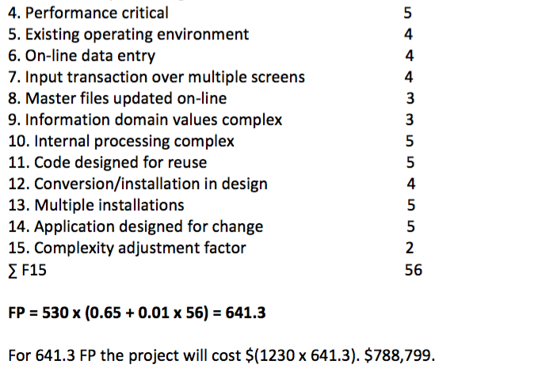
FP COST ANALYSIS

Slide 14
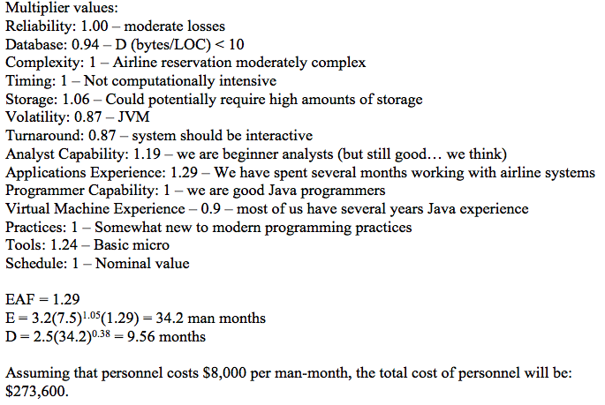
COCOMO

Slide 15
Cost Analysis
Function Point: $788,799.00
COCOMO: $273,600.00
Would lean toward the higher value
Large software projects tend to go over budget
Possibly choose some value between the two
… or use a different cost model like COCOMO II
Uses FP as input to constructive cost model

Slide 16
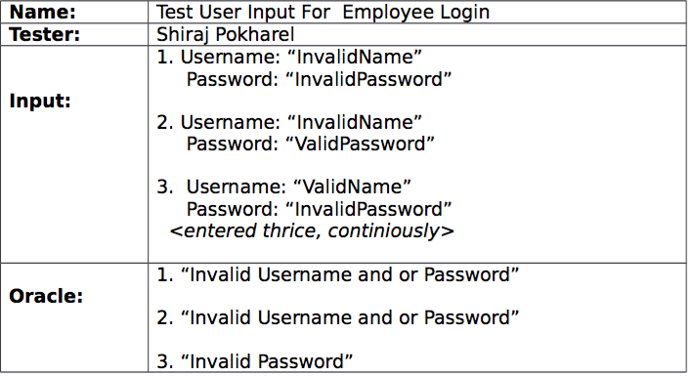
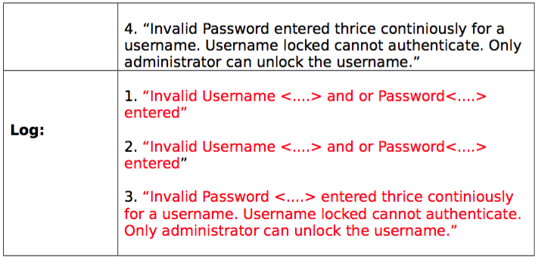
TEST CASES

Slide 17
DEMO

