Slide 1



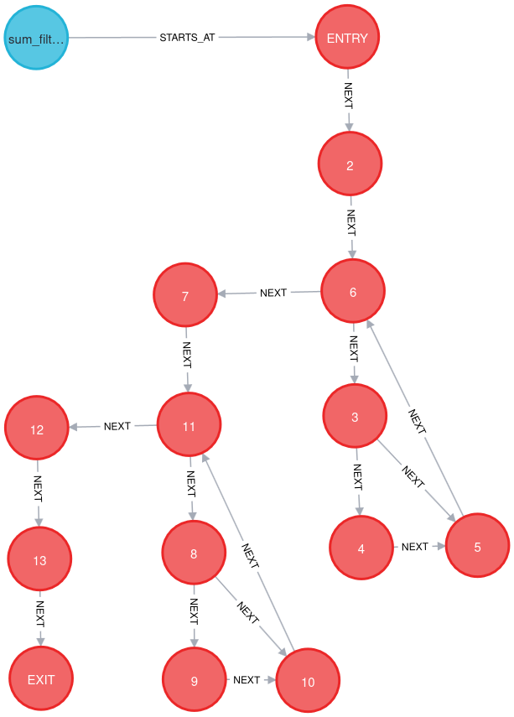
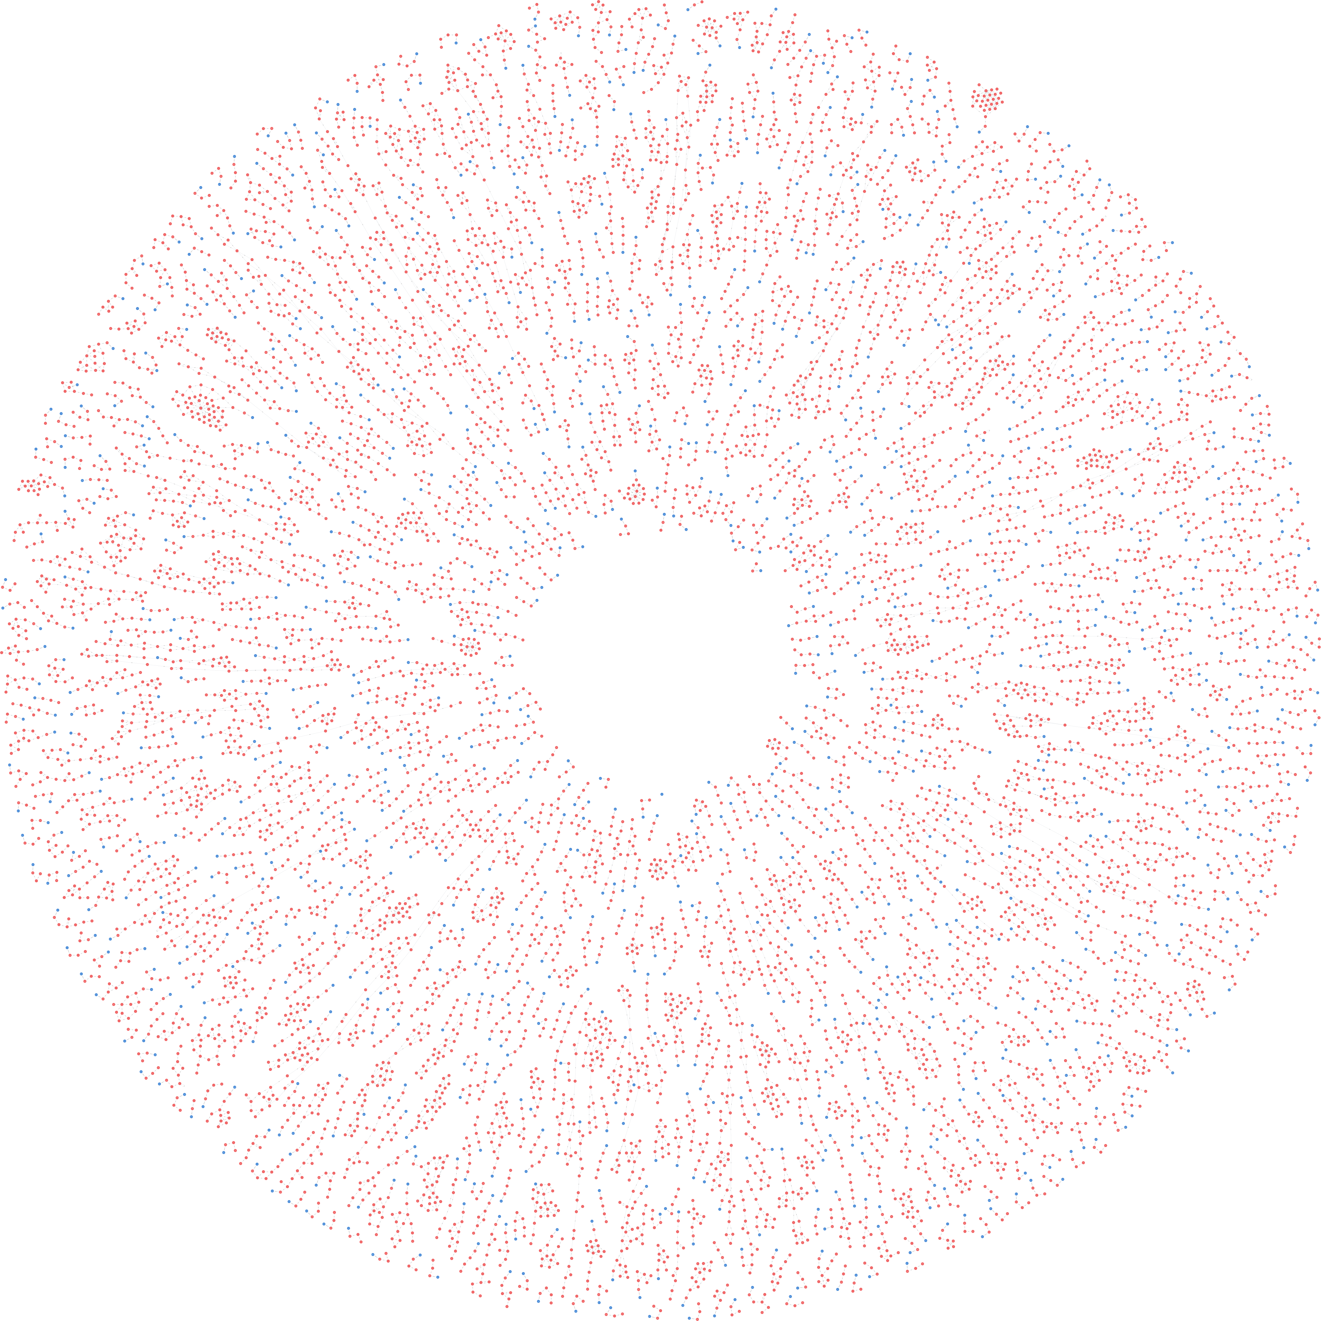

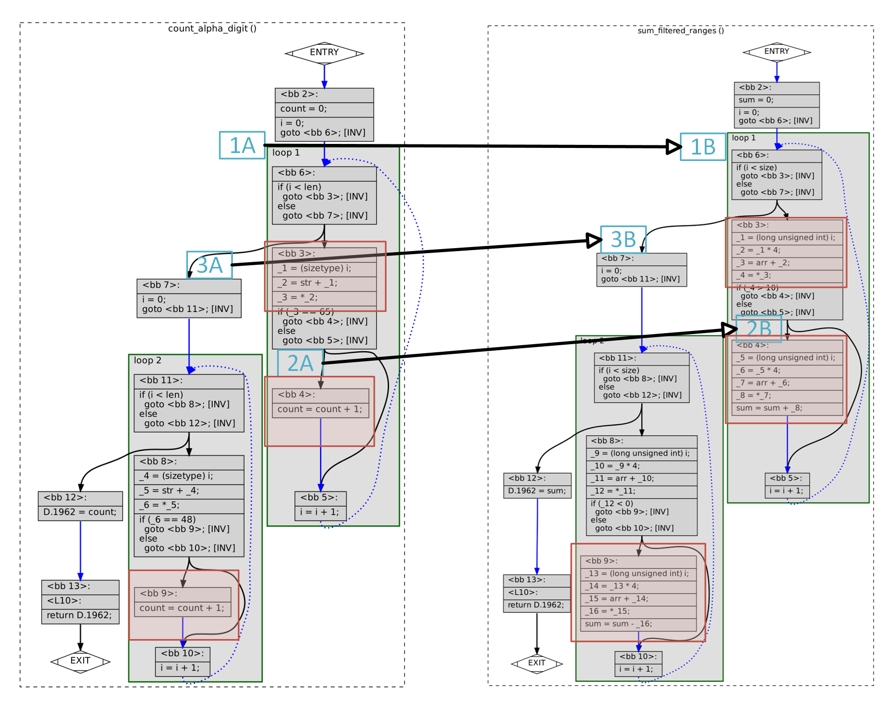
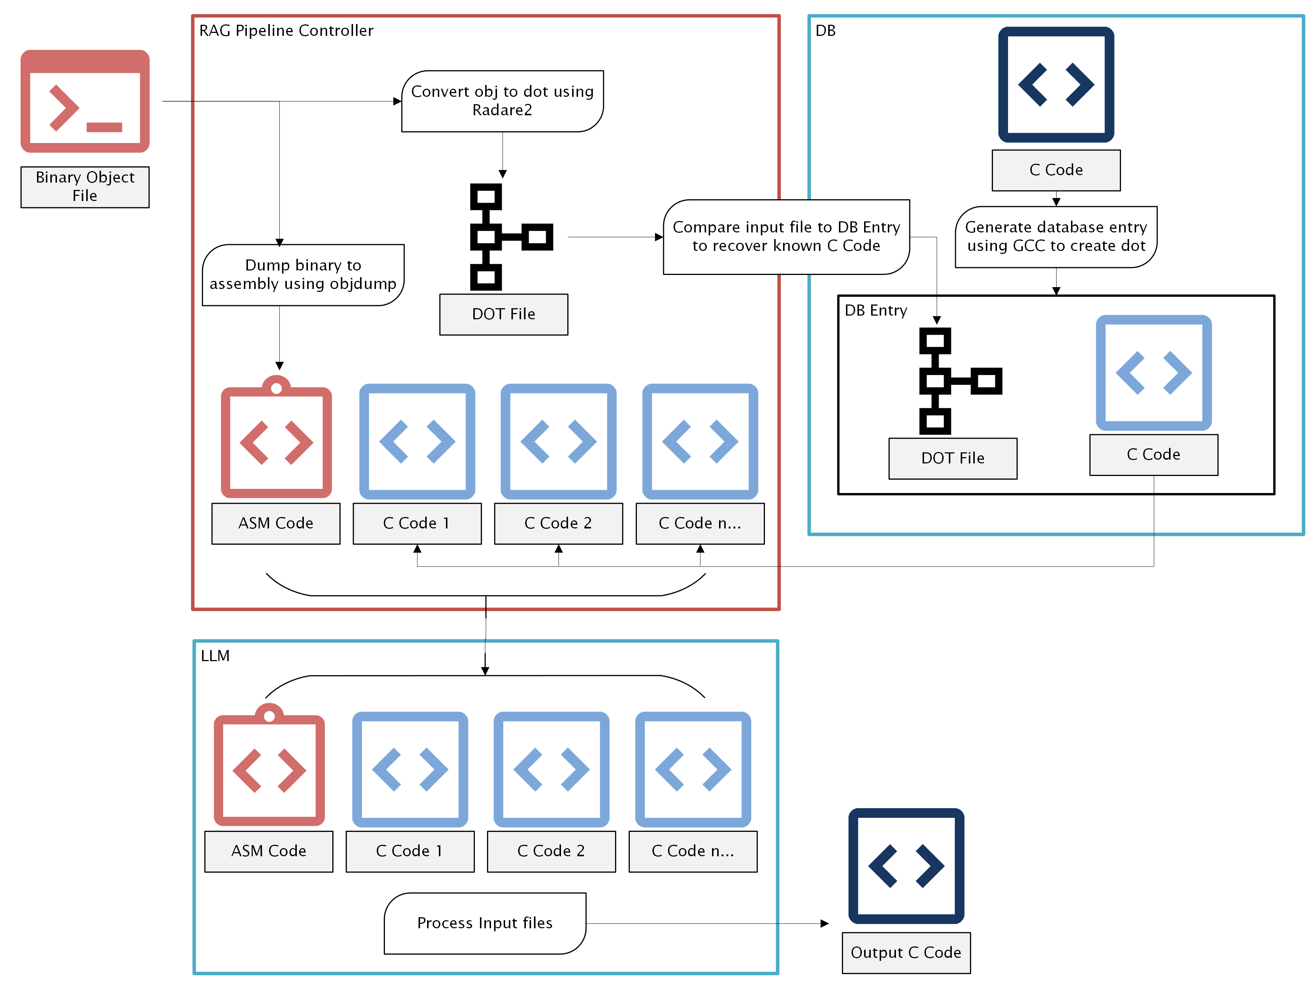
GleNN: Large Language Models for Static Reverse Engineering
Craig Kimball | Justin Rockwell | Max Bedewi | Mack Bartsch | Bisesh Acharya
ckimbal4@gmu.edu, jrockwe@gmu.edu, mbedewi2@gmu.edu, mbartsch@gmu.edu, bachary@gmu.edu
Cybersecurity Engineering | George Mason University
RESEARCH QUESTION/
HYPOTHESIS
Can the integration of a retrieval-augmented generation (RAG) pipeline improve the precision and completeness of LLM-based static reverse engineering when applied to obfuscated or optimized binaries?
ABSTRACT
Static reverse engineering enables malware analysis without executing potentially harmful code. While tools like Ghidra are widely used for this purpose, they struggle with highly optimized or obfuscated binaries. Manual analysis, though more accurate, is slow, resource-intensive, and dependent on expert knowledge. GleNN (Graph-Language Enhanced Neural Network) is our proposed solution to this challenge: a retrieval-augmented generation (RAG) pipeline that supplements a large language model (LLM) with contextual code retrieved from a Neo4j graph database. By incorporating control-flow graph (CFG) structure and semantically similar C functions, GleNN produces more complete and accurate de-compilations while reducing the burden on analysts.
INTRODUCTION
Reverse engineering obfuscated or optimized binaries is a critical challenge in cybersecurity. While automated tools like Ghidra are fast, they often fail to recover meaningful structure under code transformations. Manual methods are accurate but unscalable. GleNN enhances static decompilation by combining large language models with contextual retrieval. Building on LLM4Decompile, our approach introduces a Neo4j-based retrieval layer that identifies structurally similar control-flow graphs (.dot) and uses their associated C code to guide the model’s generation, improving output quality in difficult cases.
METHODOLOGY
Our approach is composed of four key components:
CFG Embedding & Database Storage: C files from ExeBench database are used to create CFG/.dot files that are parsed to extract the structure (nodes, edges, loops, decision points). Each graph is assigned a CodeBERT embedding and stored in a Neo4j database alongside the original C and assembly code.
Build the Retrieval-Augmented Generation (RAG): A user begins with an object binary file. The pipeline creates a dot file and assembly file to query the Neo4j graph database. This happens in two phases where the first pass uses vector-based embedding similarity search, and the second refines based on graph edit distance (GED).
LLM Inference: The original assembly file and the top retrieved C code examples are passed into a language model. These context-rich prompts allow the model to generate a more accurate final C representation. The result is evaluated based on format, syntax, and recompilability.
Neo4j Function Graph: An individual function, parsed into basic blocks and control structures, as represented and queried in the Neo4j graph database. Shows how the database focuses on a functions structure.
RESULTS
Our Neo4j graph database includes over 25,000 unique C functions, each indexed with structural metadata and embeddings. Testing was conducted on over 1,500 object files, using re-executability, syntax accuracy, and token-level matching as evaluation criteria.
GleNN achieved a 99.41% re-executability rate, compared to 63.4% from LLM4Decompile
CFGs with fewer nodes (<12) consistently showed higher fidelity in reconstruction, while large and deeply nested CFGs showed diminishing returns.
Manual review revealed that context quality significantly impacted LLM performance, with irrelevant or overly generic samples leading to hallucinated or incorrect outputs.
Models | Re-compliable | Re-executable
 |  | Compiles as Executable | Executes | Does Not Compile
LLM4Decompile | 63.8% | -- | 63.4% | --
LLM Baseline | 81.3% | 63.69% | 86.97% | 36.31%
LLM with RAG | 74.2% | 85.87% | 99.41% | 14.12%
CFG Comparison: Two structurally identical control-flow graphs (DOT format) showing the similarity of the input function (Left) to the found most structurally similar Neo4j database entry (Right). Highlighting the ability of structural comparison to identify nodes, edges, loops, and decisions.
ACKNOWLEDGEMENTS
We gratefully acknowledge Dr. Henry Coffman for his guidance, Dr. Tanvir Arafin for his technical insight, and the George Mason University CYSE Department for their continued support and resources.
CONCLUSIONS
Our results show that GleNN can improve the quality of decompilation over baseline LLM models by incorporating structurally similar context through a retrieval-augmented generation pipeline. While the improvement is incremental rather than dramatic, it demonstrates the potential of combining graph-based retrieval with LLM prompting strategies. Future work can explore optimizing code retrieval techniques, refining prompt engineering, and experimenting with alternative LLM architectures to further boost performance.
REFERENCES:
[1] H. Tan. “LLM4Decompile.” GitHub. Accessed: April 10, 2025. [Online.] Available: https://github.com/albertan017/LLM4Decompile
[2] J. Avigad, M. Heule, and W. Nawrocki. “Using SMT solvers.” Logical and Mathematical Reasoning. Accessed: Apr. 10, 2025. [Online]. Available: https://avigad.github.io/lamr/using_smt_solvers.html
[3] D. Gao, M. K. Reiter, and D. Song, “BinHunt: Automatically finding semantic differences in binary programs,” in Proc. Int. Conf. Information and Communications Security (ICICS), 2008, pp. 238–255, doi: 10.1007/978-3-540-88625-9_16.
[4] “Ghidra.” GitHub. Accessed: April 10, 2025. [Online.] Available: https://github.com/NationalSecurityAgency/ghidra
[5] “NVIDIA Deep Learning Institute.” Nvidia. Accessed: April 10, 2025. [Online.] Available: https://www.nvidia.com/en-us/deep-learning-ai/education/
End-to-End Pipeline: GleNN’s RAG-enhanced workflow: binary input → assembly conversion → .dot CFG extraction → similarity search in Neo4j → LLM decompilation with retrieved context.

