Slide 1
Welcome!
Intro myself
This study aims to understand how designers use AI-powered UI design tools (e.g., Figma Make) to create user interfaces.
What we’ll do:
Ask brief questions about your UI design background.
Give you three design tasks to complete in Figma Make.
Ask follow-up questions about your use of Figma Make.
Complete the follow-up tasks after the interview.

Slide 2
Welcome!
We will protect your privacy.
We will record this session.
We will not evaluate your design - only how AI-powered UI tools support UI development.
Feel free to ask questions at any time.

Slide 3
UI Design Background

Slide 4
Design Tasks
Please imagine you are asked to design several UIs, and complete the following three UI design tasks in Figma Make.
While you design, you may consider:
What prompts would you use?
How would you customize the prompts?
What content should be mentioned in the prompts?
Reminder: There’s no right or wrong, no need to be perfect.

Slide 5
Figma Make
Please use this account to access Figma Make
Website: https://www.figma.com/make/
Account:
Password:

Slide 6
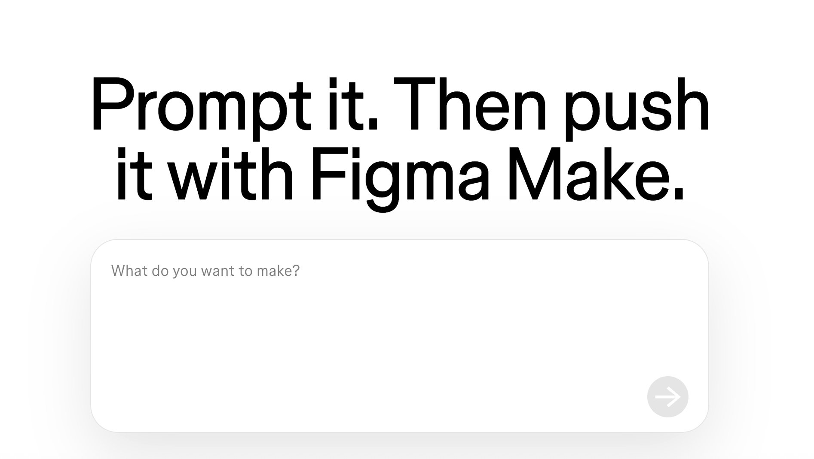
How to use figma Make
Click and Figma Make will generate the UIs
Prompts are entered here

Slide 7
UI Design Tasks
Randomly select 2 design tasks

Slide 8
Design Tasks
Please design a cookie consent banner for a website. When users first visit this website, the banner will ask whether they agree to the storage and use of cookies.
Please design an ads personalization settings interface for a website (or app) that allows users to adjust whether their personal data could be used for personalized advertising or not.
Please design an account deletion function for a website (or app). When users choose this function, the flow will allow them to permanently remove their account and all associated personal information from the service.
Please design a sign-up with email subscription option for a website (or app). When users first register, they should be able to create an account while opting in/out to receive marketing and promotional emails (such as newsletters and discount offers).

Slide 9
Design Tasks
5. Please design an unsubscribe page for a website that allows users to opt in/out of receiving newsletters or marketing emails.
6. Please design a privacy policy consent interface for a website (or app). When users first access the website (or app), the interface will require them to read and agree to its privacy policy before continuing to use it.
7. Please design a user data access request function for a website (or app). When users initiate this function, it will let them request and receive a copy of the personal data the website (or app) has collected about them.
8. Please design a permission redirect UI for an app. The interface will guide users to the system settings for them to grant system permissions such as location and notification.

Slide 10
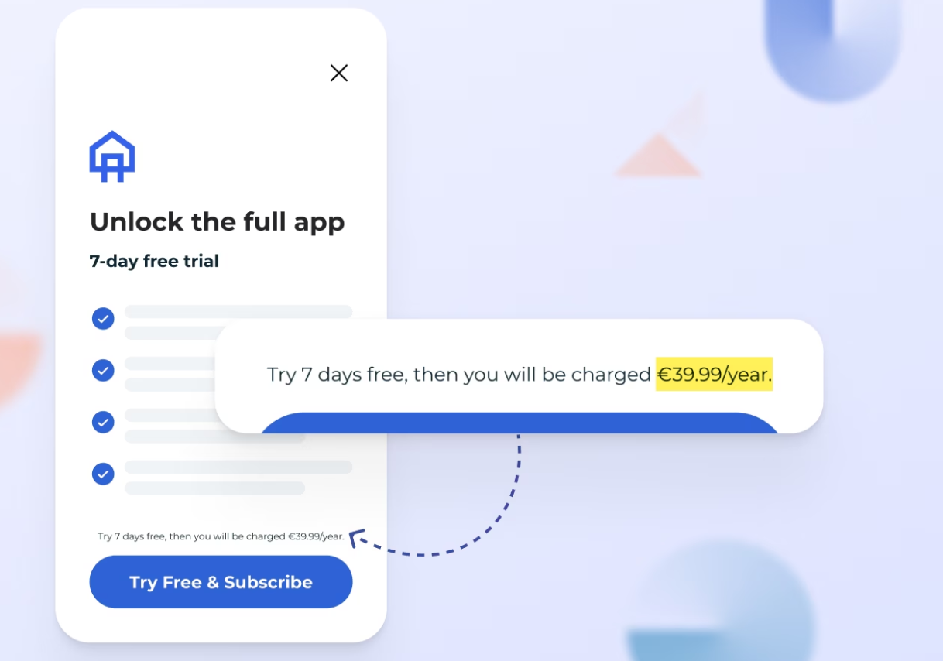
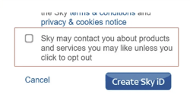
Dark Pattern
Dark patterns are used in websites and apps that make you do things that you didn't intend to, like buying or signing up for something.

Slide 11
Thank you very much for your participation. We have a few additional UI design tasks for which we’d like to collect your feedback. Could you please review these tasks after the study and share your prompts through the following survey? There’s no need for a Zoom meeting - you only need to fill in your prompts in the survey.
link

