Slide 1

Chapter 4.
Microsoft Language Integrated Query
Do Thi Ngoc Quynh
HaNoi University of Technology
Notes:
3. Data Types
2008
© 2008 Microsoft

Slide 2
Objectives
“ This chapter provides an introduction about Language Integrated Query (LINQ) which is a new feature of .NET framework 3.5. It is a Microsoft .NET Framework component that adds native data querying capabilities to .NET languages using a syntax reminiscent of SQL”
Notes:
3. Data Types
2008
© 2008 Microsoft

Slide 3
Agenda
Introduction LINQ
C# and VB.NET language enhancements
LINQ building blocks
Querying objects in memory
Querying relational data
Manipulating XML
Extending LINQ
A look to future

Slide 4
Part 1
Introduction LINQ…

Slide 5





Introduction
XML
Code
Data
Database
Software
File
Whatever language you end up with, at some point you
will have to deal with data

Slide 6
Introduction
Given that dealing with data is such a common task for developers
We would expect rich software development platforms like the .NET Framework to provide an easy way to do it
.NET does provide wide support for working with data
However, that something had yet to be achieved: deeper language and data integration
This is where LINQ to Objects, LINQ to XML, and LINQ to SQL fit in

Slide 7
What is LINQ?
With LINQ, Microsoft’s intention was to provide a solution for the problem of object-relational mapping
LINQ eventually evolved into a general-purpose language-integrated querying toolset
This toolset can be used to access data coming from:
  in-memory objects (LINQ to Objects)
  databases (LINQ to SQL)
  XML documents (LINQ to XML)
  a file-system, or any other source

Slide 8
Overview
LINQ means Language-INtegrated Query:
  Integrates queries directly within .NET languages such as C# and Visual Basic through a set of extensions to these languages
LINQ is a toolset that:
  Can be used to work with objects, XML documents, relational databases, or other kinds of data

Slide 9
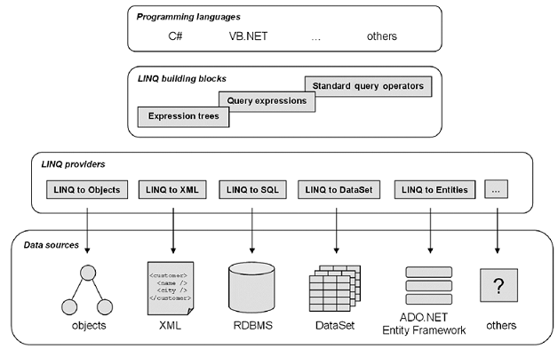
LINQ as a toolset (1)

Slide 10
LINQ as a toolset (2)
LINQ providers:
  LINQ to Objects
  LINQ to SQL
  LINQ to XML
These three LINQ providers form a family of tools that can be used separately for particular needs or combined for powerful solutions

Slide 11
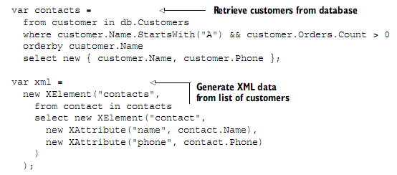
LINQ as language extensions (1)
Example: Uses LINQ query a database and create an XML document (C#)

Slide 12
LINQ as language extensions (2)
Imagine how you would do the same without LINQ, and you’ll realize how things are easier and more natural with LINQ
With the from, where, orderby, and select key- words in the listing, it’s obvious that C# has been extended to enable language-integrated queries

Slide 13
LINQ as language extensions (3)
LINQ provides a common querying architecture across programming languages
It works with C# 3.0 and VB.NET 9.0 (also known as VB 2008), and as such requires dedicated compilers, but it can be ported to other .NET languages
LINQ is not a new language, It is integrated into C# and VB.NET

Slide 14
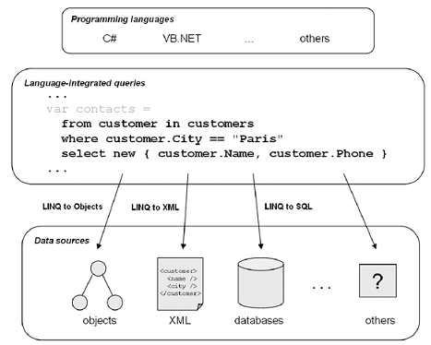
LINQ as language extensions and as a gateway to several data sources

Slide 15
The goals of the LINQ project
  Integrate objects, relational data, and XML
  SQL and XQuery-like power in C# and VB
  Extensibility model for languages
  Extensibility model for multiple data sources
  Type safety
  Extensive IntelliSense support (enabled by strong-typing)
  Debugger support
  Build on the foundations laid in C# 1.0 and 2.0, VB.NET 7.0 and 8.0
  Run on the .NET 2.0 CLR
  Remain 100% backward compatible

Slide 16
Why do we need LINQ?
What makes the previous tools inconvenient?
Why do we want a tool like LINQ?
Was LINQ created only to make working with programming languages,
relational data, and XML at the same time more convenient?

Slide 17
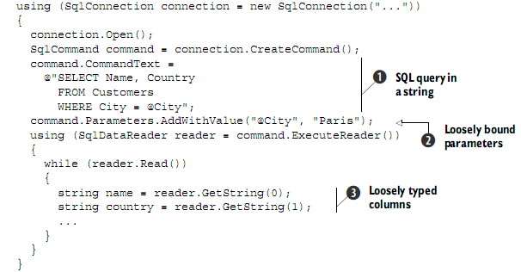
Why do we need LINQ?
Typical .NET data-access code

Slide 18
Why do we need LINQ?
Several limitations of the model:
  Although we want to perform a simple task, several steps and verbose code are required
  What if the string does not contain a valid SQL query? What if a column has been renamed in the database?
  The parameters for the dataset :
      Are the columns of the type we expect?
      are we sure we’re using the correct number of parameters?
      Are the names of the parameters in sync between the query and the parameter declarations?
  The classes we use are dedicated to SQL Server and cannot be used with another database server

Slide 19
Why do we need LINQ?
LINQ removes many of the barriers among objects, databases, and XML
It enables us to work with each of these paradigms using the same language-integrated facilities
For example, we are able to work with XML data and data coming from a relational database within the same query

Slide 20
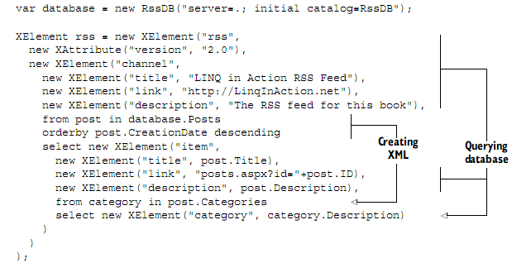
Working with relational data and XML in the same query

Slide 21
Part 2
C# and VB.NET language enhancements …
“ In this chapter, we’ll present the language extensions that make LINQ possible and allow queries to blend into programming languages “

Slide 22
Discovering the new language enhancements
Implicitly typed local variables:
  which permit the types of local variables to be inferred from the expressions used to initialize them
Object initializers:
  which ease construction and initialization of objects
Lambda expressions:
  provides improved type inference and conversion to both delegate types and expression trees

Slide 23
Discovering the new language enhancements
Extension methods:
  which make it possible to extend existing types and constructed types with additional methods.
Anonymous types:
  which are types automatically inferred and created from object initializers

Slide 24
Implicitly typed local variables – C#
var i = 5;
Implicitly typed variables
The traditional syntax
var i = 12;
var s = "Hello";
var d = 1.0;
var numbers = new[] {1, 2, 3};
var process = new ProcessData();
var processes =
new Dictionary<int, ProcessData>();
int i = 12;
string s = "Hello";
double d = 1.0;
int[] numbers = new int[] {1, 2, 3};
ProcessData process = new ProcessData();
Dictionary<int, ProcessData> processes =
new Dictionary<int, ProcessData>();

Slide 25
Implicitly typed local variables – VB
Implicitly typed variables
The traditional syntax
Dim processes =
New List(Of ProcessData)()
Dim processes As List(Of ProcessData) =
New List(Of ProcessData)()

Slide 26
Object and collection initializers
In C#
In VB
var data = new ProcessData {Id = 123, Name = "MyProcess“, Memory = 123456};
Dim data = New ProcessData With {.Id = 123, .Name = "MyProcess",
.Memory = 123456}

Slide 27

Lambda expressions – C#
Structure of a lambda expression in C#:

Slide 28

Lambda expressions – VB
Structure of a lambda expression in VB:

Slide 29
Extension methods – C#
static Int64 TotalMemory(IEnumerable<ProcessData> processes)
{
Int64 result = 0;
foreach (var process in processes)
result += process.Memory;
return result;
}
static Int64 TotalMemory(this IEnumerable<ProcessData> processes)
{
Int64 result = 0;
foreach (var process in processes)
result += process.Memory;
return result;
}

Slide 30
Extension methods – VB
<System.Runtime.CompilerServices.Extension()>
Public Function TotalMemory(
ByVal processes As IEnumerable(Of ProcessData))
As Int64
Dim result As Int64 = 0
For Each process In processes
result += process.Memory
Next
Return Result
End Function

Slide 31
Anonymous types
Using a syntax similar to that of object initializers, we can create anonymous types
They are usually used to group data into an object without first declaring a new class
var contact = new { Name = "Bob", Age = 8 }

Slide 32
Part 3
LINQ building blocks…

Slide 33
How LINQ extends .NET?
Refresher on the language extensions
The key elements of the LINQ foundation

Slide 34
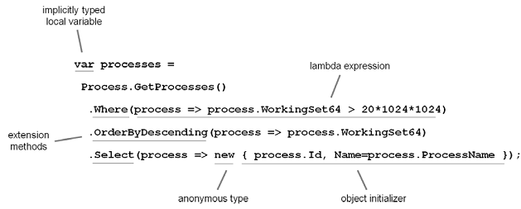
Refresher on the language extensions
The language extensions all in one picture

Slide 35
The key elements of the LINQ foundation
sequences
query expressions
query operators
deferred query execution
expression trees

Slide 36
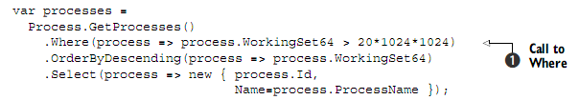
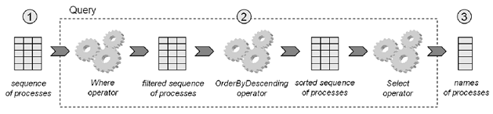
Introducing sequences and query operators
A LINQ query represented as a factory where query operators are machines and sequences are the material

Slide 37
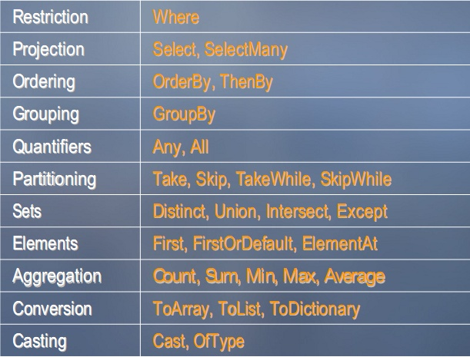
The standard query operators

Slide 38
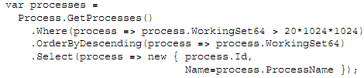

Introducing query expressions
Query operators are static methods that allow the expression of queries
You can use another syntax that makes LINQ queries resemble SQL queries => called a query expression or query syntax

Slide 39
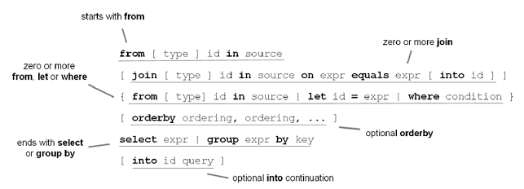
Query expressions – C# syntax

Slide 40
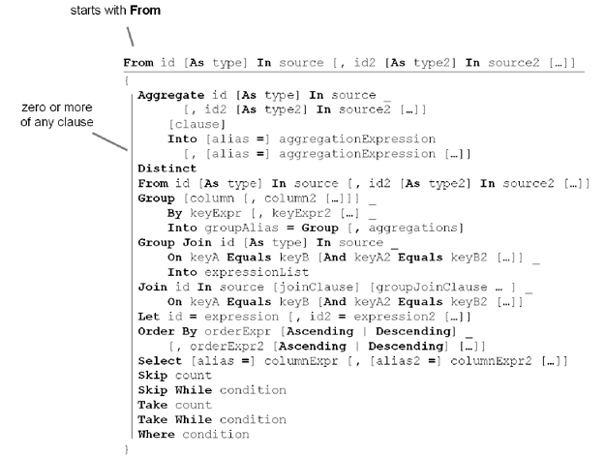
Query expressions – VB syntax

Slide 41


How the standard query operators relate to query expressions
You’ve seen that a translation happens when a query expression is compiled into calls to standard query operators
Query expression
Query operator

Slide 42
Mapping of standard query operators to query expression keywords by language
Page 101 – LINQ in Action

Slide 43
LINQ DLLs and namespaces
The classes and interfaces that you need to use LINQ in your applications come distributed in a set of assemblies (DLLs) provided with .NET 3.5
The main assembly you’ll use is System.Core.dll
In order to write LINQ to Objects queries, you’ll need to import the System.Linq namespace it contains
In order to work with LINQ to SQL or LINQ to XML, you have to use dedicated assemblies: respectively System.Data.Linq.dll or System.Xml.Linq.dll

Slide 44
An overview of the LINQ assemblies and namespaces, and their content
Page 110 – LINQ in Action

Slide 45
Part 4
Querying objects in memory …

Slide 46
Using LINQ with in-memory collections
LINQ to Objects is the flavor of LINQ that works with in-memory collections of objects
  What does this mean?
  What kinds of collections are supported by LINQ to Objects?
  What operations can we perform on these collections?

Slide 47
What can we query?
As you might guess, not everything can be queried using LINQ to Objects
The first criterion for applying LINQ queries is that the objects need to be collections
All that is required for a collection to be queryable through LINQ to Objects is that it implements the IEnumerable<T> interface

Slide 48
What can we query?
Objects implementing the IEnumerable<T> interface are called sequences in LINQ vocabulary
The good news is that almost every generic collection provided by the .NET Framework implements IEnumerable<T>!
This means that you’ll be able to query
the usual collections you were already working with in .NET 2.0

Slide 49
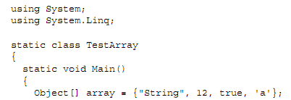
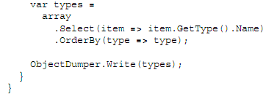
Review (1)
Arrays

Slide 50
Review (2)
Generic lists:
  System.Collections.Generic.List<T>
  System.Collections.Generic.LinkedList<T>
  System.Collections.Generic.Queue<T>
  System.Collections.Generic.Stack<T>
  System.Collections.Generic.HashSet<T>
  System.Collections.ObjectModel.Collection<T>
  System.ComponentModel.BindingList<T>

Slide 51
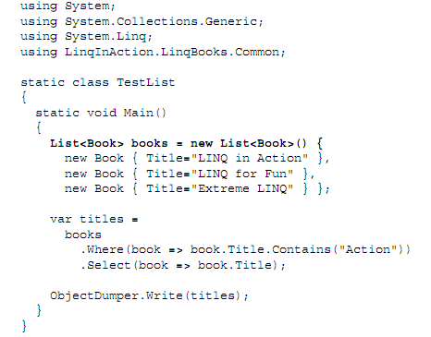
Example with generic lists

Slide 52
Review (3)
Generic dictionaries:
  System.Collections.Generic.Dictionary<TKey,TValue>
  System.Collections.Generic.SortedDictionary<TKey, TValue>
  System.Collections.Generic.SortedList<TKey, TValue>

Slide 53
Example with generic dictionaries

Slide 54

Review (4)
String

Slide 55
Using LINQ with ASP.NET and Windows Forms
Support for LINQ is built into .NET 3.5 and Visual Studio 2008, so creating applications that use LINQ is not different than creating other applications

Slide 56
Data binding for web applications
ASP.NET controls support data binding to any IEnumerable collection
This makes it easy to display the result of language-integrated queries using controls like GridView, DataList, and Repeater

Slide 57
DEMO

Slide 58
Data binding for Windows Forms applications
Using LINQ in a Windows Forms application isn’t more difficult than with ASP.NET in a web application

Slide 59

DEMO

Slide 60
Part 5
Querying relational data…

Slide 61
Why LINQ?
LINQ to SQL is better than ADO.NET because we don’t need to rewrite all of the repetitive plumbing code
LINQ to SQL is also able to reduce our network overhead by returning only the fields we need

Slide 62
Jump into LINQ to SQL
Example:
  We’re exploring ways to query our books to see those that cost less than $30 and group them by subject

Slide 63
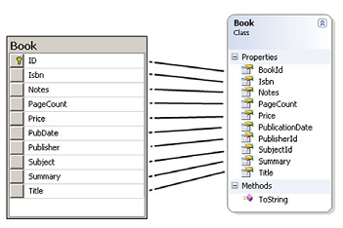
Setting up the object mapping (1)

Slide 64
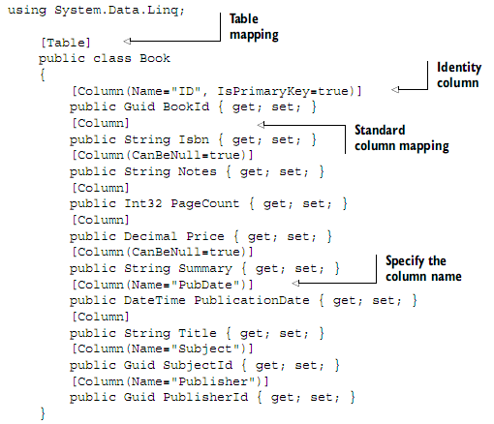
Setting up the object mapping (2)

Slide 65
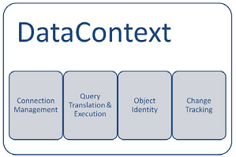
Setting up the DataContext
We instruct the DataContext about the connection string
The DataContext will handleopening and closing the connection for us

Slide 66

Reading data with LINQ to SQL
Fetch books using LINQ to SQL:
Fetch the list of book titles:

Slide 67
Refining our queries
How can we refine our queries using some of these additional server-side processes

Slide 68

Filtering
In our example, we want to see books that cost less than 30 dollars
Filtering using a range:

Slide 69

Sorting and grouping
The query expressions orderby and orderby…descending are designed to translate our sorting expression to the database
Sorting with LINQ to SQL:

Slide 70
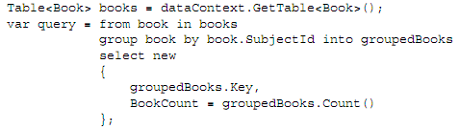
Aggregation
LINQ to SQL fully supports all of the standard aggregation methods that extend IEnumerable<T>
Thus, we can create a query to display the number of books that belong to each category
Including aggregates in the results:

Slide 71
Joining
Combing data from multiple tables is the heart and soul of relational databases
LINQ to SQL supports two syntaxes for joins:
  Syntax 1: Uses a comparison in the Where clause, which is similar to the ANSI-82 SQL syntax
  Syntax 2: The join syntax reminiscent of the ANSI-92 SQL syntax

Slide 72
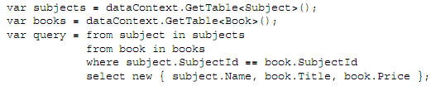
Syntax 1
We can get a reference to the Book and Subject table objects
Joining Books and Subjects:

Slide 73

Syntax 2
More than 15 years ago, the ANSI-92 standard replaced ANSI-82. Reverting to the older ANSI-82 syntax may appear unusual
Fortunately, LINQ also supports the join syntax reminiscent of the ANSI-92 SQL syntax
Joining with the Join keyword:

Slide 74
When is my data loaded and why does it matter?
When we fetch data from the database, LINQ to SQL utilizes a technique called deferred execution
With deferred execution, the results are only loaded into memory when they are requested
The SQL statements are not generated when we define the query
Instead, the database is not accessed until we actually request each record
Waiting to access the values until they are needed is called lazy loading

Slide 75

Lazy loading
When displaying results, lazy loading offers the benefit of only retrieving the data when we request it, and only returning the data we request
In many cases, this provides performance benefits, but in other cases it can lead to some unexpected results...

Slide 76
Loading details immediately
If all we want to do is fetch the results more than once, we can prefetch them and store them in an array or list using some extension methods :
  ToList
  ToDictionary
  ToLookup
  ToArray

Slide 77
Updating data
Updating the data is just as simple as fetching it
As long as we have a persistent DataContext object, we can make additions, alterations, and deletions using standard methods on the table objects
The DataContext keeps track of the changes and handles updating the database with a single method call

Slide 78
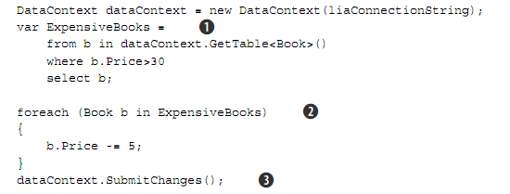
Updating values and committing them to the database

Slide 79
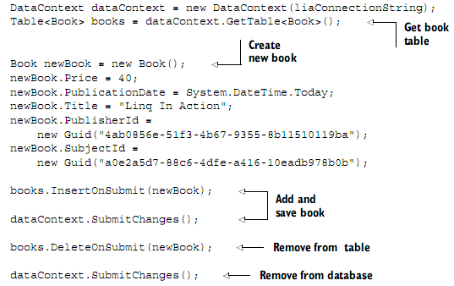
Adding and removing items from a table

Slide 80
Mapping objects to relational data
The full list of mapping options consists of:
  Attributes declared inline with your classes
  External XML files
  The command-line SqlMetal tool
  The graphical LINQ to SQL Designer tool
Homework: How to use these options?

Slide 81
Advanced database capabilities
SQL pass-through: Returning objects from SQL queries

Slide 82
SQL pass-through: Returning objects from SQL queries
Although the querying functionality in LINQ presents us with a revolutionary way of working with data, there is a major downside to the concept
The object-based query structures need to be compiled
In cases of ad hoc reporting or other user-defined data access, we often need more flexible models
To achieve this end, LINQ to SQL offers the ability to send dynamic SQL statements directly to the data-base without the need to compile them

Slide 83
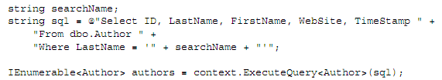
Dynamic SQL pass-through

Slide 84
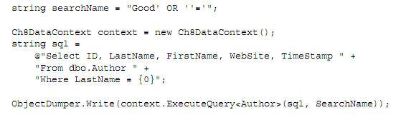
Dynamic SQL pass-through with parameters

Slide 85
Working with stored procedures
When your environment requires stored procedures for accessing data, a bit more work is necessary as opposed to using just the basic LINQ query syntax:
  The first step is to create the stored procedure to return results
  Once the procedure is set up in your database, we can access it the same as any other method call

Slide 86
Add the stored procedure (1)
We open the LINQ to SQL design surface that contains our Books class
Next, expand the Stored Procedures node of the Server Explorer and find the GetBook procedure
Drag the GetBook procedure onto the design surface and drop it on top of the Book class

Slide 87
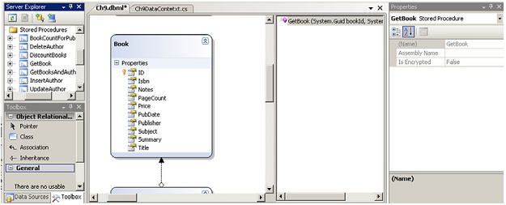
Add the stored procedure (2)

Slide 88

Using a stored procedure to return results

Slide 89
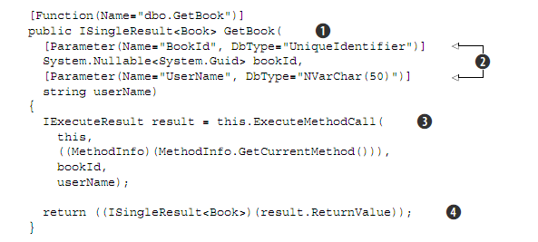
Generated GetBook code to call the stored procedure

Slide 90
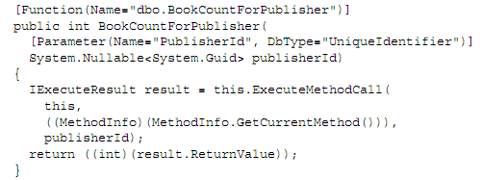
Returning a scalar value
Retrieving data via stored procedures is not limited to returning tables and result sets
They can just as easily return scalar values:

Slide 91
Part 6
Manipulating XML…

Slide 92
LINQ to XML (XLINQ)
Declarative construction of XML document
Support for language integrated queries
Cleaner, simpler, smaller and faster XML API
Notes:
© 2006 Microsoft Corporation. All rights reserved. Microsoft, Windows, Windows Vista and other product names are or may be registered trademarks and/or trademarks in the U.S. and/or other countries.
The information herein is for informational purposes only and represents the current view of Microsoft Corporation as of the date of this presentation. Because Microsoft must respond to changing market conditions, it should not be interpreted to be a commitment on the part of Microsoft, and Microsoft cannot guarantee the accuracy of any information provided after the date of this presentation.
MICROSOFT MAKES NO WARRANTIES, EXPRESS, IMPLIED OR STATUTORY, AS TO THE INFORMATION IN THIS PRESENTATION.

Slide 93
Why do we need another XML programming API?
With existing APIs, developers have too much to think about:
  We have to know when to choose between XSLT, XPath, XQuery, and XML DOM
  We have to worry about the subtle points of a lot of different APIs and need to learn technologies that have completely different conceptual models

Slide 94
Why do we need another XML programming API?
LINQ to XML aims to solve these problems by providing mainstream developers with a simple, yet powerful, XML programming API
LINQ take advantage of the advancements in programming languages that have occurred since the DOM/SAX was created nearly a decade ago
LINQ itself brings many language advancements such as extension methods, anonymous types, and lambda expressions

Slide 95
Programming XML today
Imperative model
XmlDocument doc = new XmlDocument();
XmlElement contacts = doc.CreateElement("contacts");
foreach (Customer c in customers)
if (c.Country == "USA") {
XmlElement e = doc.CreateElement("contact");
XmlElement name = doc.CreateElement("name");
name.InnerText = c.CompanyName;
e.AppendChild(name);
XmlElement phone = doc.CreateElement("phone");
phone.InnerText = c.Phone;
e.AppendChild(phone);
contacts.AppendChild(e);
}
doc.AppendChild(contacts);
Document centric
No integrated queries
Memory intensive
<contacts>
<contact>
<name>Great Lakes Food</name>
<phone>(503) 555-7123</phone>
</contact>
…
</contacts>
Notes:
© 2006 Microsoft Corporation. All rights reserved. Microsoft, Windows, Windows Vista and other product names are or may be registered trademarks and/or trademarks in the U.S. and/or other countries.
The information herein is for informational purposes only and represents the current view of Microsoft Corporation as of the date of this presentation. Because Microsoft must respond to changing market conditions, it should not be interpreted to be a commitment on the part of Microsoft, and Microsoft cannot guarantee the accuracy of any information provided after the date of this presentation.
MICROSOFT MAKES NO WARRANTIES, EXPRESS, IMPLIED OR STATUTORY, AS TO THE INFORMATION IN THIS PRESENTATION.

Slide 96
Programming XML with LINQ
Declarative model
XElement contacts = new XElement("contacts",
from c in customers
where c.Country == "USA"
select new XElement("contact",
new XElement("name", c.CompanyName),
new XElement("phone", c.Phone)
)
);
Element
centric
Integrated queries
Smaller and faster
Notes:
© 2006 Microsoft Corporation. All rights reserved. Microsoft, Windows, Windows Vista and other product names are or may be registered trademarks and/or trademarks in the U.S. and/or other countries.
The information herein is for informational purposes only and represents the current view of Microsoft Corporation as of the date of this presentation. Because Microsoft must respond to changing market conditions, it should not be interpreted to be a commitment on the part of Microsoft, and Microsoft cannot guarantee the accuracy of any information provided after the date of this presentation.
MICROSOFT MAKES NO WARRANTIES, EXPRESS, IMPLIED OR STATUTORY, AS TO THE INFORMATION IN THIS PRESENTATION.

Slide 97
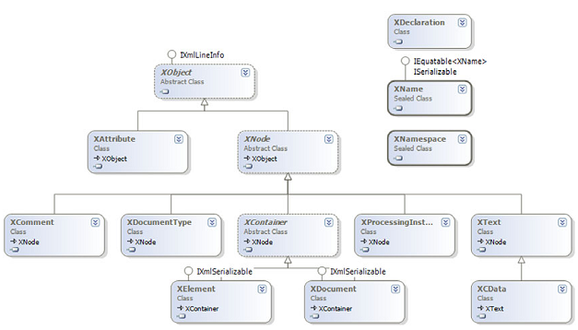
LINQ to XML class hierarchy

Slide 98
Working with XML using LINQ
The LINQ to XML API provides developers with an in-memory programming interface for reading, parsing, creating, and manipulating XML
Using the LINQ to XML API, we can quickly build applications that leverage XML data throughout

Slide 99
Loading XML
LINQ to XML allows XML to be loaded from a variety of input sources
These sources include a file, a URL, and an XmlReader
To load XML, the static Load method on XElement can be used

Slide 100
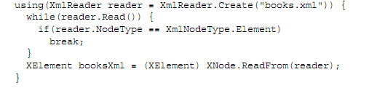
Creating an XElement from an existing XmlReader

Slide 101
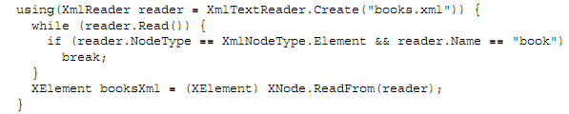
Creating an XElement object from a fragment of XML contained within an XmlReader

Slide 102
Parsing XML
In some cases the XML that we want to use won’t be in a file, or located at a URL
It will be a simple string that is being built by some other part of our application
For these cases, the XElement class provides a static Parse method that creates a new XElement from a string of XML
The Parse method has a similar interface to the Load method

Slide 103
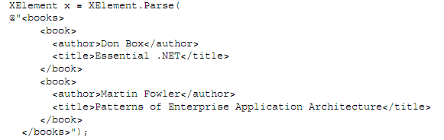
Parsing a string of XML to an XElement

Slide 104
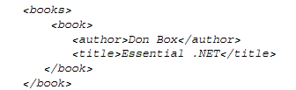
Creating XML
LINQ to XML provides a powerful approach to creating XML elements, referred to as functional construction
Functional construction allows a complete XML tree to be created in a single statement

Slide 105
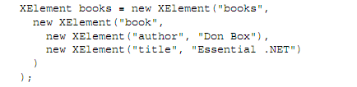
Creating an XElement with functional construction

Slide 106
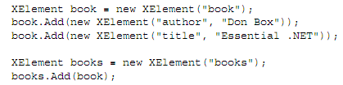
Creating an XElement using the imperative construction model provided by LINQ to XML

Slide 107

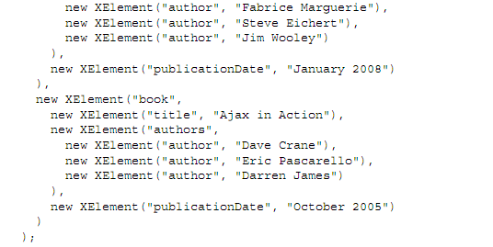
Creating an XML tree using LINQ to XML

Slide 108

Creating an XElement with a full XML name and an XNamespace

Slide 109
Creating XML documents
When working with XElement objects, we allow XElement objects, XAttribute objects, XText, IEnumerable, and strings to be added as content
XDocument allows the following to be added as child content:
  One XDocumentType for the DTD
  One XDeclaration object
  Any number of XProcessingInstruction objects
  One XElement object
  Any number of XComment objects

Slide 110
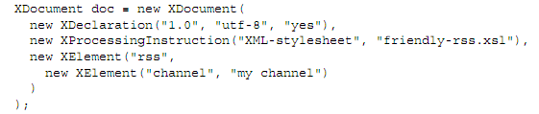
Create an XML document using the XDocument class and functional construction

Slide 111

Adding content to XML
After loading or constructing an XElement, you may want to add additional child items to the element
The Add method allows content to be added to an existing XElement

Slide 112
Removing content from XML
XElement provides several methods for removing child content:
  The most straightforward approach is to navigate to the item to be deleted and call Remove
  You can navigate to the element and then set the Value property to an empty string
  Several of the methods mentioned in this section can also be used to update XML

Slide 113
Removing one or many elements from an XElement with Remove

Slide 114
Set the Value property to an empty string

Slide 115
Updating XML content
LINQ to XML offers several alternatives when it comes to updating XML:
  The most direct approach is to use the SetElementValue method defined on Xelement
  ReplaceNodes method

Slide 116
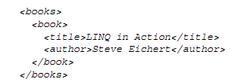
Use the SetElementValue method

Slide 117
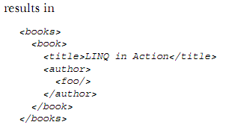
ReplaceNodes method

Slide 118
Working with attributes (1)
The XAttribute class is used to represent an attribute within LINQ to XML
Unlike earlier XML APIs, attributes are not within the same class hierarchy as elements and nodes
In LINQ to XML, attributes are simply name-value pairs

Slide 119
Working with attributes (2)
During the creation of XML, we can include attributes within our XML by passing them as one of the parameters to the functional construction statements and/or the Add method

Slide 120
Saving XML
The process of saving XML is extremely straightforward
The XElement and XDocument classes provide a Save method that will save your XML to a file, an XmlTextWriter, or an XmlWriter

Slide 121
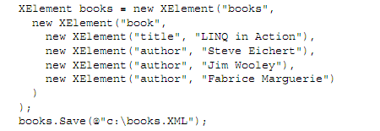
Saving an XElement to disk with the Save method

Slide 122
Query XML with LINQ to XML
LINQ to XML axis methods
Standard query operators

Slide 123


LINQ to XML axis methods (1)
Element:
Attribute:

Slide 124
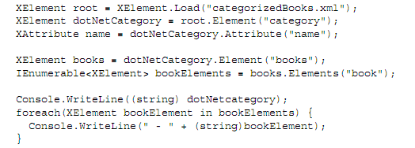
LINQ to XML axis methods (2)
Elements:

Slide 125

LINQ to XML axis methods (3)
Descendants:

Slide 126
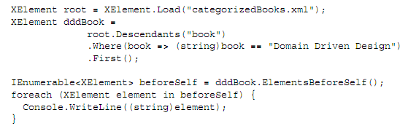
LINQ to XML axis methods (4)
ElementsAfterSelf, NodesAfterSelf, ElementsBeforeSelf, and NodesBeforeSelf

Slide 127
Standard query operators

Slide 128
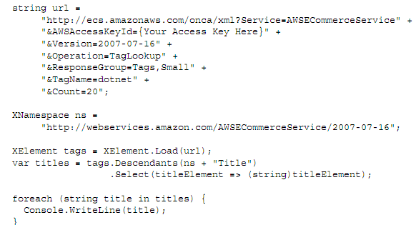
Projecting with Select

Slide 129
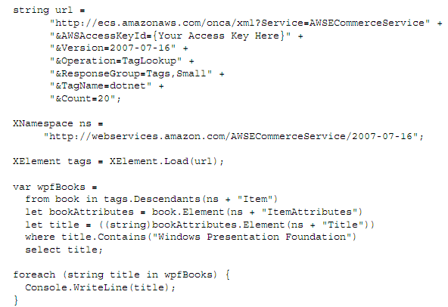
Filtering with Where

Slide 130
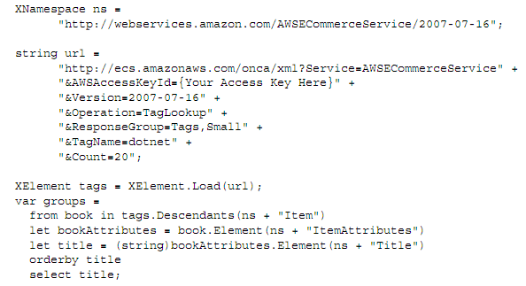
Ordering and grouping

Slide 131
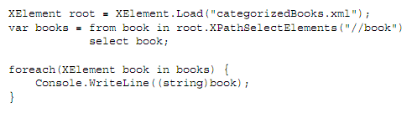
Querying LINQ to XML objects with XPath

Slide 132
Part 7
Extending LINQ…

Slide 133
Suggested use cases for LINQ’s extensibility
Querying a custom data source (such as a filesystem, Active Directory, WMI, or Windows’s Event Log)
Querying web services (Amazon, other public web services, or in-house web services)
Allowing the developers who use your product to take advantage of LINQ—if you are a tool provider or sell a development framework (examples include object-relational frameworks)

Slide 134
Creating custom query operators
Improving the standard query operators
Utility or domain-specific query operators

Slide 135
Example - Querying a web service: LINQ to Amazon
Page 502 in “LINQ in Action”

Slide 136
Part 8
A look to future…

Slide 137
LINQ to XSD, the typed LINQ to XML
LINQ to XSD, which is available at the time of this writing only as an alpha version, is designed to allow strongly typed XML queries
It provides developers with support for typed XML programming on top of LINQ
While LINQ to XML programmers operate on generic XML trees, LINQ to XSD programmers operate on typed XML trees to XML
A typed XML tree consists of instances of .NET types that model the XML types of a specific XML schema (XSD)

Slide 138
LINQ to XSD, the typed LINQ to XML
Unfortunately, no release data has been announced for LINQ to XSD, and it has not been updated to the RTM of .NET 3.5.
Will Microsoft pursue the work on this approach?

Slide 139
PLINQ: LINQ meets parallel computing
It’s a key component of Parallel FX (PFX), the next generation of concurrency support in the .NET Framework
The goal is to take advantage of LINQ queries to distribute processing over multiple CPUs or cores
http://msdn.microsoft.com/msdn-mag/issues/07/10/PLINQ/

Slide 140
LINQ to Entities, a LINQ interface for the ADO.NET Entity Framework (1)
Like LINQ to SQL, the Entity Framework and LINQ to Entities can be used to perform object-relational mapping
Unlike LINQ to SQL, the Entity Framework will support more database engines than just SQL Server
The fact that LINQ to SQL works only with SQL Server is a big limitation! Will more database engines be supported? When?

Slide 141
LINQ to Entities, a LINQ interface for the ADO.NET Entity Framework (2)
Also, the Entity Framework allows a richer mapping
It works with a true abstraction layer between the application and the database
Microsoft declared that it has targeted the first half of 2008 to ship the ADO.NET Entity Framework as an update to the .NET Framework 3.5 and to Visual Studio 2008

Slide 142
Summary
LINQ defines a set of query operators that can be used to query, project and filter data in arrays, enumerable classes, XML, relational database, and third party data sources
LINQ provider
  LINQ to object
  LINQ to SQL
  LINQ to XML
Notes:
3. Data Types
2008
© 2008 Microsoft

Slide 143
References
Books:
  FabRice Marhuerie, “LINQ in Action“
Notes:
3. Data Types
2008
© 2008 Microsoft

