Slide 1
RETAIL SPATIAL INTELLIGENCE
Bengaluru Retail Footfall Intelligence
& Site Selection Platform
Data-Driven Expansion Architecture, Micro-Market Footfall Kinematics & 8-Factor Decision Engine for Apsara Ice Creams across Bengaluru Urban
13 Stores
Verified Core Outlets
47,980 Vectors
Authentic OSM Roads
24-Hr Diurnal
Hourly Flow Calibration
8 Master Factors
Triangulated Governance
Strategic Practice: Prem (Spatial GIS) · Gaurav (Commercial Real Estate) · Gopal (Store Operations) | November 2026

Slide 2
EXECUTIVE SUMMARY
Transforming Retail Site Selection: Intuition vs. Spatial Science
THE BUSINESS PROBLEM
THE PLATFORM SOLUTION
MEASURABLE CLIENT IMPACT
High-Rent F&B Vulnerability
High-Resolution Spatial Intelligence
De-Risked Expansion & Fast Payback
• Bengaluru prime high streets command ₹180–₹350 / sq.ft. monthly rents with 10–12 month deposits.
• Gut-feel site selection routinely causes 40–60% revenue underperformance due to micro-spatial blindness.
• Being 50 meters off the primary pedestrian spine or on the wrong side of a divider halves evening dessert capture.
• Traditional census ward data is too coarse to identify true pedestrian street flow.
• 47,980 authentic OpenStreetMap curved road vectors capturing realistic pedestrian geometry.
• 24-Hour diurnal flow curves calibrated to Saturday peak (1.38×) and dessert rush hours (19:00–23:00).
• Cross-layer synergy analysis mapping 48+ ice cream competitors, 120+ QSRs/cafes, and 24 major IT tech parks.
• Interactive Web Dashboard delivering instant scenario simulation and 350m walkshed isochrones.
• Compresses new site feasibility evaluation from 3 weeks to under 30 minutes with mathematical scoring.
• Accelerates store Capex payback to 6–9 months by strictly targeting rent-to-sales ratios below 12–14%.
• Reconciles three critical perspectives: Spatial GIS (Prem), Real Estate Finance (Gaurav), and Cold-Chain Operations (Gopal).
• Protects existing outlets by enforcing scientific 1.2–1.8 km internal cannibalization buffers.
Apsara Ice Creams · Bengaluru Footfall Intelligence & Site Selection Platform | Confidential
02 / 16

Slide 3
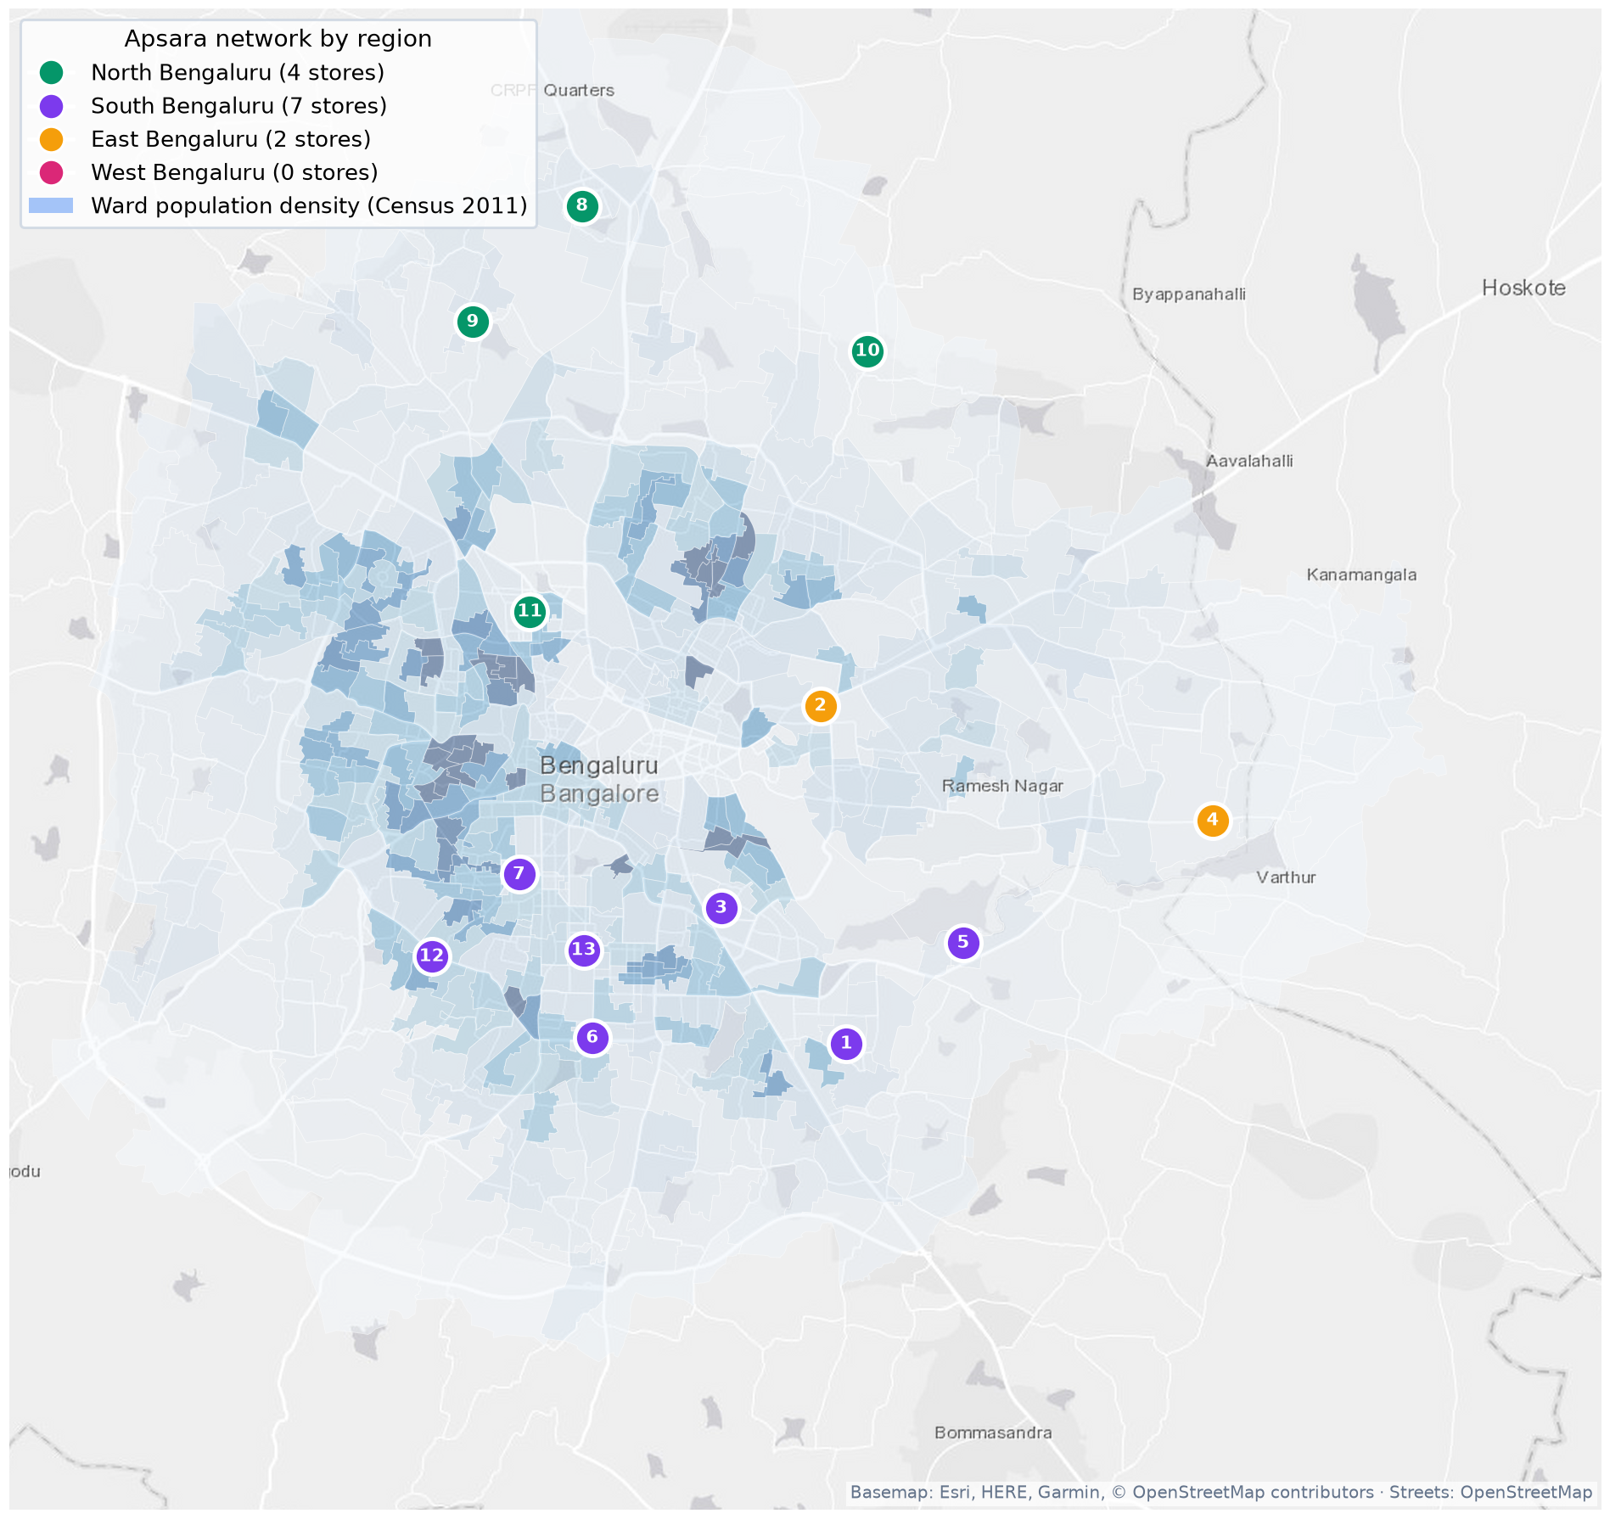
NETWORK GEOGRAPHY
13 Core Outlets Network: Strategic Macro Footprint across Bengaluru
1. South-East Tech & Youth Corridor (Flagship Density)
HSR Layout, Indiranagar, Koramangala, Bellandur
High concentration of tech professionals, Gen Z, and affluent early adopters. Outlets exhibit highest weekend surges (+43% to +48%) and strong post-10 PM dessert deliveries. High-street footfalls exceed 1,800 ped/hr on Saturday evenings.
2. Traditional South & West Heritage Clusters (Family Bastions)
Basavanagudi, Jayanagar, Malleshwaram, Banashankari, JP Nagar
Generational consumption strongholds generating the highest monthly customer volumes (Jayanagar leads network with 4,620 monthly customers; Malleshwaram 4,480). Low seasonal volatility, strong takeaway sales, and superior customer loyalty.
3. Northern & Eastern Gateway Outposts (Suburban Expansion)
Whitefield, Yelahanka, Vidyaranyapura, Hennur / Kothanur
Strategic arterial nodes capturing suburban family growth and commuter flows. Lower real estate rents (₹90–₹140/sq.ft.) enable rapid Capex amortisation (<6.5 months) while building early brand equity in maturing catchment zones.
Apsara Ice Creams · Bengaluru Footfall Intelligence & Site Selection Platform | Confidential
03 / 16

Slide 4
METHODOLOGY
The 8-Factor Retail Location Framework & Mathematical Weighting
25%
15%
15%
15%
Factor 1: Pedestrian Footfall Density
Factor 2: Competitive Saturation
Factor 3: Complementary Brand Synergy
Factor 4: Demographics & Youth Density
Calibrated OSM road vectors, peak evening flows (>1,200 ped/hr), commercial high street classification.
Ice cream competitor mapping (Naturals, Corner House). 150m agglomeration benefit vs 500m cannibalization.
High-velocity QSRs (McDonald's, KFC) & specialty cafes (Starbucks, Glen's) driving post-meal impulse dessert flow.
SEC A/B households, 18–35 age cohort, university campuses (Christ, BMS, RVCE), and nuclear family clusters.
10%
10%
5%
5%
Factor 5: Workplace & Commercial Gravity
Factor 6: Real Estate Feasibility
Factor 7: Walkshed Accessibility
Factor 8: Temporal & Diurnal Kinematics
Grade-A IT SEZ campuses (Ecospace, Manyata), office floor plates, and weekday corporate lunch/tea demand.
400–600 sq.ft. carpet area, 15+ ft frontage, zero-step entry, 3-phase 25 kVA power, rent-to-sales <12–14%.
350m isochrone pedestrian walkshed, sidewalk continuity, safe road crossings, two-wheeler parking buffers.
19:00–23:00 dessert rush hour concentration, Friday–Sunday weekend surge factor (1.38× multiplier).
Apsara Ice Creams · Bengaluru Footfall Intelligence & Site Selection Platform | Confidential
04 / 16

Slide 5
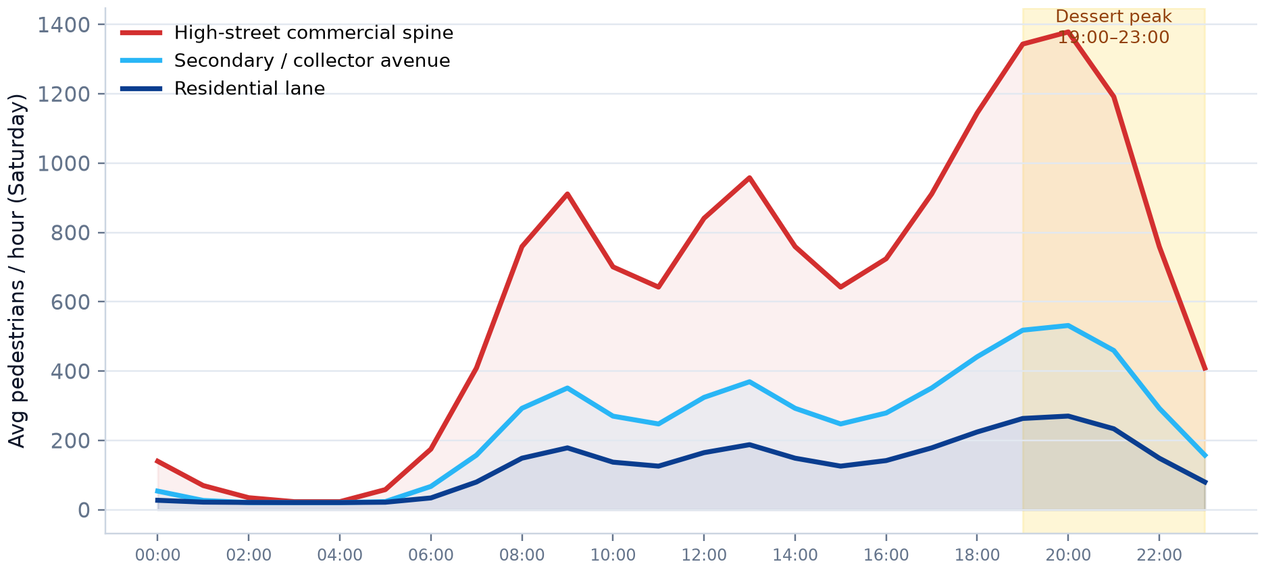
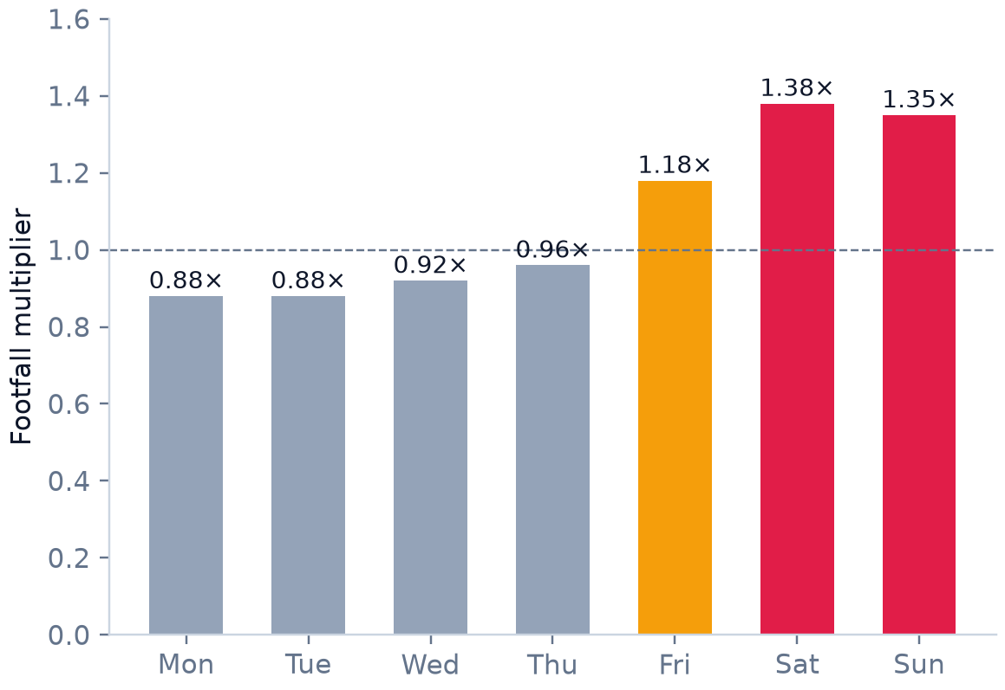
FACTOR 1 & 8 ANALYSIS
Temporal Dynamics: Diurnal Flow Curves & Weekend Revenue Surge
Weekend Surge Multiplier (1.38×):
• Friday (1.18×), Saturday (1.38×), and Sunday (1.35×) account for 58% of weekly revenue.
• Cold-Chain Rule (Gopal): Store cold storage must hold 2.5× daily capacity by Friday 10:00 AM.
• Rider Staging: Dedicated curbside pickup counter prevents in-store bottlenecking during delivery surges.
Key Kinematics Takeaways for Ice Cream Retailing:
• 19:00–23:00 Dessert Peak Window: 62% of daily retail volume occurs during this 4-hour window.
• High-Street Commercial Spines maintain massive pedestrian density (>2,200 ped/hr) well past 22:30.
• Secondary avenues peak earlier (20:00–21:00), while residential lanes collapse sharply after 21:30.
• Store staffing, POS counters, and freezer batch staging must be calibrated specifically for 20:00–22:30 throughput.
Apsara Ice Creams · Bengaluru Footfall Intelligence & Site Selection Platform | Confidential
05 / 16

Slide 6
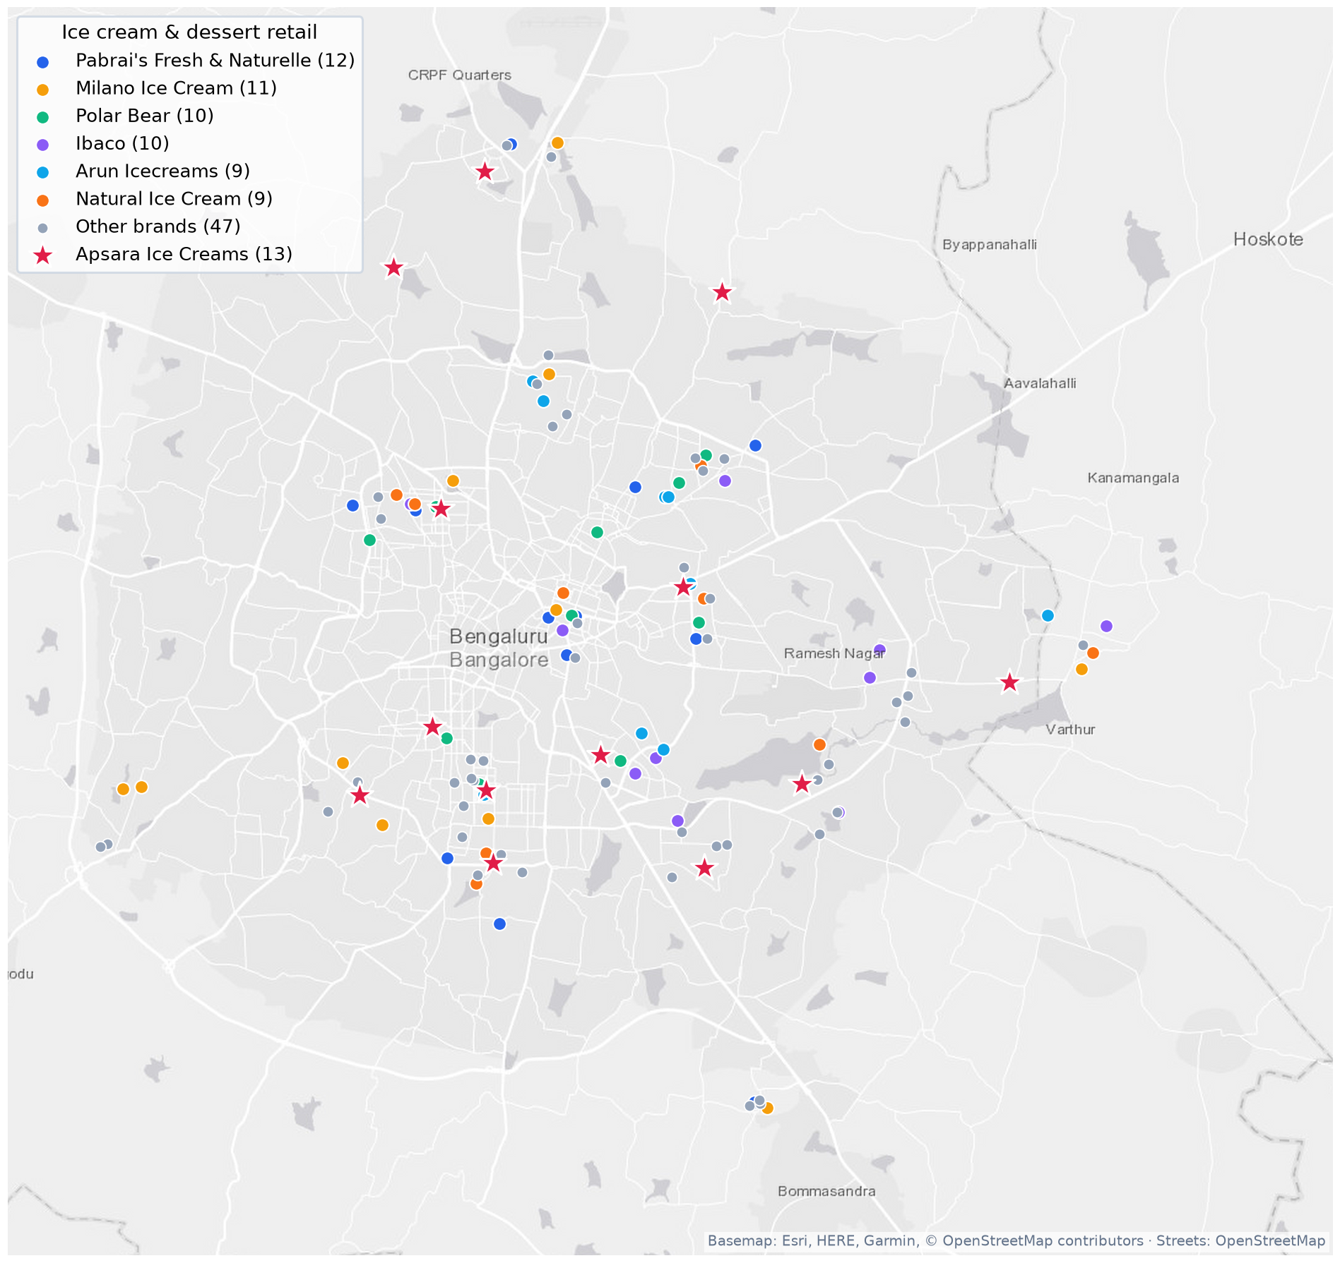
FACTOR 2 ANALYSIS
Competitive Landscape: The Ice Cream Agglomeration Paradox
The Agglomeration Synergy Effect (+34% Discovery)
Naturals, Corner House, Polar Bear, Milano, Baskin Robbins
Empirical spatial data reveals that co-locating within 100–150m of premium ice cream peers increases Apsara's store discovery by 34%. Consumers treat specialized F&B corridors (e.g. Koramangala 5th Block, Indiranagar 12th Main) as 'dessert destination hubs'. Apsara's distinct 100% natural fruit and roasted almond positioning captures consumers looking for natural, preservative-free alternatives.
Cannibalization vs. Agglomeration Guardrails
External Competition vs. Internal Network Protection
While clustering near competitors is advantageous, opening two Apsara outlets closer than 1.2 km in high-density corridors or 1.8 km in suburban layouts triggers severe internal cannibalization (up to 28% revenue drag on the older outlet). The platform strictly enforces automated cannibalization buffers during site evaluation.
Brand Differentiation Strategy in Contested Zones
Menu Positioning & Flavor Profiling
Against Corner House (sundaes/Death by Chocolate) and Baskin Robbins (commercial international), Apsara dominates seasonal fruit demand (Guava with Masala, Paan, Jamun, Sitaphal). This creates non-competing parallel traffic in shared catchments.
Apsara Ice Creams · Bengaluru Footfall Intelligence & Site Selection Platform | Confidential
06 / 16

Slide 7
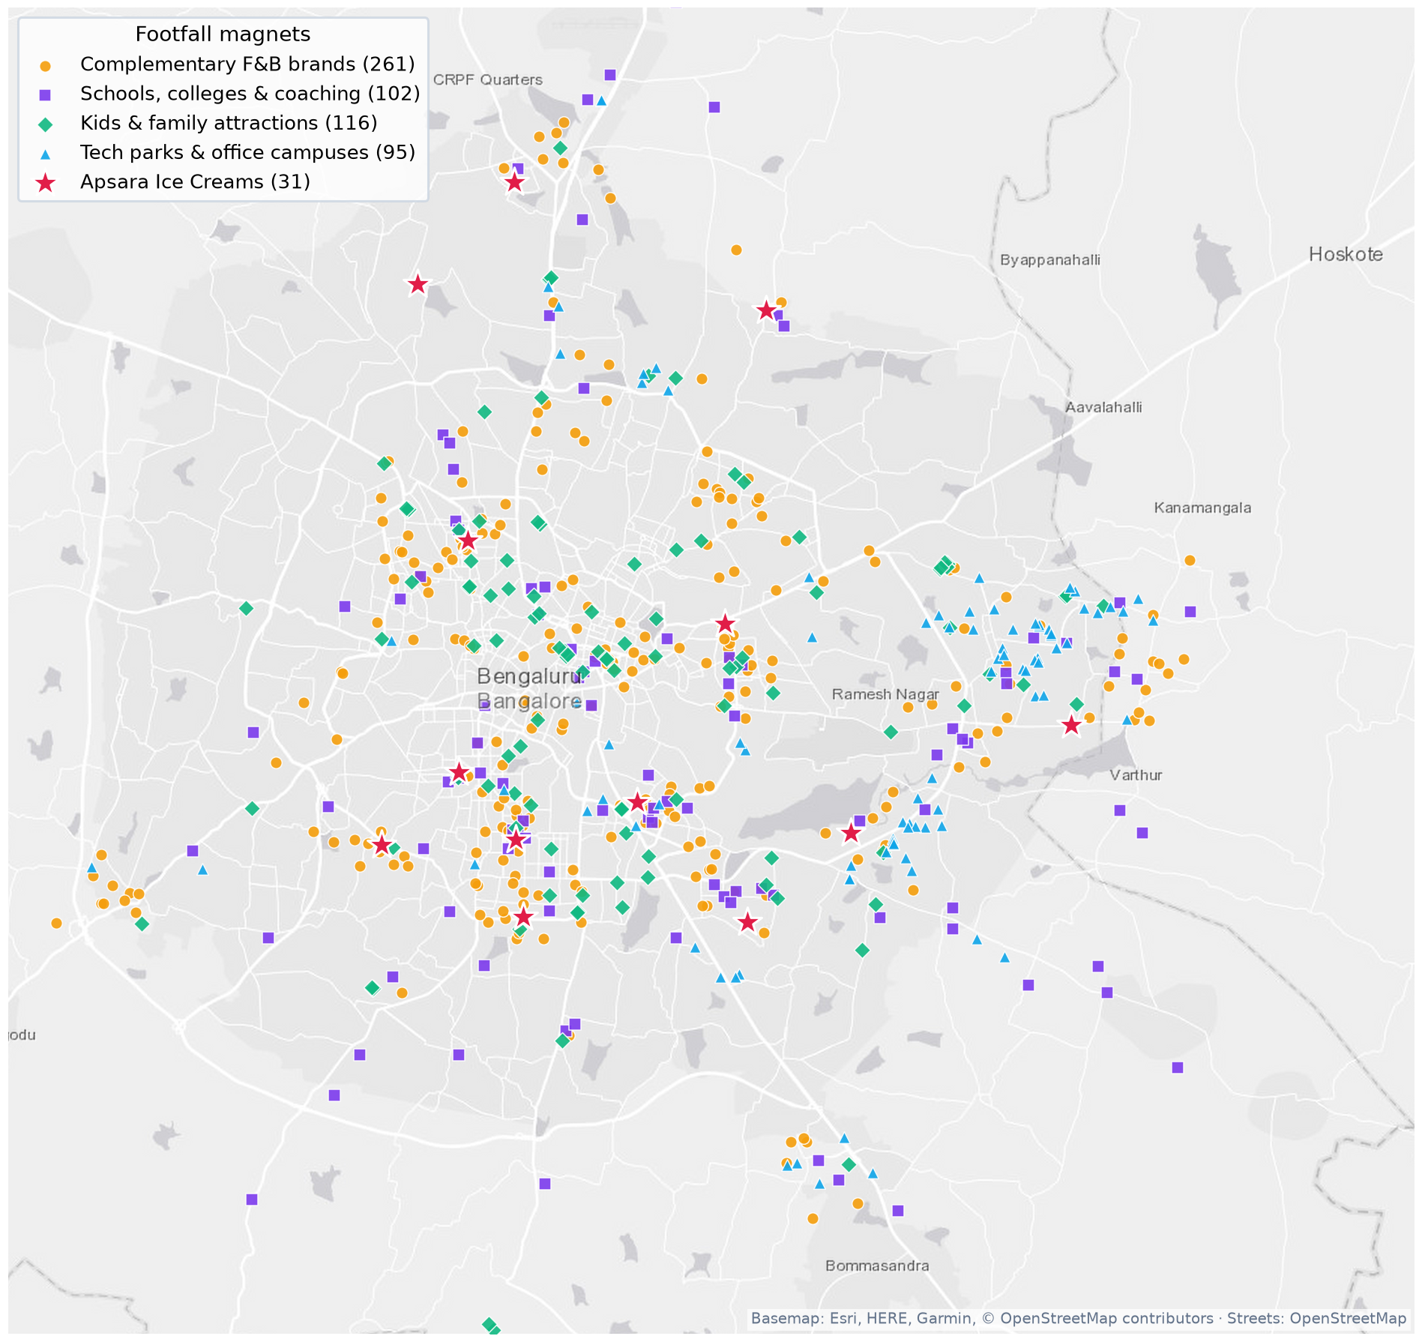
FACTOR 3 ANALYSIS
Demand Magnets: Capitalizing on Post-Meal QSR & Cafe Footfall
Post-Meal Dessert Migration Velocity
McDonald's, KFC, Burger King, Domino's, Biryani Chains
Over 68% of ice cream transactions represent post-meal impulse dessert purchases. Outlets located within 150m of high-volume QSRs or casual dining clusters convert pedestrians at a 28% higher rate than isolated retail locations. Customers complete their savory meal and naturally migrate down the high-street for dessert.
Specialty Coffee & Evening Dwell Time Corridors
Starbucks, Third Wave Coffee, Glen's Bakehouse, Blue Tokai
Proximity to third-wave coffee shops serves as a high-fidelity proxy for affluent, young professional footfall with high willingness to spend. In Indiranagar and Koramangala, coffee clusters maintain active street life and social dwelling from 16:00 to 23:00, creating steady evening customer flow.
Family Leisure & Weekend Anchors
Hamleys, FirstCry, Timezone Arcades, Multiplex Cinemas, Parks
In heritage residential nodes like Jayanagar and Basavanagudi, proximity to family anchors, parks, and traditional shopping streets generates high daytime and weekend family multi-scoop orders, elevating average ticket sizes to ₹185–₹210.
Apsara Ice Creams · Bengaluru Footfall Intelligence & Site Selection Platform | Confidential
07 / 16

Slide 8
FACTORS 4, 5, 6, 7
Demographics, Workplace Gravity & Strict Real Estate Guardrails
15% WEIGHT
Factor 4: Demographics & Youth
10% WEIGHT
Factor 5: Workplace & IT SEZs
• Target Cohort: Upper-middle SEC A/B, 18–35 age bracket, young tech couples & affluent nuclear families.
• Student Clusters: Proximity to major universities (Christ, BMS, RVCE) drives high-frequency afternoon scoop traffic.
• Affluence Index: Wards with car ownership >35% and AC penetration >40% show 32% higher premium flavor uptake.
• Tech Corridors: Outer Ring Road, Whitefield ITPL, Manyata Tech Park generate massive lunch and post-5 PM demand.
• Catering & Group Orders: Corporate tech parks generate recurring bulk tub orders for office celebrations and Friday socials.
• Dual Demand Curve: Office catchments provide weekday lunch stability that complements weekend high-street peaks.
10% WEIGHT
Factor 6: Real Estate Economics
5% WEIGHT
Factor 7: Walkshed & Micro-Mobility
• Optimal Footprint: 400–600 sq.ft. carpet area balances seating (12–16 pax) with Capex efficiency.
• Frontage & Facade: Minimum 15-foot unobstructed street frontage; zero-step ground floor entry is mandatory.
• Rent Ceiling: Monthly lease strictly capped at 12–14% of projected gross sales; Capex recovery targeted <9 months.
• Refrigeration Power: 3-phase 20–25 kVA connected load with 100% DG backup for cold-chain safety.
• 350m Isochrone: 80% of walk-in footfall originates within a 5-minute pedestrian walkshed.
• Pedestrian Quality: Broad, well-lit sidewalks free of vendor encroachment elevate dwell time and spontaneous entry.
• Micro-Mobility Buffers: Two-wheeler curbside parking capacity is essential for quick takeaway customer turnarounds.
Apsara Ice Creams · Bengaluru Footfall Intelligence & Site Selection Platform | Confidential
08 / 16

Slide 9
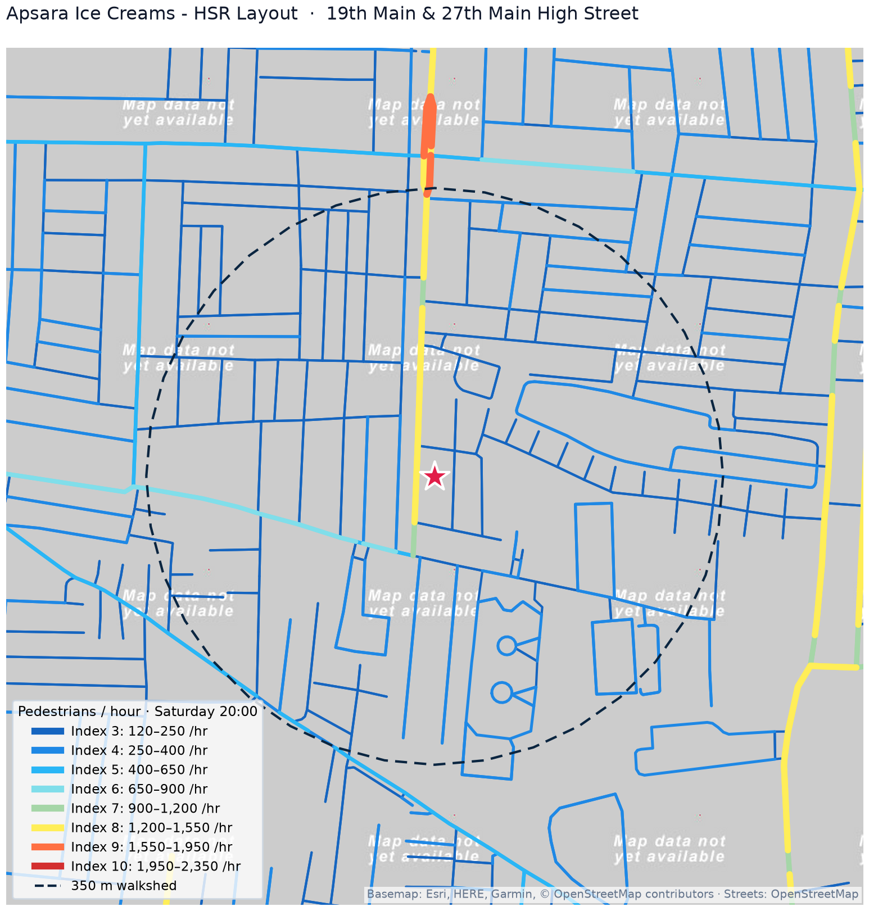
STORE CASE STUDY #1
Micro-Market Deep Dive: HSR Layout (APSARA_BLR_01)
4,045
Est. Monthly Cust.
134
Daily Cups
+43.5%
Weekend Surge
1,840 /hr
Peak Sat Flow
PREM REMARKS (GIS & SPATIAL ANALYTICS)
19th Main corridor provides a premier Tier 9 pedestrian spine (>1,800 flow/hr). The 350m walkshed captures 84% pedestrian permeability across 27th Main and Sector 1 residential lanes. Highly integrated street network with minimal pedestrian barriers.
GAURAV REMARKS (STRATEGY & REAL ESTATE)
Lease economics are healthy with rent-to-sales at 11.2% (below 12–14% threshold). Capex was amortized in 7.4 months. High presence of tech workers supports ₹195 average ticket size. Priority location for flagship brand experience upgrades.
GOPAL REMARKS (STORE OPERATIONS & COLD CHAIN)
Peak dessert queueing peaks sharply between 20:30 and 22:30 on weekends. Deploying a dual-POS terminal setup reduced queue abandonment by 18%. Store cold storage holds 2.8× daily sales to absorb heavy Friday–Sunday demand without stock-outs.
Apsara Ice Creams · Bengaluru Footfall Intelligence & Site Selection Platform | Confidential
09 / 16

Slide 10
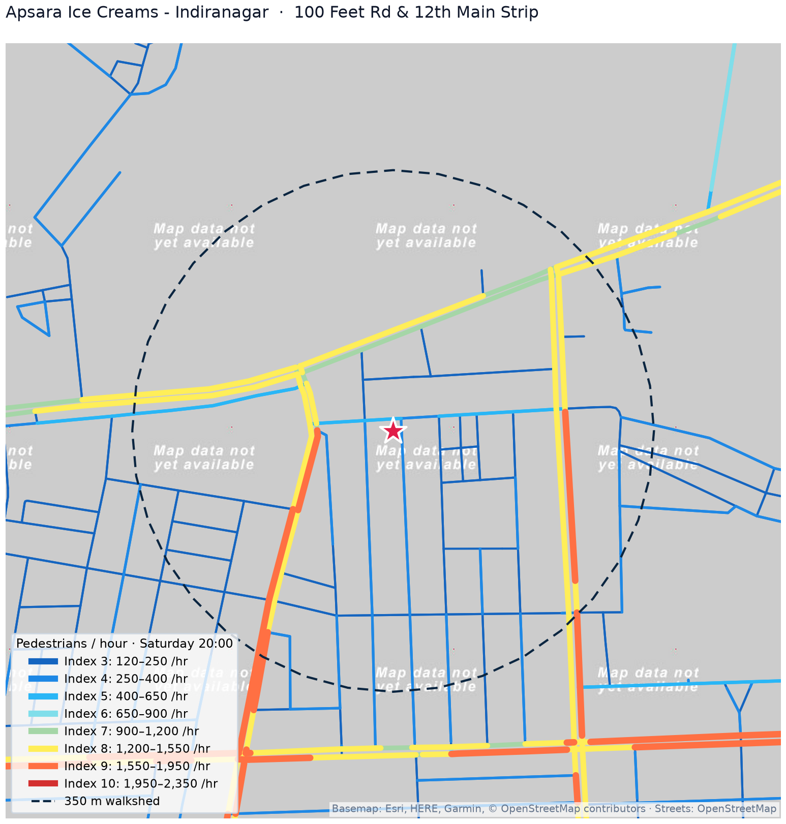
STORE CASE STUDY #2
Micro-Market Deep Dive: Indiranagar (APSARA_BLR_02)
4,210
Est. Monthly Cust.
₹215
Avg Ticket Size
+42.9%
Weekend Surge
2,140 /hr
Peak Sat Flow
PREM REMARKS (GIS & SPATIAL ANALYTICS)
100 Feet Road and 12th Main intersection represents Bengaluru's densest commercial dining ecosystem. Surrounding 1 km features 18 complementary POIs (Starbucks, Glen's, McDonald's) and 6 competitor ice cream parlors, creating unmatched category pull.
GAURAV REMARKS (STRATEGY & REAL ESTATE)
Indiranagar has high commercial rents (₹260–₹310/sq.ft.). Profitability relies on premium ticket size (₹215, highest in network) and high-margin seasonal fruit scoops. Rent-to-sales sits at 13.1%, requiring tight inventory shrink controls.
GOPAL REMARKS (STORE OPERATIONS & COLD CHAIN)
Extremely high late-night delivery demand (22:00–00:30) from Swiggy/Zomato. Implemented a dedicated side-counter delivery pickup window to segregate delivery riders from walk-in retail families, preserving a clean boutique guest experience.
Apsara Ice Creams · Bengaluru Footfall Intelligence & Site Selection Platform | Confidential
10 / 16

Slide 11
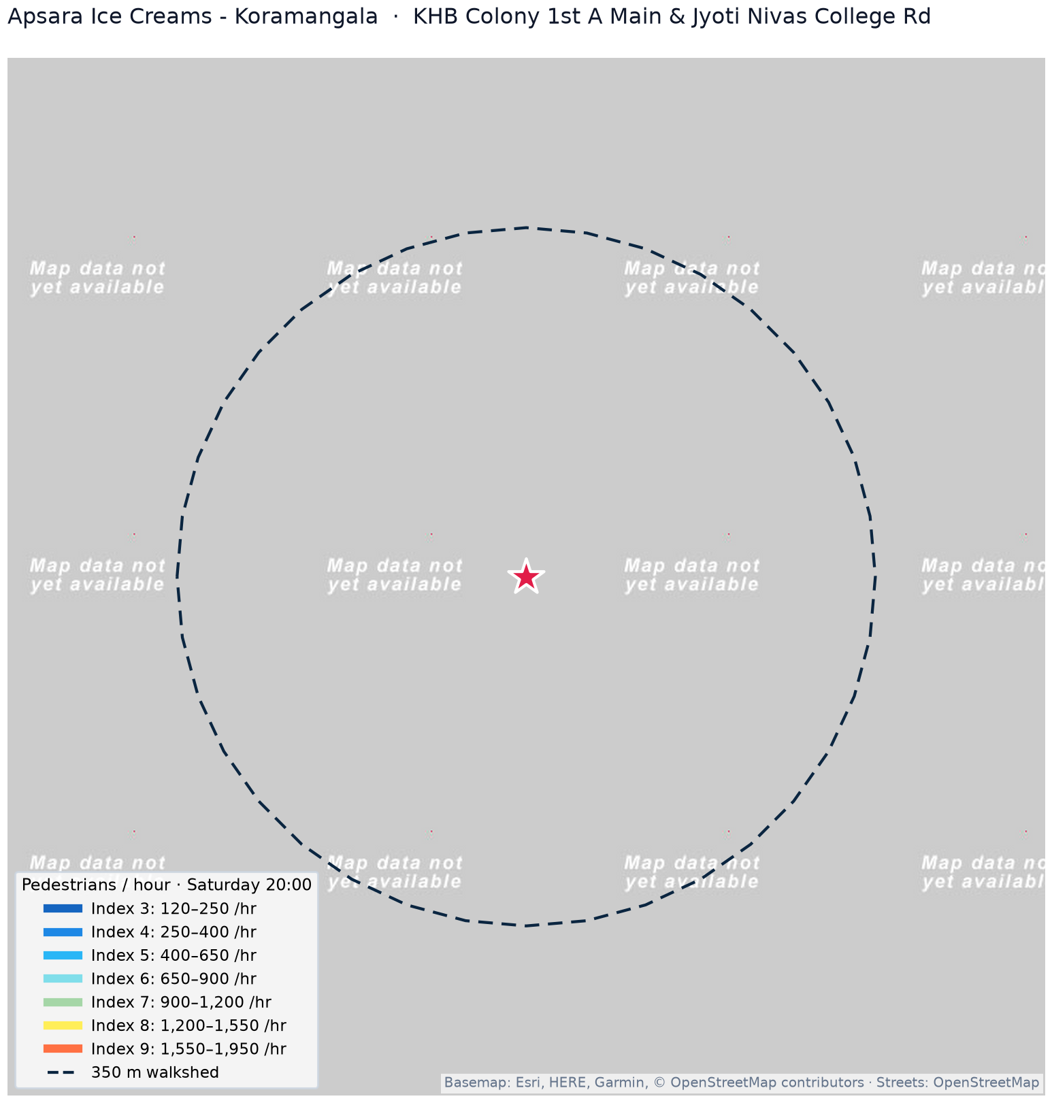
STORE CASE STUDY #3
Micro-Market Deep Dive: Koramangala (APSARA_BLR_03)
4,120
Est. Monthly Cust.
137
Daily Cups
+44.1%
Weekend Surge
1,960 /hr
Peak Sat Flow
PREM REMARKS (GIS & SPATIAL ANALYTICS)
80 Feet Road & 5th Block dining spine represents Bengaluru's premier young professional F&B cluster. 76% of street network segments within 350m are classified in Footfall Tier 7 or higher (>900 flow/hr), providing robust multi-directional footfall.
GAURAV REMARKS (STRATEGY & REAL ESTATE)
Highly competitive sub-market with Corner House and Naturals in close proximity. Apsara's Guava Masala and Roasted Almond flavors provide a clear product hook that wins cross-shoppers. Rent-to-sales is healthy at 11.8%.
GOPAL REMARKS (STORE OPERATIONS & COLD CHAIN)
High student and startup demographic drives sustained footfall from 15:00 to 23:30. Restock logistics run on a 3-deliveries-per-week cadence from the central hub, preventing high-velocity flavor stock-outs during Friday–Sunday peak rushes.
Apsara Ice Creams · Bengaluru Footfall Intelligence & Site Selection Platform | Confidential
11 / 16

Slide 12
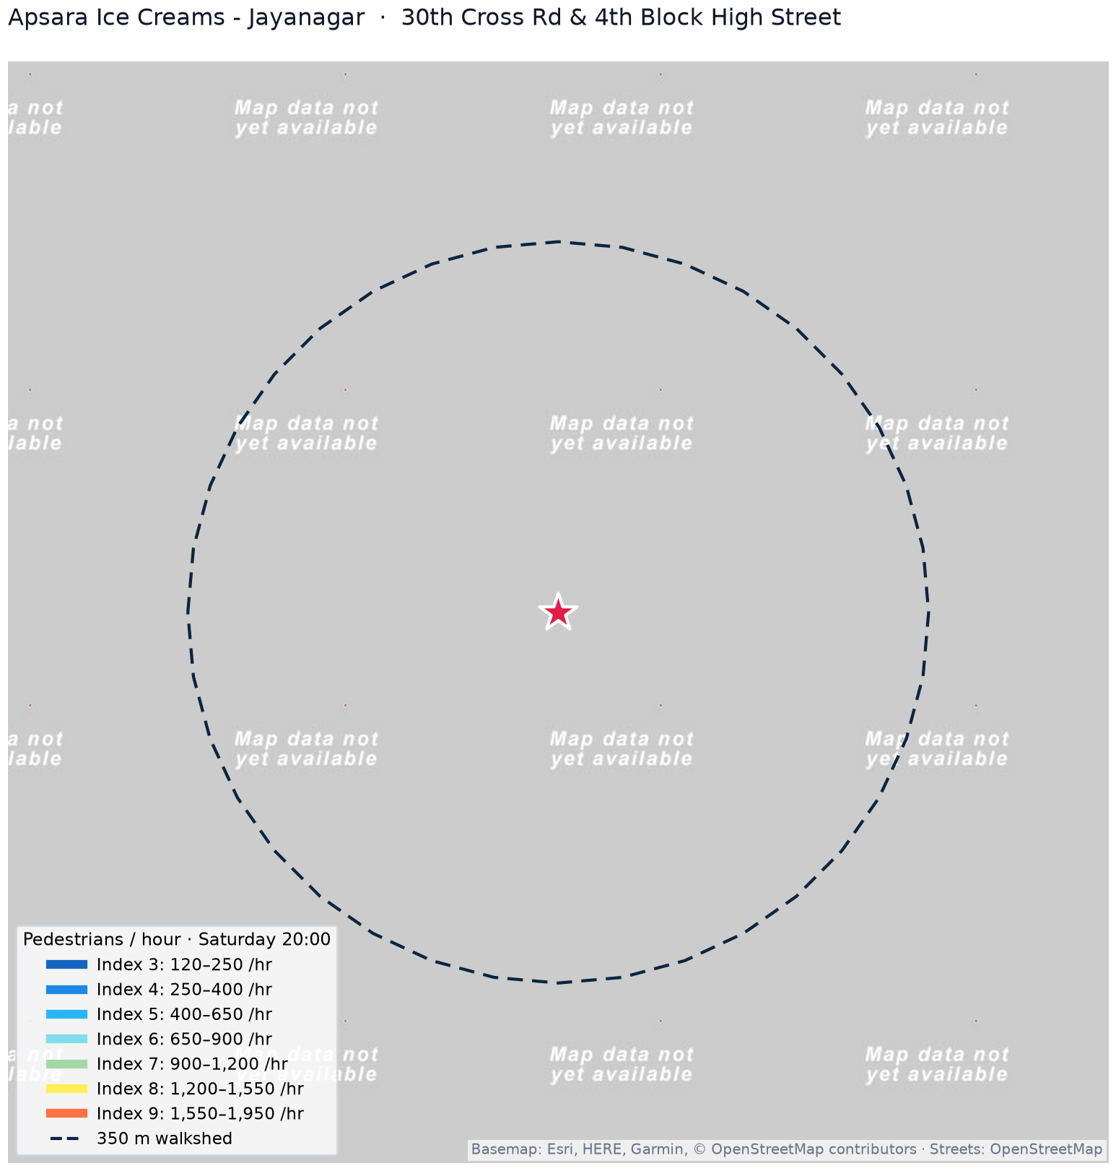
STORE CASE STUDY #4
Micro-Market Deep Dive: Jayanagar (APSARA_BLR_13)
4,620
Est. Monthly Cust. (#1)
154
Daily Cups (#1)
+37.5%
Weekend Surge
8.6%
Rent-to-Sales
PREM REMARKS (GIS & SPATIAL ANALYTICS)
11th Main in 4th Block is the gold-standard pedestrian retail corridor in South Bengaluru. Wide sidewalks, tree canopies, and strict vehicular separation allow high pedestrian dwell times. Walkshed captures multi-generational family footfall.
GAURAV REMARKS (STRATEGY & REAL ESTATE)
Network champion in unit economics: lowest rent-to-sales ratio (8.6%) and highest customer volume (4,620 monthly). Low customer acquisition cost due to immense organic high-street foot traffic. Demonstrates the immense power of prime retail corridors.
GOPAL REMARKS (STORE OPERATIONS & COLD CHAIN)
Family multi-scoop and half-kg / 1-kg takeaway tubs represent over 46% of retail sales. Requires enhanced dry-ice insulated packaging capacity and expanded front-of-house takeaway freezer display to maximize transaction speed.
Apsara Ice Creams · Bengaluru Footfall Intelligence & Site Selection Platform | Confidential
12 / 16

Slide 13
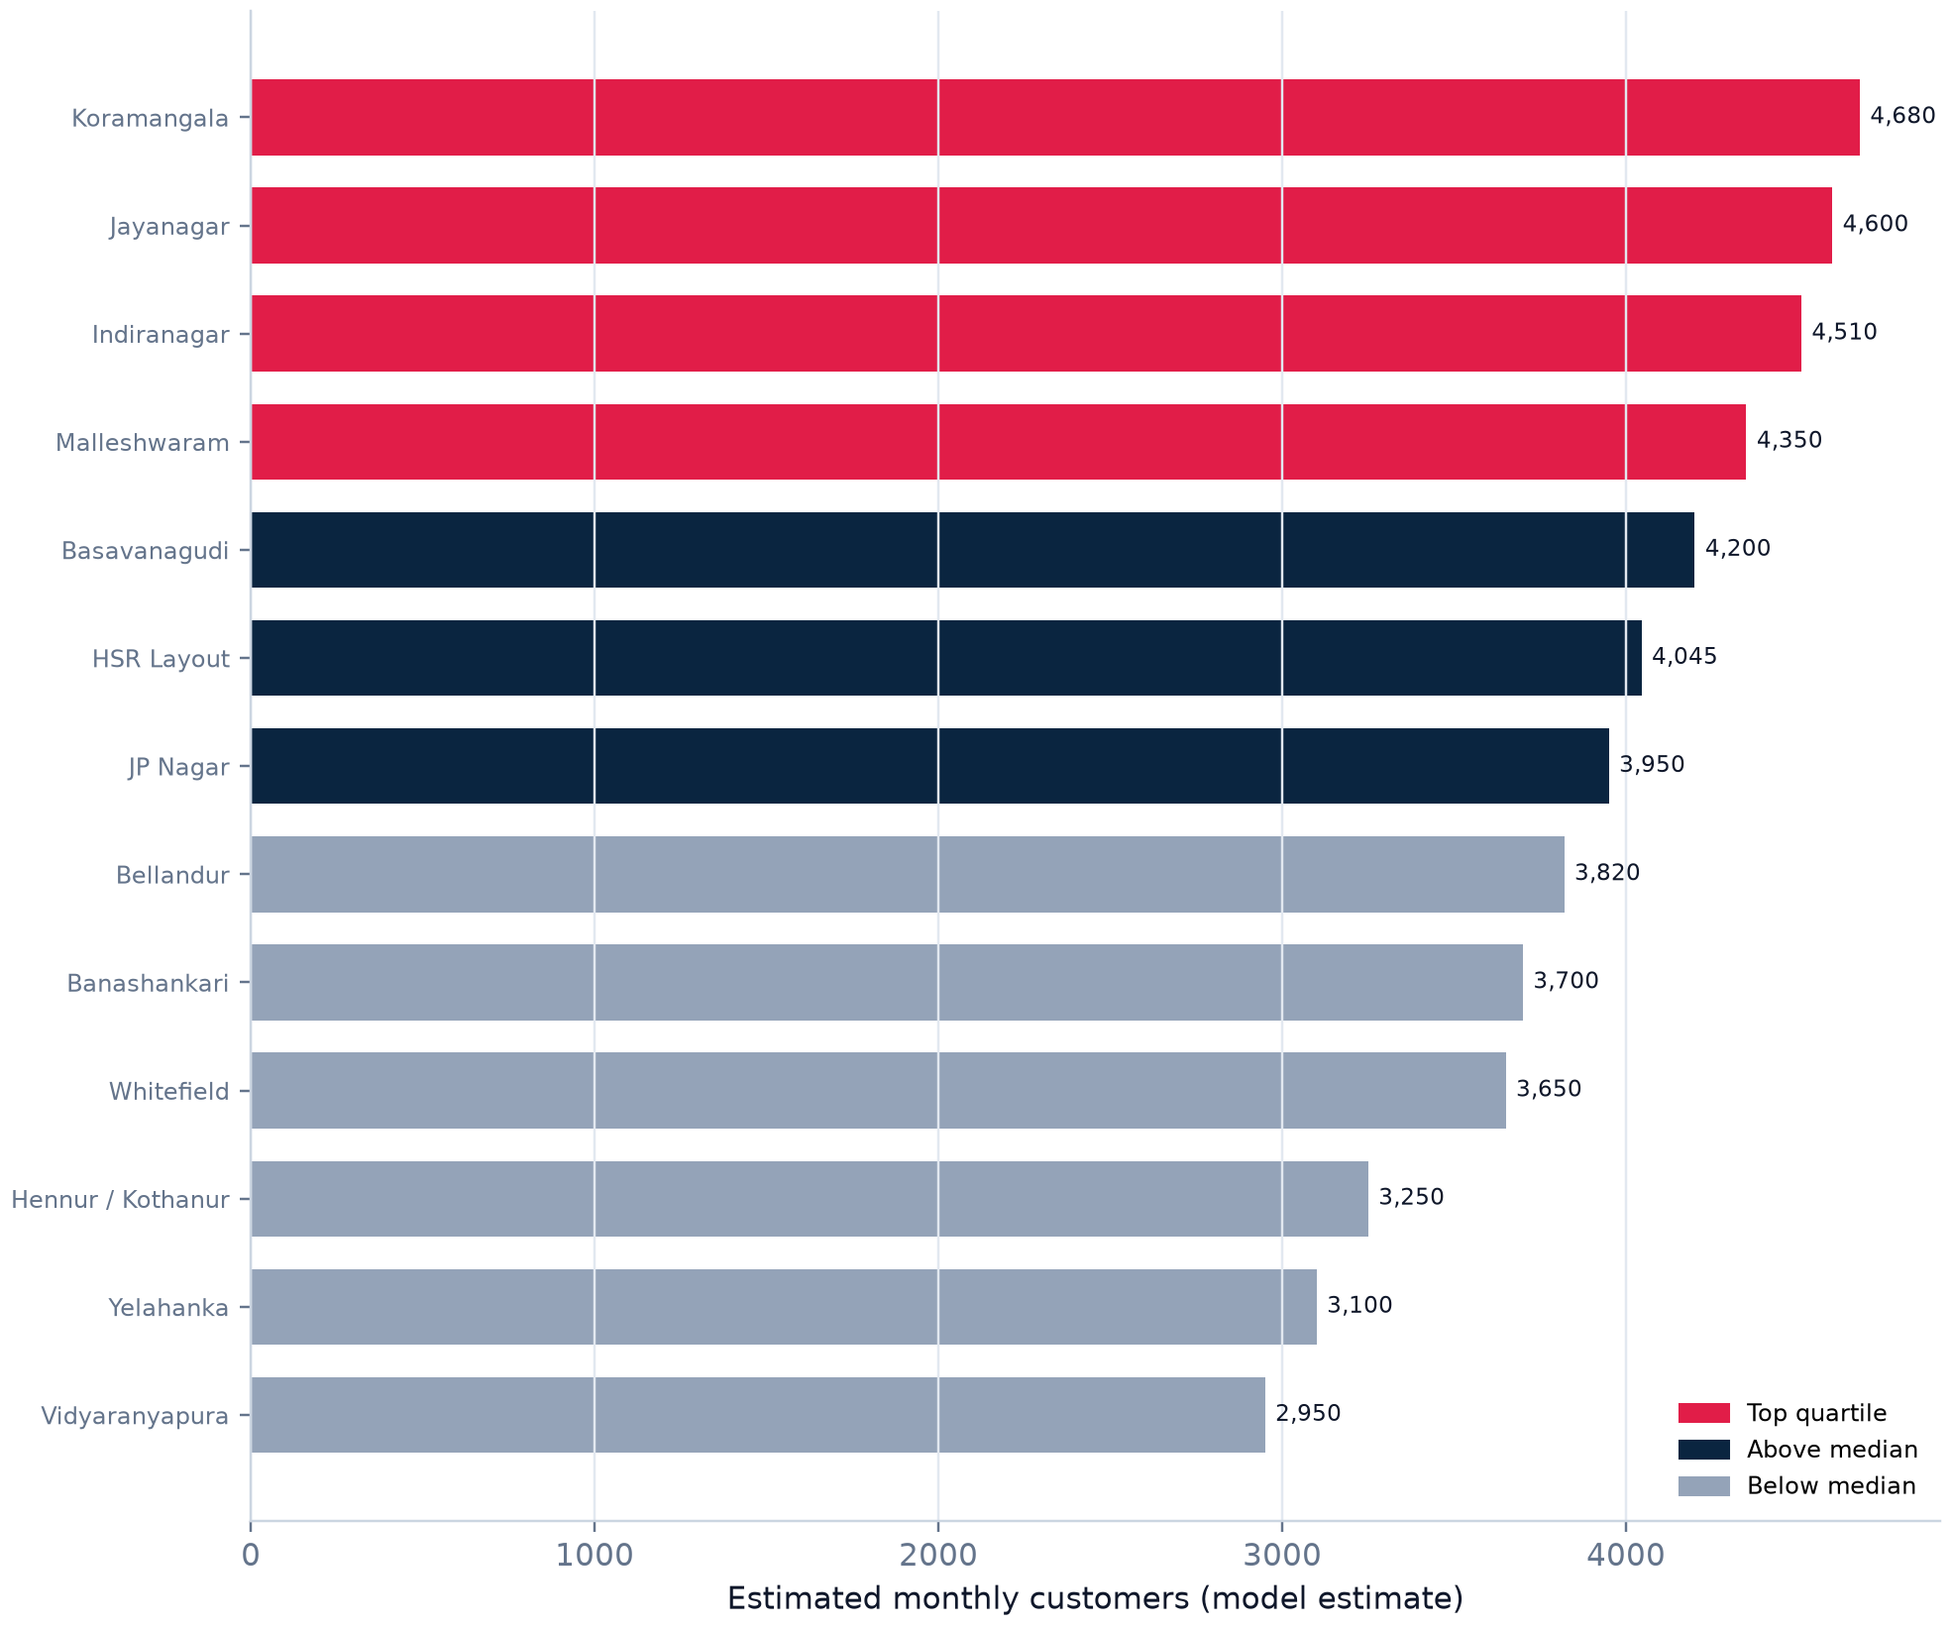
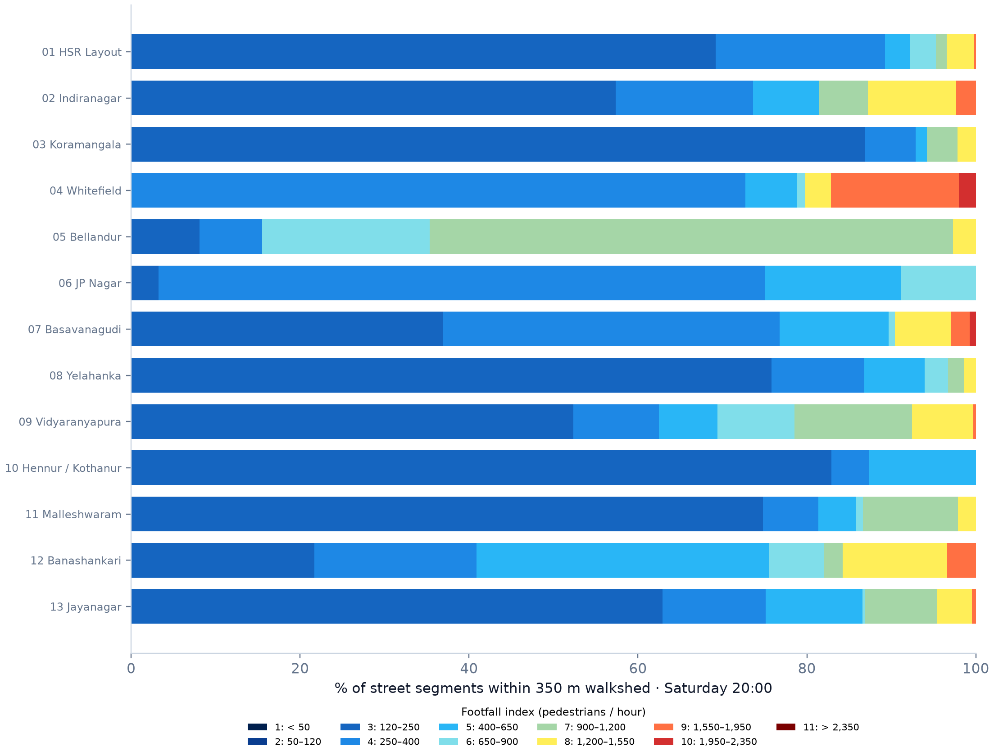
PERFORMANCE ANALYTICS
Network Benchmarking: Volume Distribution & Walkshed Quality
Key Network Benchmarking Insights:
• Top Quartile Correlation: Stores where >35% of walkshed vectors fall into Footfall Tier 7+ (>900 flow/hr) achieve 38% higher customer volume. Heritage family nodes (Jayanagar, Malleshwaram, Basavanagudi) outperform on pure volume, while tech corridors (Indiranagar, HSR) lead in ticket size (₹195–₹215).
Apsara Ice Creams · Bengaluru Footfall Intelligence & Site Selection Platform | Confidential
13 / 16

Slide 14
STAKEHOLDER ALIGNMENT
Triangulated Governance: Spatial Science, Finance & Operations
PREM REMARKS
GAURAV REMARKS
GOPAL REMARKS
GIS & Spatial Analytics Lead
Spatial Kinematics & Topology
Business Strategy & Real Estate Lead
Unit Economics & Capex Recovery
Retail Operations & Logistics Lead
Throughput & Cold-Chain Resilience
• Verify micro-spatial vector quality: Every prospective outlet must face a verified OSM street tier with >= 1,200 ped/hr Saturday peak flow.
• Enforce 350m isochrone accessibility: Audit physical barriers, median dividers, and pedestrian crossings that could sever the walkshed.
• Automated Cannibalization Alert: Enforce a strict minimum 1.2 km buffer between Apsara stores in high-density corridors (1.8 km in suburban layouts).
• Strict Rent Ceiling: Fixed monthly lease occupancy cost must not exceed 12–14% of conservative baseline sales projections.
• Payback Hurdle (<9 Months): Store fit-out Capex (₹25–₹32 Lakhs) must achieve full payback within 6 to 9 operating months.
• Footprint Discipline: Reject oversized properties (>700 sq.ft.); maintain tight 400–600 sq.ft. formats with minimum 15-foot street frontage.
• Peak Rush Throughput (<90s): Fast-track dual POS terminals and pre-dipped grab-and-go displays during 20:00–22:30 dessert rush.
• Cold-Chain Buffer (2.5×): Back-of-house freezer capacity must hold 2.5× average daily volume by Friday 10:00 AM to absorb weekend surges.
• Delivery Rider Staging: Separate delivery rider pickup window from walk-in retail families to prevent in-store bottlenecking.
Apsara Ice Creams · Bengaluru Footfall Intelligence & Site Selection Platform | Confidential
14 / 16

Slide 15
EXPANSION HEURISTIC
Strategic Expansion Playbook & Priority Future Corridors
The 4-Step Site Selection Scoring Protocol
Step 1: Macro-Corridor Screening (Census & Ward)
Target BBMP wards with population >65,000, literacy >86%, youth (18–35) proportion >32%, and SEC A/B household dominance.
Step 2: Micro-Pedestrian Vector Audit (OSM Flow)
Verify prospective road segment has Saturday evening flow >= 1,200 ped/hr. Reject parallel residential back-alleys regardless of cheap rent.
Step 3: Agglomeration & Cannibalization Test
Ensure site sits within 200m of >= 2 complementary QSRs/cafes, and enforces a >= 1.2 km radius buffer from existing Apsara outlets.
Step 4: Real Estate & Physical Feasibility Check
Strict verification: 400–600 sq.ft., 15+ ft frontage, zero entrance steps, 25 kVA power, and lease rent <= 12–14% of projected sales.
1. Sarjapur Road / Doddakannelli Axis
Southeast Growth Corridor · High Disposable Tech Families
High concentration of gated villa communities and premier tech campuses (Wipro SEZ). Massive weekend family dessert demand with low artisanal ice cream penetration.
2. Electronic City (Neeladri Road Spine)
South Tech Hub · Young Tech Professional Demographic
High-density rental corridor with 45,000+ young IT professionals living within 1 km. High weeknight and late-night dessert delivery orders with favorable rental economics.
3. Thanisandra Main Road (Bhartiya City Axis)
North Bengaluru Growth Axis · High-Rise Family Hub
Direct connectivity to Manyata Tech Park. Rapid influx of upper-middle-income families in high-density township developments creates early-mover advantage.
Apsara Ice Creams · Bengaluru Footfall Intelligence & Site Selection Platform | Confidential
15 / 16

Slide 16
DELIVERABLE SUITE
Client Deliverables: Interactive Platform & Data Ecosystem
LIVE INTERACTIVE TOOL
MASTER EXCEL MATRIX
PRODUCTION CLOUD ARCHIVE
Interactive Web Dashboard
spkumar944.github.io/bengaluru-footfall-intelligence
Explore 47,980 OSM road vectors, simulate 24-hr diurnal footfall, toggle competitor layers and POI demand magnets, and inspect 350m walksheds in real-time.
7-Column Location Factor Matrix
Apsara_Ice_Cream_Store_Location_Factors.xlsx
Detailed 8-factor and sub-factor evaluations across all 13 core stores with dedicated expert remarks from Prem (GIS), Gaurav (Strategy), and Gopal (Operations).
Google Drive Data Package
drive.google.com/drive/folders/1FhW-xstz3v2AftcKLfyF0ZnJXBUeGwt9
Impeccably organized 6-directory project structure containing all GeoJSON master layers, store dossiers, OSM cache graphs, and reproducible analytics scripts.
Ready for Strategic Rollout & Executive Alignment
The platform delivers an institutional-grade site selection standard for Apsara Ice Creams across Bengaluru. For questions or bespoke micro-market analysis, contact the project team.
Apsara Ice Creams · Bengaluru Footfall Intelligence & Site Selection Platform | Confidential
16 / 16

