Slide 1
PDDL Copilot — sweep-5 LIVE (in-flight, v11-v16 active prompts)
Qwen3.5:0.8B / 4B / 9B · gemma4:26b-a4b · qwen3.6:35b · sweep-5 active arms: neutral v11-v13 + steered v14-v16 · all-tools vs no-tools · think on/off · PRELIMINARY — partial cells (min-out 100 trials); missing bars = cell not yet at threshold

Slide 2
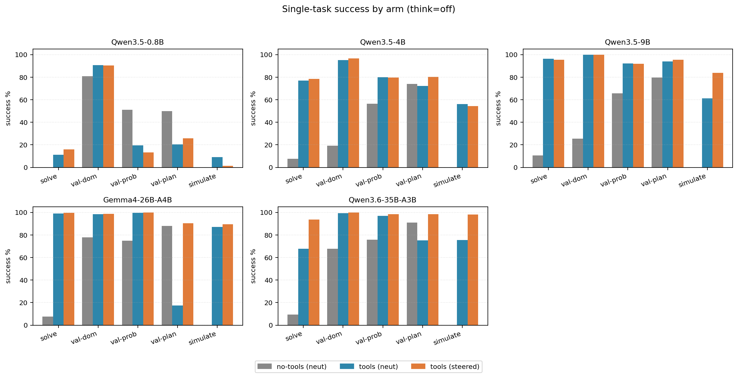
Success rates: by arm (think=off)
PRELIMINARY view: per-task success on partial sweep-5 cells (v11-v16, min-out 100). Missing bars = cell not yet at threshold. As of this rebuild, qwen3_6_35b and the smaller Qwen3.5 sizes have the most coverage; gemma4 no-tools cells lag.

Slide 3
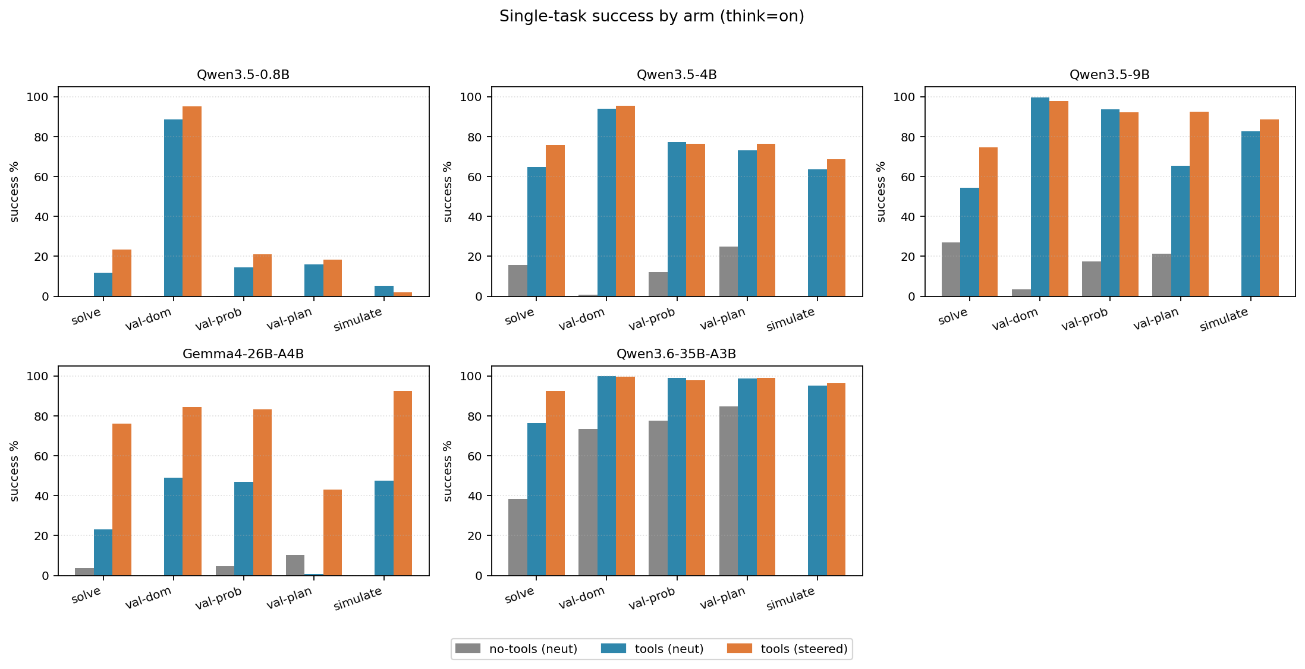
Success rates: by arm (think=on)
Same chart, think=on. Note Qwen3.5-0.8B on/no-tools is dominated by truncated_no_answer (reasoning consumes the entire output budget). gemma4 on/no-tools is below the min-out threshold so has no bar.

Slide 4
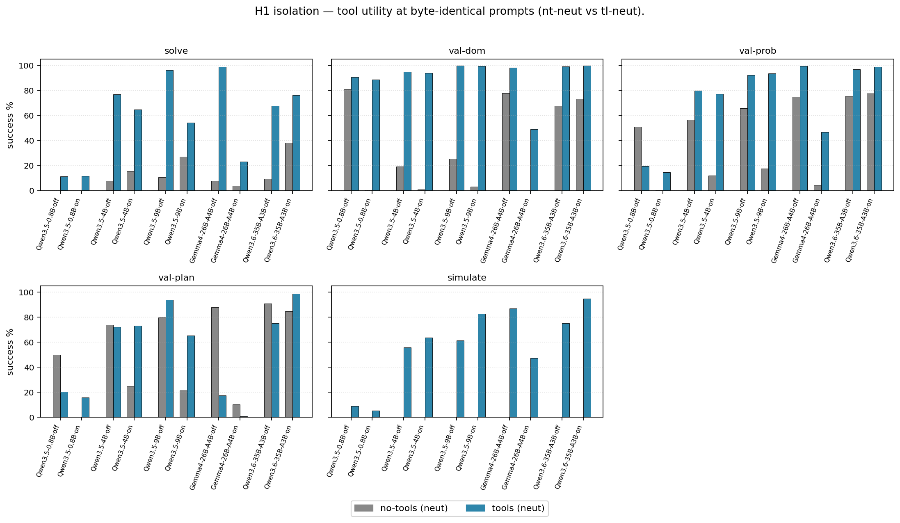
H1 — tool utility (byte-identical prompts)
H1 — tool utility at byte-identical prompt content. Grey = no-tools (neut), blue = with-tools (neut). The (blue − grey) gap is the headline tool-utility claim from arXiv:2509.12987 under sweep-5's controlled comparison (same prompt text on both sides).

Slide 5
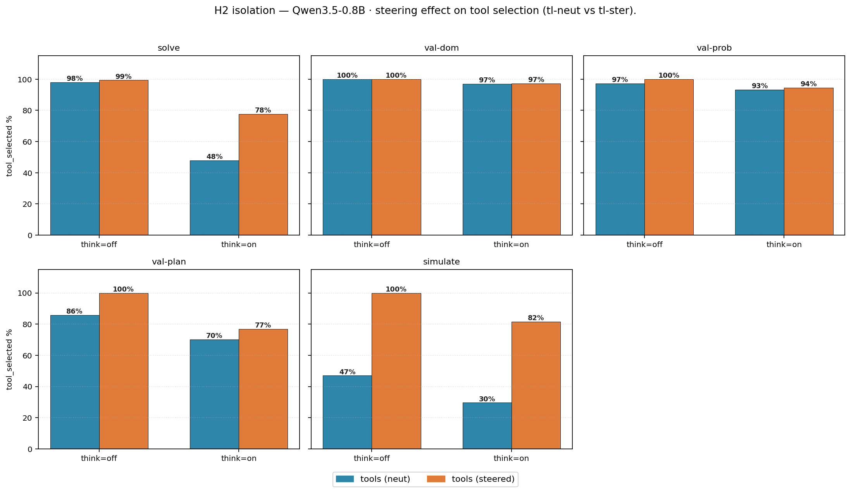
H2 — steering effect on tool selection · Qwen3.5-0.8B
H2 — steering effect on tool selection, isolated to this model. Blue = with-tools (neut), orange = with-tools (steered). Bar height = tool_selected%; black label above bar = selection mean. H2 predicts blue → orange raises selection. Per-model slides — H2 is a within-model claim (does steering shift *this* model's selection), so each model stands alone rather than competing on a shared axis. FR_WRONG_TOOL share is 0% across this sweep (marketplace 1.4.0 classifier separates no-tool-call from wrong-tool) so its inset was dropped from the bars.

Slide 6
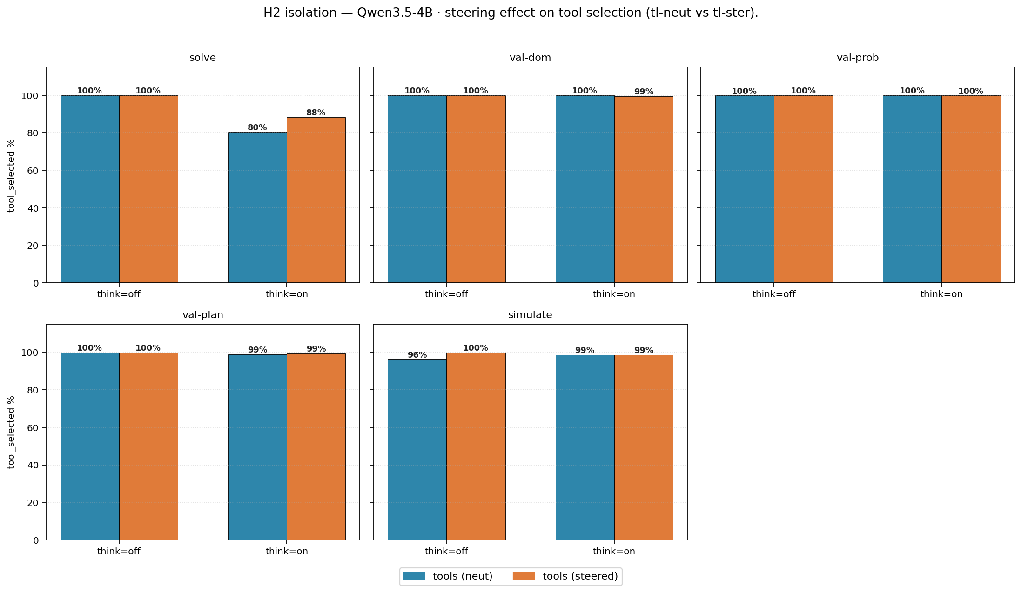
H2 — steering effect on tool selection · Qwen3.5-4B
H2 — steering effect on tool selection, isolated to this model. Blue = with-tools (neut), orange = with-tools (steered). Bar height = tool_selected%; black label above bar = selection mean. H2 predicts blue → orange raises selection. Per-model slides — H2 is a within-model claim (does steering shift *this* model's selection), so each model stands alone rather than competing on a shared axis. FR_WRONG_TOOL share is 0% across this sweep (marketplace 1.4.0 classifier separates no-tool-call from wrong-tool) so its inset was dropped from the bars.

Slide 7
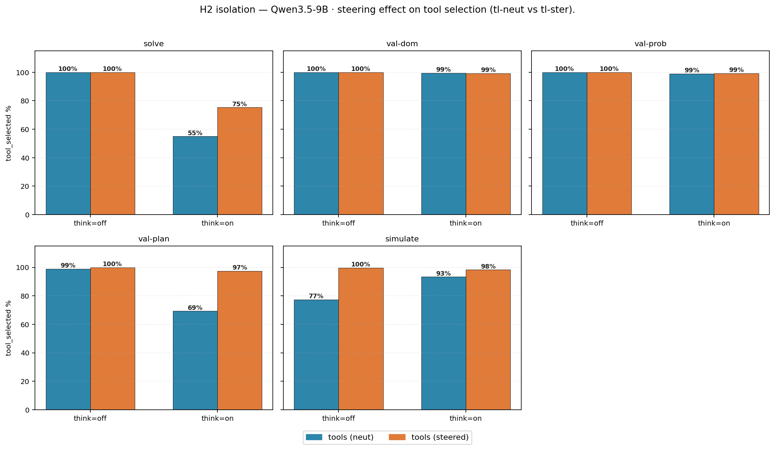
H2 — steering effect on tool selection · Qwen3.5-9B
H2 — steering effect on tool selection, isolated to this model. Blue = with-tools (neut), orange = with-tools (steered). Bar height = tool_selected%; black label above bar = selection mean. H2 predicts blue → orange raises selection. Per-model slides — H2 is a within-model claim (does steering shift *this* model's selection), so each model stands alone rather than competing on a shared axis. FR_WRONG_TOOL share is 0% across this sweep (marketplace 1.4.0 classifier separates no-tool-call from wrong-tool) so its inset was dropped from the bars.

Slide 8
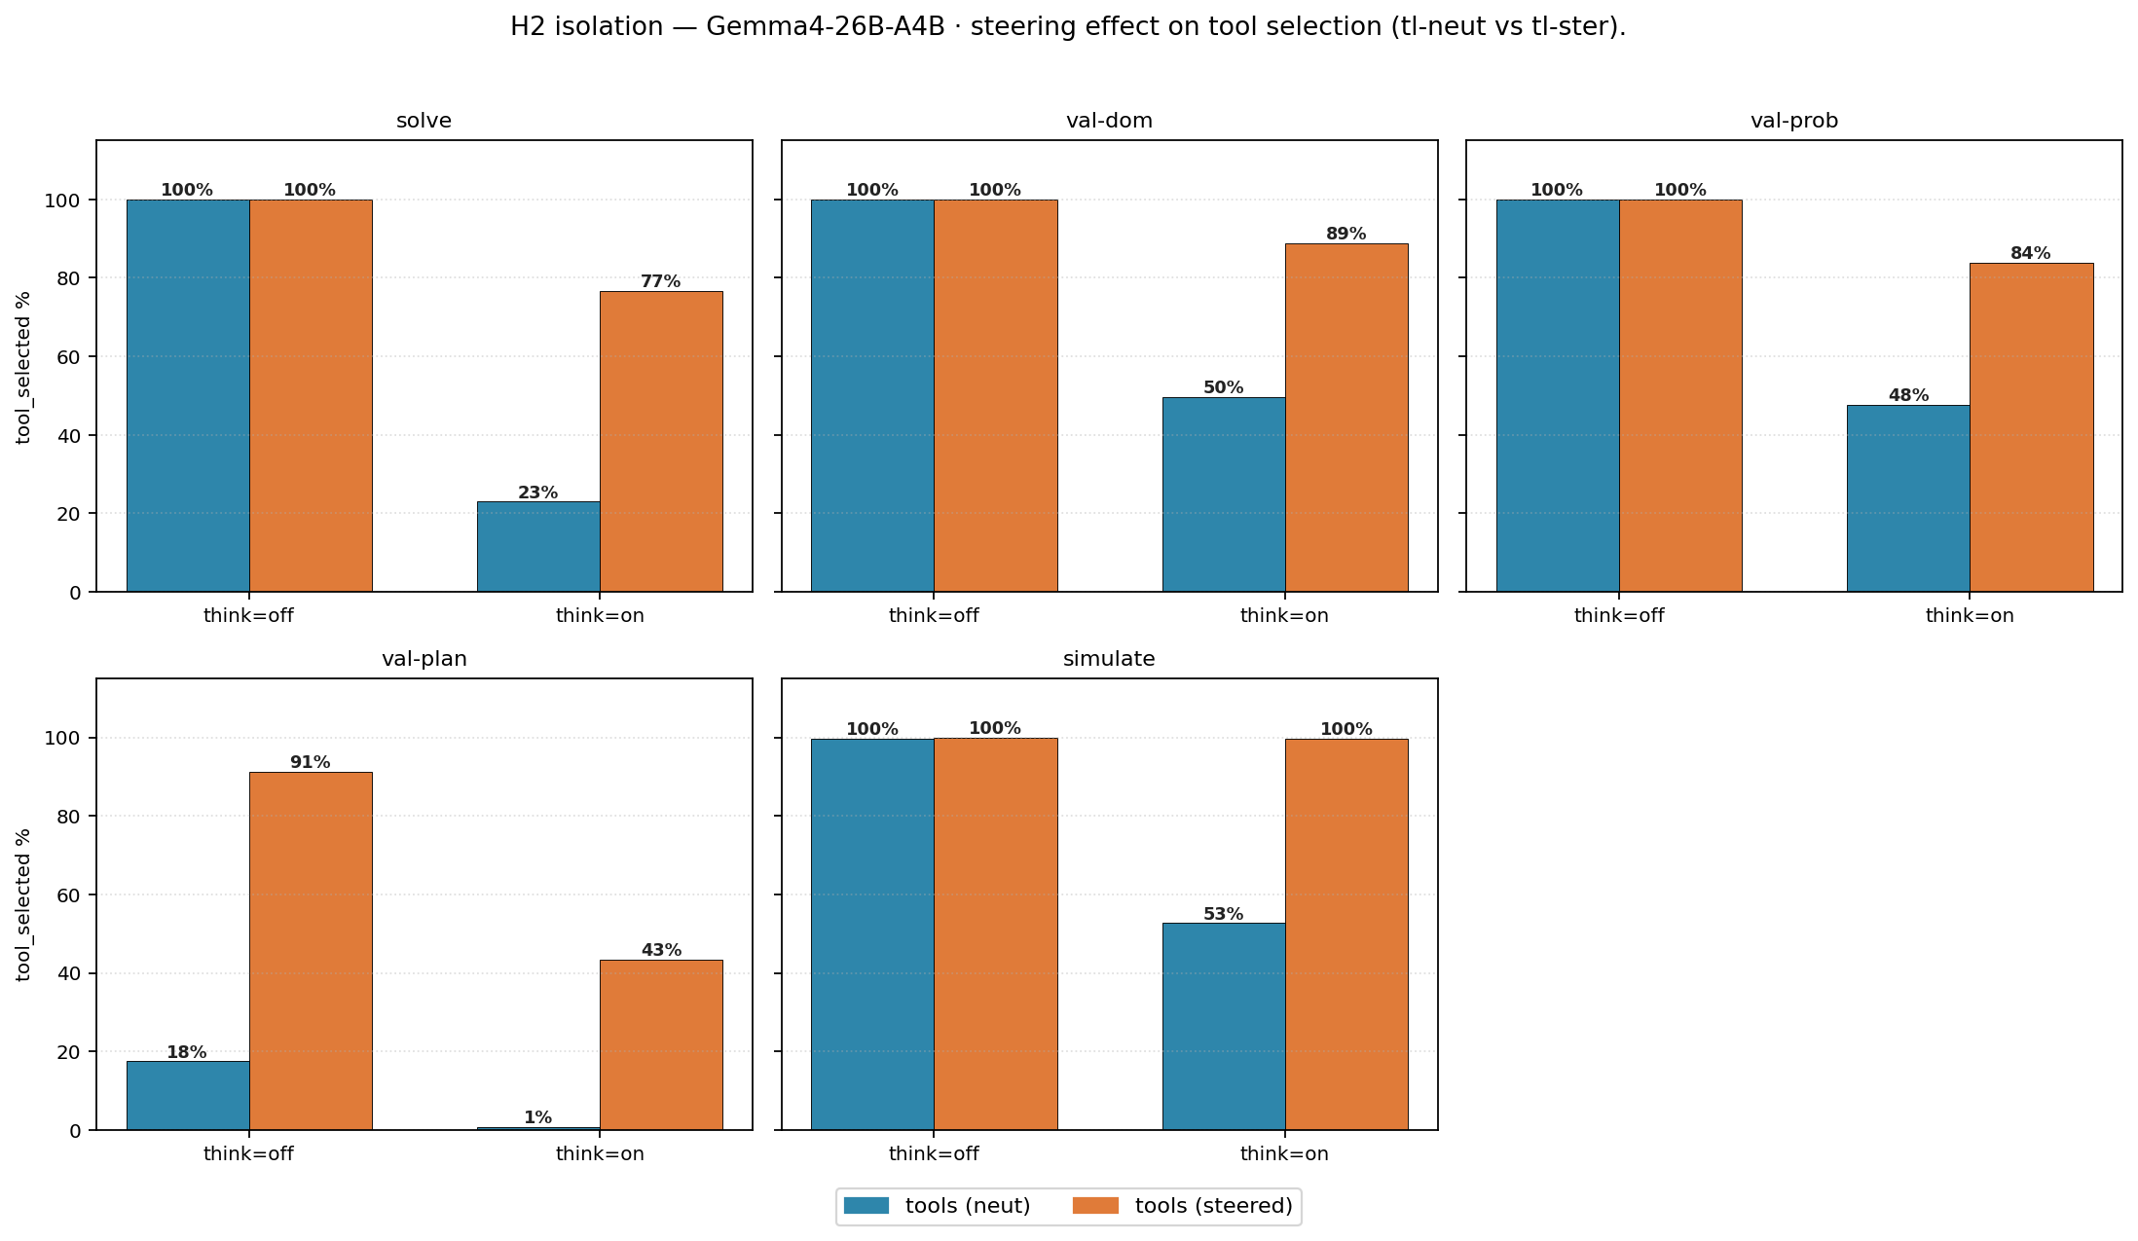
H2 — steering effect on tool selection · Gemma4-26B-A4B
H2 — steering effect on tool selection, isolated to this model. Blue = with-tools (neut), orange = with-tools (steered). Bar height = tool_selected%; black label above bar = selection mean. H2 predicts blue → orange raises selection. Per-model slides — H2 is a within-model claim (does steering shift *this* model's selection), so each model stands alone rather than competing on a shared axis. FR_WRONG_TOOL share is 0% across this sweep (marketplace 1.4.0 classifier separates no-tool-call from wrong-tool) so its inset was dropped from the bars.

Slide 9
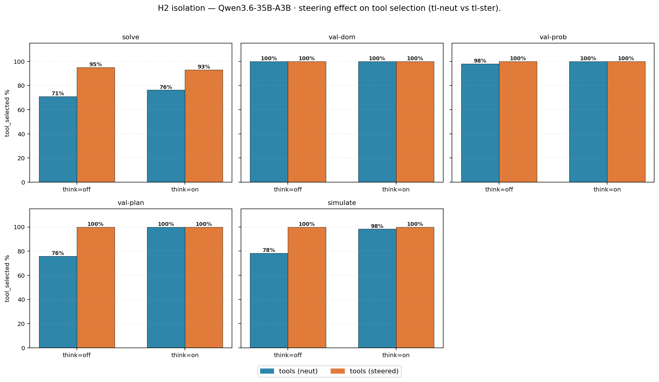
H2 — steering effect on tool selection · Qwen3.6-35B-A3B
H2 — steering effect on tool selection, isolated to this model. Blue = with-tools (neut), orange = with-tools (steered). Bar height = tool_selected%; black label above bar = selection mean. H2 predicts blue → orange raises selection. Per-model slides — H2 is a within-model claim (does steering shift *this* model's selection), so each model stands alone rather than competing on a shared axis. FR_WRONG_TOOL share is 0% across this sweep (marketplace 1.4.0 classifier separates no-tool-call from wrong-tool) so its inset was dropped from the bars.

Slide 10
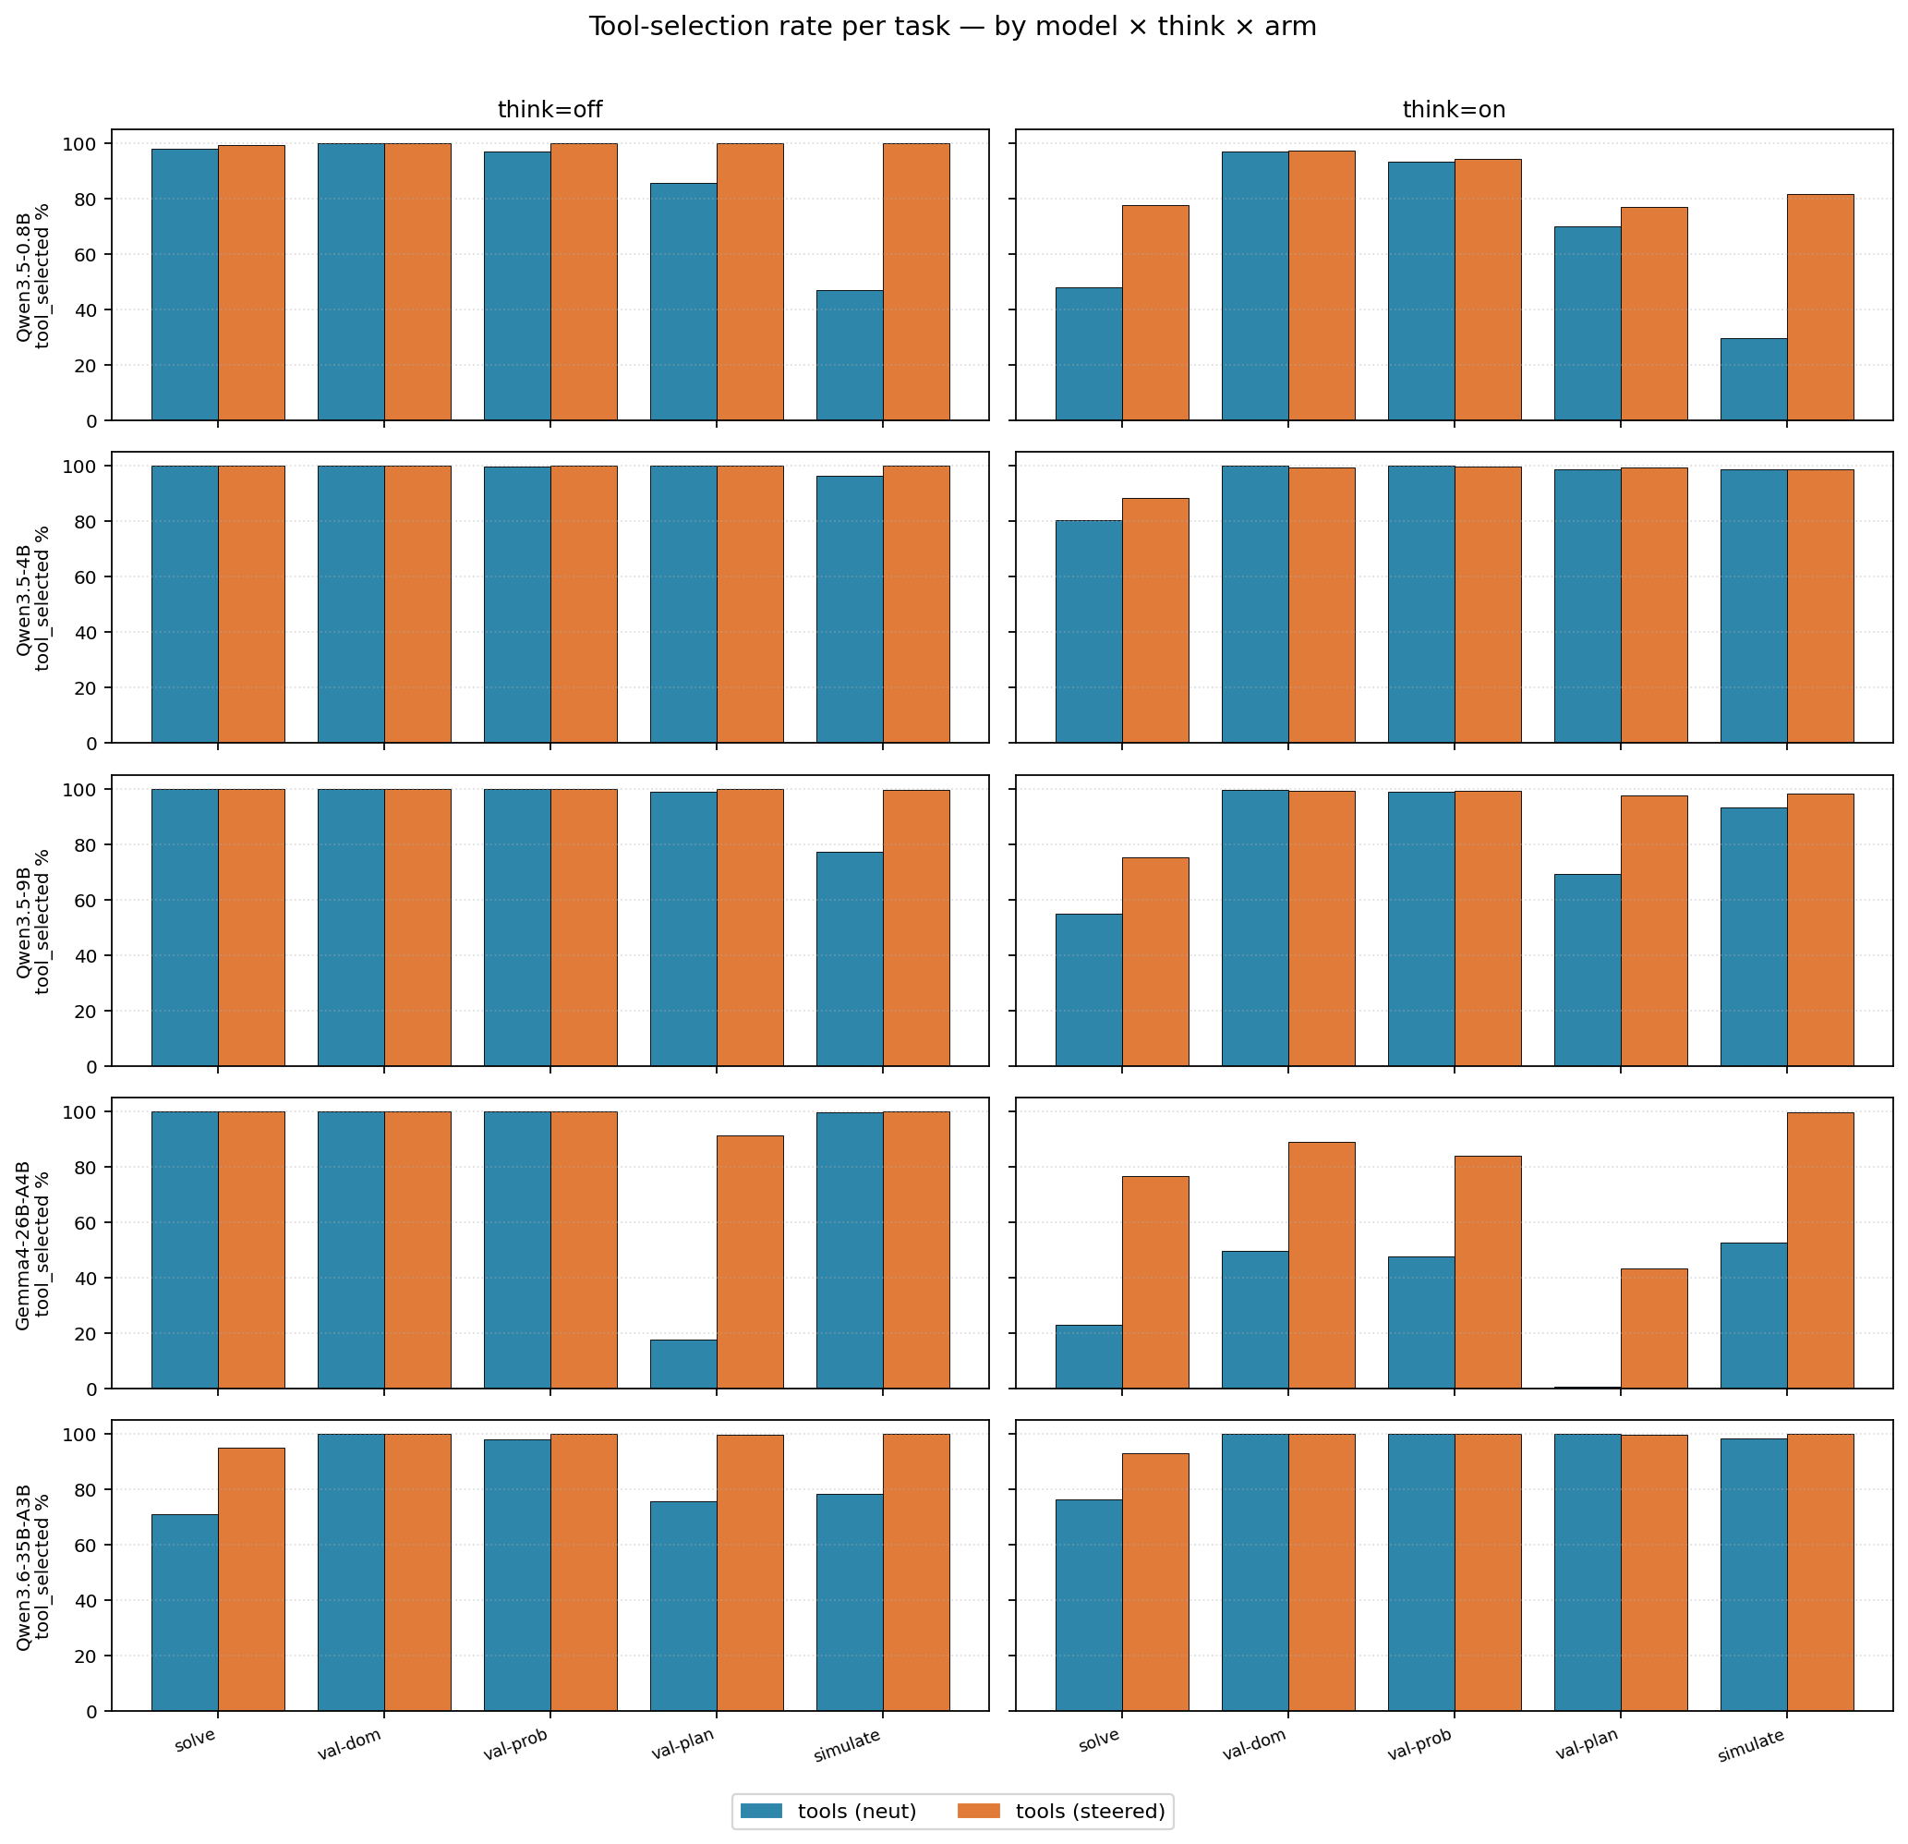
Tool selection rate per task — by arm
% of with-tools trials where the model invoked the expected planner/validator tool, over v11-v16 partial cells.

Slide 11
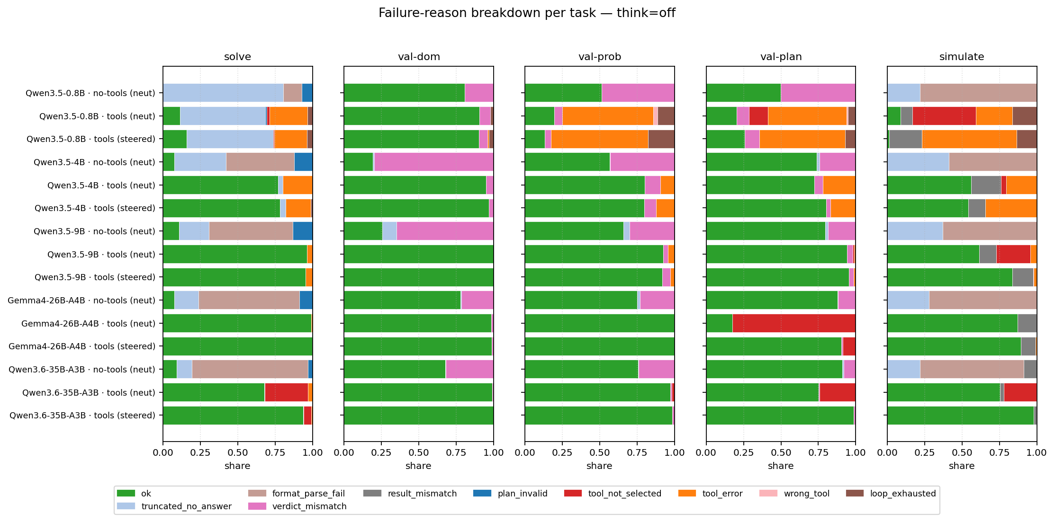
Failure-reason breakdown per task (think=off)
100%-stacked share of failure reasons per (model × arm × task) at think=off. verdict_mismatch and format_parse_fail dominate; truncated_no_answer present on the few rows that did hit the output cap. think_overflow is empty by gate — only think=on rows can carry it.

Slide 12
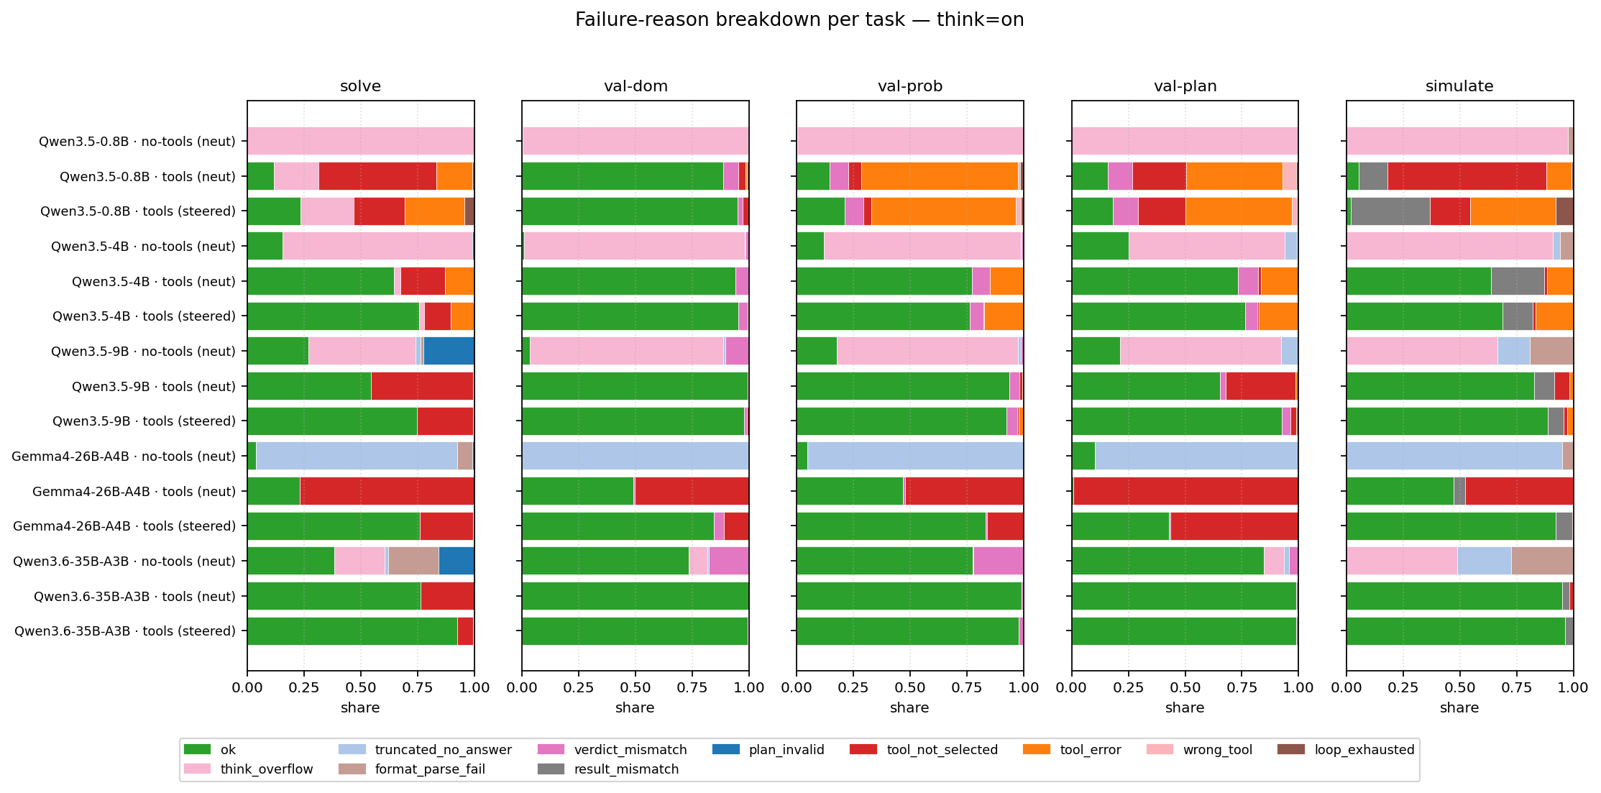
Failure-reason breakdown per task (think=on)
Same chart at think=on. The light-pink think_overflow slab is the 2026-05-25 read-time relabel: rows where the model exhausted the output budget without emitting a visible response (vLLM qwen3 reasoning-parser eats partial `<think>` content on length-truncation). Qwen3.5 sizes are dominated by think_overflow on no-tools tasks; gemma4 (no reasoning parser) stays on truncated_no_answer because its response field is non-empty.

Slide 13
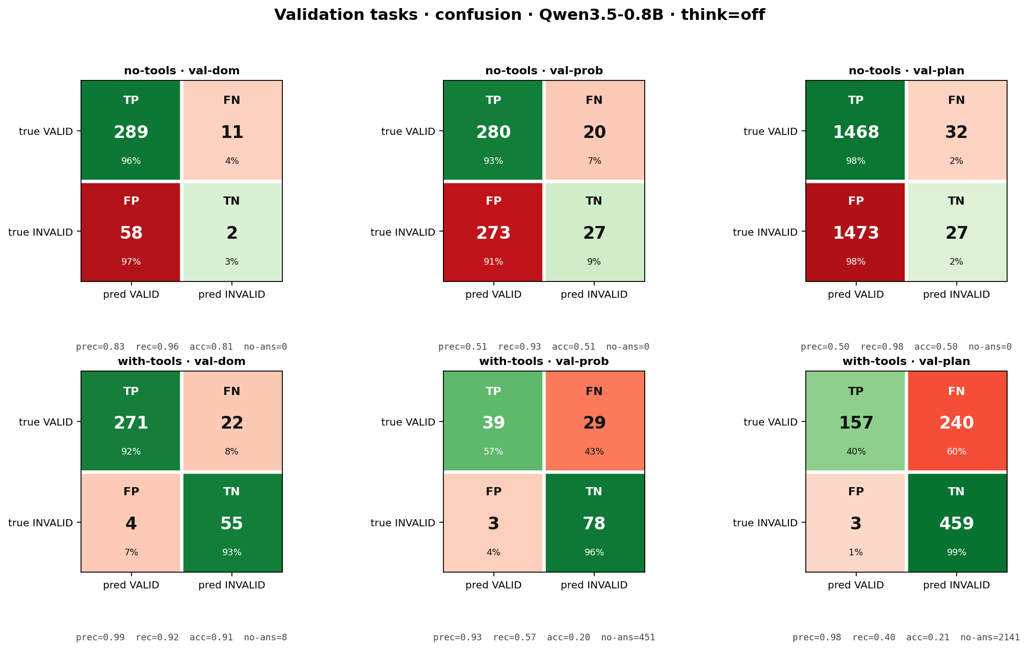
Validation confusion · Qwen3.5-0.8B · think=off
One row per model; columns = validate_domain, validate_problem, validate_plan. TP = correctly predicted VALID, TN = correctly predicted INVALID. 'no-ans' counts truncated / parse-fail trials excluded from prec/rec/acc.

Slide 14
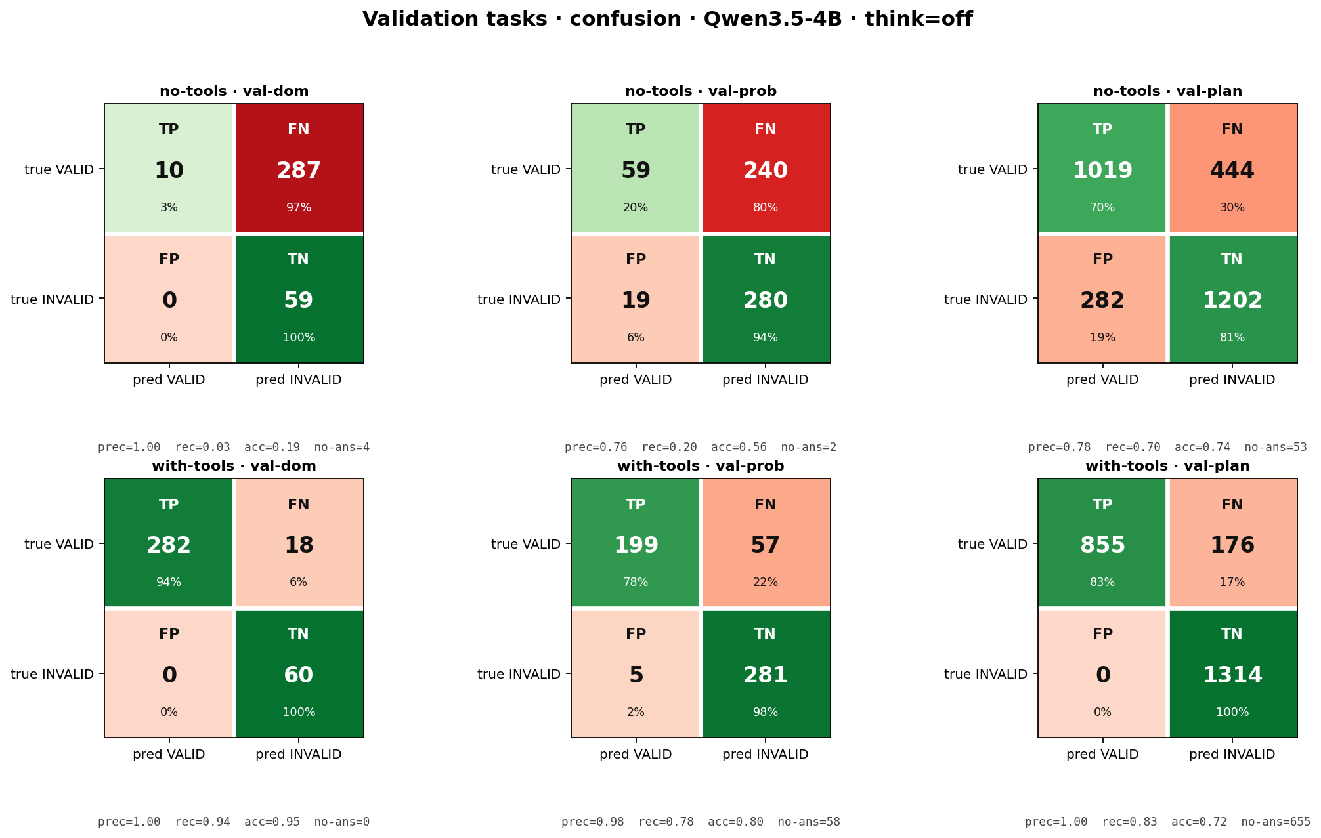
Validation confusion · Qwen3.5-4B · think=off
One row per model; columns = validate_domain, validate_problem, validate_plan. TP = correctly predicted VALID, TN = correctly predicted INVALID. 'no-ans' counts truncated / parse-fail trials excluded from prec/rec/acc.

Slide 15
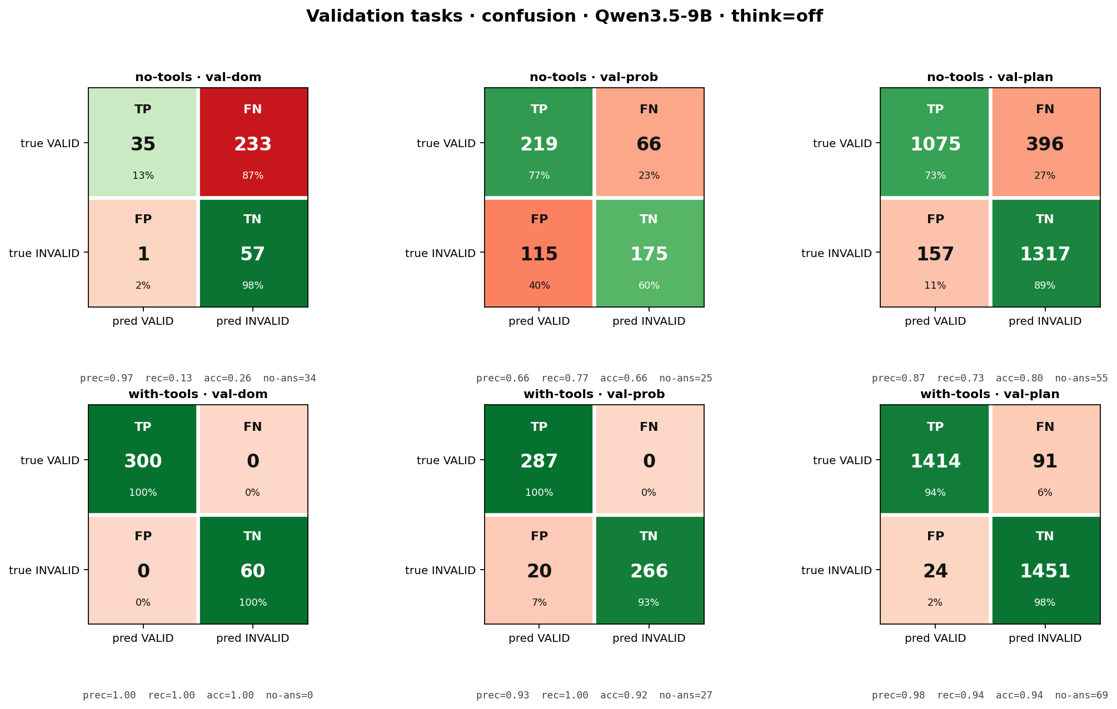
Validation confusion · Qwen3.5-9B · think=off
One row per model; columns = validate_domain, validate_problem, validate_plan. TP = correctly predicted VALID, TN = correctly predicted INVALID. 'no-ans' counts truncated / parse-fail trials excluded from prec/rec/acc.

Slide 16
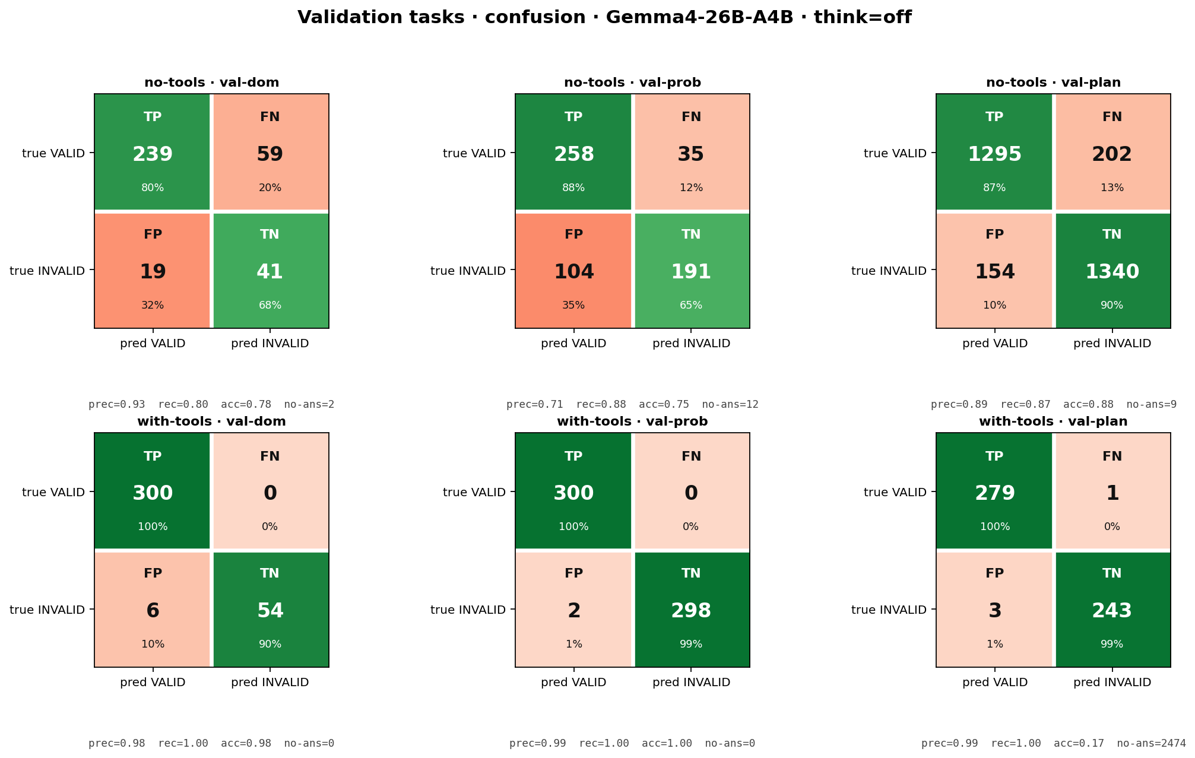
Validation confusion · Gemma4-26B-A4B · think=off
One row per model; columns = validate_domain, validate_problem, validate_plan. TP = correctly predicted VALID, TN = correctly predicted INVALID. 'no-ans' counts truncated / parse-fail trials excluded from prec/rec/acc.

Slide 17
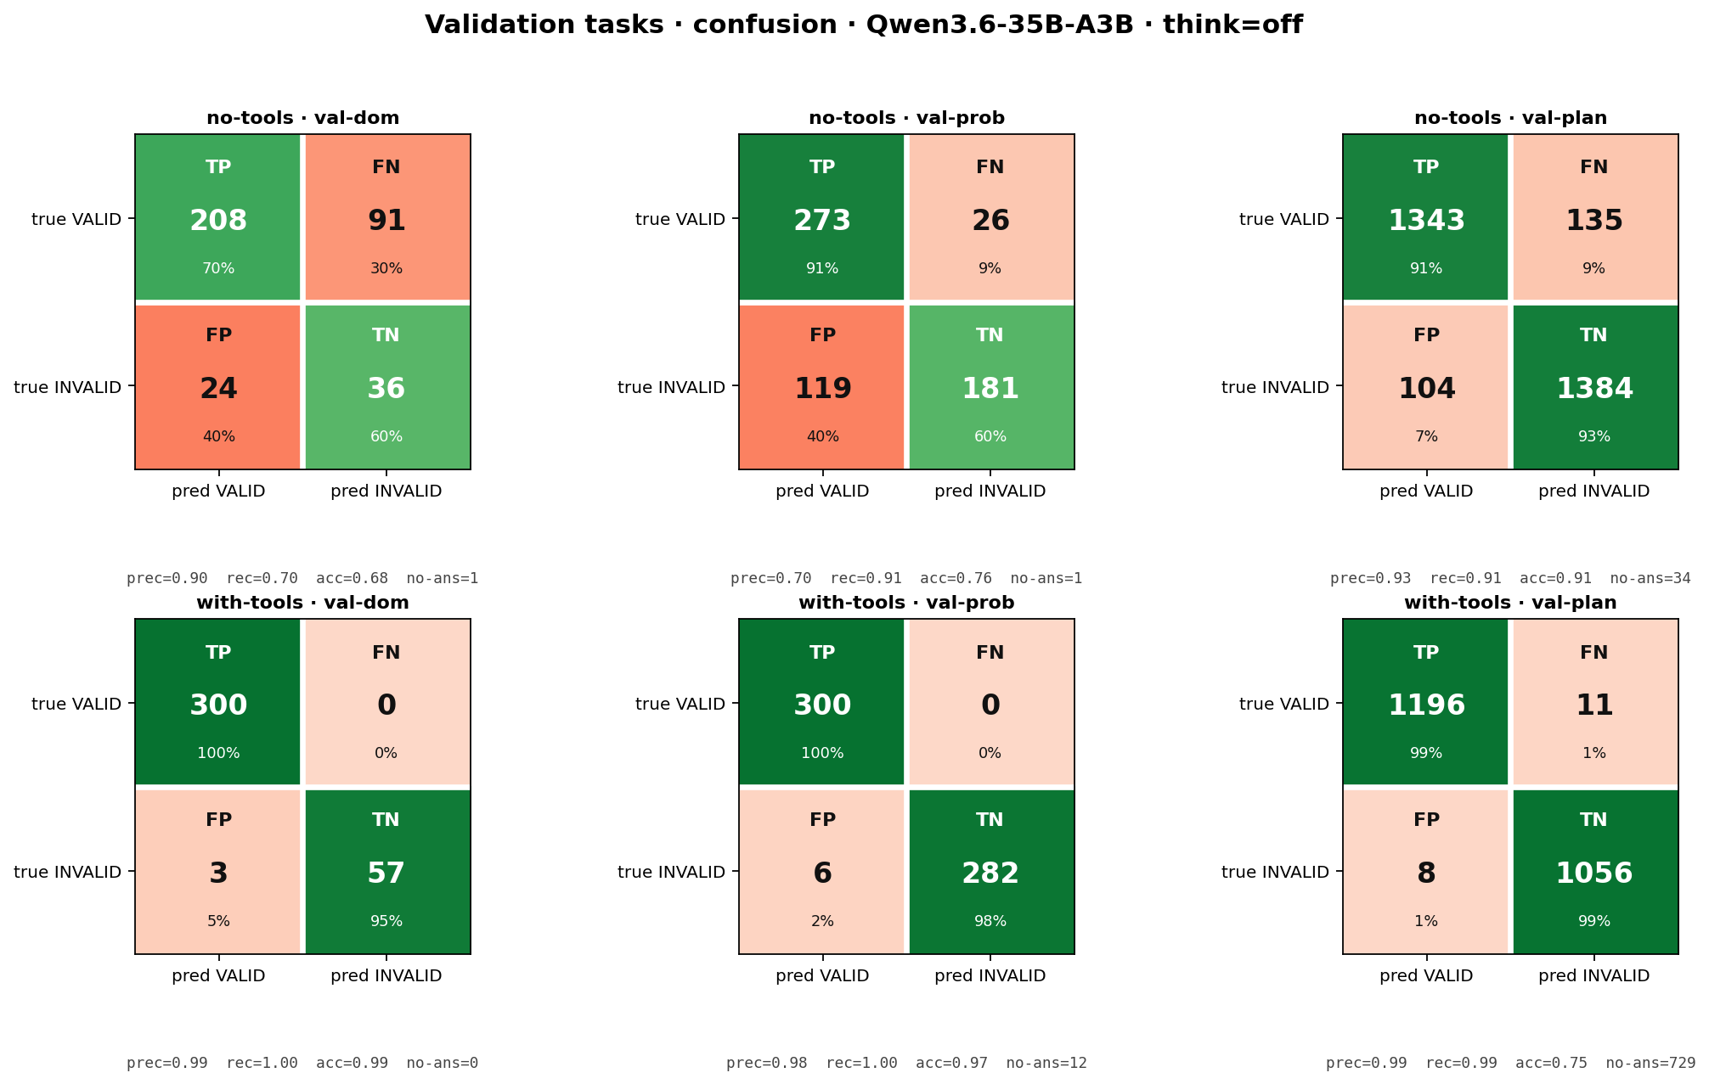
Validation confusion · Qwen3.6-35B-A3B · think=off
One row per model; columns = validate_domain, validate_problem, validate_plan. TP = correctly predicted VALID, TN = correctly predicted INVALID. 'no-ans' counts truncated / parse-fail trials excluded from prec/rec/acc.

Slide 18
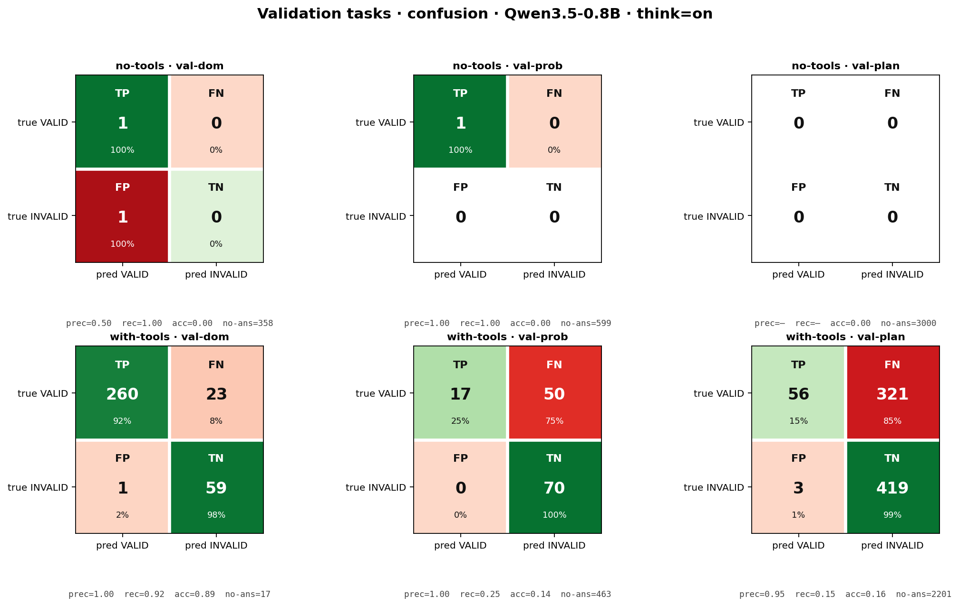
Validation confusion · Qwen3.5-0.8B · think=on
think=on bloats output budget — note the no-ans count: at this corpus the entire response is reasoning text with no JSON verdict (truncated_no_answer + format_parse_fail dominate).

Slide 19
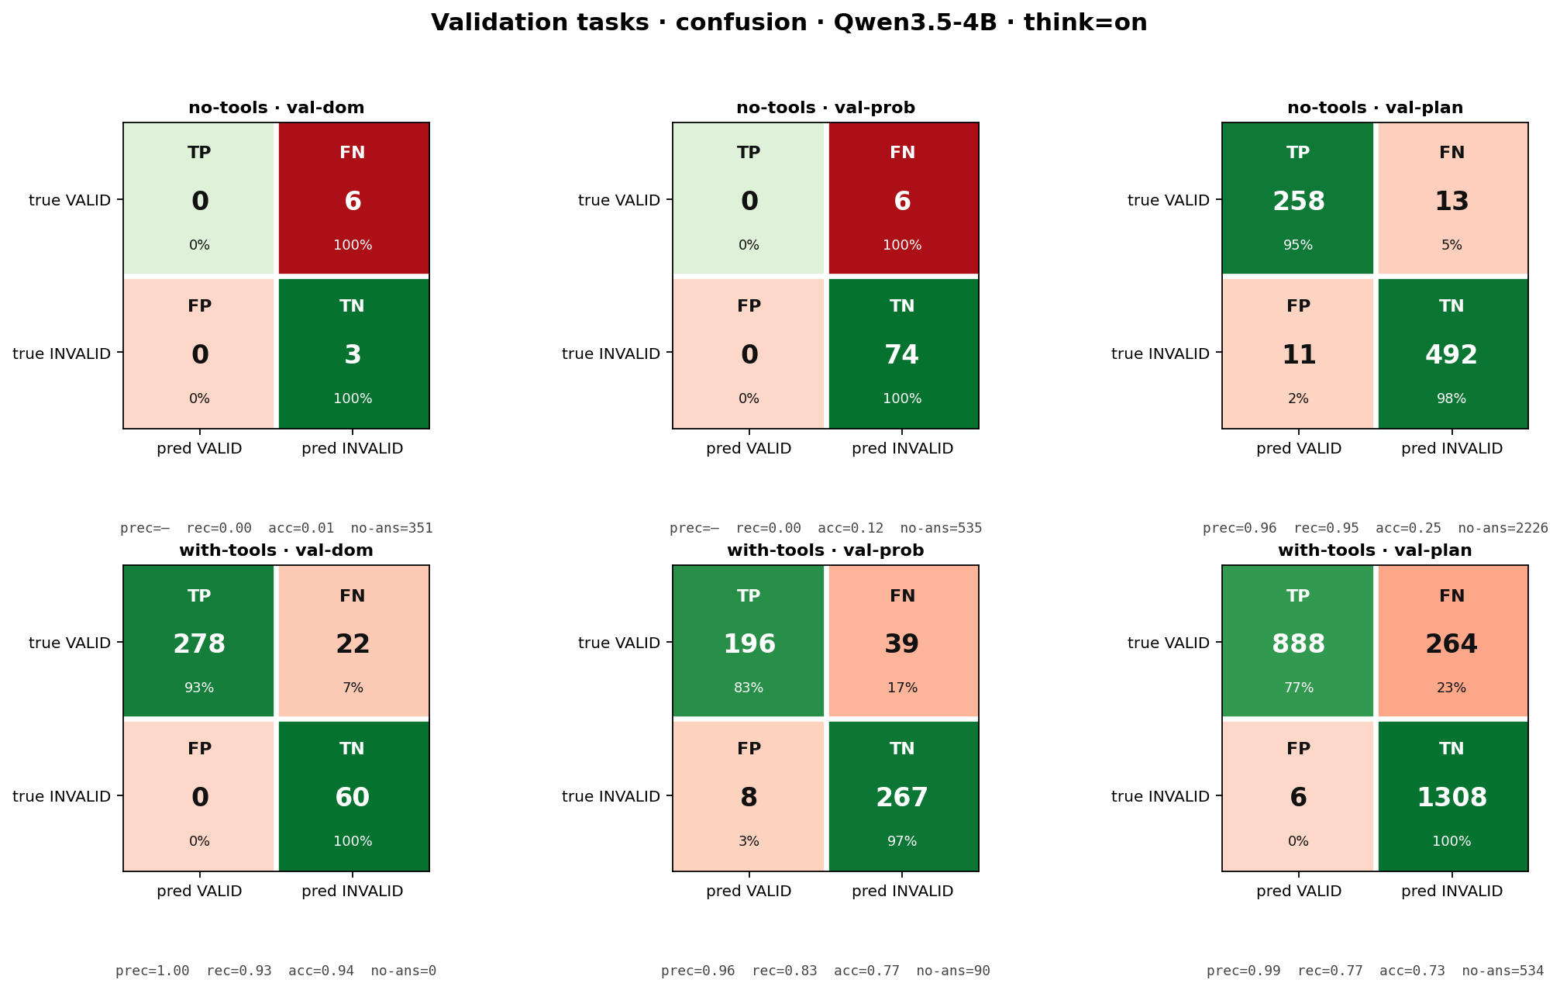
Validation confusion · Qwen3.5-4B · think=on
think=on bloats output budget — note the no-ans count: at this corpus the entire response is reasoning text with no JSON verdict (truncated_no_answer + format_parse_fail dominate).

Slide 20
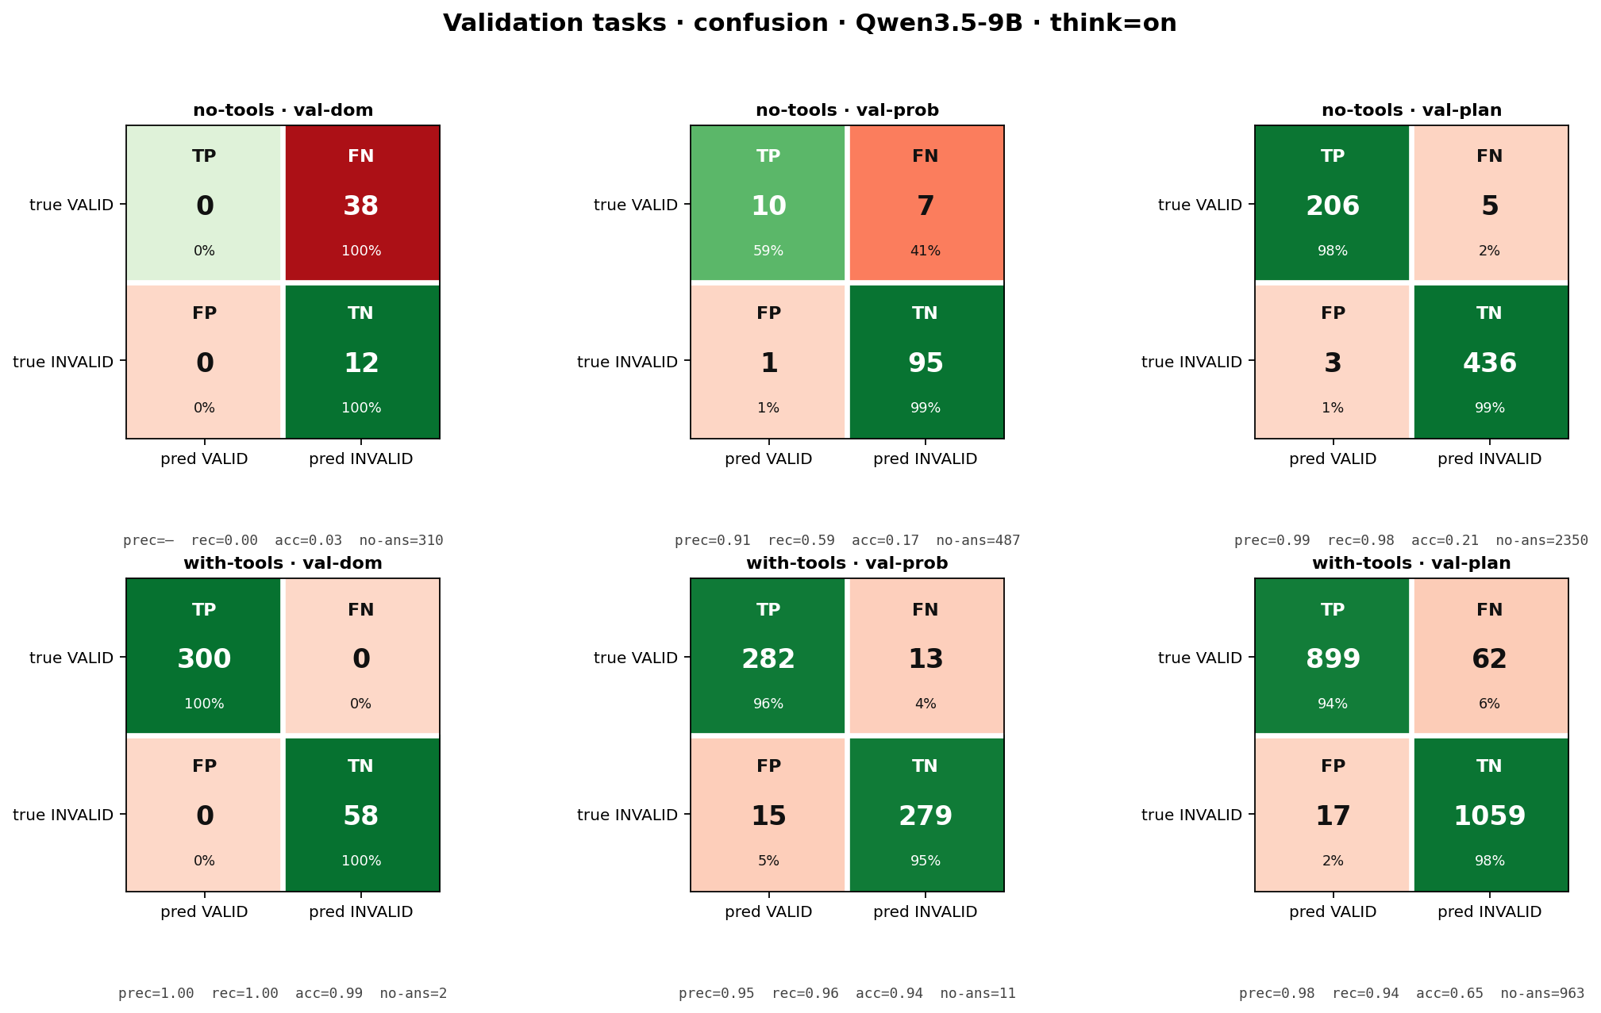
Validation confusion · Qwen3.5-9B · think=on
think=on bloats output budget — note the no-ans count: at this corpus the entire response is reasoning text with no JSON verdict (truncated_no_answer + format_parse_fail dominate).

Slide 21
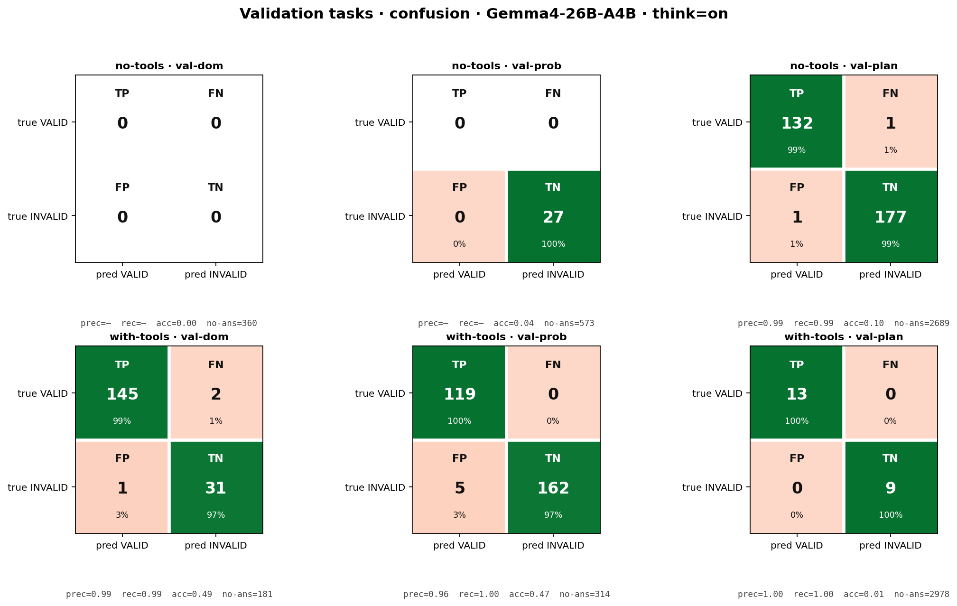
Validation confusion · Gemma4-26B-A4B · think=on
think=on bloats output budget — note the no-ans count: at this corpus the entire response is reasoning text with no JSON verdict (truncated_no_answer + format_parse_fail dominate).

Slide 22
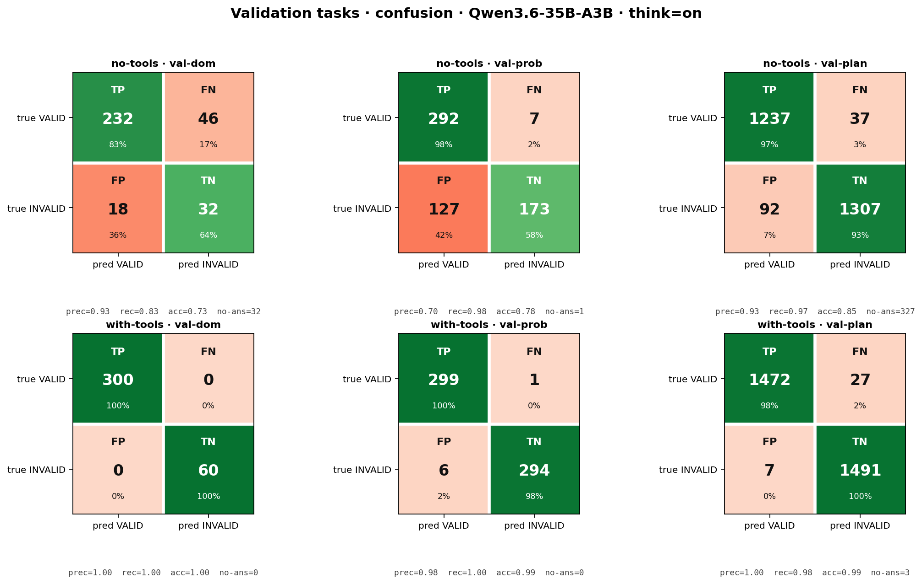
Validation confusion · Qwen3.6-35B-A3B · think=on
think=on bloats output budget — note the no-ans count: at this corpus the entire response is reasoning text with no JSON verdict (truncated_no_answer + format_parse_fail dominate).

Slide 23
Validation-task metrics · no-tools · think=off
model | task | TP | FP | FN | TN | no-ans | prec | rec | acc
Qwen3.5-0.8B | val-dom | 289 | 58 | 11 | 2 | 0 | 0.83 | 0.96 | 0.81
Qwen3.5-0.8B | val-prob | 280 | 273 | 20 | 27 | 0 | 0.51 | 0.93 | 0.51
Qwen3.5-0.8B | val-plan | 1468 | 1473 | 32 | 27 | 0 | 0.50 | 0.98 | 0.50
Qwen3.5-4B | val-dom | 10 | 0 | 287 | 59 | 4 | 1.00 | 0.03 | 0.19
Qwen3.5-4B | val-prob | 59 | 19 | 240 | 280 | 2 | 0.76 | 0.20 | 0.56
Qwen3.5-4B | val-plan | 1019 | 282 | 444 | 1202 | 53 | 0.78 | 0.70 | 0.74
Qwen3.5-9B | val-dom | 35 | 1 | 233 | 57 | 34 | 0.97 | 0.13 | 0.26
Qwen3.5-9B | val-prob | 219 | 115 | 66 | 175 | 25 | 0.66 | 0.77 | 0.66
Qwen3.5-9B | val-plan | 1075 | 157 | 396 | 1317 | 55 | 0.87 | 0.73 | 0.80
Gemma4-26B-A4B | val-dom | 239 | 19 | 59 | 41 | 2 | 0.93 | 0.80 | 0.78
Gemma4-26B-A4B | val-prob | 258 | 104 | 35 | 191 | 12 | 0.71 | 0.88 | 0.75
Gemma4-26B-A4B | val-plan | 1295 | 154 | 202 | 1340 | 9 | 0.89 | 0.87 | 0.88
Qwen3.6-35B-A3B | val-dom | 208 | 24 | 91 | 36 | 1 | 0.90 | 0.70 | 0.68
Qwen3.6-35B-A3B | val-prob | 273 | 119 | 26 | 181 | 1 | 0.70 | 0.91 | 0.76
Qwen3.6-35B-A3B | val-plan | 1343 | 104 | 135 | 1384 | 34 | 0.93 | 0.91 | 0.91
Notes:
prec=TP/(TP+FP), rec=TP/(TP+FN), acc=(TP+TN)/all trials including no-ans.

Slide 24
Validation-task metrics · with-tools · think=off
model | task | TP | FP | FN | TN | no-ans | prec | rec | acc
Qwen3.5-0.8B | val-dom | 271 | 4 | 22 | 55 | 8 | 0.99 | 0.92 | 0.91
Qwen3.5-0.8B | val-prob | 39 | 3 | 29 | 78 | 451 | 0.93 | 0.57 | 0.20
Qwen3.5-0.8B | val-plan | 157 | 3 | 240 | 459 | 2141 | 0.98 | 0.40 | 0.21
Qwen3.5-4B | val-dom | 282 | 0 | 18 | 60 | 0 | 1.00 | 0.94 | 0.95
Qwen3.5-4B | val-prob | 199 | 5 | 57 | 281 | 58 | 0.98 | 0.78 | 0.80
Qwen3.5-4B | val-plan | 855 | 0 | 176 | 1314 | 655 | 1.00 | 0.83 | 0.72
Qwen3.5-9B | val-dom | 300 | 0 | 0 | 60 | 0 | 1.00 | 1.00 | 1.00
Qwen3.5-9B | val-prob | 287 | 20 | 0 | 266 | 27 | 0.93 | 1.00 | 0.92
Qwen3.5-9B | val-plan | 1414 | 24 | 91 | 1451 | 69 | 0.98 | 0.94 | 0.94
Gemma4-26B-A4B | val-dom | 300 | 6 | 0 | 54 | 0 | 0.98 | 1.00 | 0.98
Gemma4-26B-A4B | val-prob | 300 | 2 | 0 | 298 | 0 | 0.99 | 1.00 | 1.00
Gemma4-26B-A4B | val-plan | 279 | 3 | 1 | 243 | 2474 | 0.99 | 1.00 | 0.17
Qwen3.6-35B-A3B | val-dom | 300 | 3 | 0 | 57 | 0 | 0.99 | 1.00 | 0.99
Qwen3.6-35B-A3B | val-prob | 300 | 6 | 0 | 282 | 12 | 0.98 | 1.00 | 0.97
Qwen3.6-35B-A3B | val-plan | 1196 | 8 | 11 | 1056 | 729 | 0.99 | 0.99 | 0.75
Notes:
prec=TP/(TP+FP), rec=TP/(TP+FN), acc=(TP+TN)/all trials including no-ans.

Slide 25
Validation-task metrics · no-tools · think=on
model | task | TP | FP | FN | TN | no-ans | prec | rec | acc
Qwen3.5-0.8B | val-dom | 1 | 1 | 0 | 0 | 358 | 0.50 | 1.00 | 0.00
Qwen3.5-0.8B | val-prob | 1 | 0 | 0 | 0 | 599 | 1.00 | 1.00 | 0.00
Qwen3.5-0.8B | val-plan | 0 | 0 | 0 | 0 | 3000 | — | — | 0.00
Qwen3.5-4B | val-dom | 0 | 0 | 6 | 3 | 351 | — | 0.00 | 0.01
Qwen3.5-4B | val-prob | 0 | 0 | 6 | 74 | 535 | — | 0.00 | 0.12
Qwen3.5-4B | val-plan | 258 | 11 | 13 | 492 | 2226 | 0.96 | 0.95 | 0.25
Qwen3.5-9B | val-dom | 0 | 0 | 38 | 12 | 310 | — | 0.00 | 0.03
Qwen3.5-9B | val-prob | 10 | 1 | 7 | 95 | 487 | 0.91 | 0.59 | 0.17
Qwen3.5-9B | val-plan | 206 | 3 | 5 | 436 | 2350 | 0.99 | 0.98 | 0.21
Gemma4-26B-A4B | val-dom | 0 | 0 | 0 | 0 | 360 | — | — | 0.00
Gemma4-26B-A4B | val-prob | 0 | 0 | 0 | 27 | 573 | — | — | 0.04
Gemma4-26B-A4B | val-plan | 132 | 1 | 1 | 177 | 2689 | 0.99 | 0.99 | 0.10
Qwen3.6-35B-A3B | val-dom | 232 | 18 | 46 | 32 | 32 | 0.93 | 0.83 | 0.73
Qwen3.6-35B-A3B | val-prob | 292 | 127 | 7 | 173 | 1 | 0.70 | 0.98 | 0.78
Qwen3.6-35B-A3B | val-plan | 1237 | 92 | 37 | 1307 | 327 | 0.93 | 0.97 | 0.85
Notes:
prec=TP/(TP+FP), rec=TP/(TP+FN), acc=(TP+TN)/all trials including no-ans.

Slide 26
Validation-task metrics · with-tools · think=on
model | task | TP | FP | FN | TN | no-ans | prec | rec | acc
Qwen3.5-0.8B | val-dom | 260 | 1 | 23 | 59 | 17 | 1.00 | 0.92 | 0.89
Qwen3.5-0.8B | val-prob | 17 | 0 | 50 | 70 | 463 | 1.00 | 0.25 | 0.14
Qwen3.5-0.8B | val-plan | 56 | 3 | 321 | 419 | 2201 | 0.95 | 0.15 | 0.16
Qwen3.5-4B | val-dom | 278 | 0 | 22 | 60 | 0 | 1.00 | 0.93 | 0.94
Qwen3.5-4B | val-prob | 196 | 8 | 39 | 267 | 90 | 0.96 | 0.83 | 0.77
Qwen3.5-4B | val-plan | 888 | 6 | 264 | 1308 | 534 | 0.99 | 0.77 | 0.73
Qwen3.5-9B | val-dom | 300 | 0 | 0 | 58 | 2 | 1.00 | 1.00 | 0.99
Qwen3.5-9B | val-prob | 282 | 15 | 13 | 279 | 11 | 0.95 | 0.96 | 0.94
Qwen3.5-9B | val-plan | 899 | 17 | 62 | 1059 | 963 | 0.98 | 0.94 | 0.65
Gemma4-26B-A4B | val-dom | 145 | 1 | 2 | 31 | 181 | 0.99 | 0.99 | 0.49
Gemma4-26B-A4B | val-prob | 119 | 5 | 0 | 162 | 314 | 0.96 | 1.00 | 0.47
Gemma4-26B-A4B | val-plan | 13 | 0 | 0 | 9 | 2978 | 1.00 | 1.00 | 0.01
Qwen3.6-35B-A3B | val-dom | 300 | 0 | 0 | 60 | 0 | 1.00 | 1.00 | 1.00
Qwen3.6-35B-A3B | val-prob | 299 | 6 | 1 | 294 | 0 | 0.98 | 1.00 | 0.99
Qwen3.6-35B-A3B | val-plan | 1472 | 7 | 27 | 1491 | 3 | 1.00 | 0.98 | 0.99
Notes:
prec=TP/(TP+FP), rec=TP/(TP+FN), acc=(TP+TN)/all trials including no-ans.

Slide 27
Simulate · no-tools · failure proofs (think=off) — raw model output
Qwen3.5-0.8B · failure_reason = format_parse_fail (234/300 simulate trials, 78%) · sailing/p01
{
"step": 0,
"action": "",
"state": {
"boolean": [],
"numeric": {}
}
}
Qwen3.5-4B · failure_reason = format_parse_fail (176/300 simulate trials, 59%) · barman/p01
Here is the step-by-step state trace for the given PDDL plan.
### Step 0: Initial State
**Action:** (empty)
**State:**
- **Booleans:**
- `(ontable shaker1)`
- `(ontable shot1)`
... [+14 more lines]
Qwen3.5-9B · failure_reason = format_parse_fail (201/319 simulate trials, 63%) · miconic/p01
{
"step": 0,
"action": "",
"state": {
"boolean": [
"(above f0 f1)",
"(origin p0 f0)",
"(destin p0 f1)",
... [+5 more lines]
Gemma4-26B-A4B · failure_reason = format_parse_fail (216/300 simulate trials, 72%) · barman/p02
```json
[
{"step": 0, "action": "", "state": {"boolean": ["(ontable shaker1)", "(ontable shot1)", "(ontable shot2)", "(dispenses dispenser1 ingredient1)", "(dispenses dispenser2 ingredient2)", "(clean shaker1)", "(clean shot1)", "(clean shot2)", "(empty shaker1)", "(empty shot1)", "(empty shot2)", "(handempty left)", "(handempty right)", "(shaker_empty_level shaker1 l0)", "(shaker_level shaker1 l0)", "(next l0 l1)", "(next l1 l2)", "(cocktail_part1 cocktail1 ingredient2)", "(cocktail_part2 coc
Qwen3.6-35B-A3B · failure_reason = format_parse_fail (208/300 simulate trials, 69%) · sailing/p05
{
"step": 0,
"action": "",
"state": {
"boolean": [],
"numeric": {
"(x b0)": 4,
"(y b0)": 0,
... [+5 more lines]

Slide 28
Simulate · no-tools · failure proofs (think=on) — raw model output
Qwen3.5-0.8B · failure_reason = think_overflow (293/300 simulate trials, 98%) · barman/p01
(empty response)
Qwen3.5-4B · failure_reason = think_overflow (273/300 simulate trials, 91%) · barman/p01
(empty response)
Qwen3.5-9B · failure_reason = think_overflow (200/300 simulate trials, 67%) · barman/p01
(empty response)
Gemma4-26B-A4B · failure_reason = truncated_no_answer (285/300 simulate trials, 95%) · barman/p01
thought
* `grasp(h, c)`: `ontable(c)` and `handempty(h)` $\rightarrow$ `not ontable(c)`, `not handempty(h)`, `holding(h, c)`.
* `leave(h, c)`: `holding(h, c)` $\rightarrow$ `not holding(h, c)`, `handempty(h)`, `ontable(c)`.
* `fill_shot(s, i, h1, h2, d)`: `holding(h1, s)`, `handempty(h2)`, `dispenses(d, i)`, `empty(s)`, `clean(s)` $\rightarrow$ `not empty(s)`, `contains(s, i)`, `not clean(s)`, `used(s, i)`.
* `refill_shot(s, i, h1, h2, d)`: `holding(h1, s)`, `handempty(h2)`,
Qwen3.6-35B-A3B · failure_reason = think_overflow (146/300 simulate trials, 49%) · barman/p01
(empty response)

Slide 29
Note on token accounting (output only)
• This section reports OUTPUT (completion) tokens only. Input tokens are dropped from the deck (2026-05-24): the 2-turn with-tools input premium is structural and not informative for arm comparison.
• Output tokens = vLLM `completion_tokens` per trial. A `trial` = one harness call for one (model, task, problem, prompt-variant). For with-tools trials the harness runs a 2-turn agent loop; the per-trial output is SUMMED across both turns (pddl_eval/chat.py).
• Each bar carries TWO numbers: the mean (the bar height) and the median (the `(m:NN)` parenthetical). The median is robust to truncation outliers — preferred when one model truncates heavily and another doesn't.
• Bar-internal label `f:NN%` is the cell failure% so expensive cells with low utility surface visibly.
• Sweep-5 H3 predicts with-tools < no-tools on per-successful-trial output tokens (the tool short-circuits long reasoning). Compare tl-* arms against nt-* arms at the same model × think.

Slide 30
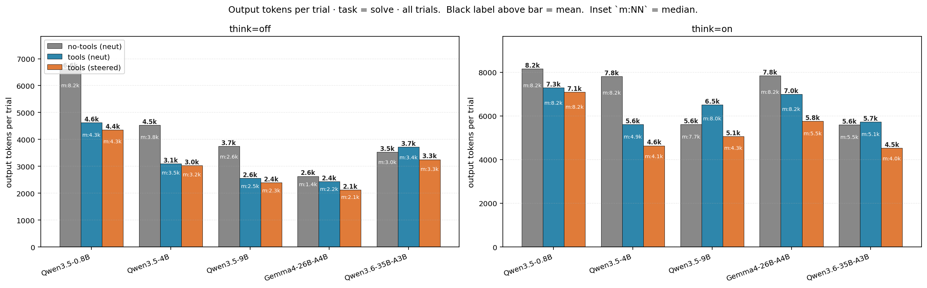
Output tokens · solve
Output tokens per `solve` trial. Bar label = mean (m:median).

Slide 31
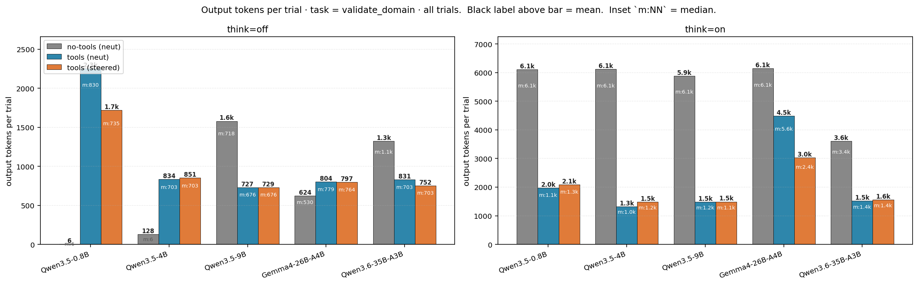
Output tokens · val-dom
Output tokens per `validate_domain` trial. Bar label = mean (m:median).

Slide 32
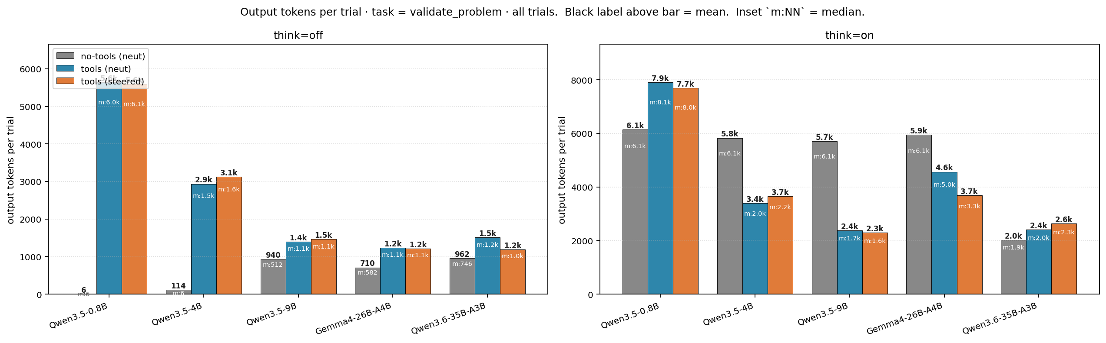
Output tokens · val-prob
Output tokens per `validate_problem` trial. Bar label = mean (m:median).

Slide 33
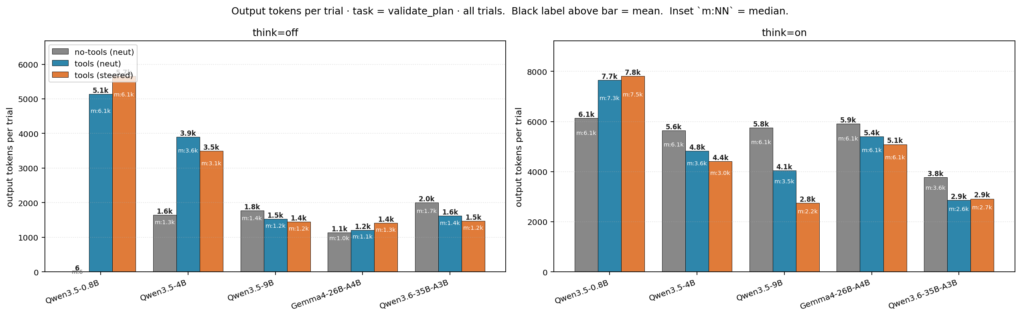
Output tokens · val-plan
Output tokens per `validate_plan` trial. Bar label = mean (m:median).

Slide 34
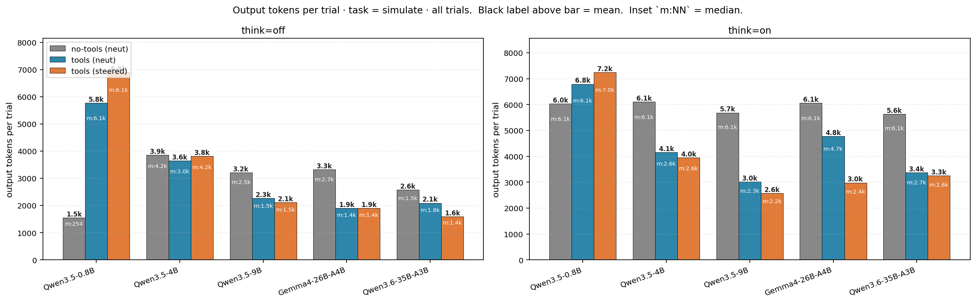
Output tokens · simulate
Output tokens per `simulate` trial. Bar label = mean (m:median). Long step-by-step traces drive output; no-tools failure% is ~100% across the board.

Slide 35
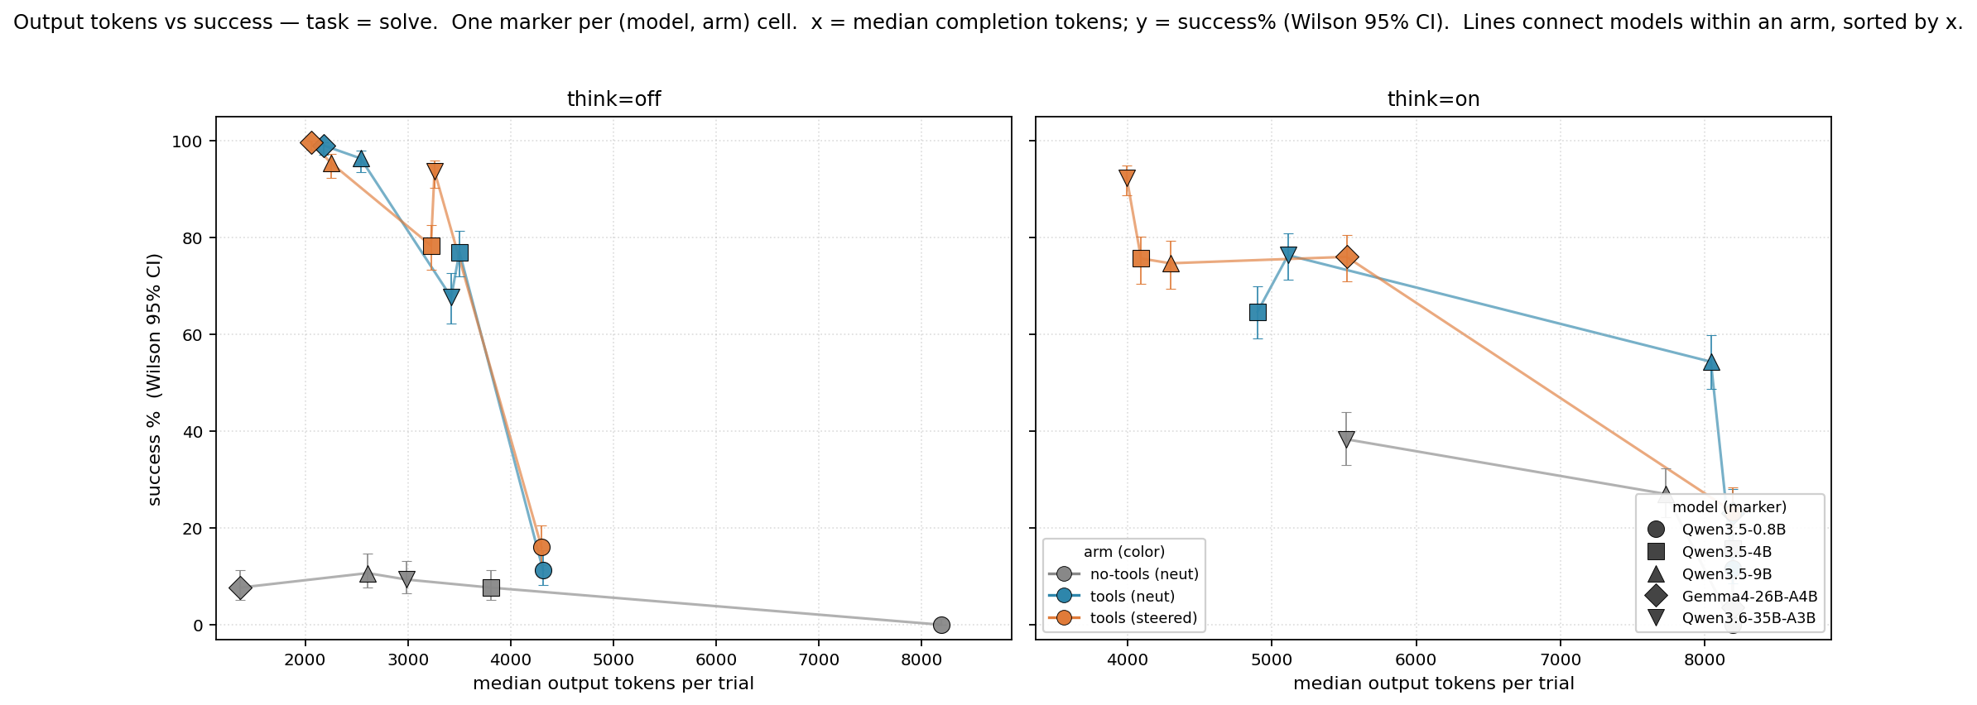
Output tokens vs success · solve
Per-cell scatter for `solve`. Each marker = one (model, arm) cell; color = arm, marker shape = model. Lines connect the 5 model markers WITHIN an arm, sorted by x — so each line traces the within-arm correlation between token spend and success across model sizes. Compare line altitudes: tl-* arms sitting above nt-neut at lower x is the H3 read.

Slide 36
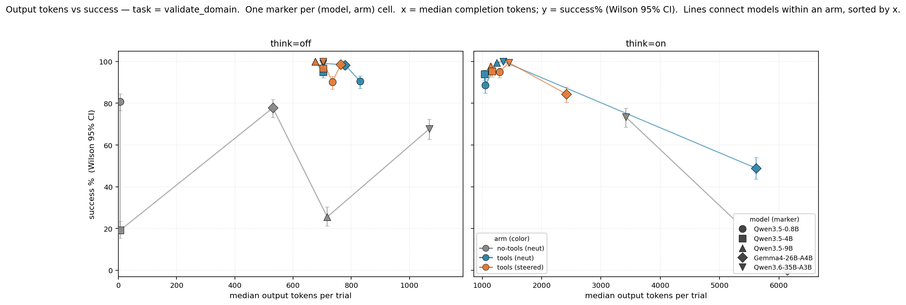
Output tokens vs success · val-dom
Per-cell scatter for `validate_domain`. Same encoding. Lines connect models within an arm (sorted by x), so the within-arm slope reads as 'do verbose cells do better or worse?' for that condition.

Slide 37
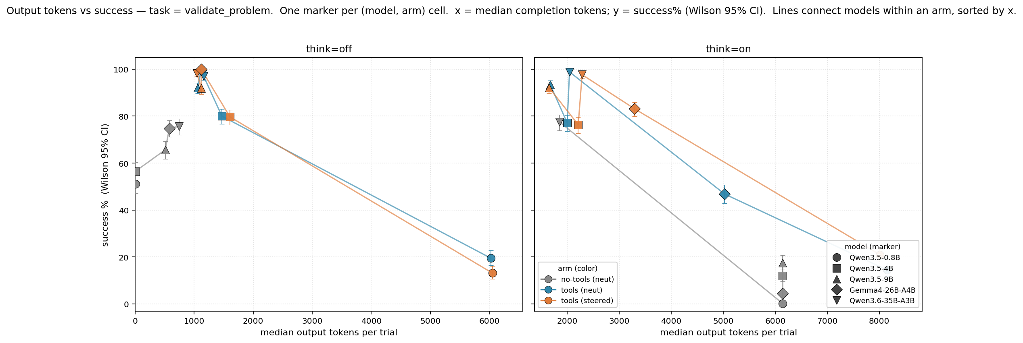
Output tokens vs success · val-prob
Per-cell scatter for `validate_problem`. Within-arm correlation across model sizes. The arm whose line sits highest AND leftmost is the Pareto-best configuration on this task.

Slide 38
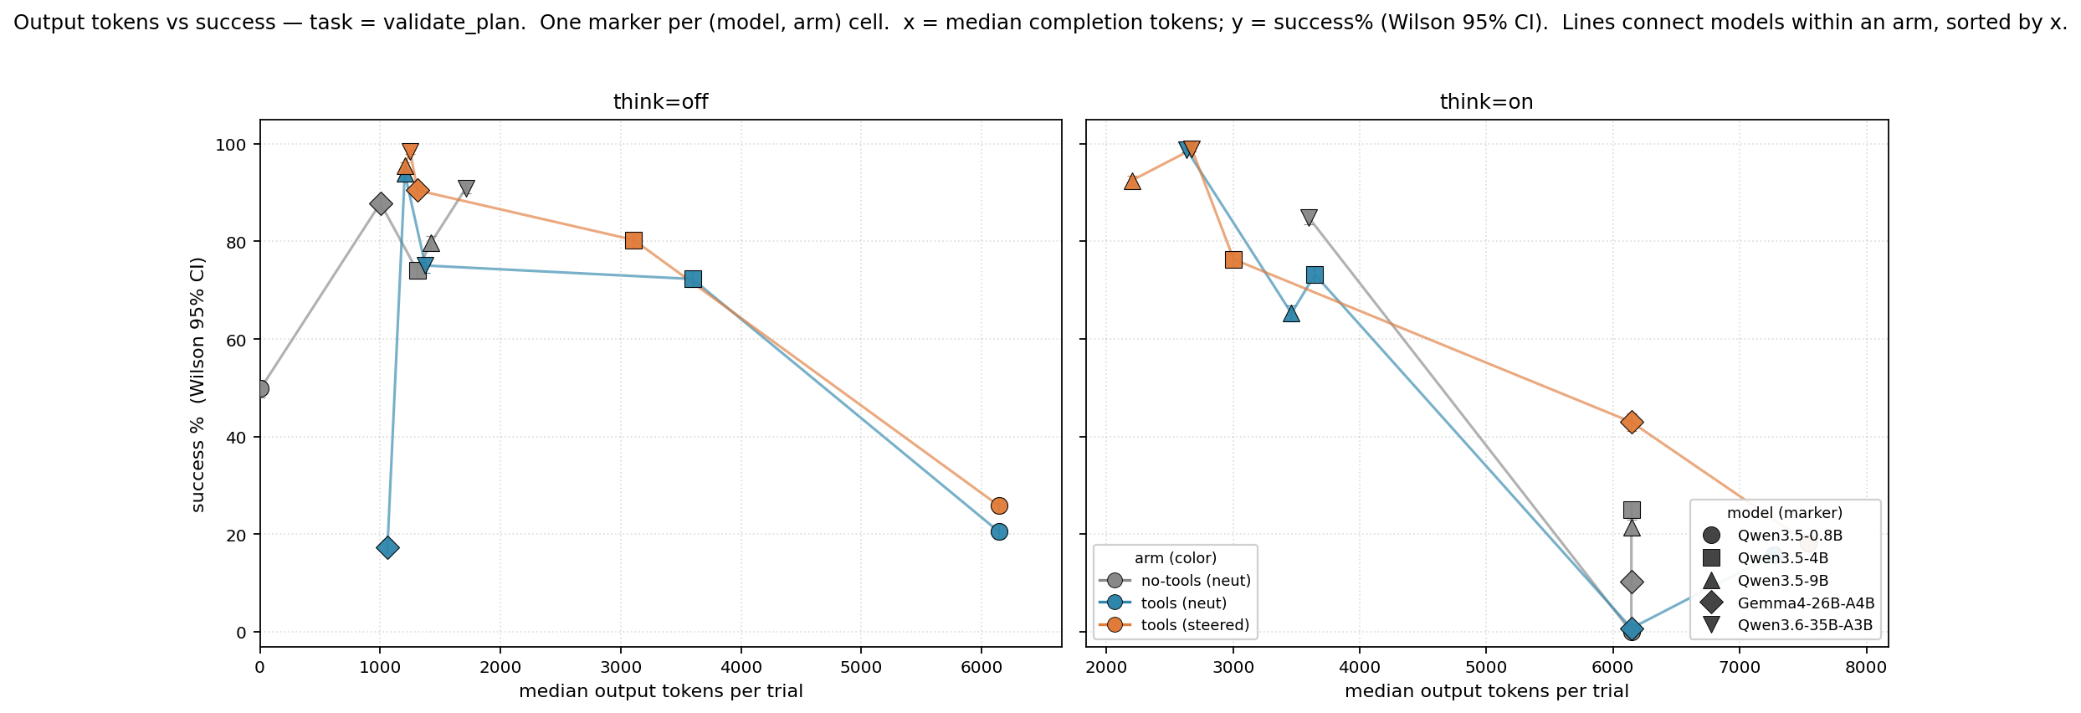
Output tokens vs success · val-plan
Per-cell scatter for `validate_plan`. Same encoding.

Slide 39
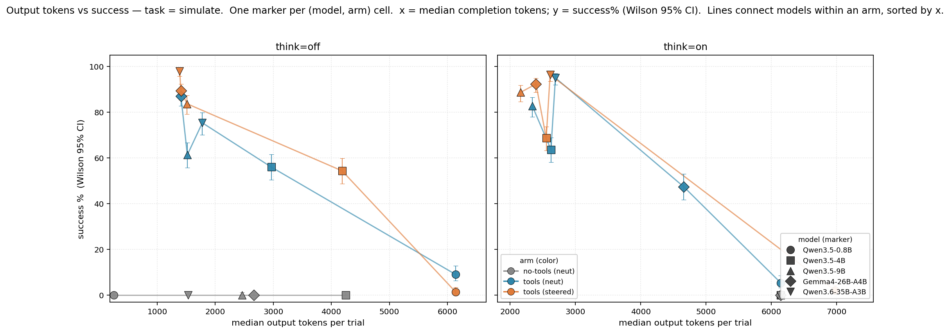
Output tokens vs success · simulate
Per-cell scatter for `simulate`. The most expensive task per output-token budget; no-tools cells often sit at ~0% across the board (long step-by-step traces). Tools-arm lines vault above the no-tools line at lower x — the simulate-tool short-circuit replacing reasoning.

