Slide 1
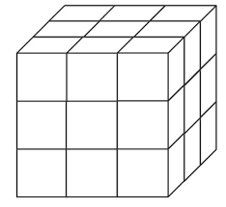
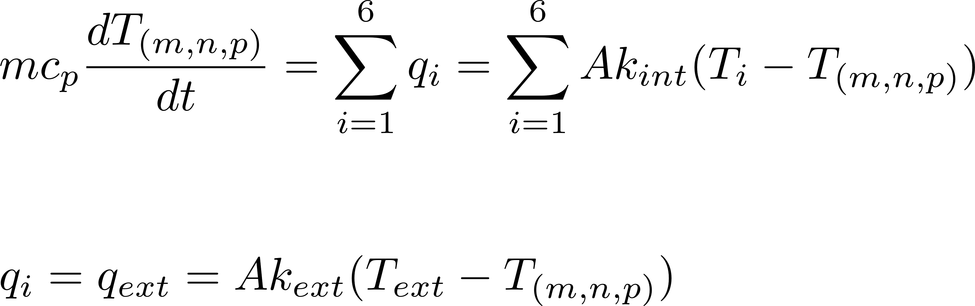
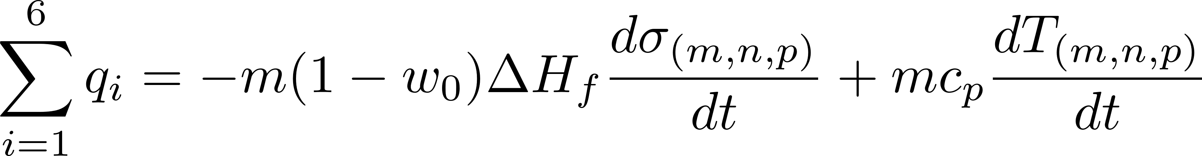
Governing Equations: Freezing Model (c)
Simplified geometry:
Cubic vials, uniform temperature and composition.
Heat transfer via surfaces.
Initial state:
Liquid solution
Initial state: t = 0: T = T₀ , σ = 0, identical for all vials.
Thermal evolution based on energy balance.
Energy balance in liquid state
i: Neighboring vial
Ice nucleation
For surfaces in contact with the environment:
Test for nucleation when T^{k} < T_{eq}
If nucleated: Set T^{k+1} = T_{eq} and calculate initial σ.
Ice nucleation: Empirical model [1]
Mass fraction of ice crystals increases (0 < σ < 1).
Freeze concentration of solute.
Temperature follows freezing point depression.
Define threshold for σ , i.e σ = 0.9 to calculate solidification times.
Compare with random number sampled from uniform distribution over [0,1] to initiate nucleation.
Ice growth state
Governing equations in ice growth state

Slide 2
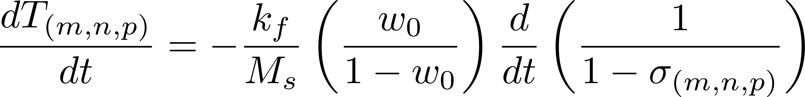
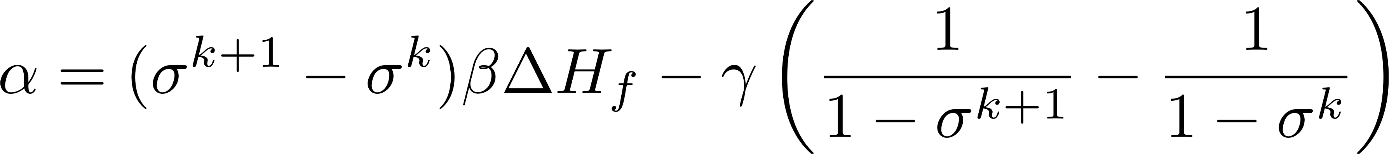
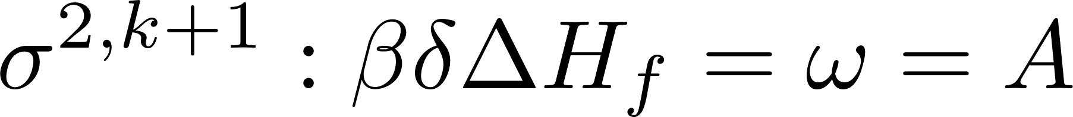
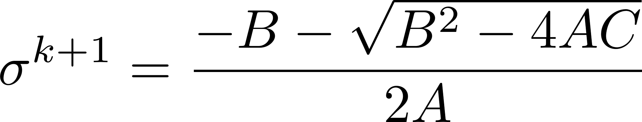
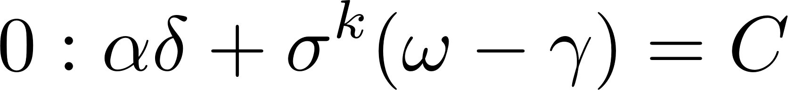
Discretization of the Governing Equations
Start from energy balance:
Insert relation for temperature into energy balance:
Discretize:
We obtain a quadratic equation in sigma; to solve it we have to rearrange. For simplicity I introduce a number of dummy variables.
Standard formula for quadratic polynoms. The physically reasonable solution for sigma is obtained by using the – in front of the square root.

