Slide 1
Lecture 3: Descriptive Analysis
Yin Yao, Ph.D.
Department of Biostatistics and Computational Biology
Fudan University

Slide 2
Outline
Descriptive Statistics
Types of descriptive statistics
Measure of frequency, central tendency, dispersion, frequency, etc.
Univariate, Bivariate and Multivariate analysis
Descriptive Plots
Types of descriptive plots
Histogram, box-and-whisker, stem-and-leaf, graph with error bars, etc.
Application of R

Slide 3
Descriptive Statistics
Describe the basic features of the data in a study
Provide simple summaries about the sample and the measures
Before analyzing data: check/ clean/ quality control
Notes:
Any scientific paper

Slide 4
Descriptive Statistics
In papers reporting on human subjects, typically a table is included providing:
Overall sample size
Sample sizes in important subgroups
e.g., treatment or exposure group
Demographic or clinical characteristics
Average age
Proportion of male or female
Proportion of subjects with related comorbidities
Notes:
Treatment – Group of samples w/ Stimulus vs. w/o Stimulus
Exposure – Group of samples w/ Light vs. w/o Light
Comorbidity – Diabetes & Hypertension
(2 chronic disease/conditions at the same time)

Slide 5
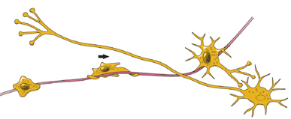
Example 1
The Williams syndrome chromosome 7q11.23 hemideletion confers hypersocial, anxious personality coupled with altered insula structure and function. M Jabbia, JS Kippenhan, P Kohn, S Marenco, C Mervis, C Morris, A Meyer-Lindenberg, K Berman. PNAS, Mar 2012
WS: a rare disorder caused by a deletion on chromosome 7q11.23.
LIMK1, CLIP2
Important for neuronal migration
Characterized by a hypersocial but anxious personality
37 subjects participated in fMRI scanning
28 subjects participated in PET scanning
10 subjects participated in DTI scans
Notes:
How the genes bring together the WS characteristics with changes in insula structure?
In this study, authors show an overall decrease in insula in WS compared to NC.
Neuronal migration is the method by which neurons travel from their origin to their final position in the brain.

Slide 6
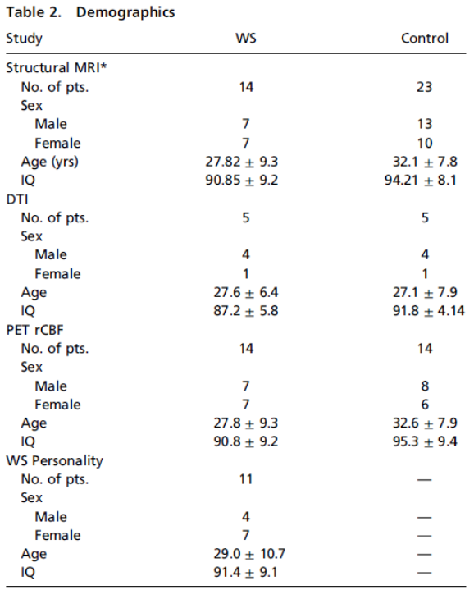
Example 1 (Conti.)
Table 2. Demographics.
(Values presented as mean ± SD where appropriate)
WS: Williams Syndrome
DTI: diffusion tensor Imaging
PET: Positron-emission tomography
rCBF: regional cerebral blood Flow
Notes:
Parents of 11 participants with WS completed the parent report form of the MPQ (Multidimensional Personality Questionnaire)
to assess WS personality and association with Brain structure and function.
How to compare the study variables of brain activity measures
such as fractional anisotropy will be discussed in the next lecture
when we study T-test, ANOVA, Mann-Whitney U test, etc.
In this example, we will focus on the descriptive statistics of demographic variables

Slide 7
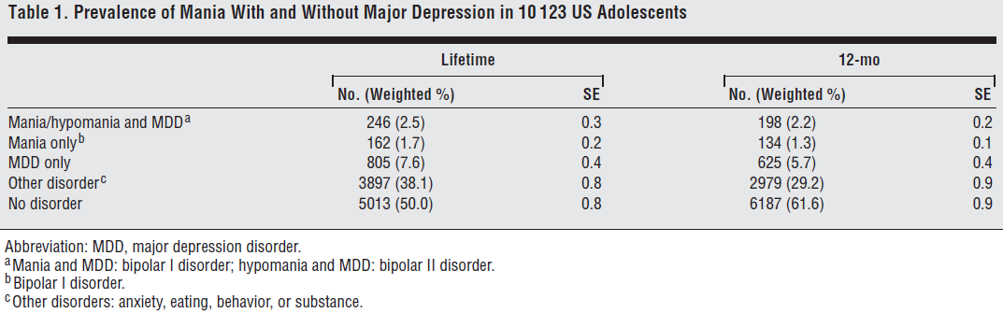
Example 2
Mania With and Without Depression in a Community Sample of US Adolescents. K Merikangas, L Cui, G Kattan, G Carlson, E Youngstrom, J Angst. Arch Gen Psychiatry, 2012.
Present the prevalence and clinical correlates of mania with and without depressive episodes in US adolescent sample
Cross-sectional study using the face-to-face survey data
10,123 adolescents aged 13 to 18 years
Notes:
US census data:
Student 96.6%, Non-student 3.4% in US adolescent Age 13-17
Weighted % = student x 0.966 = non-student x 0.034
Ex) test 50%, quiz 30%, homework 20% → Weighted % = test score x 0.5 + quiz x 0.3 = homework x 0.2
SE: SD of the sampling distribution. Will be discussed in detail in a few slides later.

Slide 8
Example 2 (Conti.)
Table 2. Prevalence Rates of Mania and Major Depression by Sociodemographic Characteristics of 10,123 US Adolescents
Logistic regression (lecture 6)
Notes:
Prevalence rates of Mania and MDD were significantly greater
among females than males (3.3% vs. 1.8%).
Similarly, the prevalence rates of MDD only were significantly greater
among females than males (10.2% vs. 5.1%).
In Contrast, the prevalence rates of Mania only were significantly greater
among males than females (2.2% vs. 1.2%).

Slide 9
Descriptive Statistics
Help us to simplify large amounts of data in a sensible way.
Reduce lots of data into a simpler summary.
Consider, the Grade Point Average (GPA).
This single number describes the general performance of a student across a potentially wide range of course experiences.
Notes:
New data: 200 columns and 300 rows
Or even, 5 columns and 20 rows

Slide 10
Types of Descriptive Statistics
Measure of central tendency
Mean （均值）
Median （中位数）
Mode （众数）
Measure of dispersion
Standard deviation (SD), standard error (SE), variance （方差）
Minimum and maximum
Kurtosis （峰度）and skewness （偏度）
Measure of frequency
Count, Frequency, Percent

Slide 11
Measure of Central Tendency
Mean （均值）
To obtain an average value, add up all your data values and divide by the number of data items.
Median （中位数）
To obtain the median value, first sort your list from lowest to highest: and then select the value in the exact middle as the median.
Mode （众数）
The most repeated value in the data set.

Slide 12

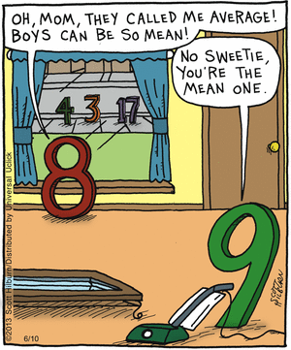
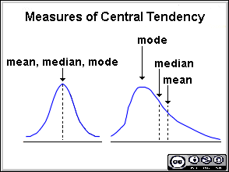
Notes:
Mean of (3, 4, 8, 17) = 32 / 4 = 8
Median of (3, 4, 8, 17) = (4+8) / 2 = 6
No Mode in this data set.
There may be no mode if no value appears more than any other.
There may also be two modes (bimodal), three modes (tri-modal), or four or more modes (multimodal).

Slide 13
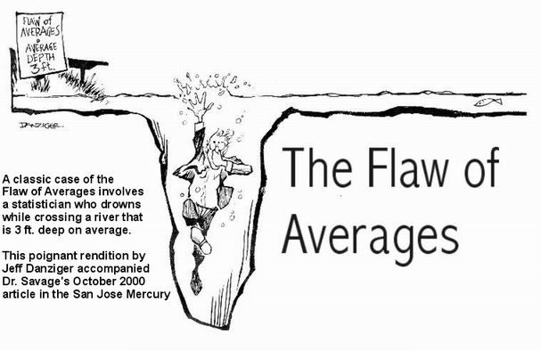
Notes:
Why we need another type of descriptive statistics

Slide 14
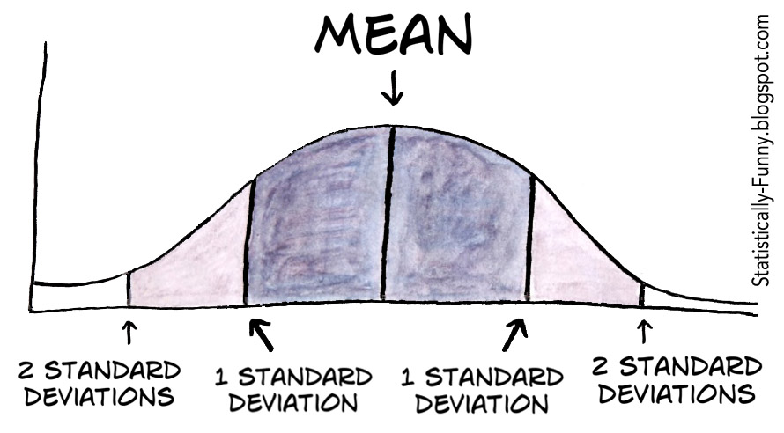
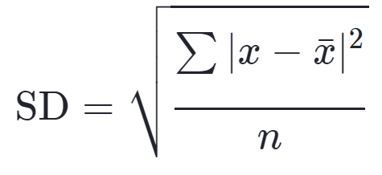
Measure of Dispersion
Minimum and Maximum
Standard deviation (SD)
Measure to quantify the amount of variation or dispersion （离散度）.
A low SD indicates that the data points tend to be close to the mean
A high SD indicates that the data points are spread out over a wider range of values.
Square root of variance
Notes:
Min/Max – not reported often, should be checked for our own good.
(Any outlier? Discrepancy?)
* Why use SD instead of Variance?
SD is expressed in same units as the mean is.
SD is useful to describe the variability of data.
Variance is expressed in squared units.
More useful mathematically.

Slide 15
SD vs. SE
SE of a statistic is the SD of its sampling distribution of a statistic.
For example:
SD of a sample is the degree to which individuals within the sample differ from the sample mean.
SE of the sample mean is an estimate of how far the sample mean is likely to be from the population mean.
Relationship
For a given sample size, the SE equals the SD divided by the square root of the sample size.
Notes:
SE provide simple measures of uncertainty in a value.
The SEM quantifies the precision of the mean. It is a measure of how far your sample mean is likely to be from the true pop. mean.
The SEM is always smaller than the SD.
As the sample size increases, the SE decreases
i.e., the sample means cluster more closely around the pop. Mean.
In regression analysis, the term “SE" is also used in the phrase ’SE of the regression’ to mean the ordinary least squares estimate of the SD of the underlying errors.

Slide 16
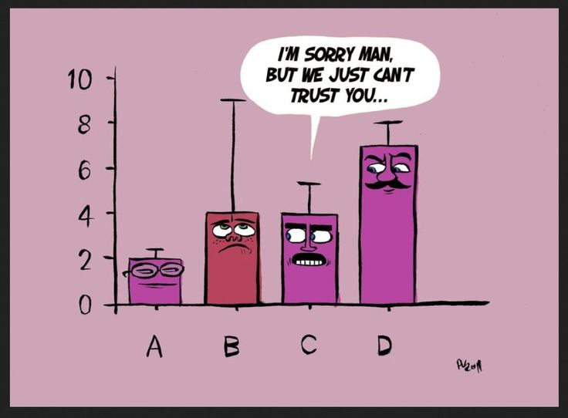
facebook.com/pedromics
Notes:
If your SE is too big, you cannot trust that your sample mean represent the pop mean.

Slide 17
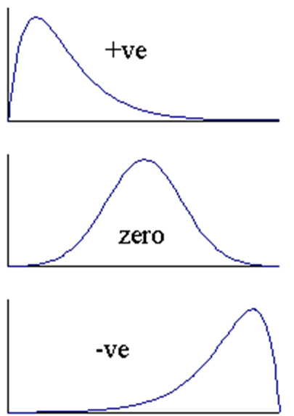
Measure of Dispersion
Skewness
A measure of the asymmetry of the probability distribution
The normal distribution has a skewness of zero
Positive skew
The right tail is longer; right-skewed; skewed to the right.
Negative skew
The left tail is longer; left-skewed; skewed to the left.
Notes:
The skewness is the third standardized moment

Slide 18
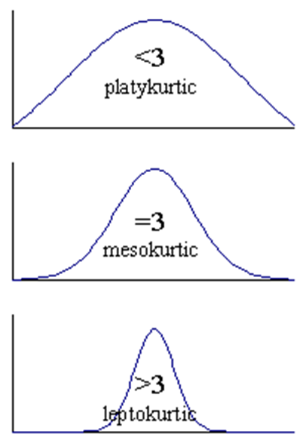
Measure of Dispersion
Kurtosis
A descriptor of the shape of a probability distribution.
The kurtosis of any univariate normal distribution is 3.
Distributions with kurtosis < 3:
Produce fewer and less extreme outliers than the normal distribution.
Distributions with kurtosis > 3:
Produce more outliers than the normal distribution.
Notes:
The kurtosis is the fourth standardized moment.
K(X) = E[ {(x-m)/sigma}^4 ]
= E[(X-m)^4] / ( E[(X-m)^2] )^2
Extreme cases:
1. Uniform distribution
2. Laplace distribution: the distribution of differences between two independent variates with identical exponential distributions

Slide 19
Assumption of Normal Distribution
Some biological variables do not meet the assumptions of a normal distribution
Non-parametric statistical tests
Wilcoxon rank sum test, Mann-Whitney U test, etc.
Will be discussed in the next lecture
Data transformation
Normalization
Informative plotting
Getting outliers in line
Notes:
The most frequent reason that researchers transform their data is to make the distribution of the data “normal”, and thus fulfill one of the assumptions of conducting a parametric means comparison. (T-test, ANOVA, linear regression etc.)
Disadvantage of non-parametric test:
The power of these tests is (slightly) smaller than those of normal-based tests if the data are normally distributed.
Transformation can bring the extreme outliers closer to the rest of the data
(Log- transform) .

Slide 20
Data Transformation
To transform data
Perform a mathematical operation on each observation
Use the transformed numbers in the statistical test
Common transformations
Log transformation
Growth rates are often exponential, and log transforms will often normalize them.
Square-root transformation
Count data are often Poisson and square root will convert data with a Poisson distribution to a normal distribution
Notes:
Log transforms are particularly appropriate if the variance increase with the mean (reduce skewness)
It, in visualizations, can bring extreme outliers closer to the rest of the data so graphs aren’t stretched out as much.
Square root transform is often of value when the data are counts,
e.g. blood cells on a haemocytometer.
Carrying out a square root transform will convert data with a Poisson distribution to a normal distribution.
Reciprocal transformation:
If a log transform does not normalize your data you could try a reciprocal (1/x) transformation.
This is often used for enzyme reaction rate data.

Slide 21
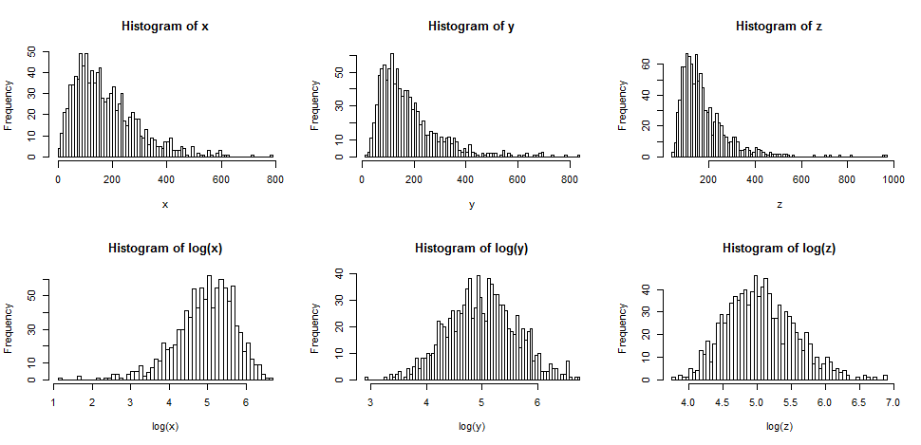
Log Transformation

Slide 22
Data Transformation
K: constant from which each score is subtracted
Notes:
Since data transformation methods involve the application of a mathematical function to your data, you need to be careful when reporting or interpreting any insights derived from the transformed data because a transformation changes the unit of the data.
For example, when we apply a logarithmic function to a population variable, the unit of measurement becomes the log of the population.

Slide 23
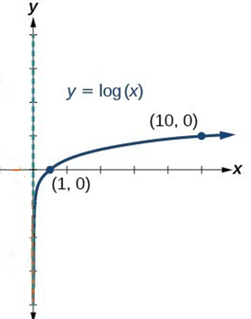
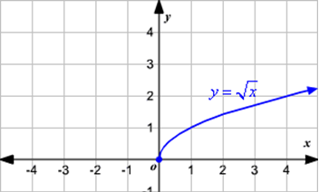
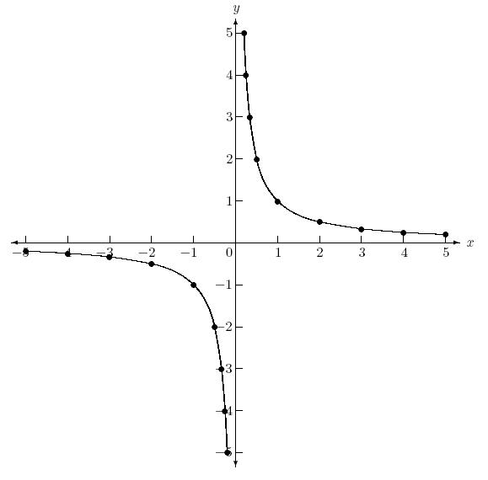
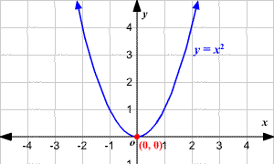
y = 1/x
Notes:
When you’re sharing results, your audience may assume that the calculated numbers or visualizations they’re seeing are based on raw data, so if the values have been transformed, you should clearly communicate what transformation was used, as well as what units the data are being displayed in.

Slide 24
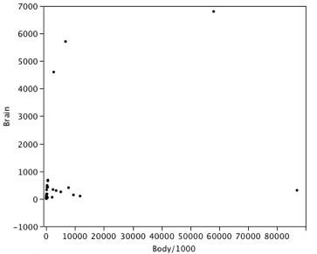
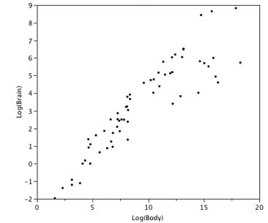
Figures show an example of how a log transformation can make patterns more visible. Both plot the brain weight of animals as a function of their body weight. The raw weights are shown in the left panel; the log-transformed weights are shown in the right panel.
Notes:
more informative graphs of the data

Slide 25
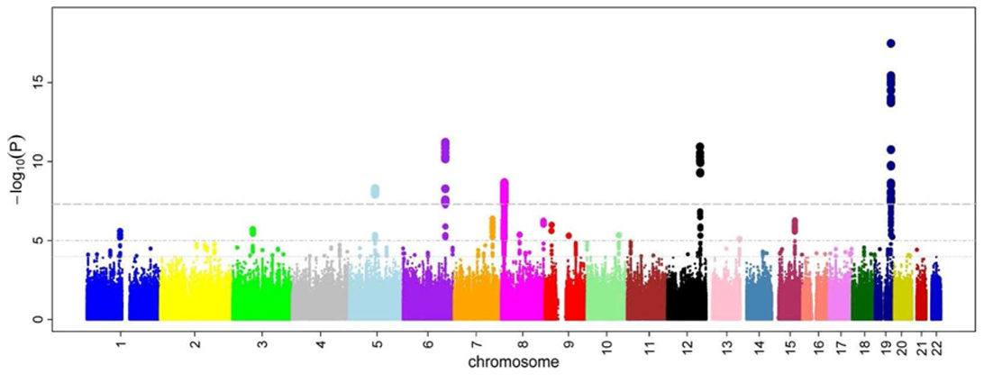
Manhattan Plot
Notes:
~ 1 million SNPs, 1 million tests

Slide 26
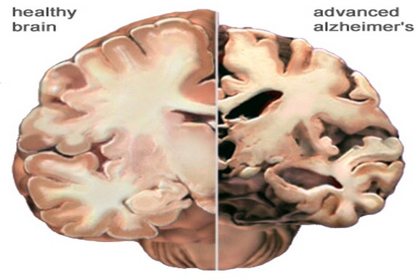
Example 3
In vivo radioligand binding to translocator protein correlates with severity of Alzheimer’s disease. WC Kreisl, et al. (RB Innis and the Biomarkers Consortium PET Radioligand Project Team). Brain 2013
TSPO (translocator protein) is a proposed biomarker for neuroinflammation.
Neuroinflammation is a pathological hallmark of Alzheimer’s disease (ALZ)
Its role in cognitive impairment and its course of development during the disease are largely unknown.
Used PET (image) to measure TSPO for patients with ALZ, MCI (Mild Cognitive Impairment) and control subjects.
Notes:
Back to some more examples
Role of TSPO gene in the brain by comparing the healthy brain to the brain of advance ALZ.

Slide 27
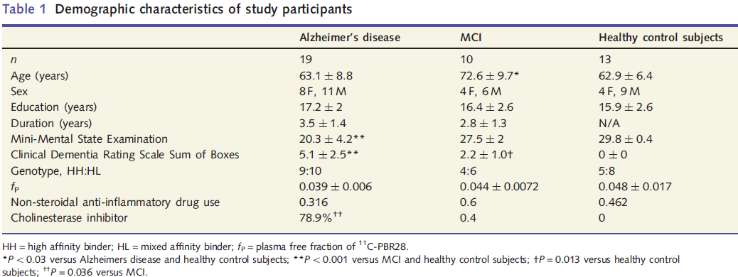
Example 3
ANOVA (lecture 4)
Table 1. Demographic Characteristics of study participants
0.789
Notes:
HH: homozygous (high-affinity: similarity, likeness, link, resemblance)
HL: heterozygotes (mixed-affinity)
LL: homozygous (low-affinity)
Cholinesterase inhibitors are a group of medicines
that block the normal breakdown of acetylcholine
(e.g., Exelon-Novartis, Aricept-Pfizer).
The use of this drug is more prevalent in patients with ALZ
than patients with MCI (79% vs. 40%, P=0.036)

Slide 28
Descriptive Statistics vs. Inferential Statistics
Descriptive statistics
First step
Simply describing what is or what the data shows
Inferential statistics
Trying to reach conclusions that extend beyond the immediate data alone.
Example 3
Note
Even when a data analysis draws its main conclusions using inferential statistics, descriptive statistics are generally also presented
Notes:
P-values from T-test, ANOVA, etc. in Descriptive Tables.
Briefly go over
More details in next lectures

Slide 29
Descriptive Statistics vs. Inferential Statistics
Statistical Methods
Descriptive Statistics
Inferential Statistics
Numerical Summaries
Plots
Confidence Intervals
Significance Tests
Notes:
C.I. is also often introduced in Descriptive Stat Tables.

Slide 30
Confidence Interval
A range of values defined that there is a specified probability that the value of a parameter lies within it.
95% confidence interval
confidence interval = sample statistic + margin of error
Notes:
Suppose that a 95% confidence interval states that the population mean is >100 and < 200. How would you interpret this statement?
Some people think this means there is a 95% chance that the population mean falls between 100 and 200. This is incorrect.
Like any population parameter, the population mean is a constant, not a random variable. It does not change. The probability that a constant falls within any given range is always 0.00 or 1.00.
It means that 95% of the intervals would include the parameter. It means that if the same population is sampled on numerous occasions and interval estimates are made on each occasion, the resulting intervals would bracket the true population parameter in approximately 95 % of the cases. The confidence level describes the uncertainty associated with a sampling method. Suppose we used the same sampling method to select different samples and to compute a different interval estimate for each sample. Some interval estimates would include the true population parameter and some would not. A 90% confidence level means that we would expect 90% of the interval estimates to include the population parameter; A 95% confidence level means that 95% of the intervals would include the parameter; and so on.

Slide 31
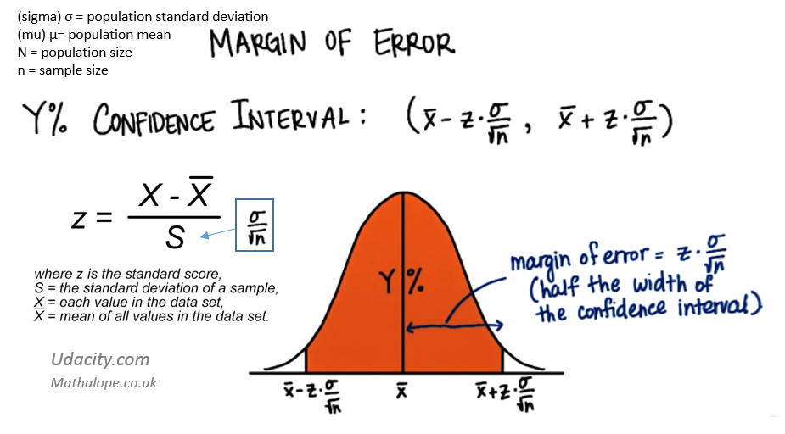

Slide 32
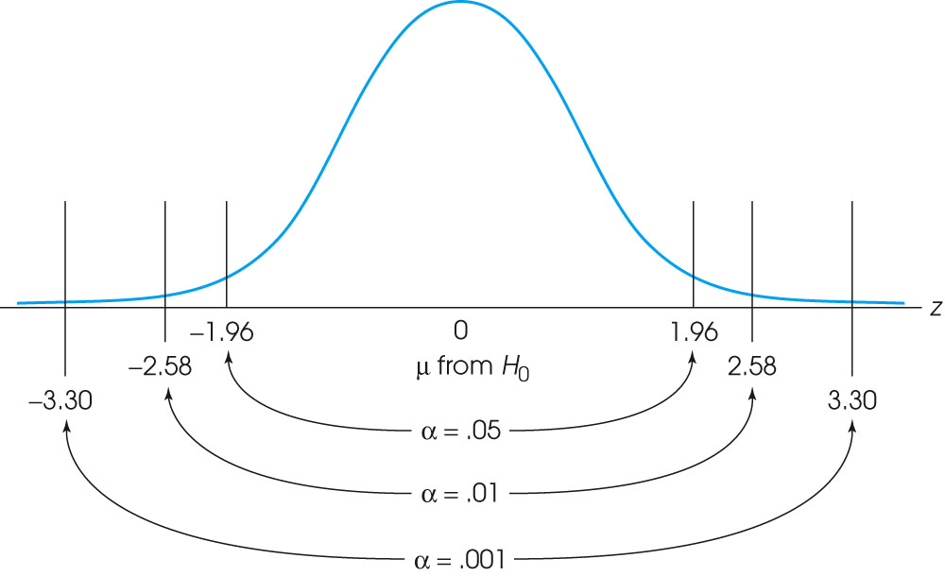
Notes:
The locations of the critical region boundaries for three different levels of significance: α = .05, α = .01, and α = .001.
If Z statistic exceed the critical value for a given alpha, we reject null hypothesis and conclude that there is significant difference

Slide 33
Measure of Frequency
Frequency/Count
Percent
Odds Ratio (OR)
A ratio of two odds
the odds that an exposed person develops disease
the odds that a non-exposure person develops disease
OR=1 Exposure is not related to disease
OR>1 Exposure is positively related to disease

Slide 34
Odds Ratio (OR)
Odds of exposure for disease group = P₁ / (1-P₁) = a / c
Odds of exposure for non-disease group = P₂ / (1-P₂) = b / d
OR = (a/c) / (b/d) = ad / bc
Ex) OR =
37x53 / (13x17) = 8.873
Notes:
i.e., Odds of developing disease for exposed person is 8.873 time higher than not exposed person
Bivariate analysis
The Difference Between OR and RR: The basic difference is that OR is a ratio of two odds whereas RR is a ratio of two probabilities.
OR is a good estimate of RR when disease being studied is not a frequent one.
OR can magnify risk when the disease is more common.
(e.g., instead of 54 and 66, if 54 vs. 1000, then OR and RR would be about the same)

Slide 35
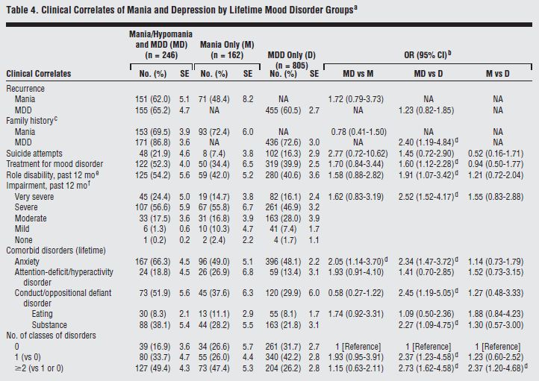
Example 2 (Conti.)
K Merikangas et. Al.
(2012)
Notes:
Dr. Merikangas’s Example 2 conti.
OR = 1.72
Odds of recurrence for person with both MDD （抑郁）and Mania is 1.72 times higher than person with Mania only
OR = 1.23
Odds of recurrence for person with both MDD and Mania is 1.23 times higher than person with MDD only
95% C.I. provides the significance of this statistics
However, C.I contains ‘1’ which means related

Slide 36
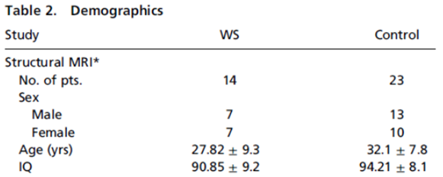
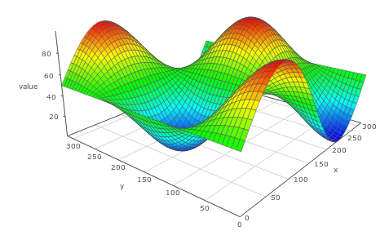
Univariate, Bivariate and Multivariate Analysis
Univariate
Examine one variable at a time.
Bivariate
Examine two variables at a time.
Cross-tabulation, scatter plot, correlation, etc.
Multivariate
Examine 3 or more variables at a time.
Multivariate regression
3-d plot
e.g.) EEG measures in three brain regions
Notes:
The main reason for differentiating univariate and bivariate analysis?
Bivariate analysis is not only simple descriptive analysis,
but also it describes the relationship between two different variables.

Slide 37
Descriptive plots
Types of Descriptive Plots
Histogram plot
Box-and-whisker plot
Scatter plot
Pedigree plot

Slide 38
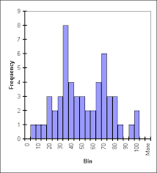
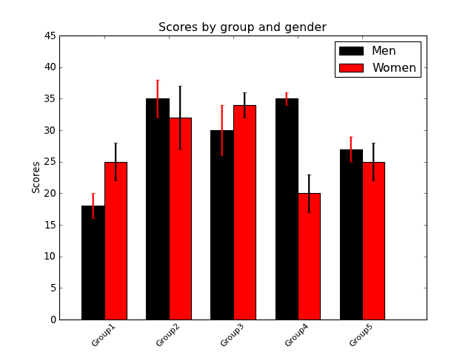
Histogram plot

Slide 39
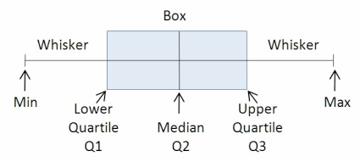
Box-and-Whisker Plot

Slide 40
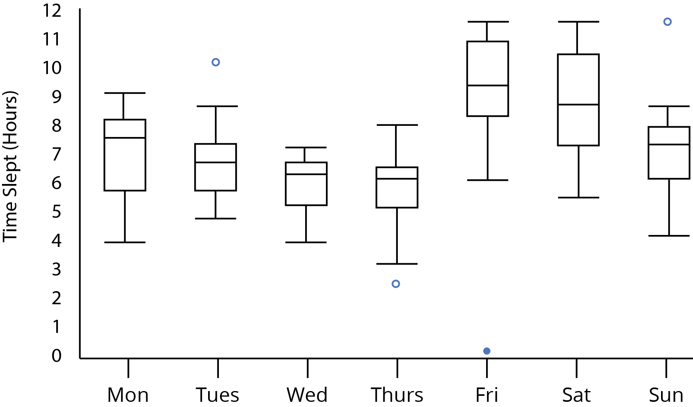
Example: Box-and-Whisker Plot

Slide 41
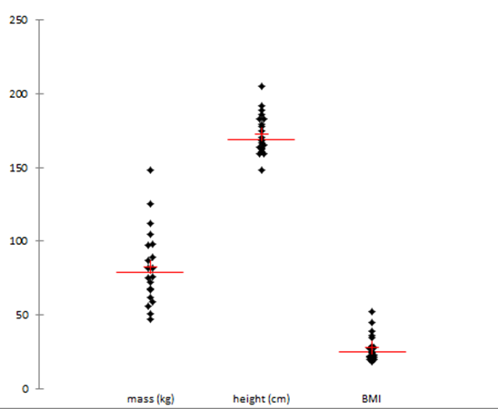
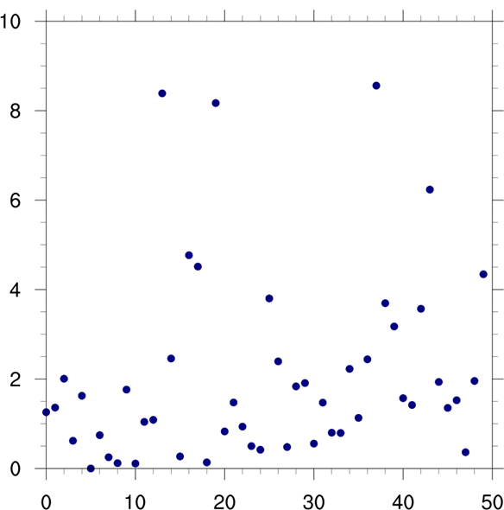
Scatter Plot
Univariate
Bivariate
Notes:
在这里打住

Slide 42
Example 7
A genetic polymorphism for translocator protein 18 kDa affects both in vitro and in vivo radioligand binding in human brain to this putative biomarker of neuroinflammation. WC Kreisl, et al. (Robert B Innis and the Biomarkers Consortium PET Radioligand Project Team). Journal of Cerebral Blood Flow & Metabolism. 2013
Figure 2. Specific [3H]PBR28 binding in dorsolateral prefrontal cortex (DLPFC) from schizophrenia patients (SZ) and healthy controls (HC) with and without (B) stratification based on genotype.
TSPO
(translocator protein)
A biomarker for neuroinflammation.
The density of TSPO was measured by PET.
Notes:
[³H]PBR28, a newly developed translocator protein-specific radioligand (with greater specific signal).
A radioligand is a radioactive biochemical substance.
It is used for diagnosis (or for research-oriented study) of the receptor systems of the body.
It is injected into the tissue. It binds to its receptor.
When the radioactive isotope in the ligand decays it can be measured by PET.
HH: homozygous high-affinity (similarity, likeness, link, resemblance)
HL: heterozygotes
LL: homozygous low-affinity

Slide 43
Application of R Example Data ‘InsectSprays’
count | spray | count | spray | count | spray | count | spray | count | spray | count | spray
10 | A | 11 | B | 0 | C | 3 | D | 3 | E | 11 | F
7 | A | 17 | B | 1 | C | 5 | D | 5 | E | 9 | F
20 | A | 21 | B | 7 | C | 12 | D | 3 | E | 15 | F
14 | A | 11 | B | 2 | C | 6 | D | 5 | E | 22 | F
14 | A | 16 | B | 3 | C | 4 | D | 3 | E | 15 | F
12 | A | 14 | B | 1 | C | 3 | D | 6 | E | 16 | F
10 | A | 17 | B | 2 | C | 5 | D | 1 | E | 13 | F
23 | A | 17 | B | 1 | C | 5 | D | 1 | E | 10 | F
17 | A | 19 | B | 3 | C | 5 | D | 3 | E | 26 | F
20 | A | 21 | B | 0 | C | 5 | D | 2 | E | 26 | F
14 | A | 7 | B | 1 | C | 2 | D | 6 | E | 24 | F
13 | A | 13 | B | 4 | C | 4 | D | 4 | E | 13 | F
Notes:
This is the internal data in R, name is InsectSprays
Effectiveness of Insect Sprays
The counts of insects in agricultural experimental units treated with different insecticides.
It includes 72 rows and 2 columns. The first row is count, and the second row is spray type (6 groups)
Statistical questions: If there is difference in the effect of Spray A,B,C,D,E,F?

Slide 44
This lecture is over. See me if you need to talk !

Slide 45
R scripts
mean(InsectSprays[,1]);
[1] 9.5
sd(InsectSprays[,1])
[1] 7.203286
quantile(InsectSprays[,1]);
> 0% 25% 50% 75% 100%
> 0.00 3.00 7.00 14.25 26.00
Notes:
This first column of InsectSprays data is the count, it is quantitative, So we can check the descriptive statistics first such as mean and sd.

Slide 46
R scripts
> boxplot(InsectSprays[,1])

Slide 47
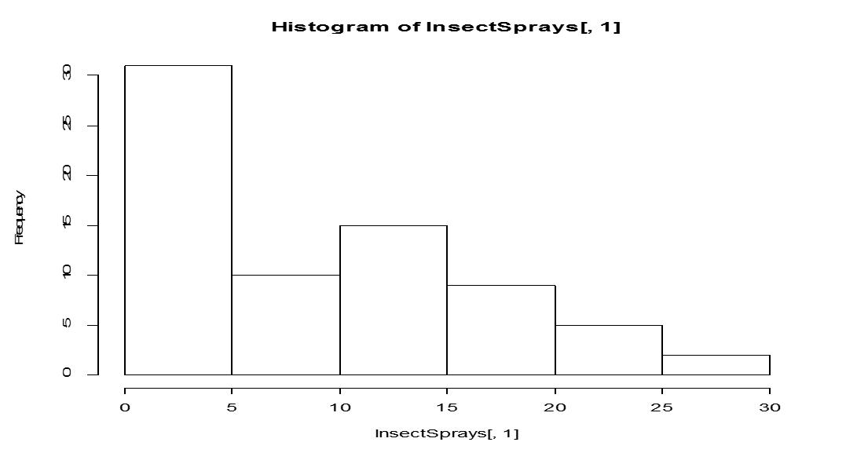
R scripts
> hist(InsectSprays[,1])

Slide 48
R scripts
> boxplot(count ~ spray, data = InsectSprays, col = "lightgray")
Notes:
Since the example data his six groups in the second column– spray, we can also draw six boxplots for each groups together.
You can tell, A and B has less difference then group A vs. group C.
We will test this in a statistical way later.

Slide 49
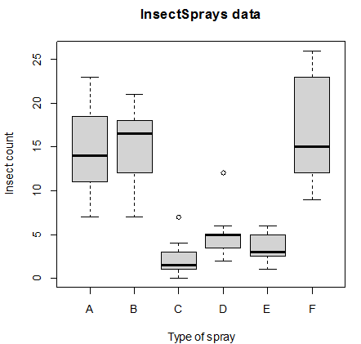
R scripts
>boxplot(count ~ spray,
data = InsectSprays,
xlab = "Type of spray",
ylab = "Insect count",
main = "InsectSprays data",
varwidth = TRUE, col = "lightgray")
Notes:
Since the example data his six groups in the second column– spray, we can also draw six boxplots for each groups together.
You can tell, A and B has less difference then group A vs. group C.
We will test this in a statistical way later.

Slide 51
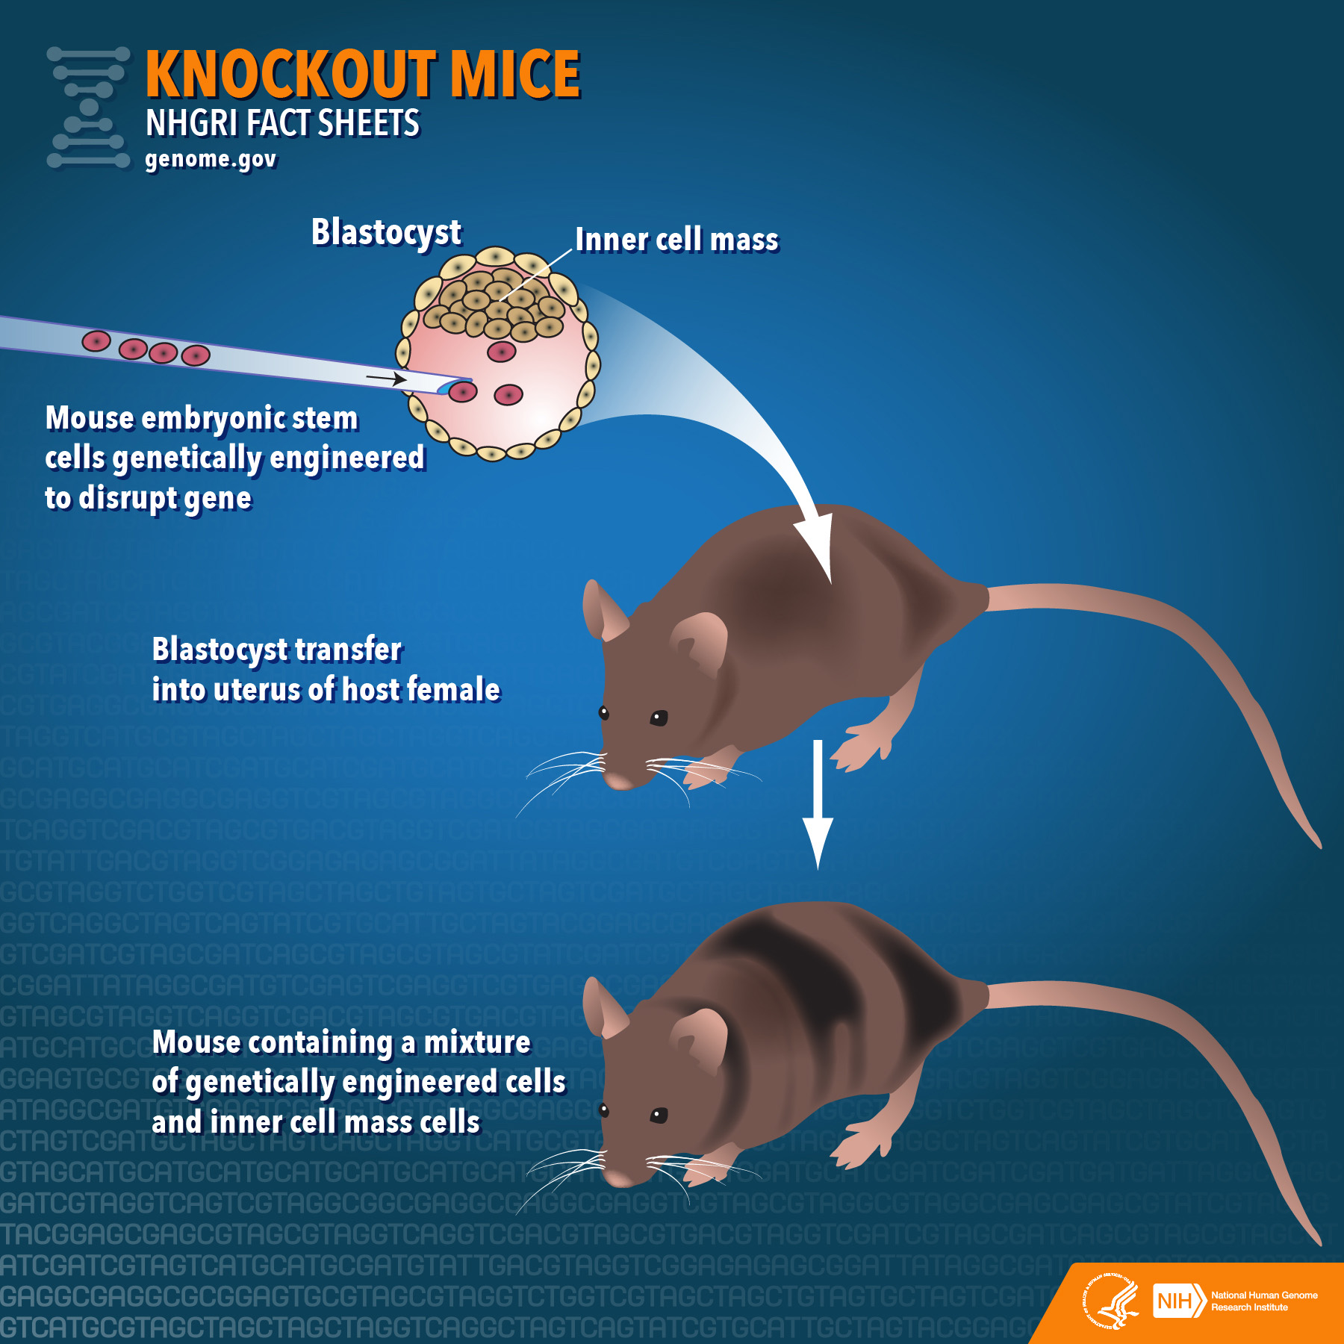
Example 4
PACAP-deficient mice show attenuated corticosterone secretion and fail to develop depressive behavior during chronic social defeat stress. M Lehmanna, T Mustafab, A Eidena, M Herkenhama, and L Eiden. Psychoneuroendocrinology. May 2013
PACAP is a protein encoded by ADCYAP1.
This gene functions as a neurotransmitter and neuromodulator.
The authors previously found that corticosterone (CORT) levels were significantly reduced in PACAP-deficient mice.
In this manuscript, the authors show that PACAP deficient mice fail to develop depressive behavior during chronic stress.
Notes:
PACAP: Pituitary adenylate cyclase-activating
ADCYAP1 (adenylate cyclase activating polypeptide 1) gene.
Recent publications show that this gene has been associated with PTSD (post-traumatic stress disorder).
CORT (Corticosterone): a hormone secreted by the adrenal cortex,
involved in regulation of energy, immune reactions, and stress responses.

Slide 52
Thank you!

