Slide 1
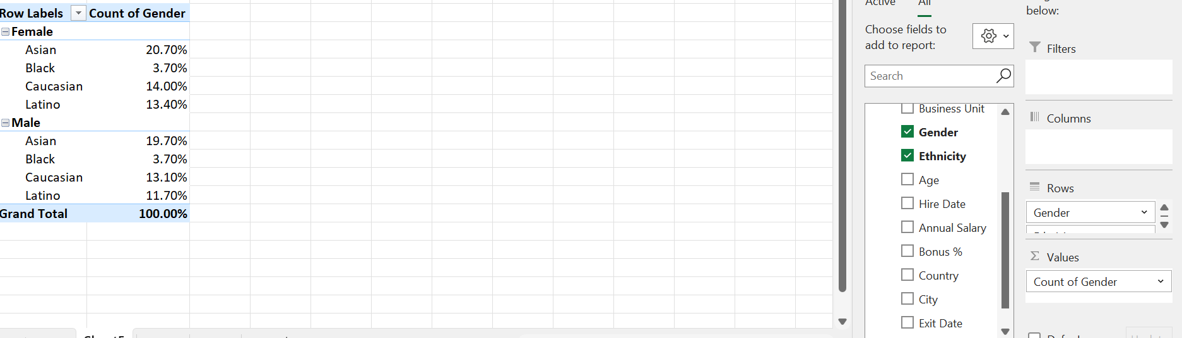
1. Gender and Ethnicity Distribution
Gender and Ethnicity are distributed with in the company and we can see that among female gender Mostly are Asian-20.7%, followed by Caucassian 14.00% ,Latino 13.40%, Black 3.70%.
Among Male The distribution are Same as above.

Slide 2
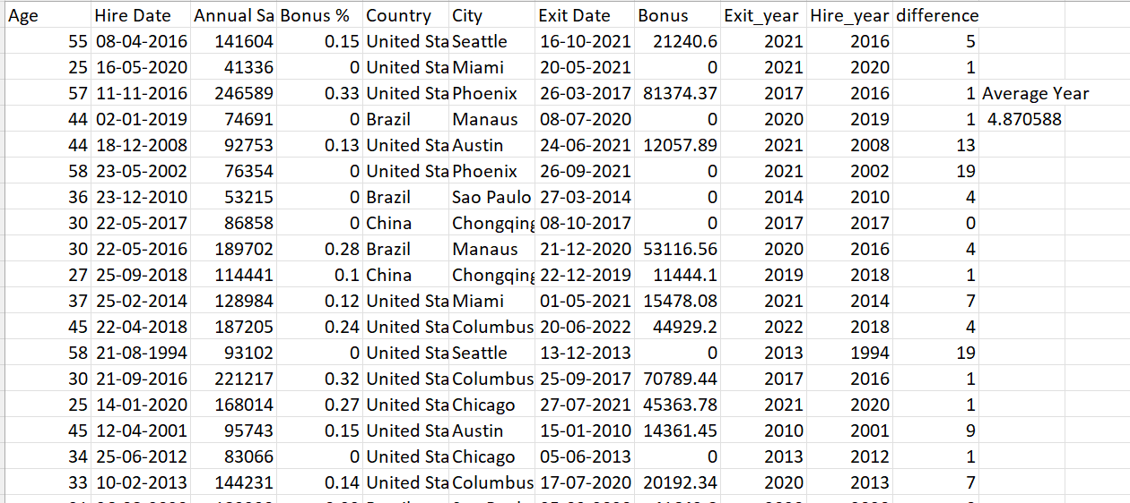
2.How long Stayed in the company before leaving
Extracted the year from hire date and exit date column using =Extract formula then subtract it from exit year to hire year and averaged it with
=Average formula , Value is 4.870588 year

Slide 3
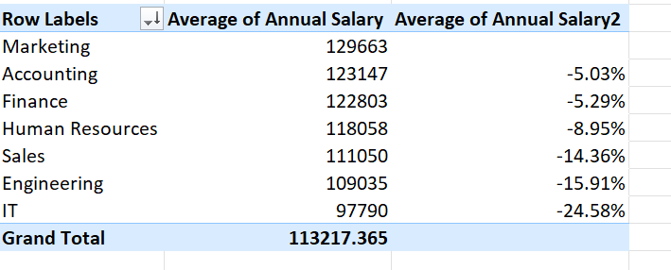
3.Average Salary difference between department
Here The Average salary is gotten from from value settings then sorted it and the percentage difference from the Marketing department to other departments shown.
IT , Engineering, Sales has from the marketing department .

Slide 4
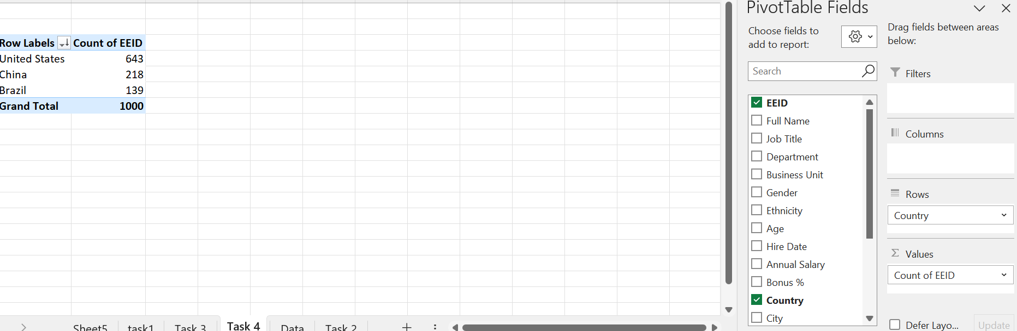
4. Country with High employee count
United States has highest number of employees.

Slide 5
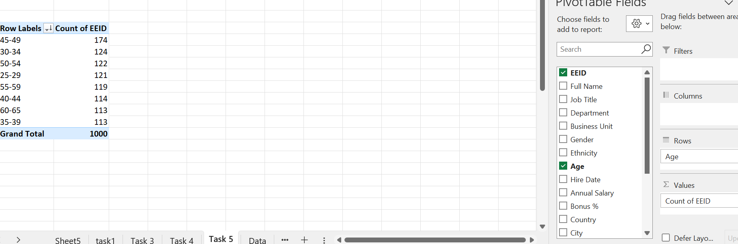
5.Age range for employee count
The age has been grouped with interval 5 then we get that the most common age range is 45-49 which consists of 174 employees

Slide 6
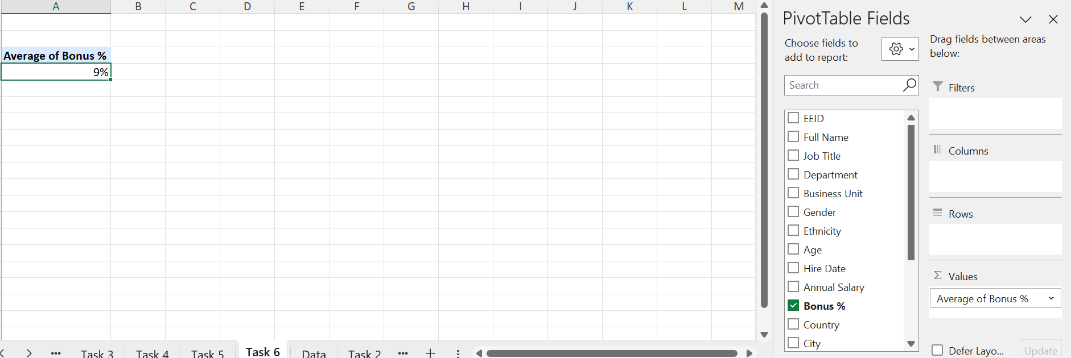
6.Average bonus percent
Average bonus percent given to employees is 9%

Slide 7
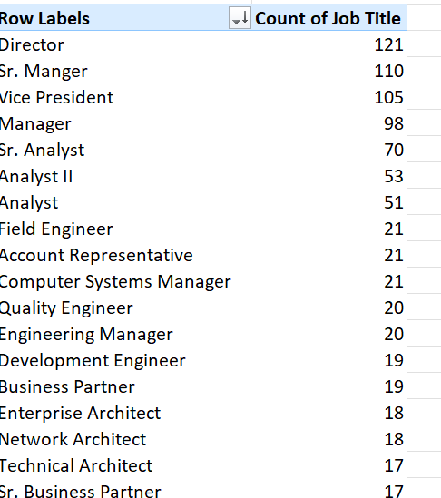
7.Title occurs most
The title column put into value to count and same column in rows
Director title occurs most which is 121

Slide 8
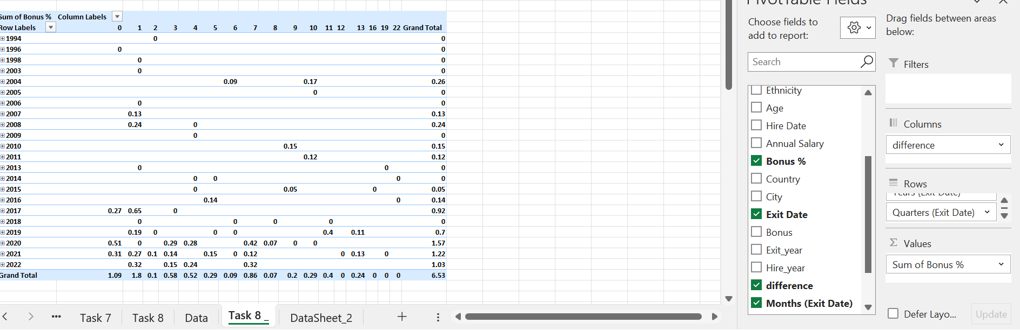
Reason For leave
The difference column is years they stay in the company
Most people leave quickly due to 0 bonus percentage

Slide 9
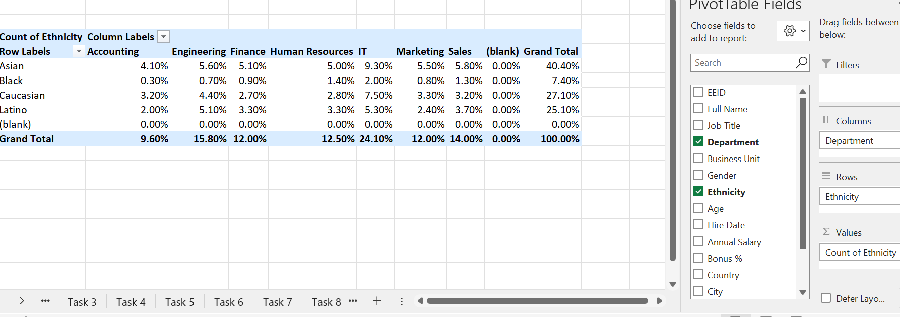
9.Highest ethinicity
IT department has highest ethinicity

Slide 10
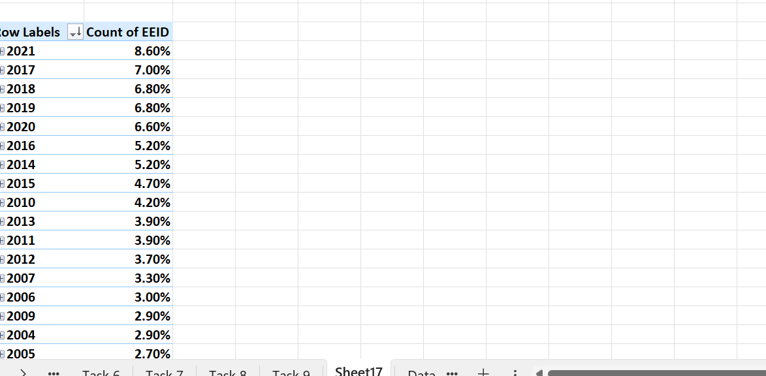
10. Increase hiring
Yes there is a increase in hiring since the begineng

