Slide 1
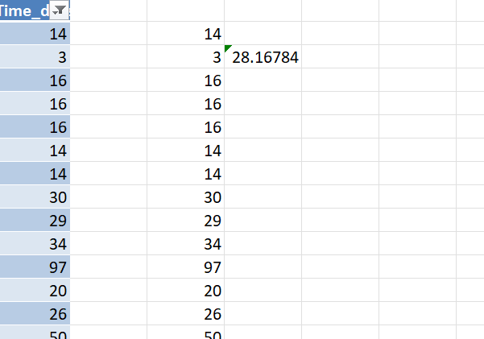
1. Average Lead time
For some places completion date was not there so I have used
“=IF([@WorkDate]-[@ReqDate]>=0,[@WorkDate]-[@ReqDate],"NA")”
the function then filter the non NA Value ans taken the average
The Value is 28.16 days

Slide 2
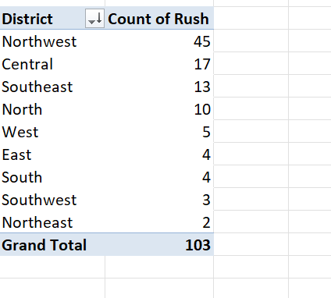
2.District with highest no of rush Jobs
Northwest district has highest number of rush jobs in the available data

Slide 3
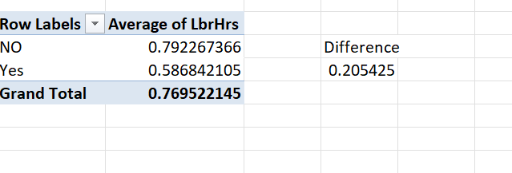
3.Average Hrs difference Between Rush Job Yes or NO
There are blank cells in the Labour Hours columns .
From the available data the average No rush hours is less for the work than rush hours by .20 hrs

Slide 4
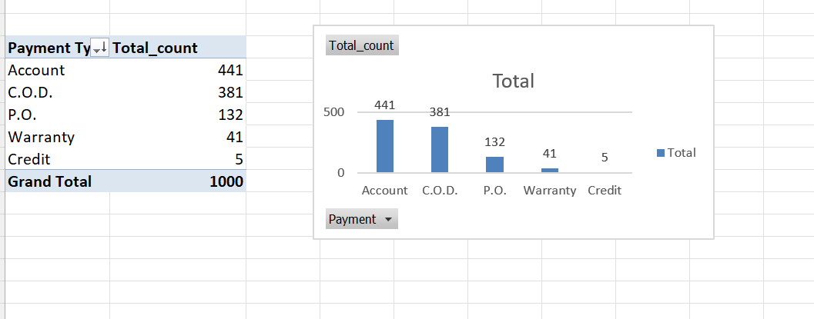
4. Distribution of Payment Type
Highest Number of payment has been done through Account followed by COD ,P.O etc

Slide 5
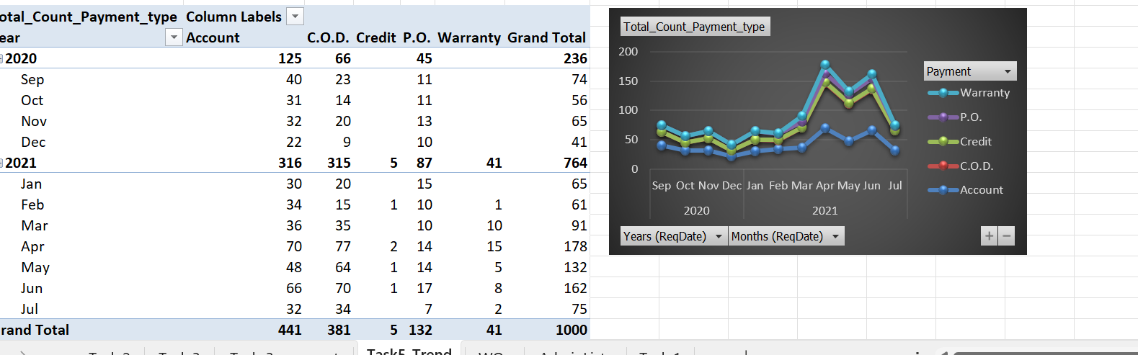
5. Trends in distribution of payment type
As we can see from the chart in 2020 there were no Credit and Warranty then since 2021 beginning, we can see upward trend for different payment types except Account payment

Slide 6
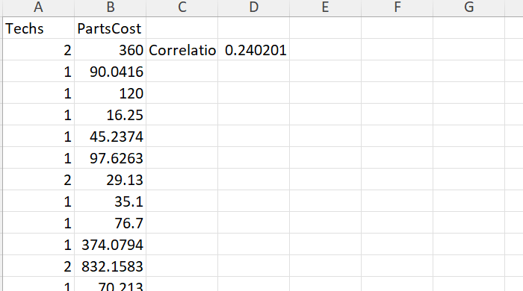
6.Relation between Techs and Parts cost
It is positively corelated .The value 0.24 define if we increase the 1 technician the value will increase 0.24 unit.

Slide 7
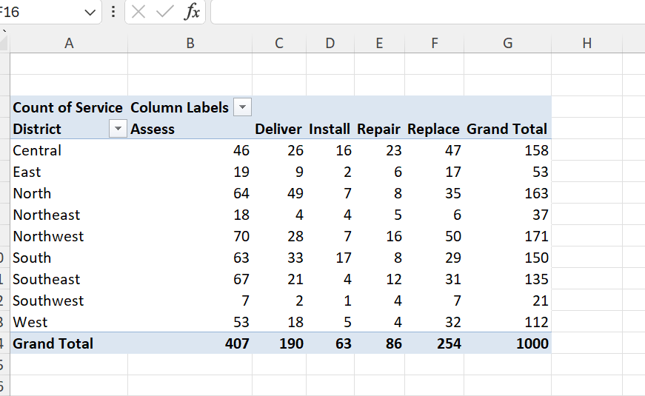
7.Most Common type of service
The most common type of service taken by each district is “Assess”.

Slide 8
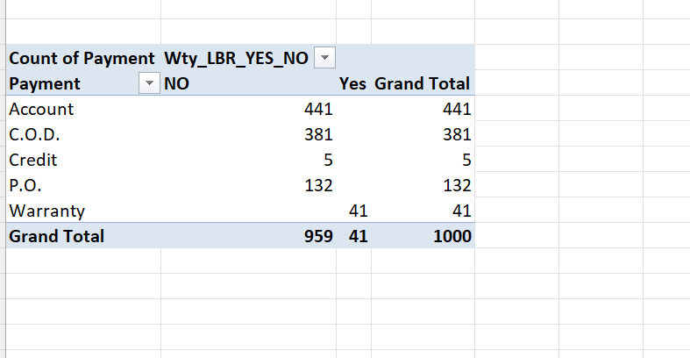
WTYLBR VS Payment type
Only Warranty has 41 WTYLBR

Slide 9
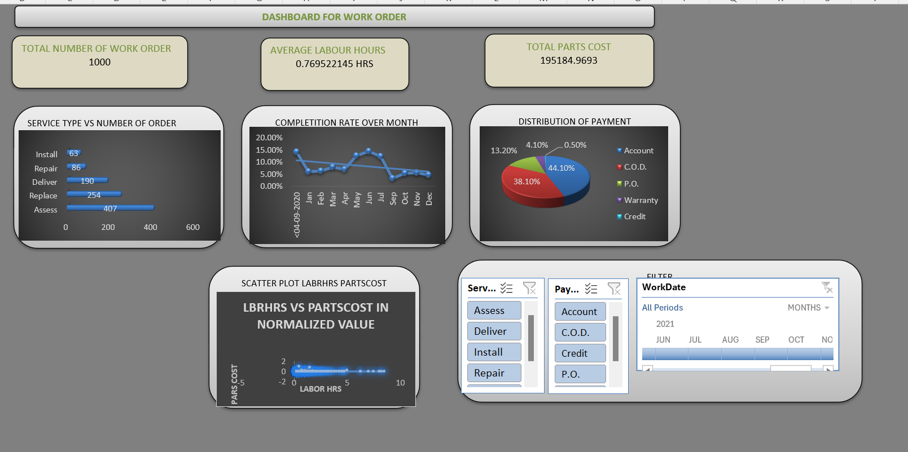
9.DASHBOARD

Slide 10
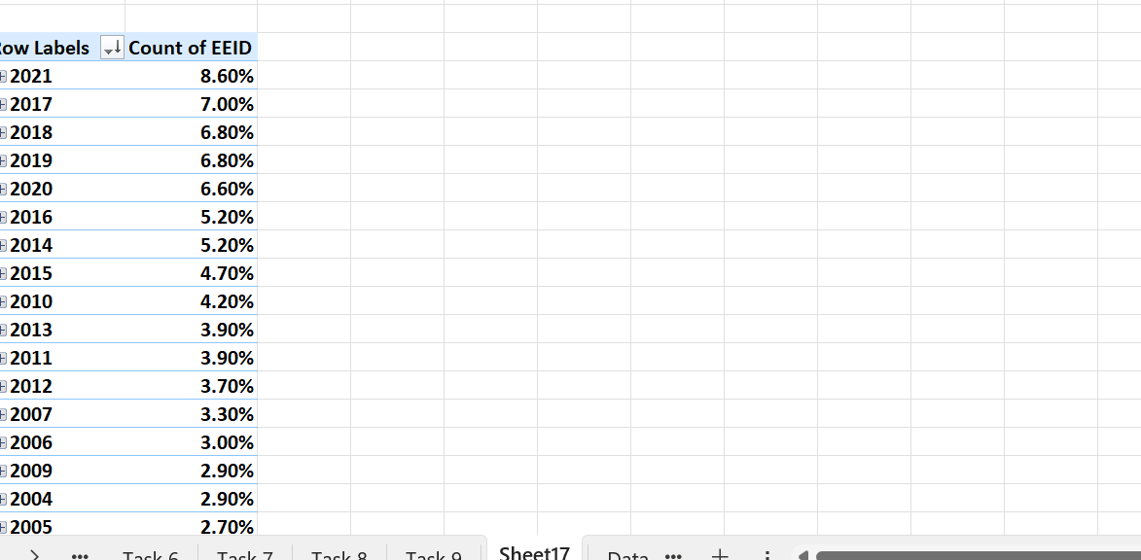
10. Increase hiring
Yes there is a increase in hiring since the begineng

Slide 11
https://github.com/SPLV2024/assesment/tree/main/excel

