Slide 1
Lab 5
Music Hub
Sohaib Mohiuddin – 100593657
Umar Riaz – 100600032
Bhavik Panchal - 100591777

Slide 2
Description
Distribution networks are a major challenge for musicians/artists especially in the developing worlds where piracy is rife. Label owners can also take advantage of the musicians. Majority of the artists prefer a system that gives them direct control of the royalties and eliminates piracy. Music hub is a service platform that allows a verified artist to upload his/her music onto the platform. Royalties will be paid directly to artists based on the number of listeners per month. The artists will be able to track their earnings on the application anytime.
The clients will subscribe to the platform with a premium account to listen to music of their choice with no advertisements, or they can create a free account that allows advertising and restricted features. Premium account holders can listen offline, but the platform will not support off-the-platform download from the application. Clients will also have a recommendation service that tracks the type of music they play most and will suggest similar music to them.

Slide 3
Why Music Hub?
People pirate music since it costs them no money and because of how easy it is to do. This however hurts artists, especially the upcoming artists. Music hub will make music easily accessible to people so that they don’t have to pirate it while benefitting the artists at the same time. This will give the artists a safe environment to release their music without the fear of not making enough money.

Slide 4
Objectives
The software will allow every artist that is verified and licensed to upload his/her music.
If the client signs up for a premium account, they will have an advertisement-free experience
Every artist’s record will be organized and managed to allow investors to add new artist’s as well as track their management
Depending on the music the user has listened to, their will be a recommendation service that will recommend music that is similar to the music already played
Clients will be able to download music in the web application. This music will have offline capabilities but will not be available outside the application.

Slide 5
Measures of Success
Artists will have an ‘artist account’ that will provide the ability to upload their music and track their earnings
A database will store customer types (premium or non-premium) to enable or disable advertisements
The investor will have a separate account on the web application where they are able to add and track the performance of new artists
A Functional database that keeps track of what customers are listening to and based on that information provides new recommendations to the customers
A web application that appeals to customers where ads are displayed appropriately for non premium customers and not for premium ones
A security mechanism to prevent customers from pirating the music

Slide 6
Features and Requirements
Users can use the free account to listen to their favorite music. However with the free account there will be ads to help support the artists.
Users can upgrade to premium account for a defined price, which disables the ads and provides the user with extra features.
Users can listen to artists and music from all over with world.
Users can keep a track of their favorite artist shows and book tickets
Artists will have to register with Music Hub in order to release their music and get their royalties

Slide 7
Implementation Model
The model we chose for our project was the Agile Model. This methodology involves continuous iterations of development and testing. The characteristics of the Agile process played to our advantage such as client focused, multidisciplinary teams (multiple people/teams involving different professional specializations) and an incremental process. The main disadvantage for us is the project going off track. Agile model involves continuous change and therefore can go off track if the project is not managed as increments are completed.

Slide 8
Software Implementation
The project will be worked on in sprints. Each task will be worked on by developers and BA’s for the development process. Concurrently there will be a testing process done by QA’s for every sprint that way the client can determine whether changes are wanted based on a fully tested sprint.

Slide 9
Integrating and system testing
In this phase we will integrate the application with new features and continue to test the application. From the previous phase we would combine the music playback system with the user account system and test them to see whether they work together. Ex. is a user able to log in and play music on the platform.

Slide 10
Operation and maintenance
All the separate functions would need to be integrated and made into one system. The system will be installed and tested by stakeholders and clients. Number of complaints and feedback would be taken into consideration and observed. This will give a guideline to what changes need to be made for future updates.

Slide 11
Possible Risks
The most common task related risk that can occur is the underestimation of cost. Since we are using Agile Methodology, project costs will also increase without planning.
Solution: This can be overcome by careful and continuous cost planning as the project will continuously change and the cost can be carefully measured for each phase and the entire project.

Slide 12


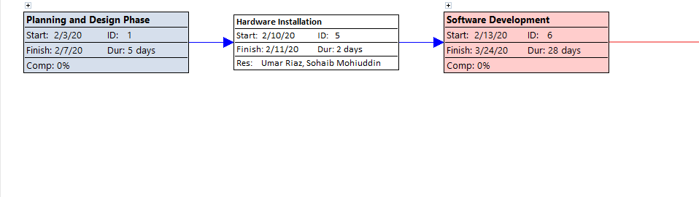


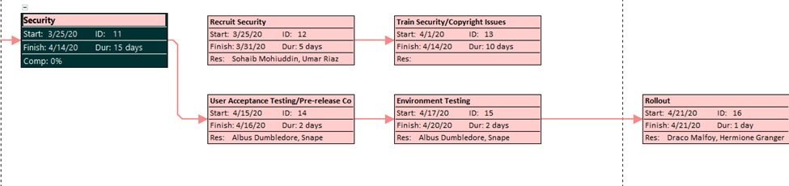

Activity Diagram
Here is the Activity Diagram, the phases that take the largest amount of time are the development phase with a duration of 28 days and the security phase with a duration of 15 days.

Slide 13
Resources
The project resources consist of multidisciplinary members (multiple specializations).
Business Analysts – 2 employees
Developers – 3 employees
IT Support – 3 employees
Quality Assurance (Tester) – 2 employees
Deployment – 2 employees

Slide 14
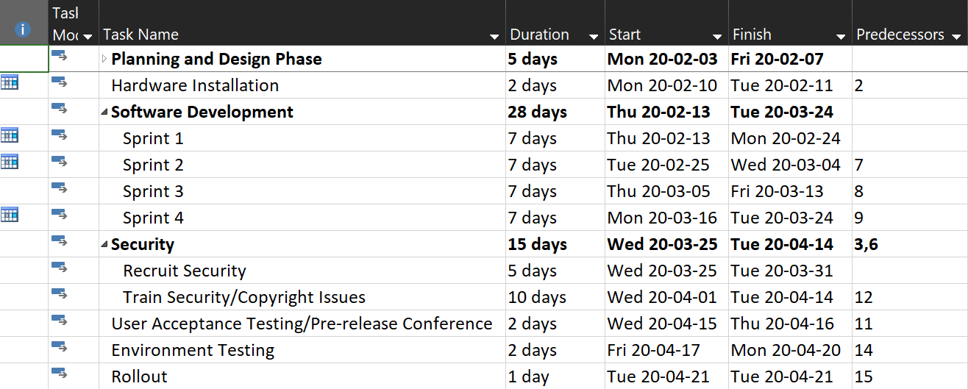
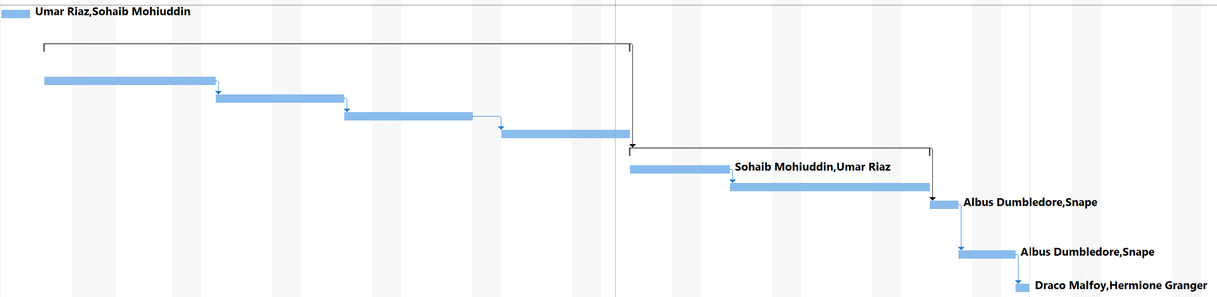
Gantt Chart & Resource Timeline

Slide 15
Thank You! Any Questions?

