Slide 1
A Picture is worth
1000 words
A Graphical Password Strategy Authentication System

Slide 2
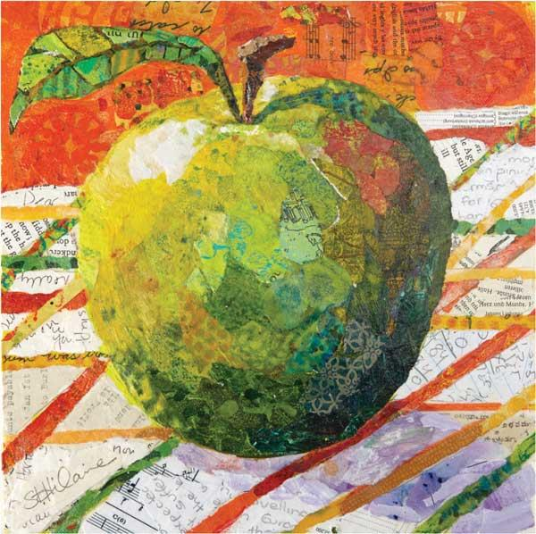
A Picture is Worth a Thousand Words
A Project by
Eric Whalls
Siddharth Tripathi
Harasees Singh Gill
A Graphical Password Strategy Application
Notes:
We chose to tackle the graphical password strategy
Our app authenticates users in a quick and seamless way to access their device and other content.

Slide 3
The Graphical Password Strategy
Goal: Provide users a secure, reliable option to authenticate without a complicated password of characters and your mother’s maiden name.
Graphical Passwords are: Quick Seamless Convenient | Different but in a good way: Added security to protect against spyware and malicious software Easily memorized, but extremely difficult to guess
Notes:
Our goal is to provide our user base with a quick, efficient, and reliable way to authenticate.
A graphical password is quick, convenient, and seamlessly integrated into current devices and applications.
Additionally a graphical password protects user’s login information from malicious software that targets keystrokes to find passwords.
The users don’t need to memorize a strong password that has many upper case, lower case, numeric, and special characters. They don’t need to know their mothers maiden name. The graphic is sufficient enough to authenticate the user, and a simple pattern is much easier to memorize.

Slide 4
Measuring Success
Scope of the Project
Total Duration of Project
Budget
Employee Satisfaction
Quality of Cost

Slide 5
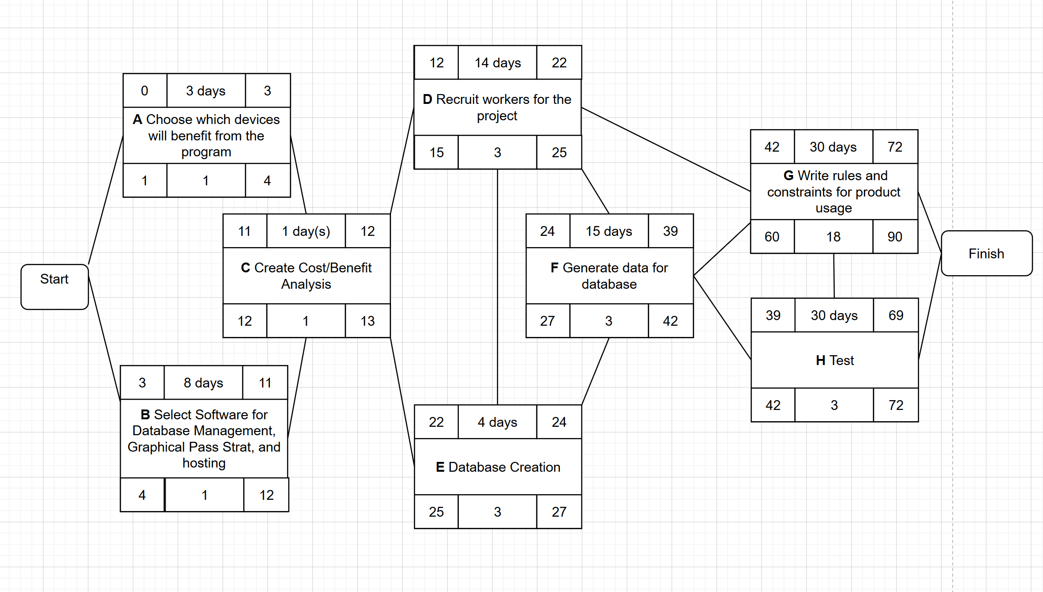
Notes:
The tasks have been split among three teams:
Quality Assurance, Data Management, and Application Development teams.
Each team is responsible for tasks on the activity diagram:
QA:
A: Choosing devices
C: Cost Benefit analysis and where to focus resources
H: Test cases and validation of application functionality
Data:
E: Database Creation and managing all user data
F: Generating initial data and test data for the database
Application:
B: Select frameworks and software platforms to develop the app
D: Recruiting developers to create the application
G: Writing the guidelines to use the software

Slide 6
Associated Risks
Doing too much for too little
Choosing the appropriate infrastructure
Finding skilled workers for the job
Database Protection against Data Corruption
Overworked Team Members
Learning Curve Delays
Notes:
Feel free to adjust how you want. I make presentations based on Buzz words. Jazz it up if it makes you happy

Slide 7
