Slide 1

SOFE 3490: Software Project Management - Lab 5
iPad Restaurant Application
Vraj Shah (100658669)
Anuj Patel (100651964)
Raj Parikh (100655911)

Slide 2
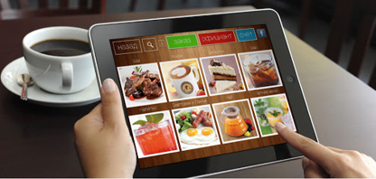
Introduction – iPad restaurant application
Build a system which will digitize the ordering process for restaurants
Improves customer satisfaction as they do not have to wait in lines to order
Can provide more information to customers (ingredients, nutrition facts) since no physical space is required

Slide 3
Objectives & Measures of Success
System displays all necessary information to customers
Accept multiple forms of payment
Allows restaurant managers to access the internal system to update any menu changes
Keep costs within selected budget

Slide 4
Risks
User interface is not optimized
Use an agile approach to involve the client and receive feedback
Hold an open beta test to understand flaws in the system
Perform unit and integration testing
Security flaws
Use secure login/sign-up methods for clients to change their menu
Consider using an off-the-shelf application

Slide 5
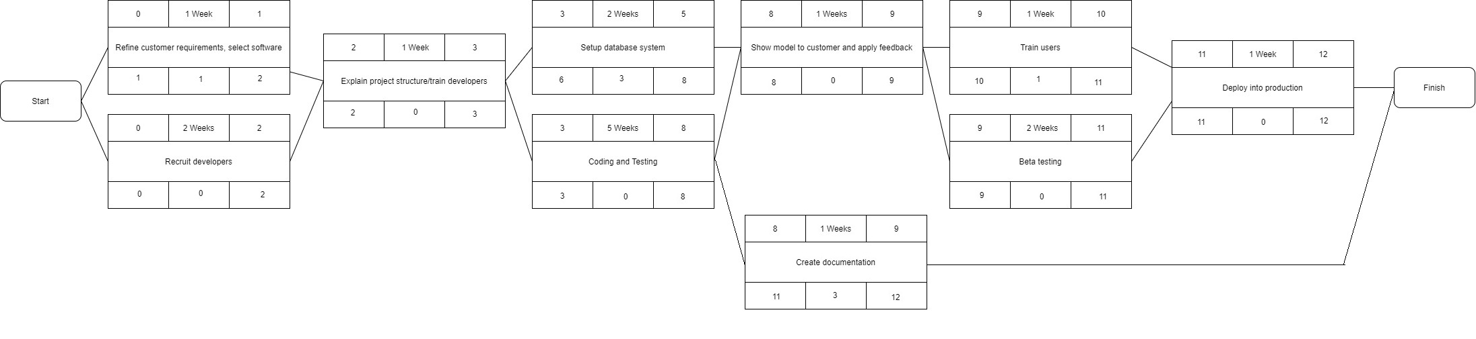
Activity Diagram

Slide 6
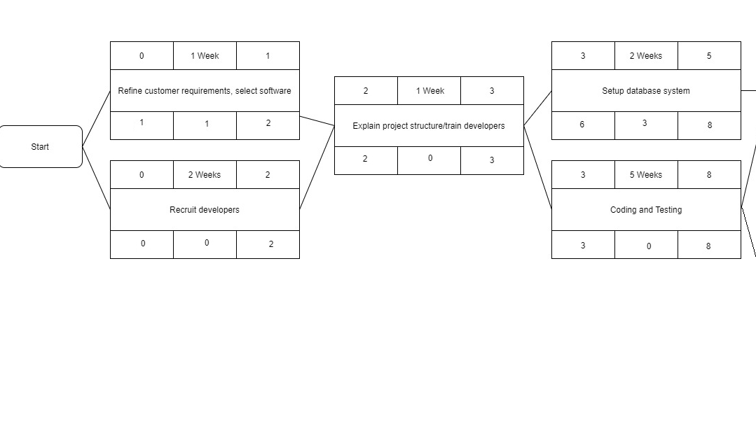
Activity Diagram – Part 1

Slide 7
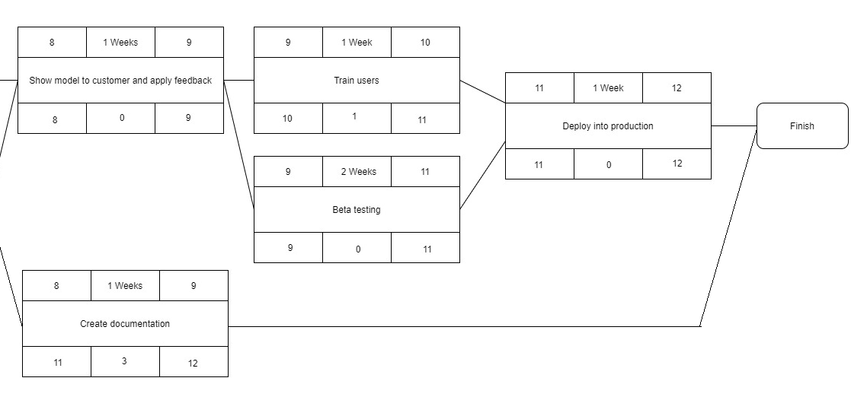
Activity Diagram – Part 2

Slide 8
Infrastructure
Cloud server to store restaurant databases
A secure database to store login/sign-up credentials for each customer
Frontend system to connect to backend database system and display information
System is compatible with latest versions of IOS

Slide 9
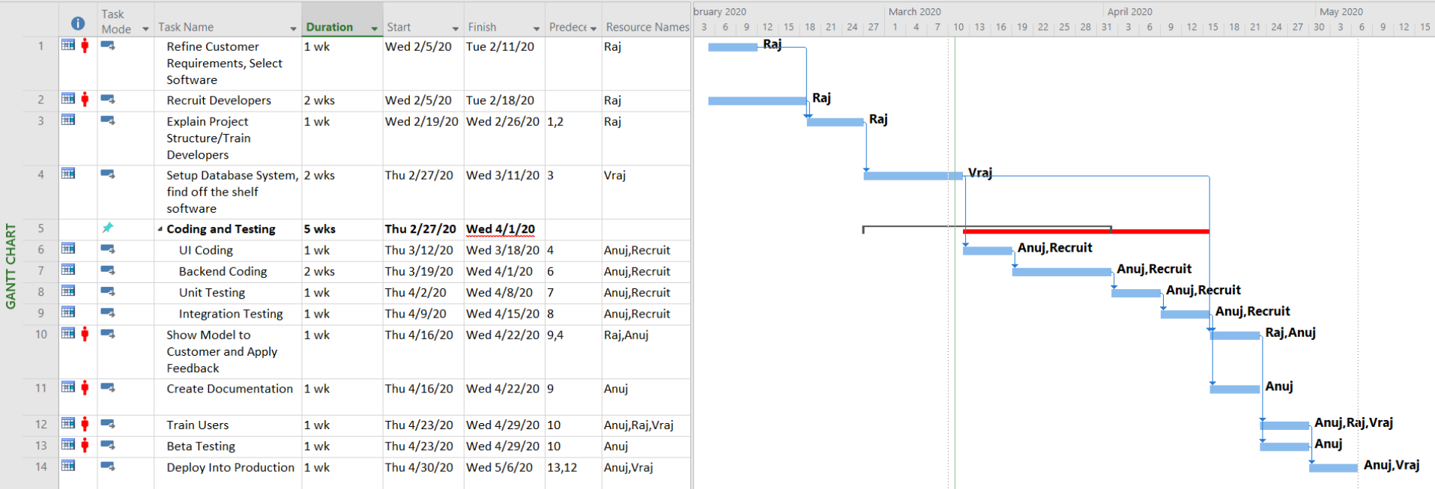
Gantt Chart

Slide 10

Questions?

