Slide 1
iPad Restaurant Application
Group 10
Faisal Pindar(100629476)
Qinghao Lu(100627854)
Zhou Mu(100676964)

Slide 2
Introduction
In recent years, there has been an increase in the demand for restaurants to provide customers with a more efficient and user friendly method for ordering at the restaurants. Our goal is to create a convenient ipad application for all casual restaurants to create their digital menus for both in-house and online customers.

Slide 3
Objectives
The iPad application should be able to establish communication with the restaurant’s POS system. Hence, the orders can be sent directly to the POS system.
The iPad application should keep track of all of the orders made by table. Customer can choose to see the total price of all the orders made at any point of their visit to the restaurant.
All the menu items can be searched and sorted by price and category. Food items should have pictures, descriptions.
The app can switch menu items to different languages and the price can be converted to corresponding currencies, based on the customer's preferences.
A rating function needs to be built in the app for all food items. The customer and restaurant team should be able to also view the reviews of all the food items from past customers.
Two levels of access need to be created for the app. An employee level with the functions to modify menu items, pictures, description and a customer level access that permits the placing/altering of an order, select payment methods and also to provide reviews for services.
Option for menu items to be read out to customers with disabilities or enhance ease of use.
The application should work of all ipad software versions.
The application can process customer payments by credit or debit cards.

Slide 4
Measures of success
The system uses a database for the menu. This contains pictures and provides descriptions on the food items in different languages as well as ratings from past customers, which proved to upscale food sales by 70% for the year.
System potential failures are tested to be low, which shows that the application should be running without crashing for 364/365 days in a year. However, with such minimal tendencies for a crash, the system faces only a potential crash for less than a day.
The system processes orders in a faster and more organized manner, thus reducing the number of returned and incorrectly processed orders by 80%.
Funds provided by investors for the project were sufficient.
Reviews show 90% of users voted the system was easy to use and navigate during the testing phase.
System provided hotels and restaurants with excellent room service allocation, this helps orders to be taken to the right rooms and tables.

Slide 5
Risks
Not enough restaurants sign-up to collaborate with the service.
Delay in the development of the software causing the delay of the completion of the whole plan.

Slide 6
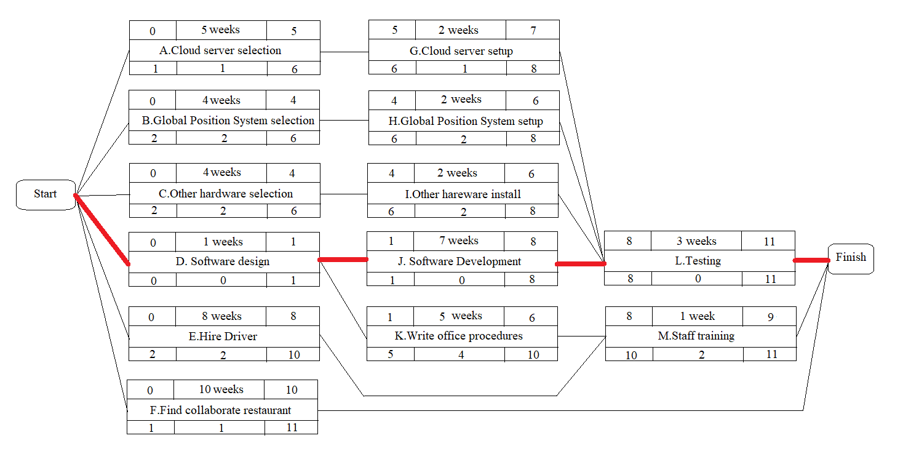
Activity diagram

Slide 7
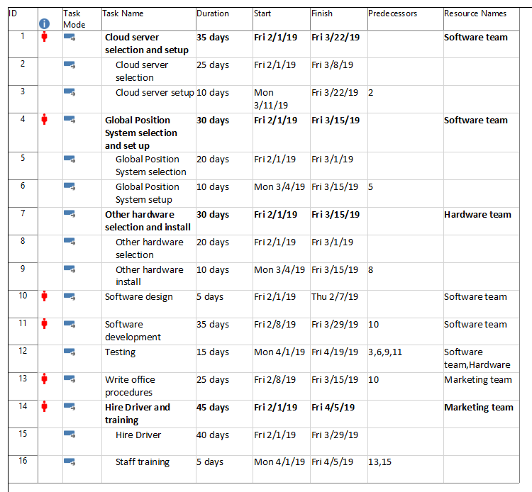
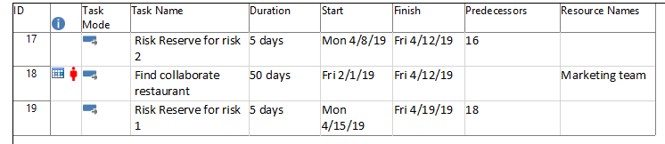
Assigned Resource

Slide 8
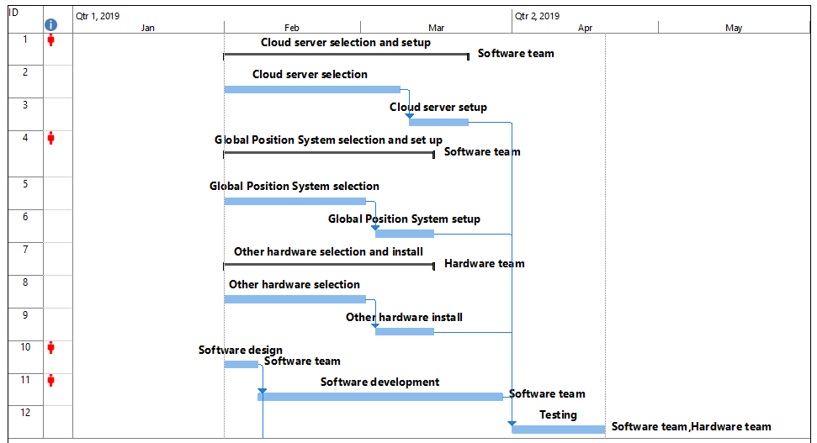
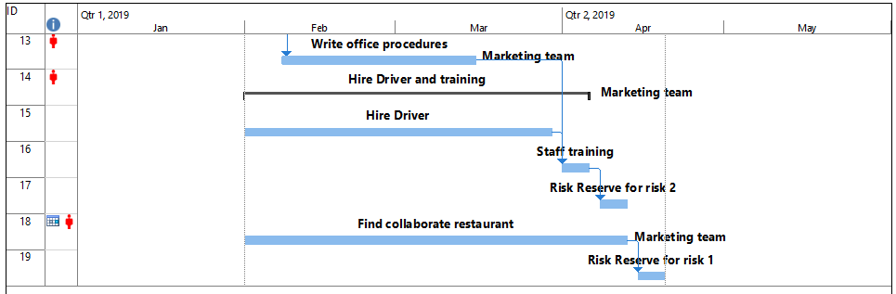
Gantt Chart
*The 22nd February is the holiday time
*There are 2 risk mitigation tasks included

Slide 9
THANK YOU!

