Slide 1
iPad Restaurant Application
Preet Khasakia (100653168)
Naweed Adel (100660467)

Slide 2
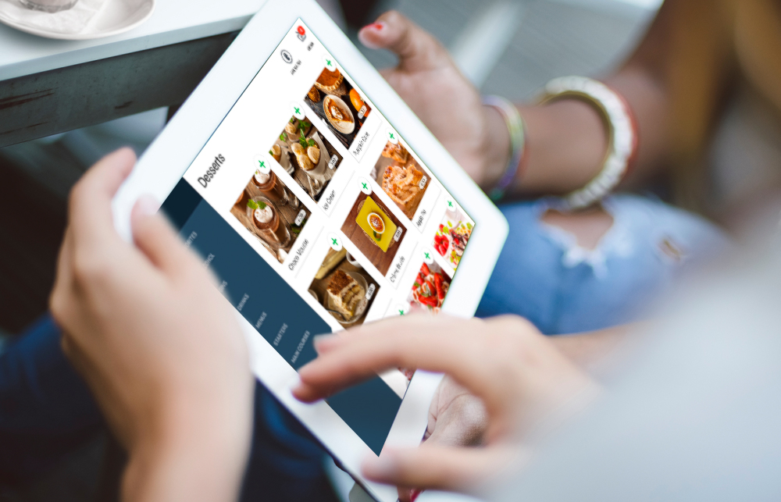
Introduction
Project Description
The iPad restaurant application aims at replacing the conventional old style menu system. Meal orders can be taken on an iPad, which will list the complete menu offered by the restaurant. Each menu item will display a description of the item, ratings given by previous customers, a large image for better knowledge of the dish, and the cost of the item. The customer may also use the iPad provided by room service for reserving a table.

Slide 3
Introduction (continued) ;)
Problem to Tackle
Since we are implementing a menu using modern technology, it is essential that our application provides customers with a menu that satisfies the given features and pertains to better customer satisfaction. As software engineers, we hope to accomplish a fully functioning restaurant application that is user friendly, easy to use and provides success to the restaurant.

Slide 4
Objectives
Improve the customer’s experience by providing crucial information such as a picture of the food, a brief description, a rating, and the price.
Remove lines by having waiters respond to when the customer finishes their order.
Provide additional assistance to customers unaware of the food or customers that aren’t familiar with the language.
iPad is more flexible than a menu, since customers can scroll through all the items, instead of having to read through long pages.

Slide 5
MORE OBJECTIVES
Organize the menu, food items can easily be categorized for customers.
Improve reputation by utilizing iPad instead of traditional menu.
iPad can also include ads while customers view items for additional income and publicity.
Receive feedback through the iPad to improve services.
Reduce stress of waiters by relieving the need to memorize or write down orders.
Conduct payment through iPad to further increase efficiency. Restaurant/waiters would receive notification of when payment is processed to ensure security.

Slide 6

Measures of Success
Ensure that the test cases from stakeholders are met prior to the release of the application.
Have an initial project planner for a working schedule of the project. To measure the success rate, track the actual performance of the project and compare it to the initial schedule by calculating the difference. This will show a result of how successfully or poorly the project is working at.
Allow customers to engage in a survey after their visit to the restaurant on their feedback towards the application and other services.

Slide 7
MORE SUCCESS
Similar to the project planner, apply an initial base case of the budget. Measure the actual spending invested in the project and through comparison, it will be determined whether the budget is overspent or underspent.
Compare and analyze services used by other companies or franchises, and evaluate the outcome to ensure if the project meets the in-demand market value or if additional changes are required to obtain further success.

Slide 8

Associated Risks
Activity: Staff Recruitment
Risk: Given that this project must be completed within 1-3 months, there is a likelihood that some candidates for the project may not meet certain qualifications.
Countermeasure: Hiring team will begin the recruitment process with an earlier deadline and assess each candidate with an interview that involves technical and behavioral questions.

Slide 9
Risky Business
Activity: Configure and Test
Risk: Project team may need to decide on the most appropriate testing methodologies, testing tools and the most efficient way to deliver results of the final working iPad Restaurant Application.
Countermeasure: Firstly, Software Developers along with Test Analysts will produce and evaluate preliminary test cases. They will then acquire necessary requirements from stakeholders, perform unit tests, integration tests and finally engage in trial runs to ensure that every test case is met for the application.

Slide 10
EVEN MORE RISKS OH YEAH
Activity: Post Project (Finish)
Risk: Users may not be comfortable with the iPad Restaurant Application and may want to express their feedback for further improvement.
Countermeasure: Project team will implement a survey database that will be used to store user feedback and ratings for the application when an optional survey window will be prompted when a customer has made their purchase using the software. This will allow the team to manage responses by users and consider any necessary improvements that need to be made to further enhance the application.

Slide 11
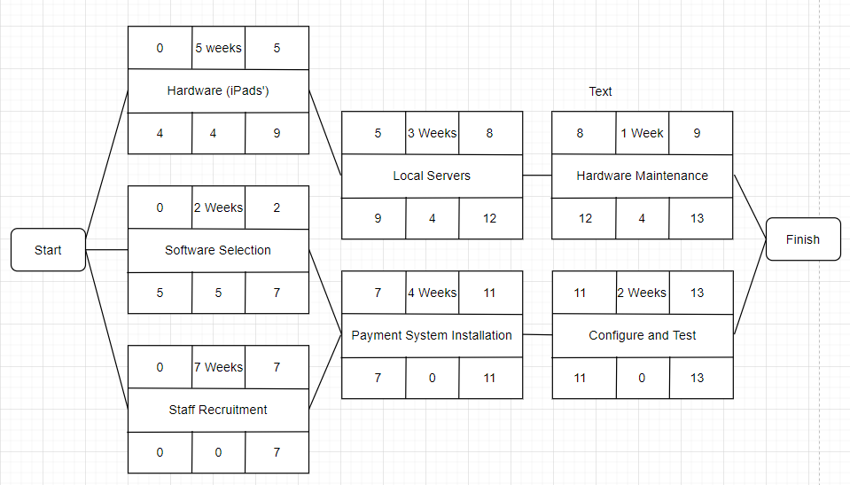
Activity Diagram

Slide 12
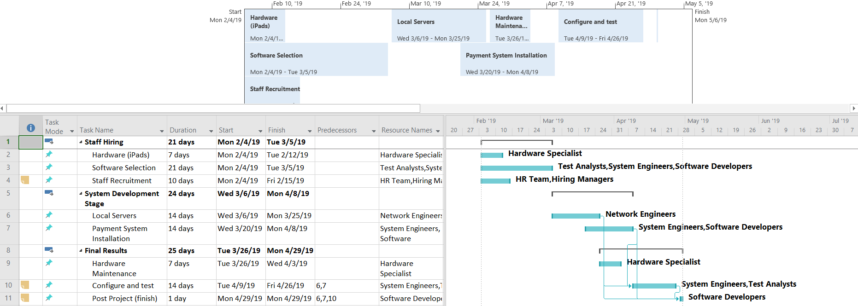
Gantttttt Chart

Slide 13
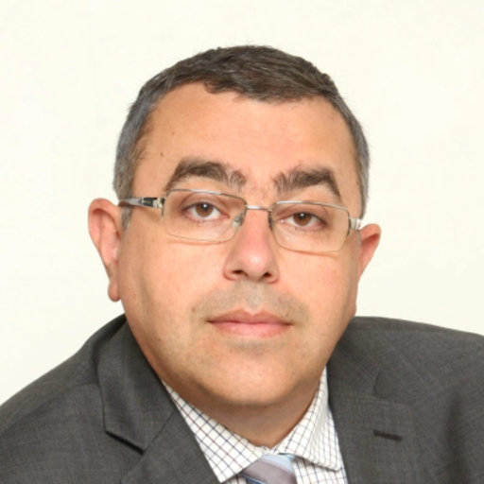
Any Questions

