Slide 1

jiroStream
Presented by: Ibrahim, Daniel and Brett

Slide 2

jiroStream
Provide an alternate, artist/user friendly media streaming platform
Focus is on the music and providing a secure base for artists to upload and profit off of their content
Notes:
Project objectives:
a. Each verified artist has a unique license that he/she uses on the platform.
b. The platform should be able to support multiple genres of music and allow artists to create a new genre subject to approval.
c. Royalties are paid directly to artists based on the number of listeners per month.
d. The artists should be able to track their earnings on the application anytime.
e. The clients can subscribe to the platform with a premium account to listen to any music of their choice with no advertisement.
i. Clients can choose to can create a free account that allows advertising and restricted features.
f. Premium account holders can listen offline.
i. The platform should not support off-the-platform download from the application.
g. The investor can add new artists, create new genres of music, and track the performance of artists in the platform.
h. Clients have a recommendation service that tracks the type of music they play most.
i. The platform shall then suggest similar music to listen to.

Slide 3
Mission Statement
“jiroStream was founded with the mission of bringing fans and artists closer together and creating a sustainable industry model that values music and artists.
- Ibrahim Noor Mohammed

Slide 4
Project Objectives/Goals
Unique licensing for Artists
Multiple genres support and genre creation capabilities
Royalties are paid directly to artists (determined by number of streams)
Artist revenue tracker accessible at anytime
Clients may subscribe to the platform with a premium account and stream with no advertisements
Clients can choose to can create a free account that allows advertising and restricted features.
Premium account holders can listen offline.
The platform should not support off-the-platform download from the application.
The investor can add new artists and create new genres of music
investors can also track the performance of artists in the platform.
Notes:
New Employee Risk:
In the activity network diagram, we detail a plan to recruit and train new employees with qualified skills to assist us on this project. This inherently is a risk because we require employees to assist us on the development. We are planning to train them during the brainstorming phase and having them up to speed before the beginning of development.
Licensing Risk:
Licensing acquisition is a major risk because the entire application model is dependent on being able to secure music licences from the respective music management companies and record labels. We can manage this by assigning a specific team to focus on acquiring media licence rights and give them a longer amount of time to collect these rights. Another thing this team could offer these companies is percentage incentives ranging from 15% and above. Then we will have them transition over to the team to assist in content collection into server databases.
Funding:
Since jiroStream is initially free to use without the pro version, it is important to use advertisements which are implemented at the application's startup and after 10 songs. This ad implementation will be an incentive for users to purchase the premium app version, as well as a method to accumulate revenue without the user having to pay a monthly fee if they do not wish to do so.
Generalization:
Generalization in project guidelines and documentation can cause confusion during development. This can lead to errors in logic and may lead to the applications functionality. An idea to counteract this is creating documentation as the development progresses, as the programmer will likely not forget the functionality of the code
Unoptimized Analytics:
The risk associated with implementing analytics within our system is that it must be optimized for the entire framework of the application to work correctly. The way we plan on minimizing this risk is to allocate enough time to be able to optimize it to a stage where it will perform smoothly.

Slide 5
Measures of Success
Scope
Schedule
Budget
Team satisfaction
Customer satisfaction
Quality
Infrastructure
Notes:
New Employee Risk:
In the activity network diagram, we detail a plan to recruit and train new employees with qualified skills to assist us on this project. This inherently is a risk because we require employees to assist us on the development. We are planning to train them during the brainstorming phase and having them up to speed before the beginning of development.
Licensing Risk:
Licensing acquisition is a major risk because the entire application model is dependent on being able to secure music licences from the respective music management companies and record labels. We can manage this by assigning a specific team to focus on acquiring media licence rights and give them a longer amount of time to collect these rights. Another thing this team could offer these companies is percentage incentives ranging from 15% and above. Then we will have them transition over to the team to assist in content collection into server databases.
Funding:
Since jiroStream is initially free to use without the pro version, it is important to use advertisements which are implemented at the application's startup and after 10 songs. This ad implementation will be an incentive for users to purchase the premium app version, as well as a method to accumulate revenue without the user having to pay a monthly fee if they do not wish to do so.
Generalization:
Generalization in project guidelines and documentation can cause confusion during development. This can lead to errors in logic and may lead to the applications functionality. An idea to counteract this is creating documentation as the development progresses, as the programmer will likely not forget the functionality of the code
Unoptimized Analytics:
The risk associated with implementing analytics within our system is that it must be optimized for the entire framework of the application to work correctly. The way we plan on minimizing this risk is to allocate enough time to be able to optimize it to a stage where it will perform smoothly.

Slide 6
Scope
3 core ideas:
protecting the rights of the artists by fighting piracy.
providing a platform for artists to receive significant financial incentives for their efforts
maximizing profit for revenue to divide amongst both the
company and the artists on the platform
Notes:
New Employee Risk:
In the activity network diagram, we detail a plan to recruit and train new employees with qualified skills to assist us on this project. This inherently is a risk because we require employees to assist us on the development. We are planning to train them during the brainstorming phase and having them up to speed before the beginning of development.
Licensing Risk:
Licensing acquisition is a major risk because the entire application model is dependent on being able to secure music licences from the respective music management companies and record labels. We can manage this by assigning a specific team to focus on acquiring media licence rights and give them a longer amount of time to collect these rights. Another thing this team could offer these companies is percentage incentives ranging from 15% and above. Then we will have them transition over to the team to assist in content collection into server databases.
Funding:
Since jiroStream is initially free to use without the pro version, it is important to use advertisements which are implemented at the application's startup and after 10 songs. This ad implementation will be an incentive for users to purchase the premium app version, as well as a method to accumulate revenue without the user having to pay a monthly fee if they do not wish to do so.
Generalization:
Generalization in project guidelines and documentation can cause confusion during development. This can lead to errors in logic and may lead to the applications functionality. An idea to counteract this is creating documentation as the development progresses, as the programmer will likely not forget the functionality of the code
Unoptimized Analytics:
The risk associated with implementing analytics within our system is that it must be optimized for the entire framework of the application to work correctly. The way we plan on minimizing this risk is to allocate enough time to be able to optimize it to a stage where it will perform smoothly.

Slide 7
Schedule
6 phases:
Planning
Analysis
Design
Development / Implementation
Maintenance
Notes:
New Employee Risk:
In the activity network diagram, we detail a plan to recruit and train new employees with qualified skills to assist us on this project. This inherently is a risk because we require employees to assist us on the development. We are planning to train them during the brainstorming phase and having them up to speed before the beginning of development.
Licensing Risk:
Licensing acquisition is a major risk because the entire application model is dependent on being able to secure music licences from the respective music management companies and record labels. We can manage this by assigning a specific team to focus on acquiring media licence rights and give them a longer amount of time to collect these rights. Another thing this team could offer these companies is percentage incentives ranging from 15% and above. Then we will have them transition over to the team to assist in content collection into server databases.
Funding:
Since jiroStream is initially free to use without the pro version, it is important to use advertisements which are implemented at the application's startup and after 10 songs. This ad implementation will be an incentive for users to purchase the premium app version, as well as a method to accumulate revenue without the user having to pay a monthly fee if they do not wish to do so.
Generalization:
Generalization in project guidelines and documentation can cause confusion during development. This can lead to errors in logic and may lead to the applications functionality. An idea to counteract this is creating documentation as the development progresses, as the programmer will likely not forget the functionality of the code
Unoptimized Analytics:
The risk associated with implementing analytics within our system is that it must be optimized for the entire framework of the application to work correctly. The way we plan on minimizing this risk is to allocate enough time to be able to optimize it to a stage where it will perform smoothly.

Slide 8
Budget
Expense management
Advertisement structure
Freemium
multiple advertisements
limited music quality
Subscription
Notes:
New Employee Risk:
In the activity network diagram, we detail a plan to recruit and train new employees with qualified skills to assist us on this project. This inherently is a risk because we require employees to assist us on the development. We are planning to train them during the brainstorming phase and having them up to speed before the beginning of development.
Licensing Risk:
Licensing acquisition is a major risk because the entire application model is dependent on being able to secure music licences from the respective music management companies and record labels. We can manage this by assigning a specific team to focus on acquiring media licence rights and give them a longer amount of time to collect these rights. Another thing this team could offer these companies is percentage incentives ranging from 15% and above. Then we will have them transition over to the team to assist in content collection into server databases.
Funding:
Since jiroStream is initially free to use without the pro version, it is important to use advertisements which are implemented at the application's startup and after 10 songs. This ad implementation will be an incentive for users to purchase the premium app version, as well as a method to accumulate revenue without the user having to pay a monthly fee if they do not wish to do so.
Generalization:
Generalization in project guidelines and documentation can cause confusion during development. This can lead to errors in logic and may lead to the applications functionality. An idea to counteract this is creating documentation as the development progresses, as the programmer will likely not forget the functionality of the code
Unoptimized Analytics:
The risk associated with implementing analytics within our system is that it must be optimized for the entire framework of the application to work correctly. The way we plan on minimizing this risk is to allocate enough time to be able to optimize it to a stage where it will perform smoothly.

Slide 9
Quality
Multiphase release:
Backend
Frontend
Alpha testing
Beta testing
Release
Notes:
New Employee Risk:
In the activity network diagram, we detail a plan to recruit and train new employees with qualified skills to assist us on this project. This inherently is a risk because we require employees to assist us on the development. We are planning to train them during the brainstorming phase and having them up to speed before the beginning of development.
Licensing Risk:
Licensing acquisition is a major risk because the entire application model is dependent on being able to secure music licences from the respective music management companies and record labels. We can manage this by assigning a specific team to focus on acquiring media licence rights and give them a longer amount of time to collect these rights. Another thing this team could offer these companies is percentage incentives ranging from 15% and above. Then we will have them transition over to the team to assist in content collection into server databases.
Funding:
Since jiroStream is initially free to use without the pro version, it is important to use advertisements which are implemented at the application's startup and after 10 songs. This ad implementation will be an incentive for users to purchase the premium app version, as well as a method to accumulate revenue without the user having to pay a monthly fee if they do not wish to do so.
Generalization:
Generalization in project guidelines and documentation can cause confusion during development. This can lead to errors in logic and may lead to the applications functionality. An idea to counteract this is creating documentation as the development progresses, as the programmer will likely not forget the functionality of the code
Unoptimized Analytics:
The risk associated with implementing analytics within our system is that it must be optimized for the entire framework of the application to work correctly. The way we plan on minimizing this risk is to allocate enough time to be able to optimize it to a stage where it will perform smoothly.

Slide 10
Project Risks
New Employee Risk
Licensing Risk
Funding
Generalization
Unoptimized Analytics
Notes:
New Employee Risk:
In the activity network diagram, we detail a plan to recruit and train new employees with qualified skills to assist us on this project. This inherently is a risk because we require employees to assist us on the development. We are planning to train them during the brainstorming phase and having them up to speed before the beginning of development.
Licensing Risk:
Licensing acquisition is a major risk because the entire application model is dependent on being able to secure music licences from the respective music management companies and record labels. We can manage this by assigning a specific team to focus on acquiring media licence rights and give them a longer amount of time to collect these rights. Another thing this team could offer these companies is percentage incentives ranging from 15% and above. Then we will have them transition over to the team to assist in content collection into server databases.
Funding:
Since jiroStream is initially free to use without the pro version, it is important to use advertisements which are implemented at the application's startup and after 10 songs. This ad implementation will be an incentive for users to purchase the premium app version, as well as a method to accumulate revenue without the user having to pay a monthly fee if they do not wish to do so.
Generalization:
Generalization in project guidelines and documentation can cause confusion during development. This can lead to errors in logic and may lead to the applications functionality. An idea to counteract this is creating documentation as the development progresses, as the programmer will likely not forget the functionality of the code
Unoptimized Analytics:
The risk associated with implementing analytics within our system is that it must be optimized for the entire framework of the application to work correctly. The way we plan on minimizing this risk is to allocate enough time to be able to optimize it to a stage where it will perform smoothly.

Slide 11
New Employee Risk
Hiring new workers
Integrating employees into the schedule
Meeting the deadlines
Notes:
Generalization:
Generalization in project guidelines and documentation can cause confusion during development. This can lead to errors in logic and may lead to the applications functionality. An idea to counteract this is creating documentation as the development progresses, as the programmer will likely not forget the functionality of the code
Unoptimized Analytics:
The risk associated with implementing analytics within our system is that it must be optimized for the entire framework of the application to work correctly. The way we plan on minimizing this risk is to allocate enough time to be able to optimize it to a stage where it will perform smoothly.

Slide 12
Licensing Risk
Acquiring Licenses
Forming a media team
Provide Incentives
Merge team into development
Notes:
New Employee Risk:
In the activity network diagram, we detail a plan to recruit and train new employees with qualified skills to assist us on this project. This inherently is a risk because we require employees to assist us on the development. We are planning to train them during the brainstorming phase and having them up to speed before the beginning of development.
Licensing Risk:
Licensing acquisition is a major risk because the entire application model is dependent on being able to secure music licences from the respective music management companies and record labels. We can manage this by assigning a specific team to focus on acquiring media licence rights and give them a longer amount of time to collect these rights. Another thing this team could offer these companies is percentage incentives ranging from 15% and above. Then we will have them transition over to the team to assist in content collection into server databases.
Funding:
Since jiroStream is initially free to use without the pro version, it is important to use advertisements which are implemented at the application's startup and after 10 songs. This ad implementation will be an incentive for users to purchase the premium app version, as well as a method to accumulate revenue without the user having to pay a monthly fee if they do not wish to do so.
Generalization:
Generalization in project guidelines and documentation can cause confusion during development. This can lead to errors in logic and may lead to the applications functionality. An idea to counteract this is creating documentation as the development progresses, as the programmer will likely not forget the functionality of the code
Unoptimized Analytics:
The risk associated with implementing analytics within our system is that it must be optimized for the entire framework of the application to work correctly. The way we plan on minimizing this risk is to allocate enough time to be able to optimize it to a stage where it will perform smoothly.

Slide 13
Funding
Freemium
Advertisements
Paid model
Subscription based
Notes:
Licensing acquisition is a major risk because the entire application model is dependent on being able to secure music licences from the respective music management companies and record labels. We can manage this by assigning a specific team to focus on acquiring media licence rights and give them a longer amount of time to collect these rights. Another thing this team could offer these companies is percentage incentives ranging from 15% and above. Then we will have them transition over to the team to assist in content collection into server databases.
Funding:
Since jiroStream is initially free to use without the pro version, it is important to use advertisements which are implemented at the application's startup and after 10 songs. This ad implementation will be an incentive for users to purchase the premium app version, as well as a method to accumulate revenue without the user having to pay a monthly fee if they do not wish to do so.
Generalization:
Generalization in project guidelines and documentation can cause confusion during development. This can lead to errors in logic and may lead to the applications functionality. An idea to counteract this is creating documentation as the development progresses, as the programmer will likely not forget the functionality of the code
Unoptimized Analytics:
The risk associated with implementing analytics within our system is that it must be optimized for the entire framework of the application to work correctly. The way we plan on minimizing this risk is to allocate enough time to be able to optimize it to a stage where it will perform smoothly.

Slide 14
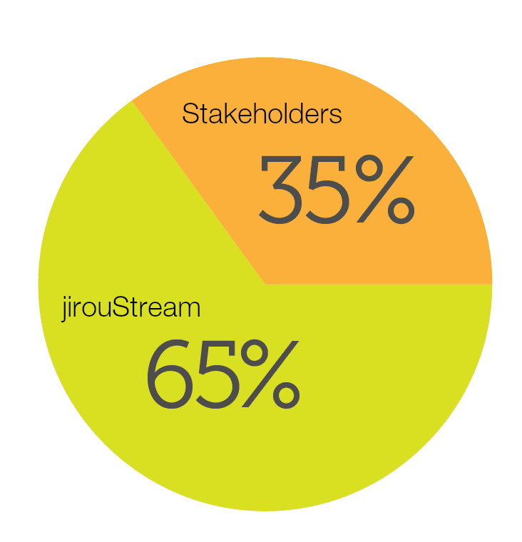
Funding
For every song played:
$0.02 CAD -> Artist
$0.01 CAD -> Rights Holders
Membership information:
- $10 monthly
- access to offline play,
lossless FLAC playback, etc.
35%
Payout to artists, stakeholders, etc.
Costs, licensing, servers, payroll, profit, etc.
65%
Notes:
New Employee Risk:
In the activity network diagram, we detail a plan to recruit and train new employees with qualified skills to assist us on this project. This inherently is a risk because we require employees to assist us on the development. We are planning to train them during the brainstorming phase and having them up to speed before the beginning of development.
Licensing Risk:
Licensing acquisition is a major risk because the entire application model is dependent on being able to secure music licences from the respective music management companies and record labels. We can manage this by assigning a specific team to focus on acquiring media licence rights and give them a longer amount of time to collect these rights. Another thing this team could offer these companies is percentage incentives ranging from 15% and above. Then we will have them transition over to the team to assist in content collection into server databases.
Funding:
Since jiroStream is initially free to use without the pro version, it is important to use advertisements which are implemented at the application's startup and after 10 songs. This ad implementation will be an incentive for users to purchase the premium app version, as well as a method to accumulate revenue without the user having to pay a monthly fee if they do not wish to do so.
Generalization:
Generalization in project guidelines and documentation can cause confusion during development. This can lead to errors in logic and may lead to the applications functionality. An idea to counteract this is creating documentation as the development progresses, as the programmer will likely not forget the functionality of the code
Unoptimized Analytics:
The risk associated with implementing analytics within our system is that it must be optimized for the entire framework of the application to work correctly. The way we plan on minimizing this risk is to allocate enough time to be able to optimize it to a stage where it will perform smoothly.

Slide 15
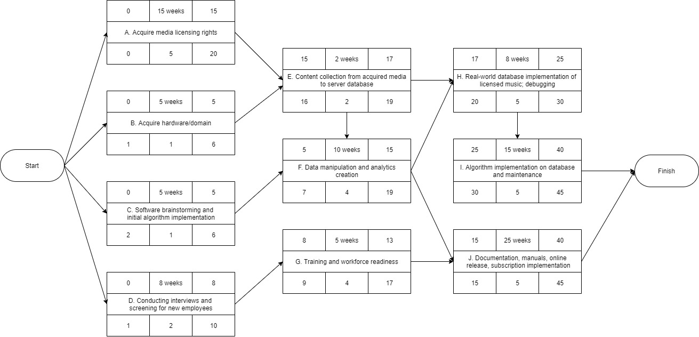
Activity Diagram

Slide 16
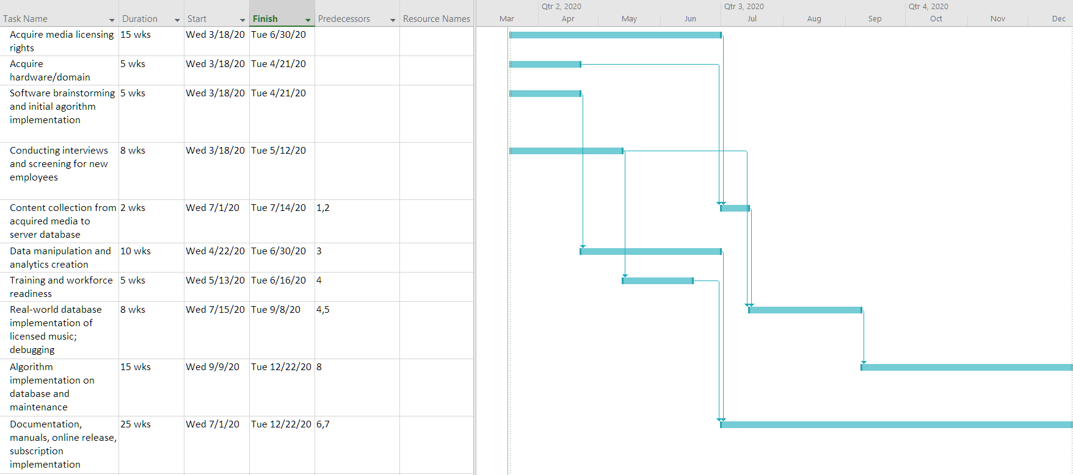
Gantt Chart

Slide 17
Thank you!
Question period, etc
"Deku gets 6 quirks"

