Slide 1
iPad Restaurant Application
Armando Cuesta Leyva 100652479
Hoang Vu 100652479
Ming Lau 100623165

Slide 2
Introduction
A restaurant POS application
A online servicing for restaurants
Provide Front End, Back End and Customer Features
Problems :
Need clarity of the items the user wants
The efficiency of the application
Different risks will be caused by lack of experiment
Notes:
(point of sale) - POS
What is it? - An Application that allows customers to order before reaching the counter to receive his/her order, creating an effective point of sale
Why is it even needed? It is crucial to enhance the flow of business by even just a fraction. Because if it is flowing that mean money is. And so the better the flow, the better the business goes
The problems that the application must address to make sure it meets the needs of the stakeholders, are clarity to make sure the customer understand there purchases, it has to be quick so reduce time complexity, evaluate it enough so risks can be minimized

Slide 3
Objectives
The restaurant POS application can be used it at the front of the restaurant
Help to take orders, add modifiers, split bills, accept payments, manage tables, track tips and more
Enhance our customer’s business
Offer access to the system's back-of-house features
Notes:
Objective
To have a POS system in front of the restaurant to keep the business flowing minimizing the disruptions as much as possible. Some will use the system. Others might still prefer going up to the person taking the person’s order. This is fine it is a positive for the idea.
Make it easier for people with problems, to order what they want thanks to how technology can help people.

Slide 4
Measures of Success
Database supports - Store the data about the restaurant and using the cloud server to update the information
User-Friendly - Easy to understand and operate the application and learn to use within 30 seconds
Maintenance - Synchronize the menu. Such as the pictures, prices, recommendation and other attributes of the dishes. Software and Hardware update
Customer-made Feature - Customize the user interface according to their restaurant-style, such as restaurant logo and color
System Supports - Software: kiosk system, Hardware: iPad, kitchen display, server
Notes:
Database is able to incorporate the many names and passwords of users, and when registered. Remembers the user and does not mistake one for another. Can use cloud base system.

Slide 5
Risks
Design Risk - Some of the design or content may fail to meet requirements or may be rejected by stakeholders. In that case, we need to reach a consensus with our customers before implementing the application.
Technology risk - Such as the connection outages that disrupt the service. To avoid this problem we have to make a backup plan which is about our contingency measures.
Lack of Experience - Some employees may lack experience implementing an ios application, and in that case, we need to understand the employee’s strengths to allocate the work.
Security Risk - The database design may introduce information security vulnerabilities. We should choose the best method to implement the database.

Slide 6
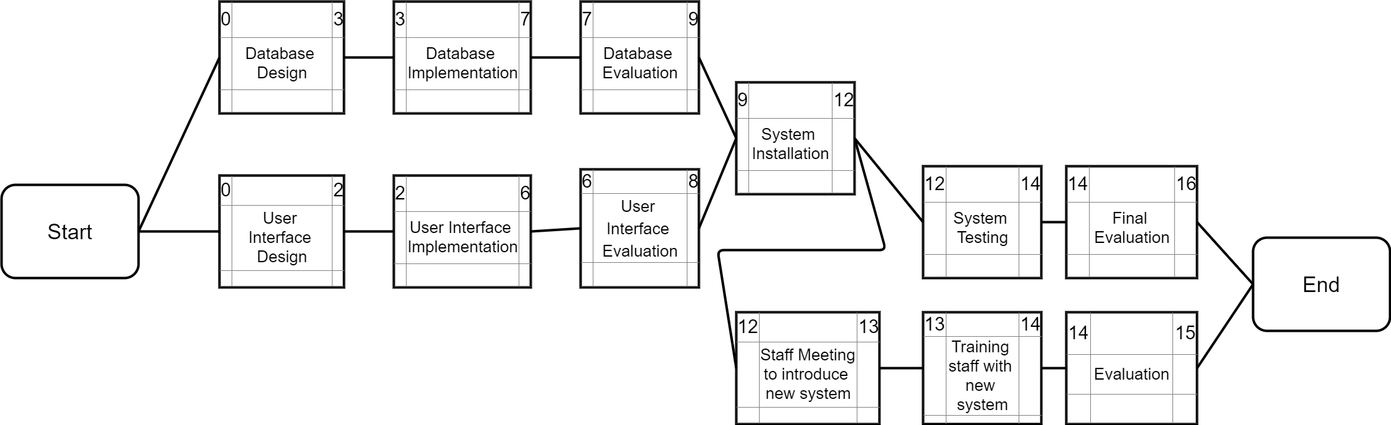
Activity Diagram
Figure 1: The Activity in Week

Slide 7
Infrastructure
iPad for customer use
Management system for staff
Cloud server to store the restaurant’ database
POS system on iPad

Slide 8
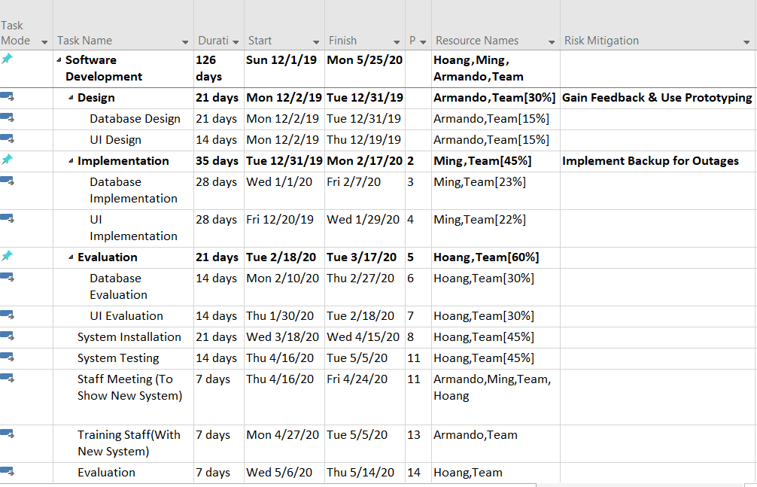
Resources Assigned
Figure 2: It shows the resources and the durations of each task

Slide 9
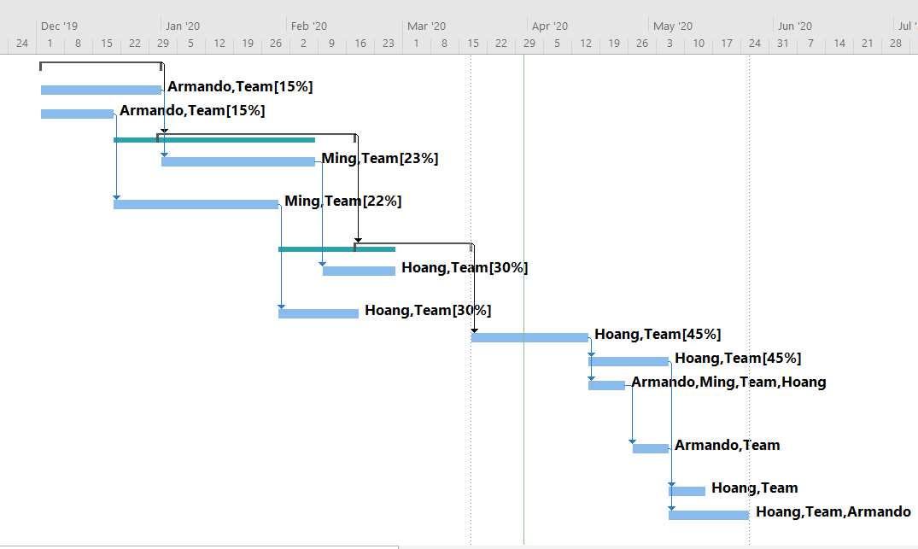
Gantt Chart
Figure 3: It shows the period of the project, estimately take around 4 months to complete

