Slide 1

LEAD SCORE CASE STUDY
GROUP MEMBERS:
Himanshu Chaudhary
Sandeep Poduval

Slide 2
Problem Statement
X education sells online courses to industry professionals
Although, X Education gets many leads but the Lead conversion is poor at only 30%
Goal is to identify Hot leads that have a higher chance of conversion
Once identified, the lead conversion rate should go up as the Sales team can concentrate on converting the Hot leads
Business Objective:
To build a Logistic Regression model to identify the “Hot Leads” and achieve a lead conversion rate up to 80%

Slide 3
Solution Methodology
Data reading
Cleaning the data
Checking and removing redundant columns
Converting the label “select” to null values
Removing columns with >35% null values
Other columns with missing values are imputed with the mode
Data Transforming
Changing the labels to dummy variables and “Yes”:1 and “No”:0
Removing the duplicate columns
Test Train Split
Splitting the data in Test and Train split and scaling the data
Plotting the Heat Map
Model Building
Running ref on 15 variable and checking the linear model regression results.
Removing the columns with high P value one by one to and checking the VIF value.
Predicting on the train model.
Checking the ROC curve and checking the accuracy, specificity and senility.
Checking and calculating precision and recall with cut-off of 0.35 and 0.41 on train and test data.

Slide 4
Understanding the data
Total Number of Rows = 9240
Total Number of Columns = 37
Removing Single value features – Magazines, Receive more updates about our Courses, update me on supply
Removing Prospect ID and Lead Number
Dropping columns having more than 35% missing values
Data Conversion
Numerical variables were scaled using MinMax Scaler
Dummy variables were created for object type variables

Slide 5
Model Building
Splitting the data into Training and Test slit with 70:30 ratio
Using RFE for feature selection
Running RFE with 15 variables
Building Model by removing the variable whose p-value is greater than 0.05 and VIF is greater than 5
Predicting the Test Data
Overall accuracy is 81%

Slide 6
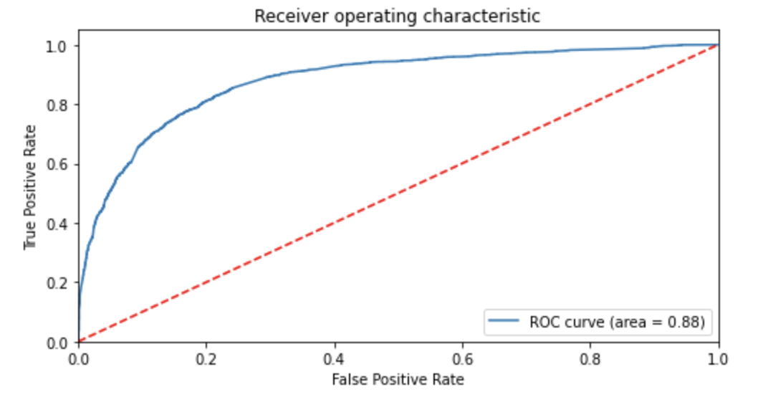
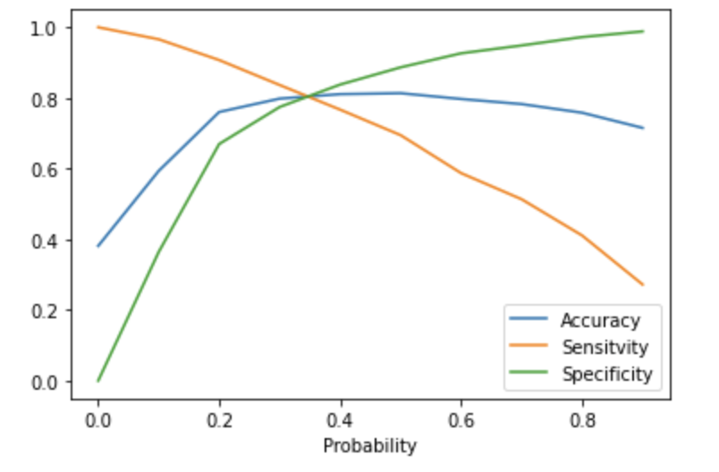
ROC Curve
Accuracy, Sensitivity, Specificity
Finding the Optimal Cut off point where we have balanced Sensitivity and Specificity.
Optimal Cut off is 0.35

Slide 7
Conclusion
The variables that mattered the most in Potential buyers:
For a good conversion ratio:
Lead Origin is through a Lead Add form that is the lead has entered his details in the form provided.
Last Notable Activity is Had a phone conversation, the customer has had a phone conversation with the Sales team.
And the Lead is a working professional

