Slide 1
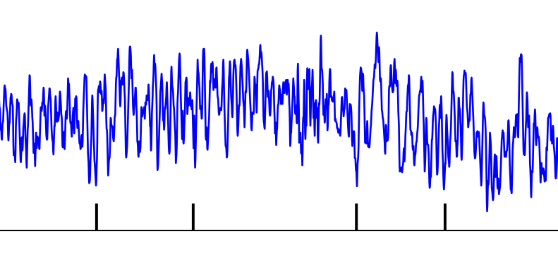
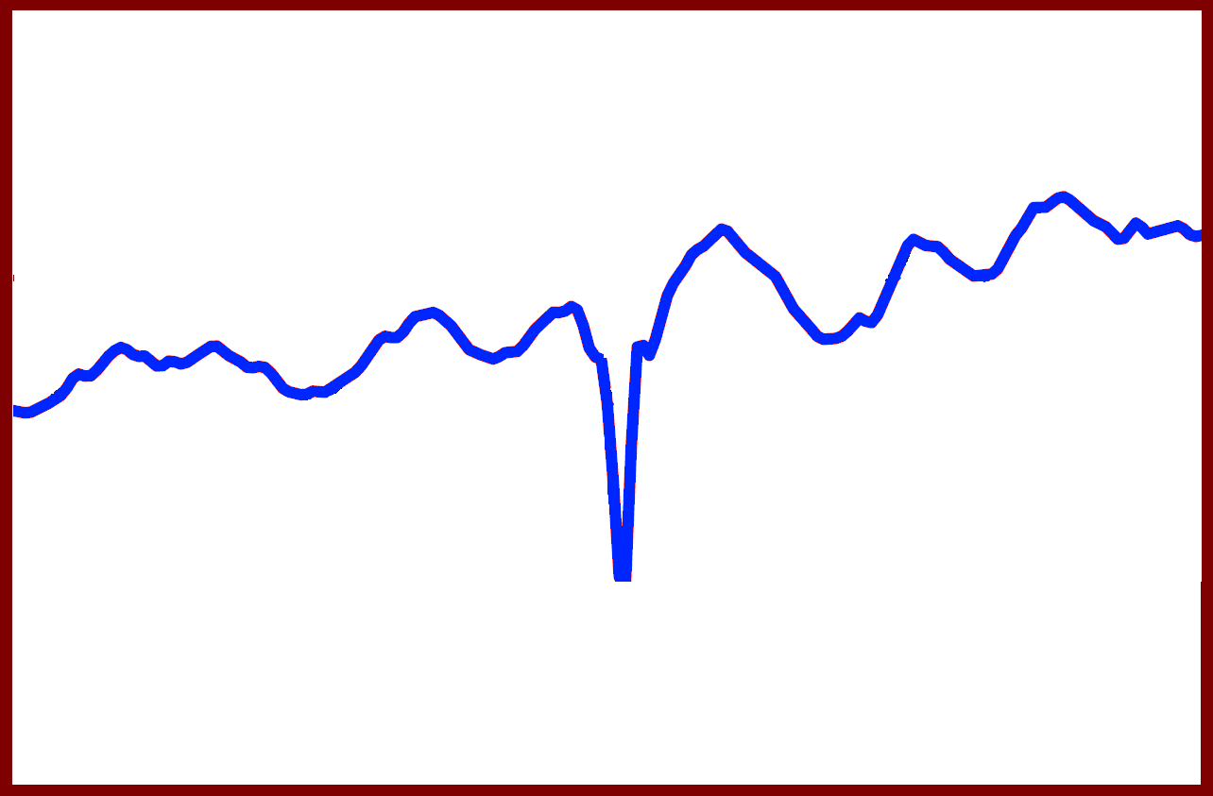
LFP
Spike times
Time
Averaging
Time relative to spike

