Slide 1
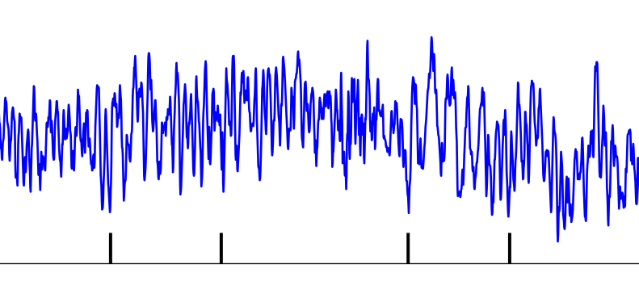
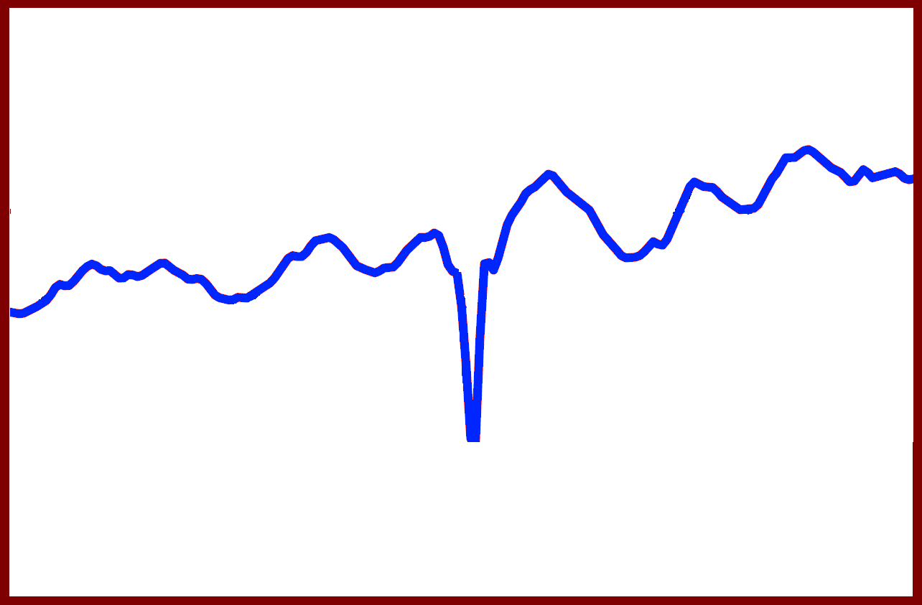
Local Field Potential (LFP)
Spike times
Time
Averaging
τ

