Slide 1
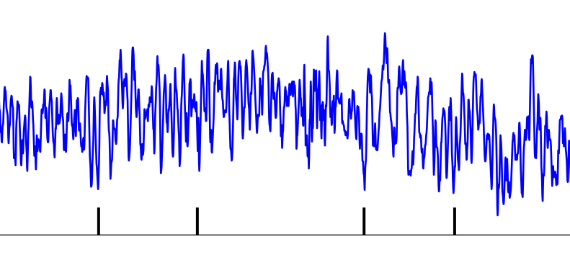
LFP
Spike times
Time
LFP
Randomized
spike times
Time

