Slide 1

Analysis of Local Field Potentials (Part I & II)
WS 2013/14 Michael Denker - Introduction Computational Neurosci., RWTH Aachen

Slide 2

Outline
Understanding Local Field Potentials What is Synchronization?
Synchronization between Local Field Potentials
Fourier Analysis
Coherence
Phase Synchronization
Synchronization between Spikes and Local Field Potentials
Spike-Triggered Averaging
Spike-Field Coherence Phase Analysis
WS 2013/14
Michael Denker - Introduction Computational Neurosci., RWTH Aachen
Slide 2

Slide 3
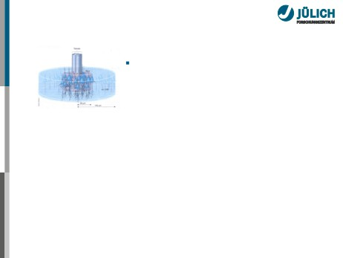
Focus: Local Field Potentials
LFP is the low-pass filtered electrode signal
Buzsaki et al, 2004
Logothetis and Wandell, 2004
WS 2013/14
Michael Denker - Introduction Computational Neurosci., RWTH Aachen
Slide 4

Slide 4
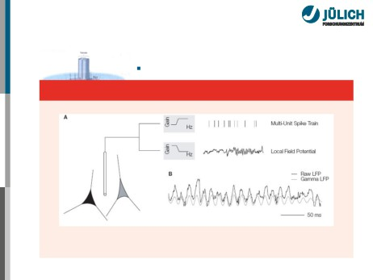
Focus: Local Field Potentials
LFP is the low-pass filtered electrode
Obtaining the LFP
Berens et al, 2008
WS 2013/14
Michael Denker - Introduction Computational Neurosci., RWTH Aachen
Slide 4

Slide 5

Focus: Local Field Potentials
LFP is the low-pass filtered electrode signal
Observed: Oscillatory structure with dominant frequencies ≾ 100 − 300 Hz
Buzsaki et al, 2004
Logothetis and Wandell, 2004
WS 2013/14
Michael Denker - Introduction Computational Neurosci., RWTH Aachen
Slide 4

Slide 6
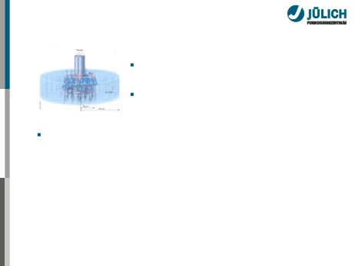
Focus: Local Field Potentials
LFP is the low-pass filtered electrode signal
Observed: Oscillatory structure with dominant frequencies ≾ 100 − 300 Hz
Buzsaki et al, 2004
Assumption: Mass activity of neurons in large volume around the electrode
Related to dendritic synaptic activity, spike generation,. . .
Logothetis and Wandell, 2004
WS 2013/14
Michael Denker - Introduction Computational Neurosci., RWTH Aachen
Slide 4

Slide 7

Focus: Local Field Potentials
LFP is the low-pass filtered electrode signal
Observed: Oscillatory structure with dominant frequencies ≾ 100 − 300 Hz
Buzsaki et al, 2004
Assumption: Mass activity of neurons in large volume around the electrode
Related to dendritic synaptic activity, spike generation, ...is thus a monitor of the network dynamics...
Logothetis and Wandell, 2004
WS 2013/14
Michael Denker - Introduction Computational Neurosci., RWTH Aachen
Slide 4

Slide 8

Focus: Local Field Potentials
LFP is the low-pass filtered electrode signal
Observed: Oscillatory structure with dominant frequencies ≾ 100 − 300 Hz
Buzsaki et al, 2004
Assumption: Mass activity of neurons in large volume around the electrode
Related to dendritic synaptic activity, spike generation, ...is thus a monitor of the network dynamics ...but interpretation of compound LFP is difficult
Logothetis and Wandell, 2004
WS 2013/14
Michael Denker - Introduction Computational Neurosci., RWTH Aachen
Slide 4

Slide 9
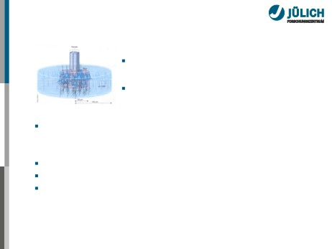
Focus: Local Field Potentials
LFP is the low-pass filtered electrode signal
Observed: Oscillatory structure with dominant frequencies ≾ 100 − 300 Hz
Buzsaki et al, 2004
Assumption: Mass activity of neurons in large volume around the electrode
Related to dendritic synaptic activity, spike generation, ...is thus a monitor of the network dynamics ...but interpretation of compound LFP is difficult Suggested spatial-temporal relationship between LFPs and spikes
Logothetis and Wandell, 2004
WS 2013/14
Michael Denker - Introduction Computational Neurosci., RWTH Aachen
Slide 4

Slide 10

Biophysical Origin of LFP
Under the assumptions of...
Quasi-static (< 1 kHz) electric field
(capacitive and inductive effects are negligible)
Isotropic extracellular medium
(conductance is a constant scalar, instead of a tensor)
∑
Ii 4πσ|r − ri|
φ(r) =
i
φ: field potential Ii: current source at ri
(σ: conductance of extracelluler medium)
Field potential is only dependent on the strength and the position of current sources.
Current source/sink in extracellular space
→ transmembrane current of neurons
WS 2013/14
Michael Denker - Introduction Computational Neurosci., RWTH Aachen
Slide 5

Slide 11
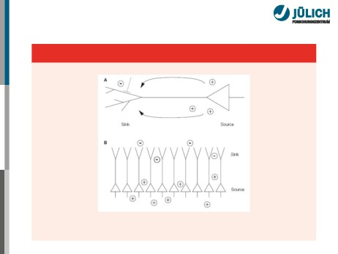
Biophysical Origin of LFP
Biophysical origin of LFP
Johnston and Wu, 1995
WS 2013/14
Michael Denker - Introduction Computational Neurosci., RWTH Aachen
Slide 5

Slide 12

Membrane Currents Caused by Neuronal Activities
∂Vm
Im =Vm+cm
rm
∂t
Im: membrane current Vm: membrane potential
rm: membrane resistance cm: membrane capaciance
Action potentials (somatic, axonal, dendritic)
Biphasic in time
Easily cancelled out by temporal jitter of multiple APs
Synaptic potentials (EPSP, IPSP)
IPSP is much slower than EPSP
Ratio of EPSP- vs. IPSP-related current components = 5:1 (Mitzdorf, 1985)
EPSPs are essentially the dominant causes of the macroscopic transmembrane current in the brain.
WS 2013/14
Michael Denker - Introduction Computational Neurosci., RWTH Aachen
Slide 6

Slide 13
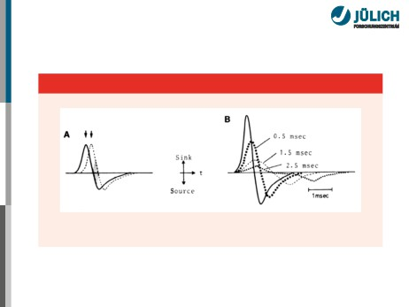
Membrane Currents Caused by Neuronal Activities
V ∂V
Cancellation of currents
Mitzdorf, 1985
macroscopic transmembrane current in the brain.
WS 2013/14
Michael Denker - Introduction Computational Neurosci., RWTH Aachen
Slide 6

Slide 14
Membrane Currents Caused by Neuronal Activities
∂Vm
Im =Vm+cm
rm
∂t
Im: membrane current Vm: membrane potential
rm: membrane resistance cm: membrane capaciance
Action potentials (somatic, axonal, dendritic)
Biphasic in time
Easily cancelled out by temporal jitter of multiple APs
Synaptic potentials (EPSP, IPSP)
IPSP is much slower than EPSP
Ratio of EPSP- vs. IPSP-related current components = 5:1 (Mitzdorf, 1985)
EPSPs are essentially the dominant causes of the macroscopic transmembrane current in the brain.
WS 2013/14
Michael Denker - Introduction Computational Neurosci., RWTH Aachen
Slide 6

Slide 15
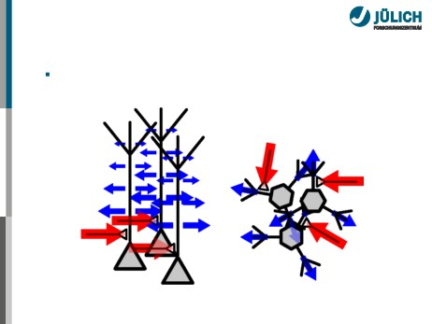
Effect of Cell Morphology
Excitatory inputs to pyramidal neurons contribute most to the cortical LFP.
WS 2013/14
Michael Denker - Introduction Computational Neurosci., RWTH Aachen
Slide 7

Slide 16

Further Contributions of and by LFPs
Further currents that may contribute to LFP: Dendritic calcium spikes
Resonant properties of the cell, self-sustained oscillations of the membrane potential
UP/DOWN states during anesthesia or non-REM sleep
WS 2013/14
Michael Denker - Introduction Computational Neurosci., RWTH Aachen
Slide 8

Slide 17

Further Contributions of and by LFPs
Further currents that may contribute to LFP: Dendritic calcium spikes
Resonant properties of the cell, self-sustained oscillations of the membrane potential
UP/DOWN states during anesthesia or non-REM sleep Ephaptic effects of the local field:
In how far can the field potential influence the membrane potential of neurons?
Evidence that constant potentials of realistic magnitude
may influence spike timing e.g., Radman et al, 2007; Anastassiou et al, 2011 Is the LFP an observable of brain dynamics or part of a feedback cycle?
WS 2013/14
Michael Denker - Introduction Computational Neurosci., RWTH Aachen
Slide 8

Slide 18
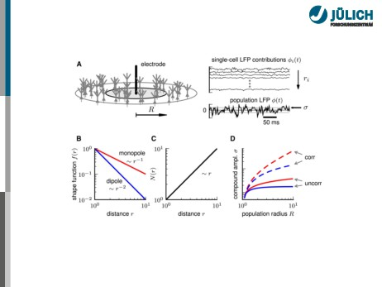
Reach of the LFP
Lindén et al, 2011
Dependence of LFP reach on cell morphology, synaptic-input distribution, and input correlations
WS 2013/14
Michael Denker - Introduction Computational Neurosci., RWTH Aachen
Slide 9

Slide 19
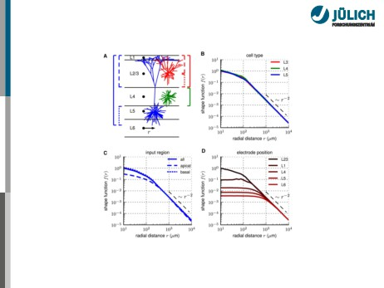
Dependencies of the Reach
Lindén et al, 2011
WS 2013/14
Michael Denker - Introduction Computational Neurosci., RWTH Aachen
Slide 10

Slide 20
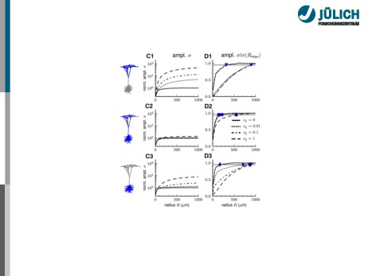
Dependencies of the Reach
Lindén et al, 2011
WS 2013/14
Michael Denker - Introduction Computational Neurosci., RWTH Aachen
Slide 10

Slide 21

Dependencies of the Reach
Uncorrelated activity OR symmetric cell morphology OR symmetric input distribution:
reach ≈ 100, . . . , 300 µm (soma layer)
Correlated activity AND asymmetric cell morphologies (pyramidal cells) AND
asymmetric distribution of synaptic inputs (e.g. apical input):
reach ≈ spatial extent of correlated activity
Small correlations (e.g. shared-input correlations) sufficient to boost LFP reach (≈ 1 mm)
WS 2013/14
Michael Denker - Introduction Computational Neurosci., RWTH Aachen
Slide 10

Slide 22
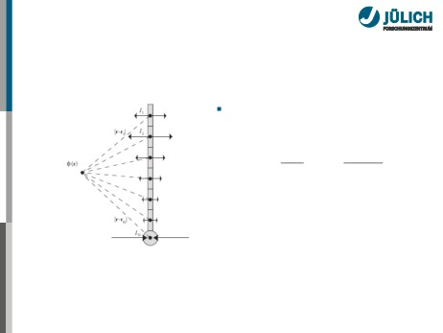
Current Source Densities
Forward problem
straight-forward (linear sup.):
∫∫∫
1
C(r′, t)
φ(r) =
V |r − r′|d3r′
4πσ
Pettersen et al, 2010
WS 2013/14
Michael Denker - Introduction Computational Neurosci., RWTH Aachen
Slide 11

Slide 23
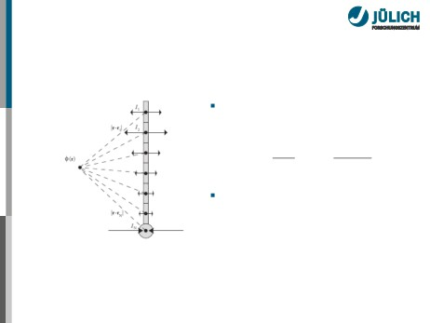
Current Source Densities
Forward problem
straight-forward (linear sup.):
∫∫∫
1
C(r′, t)
φ(r) =
V |r − r′|d3r′
4πσ
∑
C(r′, t) =
i Iiδ3(r − ri) is the
current source density [A/m3]
Pettersen et al, 2010
WS 2013/14
Michael Denker - Introduction Computational Neurosci., RWTH Aachen
Slide 11

Slide 24

Current Source Density Estimation
Inverse problem: Determine current sources and sinks
WS 2013/14
Michael Denker - Introduction Computational Neurosci., RWTH Aachen
Slide 12

Slide 25

Current Source Density Estimation
Inverse problem: Determine current sources and sinks Standard assumption: activity in xy-plane does not vary strongly → simplify to one-dimensional problem
σd2φ(z,t) = −C(z, t)
dz2
WS 2013/14
Michael Denker - Introduction Computational Neurosci., RWTH Aachen
Slide 12

Slide 26

Current Source Density Estimation
Inverse problem: Determine current sources and sinks Standard assumption: activity in xy-plane does not vary strongly → simplify to one-dimensional problem
σd2φ(z,t) = −C(z, t)
dz2
Simple CSD estimation formula for electrodes spaced at distance h:
C(zi, t) = σφ(zi +h)−2φ(zi)+φ(zi −h) h2
WS 2013/14
Michael Denker - Introduction Computational Neurosci., RWTH Aachen
Slide 12

Slide 27

Current Source Density Estimation
Inverse problem: Determine current sources and sinks Standard assumption: activity in xy-plane does not vary strongly → simplify to one-dimensional problem
σd2φ(z,t) = −C(z, t)
dz2
Simple CSD estimation formula for electrodes spaced at distance h:
C(zi, t) = σφ(zi +h)−2φ(zi)+φ(zi −h) h2
Problem: Only prediction at N − 2 contacts, strong assumptions
WS 2013/14
Michael Denker - Introduction Computational Neurosci., RWTH Aachen
Slide 12

Slide 28

Current Source Density Estimation
Inverse problem: Determine current sources and sinks Standard assumption: activity in xy-plane does not vary strongly → simplify to one-dimensional problem
σd2φ(z,t) = −C(z, t)
dz2
Simple CSD estimation formula for electrodes spaced at distance h:
C(zi, t) = σφ(zi +h)−2φ(zi)+φ(zi −h) h2
Problem: Only prediction at N − 2 contacts, strong assumptions
More advanced methods available (e.g., iCSD using a direct inversion of the forward problem (Pettersen et al., 2006)).
WS 2013/14
Michael Denker - Introduction Computational Neurosci., RWTH Aachen
Slide 12

Slide 29
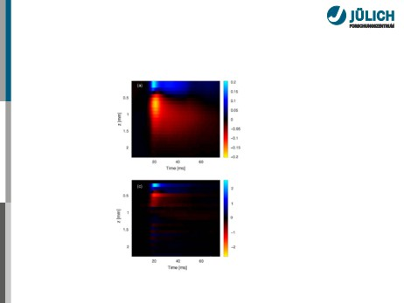
Example: Current Source Density in Response to Whisker Deflection in Rat Barrel Cortex
Pettersen et al, 2006
WS 2013/14
Michael Denker - Introduction Computational Neurosci., RWTH Aachen
Slide 13

Slide 30
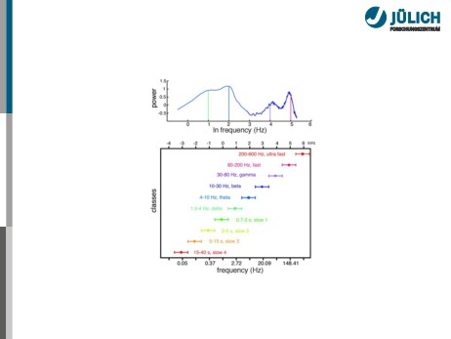
LFP Features: Oscillations
Buzsaki et al, 2004
WS 2013/14
Michael Denker - Introduction Computational Neurosci., RWTH Aachen
Slide 14

Slide 31
Outline
Understanding Local Field Potentials
What is Synchronization?
Synchronization between Local Field Potentials
Fourier Analysis
Coherence
Phase Synchronization
Synchronization between Spikes and Local Field Potentials
Spike-Triggered Averaging
Spike-Field Coherence Phase Analysis
WS 2013/14
Michael Denker - Introduction Computational Neurosci., RWTH Aachen
Slide 15

Slide 32

Synchronization of Oscillators
Synchronization is used in many different contexts. In
general, it describes a coherent, adapting time evolution of seperate, but coupled entities.
WS 2013/14
Michael Denker - Introduction Computational Neurosci., RWTH Aachen
Slide 16

Slide 33

Synchronization of Oscillators
Synchronization is used in many different contexts. In
general, it describes a coherent, adapting time evolution of seperate, but coupled entities.
The dynamics of a system can be measured by time
series. However, typically it is only a signature of the true dynamics.
WS 2013/14
Michael Denker - Introduction Computational Neurosci., RWTH Aachen
Slide 16

Slide 34

Synchronization of Oscillators
Synchronization is used in many different contexts. In
general, it describes a coherent, adapting time evolution of seperate, but coupled entities.
The dynamics of a system can be measured by time
series. However, typically it is only a signature of the true dynamics.
Coupling mediates interaction within the system that influences the time series.
WS 2013/14
Michael Denker - Introduction Computational Neurosci., RWTH Aachen
Slide 16

Slide 35

Synchronization of Oscillators
Synchronization is used in many different contexts. In
general, it describes a coherent, adapting time evolution of seperate, but coupled entities.
The dynamics of a system can be measured by time
series. However, typically it is only a signature of the true dynamics.
Coupling mediates interaction within the system that influences the time series.
How to define synchronization?
WS 2013/14
Michael Denker - Introduction Computational Neurosci., RWTH Aachen
Slide 16

Slide 36

Synchronization of Oscillators
Synchronization is used in many different contexts. In
general, it describes a coherent, adapting time evolution of seperate, but coupled entities.
The dynamics of a system can be measured by time
series. However, typically it is only a signature of the true dynamics.
Coupling mediates interaction within the system that influences the time series.
How to define synchronization?
How to detect and quantify synchronization based on the time series?
WS 2013/14
Michael Denker - Introduction Computational Neurosci., RWTH Aachen
Slide 16

Slide 37

Synchronization of Oscillators
Synchronization is used in many different contexts. In
general, it describes a coherent, adapting time evolution of seperate, but coupled entities.
The dynamics of a system can be measured by time
series. However, typically it is only a signature of the true dynamics.
Coupling mediates interaction within the system that influences the time series.
How to define synchronization?
How to detect and quantify synchronization based on the time series?
How are such measures related to the system and/or its coupling?
WS 2013/14
Michael Denker - Introduction Computational Neurosci., RWTH Aachen
Slide 16

Slide 38

A well-known example: The Millenium Bridge
Start Millenium Bridge Movie
adapted from: Pikovsky, Rosenblum, Kurths
WS 2013/14
Michael Denker - Introduction Computational Neurosci., RWTH Aachen
Slide 17

Slide 39

A well-known example: The Millenium Bridge
Start Millenium Bridge Movie
Critical number of people on the bridge leads to strong vibrations.
adapted from: Pikovsky, Rosenblum, Kurths
WS 2013/14
Michael Denker - Introduction Computational Neurosci., RWTH Aachen
Slide 17

Slide 40

A well-known example: The Millenium Bridge
Start Millenium Bridge Movie
Critical number of people on the bridge leads to strong vibrations.
Differs from Soldiers-crossing-a-bridge explanation: no external drive!
adapted from: Pikovsky, Rosenblum, Kurths
WS 2013/14
Michael Denker - Introduction Computational Neurosci., RWTH Aachen
Slide 17

Slide 41

A well-known example: The Millenium Bridge
Start Millenium Bridge Movie
Critical number of people on the bridge leads to strong vibrations.
Differs from Soldiers-crossing-a-bridge explanation: no external drive!
Instead: Coupling between walking pedestrians mediated by bridge leads to synchronization
adapted from: Pikovsky, Rosenblum, Kurths
WS 2013/14
Michael Denker - Introduction Computational Neurosci., RWTH Aachen
Slide 17

Slide 42
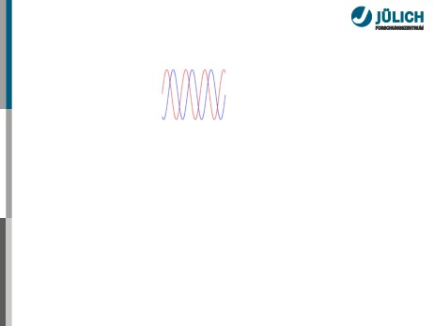
Simplest System: Two Harmonic Waves
1:1 locking
WS 2013/14
Michael Denker - Introduction Computational Neurosci., RWTH Aachen
Slide 18

Slide 43
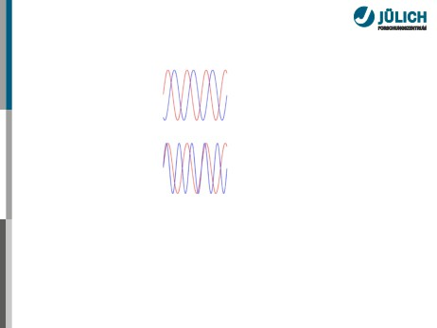
Simplest System: Two Harmonic Waves
1:1 locking
2:3 locking
WS 2013/14
Michael Denker - Introduction Computational Neurosci., RWTH Aachen
Slide 18

Slide 44
Simplest System: Two Harmonic Waves
1:1 locking
2:3 locking
Harmonic waves sin(ω1t) and sin(ω2t) have N : M-locked frequencies ω
WS 2013/14
Michael Denker - Introduction Computational Neurosci., RWTH Aachen
Slide 18

Slide 45
Simplest System: Two Harmonic Waves
1:1 locking
2:3 locking
Harmonic waves sin(ω1t) and sin(ω2t) have N : M-locked frequencies ω
Harmonic waves sin(φ1(t)) and sin(φ2(t)) are N : M-locked for fixed differences of their phase φ
Δφ = (Nφ1(t) − Mφ2(t)) mod 2π = const
WS 2013/14
Michael Denker - Introduction Computational Neurosci., RWTH Aachen
Slide 18

Slide 46
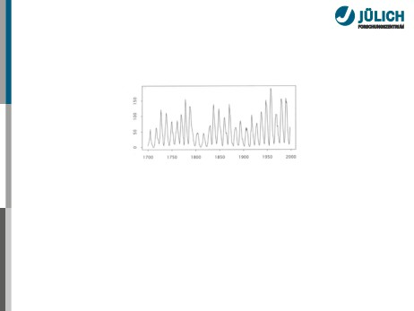
Real Signals Are Not Harmonic
How to determine synchrony for complicated time series?
Rosenblum et al, 1997; Kurths and Pikovski, 2001
WS 2013/14
Michael Denker - Introduction Computational Neurosci., RWTH Aachen
Slide 19

Slide 47

Real Signals Are Not Harmonic
How to determine synchrony for complicated time series?
Different types of synchrony:
Complete Synchronization Lag Synchronization General Synchronization Frequency Synchronization Phase Synchronization
Rosenblum et al, 1997; Kurths and Pikovski, 2001
WS 2013/14
Michael Denker - Introduction Computational Neurosci., RWTH Aachen
Slide 19

Slide 48

How to Measure Synchronicity?
In the following, we will look at two common methods to quantify synchronized time series:
Coherence detects correlation of activity of a specific spectral component in the signal
WS 2013/14
Michael Denker - Introduction Computational Neurosci., RWTH Aachen
Slide 20

Slide 49

How to Measure Synchronicity?
In the following, we will look at two common methods to quantify synchronized time series:
Coherence detects correlation of activity of a specific spectral component in the signal
Phase synchronization measures how systems with a prominent near-oscillatory (but possibly non-stationary) dynamics co-vary their oscillation to attain a fixed phase difference independent of amplitude
WS 2013/14
Michael Denker - Introduction Computational Neurosci., RWTH Aachen
Slide 20

Slide 50

How to Measure Synchronicity?
In the following, we will look at two common methods to quantify synchronized time series:
Coherence detects correlation of activity of a specific spectral component in the signal
Phase synchronization measures how systems with a prominent near-oscillatory (but possibly non-stationary) dynamics co-vary their oscillation to attain a fixed phase difference independent of amplitude
Other methods include:
Cross-Correlograms
WS 2013/14
Michael Denker - Introduction Computational Neurosci., RWTH Aachen
Slide 20

Slide 51

How to Measure Synchronicity?
In the following, we will look at two common methods to quantify synchronized time series:
Coherence detects correlation of activity of a specific spectral component in the signal
Phase synchronization measures how systems with a prominent near-oscillatory (but possibly non-stationary) dynamics co-vary their oscillation to attain a fixed phase difference independent of amplitude
Other methods include:
Cross-Correlograms
Proximity estimates of embedded dynamics
WS 2013/14
Michael Denker - Introduction Computational Neurosci., RWTH Aachen
Slide 20

Slide 52

How to Measure Synchronicity?
In the following, we will look at two common methods to quantify synchronized time series:
Coherence detects correlation of activity of a specific spectral component in the signal
Phase synchronization measures how systems with a prominent near-oscillatory (but possibly non-stationary) dynamics co-vary their oscillation to attain a fixed phase difference independent of amplitude
Other methods include:
Cross-Correlograms
Proximity estimates of embedded dynamics
WS 2013/14
Michael Denker - Introduction Computational Neurosci., RWTH Aachen
Slide 20

Slide 53
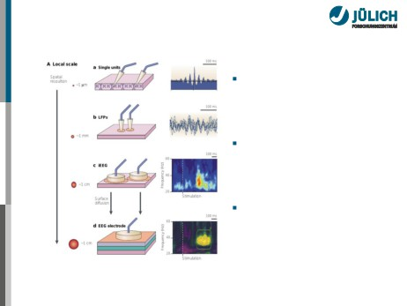
Why Study Synchrony in the Brain?
Measure coorporate
activity across brain areas → functional connectivity
Relationship between signals at various mesoscopic and microscopic scales
Coding of information in the phase
information between signals
Varela et al, 2001
WS 2013/14
Michael Denker - Introduction Computational Neurosci., RWTH Aachen
Slide 21

Slide 54
Outline
Understanding Local Field Potentials What is Synchronization?
Synchronization between Local Field Potentials
Fourier Analysis
Coherence
Phase Synchronization
Synchronization between Spikes and Local Field Potentials
Spike-Triggered Averaging
Spike-Field Coherence Phase Analysis
WS 2013/14
Michael Denker - Introduction Computational Neurosci., RWTH Aachen
Slide 22

Slide 55
Outline
Understanding Local Field Potentials What is Synchronization?
Synchronization between Local Field Potentials
Fourier Analysis
Coherence
Phase Synchronization
Synchronization between Spikes and Local Field Potentials
Spike-Triggered Averaging
Spike-Field Coherence Phase Analysis
WS 2013/14
Michael Denker - Introduction Computational Neurosci., RWTH Aachen
Slide 23

Slide 56

Decomposing a Signal - Fourier Analysis
Every (infinite, periodic) signal may be decomposed into an infinite sum of harmonics
∑
x(t) = a0 +
(an cos(2πfnt) + bn sin(2πfnt))
n=1
WS 2013/14
Michael Denker - Introduction Computational Neurosci., RWTH Aachen
Slide 24

Slide 57

Decomposing a Signal - Fourier Analysis
Every (infinite, periodic) signal may be decomposed into an infinite sum of harmonics
∑
x(t) = a0 + (an cos(2πfnt) + bn sin(2πfnt))
n=1
The coefficients an and bn can be determined using the Fourier Transform
∫
1
F (x(t)) = S(f ) = |S(f )| exp(iθ) =
2πx(t)exp(−2πitf)dt
WS 2013/14
Michael Denker - Introduction Computational Neurosci., RWTH Aachen
Slide 24

Slide 58

Decomposing a Signal - Fourier Analysis
Every (infinite, periodic) signal may be decomposed into an infinite sum of harmonics
∑
x(t) = a0 + (an cos(2πfnt) + bn sin(2πfnt))
n=1
The coefficients an and bn can be determined using the Fourier Transform
∫
1
F (x(t)) = S(f ) = |S(f )| exp(iθ) =
2πx(t)exp(−2πitf)dt
The magnitude |S(f )| corresponds to the amplitude of the harmonic at frequency f , the phase θ determines its offset from a cosine
WS 2013/14
Michael Denker - Introduction Computational Neurosci., RWTH Aachen
Slide 24

Slide 59

Decomposing a Signal - Fourier Analysis
For measured time series, we obtain an estimate of the
spectrum consisting of a finite number of N sample points
WS 2013/14
Michael Denker - Introduction Computational Neurosci., RWTH Aachen
Slide 25

Slide 60

Decomposing a Signal - Fourier Analysis
For measured time series, we obtain an estimate of the
spectrum consisting of a finite number of N sample points Discrete Fourier Transform (DFT) yields discrete, complex-valued Fourier spectrum S(f ) for N/2 evenly-spaced frequencies from 0 to the Nyquist frequency (half the sample frequency)
WS 2013/14
Michael Denker - Introduction Computational Neurosci., RWTH Aachen
Slide 25

Slide 61

Decomposing a Signal - Fourier Analysis
For measured time series, we obtain an estimate of the
spectrum consisting of a finite number of N sample points Discrete Fourier Transform (DFT) yields discrete, complex-valued Fourier spectrum S(f ) for N/2 evenly-spaced frequencies from 0 to the Nyquist frequency (half the sample frequency)
The real-valued, squared Fourier spectrum is known as the power spectrum
P(f ) = S(f )S∗(f ) = |S(f )|2 exp(i(φ − φ)) = |S(f )|2
WS 2013/14
Michael Denker - Introduction Computational Neurosci., RWTH Aachen
Slide 25

Slide 62

Decomposing a Signal - Fourier Analysis
For measured time series, we obtain an estimate of the
spectrum consisting of a finite number of N sample points Discrete Fourier Transform (DFT) yields discrete, complex-valued Fourier spectrum S(f ) for N/2 evenly-spaced frequencies from 0 to the Nyquist frequency (half the sample frequency)
The real-valued, squared Fourier spectrum is known as the power spectrum
P(f ) = S(f )S∗(f ) = |S(f )|2 exp(i(φ − φ)) = |S(f )|2
In short: Measure of how dominiant individual frequencies are present in the signal
WS 2013/14
Michael Denker - Introduction Computational Neurosci., RWTH Aachen
Slide 25

Slide 63
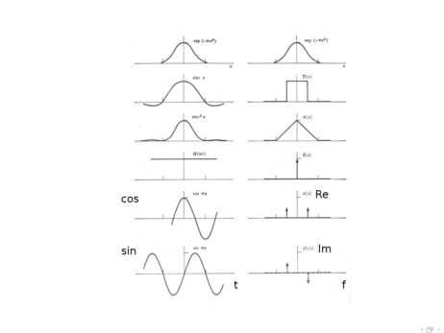
Examples of Simple Fourier Transforms
Bracewell, 1986

Slide 64
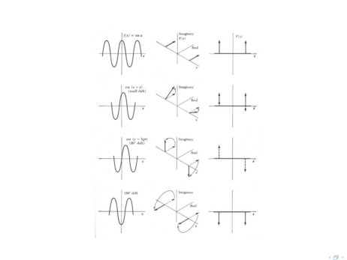
The Phase of the Fourier Transform
Bracewell, 1986

Slide 65
Outline
Understanding Local Field Potentials What is Synchronization?
Synchronization between Local Field Potentials
Fourier Analysis
Coherence
Phase Synchronization
Synchronization between Spikes and Local Field Potentials
Spike-Triggered Averaging
Spike-Field Coherence Phase Analysis
WS 2013/14
Michael Denker - Introduction Computational Neurosci., RWTH Aachen
Slide 28

Slide 66
Coherence
(Cross-)coherence measures whether a spectral component in signals x(t) and y(t) correlates
WS 2013/14
Michael Denker - Introduction Computational Neurosci., RWTH Aachen
Slide 29

Slide 67
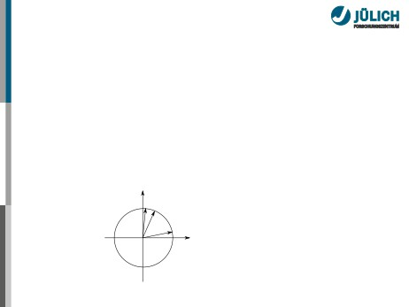
Coherence
(Cross-)coherence measures whether a spectral component in signals x(t) and y(t) correlates
Cross-spectrum:
Cxy(f) = Sx(f)S∗y(f)=|Sx(f)||Sy(f)|exp(i(φx −φy))
Im
ϕ
x
ϕy
ϕ
x-y
Re
WS 2013/14
Michael Denker - Introduction Computational Neurosci., RWTH Aachen
Slide 29

Slide 68
Coherence
(Cross-)coherence measures whether a spectral component in signals x(t) and y(t) correlates
Cross-coherence:
Cxy(f) = 〈Sx(f)S∗y(f)〉t,n,Δf
Here, 〈·〉 denotes an average over time, an average over trials, and/or an average over a small frequency band centered on f
WS 2013/14
Michael Denker - Introduction Computational Neurosci., RWTH Aachen
Slide 29

Slide 69
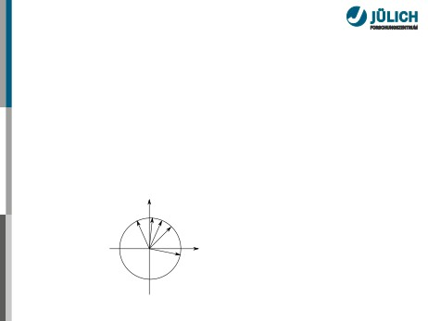
Coherence
(Cross-)coherence measures whether a spectral component in signals x(t) and y(t) correlates
Cross-coherence:
Cxy(f) = 〈Sx(f)S∗y(f)〉t,n,Δf
Im
ϕ
ϕ
ϕ
5
4
3
ϕ
2
ϕ1
Re
WS 2013/14
Michael Denker - Introduction Computational Neurosci., RWTH Aachen
Slide 29

Slide 70

Coherence
(Cross-)coherence measures whether a spectral component in signals x(t) and y(t) correlates
Cross-coherence:
Cxy(f) = 〈Sx(f)S∗y(f)〉t,n,Δf
Im
ϕ
ϕ
ϕ
5
4
3
ϕ
2
ϕ1
Re
WS 2013/14
Michael Denker - Introduction Computational Neurosci., RWTH Aachen
Slide 29

Slide 71

Coherence
Coherency:
Cxy(f)
σxy(f) = |√
|
Px(f)Py(f)
Absolute value of the averaged cross-spectra normalized by
the average power content of signals at frequency f
WS 2013/14
Michael Denker - Introduction Computational Neurosci., RWTH Aachen
Slide 30

Slide 72
Coherence
Coherency:
Cxy(f)
σxy(f) = |√
|
Px(f)Py(f)
Absolute value of the averaged cross-spectra normalized by the average power content of signals at frequency f
Mean-amplitude normalized coherence index σxy = 1 → Perfect coherence
σxy → 0 → Incoherent dynamics
WS 2013/14
Michael Denker - Introduction Computational Neurosci., RWTH Aachen
Slide 30

Slide 73
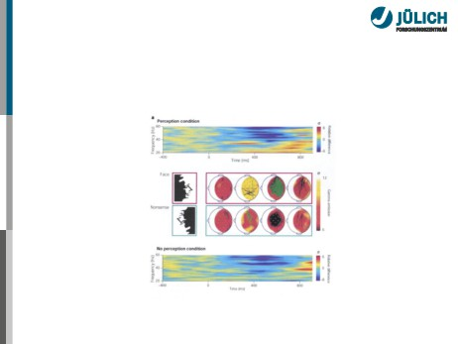
Example: Long-distance Synchronization
Face-perception task in macaque EEG recordings results in long-range gamma band synchronization
Rodriguez et al, 1999; Varela et al., 2001
WS 2013/14
Michael Denker - Introduction Computational Neurosci., RWTH Aachen
Slide 31

Slide 74
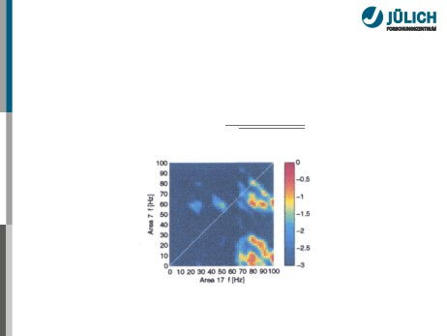
Example: Dual Bi-Coherence
Cross-analyze frequencies:
Cxy(f1,f2) = 〈Sx(f1)Sy(f2)〉t,n,Δf
σxy(f1,f2) =
√
|
Px(f1)Py(f2)
v. Stein et al, 2000
WS 2013/14
Michael Denker - Introduction Computational Neurosci., RWTH Aachen
Slide 32

Slide 75
Outline
Understanding Local Field Potentials What is Synchronization?
Synchronization between Local Field Potentials
Fourier Analysis
Coherence
Phase Synchronization
Synchronization between Spikes and Local Field Potentials
Spike-Triggered Averaging
Spike-Field Coherence Phase Analysis
WS 2013/14
Michael Denker - Introduction Computational Neurosci., RWTH Aachen
Slide 33

Slide 76
Phases in General Oscillating Systems
Consider complicated systems that reflect oscillatory dynamics
WS 2013/14
Michael Denker - Introduction Computational Neurosci., RWTH Aachen
Slide 34

Slide 77
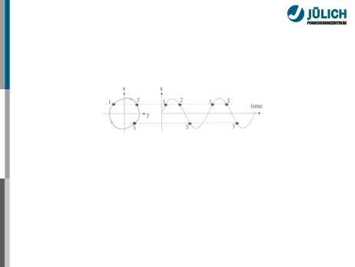
Phases in General Oscillating Systems
Consider complicated systems that reflect oscillatory dynamics
WS 2013/14
Michael Denker - Introduction Computational Neurosci., RWTH Aachen
Slide 34

Slide 78
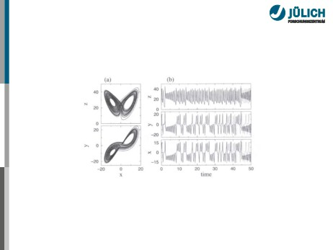
Phases in General Oscillating Systems
Consider complicated systems that reflect oscillatory dynamics
Kurths, 2001
WS 2013/14
Michael Denker - Introduction Computational Neurosci., RWTH Aachen
Slide 34

Slide 79
Phases in General Oscillating Systems
Consider complicated systems that reflect oscillatory dynamics
Kurths, 2001
Task 1: Assign a phase φ(t) to measured dynamics
WS 2013/14
Michael Denker - Introduction Computational Neurosci., RWTH Aachen
Slide 34

Slide 80
Coupling Induces Phase Synchronization
We define N : M phase synchronization between x1(t) and x2(t):
Δφ = constt = (Nφ1 − Mφ2) mod 2π = const.
WS 2013/14
Michael Denker - Introduction Computational Neurosci., RWTH Aachen
Slide 35

Slide 81
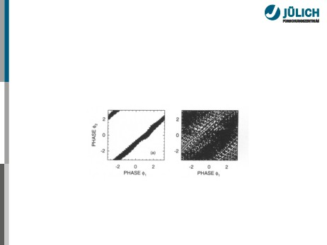
Coupling Induces Phase Synchronization
We define N : M phase synchronization between x1(t) and x2(t):
Δφ = constt = (Nφ1 − Mφ2) mod 2π = const.
Palus, 1997
WS 2013/14
Michael Denker - Introduction Computational Neurosci., RWTH Aachen
Slide 35

Slide 82
Coupling Induces Phase Synchronization
We define N : M phase synchronization between x1(t) and x2(t):
Δφ = constt = (Nφ1 − Mφ2) mod 2π = const.
Palus, 1997
Task 1: Assign a phase φ(t) to measured dynamics
Task 2: Define index to measure degree of phase synchrony
WS 2013/14
Michael Denker - Introduction Computational Neurosci., RWTH Aachen
Slide 35

Slide 83
Task 1: Obtaining Phase Estimates from Time Series
Method 1: Extract maxima of signal x(t), linear interpolation between maxima from 0 to 2π
→ Simple, but problematic (linearity, maxima detection)
WS 2013/14
Michael Denker - Introduction Computational Neurosci., RWTH Aachen
Slide 36

Slide 84

Task 1: Obtaining Phase Estimates from Time Series
Method 1: Extract maxima of signal x(t), linear interpolation between maxima from 0 to 2π
→ Simple, but problematic (linearity, maxima detection)
Method 2: Convolution of signal x(t) with complex-valued wavelet
2
w(t, f ) = exp(−t
2σ2 )exp(2πift)
First exponential localized individual points for phase estimation
Second exponential is a complex rotation that detects instantaneous phase around frequency f
WS 2013/14
Michael Denker - Introduction Computational Neurosci., RWTH Aachen
Slide 36

Slide 85
Task 1: Obtaining Phase Estimates from Time Series
Method 1: Extract maxima of signal x(t), linear interpolation between maxima from 0 to 2π
→ Simple, but problematic (linearity, maxima detection)
Method 2: Convolution of signal x(t) with complex-valued wavelet
2
w(t, f ) = exp(−t
2σ2 )exp(2πift)
First exponential localized individual points for phase estimation
Second exponential is a complex rotation that detects instantaneous phase around frequency f
Method 3: Transform into analytic signal
WS 2013/14
Michael Denker - Introduction Computational Neurosci., RWTH Aachen
Slide 36

Slide 86
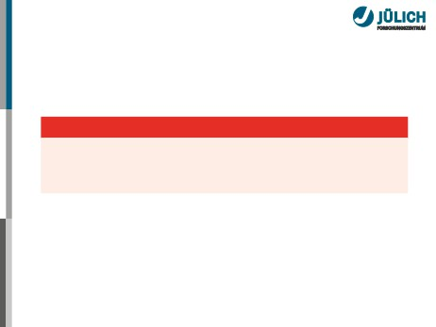
Task 1: Obtaining Phase Estimates from Time Series
Method 1: Extract maxima of signal x(t), linear interpolation between maxima from 0 to 2π
Which method to use?
Wavelets and Hilbert yield comparable results.
Here: Use analytic signal (Hilbert) approach for simplicity.
Le van Quyen et al, 2001
2σ2
First exponential localized individual points for phase estimation
Second exponential is a complex rotation that detects instantaneous phase around frequency f
Method 3: Transform into analytic signal
WS 2013/14
Michael Denker - Introduction Computational Neurosci., RWTH Aachen
Slide 36

Slide 87

Obtaining Phase Estimates using the Analytic Signal
The Analytic Signal is defined as
x(t) = x(t) + iH[x(t)]
via Hilbert Transform
H[x(t)] =−1 ∗ x(t)
πt
Idea: H yields a signal phase-shifted by π/2.
WS 2013/14
Michael Denker - Introduction Computational Neurosci., RWTH Aachen
Slide 37

Slide 88
Obtaining Phase Estimates using the Analytic Signal
The Analytic Signal is defined as
x(t) = x(t) + iH[x(t)]
via Hilbert Transform
H[x(t)] =−1 ∗ x(t)
πt
Idea: H yields a signal phase-shifted by π/2.
Simple example
eiα = cosα + i sinα
WS 2013/14
Michael Denker - Introduction Computational Neurosci., RWTH Aachen
Slide 37

Slide 89
Obtaining Phase Estimates using the Analytic Signal
The Analytic Signal is defined as
x(t) = x(t) + iH[x(t)]
via Hilbert Transform
H[x(t)] =−1 ∗ x(t)
πt
Idea: H yields a signal phase-shifted by π/2.
Simple example
eiα = cosα + i sinα = cosα + i H[cosα]
WS 2013/14
Michael Denker - Introduction Computational Neurosci., RWTH Aachen
Slide 37

Slide 90
Obtaining Phase Estimates using the Analytic Signal
The Analytic Signal is defined as
x(t) = x(t) + iH[x(t)]
via Hilbert Transform
H[x(t)] =−1 ∗ x(t)
πt
Idea: H yields a signal phase-shifted by π/2.
Simple example
eiα = cosα + i sinα = cosα + i H[cosα] Let’s look at pictures. . .
WS 2013/14
Michael Denker - Introduction Computational Neurosci., RWTH Aachen
Slide 37

Slide 91
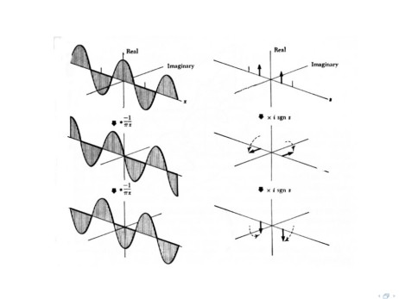
Hilbert Transform
Bracewell, 1986

Slide 92
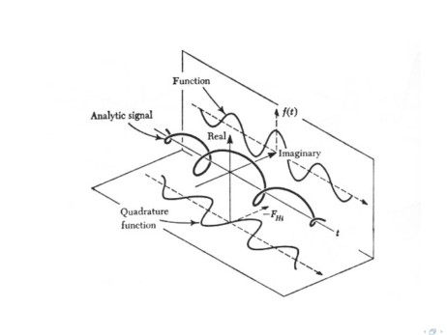
The Analytic Signal
Bracewell, 1986

Slide 93
Task 2: Index for Phase Synchrony
Basis: how constant is the phase difference over time.
For a review, see Quiroga et al, 2002.
WS 2013/14
Michael Denker - Introduction Computational Neurosci., RWTH Aachen
Slide 40

Slide 94

Task 2: Index for Phase Synchrony
Basis: how constant is the phase difference over time.
For a review, see Quiroga et al, 2002.
Example: Mutual Information
Use probability distributions p(φ1), p(φ2) and p(φ1, φ2) and calculate the mutual information
∫ ∫
I=
p(φ1, φ2) logp(φ1,φ2) p(φ1)p(φ2)dφ1dφ2
Independence of phases yields I ≈ 0
WS 2013/14
Michael Denker - Introduction Computational Neurosci., RWTH Aachen
Slide 40

Slide 95

Task 2: Index for Phase Synchrony
Basis: how constant is the phase difference over time.
For a review, see Quiroga et al, 2002.
Example: Across Trials
We define the phase locking index
∑
PLV(t) = N−1|
exp(i Δφ(t, n))|
n=1
where Δφ(t, n) is the phase difference in trial n
Lachaux et al, 1999
WS 2013/14
Michael Denker - Introduction Computational Neurosci., RWTH Aachen
Slide 40

Slide 96
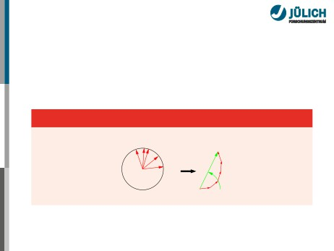
Task 2: Index for Phase Synchrony
Basis: how constant is the phase difference over time.
For a review, see Quiroga et al, 2002.
Example: Across Trials
φ5
φ4
φ3
φ
2
R
φ1
µ
0
WS 2013/14
Michael Denker - Introduction Computational Neurosci., RWTH Aachen
Slide 40

Slide 97
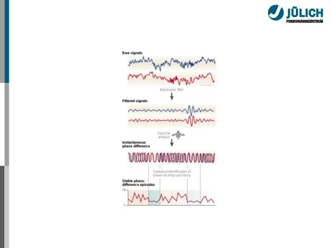
Application to Biology: Phase Synchronization
Varela et al, 2001
WS 2013/14
Michael Denker - Introduction Computational Neurosci., RWTH Aachen
Slide 41

Slide 98
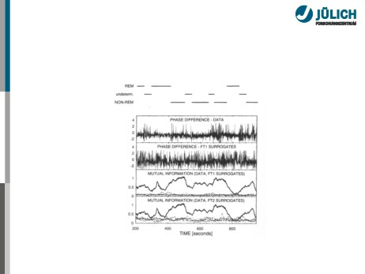
Example: Synchrony in Physiological Measurements
Measurement between respiratory and cardiac signals
Palus, 1997
WS 2013/14
Michael Denker - Introduction Computational Neurosci., RWTH Aachen
Slide 42

Slide 99
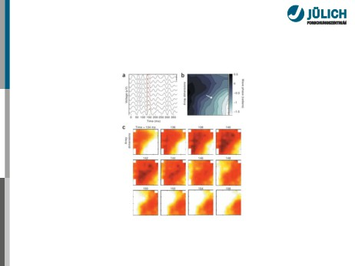
Example: Measuring LFP wave propagation across cortex
Rubino et al., 2006
WS 2013/14
Michael Denker - Introduction Computational Neurosci., RWTH Aachen
Slide 43

Slide 100
Outline
Understanding Local Field Potentials What is Synchronization?
Synchronization between Local Field Potentials
Fourier Analysis
Coherence
Phase Synchronization
Synchronization between Spikes and Local Field Potentials
Spike-Triggered Averaging
Spike-Field Coherence Phase Analysis
WS 2013/14
Michael Denker - Introduction Computational Neurosci., RWTH Aachen
Slide 44

Slide 101
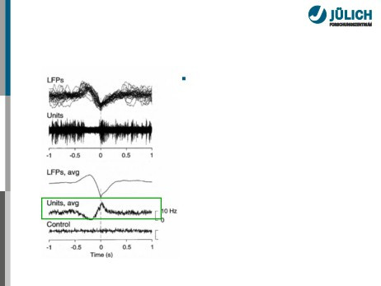
Potential Features of LFP-Spike Relationships
Locking observed in terms of
a locking probability p(φ)
Destexhe et al, 1999
WS 2013/14
Michael Denker - Introduction Computational Neurosci., RWTH Aachen
Slide 45

Slide 102
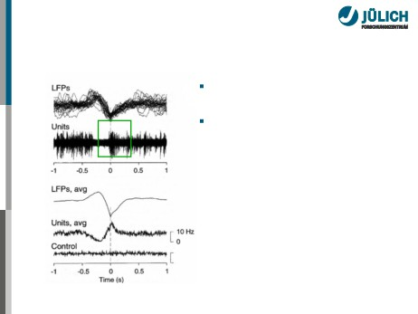
Potential Features of LFP-Spike Relationships
Locking observed in terms of
a locking probability p(φ)
Weak locking where p(φ) is broad
Destexhe et al, 1999
WS 2013/14
Michael Denker - Introduction Computational Neurosci., RWTH Aachen
Slide 45

Slide 103
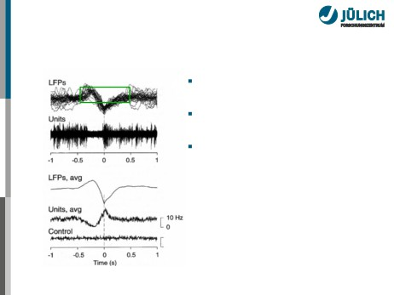
Potential Features of LFP-Spike Relationships
Locking observed in terms of
a locking probability p(φ)
Weak locking where p(φ) is broad
Non-stationary oscillations
in time or across trials
Destexhe et al, 1999
WS 2013/14
Michael Denker - Introduction Computational Neurosci., RWTH Aachen
Slide 45

Slide 104
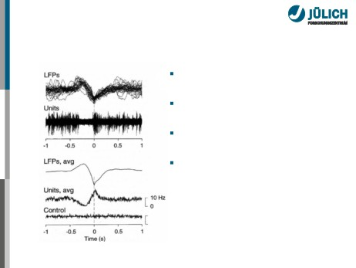
Potential Features of LFP-Spike Relationships
Locking observed in terms of
a locking probability p(φ)
Weak locking where p(φ) is broad
Non-stationary oscillations
in time or across trials Transient locking pt(φ)
Destexhe et al, 1999
WS 2013/14
Michael Denker - Introduction Computational Neurosci., RWTH Aachen
Slide 45

Slide 105

Potential Features of LFP-Spike Relationships
Locking observed in terms of
a locking probability p(φ)
Weak locking where p(φ) is broad
Non-stationary oscillations
in time or across trials Transient locking pt(φ)
Non-stationary LFP amplitude
Destexhe et al, 1999
WS 2013/14
Michael Denker - Introduction Computational Neurosci., RWTH Aachen
Slide 45

Slide 106

Potential Features of LFP-Spike Relationships
Locking observed in terms of
a locking probability p(φ)
Weak locking where p(φ) is broad
Non-stationary oscillations
in time or across trials Transient locking pt(φ)
Non-stationary LFP amplitude Multi-modal distribution of p(φ)
Destexhe et al, 1999
WS 2013/14
Michael Denker - Introduction Computational Neurosci., RWTH Aachen
Slide 45

Slide 107
Outline
Understanding Local Field Potentials What is Synchronization?
Synchronization between Local Field Potentials
Fourier Analysis
Coherence
Phase Synchronization
Synchronization between Spikes and Local Field Potentials
Spike-Triggered Averaging
Spike-Field Coherence Phase Analysis
WS 2013/14
Michael Denker - Introduction Computational Neurosci., RWTH Aachen
Slide 46

Slide 108
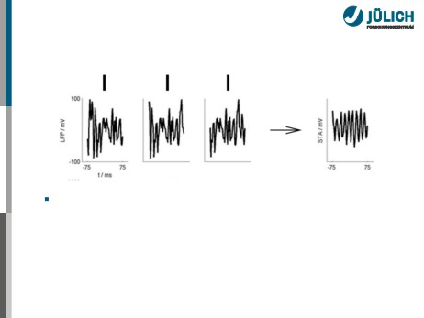
Spike-Triggered Averaging (STA)
Cut out LFP segments around spikes. . .
WS 2013/14
Michael Denker - Introduction Computational Neurosci., RWTH Aachen
Slide 47

Slide 109

Spike-Triggered Averaging (STA)
Cut out LFP segments around spikes ...and average them!
WS 2013/14
Michael Denker - Introduction Computational Neurosci., RWTH Aachen
Slide 47

Slide 110

Spike-Triggered Averaging (STA)
Cut out LFP segments around spikes ...and average them!
If spikes prefer a specific part of an oscillation cycle, it will
not average out in the STA
WS 2013/14
Michael Denker - Introduction Computational Neurosci., RWTH Aachen
Slide 47

Slide 111
Spike-Triggered Averaging as Correlation
∑
Assume LFP signal L(t) and a spike train S(t) = i δ(t − ti), where ti are the spike times
Then, the STA can be written as correlation (or alternatively: correlation coefficient)
∫
c(τ ) = L(t)S(t + τ ) dt
WS 2013/14
Michael Denker - Introduction Computational Neurosci., RWTH Aachen
Slide 48

Slide 112
Spike-Triggered Averaging as Correlation
∑
Assume LFP signal L(t) and a spike train S(t) = i δ(t − ti), where ti are the spike times
Then, the STA can be written as correlation (or alternatively: correlation coefficient)
∫
c(τ ) = L(t)S(t + τ ) dt
However: Significance estimate of STA is not trivial.
Typically one uses surrogates, such as trial shuffling, shifting the LFP, or bootstrap procedures.
WS 2013/14
Michael Denker - Introduction Computational Neurosci., RWTH Aachen
Slide 48

Slide 113
Outline
Understanding Local Field Potentials What is Synchronization?
Synchronization between Local Field Potentials
Fourier Analysis
Coherence
Phase Synchronization
Synchronization between Spikes and Local Field Potentials
Spike-Triggered Averaging
Spike-Field Coherence
Phase Analysis
WS 2013/14
Michael Denker - Introduction Computational Neurosci., RWTH Aachen
Slide 49

Slide 114
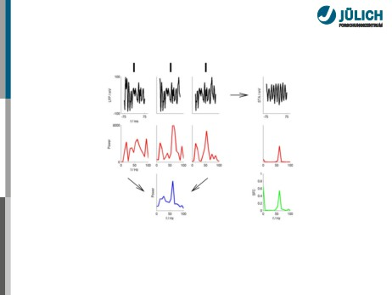
A Simple Spike-Field Coherence (SFC)
SFC is the power spectrum of the STA, normalized by average power spectrum of individual segments.
WS 2013/14
Michael Denker - Introduction Computational Neurosci., RWTH Aachen
Slide 50

Slide 115
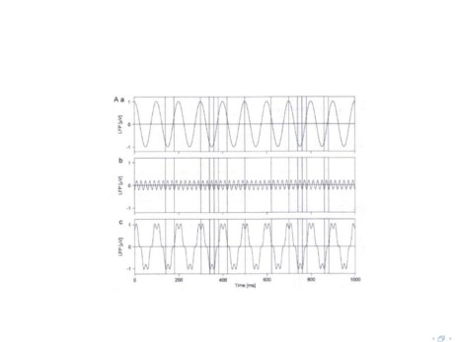
Why the normalization?
Normalization removes mean-amplitude dependence, locking to oscillations with small amplitudes becomes visible
Fries et al, 2002

Slide 116
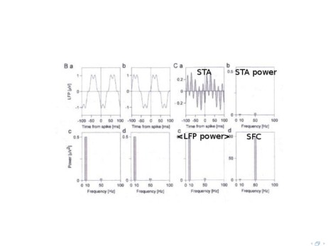
Why the normalization?
Normalization removes mean-amplitude dependence, locking to oscillations with small amplitudes becomes visible
Fries et al, 2002

Slide 117
Insight: Relationship to Coherence
In fact, spike-field coherence is only a special case of coherence as discussed before. Why?
for derivations, confidence intervals, see e.g., Jarvis et al, 2001
WS 2013/14
Michael Denker - Introduction Computational Neurosci., RWTH Aachen
Slide 52

Slide 118

Insight: Relationship to Coherence
In fact, spike-field coherence is only a special case of coherence as discussed before. Why?
Correlation Theorem (sloppy):
F (CCF(x(t), y(t))) = F (x(t)) · F (y(t))
where F (·) denotes the Fourier transform and CCF the cross-correlation function
for derivations, confidence intervals, see e.g., Jarvis et al, 2001
WS 2013/14
Michael Denker - Introduction Computational Neurosci., RWTH Aachen
Slide 52

Slide 119
Insight: Relationship to Coherence
In fact, spike-field coherence is only a special case of coherence as discussed before. Why?
Correlation Theorem (sloppy):
F (CCF(x(t), y(t))) = F (x(t)) · F (y(t))
where F (·) denotes the Fourier transform and CCF the cross-correlation function
Previous: STA is the cross correlation of LFP and spike train
for derivations, confidence intervals, see e.g., Jarvis et al, 2001
WS 2013/14
Michael Denker - Introduction Computational Neurosci., RWTH Aachen
Slide 52

Slide 120
Insight: Relationship to Coherence
In fact, spike-field coherence is only a special case of coherence as discussed before. Why?
Correlation Theorem (sloppy):
F (CCF(x(t), y(t))) = F (x(t)) · F (y(t))
where F (·) denotes the Fourier transform and CCF the cross-correlation function
Previous: STA is the cross correlation of LFP and spike train Equivalence:
F (STA) = Cxy(f )
for derivations, confidence intervals, see e.g., Jarvis et al, 2001
WS 2013/14
Michael Denker - Introduction Computational Neurosci., RWTH Aachen
Slide 52

Slide 121
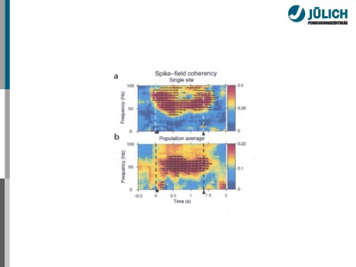
Example: Memory Task in Macaque
Pesaran et al, 2002
WS 2013/14
Michael Denker - Introduction Computational Neurosci., RWTH Aachen
Slide 53

Slide 122
Outline
Understanding Local Field Potentials What is Synchronization?
Synchronization between Local Field Potentials
Fourier Analysis
Coherence
Phase Synchronization
Synchronization between Spikes and Local Field Potentials
Spike-Triggered Averaging
Spike-Field Coherence
Phase Analysis
WS 2013/14
Michael Denker - Introduction Computational Neurosci., RWTH Aachen
Slide 54

Slide 123
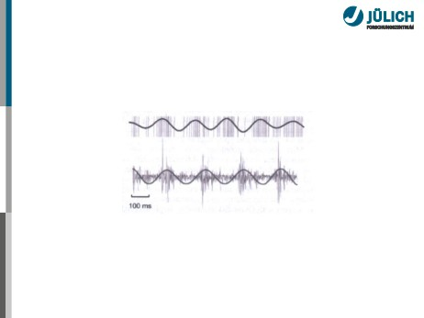
Extension to Phase Analysis
Simple Idea: Transform spike train to rate signal, and use normal phase synchronization
Hurtado et al, 2004
Drawback: Loose precise timing information about spikes (early average)
WS 2013/14
Michael Denker - Introduction Computational Neurosci., RWTH Aachen
Slide 55

Slide 124
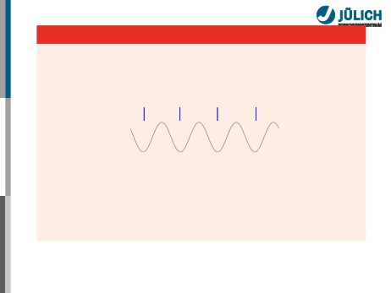
EAlternative
Determine instantaneous phase of the LFP signal related to spike timing
Spikes and LFP
Drawback: Loose precise timing information about spikes (early average)
WS 2013/14
Michael Denker - Introduction Computational Neurosci., RWTH Aachen
Slide 55

Slide 125
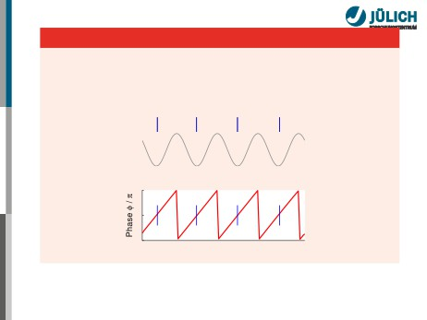
EAlternative
Determine instantaneous phase of the LFP signal related to spike timing
Spikes and LFP
2
1
0
Time
Drawback: Loose precise timing information about spikes (early average)
WS 2013/14
Michael Denker - Introduction Computational Neurosci., RWTH Aachen
Slide 55

Slide 126
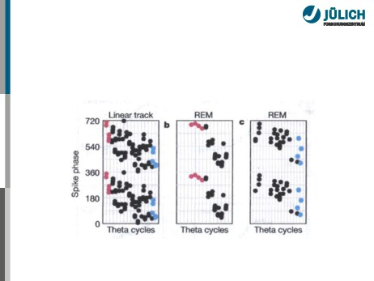
Direct Phase Estimation
Obtain phases at time instances of discrete occurances (e.g. spikes)
→ Stroboscopic sampling of the system, a synchrogram
Harris et al, 2002
WS 2013/14
Michael Denker - Introduction Computational Neurosci., RWTH Aachen
Slide 56

Slide 127

Phase Locking Statistics
Given:
Extracted phases φ(ti) of LFP at spike times ti, i = 1 . . . N.
Approach 1: Period Histogram
Bin phase axis [0; 2π)
WS 2013/14
Michael Denker - Introduction Computational Neurosci., RWTH Aachen
Slide 57

Slide 128

Phase Locking Statistics
Given:
Extracted phases φ(ti) of LFP at spike times ti, i = 1 . . . N.
Approach 1: Period Histogram
Approach 2: Circular Statistics cf., eg., Mardia and Jupp, 2000 ∑
Mean phase µ0: Reiµ0 = N−1 i∑iφi,
Variance: S := 1 − R = 1 − N−1|√ ieiφi|, Standard deviation: σ =−2 ln R,
Null hypothesis of uniform phase distribution:
2NR2 is χ2-distr. with 2 deg. of freedom.
WS 2013/14
Michael Denker - Introduction Computational Neurosci., RWTH Aachen
Slide 57

Slide 129
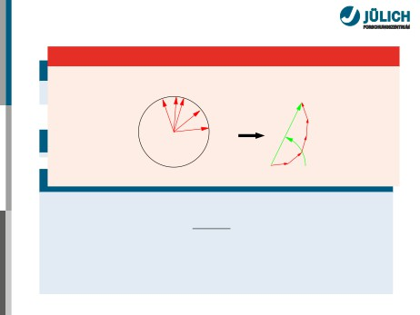
Phase Locking Statistics
Mean and variance on the circle
φ5
φ4
φ3
φ
2
R
φ1
µ
0
∑
Mean phase µ0: Reiµ0 = N−1 i∑iφi,
Variance: S := 1 − R = 1 − N−1|√ ieiφi|, Standard deviation: σ =−2 ln R,
Null hypothesis of uniform phase distribution:
2NR2 is χ2-distr. with 2 deg. of freedom.
WS 2013/14
Michael Denker - Introduction Computational Neurosci., RWTH Aachen
Slide 57

Slide 130
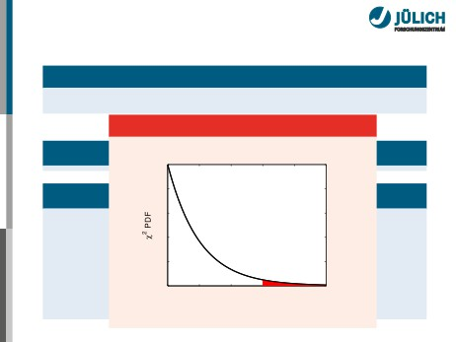
Phase Locking Statistics
Given:
Extracted phases φ(ti) of LFP at spike times ti, i = 1 . . . N. Distribution of R
Approach
0.5
Approac
0.4
Mean pha
0.3
Variance:
0.2
Standard
0.1
Null hypot 2NR2 is χ2
0
0 2 4 6 8 10
2NR2
WS 2013/14
Slide 57

Slide 131
Phase Locking Statistics
Given:
Extracted phases φ(ti) of LFP at spike times ti, i = 1 . . . N.
Approach 1: Period Histogram
Approach 2: Circular Statistics cf., eg., Mardia and Jupp, 2000 ∑
Mean phase µ0: Reiµ0 = N−1 i∑iφi,
Variance: S := 1 − R = 1 − N−1|√ ieiφi|, Standard deviation: σ =−2 ln R,
Null hypothesis of uniform phase distribution:
2NR2 is χ2-distr. with 2 deg. of freedom.
WS 2013/14
Michael Denker - Introduction Computational Neurosci., RWTH Aachen
Slide 57

Slide 132

Phase Locking Statistics
Given:
Extracted phases φ(ti) of LFP at spike times ti, i = 1 . . . N.
Approach 1: Period Histogram
Approach 2: Circular Statistics
Non-stationarity / Transient Locking Analysis performed in sliding windows.
WS 2013/14
Michael Denker - Introduction Computational Neurosci., RWTH Aachen
Slide 57

Slide 133
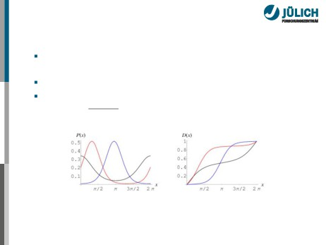
Circular tests and the von Mises distribution
Several tests in circular statistics are available, equivalent
to tests on the line. Batchelett, 1976; Fisher, 1995
Use of bootstrap and resampling methods. Stark and Abeles, 2005 Standard unimodel distribution is the von Mise distribution
Pa,b(x) =ebcos(x−a)2πI0(b)
Weisstein (MathWorld)
WS 2013/14
Michael Denker - Introduction Computational Neurosci., RWTH Aachen
Slide 58

Slide 134

Using Surrogates To Detect Genuine Locking
Q: When I observe phase synchronization between two signals, is it real?
WS 2013/14
Michael Denker - Introduction Computational Neurosci., RWTH Aachen
Slide 59

Slide 135

Using Surrogates To Detect Genuine Locking
Synchronization?
WS 2013/14
Michael Denker - Introduction Computational Neurosci., RWTH Aachen
Slide 59

Slide 136

Using Surrogates To Detect Genuine Locking
Q: When I observe phase synchronization between two signals, is it real?
For independent signals with some degree of regularity,
one might observe spurious phase locking as a side-effect of their inherent frequency relationship.
WS 2013/14
Michael Denker - Introduction Computational Neurosci., RWTH Aachen
Slide 59

Slide 137

Using Surrogates To Detect Genuine Locking
Q: When I observe phase synchronization between two signals, is it real?
For independent signals with some degree of regularity,
one might observe spurious phase locking as a side-effect of their inherent frequency relationship.
Solution: make very long measurement.
WS 2013/14
Michael Denker - Introduction Computational Neurosci., RWTH Aachen
Slide 59

Slide 138

Using Surrogates To Detect Genuine Locking
Q: When I observe phase synchronization between two signals, is it real?
For independent signals with some degree of regularity,
one might observe spurious phase locking as a side-effect of their inherent frequency relationship.
Solution: make very long measurement.
Alternative: Signals must show more precise entrainment!
WS 2013/14
Michael Denker - Introduction Computational Neurosci., RWTH Aachen
Slide 59

Slide 139

Using Surrogates To Detect Genuine Locking
Q: When I observe phase synchronization between two signals, is it real?
For independent signals with some degree of regularity,
one might observe spurious phase locking as a side-effect of their inherent frequency relationship.
Solution: make very long measurement.
Alternative: Signals must show more precise entrainment! Surrogates preserve the inherent time structure
WS 2013/14
Michael Denker - Introduction Computational Neurosci., RWTH Aachen
Slide 59

Slide 140

Using Surrogates To Detect Genuine Locking
Q: When I observe phase synchronization between two signals, is it real?
For independent signals with some degree of regularity,
one might observe spurious phase locking as a side-effect of their inherent frequency relationship.
Solution: make very long measurement.
Alternative: Signals must show more precise entrainment! Surrogates preserve the inherent time structure Here: Surrogates by locally shuffling inter-spike intervals
WS 2013/14
Michael Denker - Introduction Computational Neurosci., RWTH Aachen
Slide 59

Slide 141

Using Surrogates To Detect Genuine Locking
Local ISI Shuffles
WS 2013/14
Michael Denker - Introduction Computational Neurosci., RWTH Aachen
Slide 59

Slide 142

Using Surrogates To Detect Genuine Locking
R Distributions
WS 2013/14
Michael Denker - Introduction Computational Neurosci., RWTH Aachen
Slide 59

Slide 143

The Meaning of Phase
Instantaneous phase (IP) and Fourier phase (FP) are two distinct measures!
Interpretation of IP is controversial.
Commonly instantaneous frequency defined as the instantaneous change of phase angle.
Time-average of the IP frequency is related to the average spectral frequency:
< fF >f=< fIP >t
Hard to interpret IP for multi-component signals ... or small amplitude signals!
IP tracks non-stationarity of signals in time.
SFC and phase-locking are two important complementary measueres.
Boashash, 1992a,b; Lachaux et al, 2001
WS 2013/14
Michael Denker - Introduction Computational Neurosci., RWTH Aachen
Slide 60

Slide 144

The Electrode Issue
Spikes recorded from the LFP electrode may contaminate high frequency LFP
WS 2013/14
Michael Denker - Introduction Computational Neurosci., RWTH Aachen
Slide 61

Slide 145

The Electrode Issue
Spikes recorded from the LFP electrode may contaminate high frequency LFP
WS 2013/14
Michael Denker - Introduction Computational Neurosci., RWTH Aachen
Slide 61

Slide 146

Today’s Exercises
Task 1: Implement STA and spike-triggered phases Task 2: Apply these measures to the data set
WS 2013/14
Michael Denker - Introduction Computational Neurosci., RWTH Aachen
Slide 62

