Slide 1

Core message
SCW16 / Paper 05
The paper turns biology inputs from static model files into a reproducible audit: what is fixed, what differs by stock hypothesis, and where the Far North weight-at-age update needs benchmark attention.
JM Biology
Biological data used in the joint jack mackerel assessment
Inputs
Focus
Use
1.14.dat plus h1/h2 control files
M, maturity, population WAA, fishery/index WAA
Benchmark decisions and MSE readiness
What was checked in model 1.14
Source: SCW16-Doc05_JM_Biology.qmd

Slide 2
SCW16 / Paper 05
Source files
2
The review is anchored to model 1.14 source files
The same common data file feeds both stock hypotheses; control files determine the biological assumptions.
h1_1.14 control
Single-stock hypothesis
One M value
One maturity vector
One population WAA vector
Common data file
Reproducible checks
1.14.dat
Years 1970-2025
12 age classes
4 fisheries + 7 indices
Fishery/index weight-at-age arrays
Summaries, tables, correlation diagnostics, and fitted spawning-biomass contribution are generated directly from model inputs and outputs.
h2_1.14 control
Two-stock hypothesis
Stock-specific M
Stock-specific maturity
Stock-specific population WAA
Source: SCW16-Doc05_JM_Biology.qmd; model 1.14 inputs from jjm/assessment

Slide 3
SCW16 / Paper 05
M and maturity
3
Biological assumptions diverge under the two-stock hypothesis
The single-stock model uses Stock 1 biology; h2 separates Stock 1 and Stock 2 natural mortality, maturity, and population WAA.
0.28
0.33
10.5
12
Natural mortality: h1 and h2 Stock 1
Natural mortality: h2 Stock 2
Spawning month
Age classes
Configured under #N_Mort
Stock-specific assumption
SSB calculated after 0.792 of annual mortality
Includes age-12 plus group
Stock 1 maturity
Stock 2 maturity
Age 1 is partially mature (0.52); ages 2+ are fully mature. This schedule is also used by the single-stock model.
Age 1 is immature, age 2 is partial (0.37), age 3 is near mature (0.98), and ages 4+ are mature.
Source: SCW16-Doc05_JM_Biology.qmd; model 1.14 inputs from jjm/assessment

Slide 4
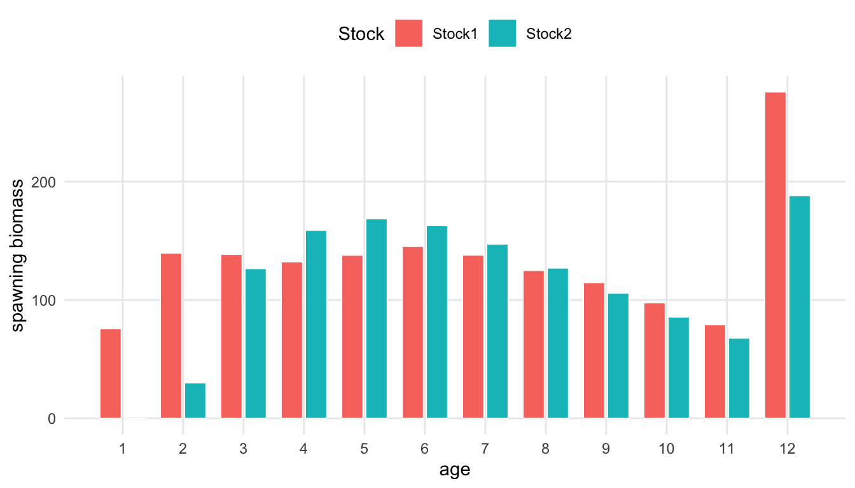
SCW16 / Paper 05
Spawning biomass
4
The paper makes the SSB calculation explicit
Spawning biomass is tied to numbers-at-age, survival to the spawning month, population weight-at-age, and maturity-at-age.
SSB ingredient chain
N at age
Survival to
spawn
WAA x
maturity
Population WAA is fixed by stock in the control file; fishery/index WAA arrays are used for predicted catch and index biomass, not for SSB.
Age-specific spawning biomass per recruit highlights that h2 biology is not interchangeable between stocks.
Source: SCW16-Doc05_JM_Biology.qmd; model 1.14 inputs from jjm/assessment

Slide 5
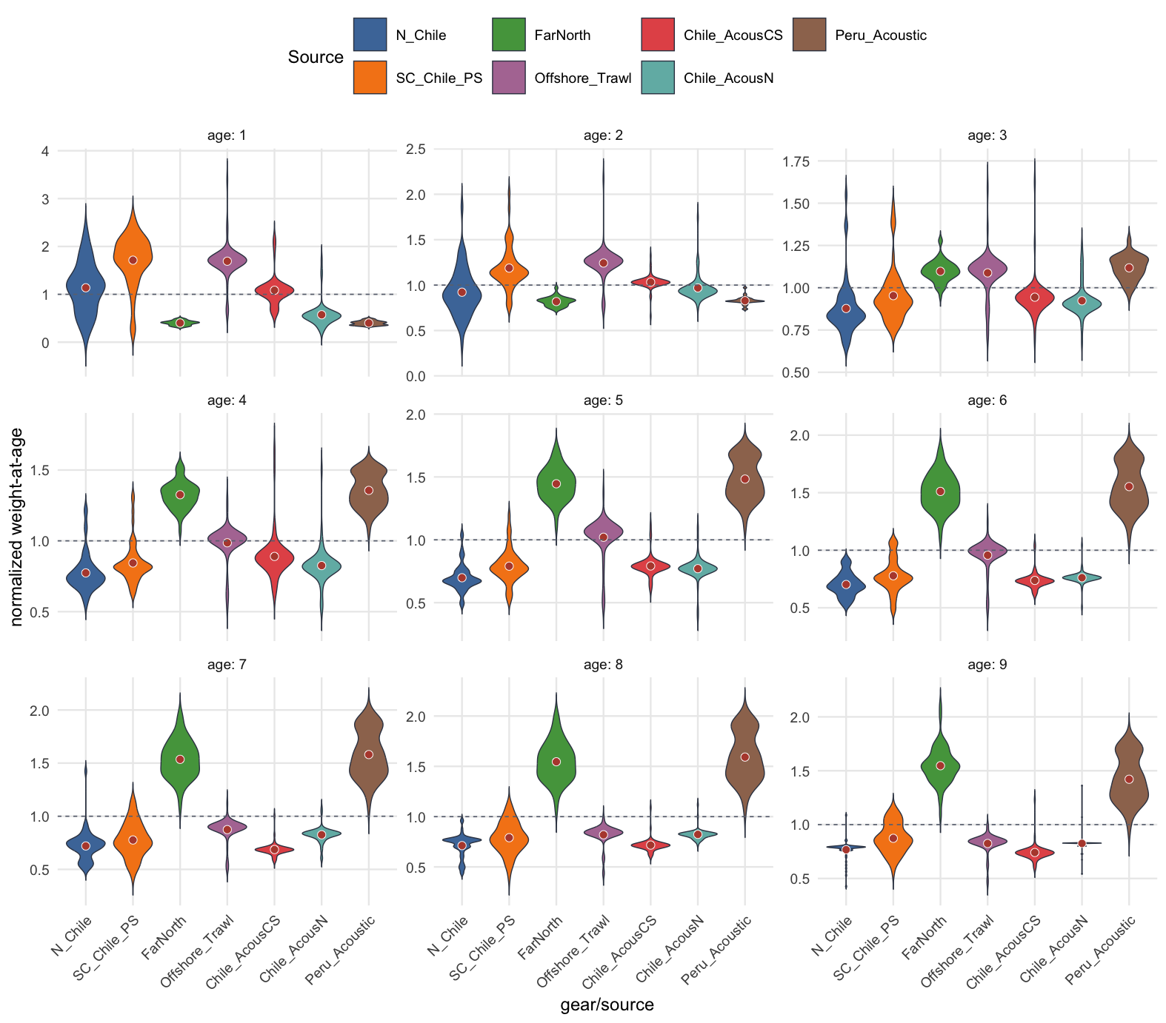
SCW16 / Paper 05
Weight-at-age
5
Weight-at-age is the central update in model 1.14
The defining change from 1.13 is an update to historical Far North weight-at-age, so the paper treats WAA as the main biological data issue.
What was separated
Population WAA used for SSB vs. time-varying fishery and index WAA used for catch/index biomass.
What was compared
Fishery and acoustic-survey WAA sources by age, excluding duplicated CPUE and DEPM series.
What still needs review
Explicit comparison with model 1.13 and interpretation of how Far North updates affect biomass signals.
Source: SCW16-Doc05_JM_Biology.qmd; model 1.14 inputs from jjm/assessment

Slide 6
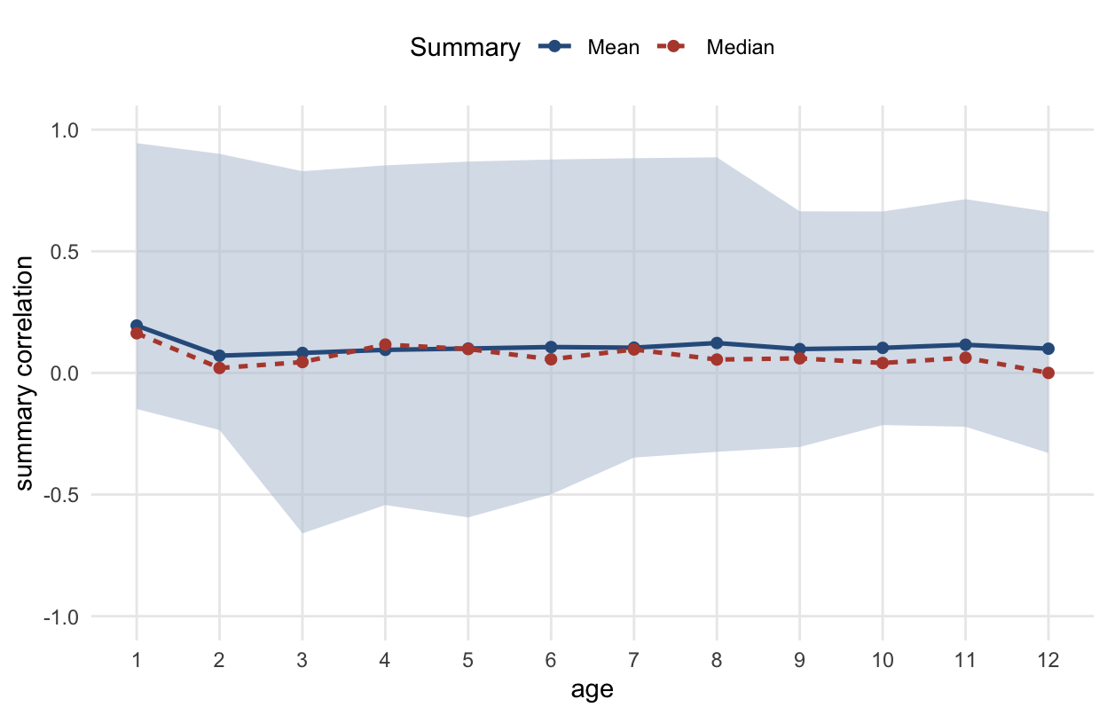
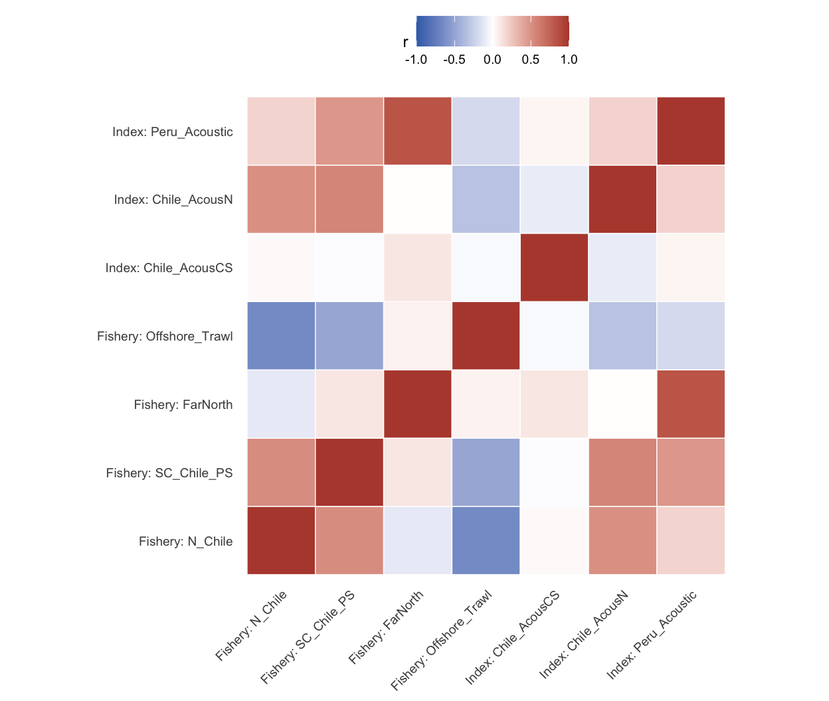
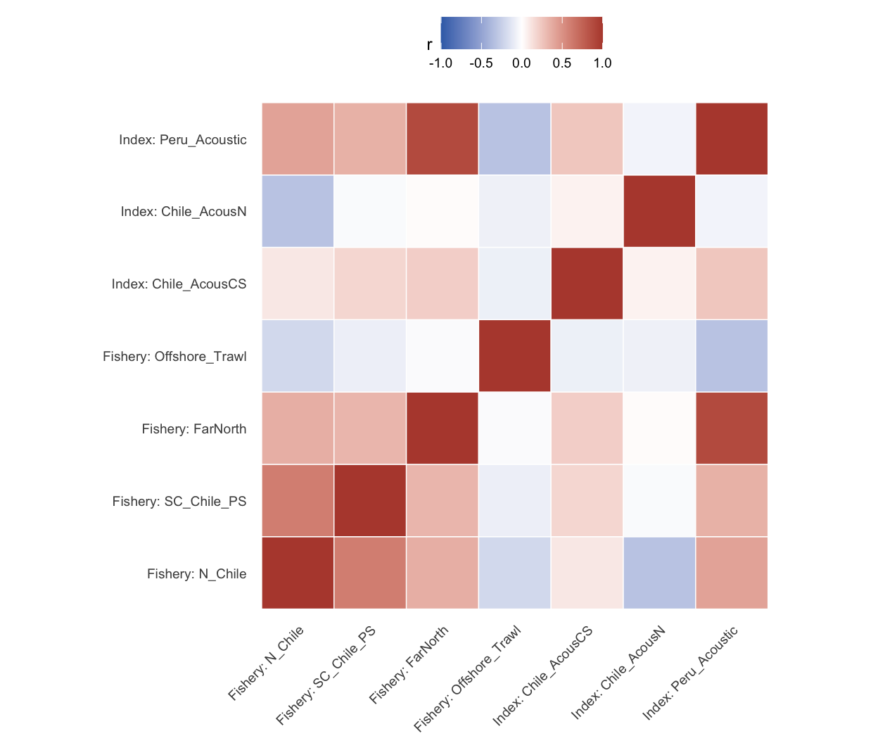
SCW16 / Paper 05
Correlation diagnostics
6
Cross-source WAA signals are generally modest
The diagnostics show low average pairwise correlations by age, with some strong pairs reflecting shared sampling and imputation histories.
Age 3
Age 8
Interpretation
Median pairwise r = 0.04; 8 negative pairs among 21 source pairs.
Highest mean pairwise correlation, but median remains low at 0.05.
Correlation structure is diagnostic, not a decision by itself; source provenance matters.
Source: SCW16-Doc05_JM_Biology.qmd; model 1.14 inputs from jjm/assessment

Slide 7
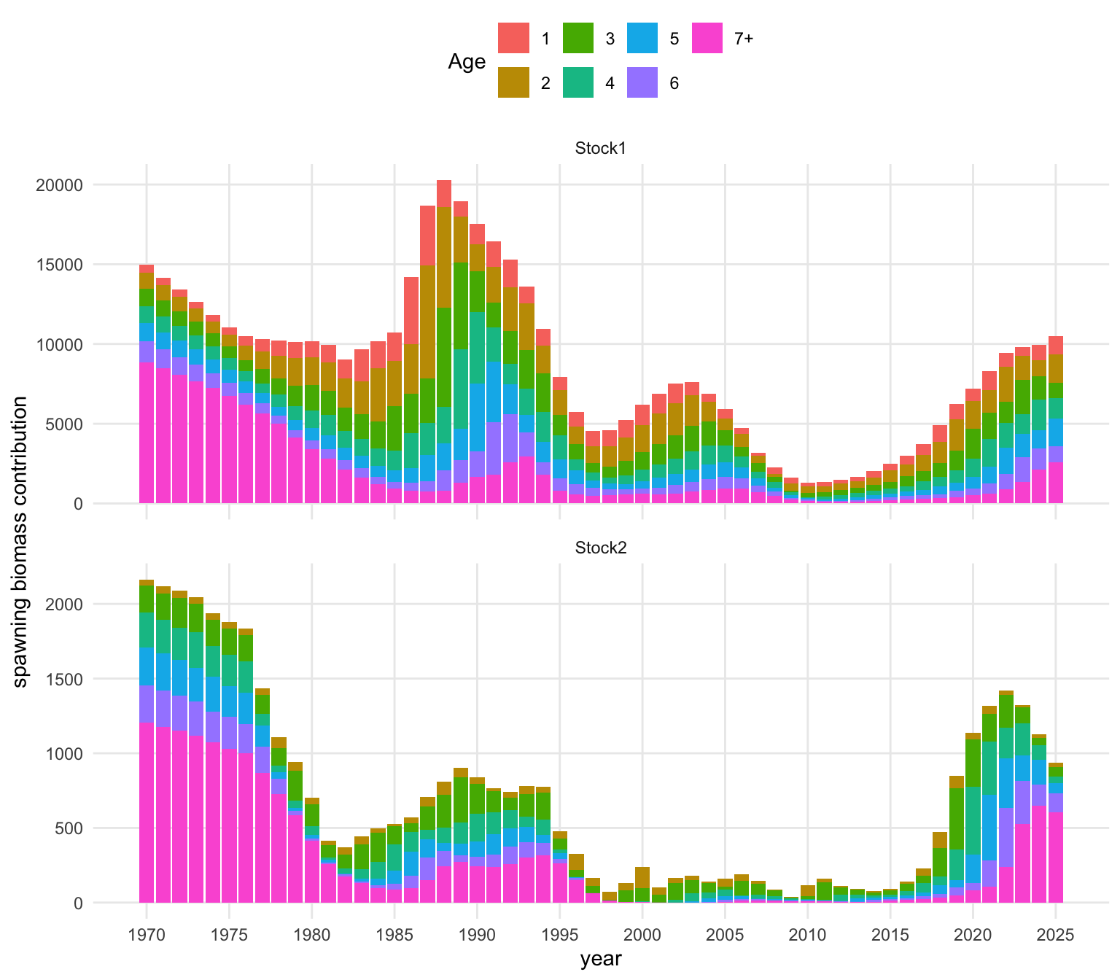
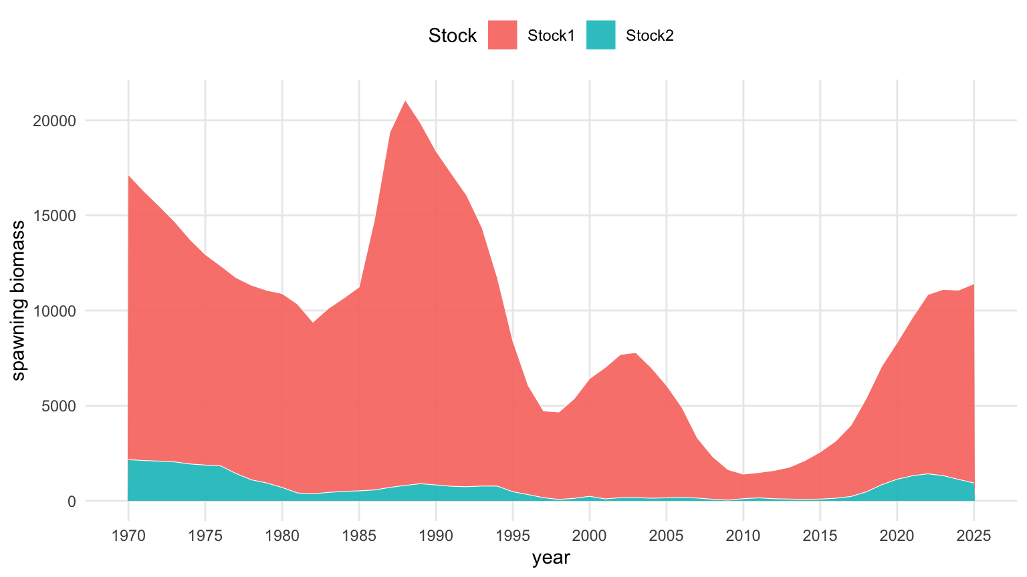
SCW16 / Paper 05
Fitted h2 result
7
Fitted h2 spawning biomass shows age and stock structure
The paper carries biology through to fitted SSB contribution so the implications are visible, not only listed as input vectors.
Stock 1 has broader age contribution; Stock 2 is shifted older because early ages mature later.
The stock-scale figure helps separate biological contribution from relative stock scale in h2.
Source: SCW16-Doc05_JM_Biology.qmd; model 1.14 inputs from jjm/assessment

Slide 8
SCW16 / Paper 05
Day 3 decisions
8
What Day 3 needs to decide from the biology review
The paper is ready to support benchmark decisions if the group converts checks into accepted inputs and targeted sensitivities.
1. Confirm base biology
2. Compare 1.13 vs 1.14
3. Define sensitivities
Are the model 1.14 M, maturity, spawning month, and population WAA inputs acceptable for the base benchmark model?
Quantify and explain the historical Far North WAA update before treating it as settled input.
Identify plausible alternatives for M, maturity, and WAA that affect SSB or reference points.
4. Link Peru papers
5. Update report text
6. MSE readiness
Connect Doc13 length-weight and Doc14 length-frequency evidence to Far North biology/composition treatment.
Move from placeholders to clear accepted inputs, caveats, and follow-up owners.
State which biology uncertainty dimensions should condition June 2026 operating-model work.
Recommended closeout: accept model 1.14 biology where documented, run only high-value sensitivities, and keep the Far North WAA comparison as the critical unresolved check.
Source: SCW16-Doc05_JM_Biology.qmd; model 1.14 inputs from jjm/assessment

