Slide 1
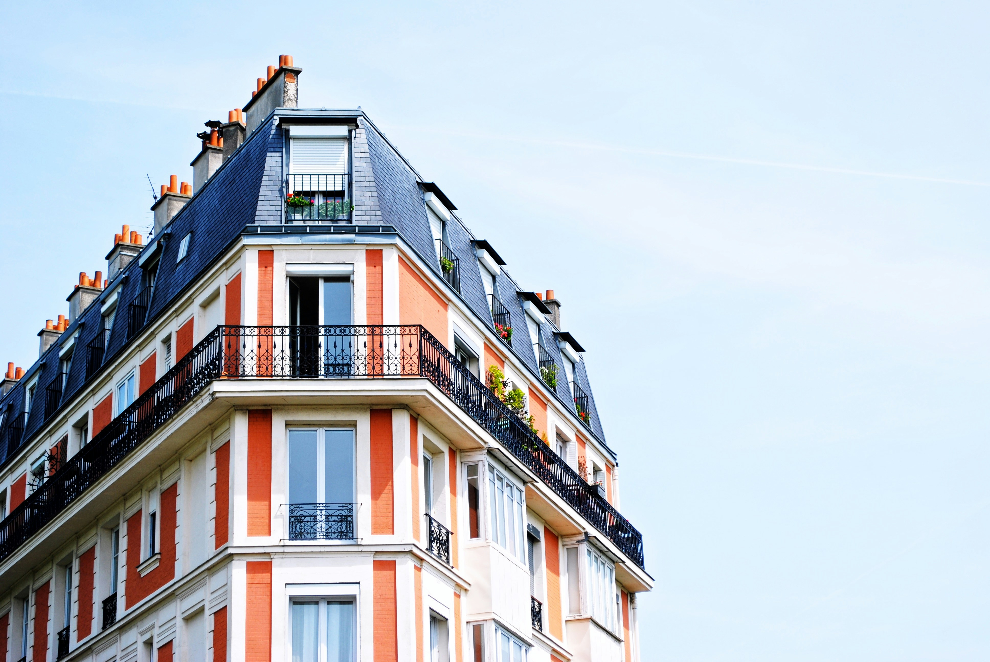
Residential Investment Project
March 2024
Mexico city

Slide 2
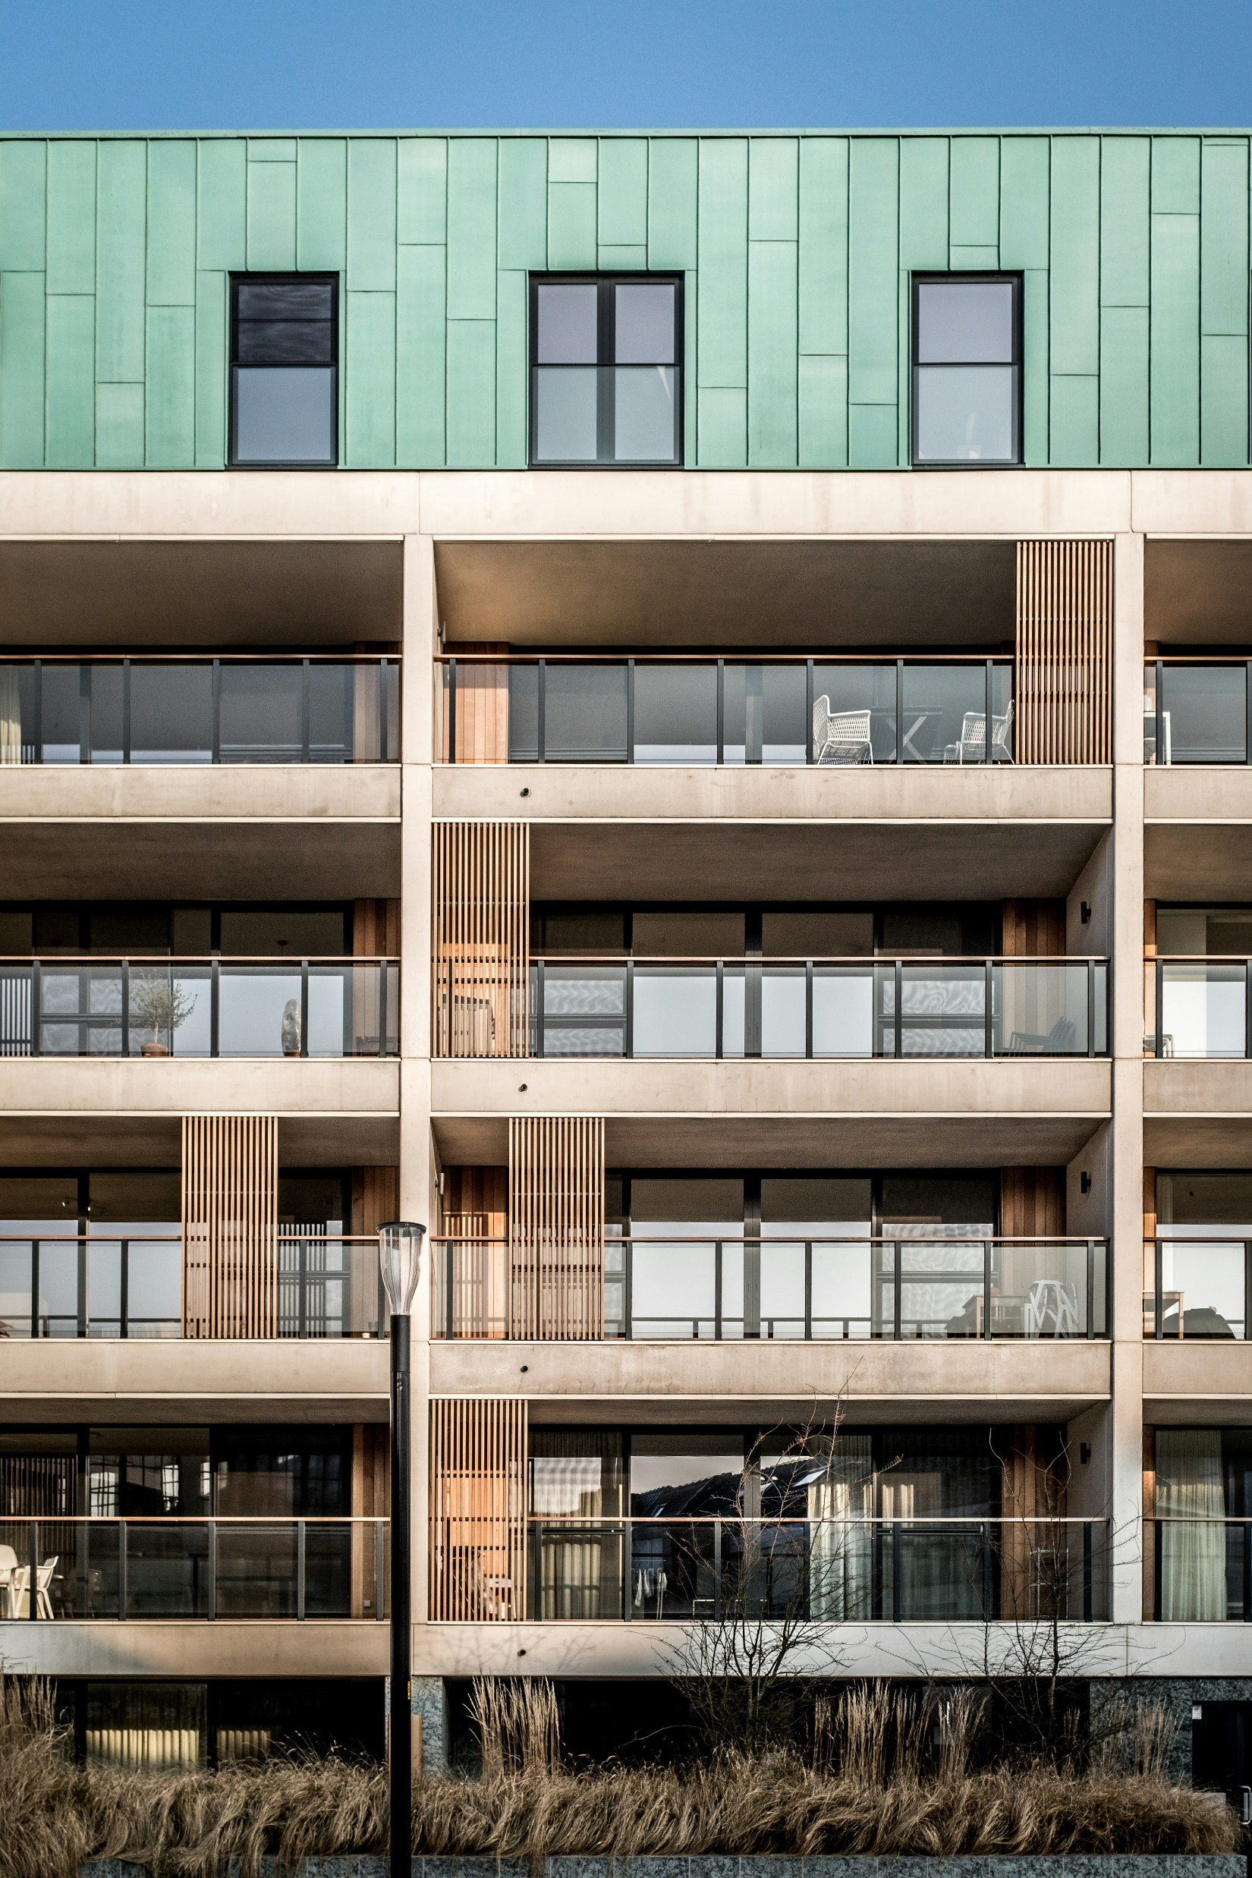

Project description
300 New appartments of 105
Development cost $1,500 M
Estimated value of the Project $1,968 M
A development of 31,500
The estimated duration will be two years
Year 1 – 7,875
Year 2 – 23,625

Slide 3
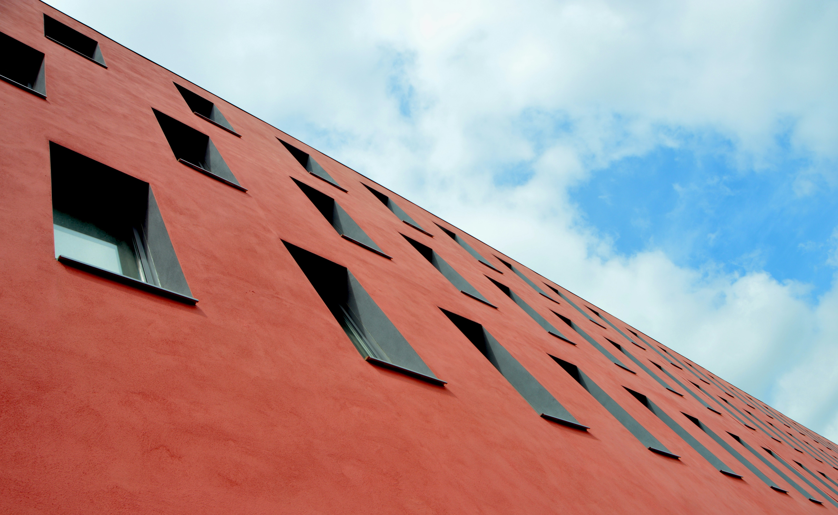
Market Analysis
Periodo | Viviendas
2020 | 2,756,319
2015 | 2,601,323
2010 | 2,453,031
2005 | 2,287,189
2000 | 2,131,410
1995 | 2,010,799
1990 | 1,798,067
https://www.inegi.org.mx/app/areasgeograficas/?ag=09#tabMCcollapse-Indicadores
Periodo | Habitantes por kilómetro cuadrado
2020 | 6,163.3
2015 | 5,967.3
2010 | 5,920.5
2005 | 5,718.6
2000 | 5,642.8
1995 | 5,487.4
1990 | 5,494.0
1980 | 5,971.0
1970 | 4,585.8
1960 | 3,249.4
1950 | 2,056.9
1940 | 1,185.1
1930 | 829.1
1921 | 611.0
1910 | 486.0
1900 | 361.3

Slide 4
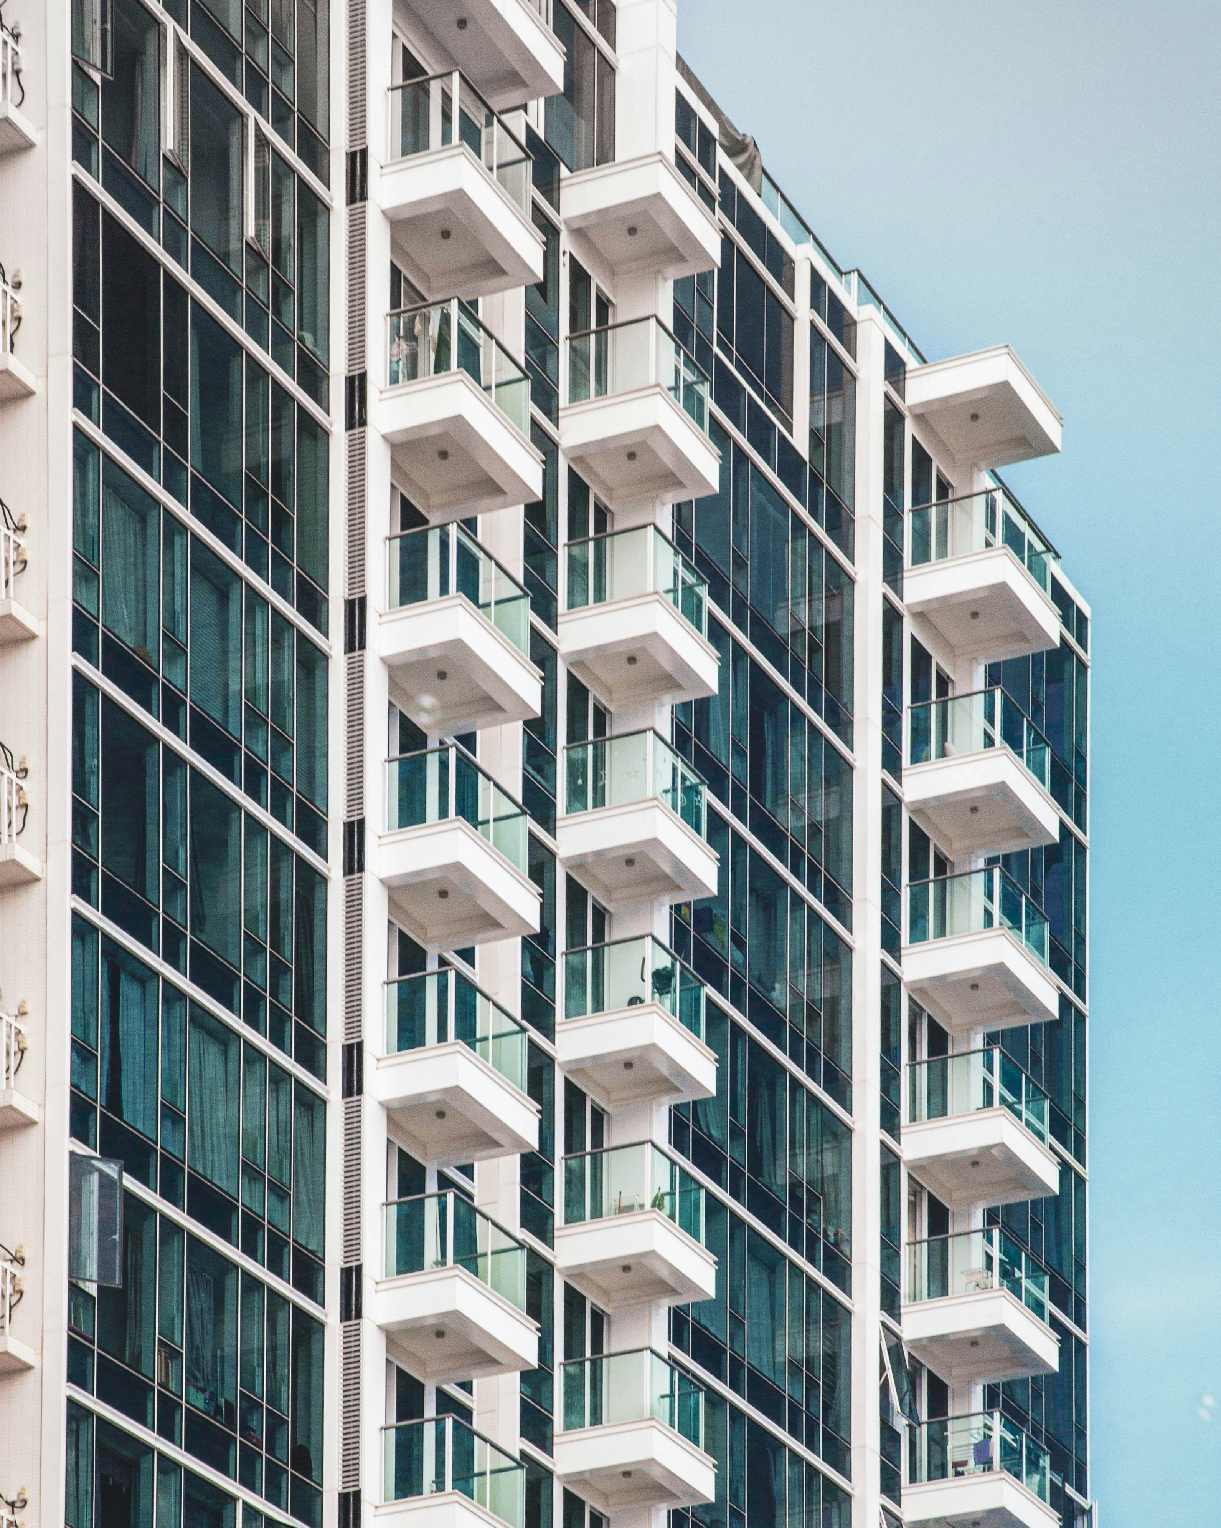
Oportunity cost:

Slide 5
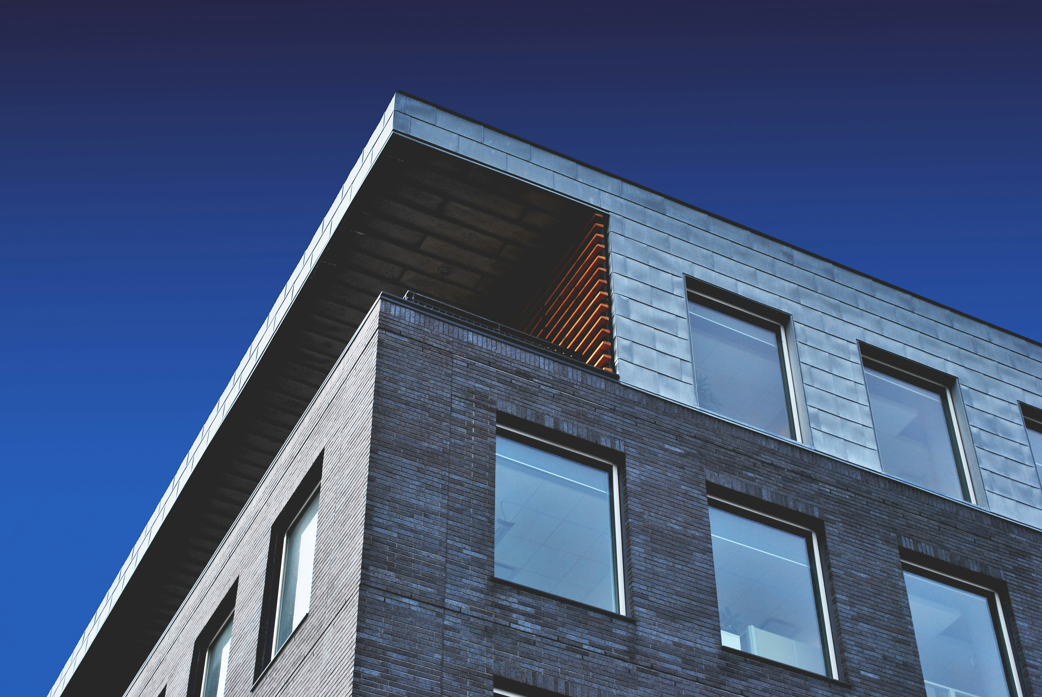
Return Analysis

Slide 6
Investment recomendation

