Slide 1

FINAL DATA ANALYSIS PRESENTATION
Bluestock Fintech Data Analytics Internship

Slide 2
Executive Overview
01
SCHEMES ANALYZED
NAV OBSERVATIONS
DEC-2025 SIP INFLOW
DEC-2025 FOLIOS
INVESTOR TXNS
40
46,000
₹31,002 cr
26.12 cr
32,778
Core fund master
Historical observations
Monthly inflow
Total folios
Transaction records
WHAT THE DATA SAYS
CORE MESSAGE
• SIP inflow rises from ₹11,517 crore in Jan-2022 to ₹31,002 crore in Dec-2025 (+169.2%).
• Total folios rise from 13.26 crore to 26.12 crore (+97.0%) over the same endpoints.
• Return leadership and risk-adjusted leadership are different: SBI Small Cap leads 3-year return, while ICICI Pru Liquid leads Sharpe.
• Downside risk is material in several small-cap schemes; the largest detailed drawdown is −52.57%.
Growth is strong, but selection requires a risk-aware lens.
Use return + Sharpe/Sortino + alpha + drawdown + concentration together.
2

Slide 3
Problem Statement & Objectives
02
PROBLEM STATEMENT
ANALYTICAL GOALS
Mutual-fund analysis spans scheme characteristics, NAV history, AUM, SIP flows, investor transactions, portfolio holdings and benchmarks. The challenge is to connect these views while preserving data quality and decision usefulness.
1
Build a repeatable ingestion, cleaning and validation workflow.
2
Compare schemes using return, risk-adjusted and benchmark-relative measures.
3
Assess downside risk with drawdown, VaR and CVaR.
4
Analyze investor cohorts and SIP continuity.
KEY QUESTIONS
Measure sector concentration with HHI.
• How did AUM, SIP inflows and folio counts change across the supplied periods?
• Which schemes lead on 3-year return, Sharpe, alpha and composite score?
• Where does downside risk appear highest, and what does investor continuity look like?
• Which portfolio exposures show comparatively high sector concentration?
5
6
Translate findings into a simple recommender and Power BI dashboard.
3

Slide 4
Dataset Overview & Analytical Architecture
03
CORE DATASETS
SQLITE ROWS
SCHEME PERFORMANCE
PORTFOLIO HOLDINGS
BENCHMARK ROWS
10
87,533
40
322
8,050
Analytical CSV families
Loaded analytical rows
One record per scheme
Holdings records
Historical benchmark data
Raw CSVs
→
Cleaning & QA
→
SQLite
→
EDA + Risk
→
Power BI
COVERAGE
IMPORTANT VARIABLES
• NAV + benchmark history: Jan-2022 to May-2026.
• AUM, SIP inflows and folios: through Dec-2025.
• Investor transactions: Jan-2024 to May-2025.
• Portfolio holdings snapshot: 31 Dec 2025.
• Scheme: category, plan, risk, expense ratio, benchmark.
• Performance: return, alpha, beta, Sharpe, Sortino, volatility, drawdown.
• Investor: transaction type, amount, state, city tier, age, gender, KYC.
• Portfolio: sector, weight and market value.
4

Slide 5
Data Cleaning & Preprocessing
04
SUPPORTED TRANSFORMATIONS
NAV history
Date conversion, sorting, duplicate removal, forward-fill within scheme, positive-NAV filter.
Investor transactions
Standardize transaction type/KYC; keep supported types; positive amounts; deduplicate.
Scheme performance
Numeric coercion of performance/risk fields; duplicate removal.
Other core files
Deduplication and date/month conversion where applicable.
QUALITY CHECK
40 fund-master AMFI codes; all represented in NAV history; project README records the pipeline validation as passed.
5

Slide 6
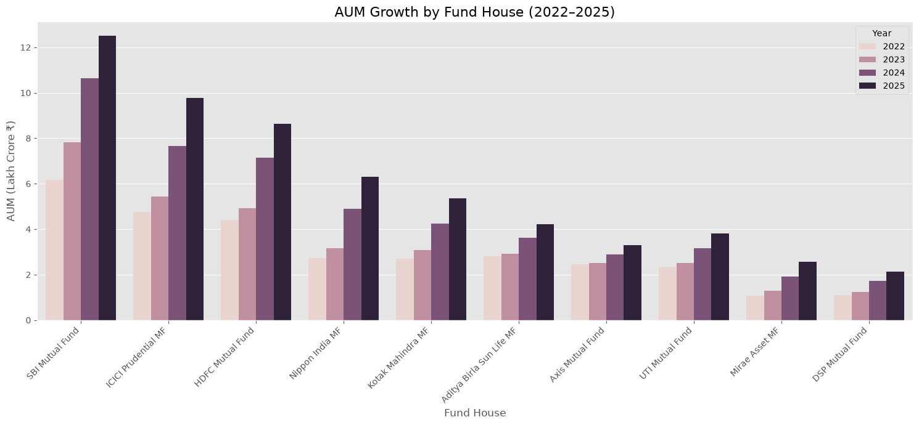
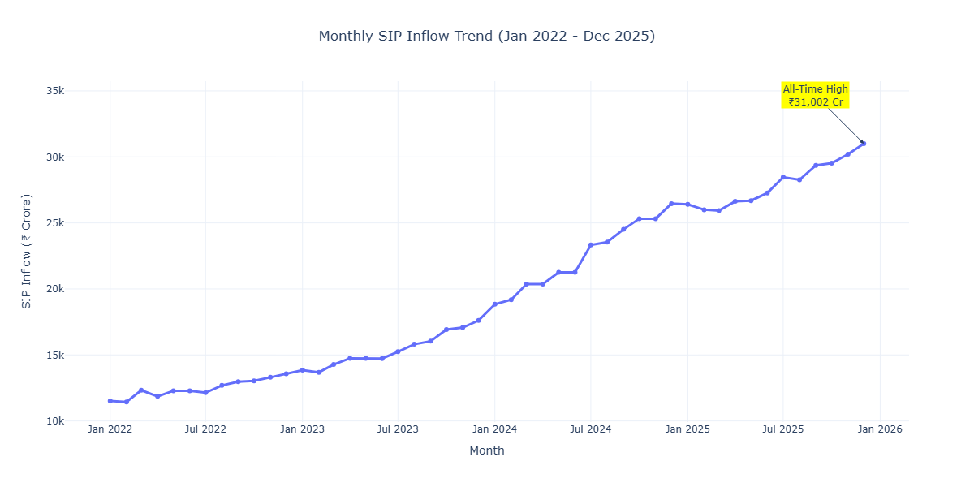
Exploratory Data Analysis — Market Expansion
05
AUM growth by fund house, 2022–2025
Monthly SIP inflow trend, Jan-2022 to Dec-2025
SIP INFLOW GROWTH
SBI MF AUM
MARKET SIGNAL
+169.2%
₹12.50 lakh cr
Sustained expansion
₹11,517 cr → ₹31,002 cr
Dec-2025
Systematic investing
6

Slide 7
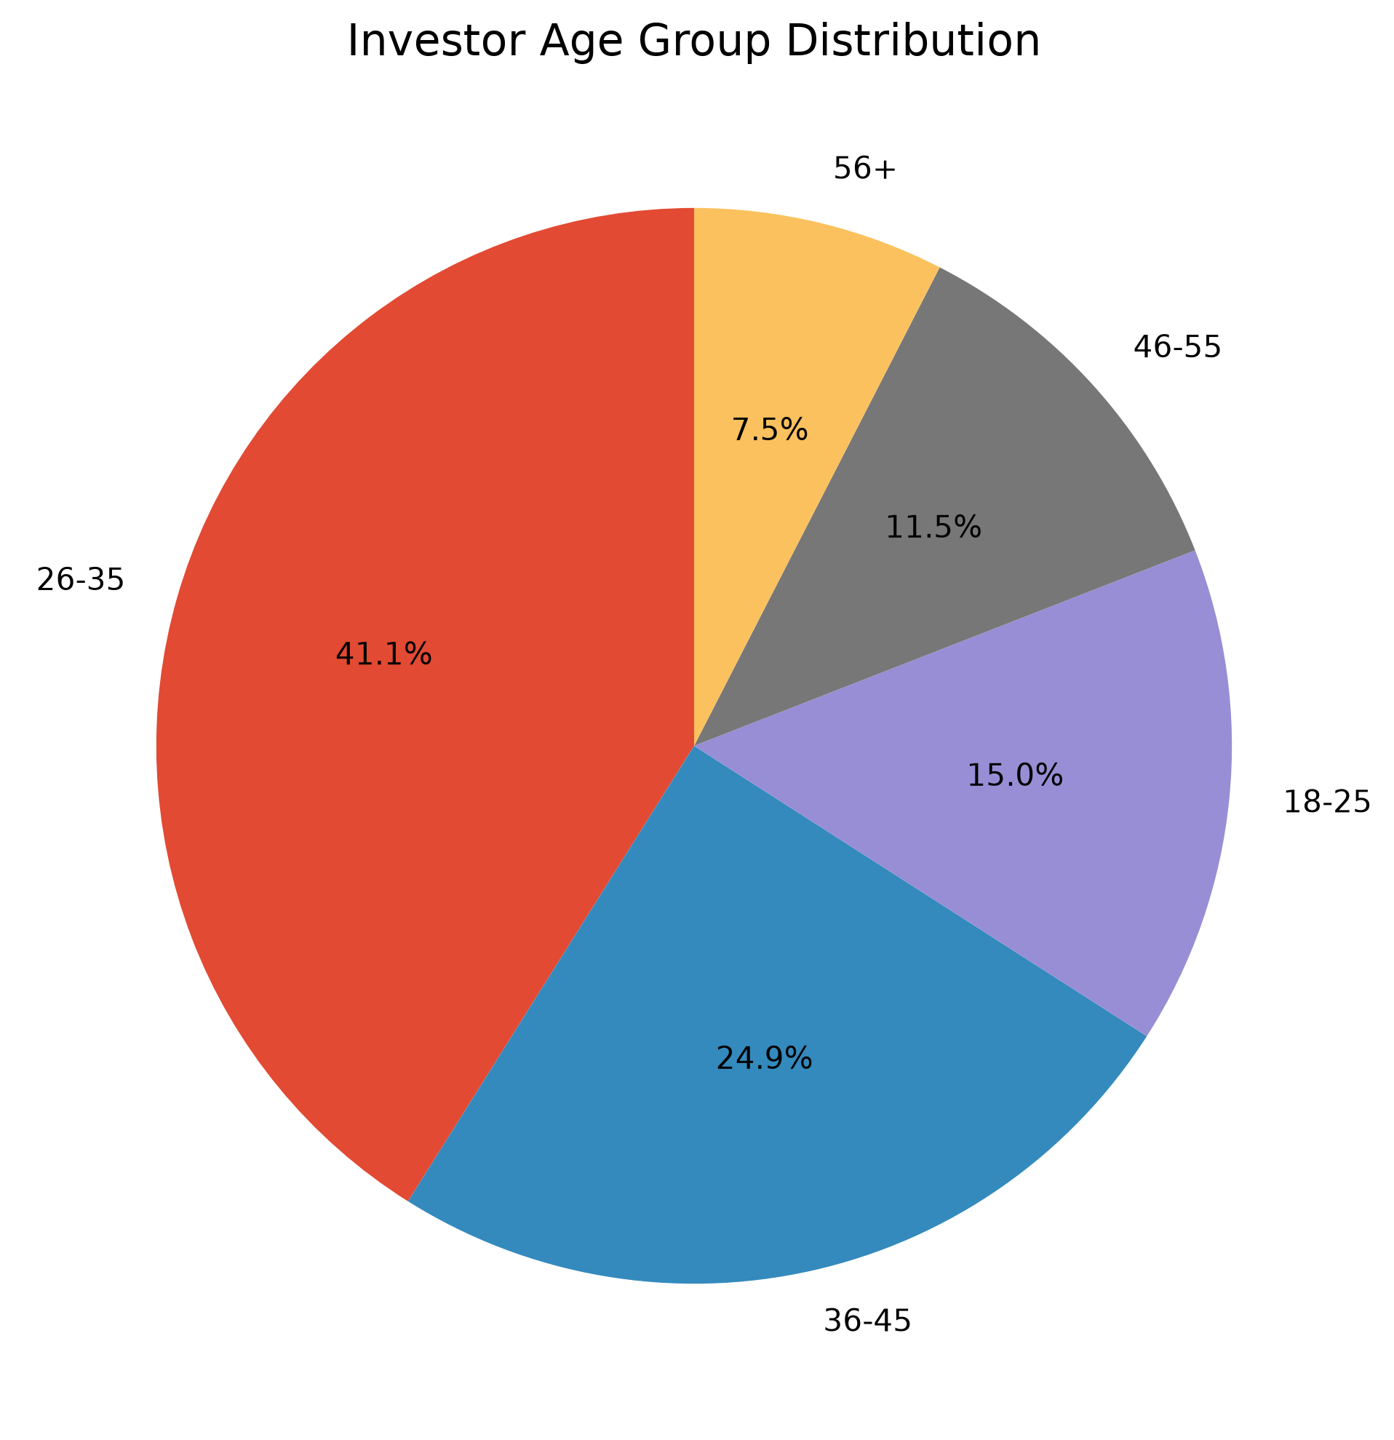
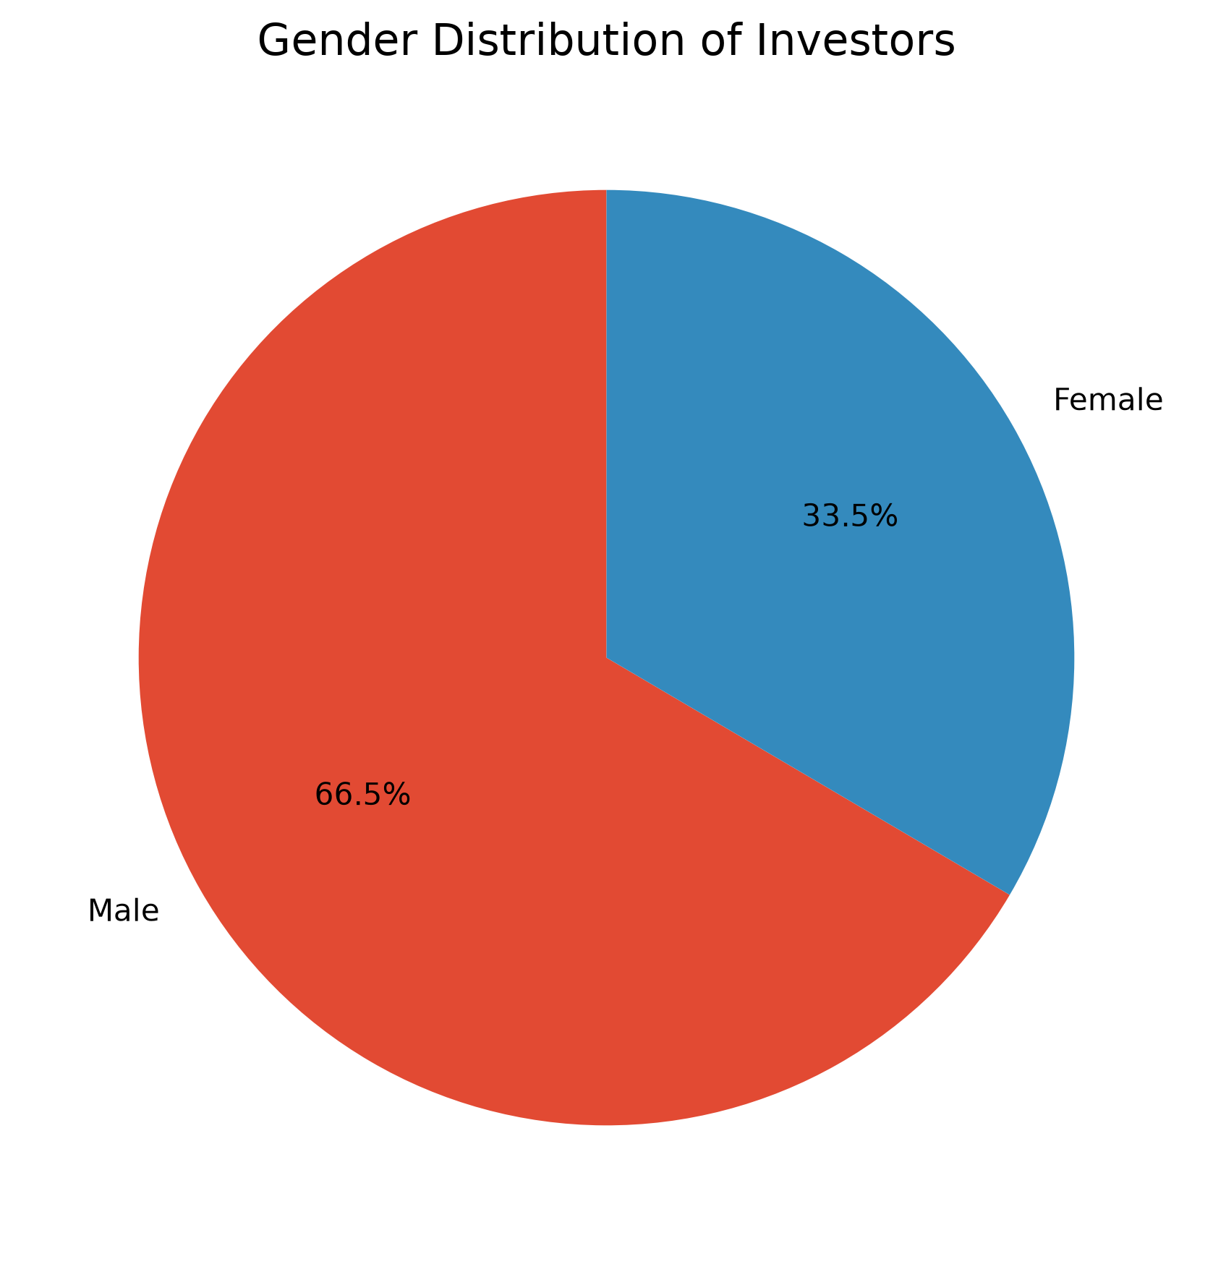
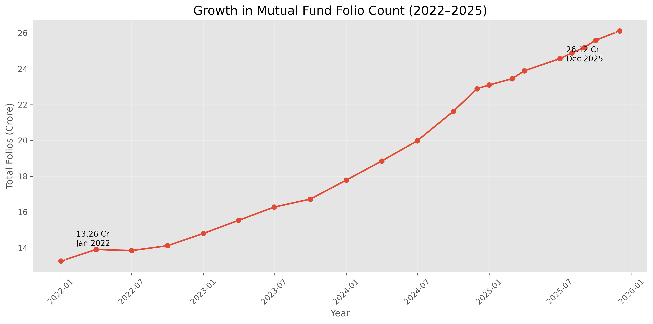
Investor Participation & Demographics
06
Age-group distribution
Gender distribution
Total folio count growth
LARGEST AGE GROUP
MALE TRANSACTION SHARE
FOLIO GROWTH
26–35
66.5%
+97.0%
Most represented segment
Transaction records
13.26 cr → 26.12 cr
7

Slide 8
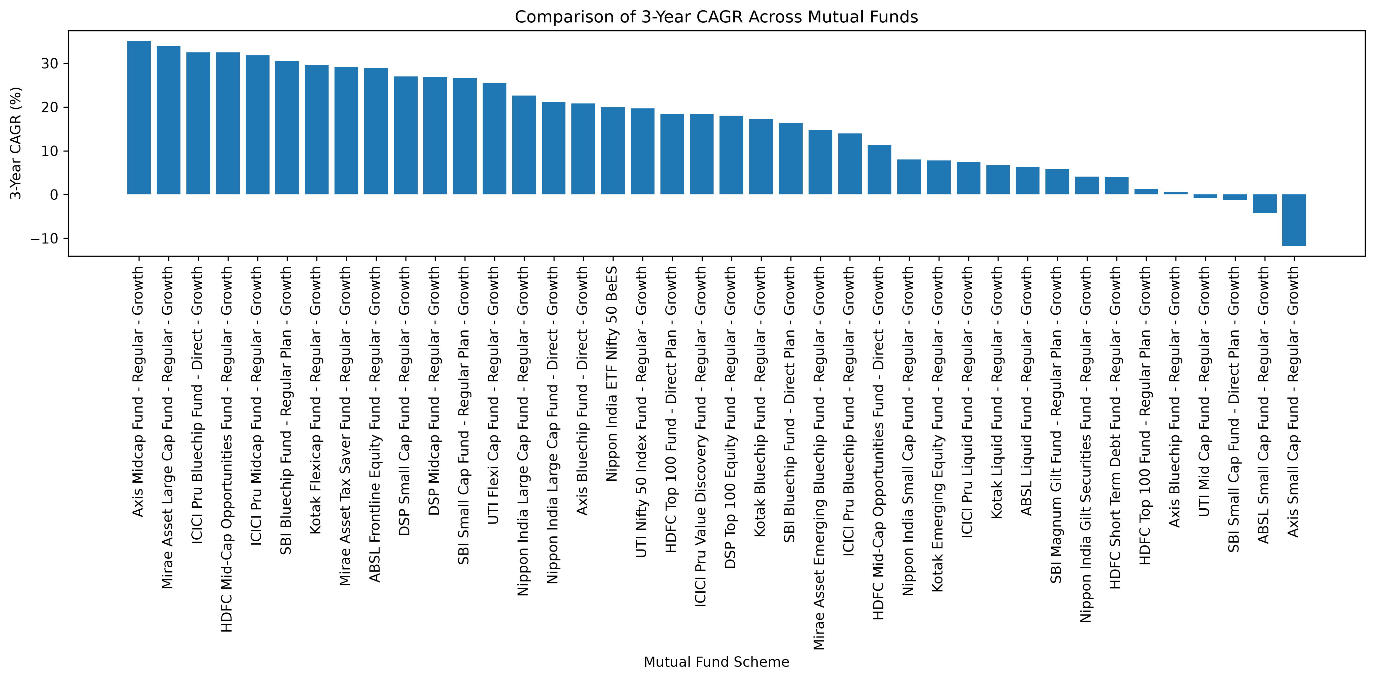
Detailed Analysis — Fund Performance
07
RETURN LEADERS
SBI Small Cap — Regular
23.39%
SBI Small Cap — Direct
23.14%
ABSL Small Cap — Regular
22.38%
Axis Small Cap — Regular
20.98%
Nippon India Small Cap — Regular
20.15%
Mean 3-year return: 14.09% Mean benchmark 3-year return: 12.84% Mean alpha: 1.25
8

Slide 9
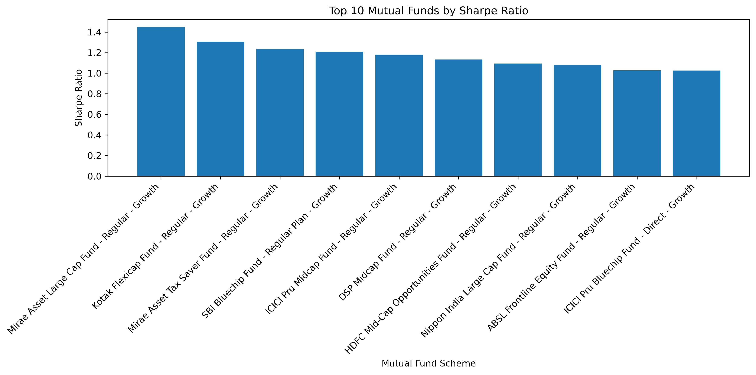
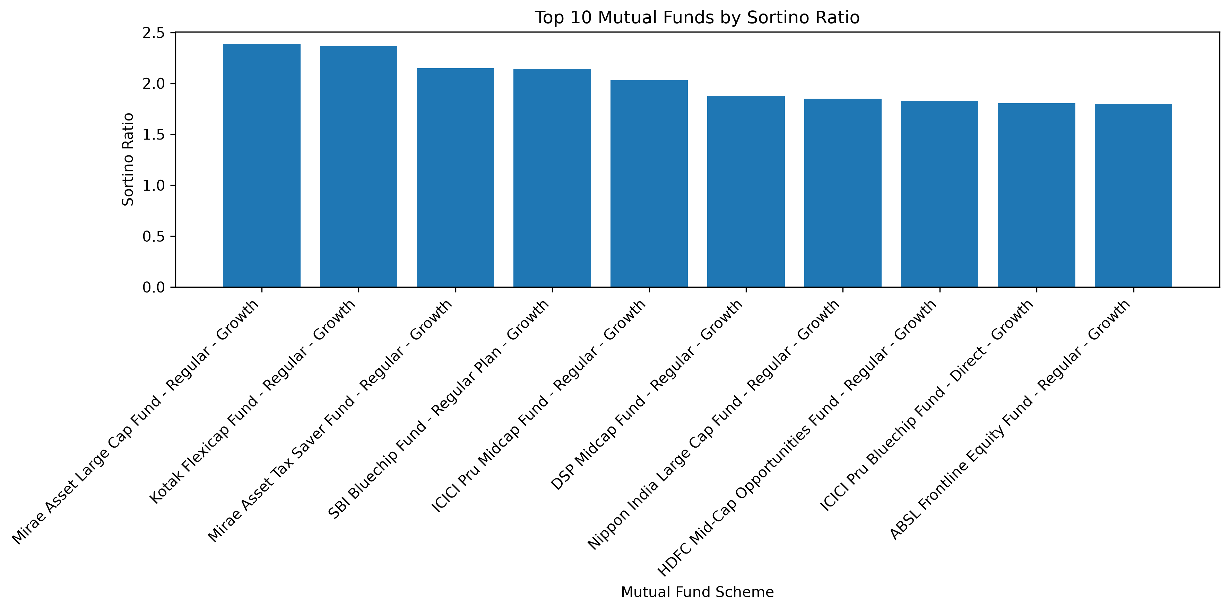
Detailed Analysis — Risk-Adjusted Performance
08
Top schemes by Sharpe ratio
Top schemes by Sortino ratio
MAX SHARPE
MAX SORTINO
MAX ALPHA
7.68
10.37
1.98
ICICI Pru Liquid — Regular
ICICI Pru Liquid — Regular
HDFC Short Term Debt — Regular
9

Slide 10
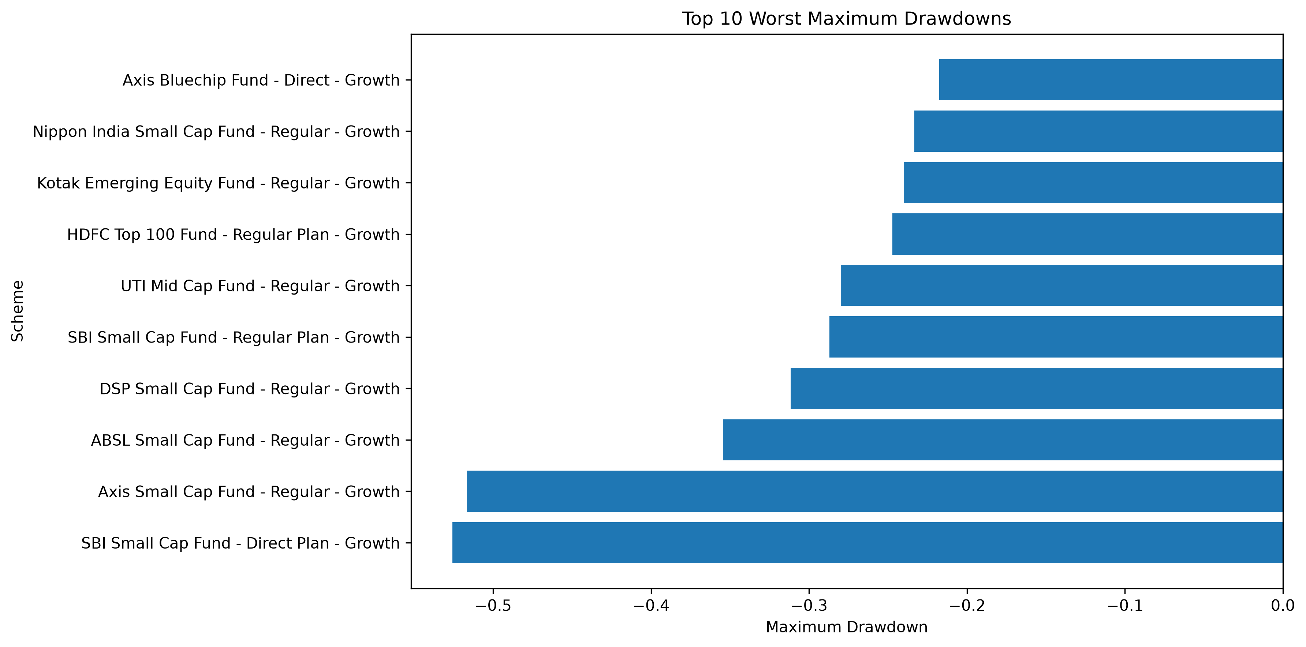
Detailed Analysis — Downside & Tail Risk
09
LARGEST DRAWDOWNS
SBI Small Cap — Direct
−52.6%
Axis Small Cap — Regular
−51.7%
ABSL Small Cap — Regular
−35.4%
DSP Small Cap — Regular
−31.2%
SBI Small Cap — Regular
−28.7%
Worst daily VaR 95% ≈ −2.69% Corresponding CVaR ≈ −3.24% Tail losses exceed the VaR threshold by construction.
10

Slide 11
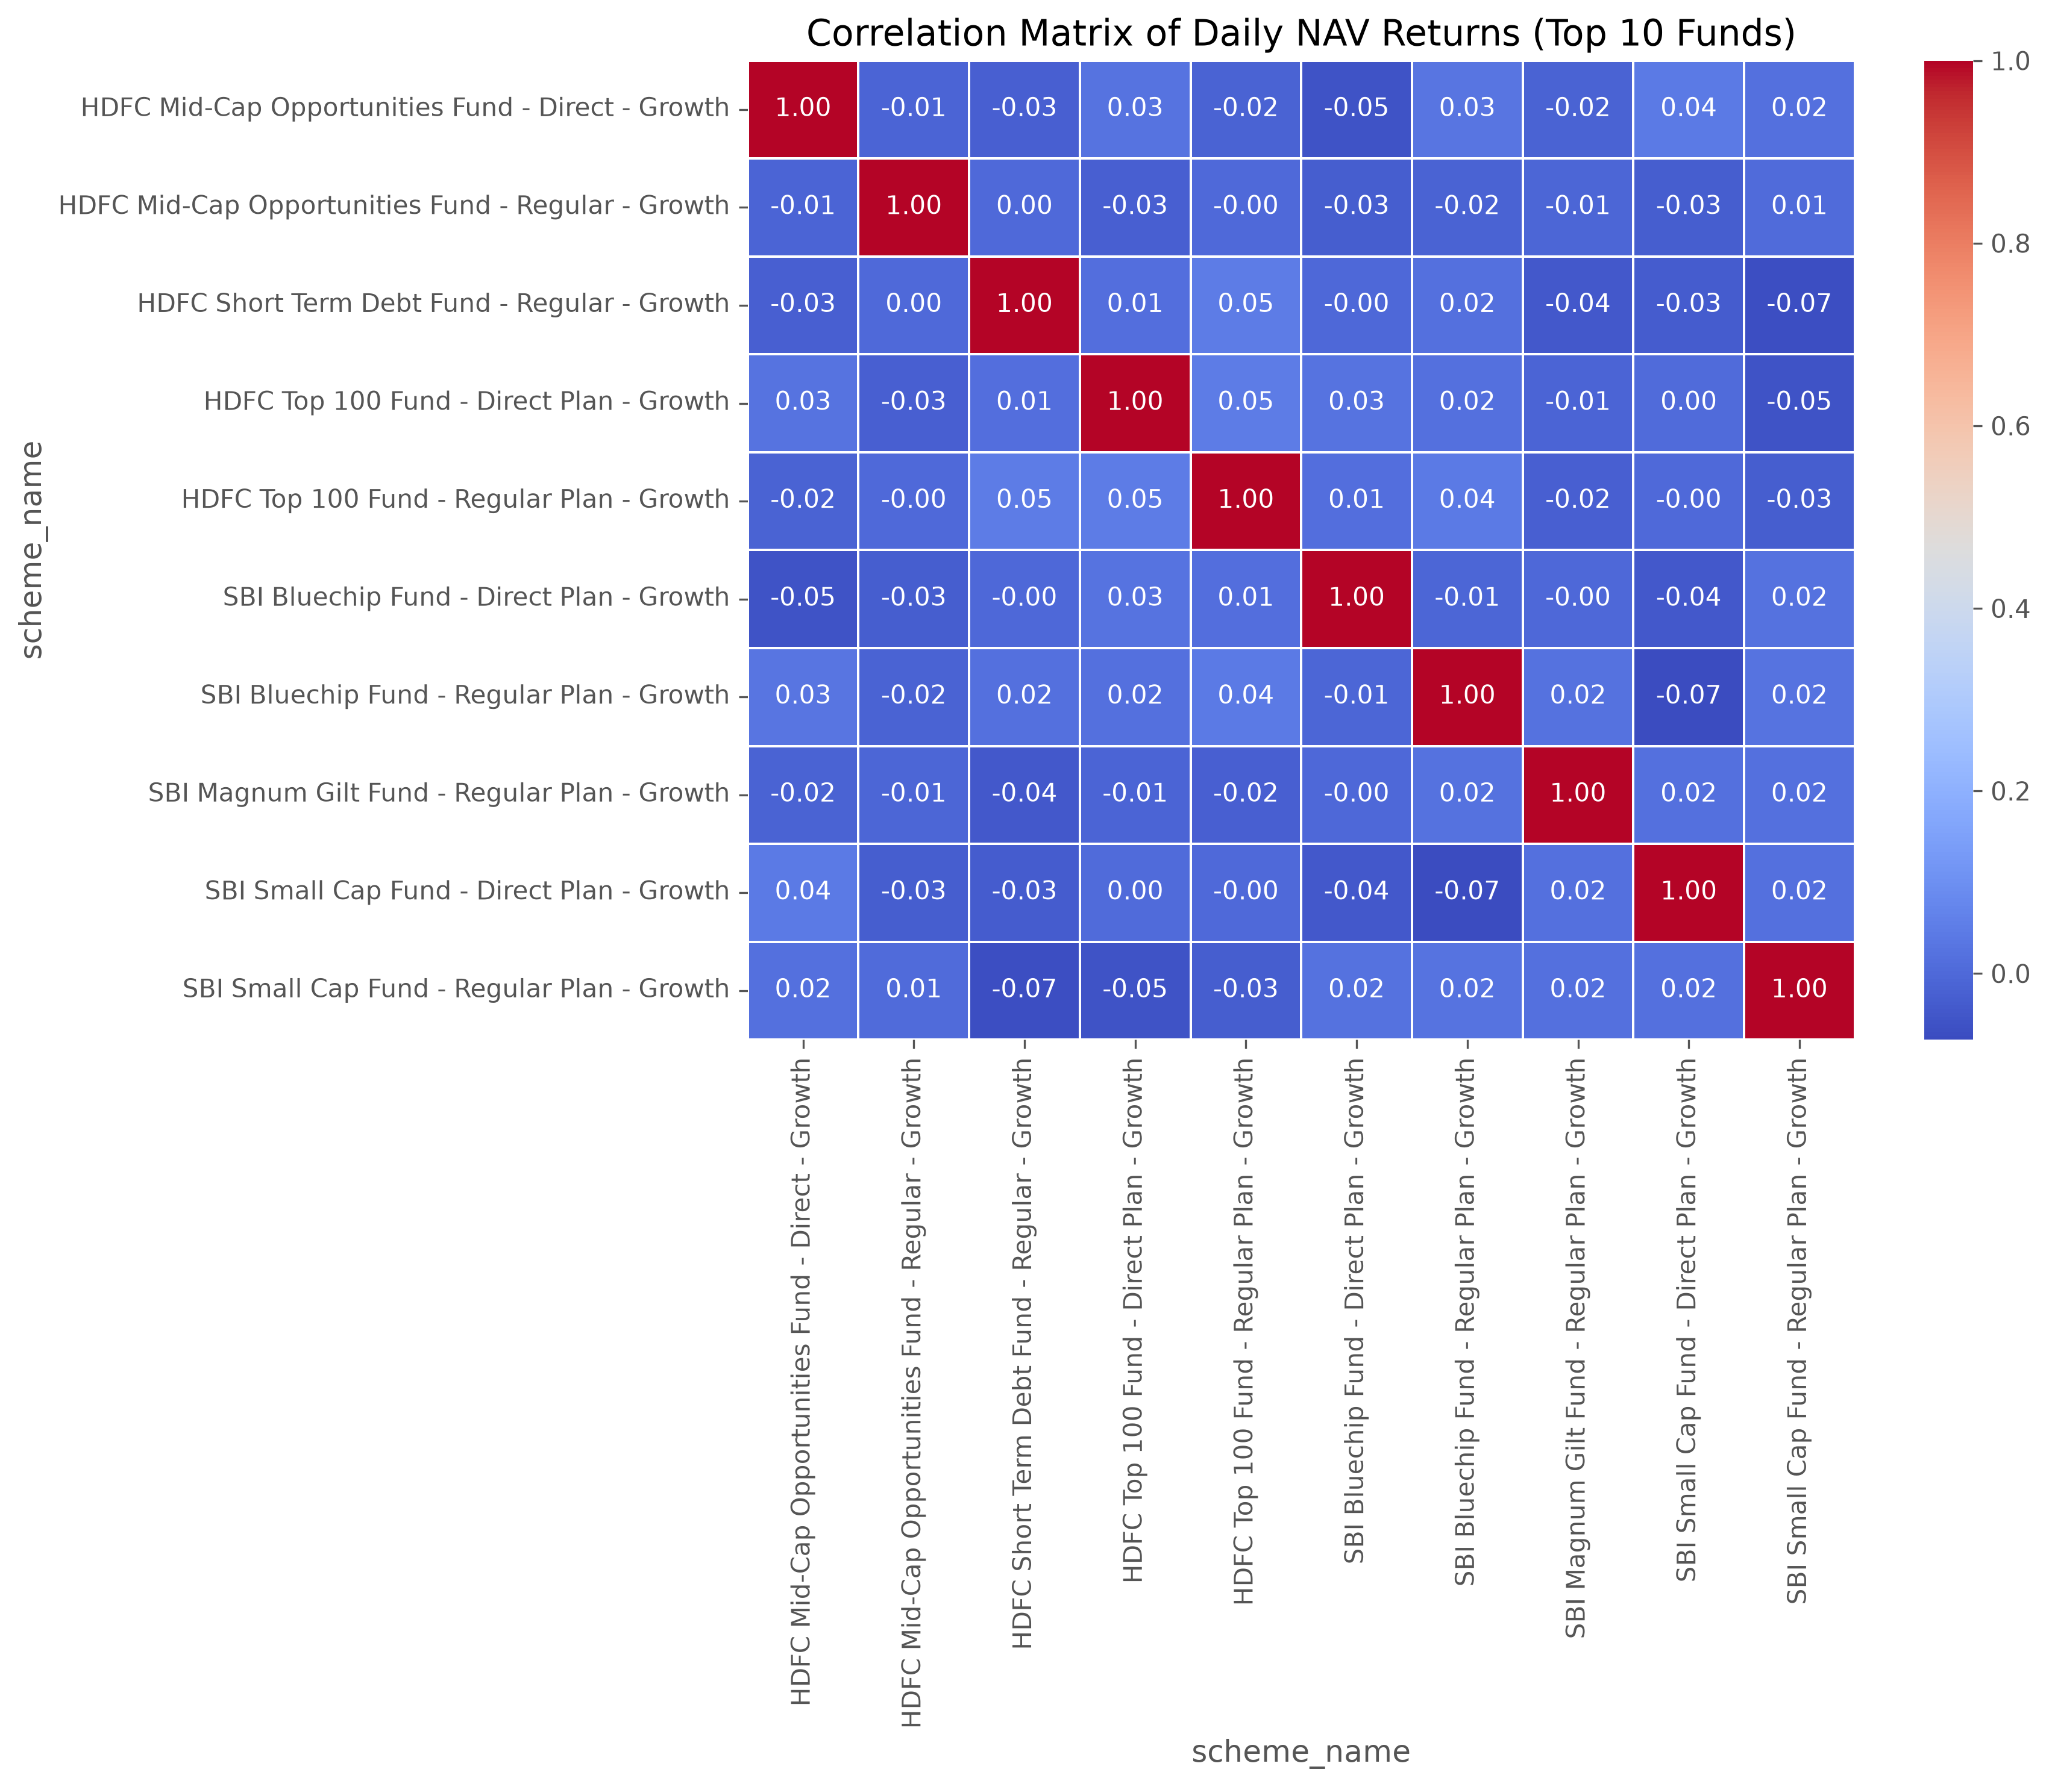
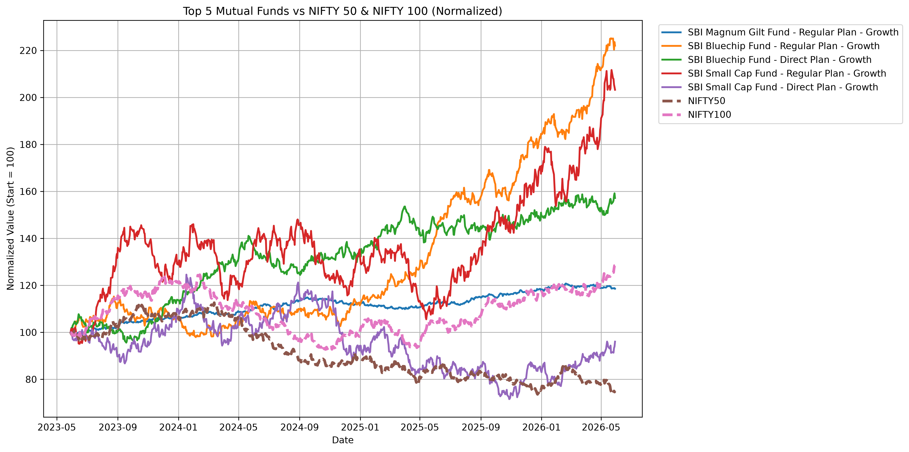
Benchmark, Correlation & Portfolio Structure
10
Selected fund vs NIFTY 50 / NIFTY 100
Return correlation among selected schemes
TRACKING ERROR RANGE
HIGHEST EQUITY HHI
SECTOR SIGNAL
0.1333–0.2867
2967.69
Financials + IT + Healthcare
Five selected SBI schemes
Axis Bluechip — Regular
Concentration matters
11

Slide 12
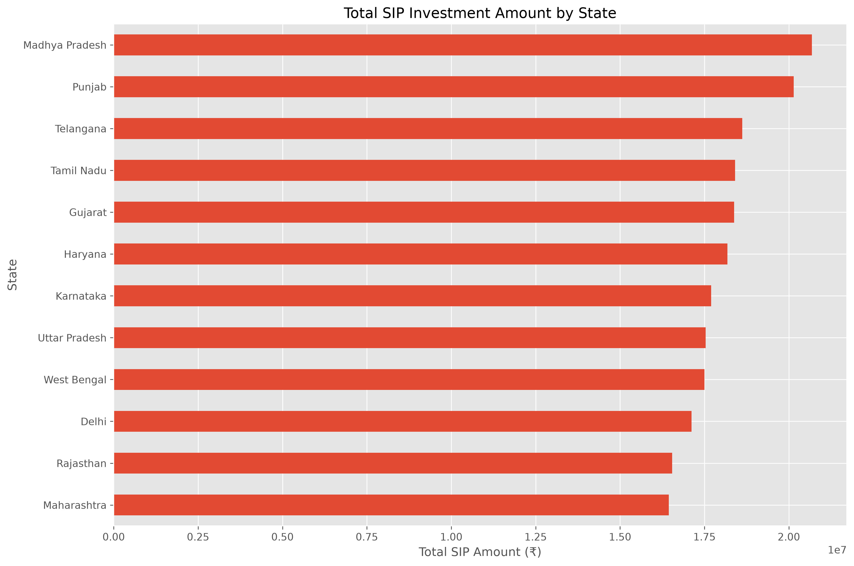
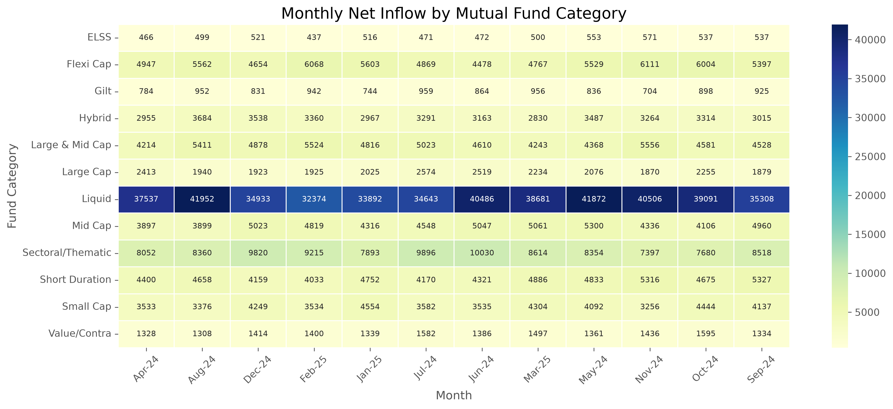
SIP Behaviour, Market Trends & Continuity
11
Category-wise monthly net inflow heatmap
SIP amount by state
SIP INVESTORS
ELIGIBLE
AT-RISK
4,762
1,362
1,332
Unique SIP investors
≥ 6 SIP transactions
97.80% under >35-day rule
12

Slide 13
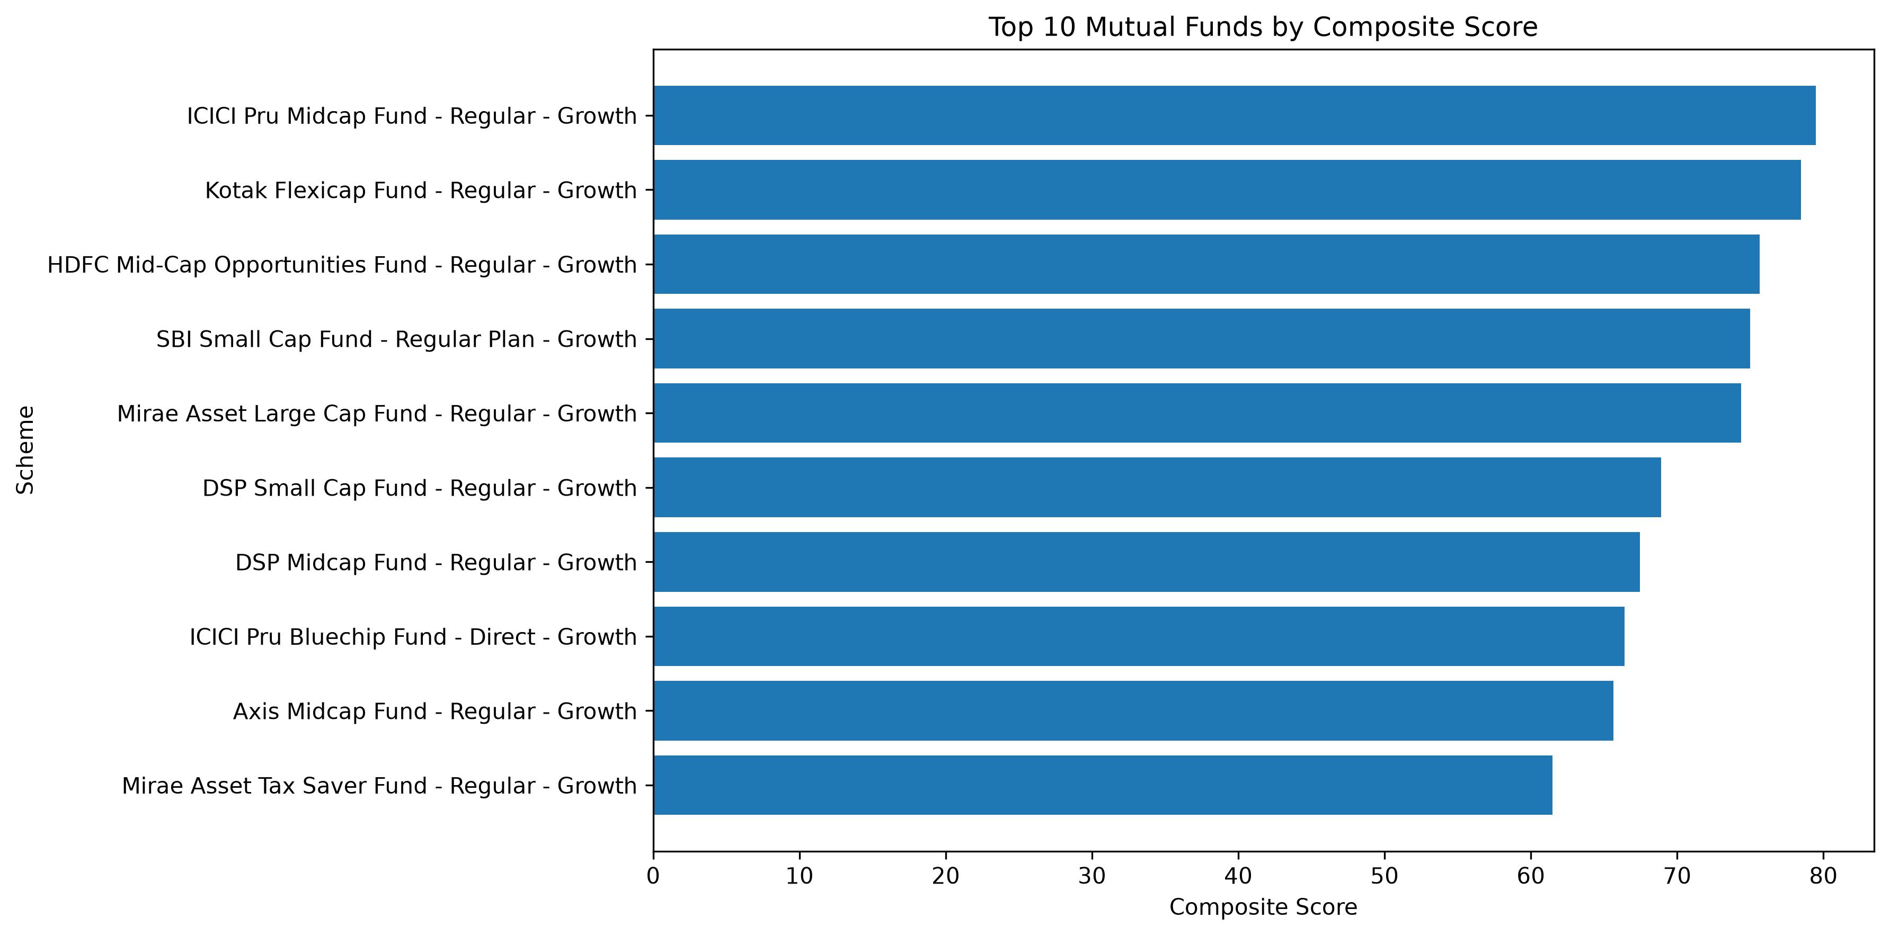
Advanced Analytics & Recommendation Logic
12
90-day rolling Sharpe — five selected key funds
Composite fund scorecard
RECOMMENDER
TOP SCORE
• Accepts Low / Moderate / High risk appetite.
• Filters by risk category, then ranks by Sharpe and returns top 3.
ICICI Pru Midcap — Regular: 79.49 Kotak Flexicap — Regular: 78.46
13

Slide 14
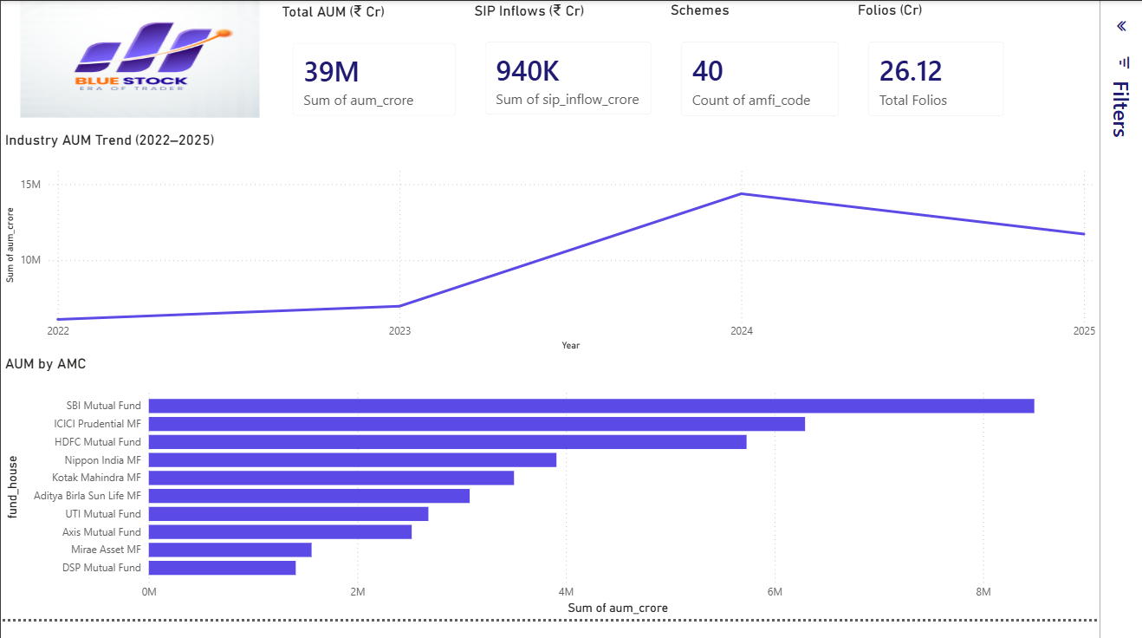
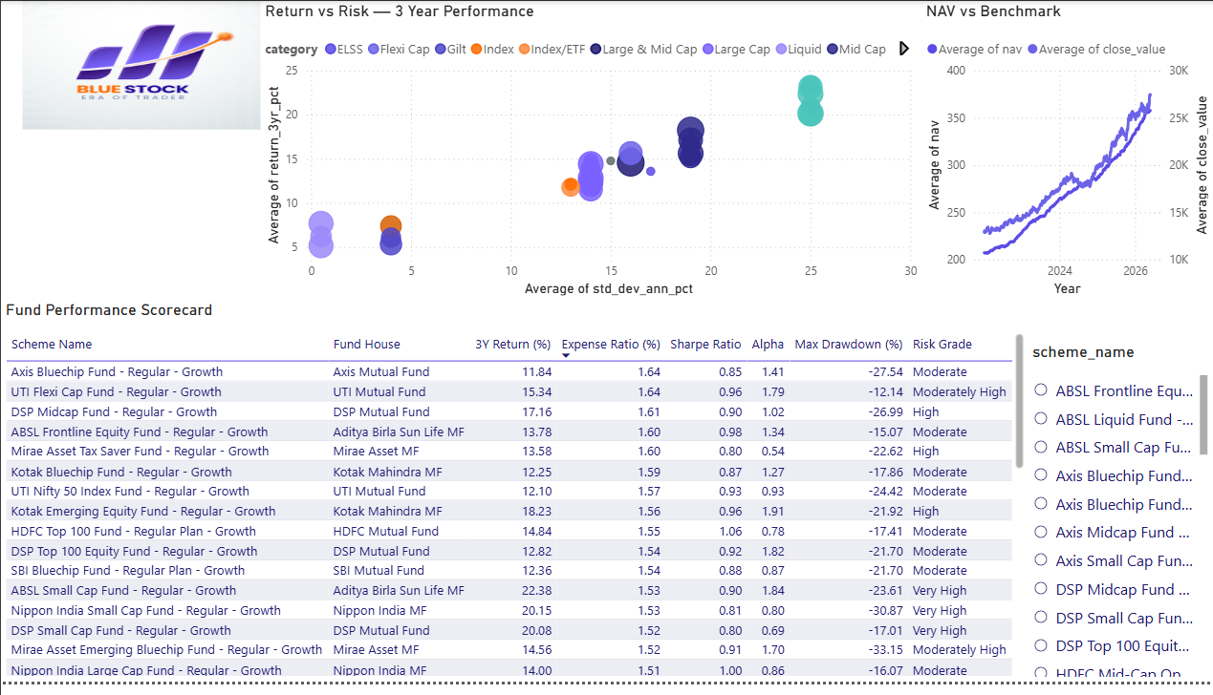
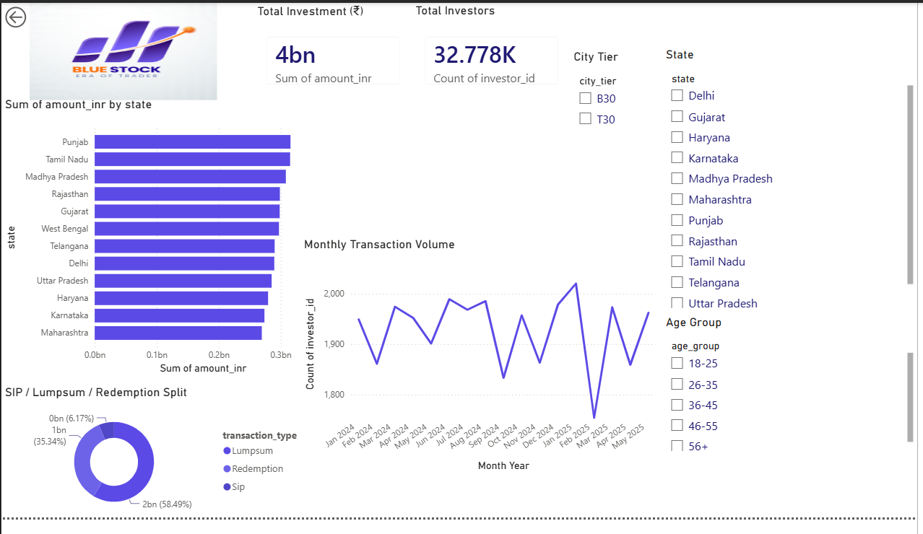
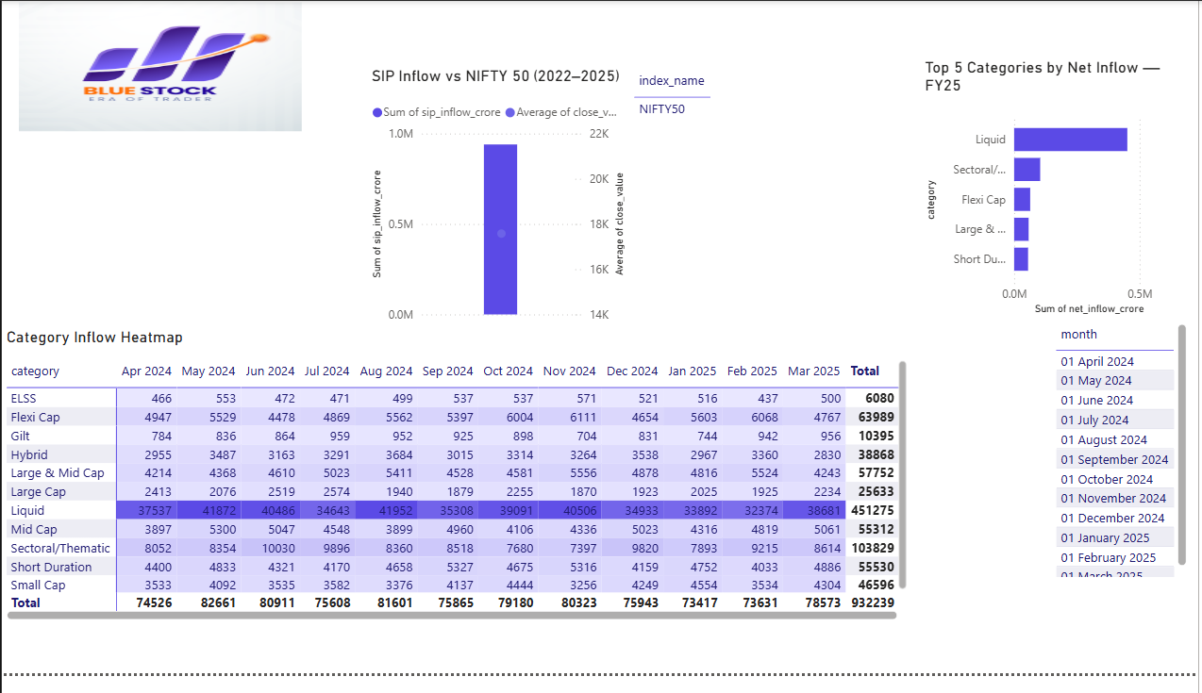
Power BI Reporting Layer
13
Industry Overview
Fund Performance
Investor Analytics
SIP & Market Trends
Four principal dashboard pages provide the interactive presentation layer; underlying metrics remain traceable to the supplied CSVs and notebooks.
14

Slide 15
Key Findings
14
01
SIP expansion
04
Risk-adjusted leadership
₹11,517 cr → ₹31,002 cr
Sharpe 7.68
169.2% growth in monthly SIP inflow.
ICICI Pru Liquid — Regular leads Sharpe.
02
Folio expansion
05
Tail risk
13.26 cr → 26.12 cr
−52.57%
97.0% growth in total folios.
Largest detailed drawdown: SBI Small Cap — Direct.
03
Return leadership
06
SIP continuity
23.39%
97.80% at-risk
SBI Small Cap — Regular leads 3-year return.
1,332 of 1,362 eligible investors.
15

Slide 16
Insights, Recommendations & Future Scope
15
1
Strengthen SIP continuity monitoring
4
Use benchmark-relative measures
Use the >35-day average-gap rule as a retention watchlist.
Track alpha, beta and tracking error with absolute returns.
2
Separate return and risk leadership
5
Segment investor engagement
Combine return, Sharpe/Sortino, alpha and drawdown.
Use age, city tier, state and payment mode descriptively.
3
Monitor concentration
6
Preserve pipeline traceability
Use HHI with sector weights, especially where drawdown is high.
Maintain ingestion → cleaning → validation → SQLite → analytics → Power BI.
FUTURE SCOPE
Predictive churn modelling • rolling downside monitoring • joint concentration/drawdown analysis • automated dashboard refresh
16

Slide 17
Conclusion
The supplied project shows strong market expansion alongside heterogeneous fund-level performance. The most useful decision lens is not a single ranking: return, risk-adjusted performance, downside risk, benchmark-relative measures and portfolio concentration should be considered together.
MARKET
SCHEMES
INVESTORS
Growth
Divergence
Retention
SIP inflows and folios expanded materially.
Return leaders differ from risk-adjusted leaders.
SIP continuity is the clearest engagement opportunity.
Limitations: different observation windows, notebook-defined methodology, SIP continuity eligibility rules, and a simple Sharpe-based recommender. Findings are limited to the supplied project ZIP.
Thank you • Questions & Discussion

