Slide 1
FIREWALL
By -- KHUSH DASSANI (1NT18CS074)
SAILESH PANDEY (1NT18CS201)
B

Slide 2

What is Firewall?
A firewall is a system that provides network security by filtering incoming and outgoing network traffic based on a set of user-defined rules.
It reduces or eliminates the occurrence of unwanted network communications while allowing all legitimate communication to flow freely.
It acts as barrier between a trusted network and an untrusted network i.e. the internet.

Slide 3
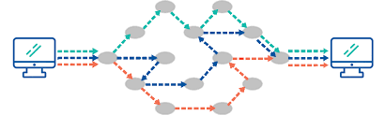
How does firewall work?
Networking uses TCP/IP protocol for communication.
In these protocol, communication takes places in blocks of data called packets.
The protocol specifies how data is packetized, addressed, transmitted, routed and received.
Packets consists of two parts: Control information and Sequence Information (data)
Control information is very useful for firewall implementation.

Slide 4
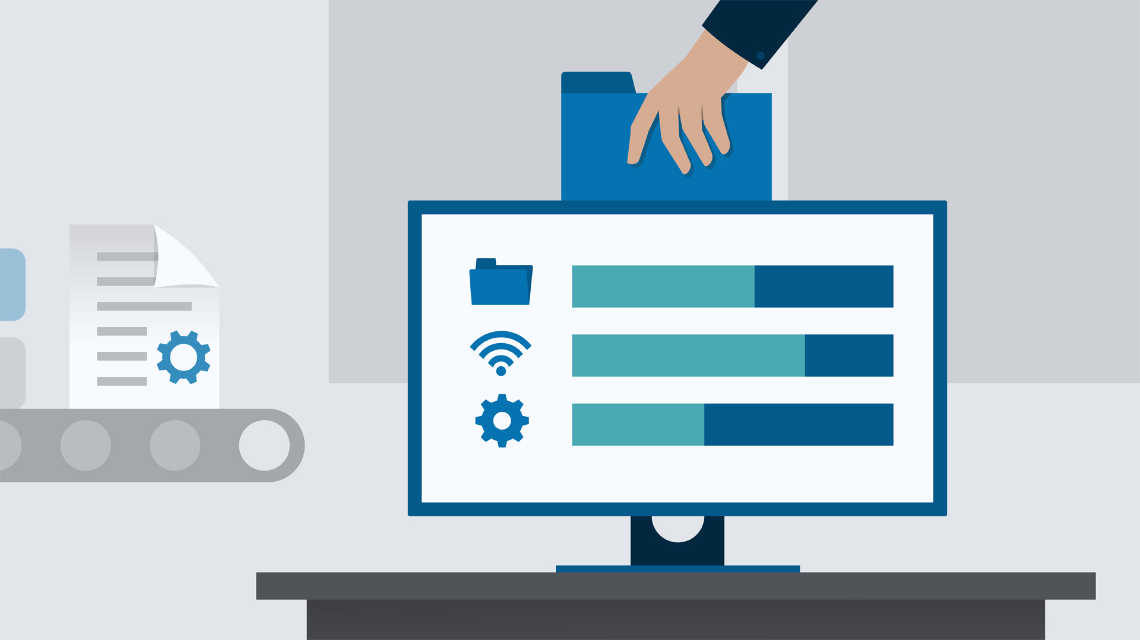
Types of firewall
HOST-BASED FIREWALLS
They are installed on each network node which controls incoming and outgoing packets.
It is a software suite of applications that comes as a part of the operating system itself.
They are used to provide security in a trusted network.
Host firewall protects each host from attacks and unauthorized access.
E.G : Windows defender firewall

Slide 5
Cont..
NETWORK FIREWALLS
They function on network level.
These firewalls filter all incoming and outgoing traffic across the network.
These firewall might have two or more network interface cards (NICs).
These firewall is usually a dedicated system with proprietary software installed.

Slide 6
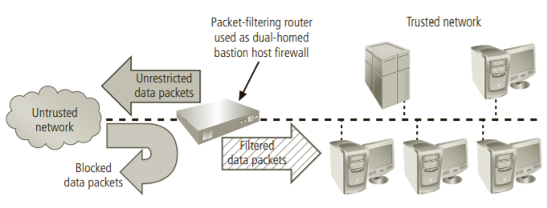
Generations of firewall
PACKET FILTERING FIREWALL
Packet filtering, or stateless, firewalls work by inspecting individual packets in isolation.
Packet filtering firewalls are implemented at the IP layers of the TCP/IP protocol suite.
These firewall matches the data packets against a list or sequence of firewall determines whether to deny (drop) a packet or allow (forward) it to the next network connection.
If the device finds a packet that matches a restriction, it stops the packet from traveling from one network to another.

Slide 7
Cont..
APPLICATION FIREWALL
These firewall use a series of configured policies to determine whether to block or allow communications to or from an app.
It is implemented in conjunction with the firewall router.
Active app firewalls actively inspect all incoming requests
Also called proxy servers that can run a software which acts as a proxy for a service requests.
The servers are also known as cache servers as they can store information about the most visited pages.

Slide 8
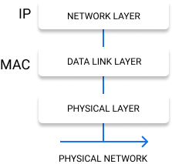
Cont..
MEDIA ACCESS CONTROL FIREWALL
It makes filtering decisions based on the specific host computer’s identity MAC address.
Computers are identified on the network based on the IP address(network) and the MAC address(data link).
All machines on a network will listen for packets that have their MAC address in the destination field of the packet
The Physical Layer understands the electrical signals on the network and creates the frame which gets passed to the Datalink layer.

Slide 9
Cont..
HYBRID FIREWALLS
Hybrid firewall combine the elements of other types of firewalls
A hybrid firewall system may consist of two separate firewall devices; each is a separate firewall system, but they are connected so that they work in tandem.
They are mostly used to protect a user servers and workstations from malicious attacks.
Also known as next gen firewalls.
Ex: A mixture of packet filtering firewall with application firewall.

Slide 10
Firewall Architectures
DUAL HOMED HOST ARCHITECTURE
Dual homed architecture is a combination of two single bastion hosts.
Single bastion hosts are packet filtering routers or are firewalls placed behind routers that are not configured for packet filtering
In order to increase depth, single bastion hosts are placed behind the external network as well as the internal network
One major disadvantage of this setting is that an attacker can gain info about internal configuration and provide it to the external network.

Slide 11
Cont..
SCREENED HOST ARCHITECTURE
Here a packet filtering router is combined with a application level firewall.
These architecture allows packets to move from the Internet to the internal networks
It is less secure than dual homed host architecture.
So the single bastion host of this setting should be thoroughly secured.
One advantage of this setting is that it allows the router to predetermine the data packets and hence it helps in load balancing.

Slide 12
Cont..
SCREENED SUBNET HOST ARCHITECTURE
A common arrangement is a subnet firewall that consists of two or more internal bastion hosts behind a packet-filtering router, with each host protecting the trusted network.
In other words it is combination of dual homed architecture and screened hot architecture .
Here each architecture performs a specific task providing great flexibility.

Slide 13
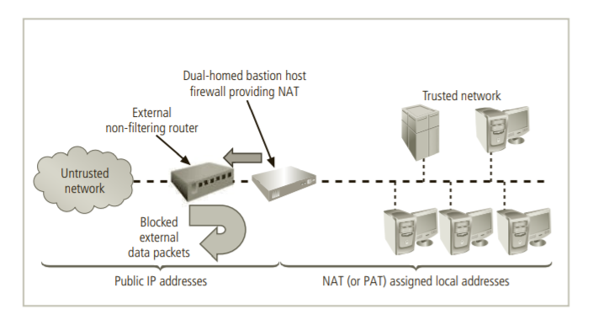
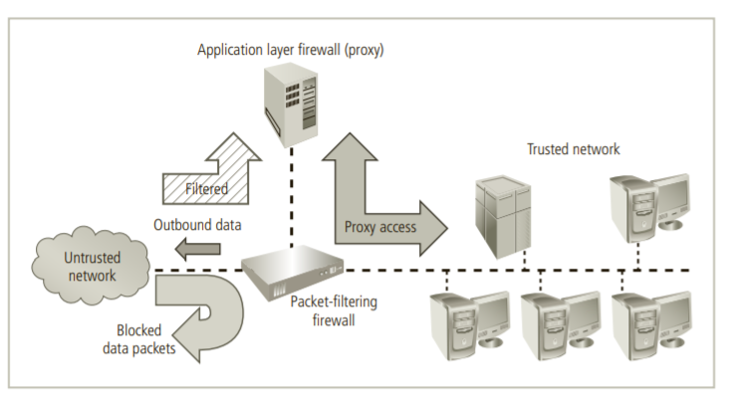
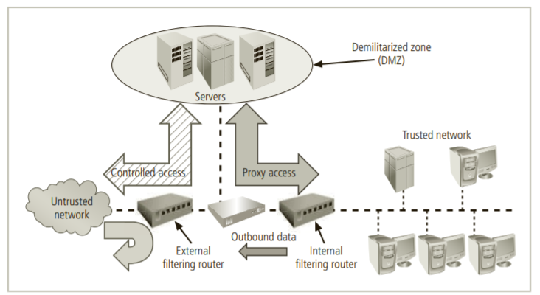
Diagrams
DUAL HOST
SCREENED HOST
SCREENED SUBNET

Slide 14
Firewall Rules
The incoming TCP packets requires the receiver to send outgoing acknowledgment packets back to the sender.
The combination of the control information in the incoming and outgoing packets can be used to determine the connection state.
A firewall is a network security device, either hardware or software-based, which monitors all incoming and outgoing traffic and based on a defined set of security rules it accepts, rejects or drops that specific traffic.
Accept : allow the traffic.
Reject : block the traffic but reply with an “unreachable error”.
Drop : block the traffic with no reply.

Slide 15
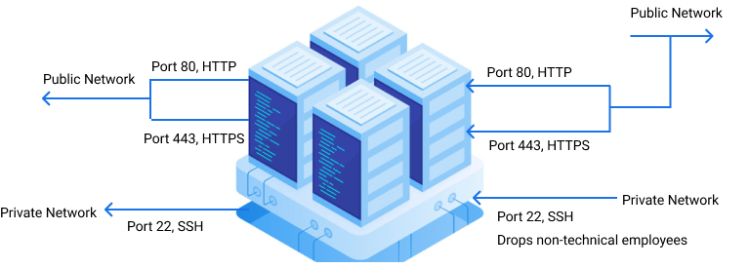
Example

Slide 16
Incoming and Outgoing Traffic
It is typical for a server to allow most outgoing traffic because the server is usually, to itself, trustworthy. Still, the outgoing rule set can be used to prevent unwanted communication in the case that a server is compromised by an attacker or a malicious executable. Keep in mind that the appropriate outgoing rules must be in place so that a server will allow itself to send outgoing acknowledgements to any appropriate incoming connections. Also, as a server typically needs to initiate its own outgoing traffic for various reasons—for example, downloading updates or connecting to a database—it is important to include those cases in your outgoing rule set as well. Suppose our example firewall is set to drop outgoing traffic by default. This means our incoming accept rules would be useless without complementary outgoing rules.

Slide 17
Default policies
Notice that we cannot take care of each and every to not explicitly cover every possible condition.
For this reason, firewall chains must always have a default policy specified, which consists only of an action (accept, reject, or drop).

Slide 18
Conclusion
Whenever you put your website to the internet, you need to make sure that you ensure safety to your network. Based on your needs you can go with any type of architecture. But configuring firewalls is not an easy task. So an alternative approach is cloud where you just tag the applications running on a network with a firewall rule. This also reduces costs as it eliminates the cost of purchasing physical servers. While using cloud, you simply rent this physical servers.

Slide 19
References
http://www.firewall.cx/networking-topics/general-networking/105-mac-addresses.html
https://docs.microsoft.com/en-us/windows/security/threat-protection/windows-firewall/windows-firewall-with-advanced-security#:~:text=By%20providing%20host%2Dbased%2C%20two,out%20of%20the%20local%20device.
https://www.geeksforgeeks.org/
Principles of Information Security by Michael E. Whitman, and Herbert J. Mattord

