Slide 1
VPN(Virtual Private Network)
By: SAILESH PANDEY(1NT18CS201)
KHUSH DASSANI(1NT18CS074)

Slide 2
COVID-19 and VPN
VPN have been very helpful during this PANDAMIC.
The coronavirus crisis has wrought many changes, not the least of which are
happening in the world of business. With much of the world under shelter in
place quarantines, the number of people working from home has exploded—
and with it the use of enterprise virtual private networks (VPNs).
VPNs are considered the most secure method of enabling employees to
connect with digital company resources when they are out of the office. VPNs allow companies to establish a secure tunnel to the corporate network, which makes company servers and assets available to employees without exposing
them to the public. Work from home is possible only due to availability of VPN services.
1

Slide 3
What is VPN?
Virtual Private Network
A virtual private network (VPN) extends a private network across a public network and enables users to send and receive data across shared or public networks as if their computing devices were directly connected to the private network.
It was not so popular like today, but became popular as more employees worked in remote locations.
VPNs use advanced encryption and ‘tunneling’ technology to establish secure, end-to-end private network connections over Internet.
2

Slide 4
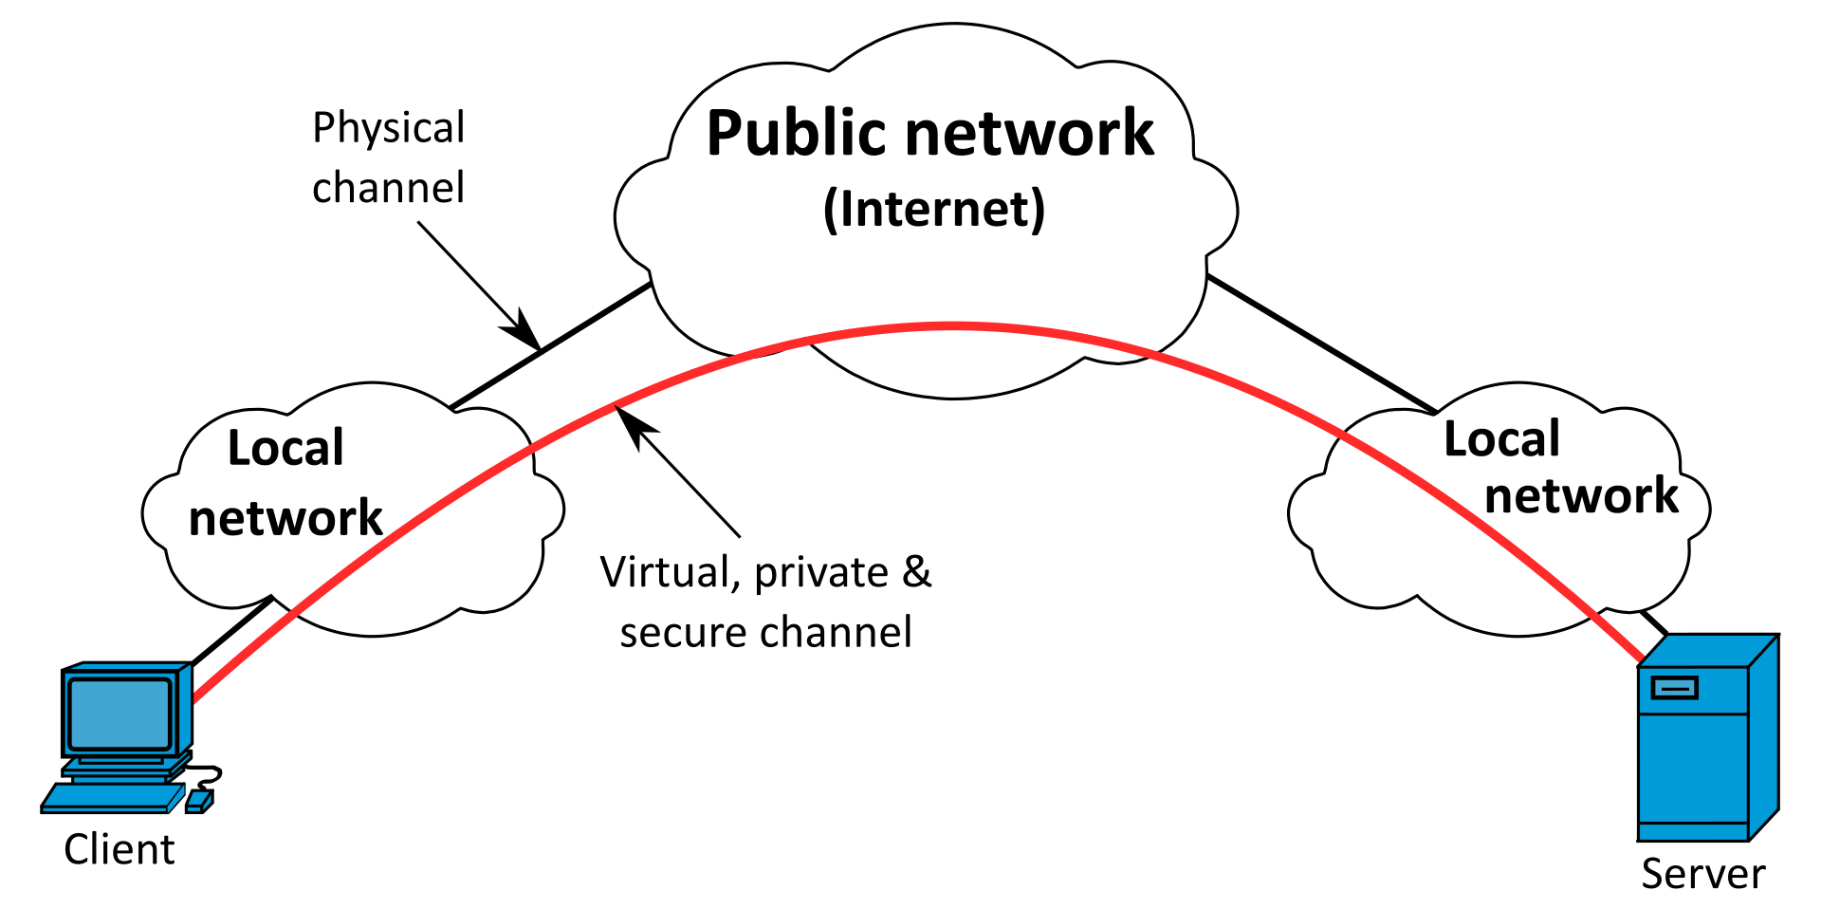
VPN connectivity overview
3

Slide 5
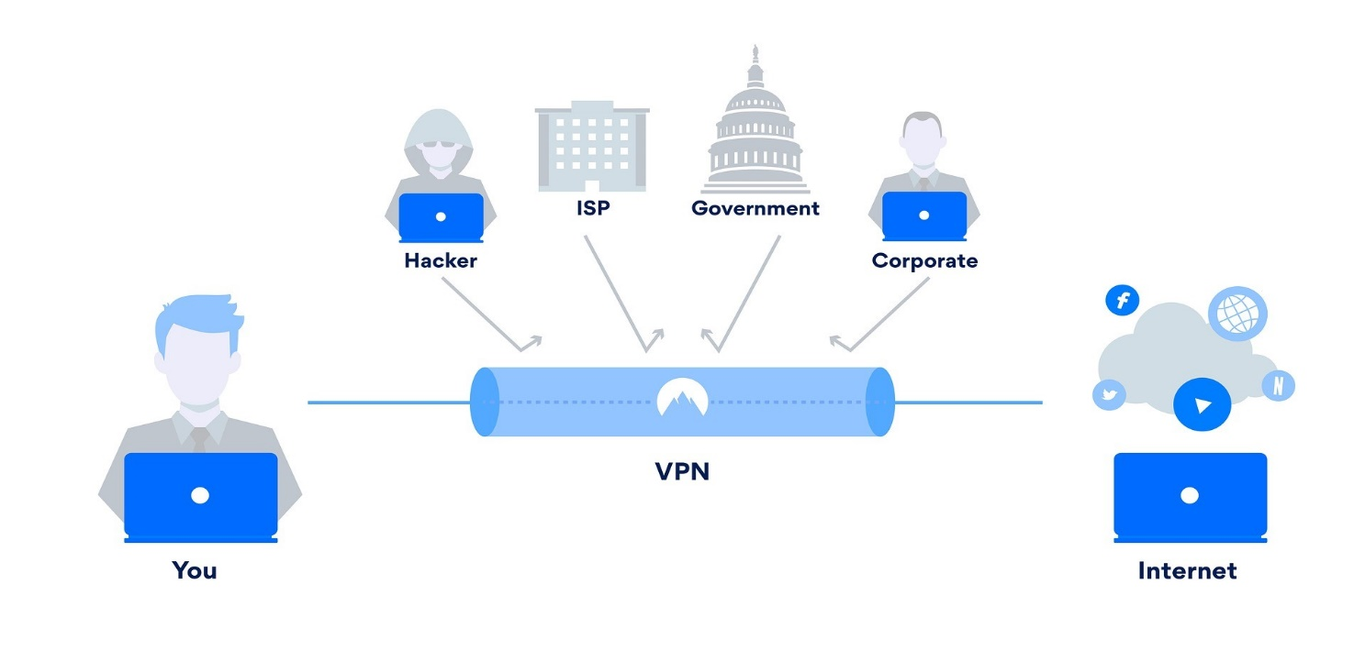
VPN Tunnel
4

Slide 6
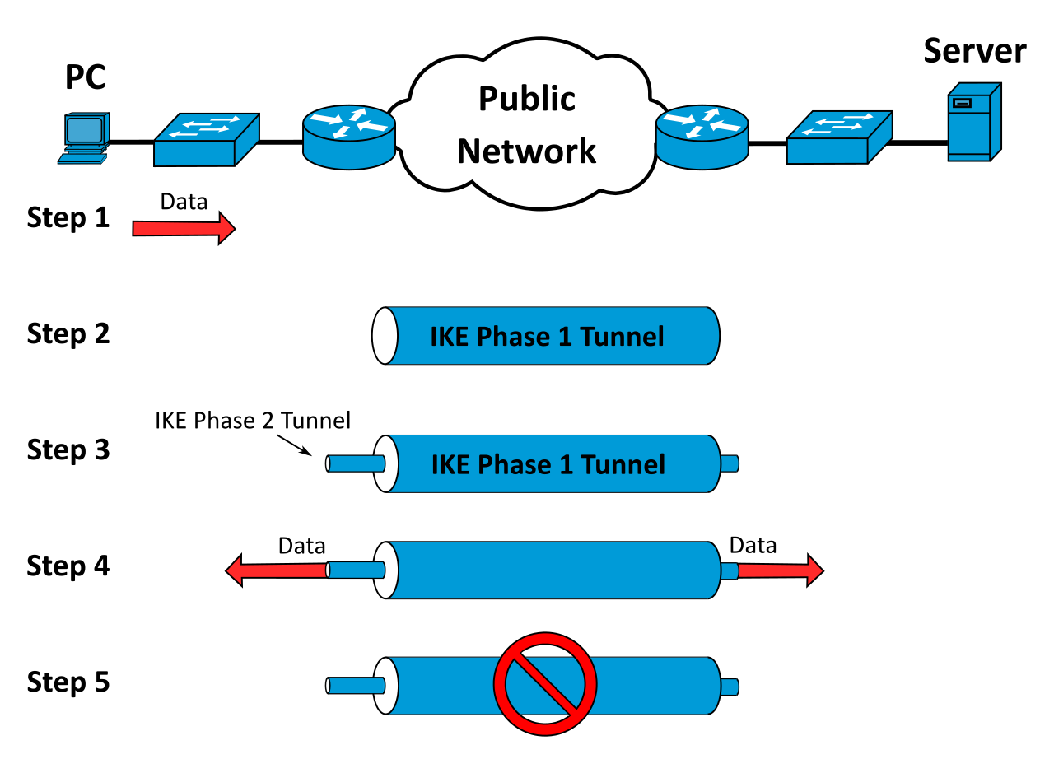
Tunneling
A virtual point-to-point connection
made through a public network. It transports
encapsulated datagrams.
5

Slide 7
VPNs
A VPN – or Virtual Private Network – is a tool that provides private and secure internet access. In short, a VPN masks your IP address by connecting you to a server in a different location/country.
For example, if you’re in India and you connect to a VPN server in the US, your IP address will appear as a US IP. This lets you hide your online activities from prying eyes.
6

Slide 8
VPNs over private networks
Employees can access the network (Intranet) from remote
locations : This means that any network can be accessed by
users from different locations than the place at which the
network is placed. Users need not go the network to access it . They can access it from their own convenient location.
Secured networks : VPN services are more secured .Basically
it uses Two Factor Authentication(it’s a technique where more
than just a username and password are required to authenticate)
7

Slide 9
VPNs over private networks
Saves cost tremendously from reduction of equipment and maintenance costs as it allows access to the network without any additional technology or equipment's like network repeater or wires from the network to the users place.
VPNs extend corporate networks to remote offices, mobile
users, telecommuters and other extranet partners. It can be
useful if something goes wrong with the network and the
system administrator is really far from your area . For this
problem the sys administrator can works from his own location to solve the problem using VPN services.
8

Slide 10
How VPNs work?
A virtual private network (VPN) is like a series of virtual connections routed
over the internet which encrypts your data as it travels back and forth between your client machine and the internet resources you're using, such as web
servers. Many internet protocols have built-in encryption, such as HTTPS,
SSH, NNTPS, and LDAPS. So assuming that everything involved is working
properly, if you use those ports over a VPN connection, your data is encrypted at least twice than the network you use everyday.
9

Slide 11
A VPN connection usually works like this…
Data is transmitted from your client machine to a point in your VPN network. The VPN point encrypts your data and sends it
through the internet. Another point in your VPN network
decrypts your data and sends it to the appropriate internet
resource, such as a web server, an email server, or your
company's intranet. Then the internet resource sends data
back to a point in your VPN network, where it gets encrypted.
That encrypted data is sent through the internet to another
point in your VPN network, which decrypts the data and sends
it back to your client machine.
10

Slide 12
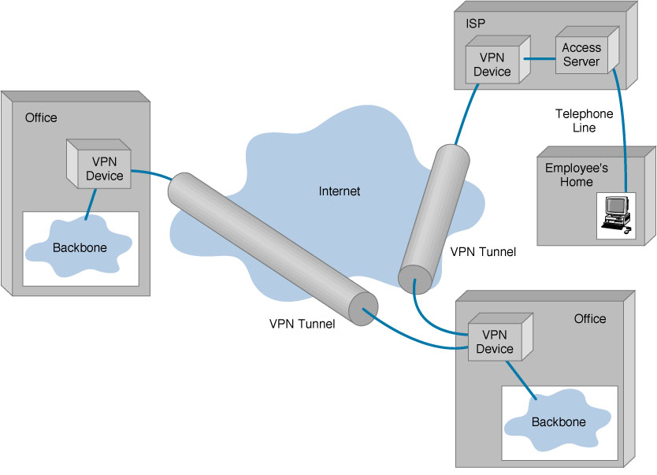
11

Slide 13
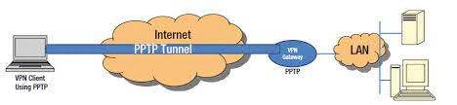
Types of VPN technologies
The technologies that a VPN may use:
Point-to-Point Tunneling Protocol: PPTP has been around
since the mid 1990s, and it's still frequently used. PPTP in and of itself doesn't do encryption. It tunnels data packets and then uses the GRE protocol for encapsulation.
12

Slide 14
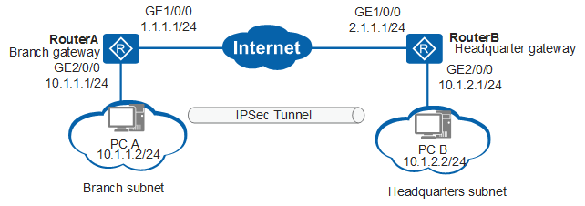
IPSec: You should consider IPSec to be a better alternative to PPTP. IPSec is actually a suite of different protocols and technologies. Packet encapsulation is done through the ESP protocol, and AES-GCM, AES-CBC, 3DES-CBC, or HMAC-SHA1/SHA2 may be used for encryption.
13

Slide 15
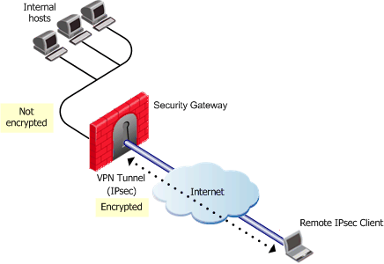
Layer 2 Tunneling Protocol: L2TP can be used for tunneling with IPSec for added security.
14

Slide 16
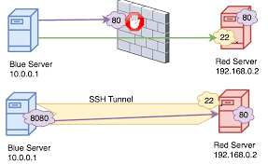
SSH : can be used to handle both the tunneling and encryption in a VPN network.
15

Slide 17
EVERYTHING IS HACKABLE.
VPNS are very secure to use and almost all the countries of
the world have instructed their users and service providers to
use VPNs in order to browse safely and stay secure on the
internet.
There is no doubt that ISP work hard to keep the network safe. But they cant keep it secure. Using VPN means double safety . Your ISP and your VPN make their own layers of encryption to secure your data.
“CEOs need to know that everything is hackable,” cyber
security expert Theresa Payton, who served as federal chief
information officer for two years under President George W.
Bush once told to a group of business owners.
16

Slide 18
VPN Blocking
VPN blocking is a technique used to block the encrypted
protocol tunneling communications methods used by virtual
private network (VPN) systems .It is used by large
organizations such as national governments or corporations.
Some countries and organizations have banned the use of
VPNs for their users while others have registered the VPNs under their provision .
NOTE : Registered VPNs are a security threat because they
may leak your browsing activity to the government.
17

Slide 19
COUNTRIES THAT HAVE BLOCKED THE USE OF VPNs.
CHINA : In 2017, telecommunications carriers in China
were instructed by the government to block
individuals' use of VPNs by February 2018 .
IRAN : The government of Iran began blocking access to
non-government sanctioned VPNs in March 2013,
a few months prior to their 2013 elections and
registered few VPNs under it.
RUSSIA : VPN usage is banned when attempting to access
sites already blocked by Russia's governing body
for telecommunications and mass media
communications.
18

Slide 20
SYRIA : The government of Syria activated deep packet
Inspection after the uprising in 2011 in order to
block VPN connections.
PAKISTAN : It is legal to use a VPN in Pakistan, but the
government requires all VPN services to be
registered. Unregistered VPNs are blocked.
Also, you can’t access these top online services by the use of VPNs
NETFLIX
HULU
BBC iPlayer
19

Slide 21
References
https://en.wikipedia.org/wiki/Virtual_private_network
https://cybersecurity.att.com/blogs/security-essentials/explain-how-vpn-works
https://usa.kaspersky.com/resource-center/definitions/how-does-vpn-keep-me-safe-online
https://www.wikihow.com/Use-a-VPN
https://www.security.org/vpn/best/
20

Slide 22


