Slide 1
Supplementary
Figures

Slide 2
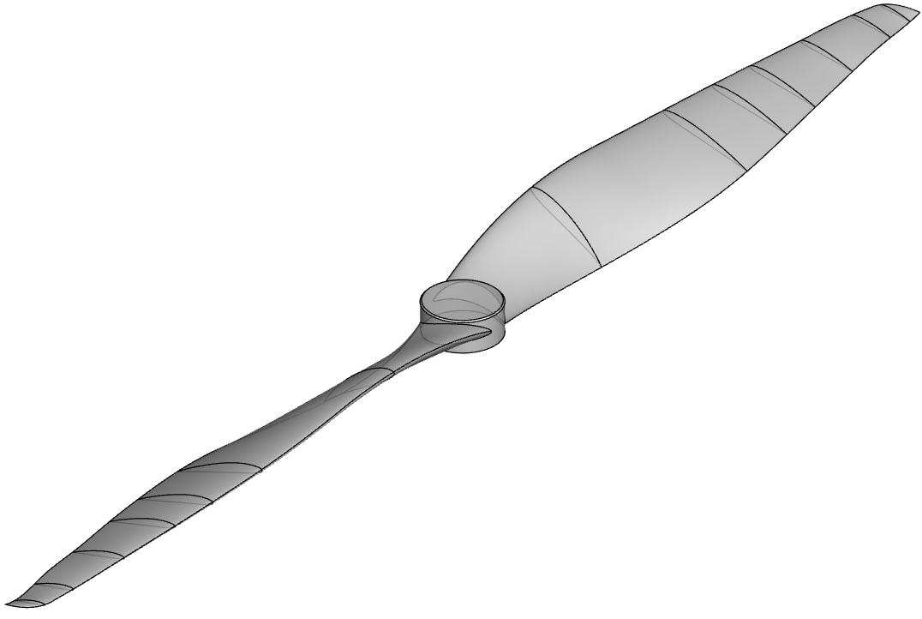
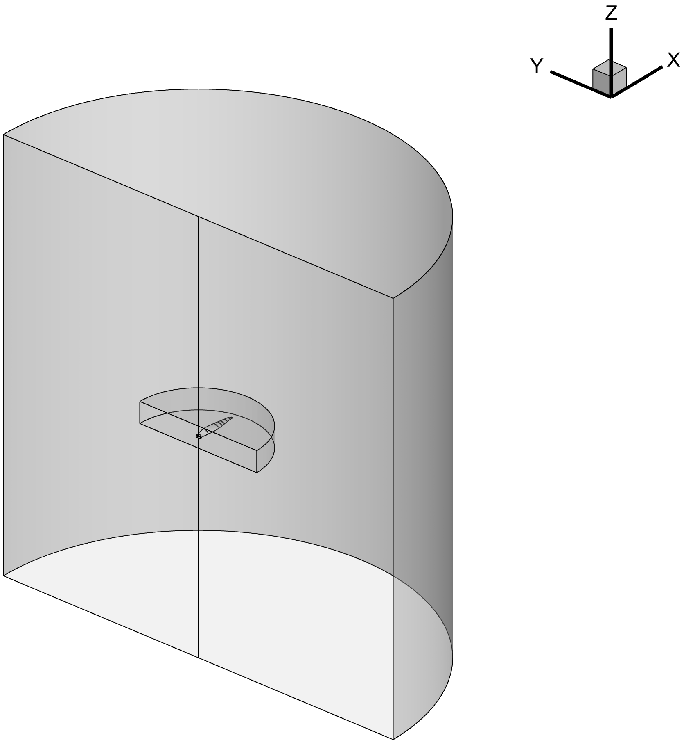
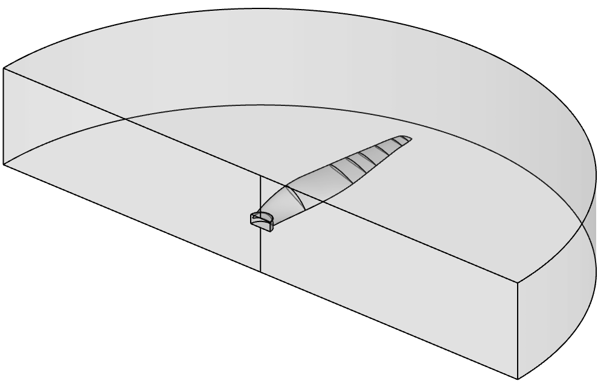
Computational domain
D
10R
Velocity Inlet
Slip Wall
(a)
10R
Periodic Interface
0.5R
3R
Pressure Outlet
(c)
(b)

Slide 3
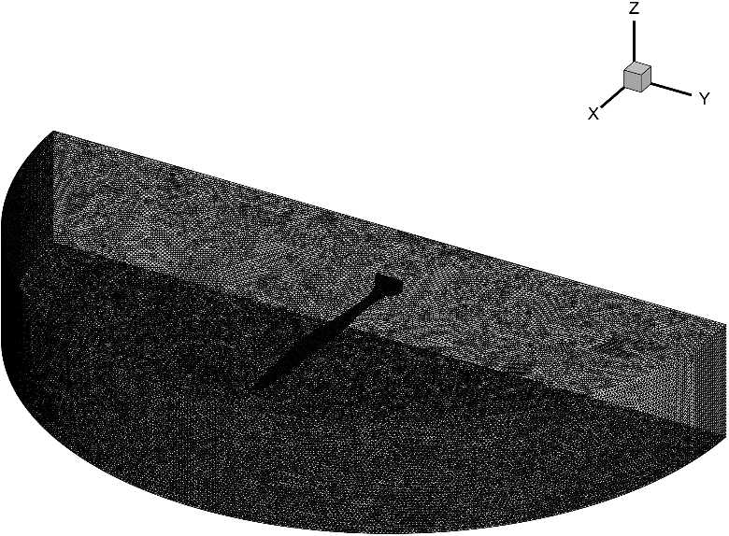
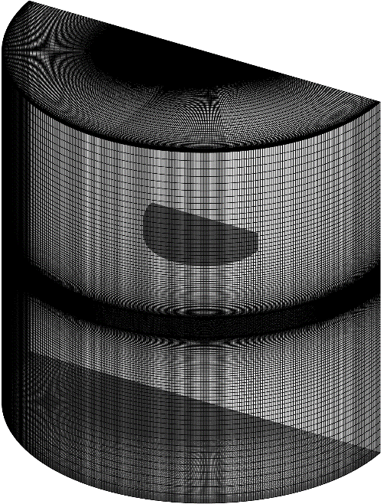
Grids
10R
Velocity Inlet
3R
Slip Wall
10R
0.5R
Pressure Outlet

Slide 4
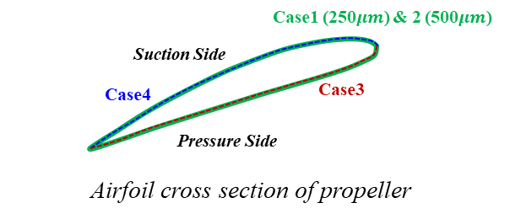
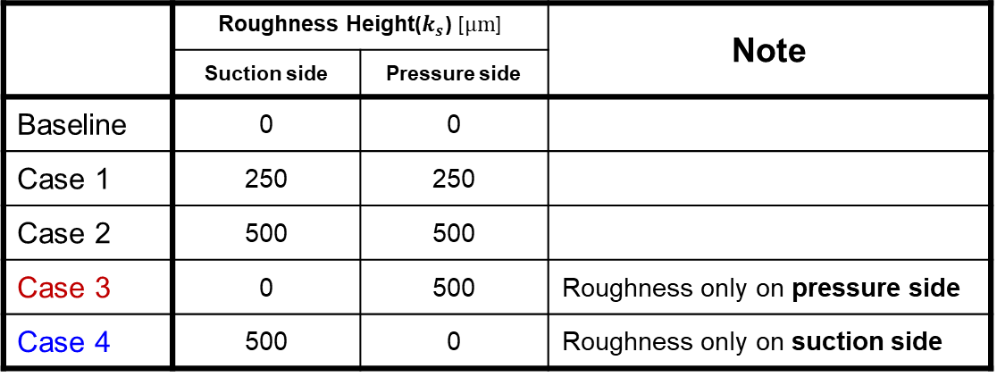
Sensitivity test
Steady | Baseline | Case 1 | Case 2 | Case 3 | Case 4
Thrust [N] | 69.71 | 67.70 | 66.99 | 71.70 | 65.36
Moment [N-m] | 2.96 | 3.06 | 3.01 | 3.09 | 3.00
Efficiency [-] | 58.6 | 55.0 | 55.3 | 57.6 | 54.4
Acoustic Power Level [dB] | 17.1 | 17.2 | 16.9 | 16.5 | 16.3

Slide 5
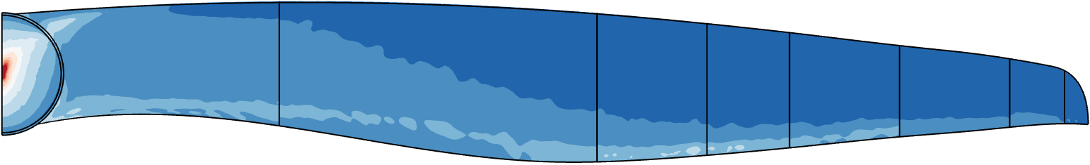
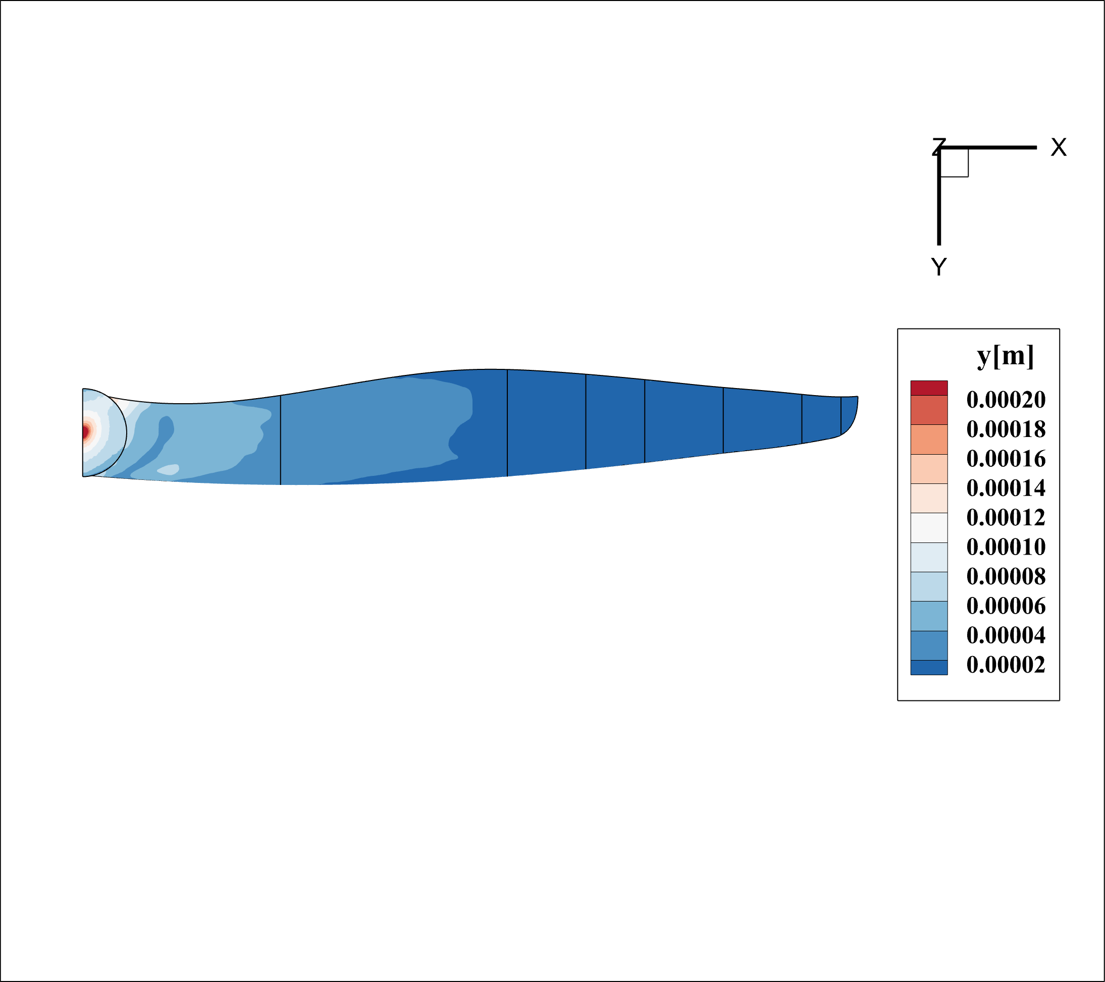
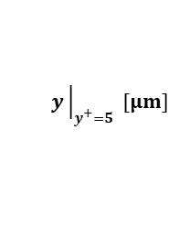
Smooth wall
Suction side
$$y{\left.​\right|}_{y^{+}=5} [μm]$$
200
180
160
140
120
Pressure side
100
80
60
40
20

Slide 6
Sensitivity test results

Slide 7
Sensitivity test results

Slide 8
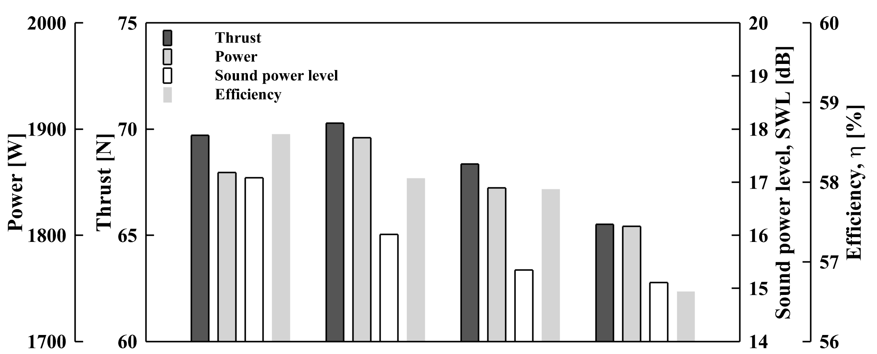




Steady results
Baseline
Opt.1
Opt.2
Opt.3

Slide 9
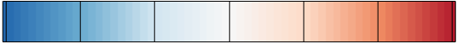
Pressure side pressure contour
Pressure
[Pa]
32
64
128
256
512
1024
2048

Slide 10
Turbulent intensity

Slide 11
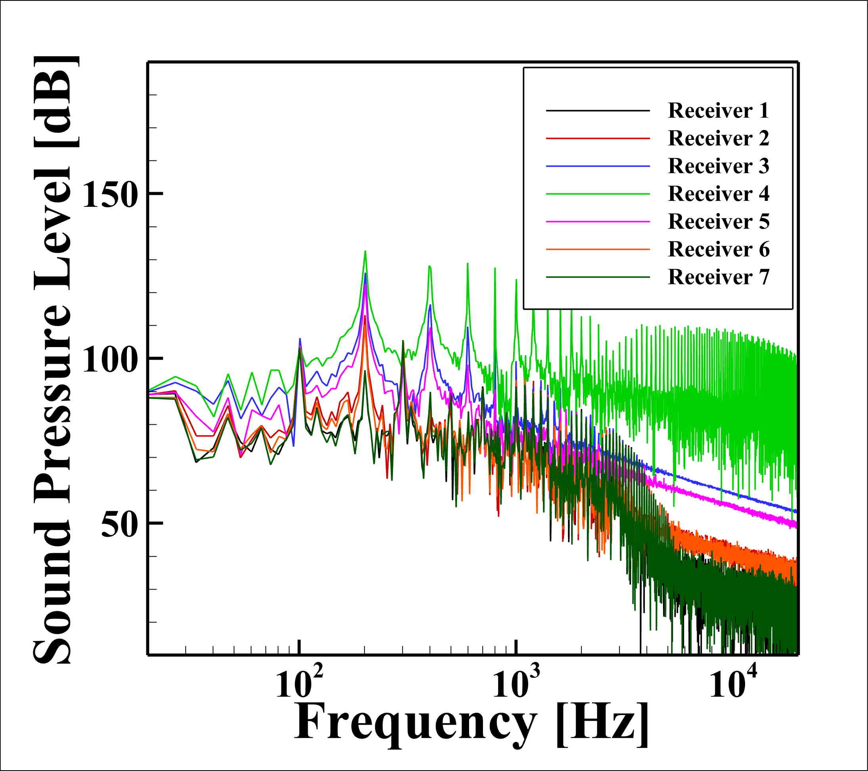
FW-H) Baseline results

Slide 12
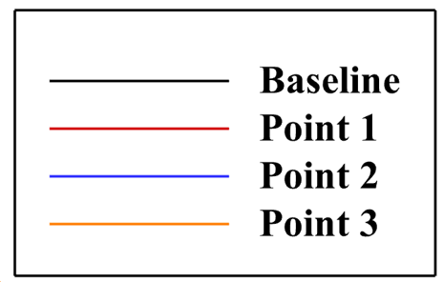
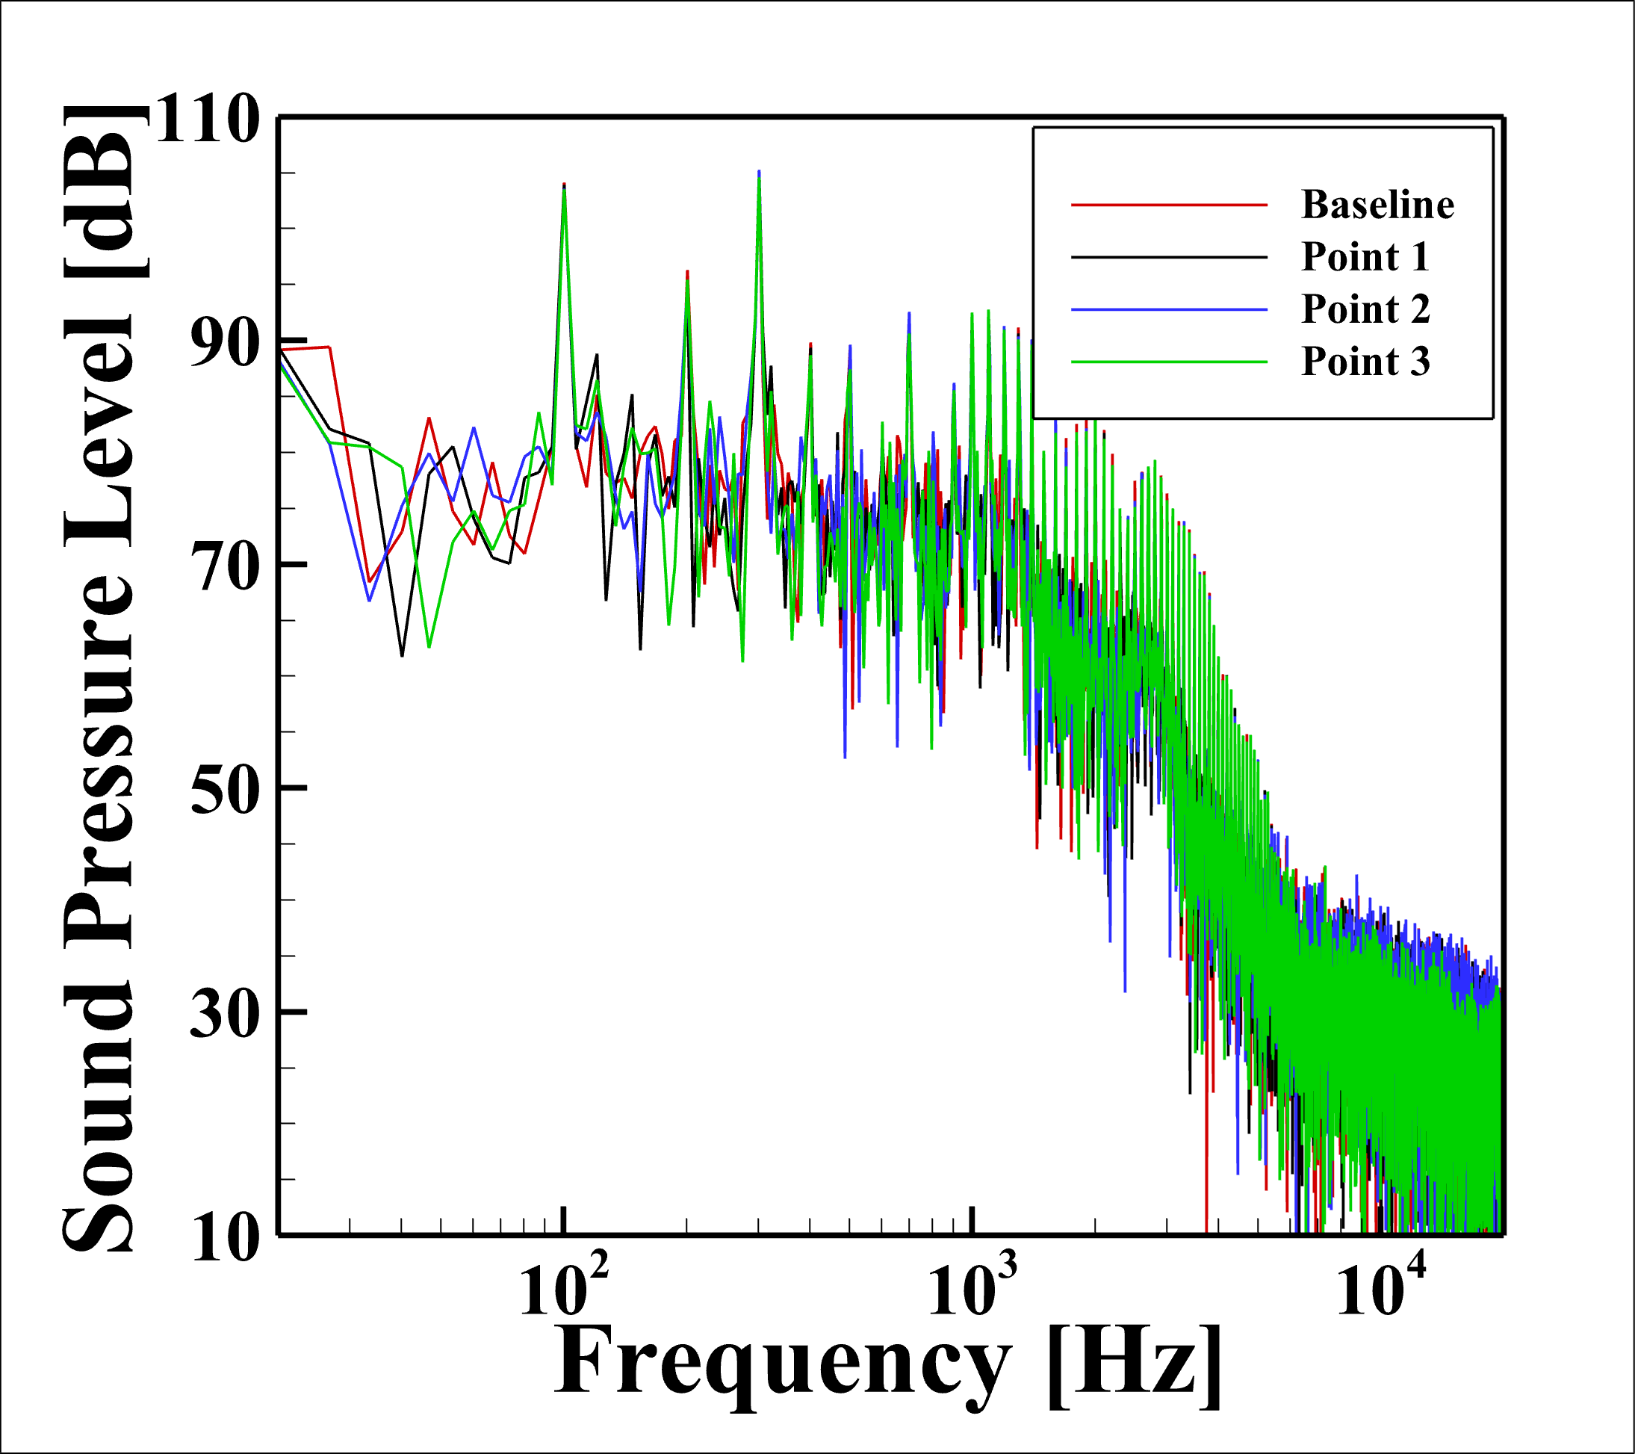
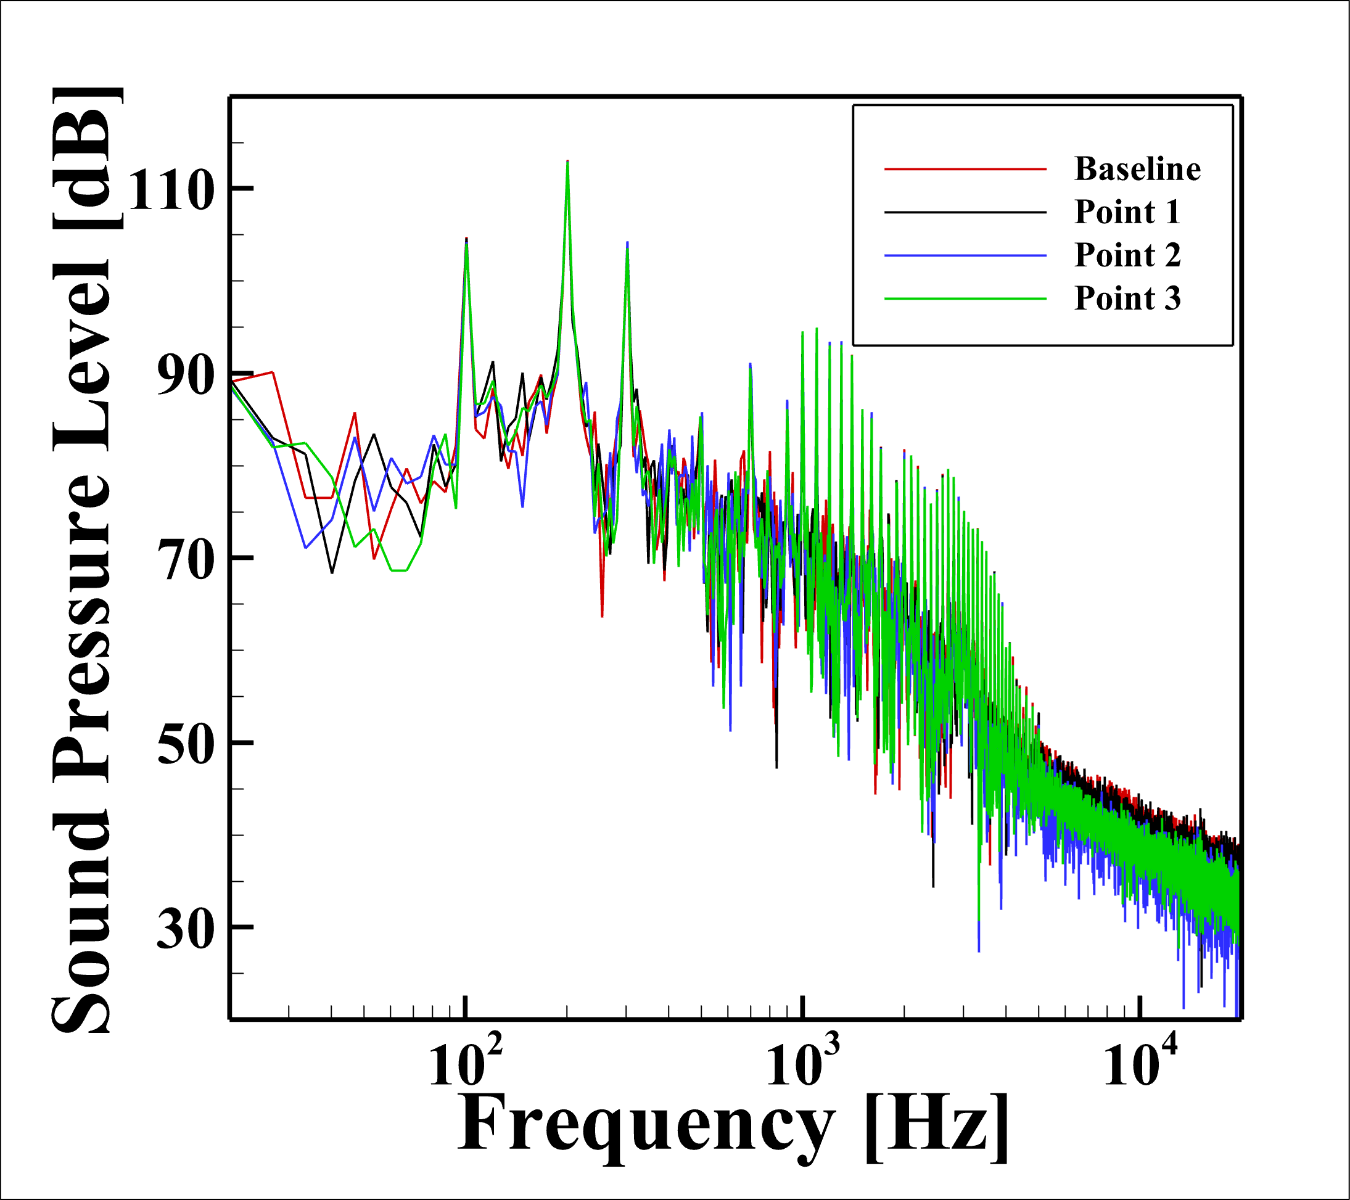
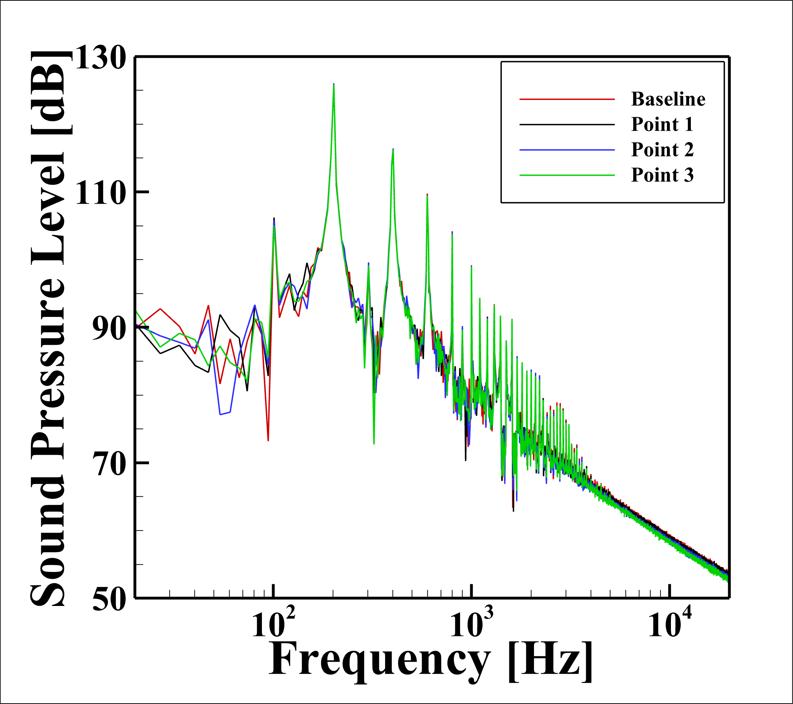
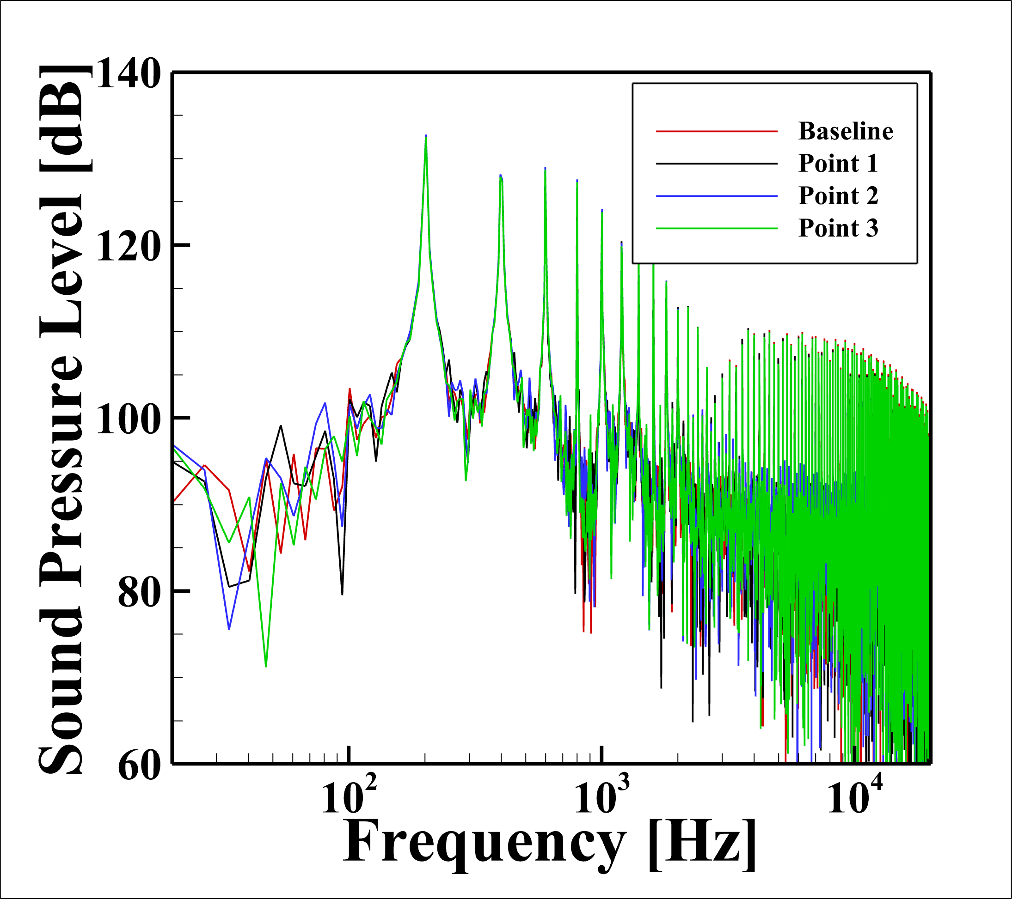
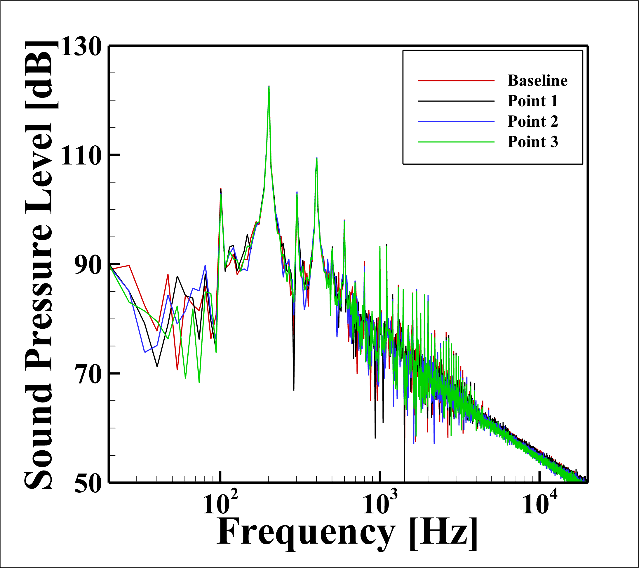
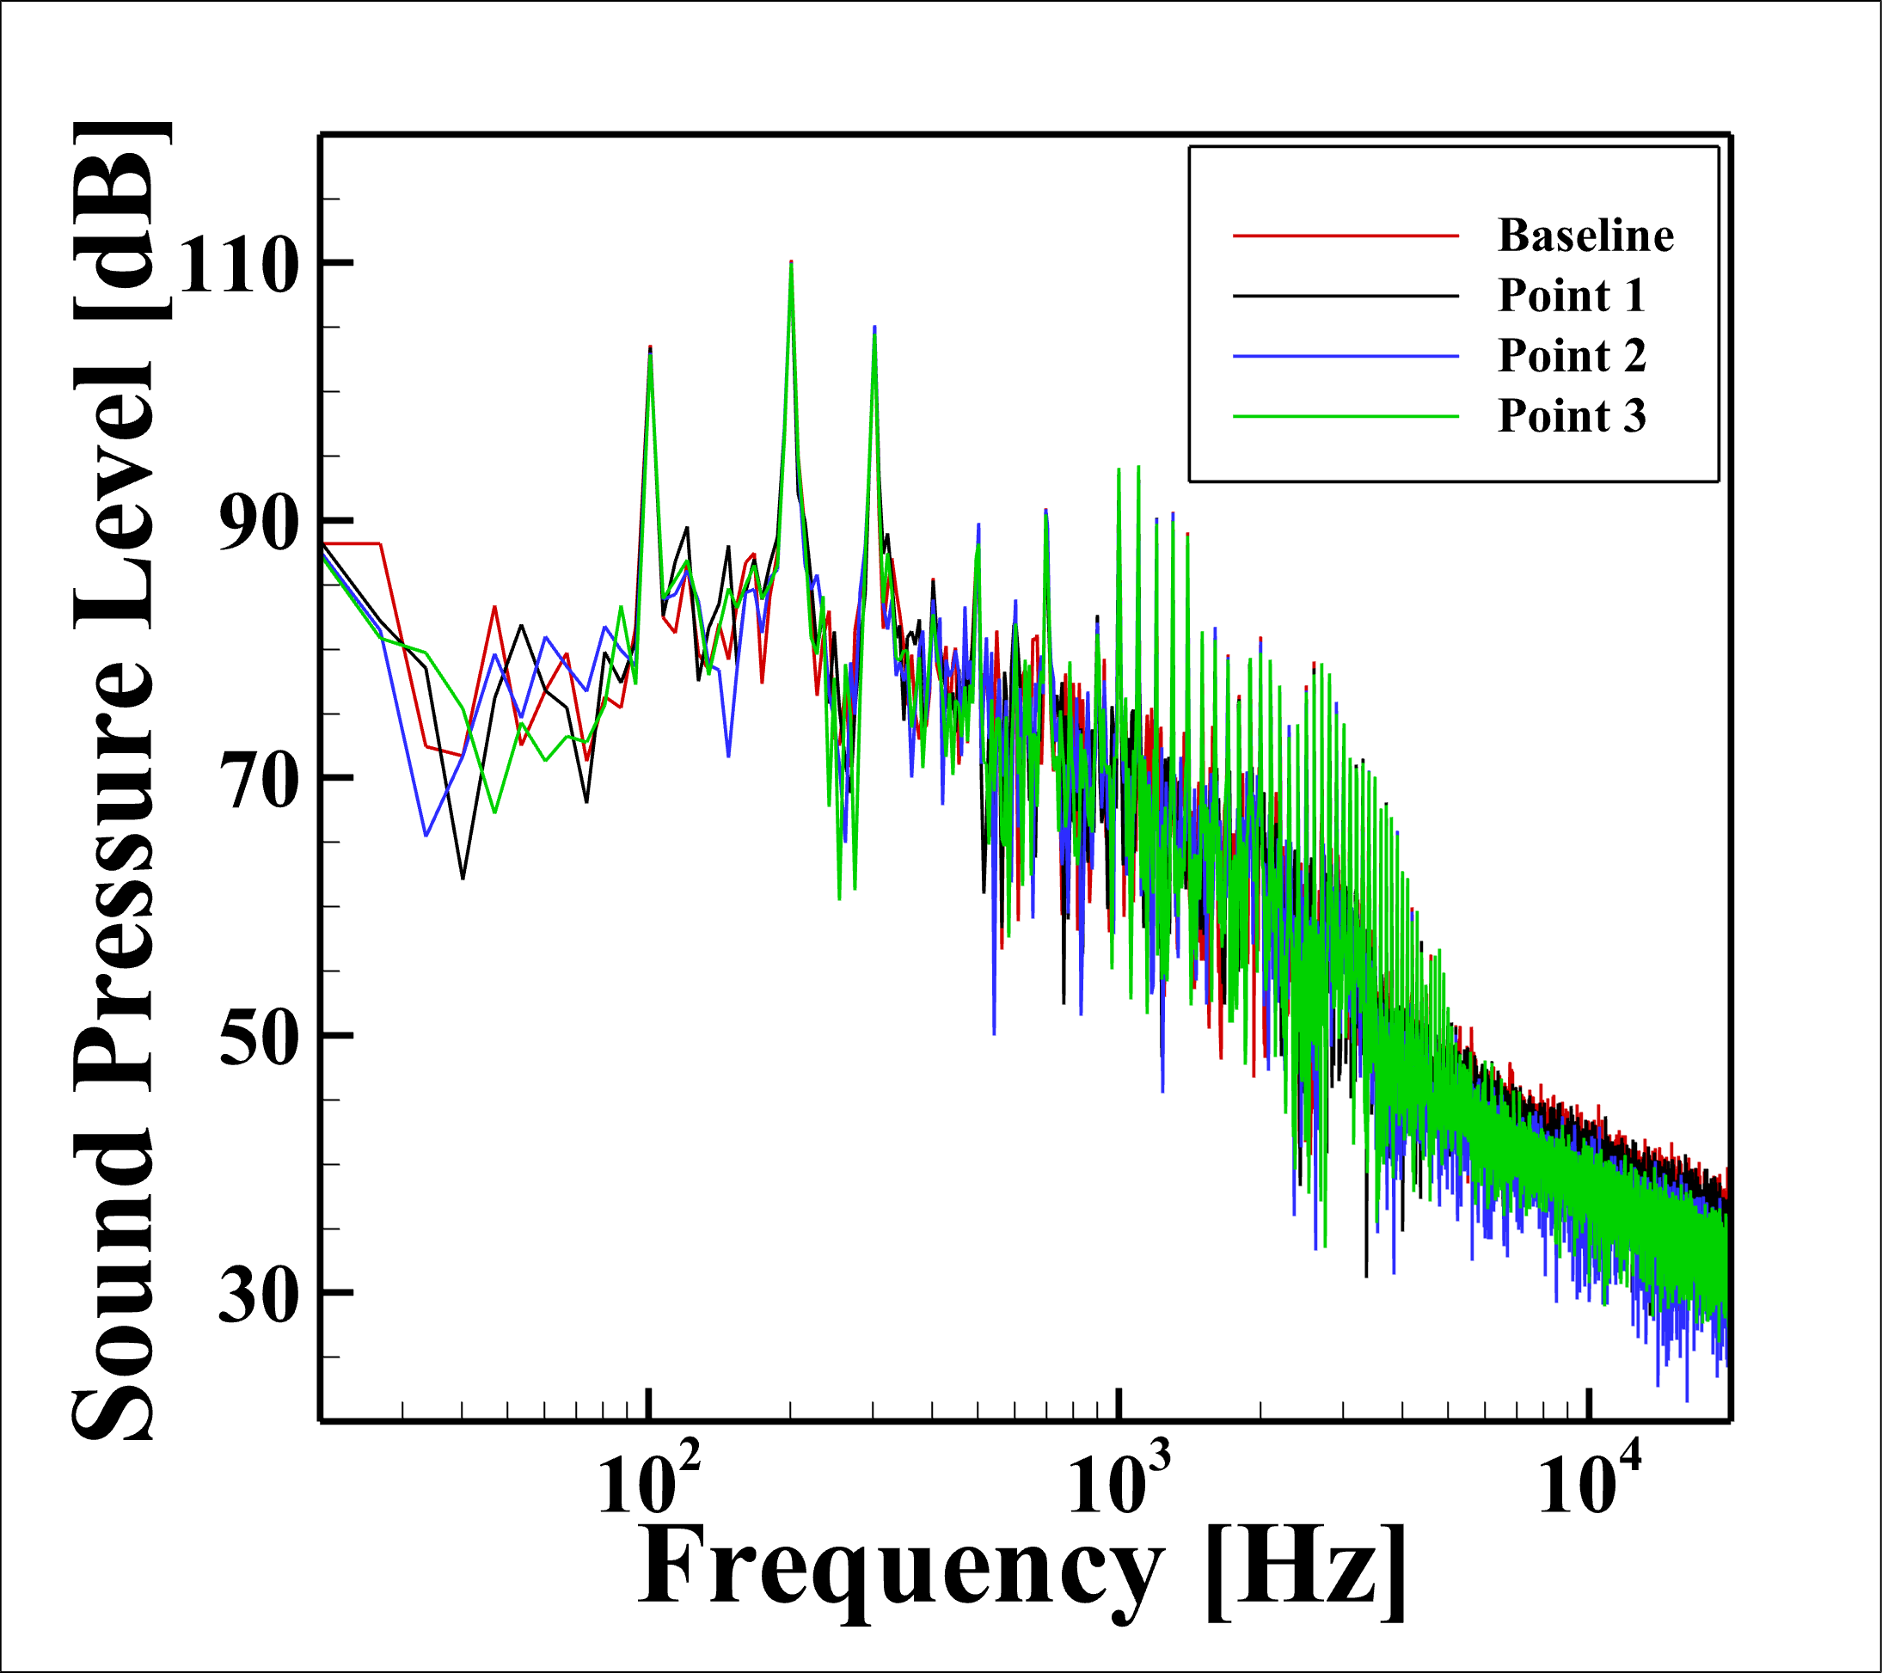

FW-H) Results at 6,000 RPM
Point1 = Opt.1
Point2 = Opt.2
Point3 = Opt.3
Rec.1
Rec.2
Rec.3
Rec.4
Rec.5
Rec.6
Rec.7

Slide 13
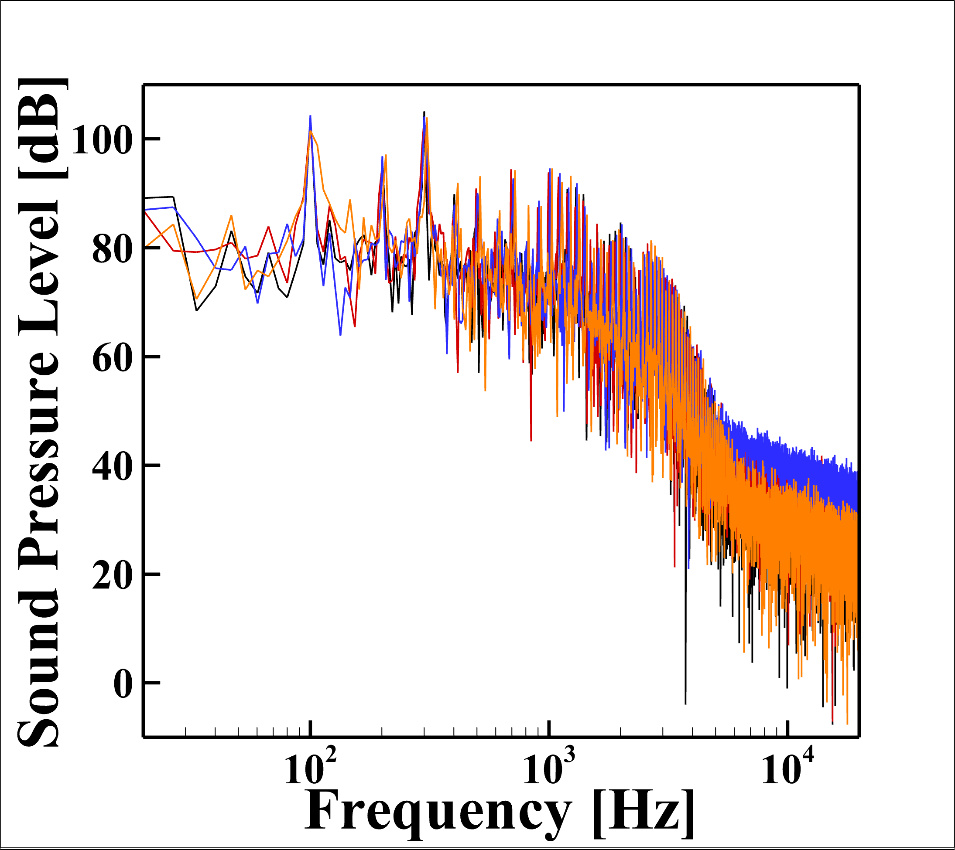
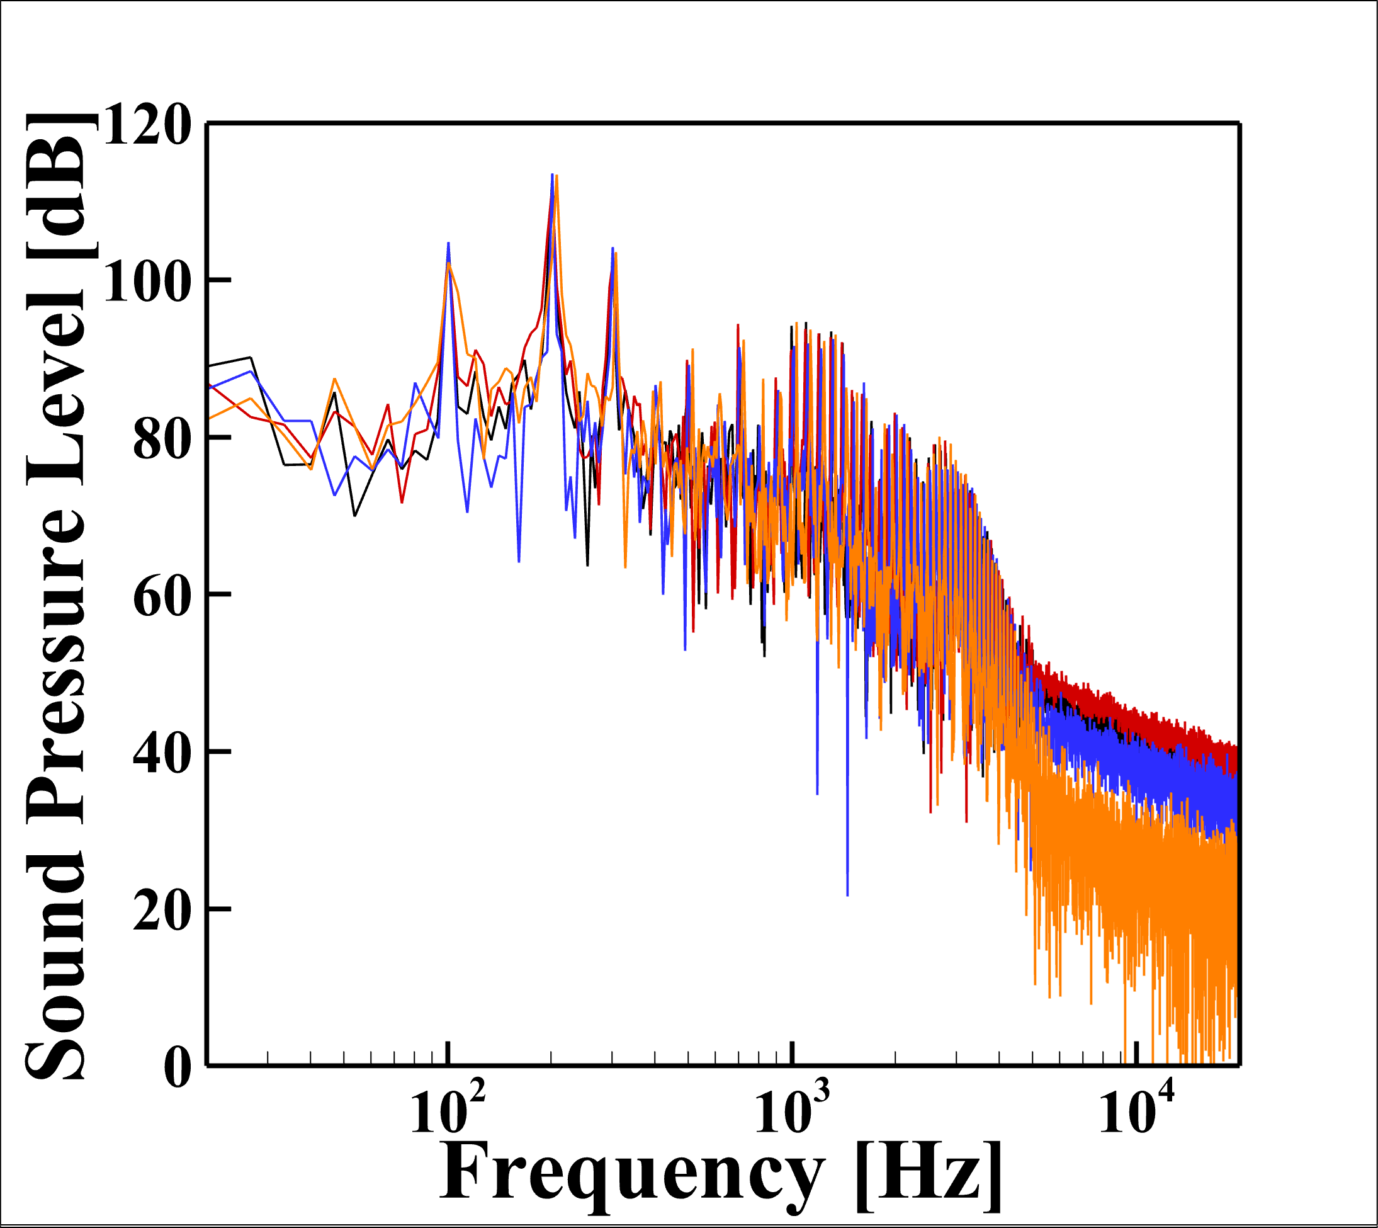
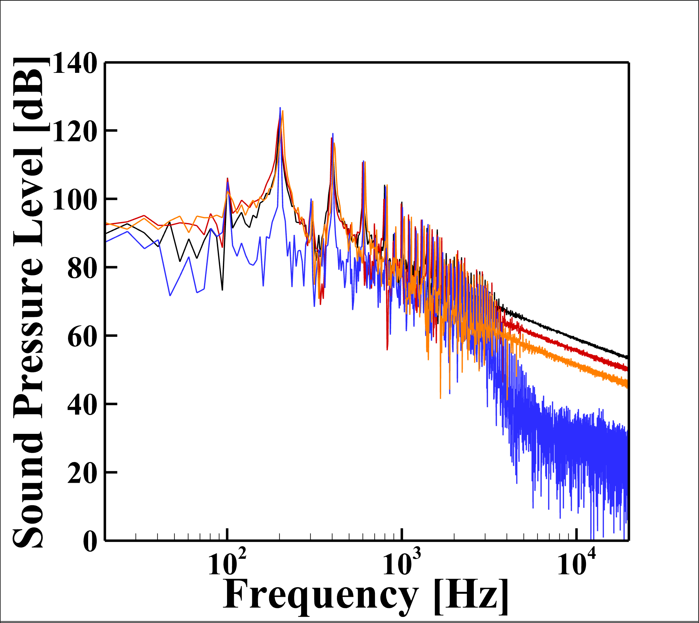
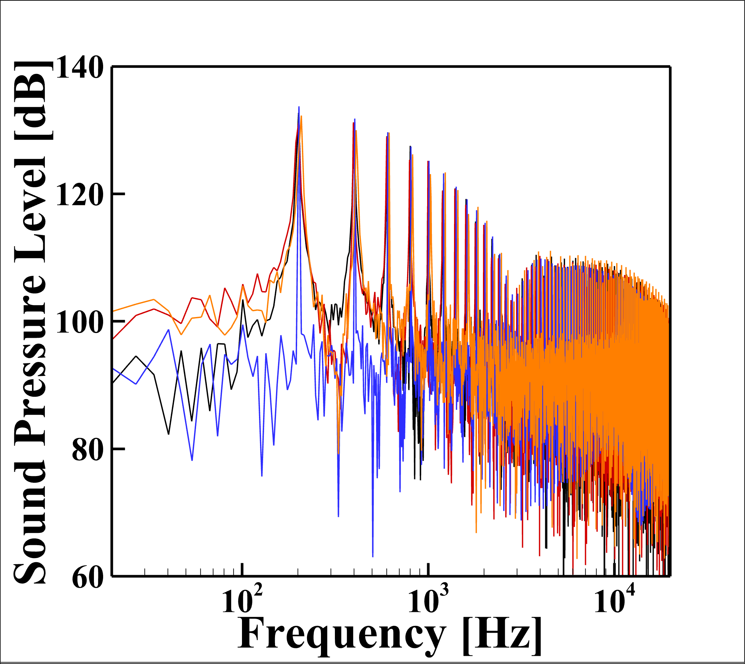
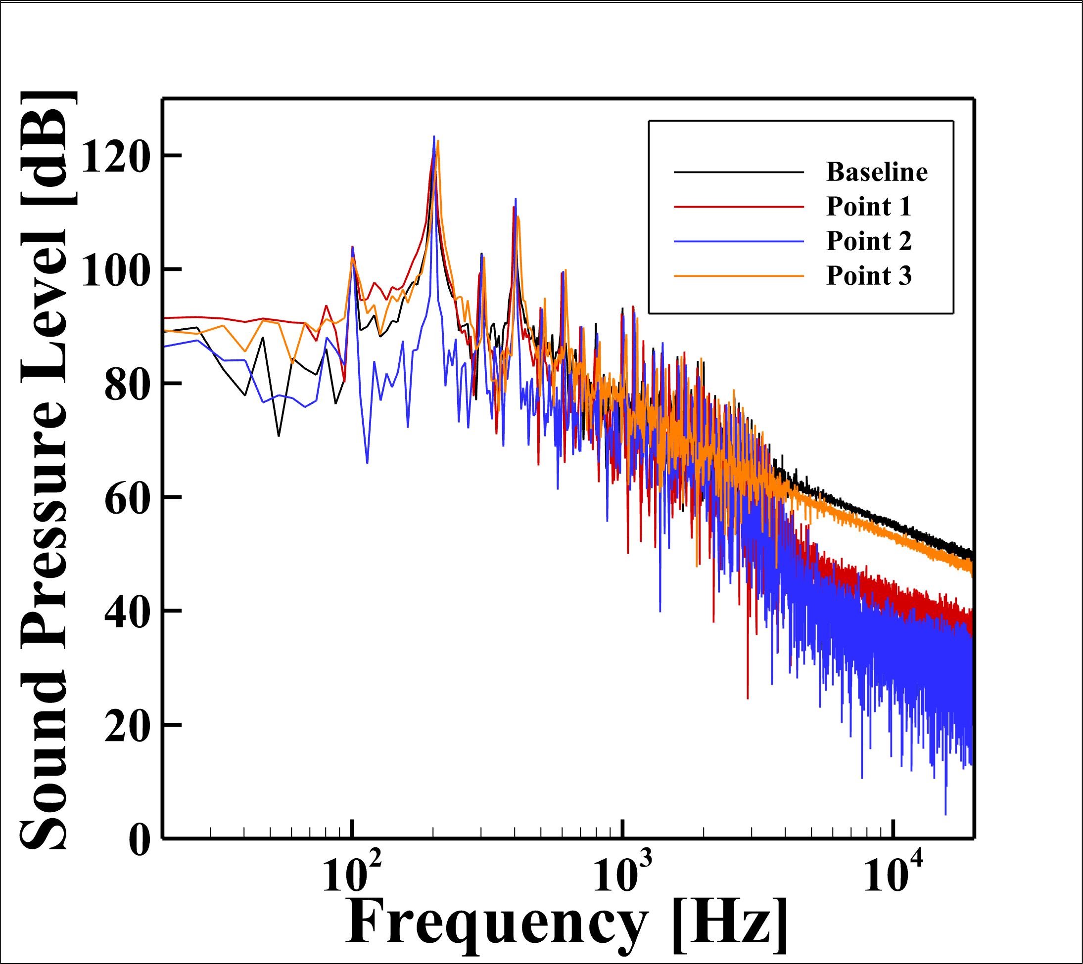
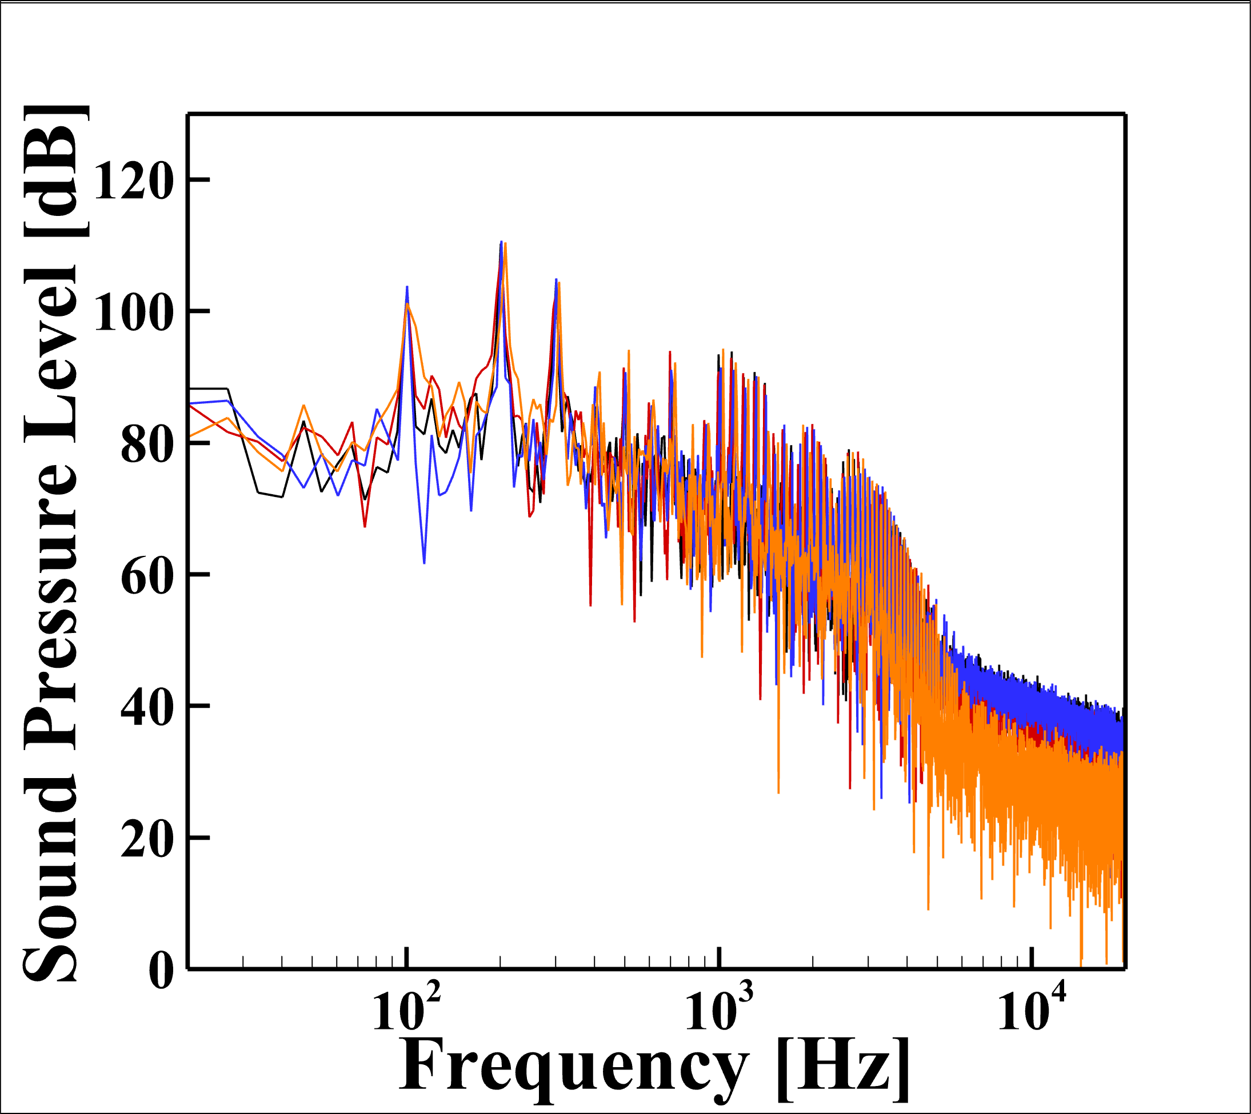
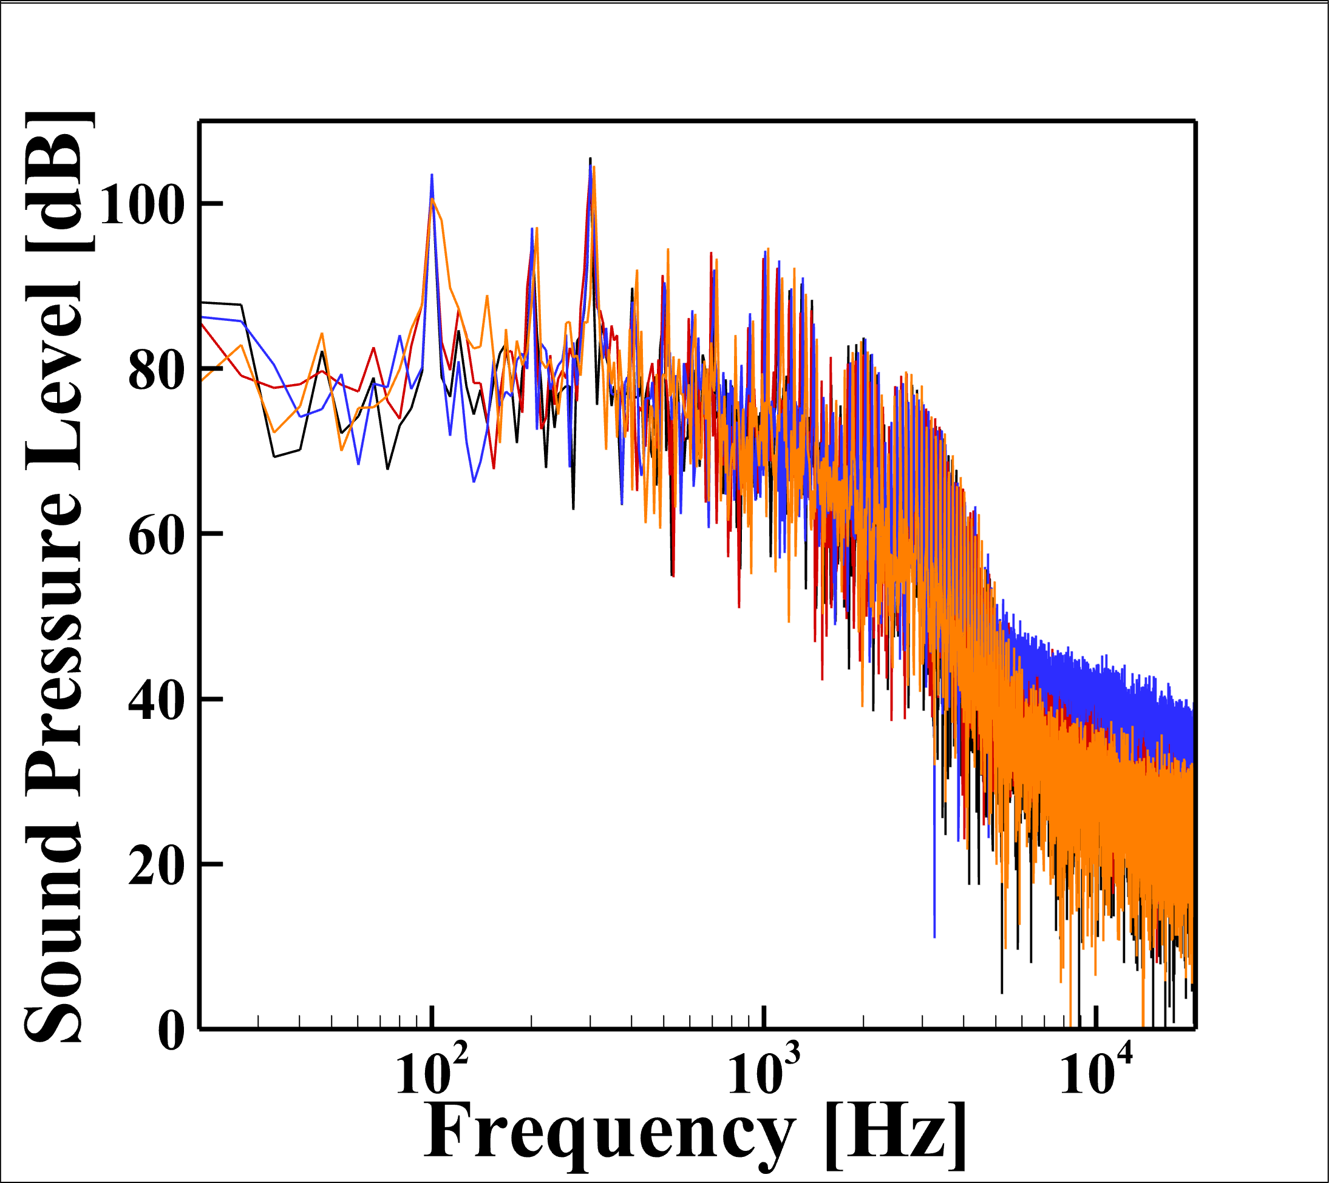
FW-H) Results with ang. vel. revision.
Point1 = Opt.1
Point2 = Opt.2
Point3 = Opt.3
Rec.1
Rec.2
Rec.3
Rec.4
Rec.5
Rec.6
Rec.7

