Slide 1
Analysis of
Instruction Partners survey data
By Sarah (Sophie) Eddy

Slide 2
About the data
Collected between July 2021 and February 2022.
There are 224 number of schools spread across 73 school systems.
There are 63 Primary facilitators, 54 of which also facilitate at another level.
Analysis was done using MySQL and Tableau

Slide 3
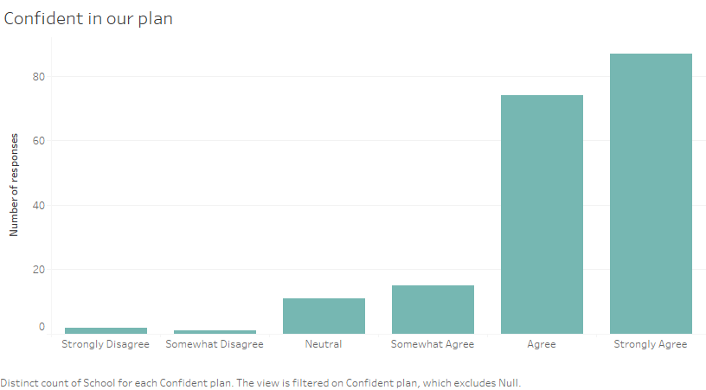
Key takeaway 1: Vast majority is confident in plan
More than 160 of the approximately 200
of survey respondents have
some degree of
confidence in plan.

Slide 4
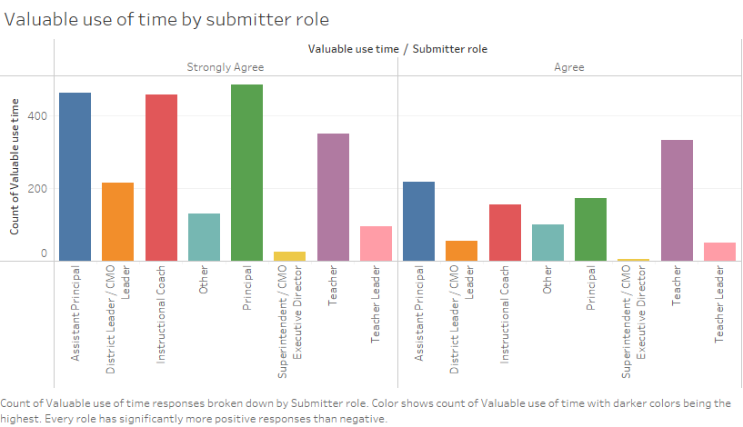
Key takeaway 2: Some roles have better outcomes
Some roles feel the program is a better
use of time than others.
Assistant Principals, Principals,
Instructional Coaches, and
Teachers find it more worth their time
than District Leaders, Superintendents,
and Teacher Leaders.

Slide 5
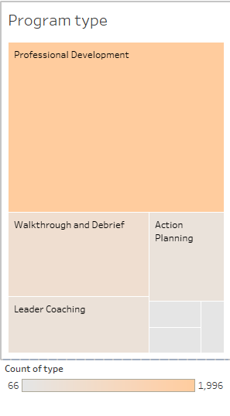
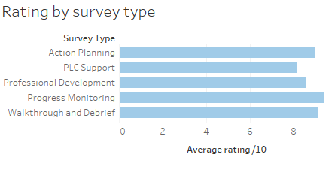
Key takeaway 3
Most common type of survey is for Professional Development, with almost 2,000 attendants for the period.
The average rating per survey type is pictured below.

Slide 6
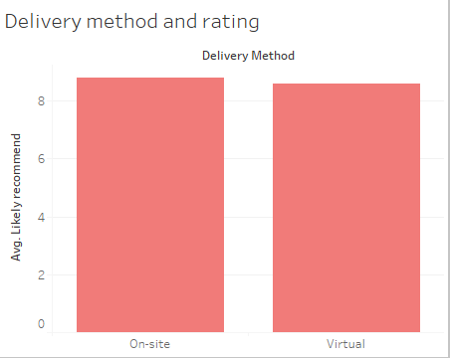
Areas of Success
Virtual and on-site
Instruction have extremely
similar ratings.
75% of participants under
Role 3 facilitators felt
strongly they had learned
something.

Slide 7
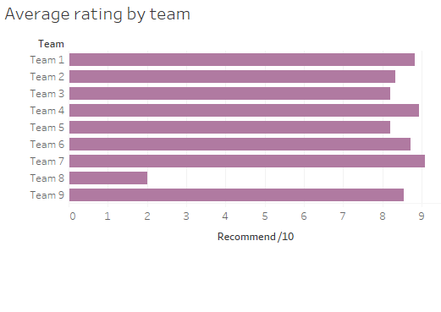
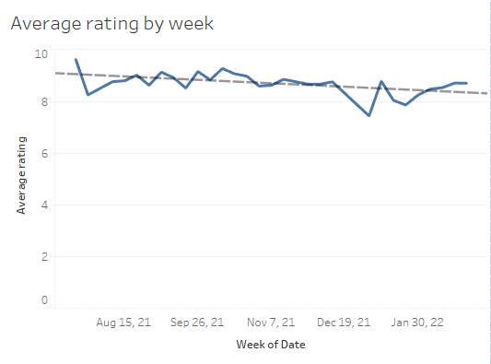
Room for improvements
Team 8 has lower recommendation
rate than other teams.
Ratings in general have gone down
slightly over time.

Slide 8
Thank you for your time!
Questions are welcome.

