Slide 1
50.003: Elements of Software Construction
Concurrency: Testing

Slide 2
Course Plan
Week | Cohort Class 1 | Cohort Class 2 | Cohort Class 3 | Remarks
1 (Jan 22) | Software Development Process
2 (Jan 29) | Software Design and UML |  | Project Meeting I | Problem Set 1
3 (Feb 5) | Software Design and UML |  | Guest Lectures
4 (Feb 12) | Design Patterns |  |  | Problem Set 2. Quiz 1
5 (Feb 19) | Software Testing |  | Project Meeting II
6 (Feb 26) | Software Testing |  |  | Problem Set 3
7 (Mar 5) | Recess |  |  | Problem Set 4
8 (Mar 12) | Software Debugging, Code smells and Maintenance |  | Project Meeting III | Quiz 2
9 (Mar 19) | Concurrency: Requirement |  |  | Problem Set 5
10 (Mar 26) | Concurrency: Design and Implementation |  |  | Problem Set 6; Quiz 3
11 (Apr 2) | Concurrency: Testing |  | Project Meeting IV | Problem Set 7
12 (Apr 9) | Concurrency: Optimization |  |  | Problem Set 8; Quiz 4
13 (Apr 16) | Final Project Presentation (15 minutes for each group) |  |  | Project Report/Code Due
14 (Apr 27) | Final Exam

Slide 3
Testing Sequential Program
int previousMax;
0. public int max (int[] list) {
1. int max = list[0];
2. for (int i = 1; 3. i < list.length; 4. i++) {
5. if (max < list[i]) {
6. max = list[i];
7. }
8. }
9. previousMax = max;
10. return max;
11. }
0
list = …
1
max = list[0]
2
i = 1
i >= list.length
9
3
previous=max
i < list.length
i++
return max
10
4
5
max >= list[i]
max < list[i]
…
11
8
7
6
max = list[i]

Slide 4
Test Execution
With input = [2,4]
0
1
2
3
5
6
10
9
3
4
8
7
11
…
i
: a configuration of the program with control at line i

Slide 5
Test Execution
With input = [4,2]
0
1
2
3
5
10
9
3
4
8
7
11
…
i
: a configuration of the program with control at line i

Slide 6
Testing
For sequential programs,
Finding the right inputs
For concurrent programs,
Finding the right inputs and scheduling
To be able to generate more scheduling, we could use Thread.sleep(), and synchronizers.

Slide 7
Synchronizers
A synchronizer is an object that coordinates the control flow of threads based on its state.
Semaphore
CyclicBarrier
CountDownLatch
Phaser

Slide 8
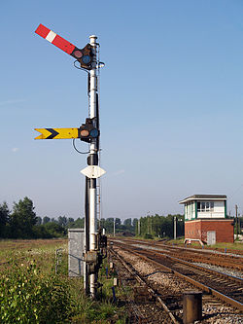
Semaphores
A semaphore maintains a set of permits. Each acquire() blocks if necessary until a permit is available, and then takes it. Each release() adds a permit, potentially releasing a blocked acquirer.
Thread A
Thread B
Thread C
Semaphore
(with 2 permits)
Example: SemaphoreExample.java

Slide 9
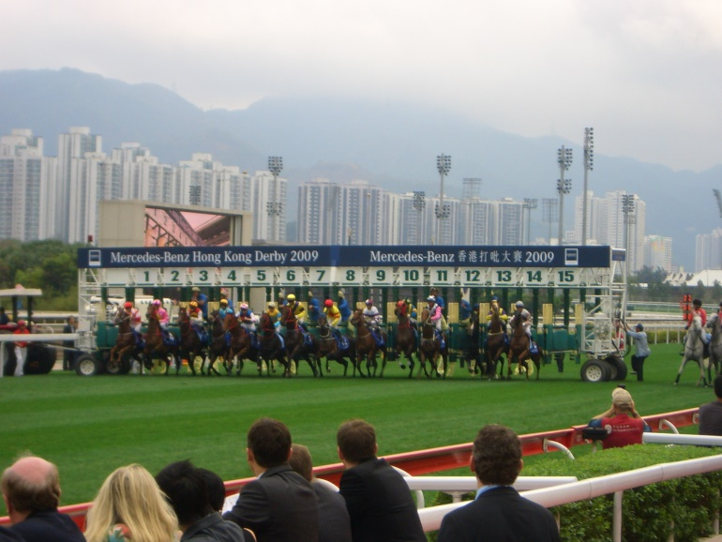
Cyclic Barriers
A synchronization aid that allows a set of threads to all wait for each other to reach a common barrier point. The barrier is often called cyclic because it can be re-used after the waiting threads are released.
Thread A
Thread B
Thread C
Barrier
Click here for a sample program: BarrierExample.java

Slide 10
Cohort Exercise 1
Given MyCyclicBarrier.java, complete method await() such that you can replace CyclicBarrier in BarrierExample.java with MyCyclicBarrier without changing its behaviour.

Slide 11
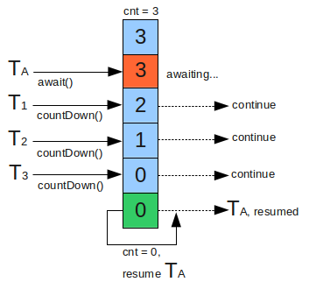
CountDownLatch
A synchronization aid that allows one or more threads to wait until a set of operations being performed in other threads completes.
Click here for a sample program: CountDownLatchExample.java

Slide 12
Cohort Exercise 2
Given an (large) array of strings (of grades), write a multi-threaded program, using CountDownLatch, to check whether the array contains 7 “F”. Stop all threads as soon as possible.

Slide 13
Phaser
Phaser (introduced in Java 7)
A reusable synchronization barrier, similar in functionality to CyclicBarrier and CountDownLatch but supporting more flexible usage.
Sample program: PhaserExample.java

Slide 14
Cohort Exercise 3
Draw the state machine diagram for a Phaser object.
A state should be identified by three numbers: the phase number, the number of registrations, the number of arrivals. For simplicity, limit the numbers to maximum 2.
The transitions should be labelled with methods in the class.

Slide 15
Barrier vs Latch vs Phaser
CountDownLatch
Created with a fixed number of threads
Cannot be reset
Allow threads to wait (method await) or continue with its execution (method countdown())
Cyclic Barrier
Can be reset.
Does not provide a method for the threads to advance. The threads have to wait till all the threads arrive.
Created with fixed number of threads.
Phaser
Number of threads need not be known at Phaser creation time. They can be added dynamically.
Can be reset and hence is, reusable.
Allows threads to wait (method arriveAndAwaitAdvance()) or continue with its execution(method arrive()).
Supports multiple Phases.

Slide 16
Testing for Concurrency
Testing for correctness
Safety: nothing bad ever happens
Liveness: something good eventually happens (e.g., no deadlock)
Testing for performance
Throughput: the rate at which a set of concurrent tasks is completed
Responsiveness: the delay between a request and completion of some action

Slide 17
Step 1: Identifying Specification
You must know what is correct.
Identify
class invariants which specify relationships among the variables;
pre/post-conditions for each method;
whether the class is thread-safe and how its states guarded
Sample program: BoundedBufferWithSpec.java

Slide 18
Step 2: Basic Unit Tests
Create an object of the class, call its methods (in different sequences with different inputs) and assert post-conditions and invariants.
Sample program: BoundedBufferTest.java
Test: testIsEmptyWhenConstructued()

Slide 19
Step 3: Test for Concurrency
Set up multiple threads performing operations over some amount of time and then somehow test that nothing went wrong
Mind that the test programs are concurrent programs too!
It’s best if checking the test property does not require any synchronization
Sample program: BoundedBufferTest.java
Test: testIsFullAfterPuts()

Slide 20
Cohort Exercise 4
Given BoundedBufferTest.java,
write two more test cases (with threads)
document what you are testing for.

Slide 21
Additional Synchronization
Example: how do we test that everything put into the buffer comes out of it and that nothing else does, assuming there are multiple producers and consumers?
A naïve approach: maintain a “shadow” list and assert that the buffer is consistent with the “shadow” list
Use a check sum function would be better (see example later)

Slide 22
Example
Some test data should be generated randomly
Random number generator can create couplings between classes and timing artifacts because most random number generator classes are thread-safe and therefore introduce additional synchronization.
Use pseudo-random number generator
static int xorShift (int y) {
y ^= (y << 6);
y ^= (y >>> 21);
y ^= (y << 7);
return y;
}

Slide 23
Example
Click here for a sample program: PutTakeTest.java

Slide 24
Generating More Scheduling
Test with more active threads than CPUs
Testing with different processor counts, operating systems, and processor architectures
Encourage context switching using Thread.yield() or Thread.sleep(10)
Public synchronized void transfer (Account from, Account to, int amount) {
from.debit(amount);
if (random.nextInt(1000) > THREADHOLD) {
Thread.yield();
}
to.credit(amount);
}

Slide 25
Testing Blocking Operations
How do we test that an operation has been blocked (in a concurrent context)?
Click here for a sample program: BoundedBufferTest.java
Test: testTakeBlocksWhenEmpty()

Slide 26
Step 4: Testing for Performance
Identify appropriate test scenarios – how the class is used
Sizing empirically for various bounds, e.g., number of threads, buffer capabilities, etc.
Click here for a sample program: TimedPutTakeTest.java
TimedPutTakeTestABQ; TimedPutTakeTestLBQ.java

Slide 27
Cohort Exercise 5
Design a test to compare the performance difference between Collections.synchronizedMap and ConcurrrentHashMap.

Slide 28
Beyond Testing
Code review (e.g. Team Explorer)
Static analysis (e.g. Coverity Scan, and Facebook Infer)
Symbolic execution (e.g. KLEE, and Microsoft SAGE)
Model checking (e.g. SPIN, Uppaal, and Microsoft Static Analyzer)
Theorem proving (e.g. Coq and PVS)

