Slide 1


Design Project 2
Western New England University
College of Engineering
EE 456 RF & mm-Wave Active Circuits
Steven Placzek
Low-Noise Amplifier Matching Network Design

Slide 2
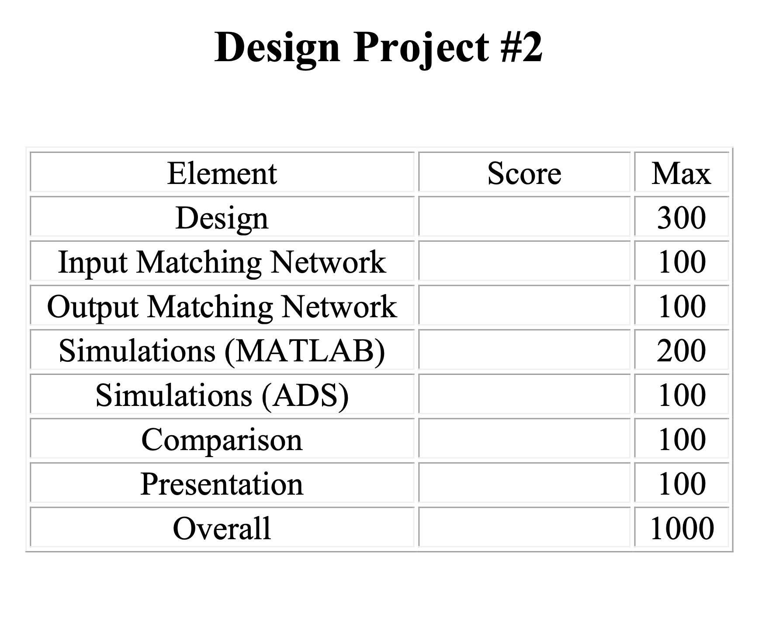
EE 456
RF & mm-Wave Active Circuits
Design Project 2

Slide 3
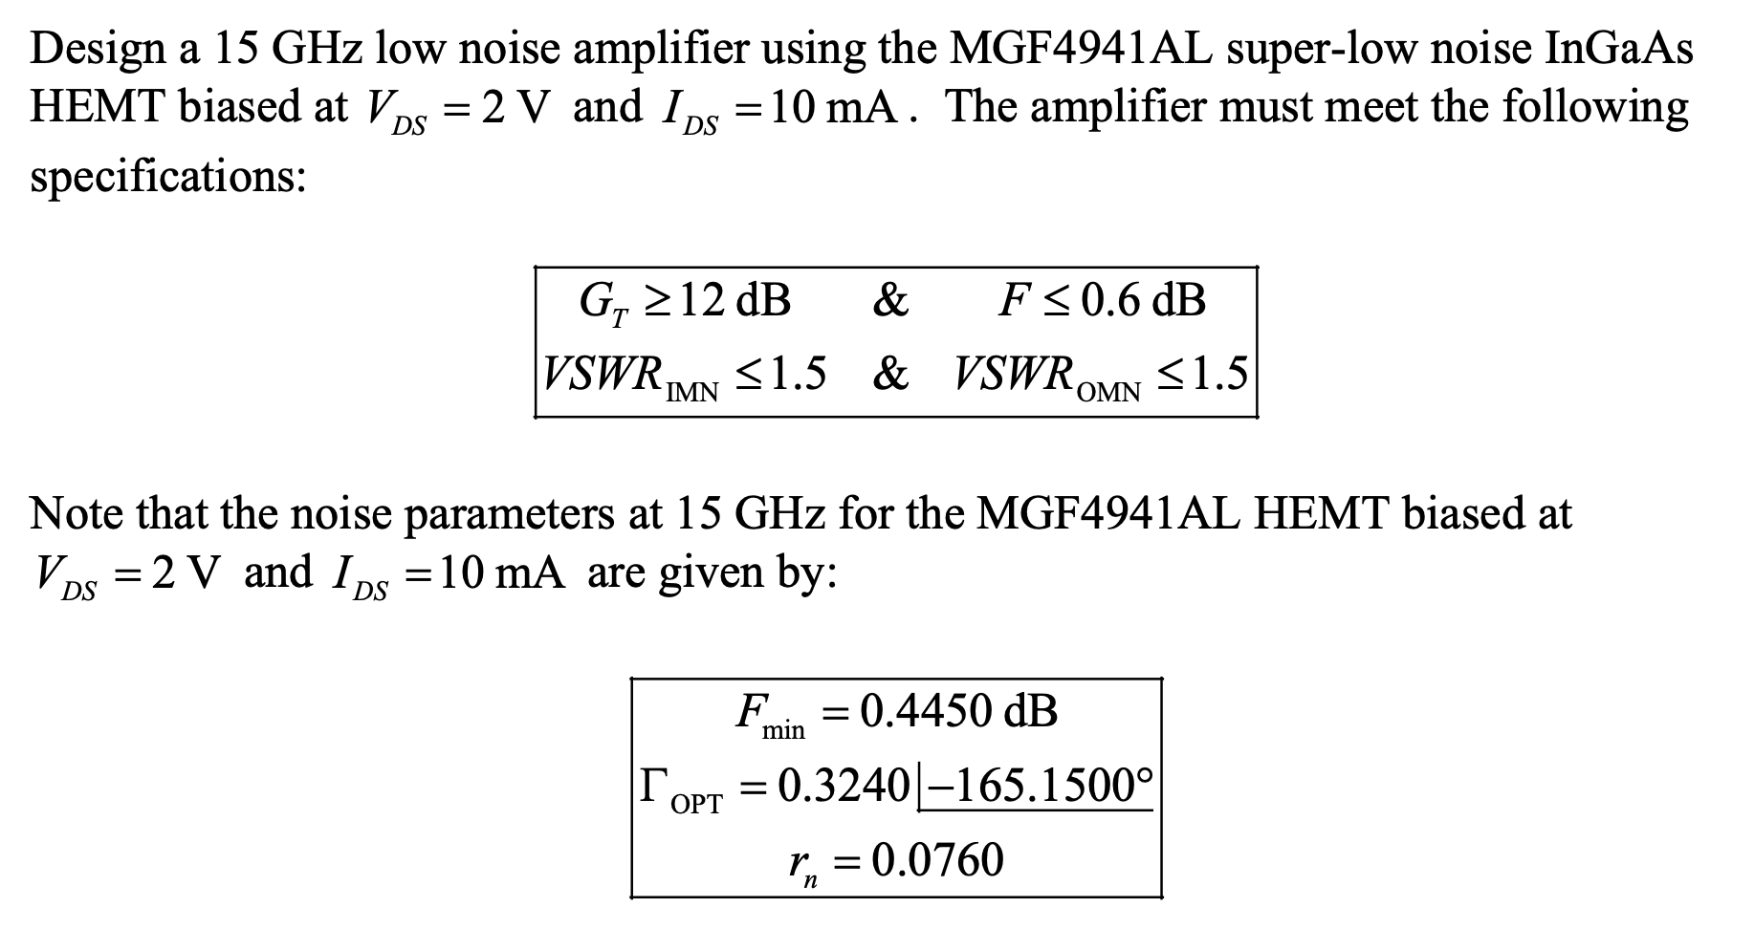
EE 456
RF & mm-Wave Circuits
Design Project 2
Design Project Objective

Slide 4
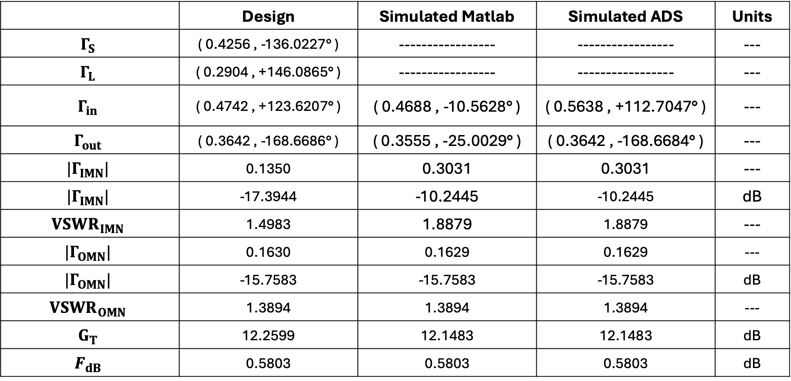
Design and Simulation Results
EE 456
RF & mm-Wave Active Circuits
Design Project 2
Table 1
 | Design | Simulated Matlab | Simulated ADS | Units
$$Γ_{S}$$ | ( 0.4256 , -136.0227° ) | ----------------- | ----------------- | ---
$$Γ_{L}$$ | ( 0.2904 , +146.0865° ) | ----------------- | ----------------- | ---
$$Γ_{in}$$ | ( 0.4742 , +123.6207° ) | ( 0.4688 , -10.5628° ) | ( 0.5638 , +112.7047° ) | ---
$$Γ_{out}$$ | ( 0.3642 , -168.6686° ) | ( 0.3555 , -25.0029° ) | ( 0.3642 , -168.6684° ) | ---
$$|Γ_{IMN}|$$ | 0.1350 | 0.3031 | 0.3031 | ---
$$|Γ_{IMN}|$$ | -17.3944 | -10.2445 | -10.2445 | dB
$${VSWR}_{IMN}$$ | 1.4983 | 1.8879 | 1.8879 | ---
$$|Γ_{OMN}|$$ | 0.1630 | 0.1629 | 0.1629 | ---
$$|Γ_{OMN}|$$ | -15.7583 | -15.7583 | -15.7583 | dB
$${VSWR}_{OMN}$$ | 1.3894 | 1.3894 | 1.3894 | ---
$$G_{T}$$ | 12.2599 | 12.1483 | 12.1483 | dB
$$F_{dB}$$ | 0.5803 | 0.5803 | 0.5803 | dB

Slide 5
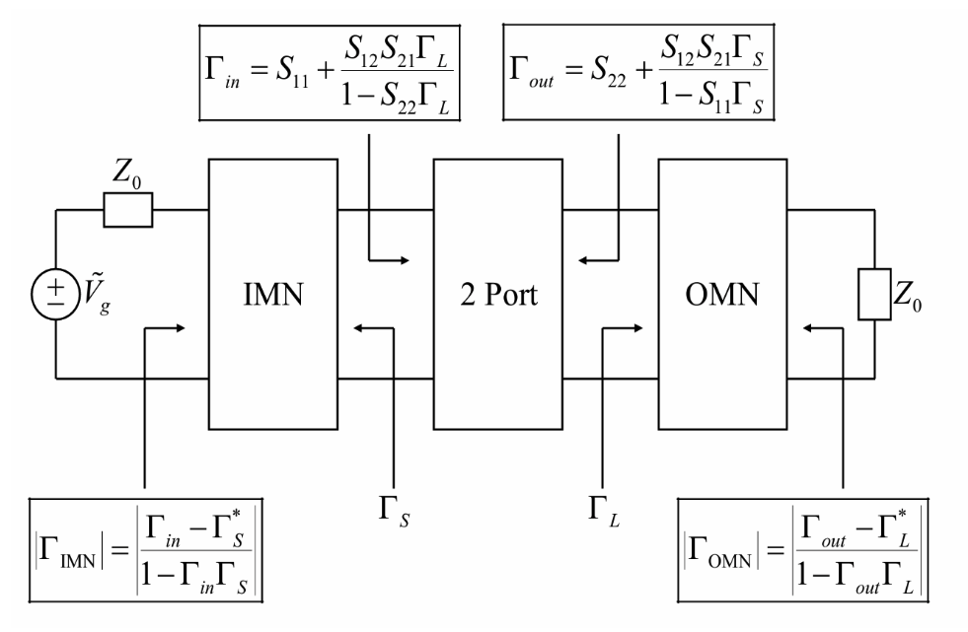
EE 456
RF & mm-Wave Circuits
Design Project 2
LNA Design: Network Layout / Reflection Coefficients
Image Credit: Dr. Burke

Slide 6
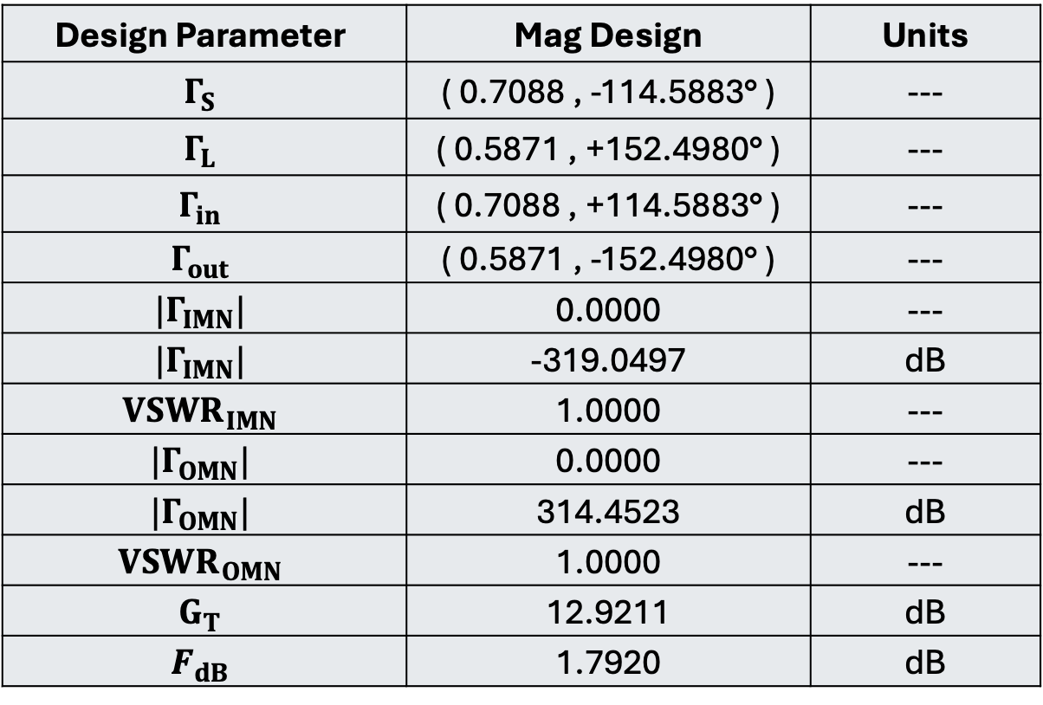
MAG Design
EE 456
RF & mmWave Circuits
Design Project 2
Design Parameter | Mag Design | Units
$$Γ_{S}$$ | ( 0.7088 , -114.5883° ) | ---
$$Γ_{L}$$ | ( 0.5871 , +152.4980° ) | ---
$$Γ_{in}$$ | ( 0.7088 , +114.5883° ) | ---
$$Γ_{out}$$ | ( 0.5871 , -152.4980° ) | ---
$$|Γ_{IMN}|$$ | 0.0000 | ---
$$|Γ_{IMN}|$$ | -319.0497 | dB
$${VSWR}_{IMN}$$ | 1.0000 | ---
$$|Γ_{OMN}|$$ | 0.0000 | ---
$$|Γ_{OMN}|$$ | 314.4523 | dB
$${VSWR}_{OMN}$$ | 1.0000 | ---
$$G_{T}$$ | 12.9211 | dB
$$F_{dB}$$ | 1.7920 | dB

Slide 7
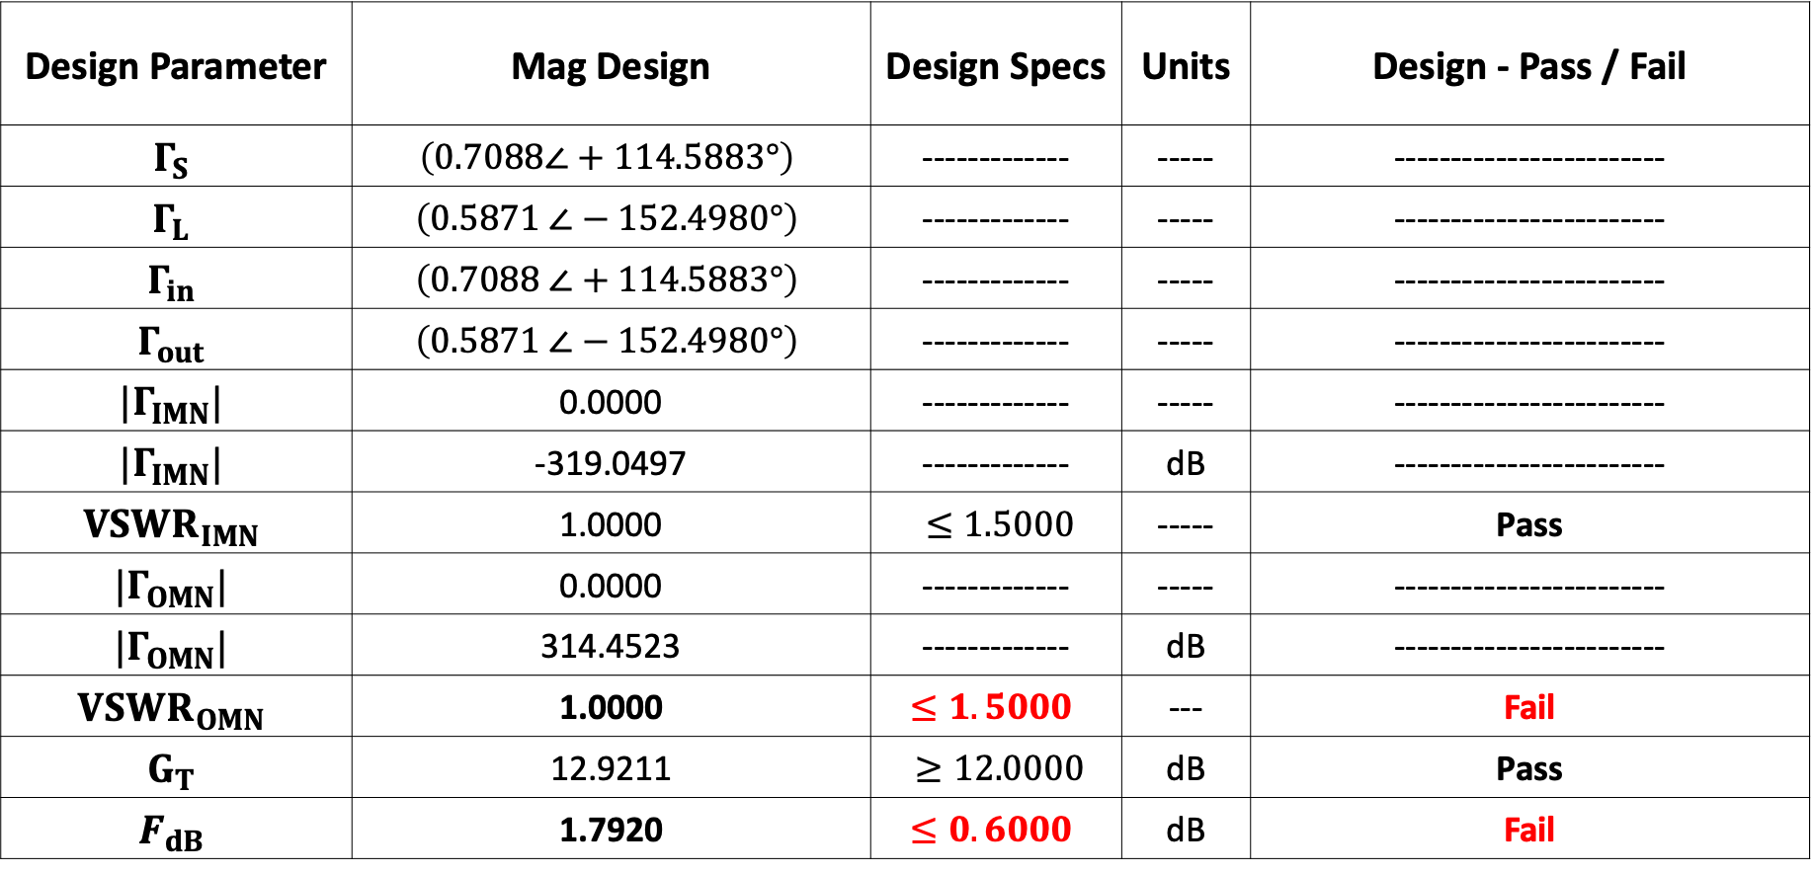
MAG Design
EE 456
RF & mmWave Circuits
Design Project 2
Design Parameter | Mag Design | Design Specs | Units | Design - Pass / Fail
$$Γ_{S}$$ | $$\left(0.7088∠+114.5883°\right)$$ | ------------- | ----- | ------------------------
$$Γ_{L}$$ | $$\left(0.5871 ∠−152.4980°\right)$$ | ------------- | ----- | ------------------------
$$Γ_{in}$$ | $$\left(0.7088 ∠+114.5883°\right)$$ | ------------- | ----- | ------------------------
$$Γ_{out}$$ | $$\left(0.5871 ∠−152.4980°\right)$$ | ------------- | ----- | ------------------------
$$|Γ_{IMN}|$$ | 0.0000 | ------------- | ----- | ------------------------
$$|Γ_{IMN}|$$ | -319.0497 | ------------- | dB | ------------------------
$${VSWR}_{IMN}$$ | 1.0000 | $≤1.5000$ | ----- | Pass
$$|Γ_{OMN}|$$ | 0.0000 | ------------- | ----- | ------------------------
$$|Γ_{OMN}|$$ | 314.4523 | ------------- | dB | ------------------------
$${VSWR}_{OMN}$$ | 1.0000 | $≤1.5000$ | --- | Fail
$$G_{T}$$ | 12.9211 | $≥12.0000$ | dB | Pass
$$F_{dB}$$ | 1.7920 | $≤0.6000$ | dB | Fail

Slide 8
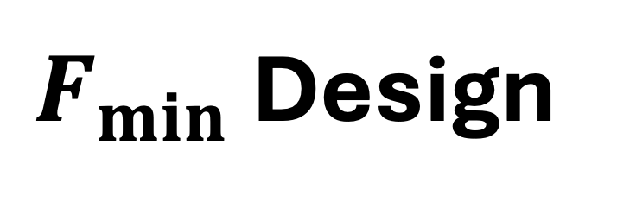
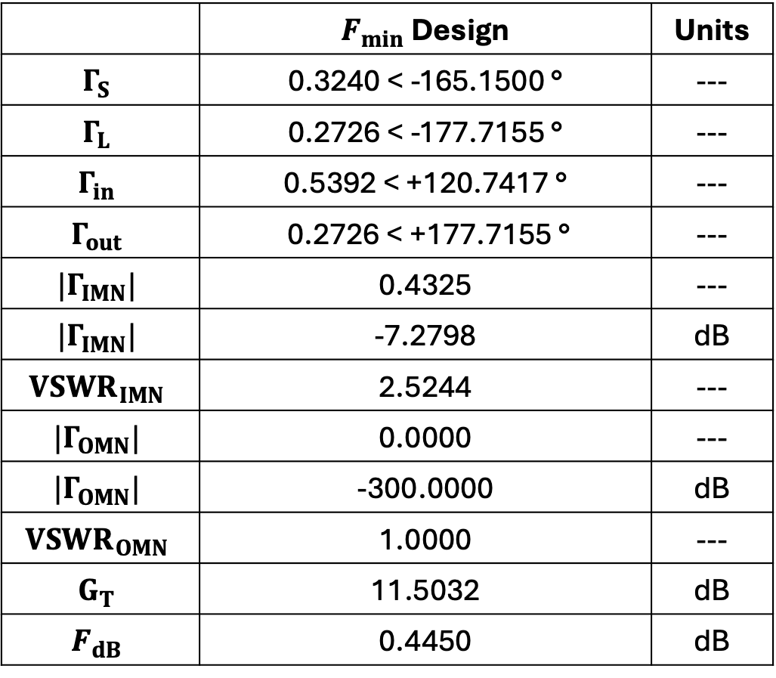
EE 456
RF & mm-Wave Circuits
Design Project 2
$F_{min}$ Design
 | $F_{min}$ Design | Units
$$Γ_{S}$$ | 0.3240 < -165.1500 ° | ---
$$Γ_{L}$$ | 0.2726 < -177.7155 ° | ---
$$Γ_{in}$$ | 0.5392 < +120.7417 ° | ---
$$Γ_{out}$$ | 0.2726 < +177.7155 ° | ---
$$|Γ_{IMN}|$$ | 0.4325 | ---
$$|Γ_{IMN}|$$ | -7.2798 | dB
$${VSWR}_{IMN}$$ | 2.5244 | ---
$$|Γ_{OMN}|$$ | 0.0000 | ---
$$|Γ_{OMN}|$$ | -300.0000 | dB
$${VSWR}_{OMN}$$ | 1.0000 | ---
$$G_{T}$$ | 11.5032 | dB
$$F_{dB}$$ | 0.4450 | dB

Slide 9

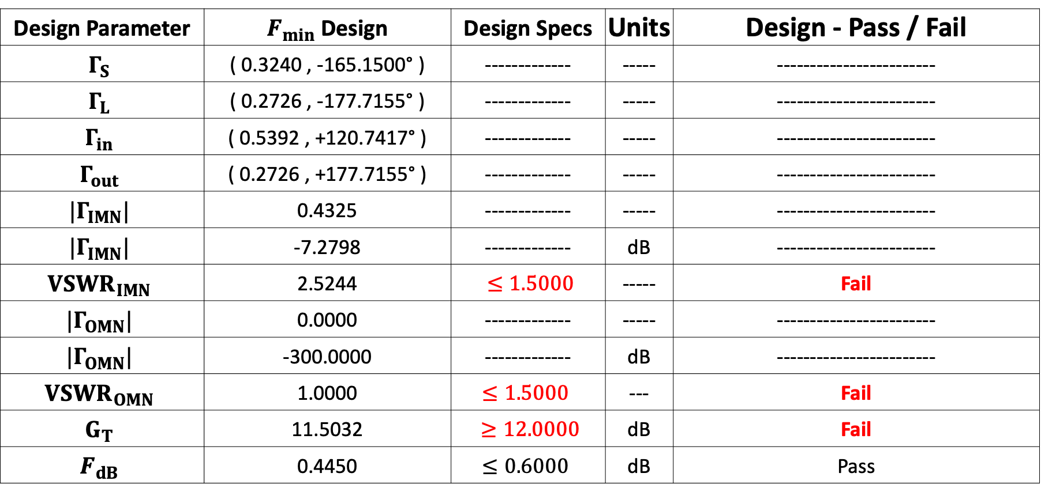
EE 456
RF & mm-Wave Circuits
Design Project 2
$F_{min}$Design
Design Parameter | $F_{min}$ Design | Design Specs | Units | Design - Pass / Fail
$$Γ_{S}$$ | ( 0.3240 , -165.1500° ) | ------------- | ----- | ------------------------
$$Γ_{L}$$ | ( 0.2726 , -177.7155° ) | ------------- | ----- | ------------------------
$$Γ_{in}$$ | ( 0.5392 , +120.7417° ) | ------------- | ----- | ------------------------
$$Γ_{out}$$ | ( 0.2726 , +177.7155° ) | ------------- | ----- | ------------------------
$$|Γ_{IMN}|$$ | 0.4325 | ------------- | ----- | ------------------------
$$|Γ_{IMN}|$$ | -7.2798 | ------------- | dB | ------------------------
$${VSWR}_{IMN}$$ | 2.5244 | $≤1.5000$ | ----- | Fail
$$|Γ_{OMN}|$$ | 0.0000 | ------------- | ----- | ------------------------
$$|Γ_{OMN}|$$ | -300.0000 | ------------- | dB | ------------------------
$${VSWR}_{OMN}$$ | 1.0000 | $≤1.5000$ | --- | Fail
$$G_{T}$$ | 11.5032 | $≥12.0000$ | dB | Fail
$$F_{dB}$$ | 0.4450 | $≤0.6000$ | dB | Pass

Slide 10
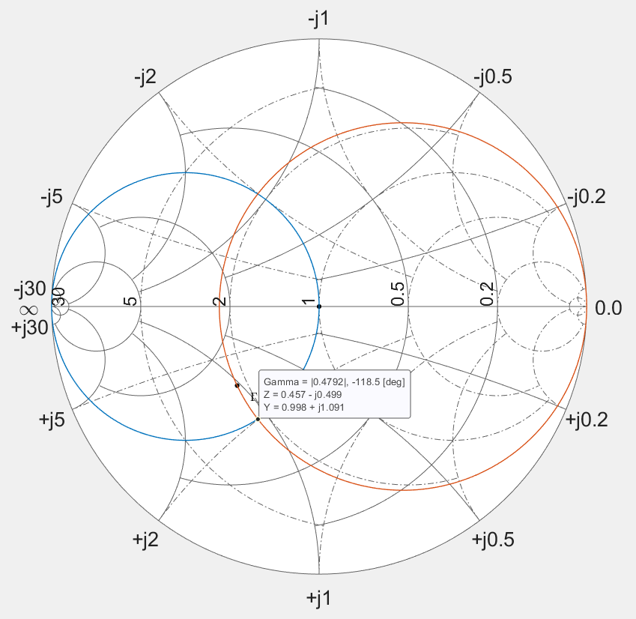

EE 456
RF & mm-Wave Circuits
Design Project 2
IMN Design
Constant Resistance Circle with $Γ_{S}$, its point of intersection with the constant conductance circle was used to determine the length of the transmission line between the amp and the stub in the Input Matching Network.

Slide 11
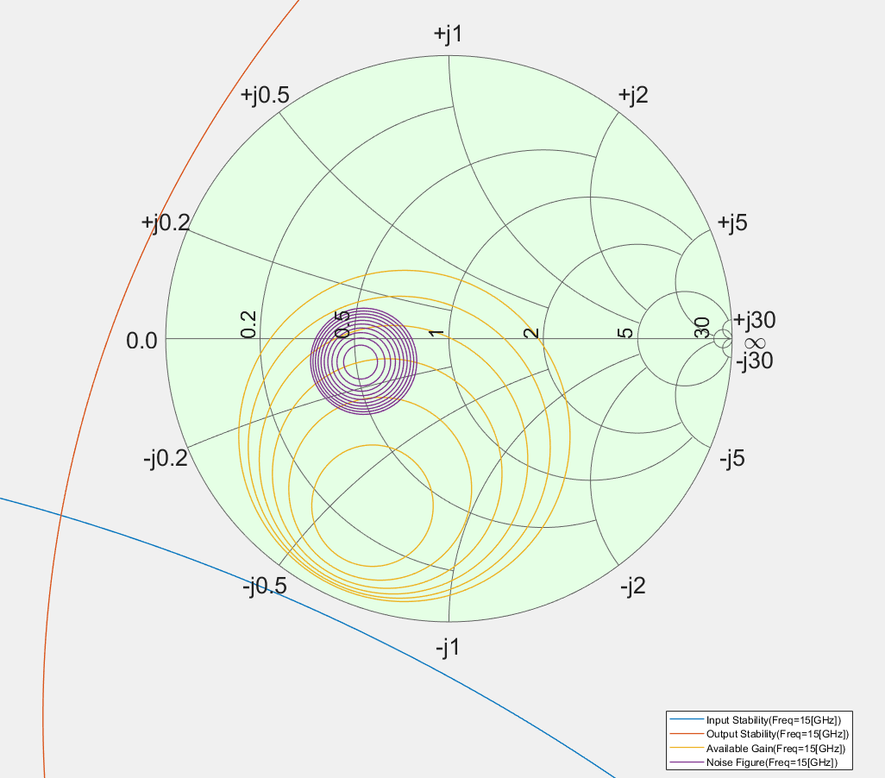
EE 456
RF & mm-Wave Circuits
Design Project 2
Un-Matched Amplifier Input/Output Stability, Ga, & Noise Figure Circles

Slide 12
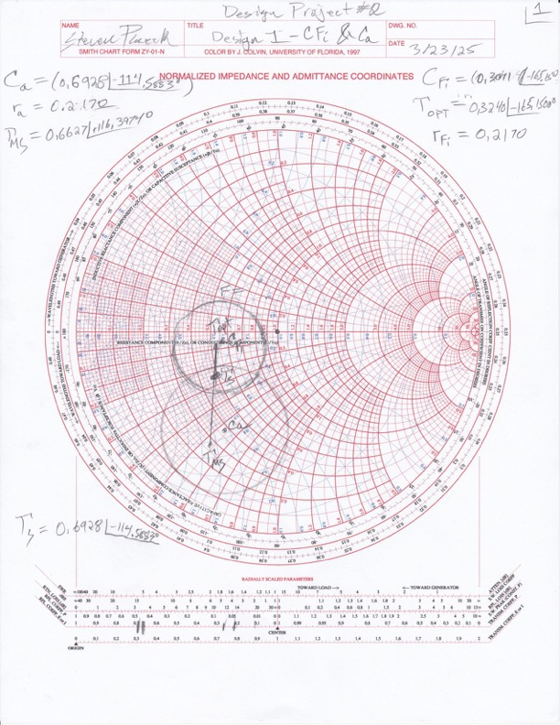
EE 456
RF & mm-Wave Circuits
Design Project 2

Slide 13
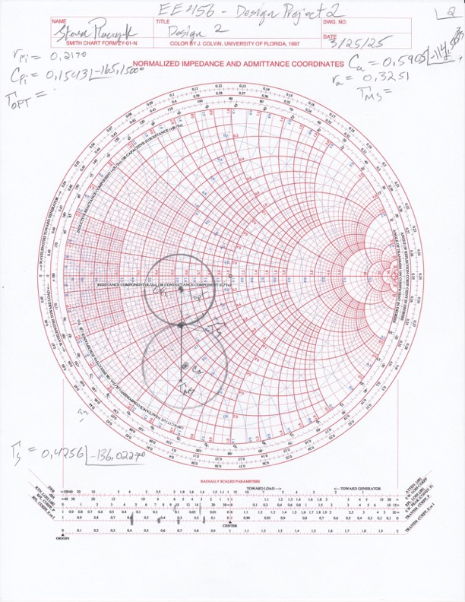
EE 456
RF & mm-Wave Circuits
Design Project 2

Slide 14
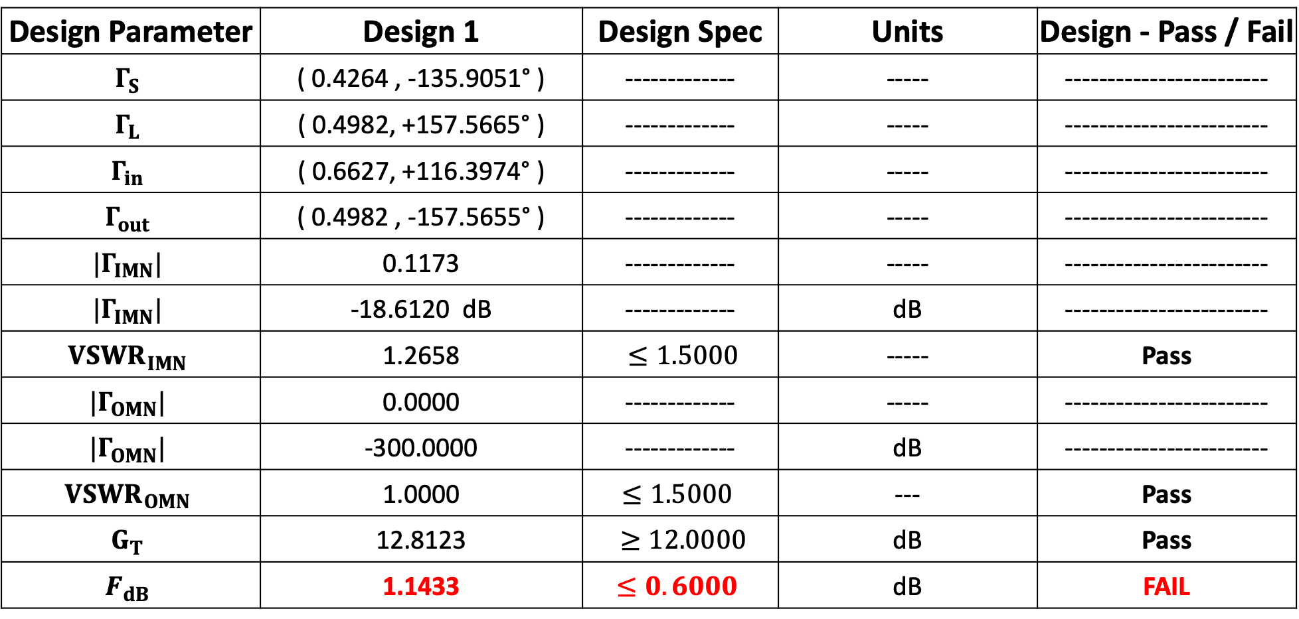
EE 456
RF & mm-Wave Circuits
Design Project 2
Design 1
Design Parameter | Design 1 | Design Spec | Units | Design - Pass / Fail
$$Γ_{S}$$ | ( 0.4264 , -135.9051° ) | ------------- | ----- | ------------------------
$$Γ_{L}$$ | ( 0.4982, +157.5665° ) | ------------- | ----- | ------------------------
$$Γ_{in}$$ | ( 0.6627, +116.3974° ) | ------------- | ----- | ------------------------
$$Γ_{out}$$ | ( 0.4982 , -157.5655° ) | ------------- | ----- | ------------------------
$$|Γ_{IMN}|$$ | 0.1173 | ------------- | ----- | ------------------------
$$|Γ_{IMN}|$$ | -18.6120 dB | ------------- | dB | ------------------------
$${VSWR}_{IMN}$$ | 1.2658 | $≤1.5000$ | ----- | Pass
$$|Γ_{OMN}|$$ | 0.0000 | ------------- | ----- | ------------------------
$$|Γ_{OMN}|$$ | -300.0000 | ------------- | dB | ------------------------
$${VSWR}_{OMN}$$ | 1.0000 | $≤1.5000$ | --- | Pass
$$G_{T}$$ | 12.8123 | $≥12.0000$ | dB | Pass
$$F_{dB}$$ | 1.1433 | $≤0.6000$ | dB | FAIL

Slide 15
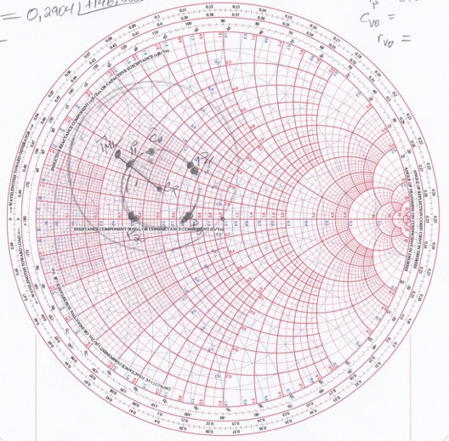

EE 456
RF & mm-Wave Circuits
Design Project 2
$${P_{3}}_{Γ_{L}}=0.2904 ∠+146.0865 °$$

Slide 16
EE 456
RF & mm-Wave Circuits
Design Project 2
Blank

Slide 17
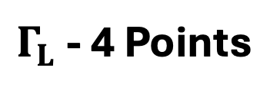
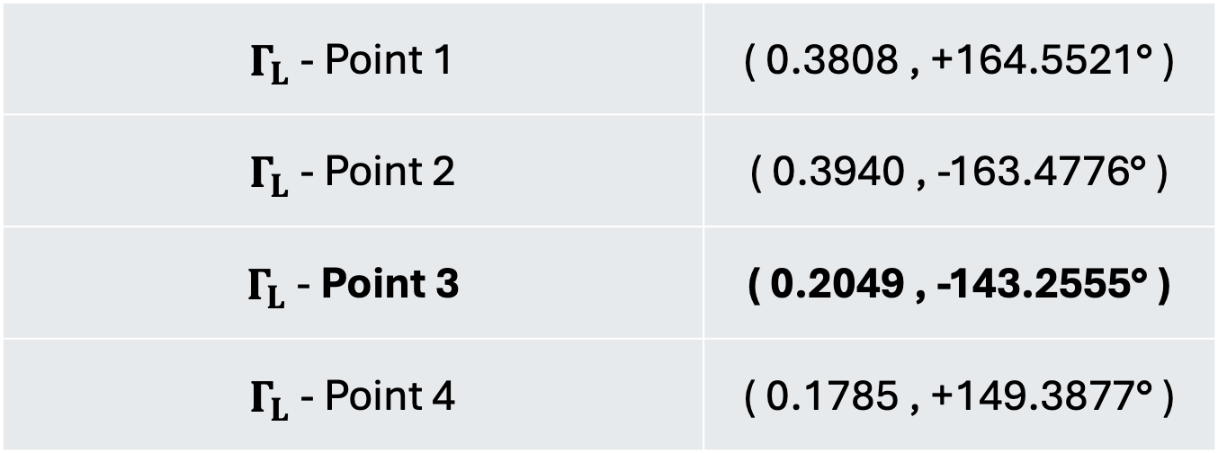
EE 456
RF & mm-Wave Circuits
Design Project 2
$Γ_{L}$ - 4 Points
$Γ_{L}$ - Point 1 | ( 0.3808 , +164.5521° )
$Γ_{L}$ - Point 2 | ( 0.3940 , -163.4776° )
$Γ_{L}$ - Point 3 | ( 0.2049 , -143.2555° )
$Γ_{L}$ - Point 4 | ( 0.1785 , +149.3877° )

Slide 18
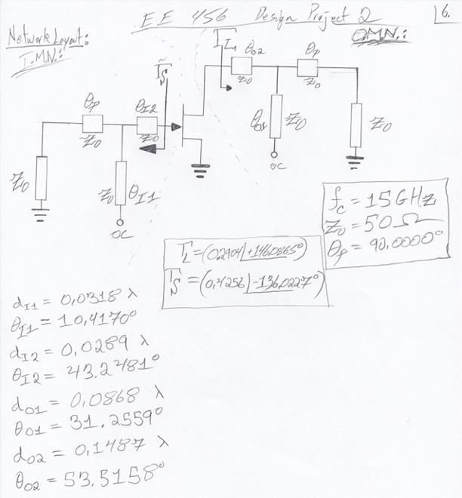
EE 456
RF & mm-Wave Circuits
Design Project 2
Design 2 – Network Layout

Slide 19
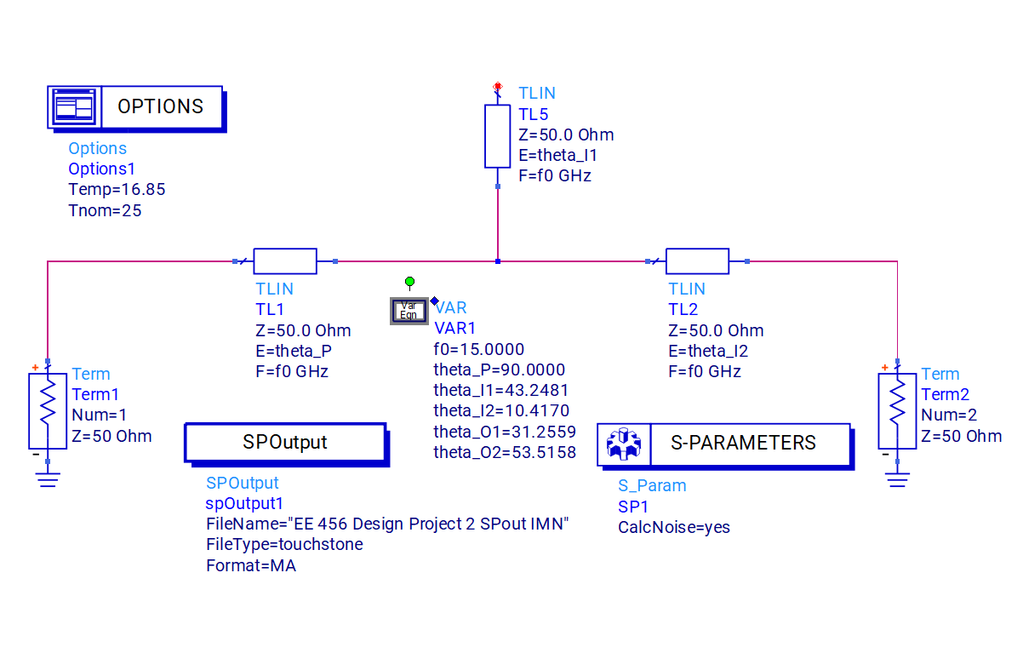
EE 456
RF & mm-Wave Circuits
Design Project 2
IMN Network Design in ADS

Slide 20
EE 456
RF & mm-Wave Circuits
Design Project 2

Slide 21
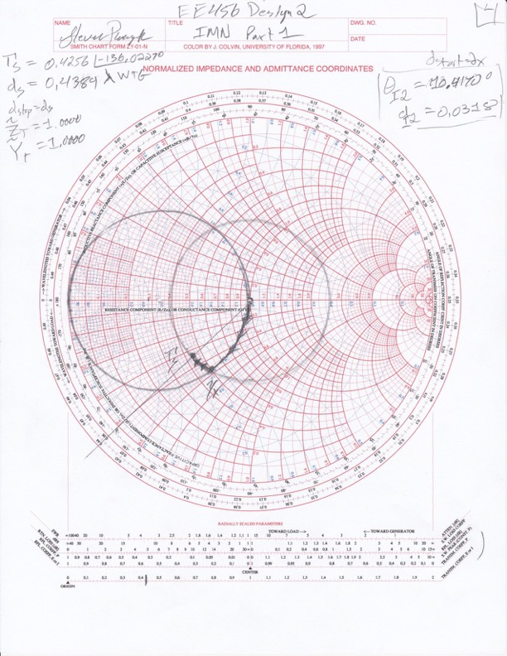
EE 456
RF & mm-Wave Circuits
Design Project 2
IMN Network Design
Part One

Slide 22
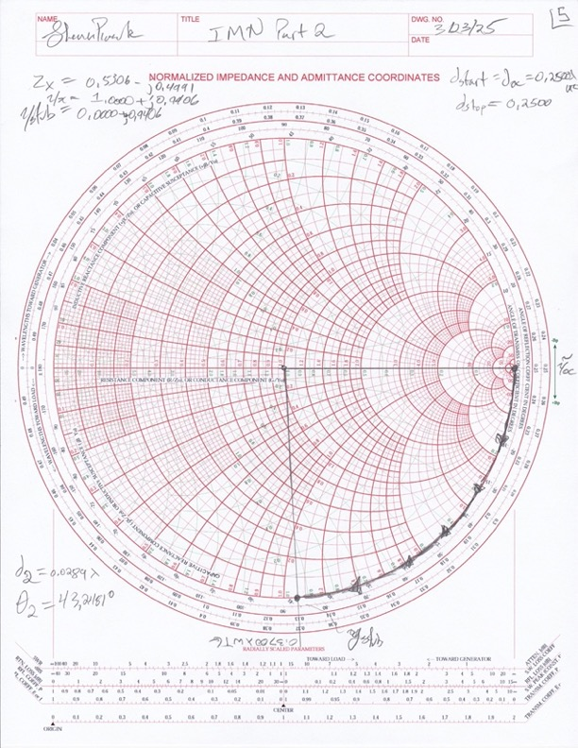
EE 456
RF & mm-Wave Circuits
Design Project 2
IMN Network Design
Part Two

Slide 23
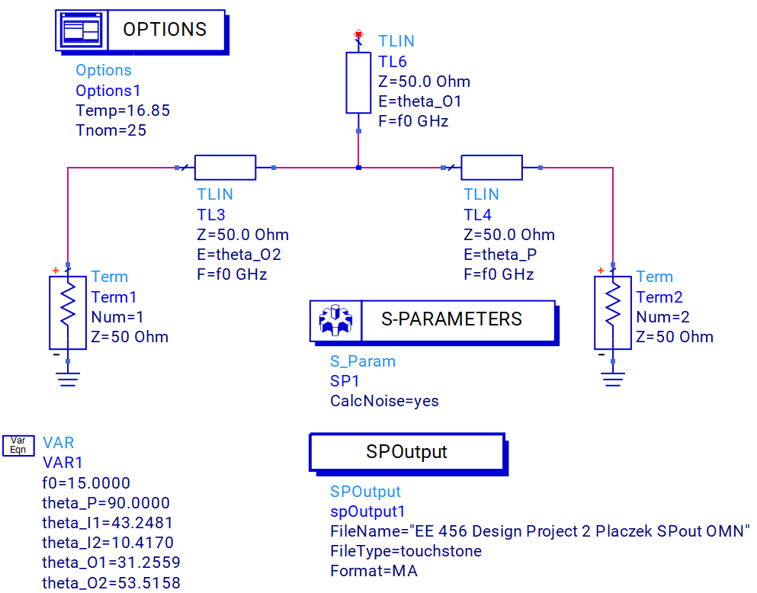
EE 456
RF & mm-Wave Circuits
Design Project 2
OMN Network Design in ADS

Slide 24
EE 456
RF & mm-Wave Circuits
Design Project 2

Slide 25
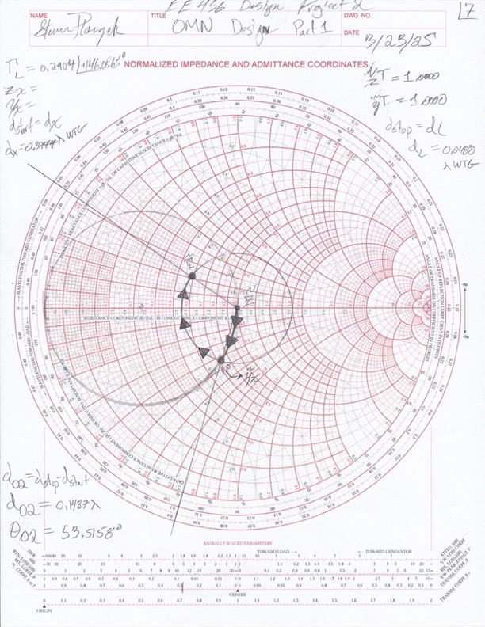
EE 456
RF & mm-Wave Circuits
Design Project 2
OMN Network Design
Part One

Slide 26
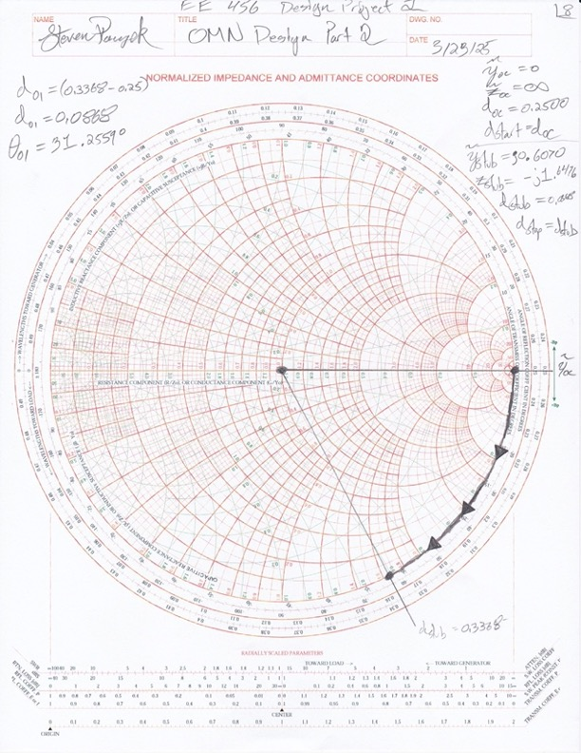
EE 456
RF & mm-Wave Circuits
Design Project 2
OMN Network Design
Part Two

Slide 27
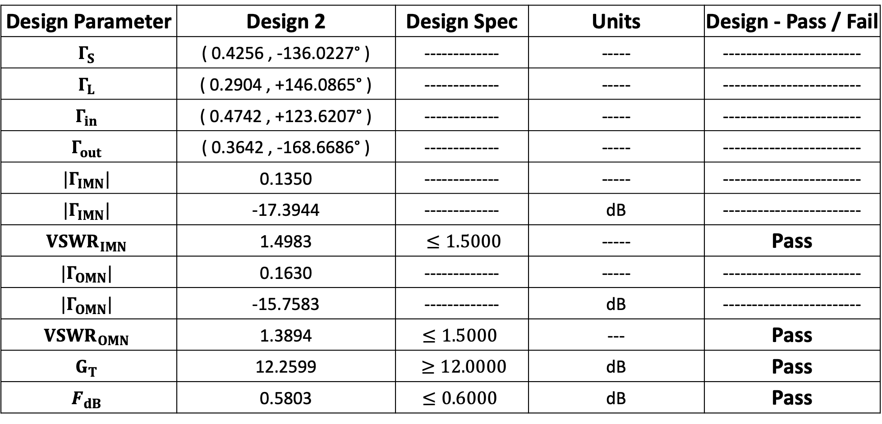
EE 456
RF & mm-Wave Circuits
Design Project 2
Design 2
Design Parameter | Design 2 | Design Spec | Units | Design - Pass / Fail
$$Γ_{S}$$ | ( 0.4256 , -136.0227° ) | ------------- | ----- | ------------------------
$$Γ_{L}$$ | ( 0.2904 , +146.0865° ) | ------------- | ----- | ------------------------
$$Γ_{in}$$ | ( 0.4742 , +123.6207° ) | ------------- | ----- | ------------------------
$$Γ_{out}$$ | ( 0.3642 , -168.6686° ) | ------------- | ----- | ------------------------
$$|Γ_{IMN}|$$ | 0.1350 | ------------- | ----- | ------------------------
$$|Γ_{IMN}|$$ | -17.3944 | ------------- | dB | ------------------------
$${VSWR}_{IMN}$$ | 1.4983 | $≤1.5000$ | ----- | Pass
$$|Γ_{OMN}|$$ | 0.1630 | ------------- | ----- | ------------------------
$$|Γ_{OMN}|$$ | -15.7583 | ------------- | dB | ------------------------
$${VSWR}_{OMN}$$ | 1.3894 | $≤1.5000$ | --- | Pass
$$G_{T}$$ | 12.2599 | $≥12.0000$ | dB | Pass
$$F_{dB}$$ | 0.5803 | $≤0.6000$ | dB | Pass

Slide 28
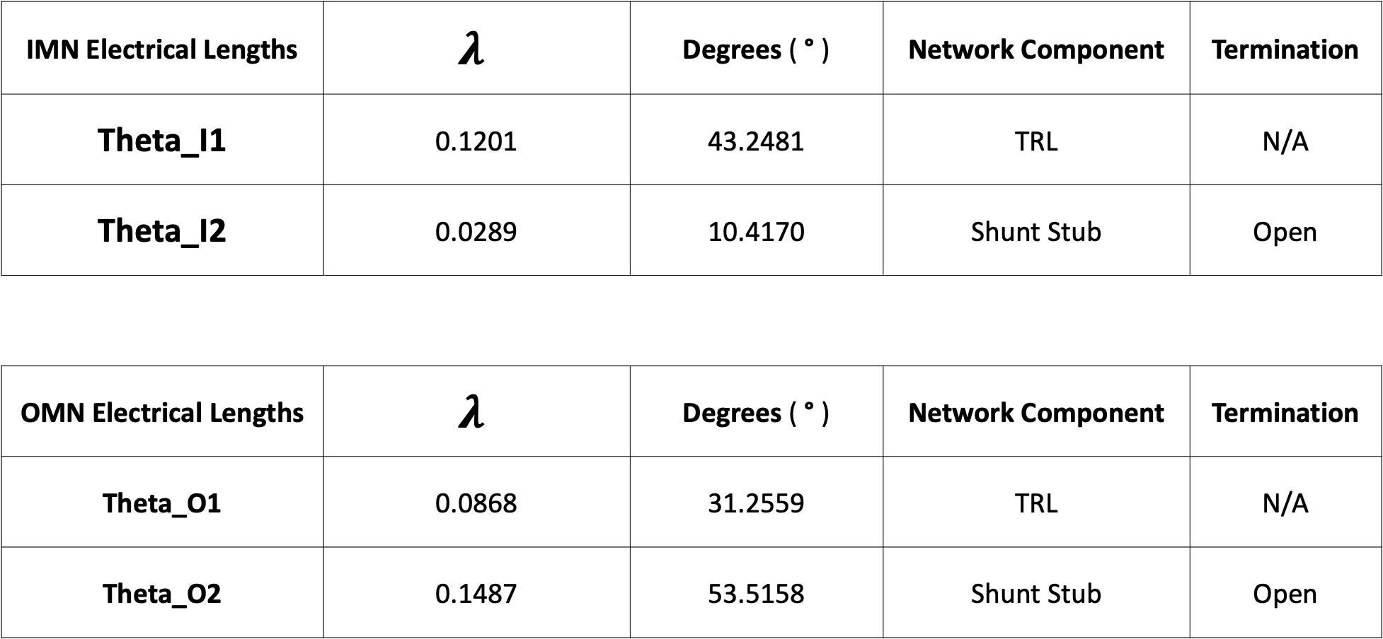
EE 456
RF & mm-Wave Circuits
Design Project 2
Design 2
IMN Electrical Lengths | $$λ$$ | Degrees ( ° ) | Network Component | Termination
Theta_I1 | 0.1201 | 43.2481 | TRL | N/A
Theta_I2 | 0.0289 | 10.4170 | Shunt Stub | Open
OMN Electrical Lengths | $$λ$$ | Degrees ( ° ) | Network Component | Termination
Theta_O1 | 0.0868 | 31.2559 | TRL | N/A
Theta_O2 | 0.1487 | 53.5158 | Shunt Stub | Open

Slide 29
EE 456
RF & mm-Wave Circuits
Design Project 2
Design Verification
ADS & MATLAB Simulations

Slide 30
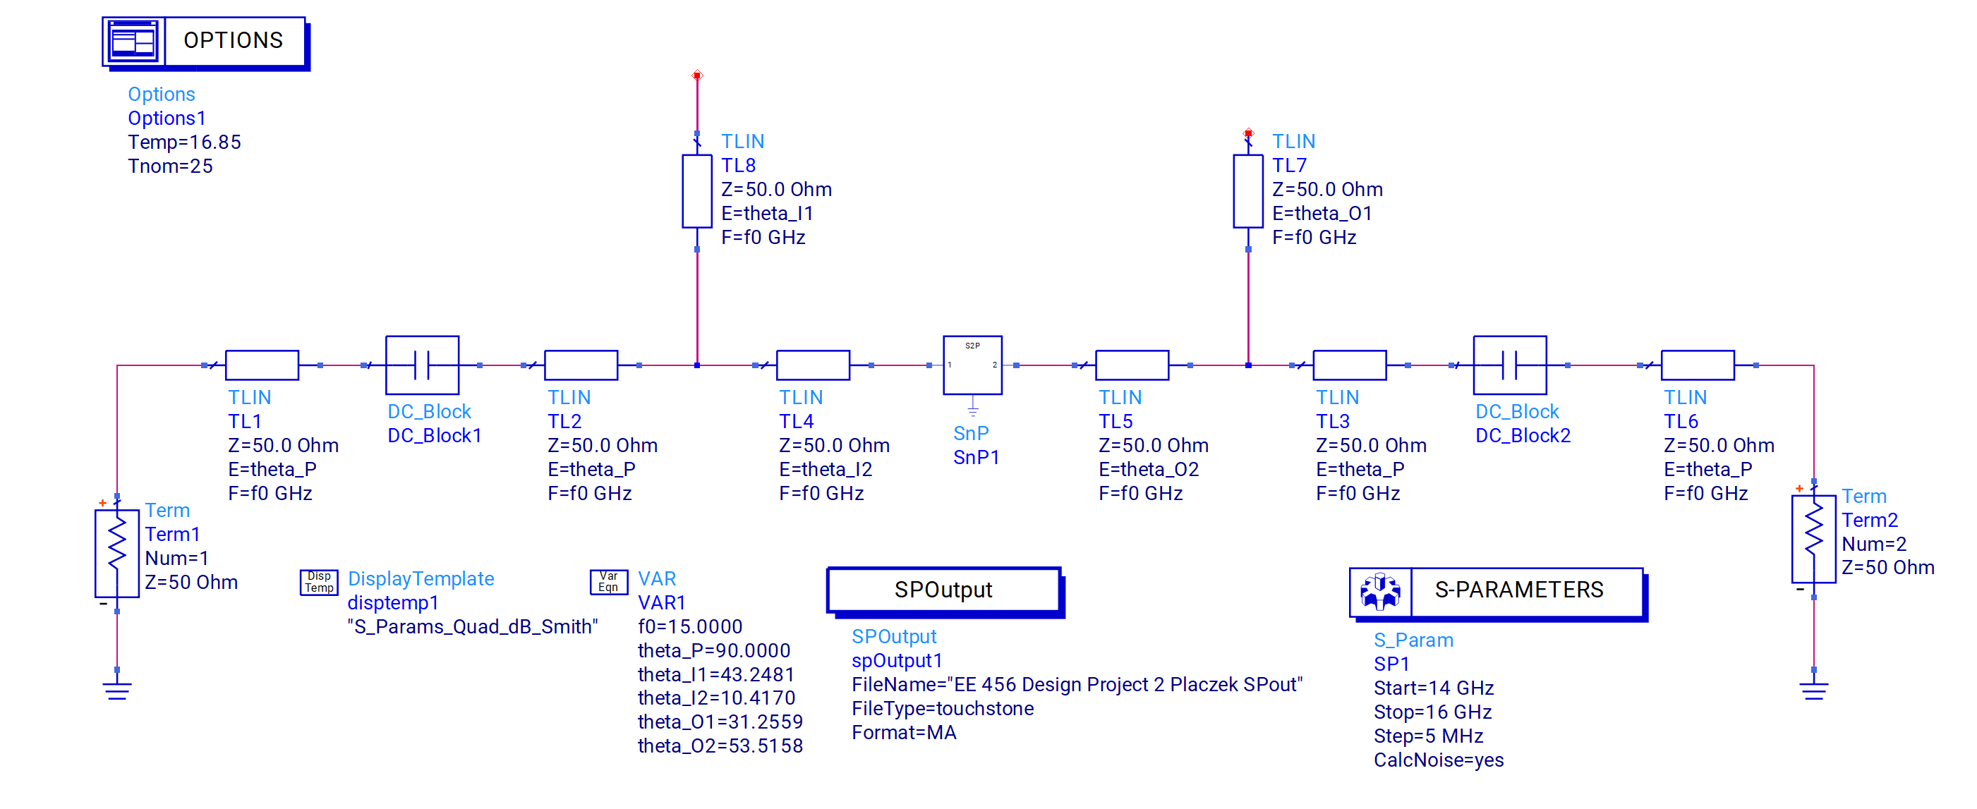
EE 456
RF & mm-Wave Circuits
Design Project 2
ADS Simulation

Slide 31
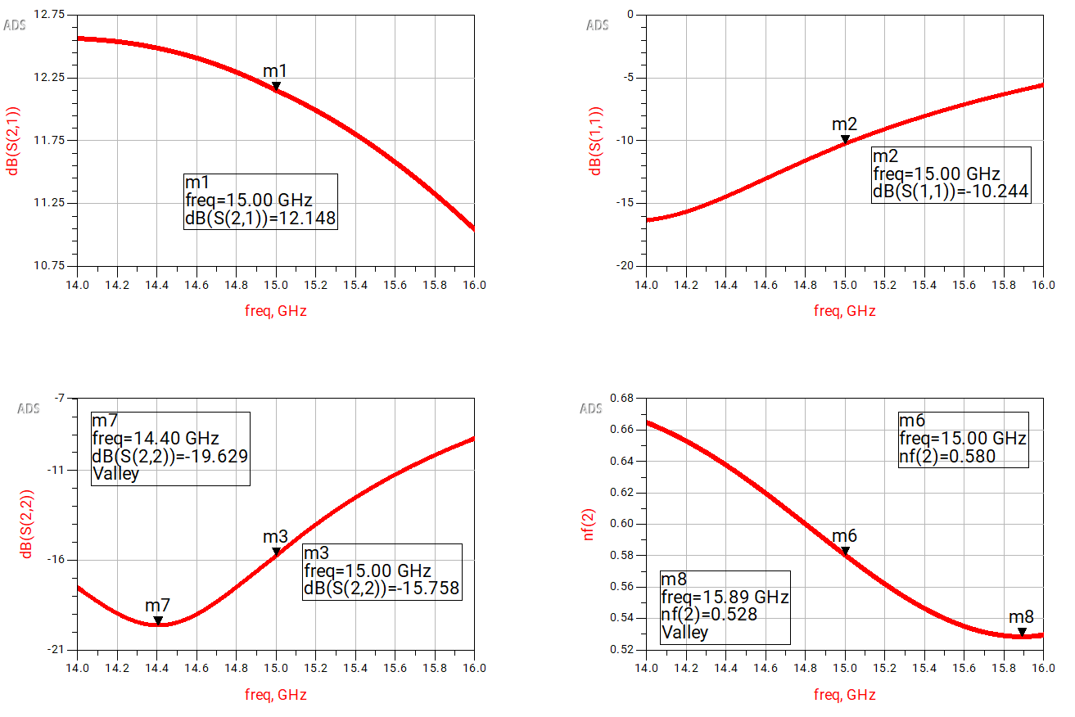
EE 456
RF & mm-Wave Circuits
Design Project 2
ADS Simulations

Slide 32
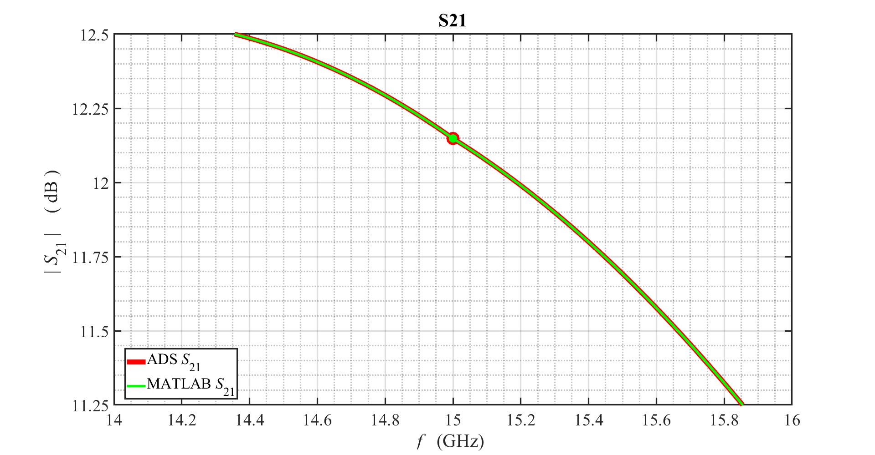
EE 456
RF & mm-Wave Circuits
Design Project 2
ADS & MATLAB Simulations

Slide 33
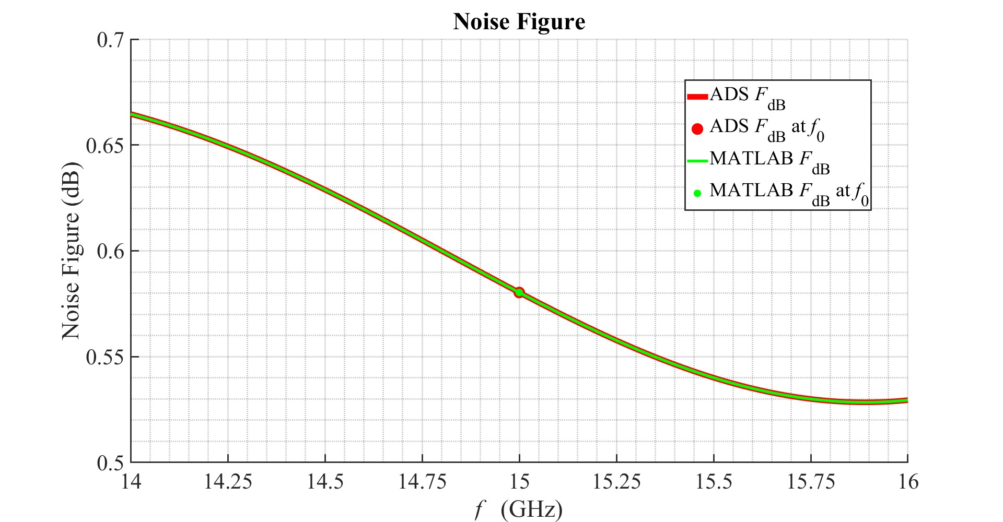
EE 456
RF & mm-Wave Circuits
Design Project 2
ADS & MATLAB Simulations

Slide 34
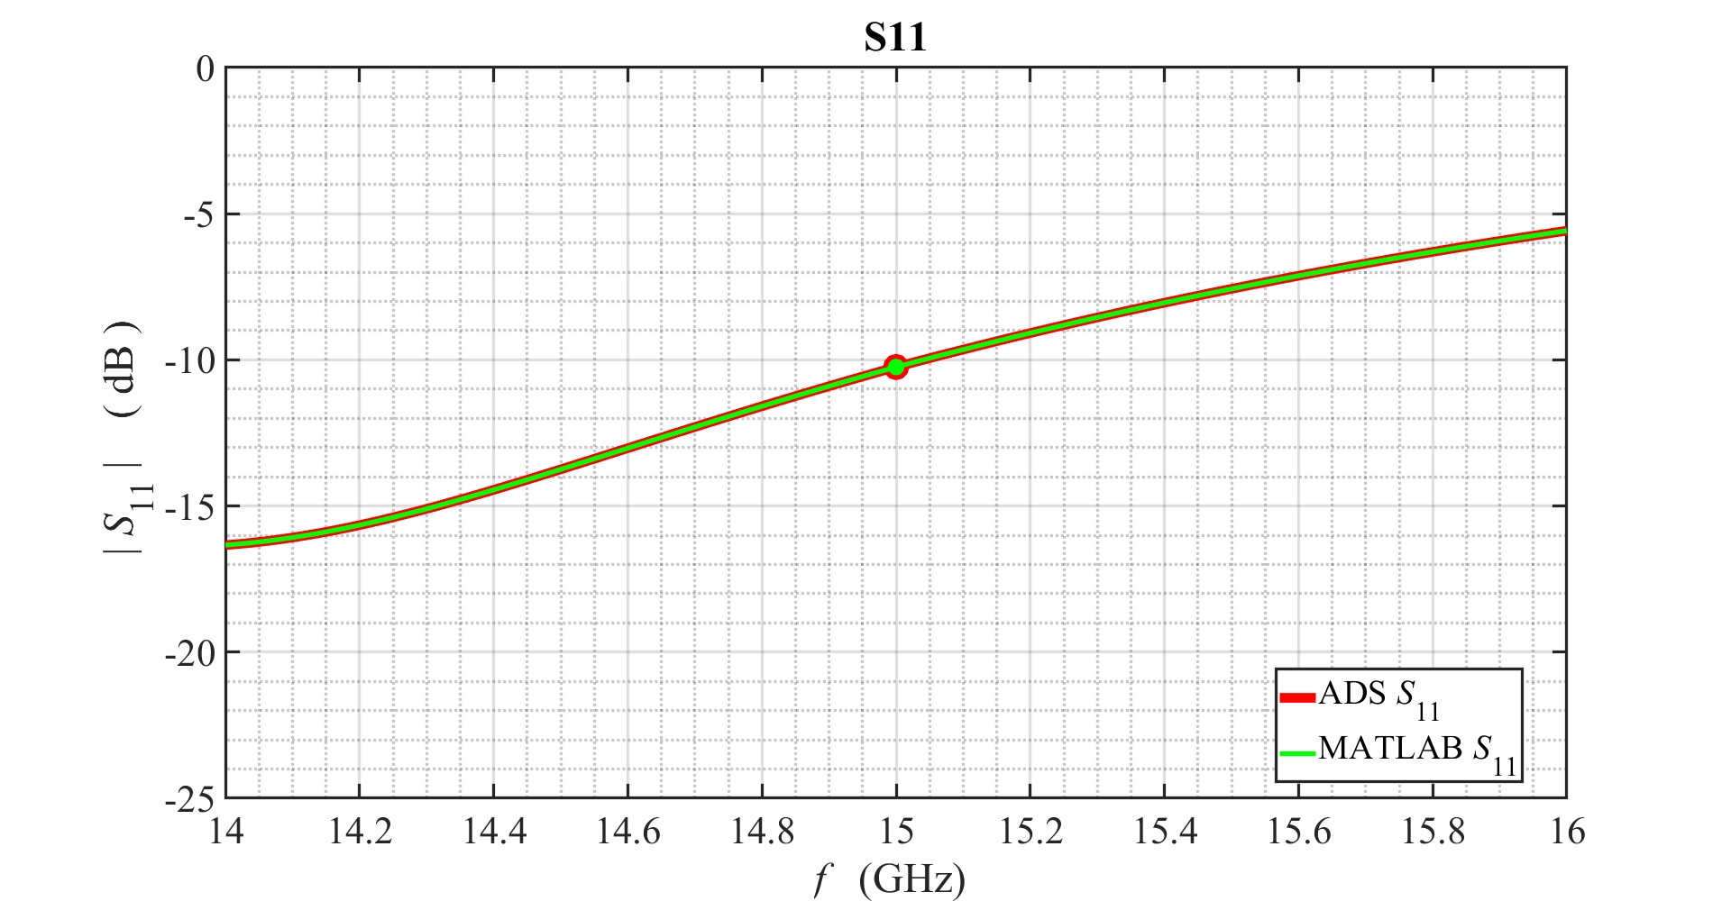
EE 456
RF & mm-Wave Circuits
Design Project 2
ADS & MATLAB Simulations

Slide 35
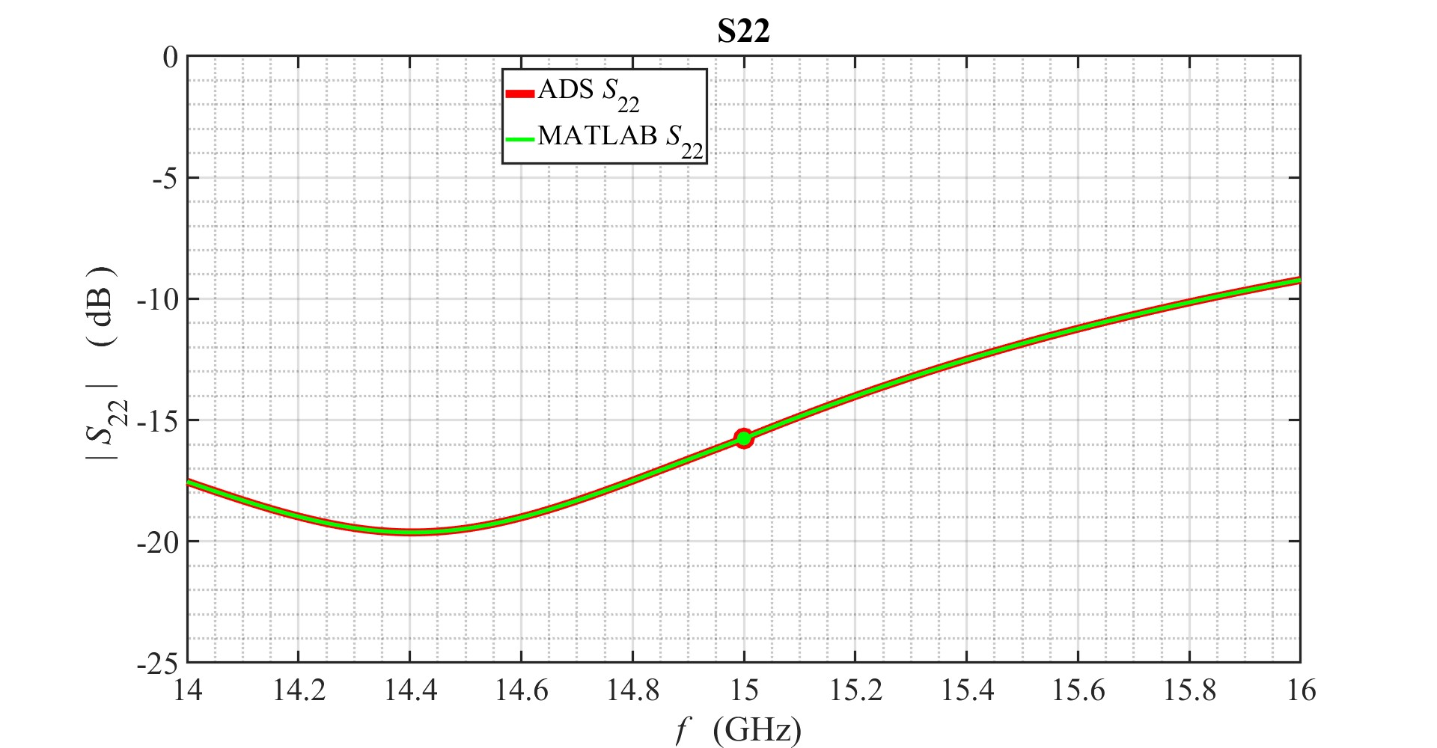
EE 456
RF & mm-Wave Circuits
Design Project 2
ADS & MATLAB Simulations

Slide 36
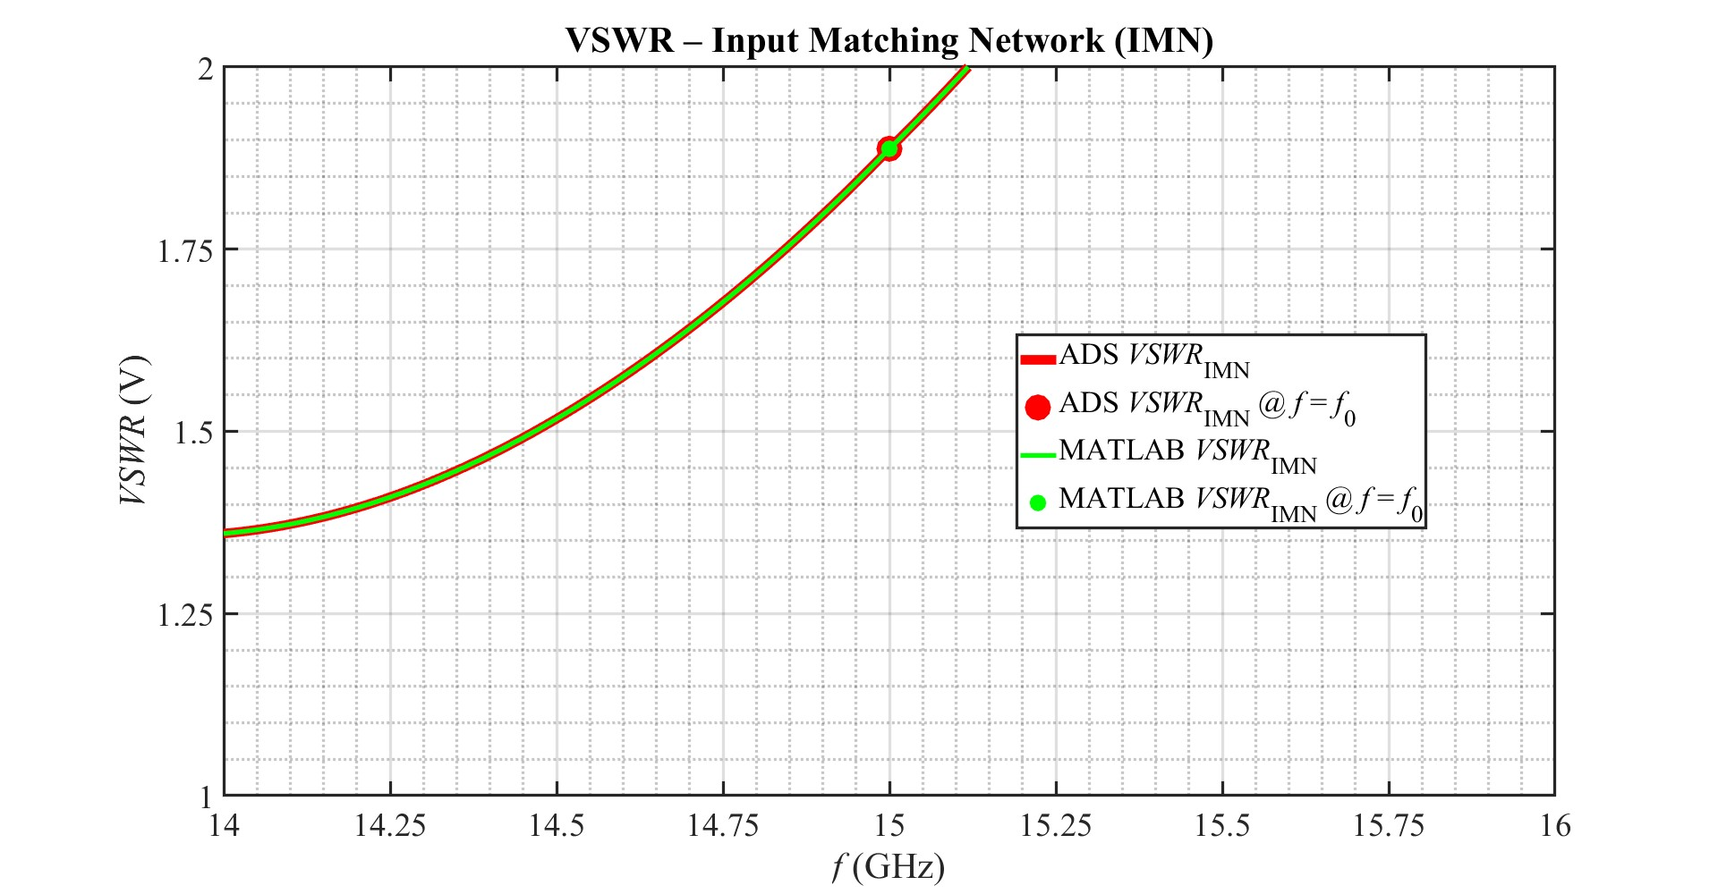
EE 456
RF & mm-Wave Circuits
Design Project 2
ADS & MATLAB Simulations

Slide 37
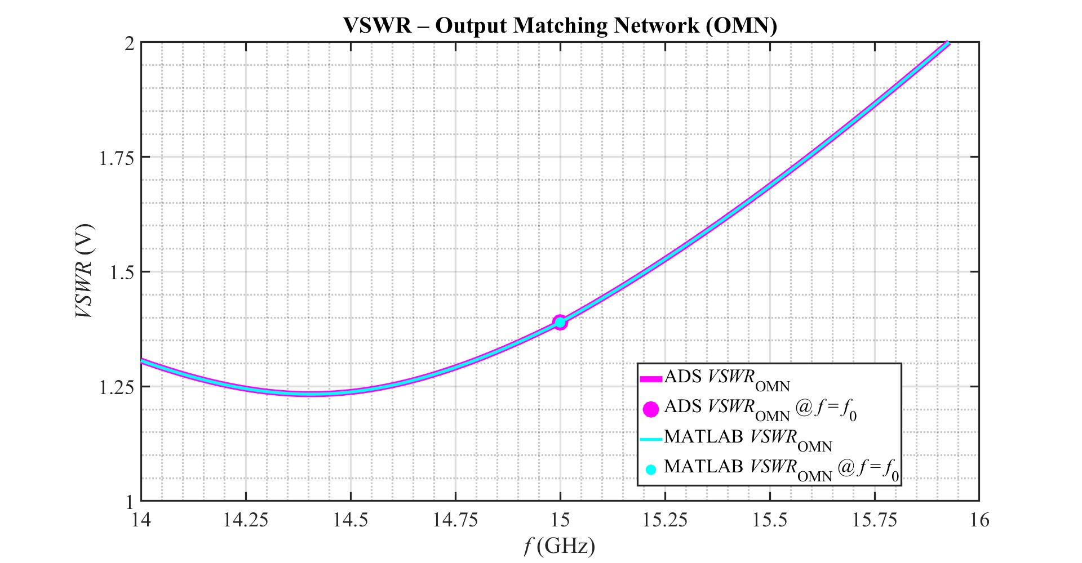
EE 456
RF & mm-Wave Circuits
Design Project 2
ADS & MATLAB Simulations

Slide 38
EE 456
RF & mm-Wave Circuits
Design Project 2
Simulation Comparison
This LNA configuration succeeded in meeting all the specifications which the design required.
Both the MATLAB and the ADS simulations provide the same values for the LNA.
MATLAB and ADS provided simulated values for the parameters listed in table 1,
these values are essentially the same, showing an excellent match:
— there is less than a 0.0001 percent difference between MATLAB and ADS values.
The noise figure could be lower, however overall gain provided by this design
isn’t as lacking as many of the other designs solutions which were considered before this one.

Slide 39
Additional Material Submitted to Kodiak: - Excel - Matlab Code - ADS Files - Scans / Screenshots
EE 456
RF & mm-Wave Circuits
Design Project 2
Steven Placzek
End of Design Project 2 Presentation

Slide 40
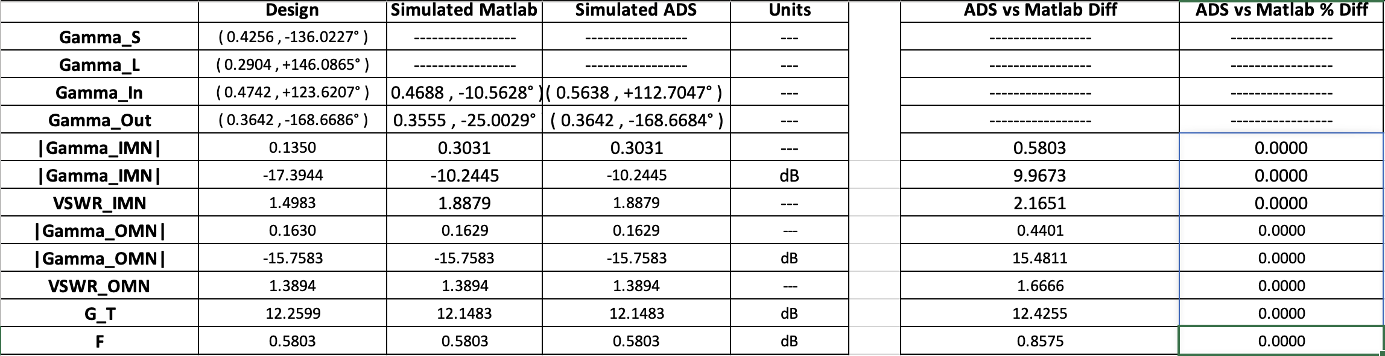
Appendix I — Excel Spreadsheets
EE 456
RF & mm-Wave Circuits

Slide 41
END
EE 456
RF & mm-Wave Circuits

